Slide 1
Feature × scenario matrix
A matrix makes intersections visible
learn_verification_planning_management — feature matrix
Notes:
A matrix makes intersections visible. Rows are features; columns are scenarios. Each cell is empty, planned, or covered. Empty means you never decided; planned means intent without proof; covered means evidence exists. Scanning gaps is how plans stop lying to you.

Slide 2
Planned versus covered
Mark P when you intend a test or story for that intersection
Mark C when a bin, checklist, or passing directed check proves it
A board with no empty cells can still be weak if everything is only P
Closing gaps means either plan the empty cell or produce coverage for a planned one
learn_verification_planning_management — feature matrix
Notes:
Mark P when you intend a test or story for that intersection. Mark C when a bin, checklist, or passing directed check proves it. A board with no empty cells can still be weak if everything is only P—intent without evidence. Closing gaps means either plan the empty cell or produce coverage for a planned one.

Slide 3
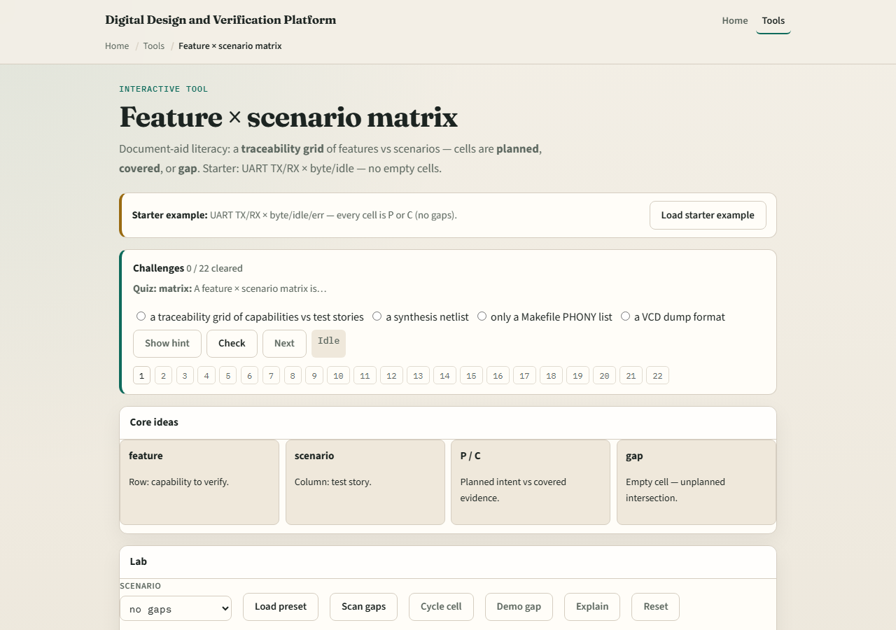
Browser lab
Lab starter
learn_verification_planning_management — feature matrix
Notes:
In the feature-matrix lab, load the starter UART transmit and receive against byte, idle, and error scenarios with no empty cells. Cycle cells between empty, P, and C. Load a one-gap or many-gaps preset and scan until you can name every hole.

Slide 4
Planning docs practice
Draw a two-by-three grid for one block: two features, three scenarios
Fill each cell with dash, P, or C
Leave one empty on purpose, then write the next action that would fill it
That next-action habit is the point of the matrix
learn_verification_planning_management — feature matrix
Notes:
Draw a two-by-three grid for one block: two features, three scenarios. Fill each cell with dash, P, or C. Leave one empty on purpose, then write the next action that would fill it. That next-action habit is the point of the matrix.

Slide 5
Pitfalls to watch
Do not conflate P with C
Do not celebrate zero empty cells when nothing is covered
Do not hide rare scenarios off the grid
And do not grow the matrix so huge that nobody maintains it, start small and real
learn_verification_planning_management — feature matrix
Notes:
Do not conflate P with C. Do not celebrate zero empty cells when nothing is covered. Do not hide rare scenarios off the grid. And do not grow the matrix so huge that nobody maintains it—start small and real.

Slide 6
Your turn
Complete the checklist for at least one track, preferably both
Scan one matrix for gaps, fix or name them, then take the quiz and continue to cover bins
learn_verification_planning_management — feature matrix
Notes:
Complete the checklist for at least one track—preferably both. Scan one matrix for gaps, fix or name them, then take the quiz and continue to cover bins.

