Slide 1
Risk-based plan
Bandwidth is finite
learn_verification_planning_management — risk plan
Notes:
Bandwidth is finite. Risk-based planning scores how likely a bug class is and how bad it is if it escapes, then assigns priority: must-test now, next wave, later, or defer. Without that matrix, everything becomes P0 and nothing is.

Slide 2
Risk times impact
Risk is likelihood; impact is severity if it escapes silicon or a customer
High-high and medium-high often land as P0
Low-medium may be P2
Low-low can defer
Aligned means your labels match the matrix suggestion
learn_verification_planning_management — risk plan
Notes:
Risk is likelihood; impact is severity if it escapes silicon or a customer. High-high and medium-high often land as P0. Low-medium may be P2. Low-low can defer. Aligned means your labels match the matrix suggestion; mismatch means you called high-high a defer or left rows open.

Slide 3
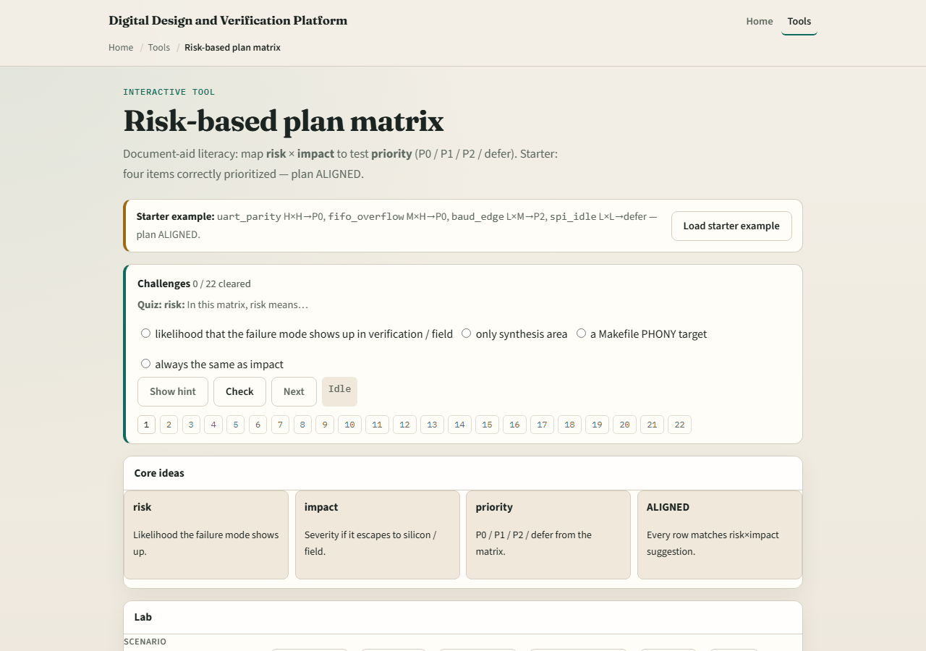
Browser lab
Lab starter
learn_verification_planning_management — risk plan
Notes:
In the risk-plan lab, load the starter four items correctly prioritized—aligned. Reorder a high-impact UART parity item versus cosmetic idle noise. Scan the matrix when priorities fight the risk-impact product. Challenges force you to prioritize the last open row honestly.

Slide 4
Planning docs practice
List four bug concerns for a block you know
Score each likelihood and impact low, medium, or high, then assign P0, P1, P2, or defer
If more than half are P0, demote two with a written reason
learn_verification_planning_management — risk plan
Notes:
List four bug concerns for a block you know. Score each likelihood and impact low, medium, or high, then assign P0, P1, P2, or defer. If more than half are P0, demote two with a written reason.

Slide 5
Pitfalls to watch
Do not mark everything P0
Do not defer high-likelihood, high-impact items because they are hard
Do not confuse taxonomy tiers with risk scores, they cooperate but are not the same
And do not skip owners on deferred items
learn_verification_planning_management — risk plan
Notes:
Do not mark everything P0. Do not defer high-likelihood, high-impact items because they are hard. Do not confuse taxonomy tiers with risk scores—they cooperate but are not the same. And do not skip owners on deferred items.

Slide 6
Your turn
Complete the checklist for at least one track, preferably both
Produce a small aligned priority list, then take the quiz and continue to seeds, config
learn_verification_planning_management — risk plan
Notes:
Complete the checklist for at least one track—preferably both. Produce a small aligned priority list, then take the quiz and continue to seeds, config, and tags.

