Slide 1
Regression triage
Nightly noise without buckets wastes the morning
learn_verification_planning_management — regression triage
Notes:
Nightly noise without buckets wastes the morning. Triage sorts fails into reproducible DUT or VIP fails, flakes, first-seen new issues, and environment or infra problems. A clean board means every row has a bucket—not that bugs vanished.

Slide 2
Fail, flake, new, env
Fail means reproducible design, VIP, or scoreboard breakage, own and fix
Flake means intermittent or seed-sensitive, quarantine and stabilize, do not bury
New means first appearance this run, escalate; do not assume known
Env means license, disk, tool, or farm crash, infra, not RTL
learn_verification_planning_management — regression triage
Notes:
Fail means reproducible design, VIP, or scoreboard breakage—own and fix. Flake means intermittent or seed-sensitive—quarantine and stabilize, do not bury. New means first appearance this run—escalate; do not assume known. Env means license, disk, tool, or farm crash—infra, not RTL.

Slide 3
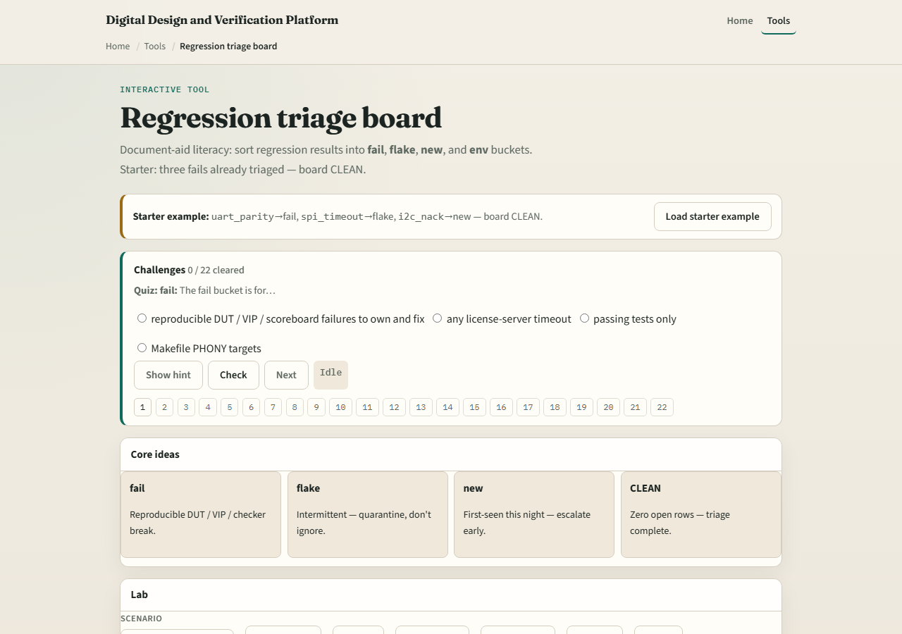
Browser lab
Lab starter
learn_verification_planning_management — regression triage
Notes:
In the regression-triage lab, load the starter with three fails already bucketed—board clean. Open a row, triage it, and scan until open count is zero. Try an environment hit preset. Challenges stop you from leaving rows unlabeled.

Slide 4
Planning docs practice
Take three fictional nightly lines and assign fail
Mark which one you would debug first and why
Optional: note which seed-tag fields you would demand on the flake
learn_verification_planning_management — regression triage
Notes:
Take three fictional nightly lines and assign fail, flake, new, or env with one-line reasons. Mark which one you would debug first and why. Optional: note which seed-tag fields you would demand on the flake.

Slide 5
Pitfalls to watch
Do not mark everything flake to clear the board
Do not treat env red as a DUT bug
Do not ignore new fails because the night was busy
And do not close triage without an owner on real fails
learn_verification_planning_management — regression triage
Notes:
Do not mark everything flake to clear the board. Do not treat env red as a DUT bug. Do not ignore new fails because the night was busy. And do not close triage without an owner on real fails.

Slide 6
Your turn
Complete the checklist for at least one track, preferably both
Bucket a small board to clean, then take the quiz and continue to verification metrics
learn_verification_planning_management — regression triage
Notes:
Complete the checklist for at least one track—preferably both. Bucket a small board to clean, then take the quiz and continue to verification metrics.

