Slide 1
Verification metrics
Plans need numbers that leadership and engineers share
learn_verification_planning_management — verif metrics
Notes:
Plans need numbers that leadership and engineers share. Common bars: regression pass rate, plan or functional coverage percent, and severe bug escapes. Healthy means every metric meets its bar. Blocked means an escape bar was broken. Open means you are under on pass or coverage.

Slide 2
Bars that matter
Pass rate below the bar means instability, you cannot trust green stories
Coverage percent below goal means unfinished plan risk
Bug escapes above zero at a sev-one bar usually stop the gate
Levels good, warn, and bad are how you talk without drowning in raw dumps
learn_verification_planning_management — verif metrics
Notes:
Pass rate below the bar means instability—you cannot trust green stories. Coverage percent below goal means unfinished plan risk. Bug escapes above zero at a sev-one bar usually stop the gate. Levels good, warn, and bad are how you talk without drowning in raw dumps.

Slide 3
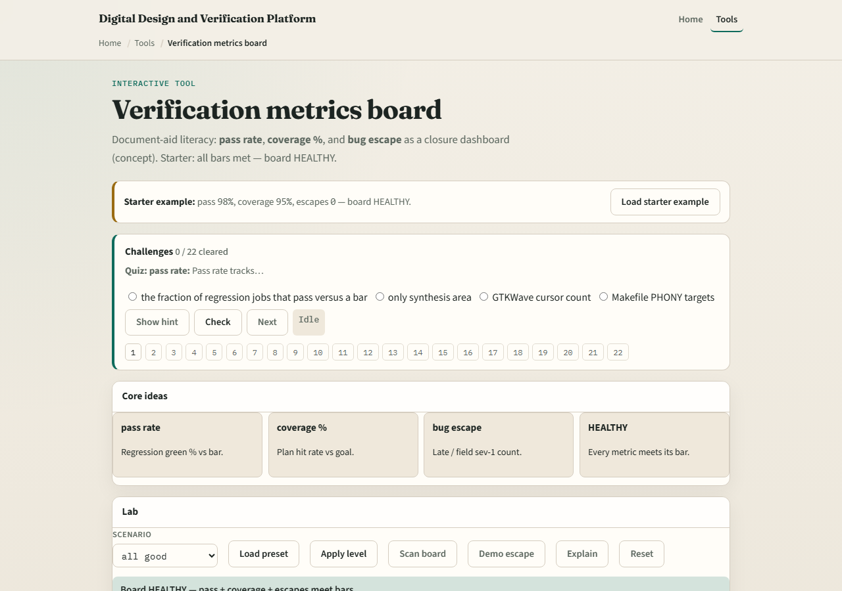
Browser lab
Lab starter
learn_verification_planning_management — verif metrics
Notes:
In the metrics lab, load the starter with strong pass rate, coverage, and zero escapes—healthy. Drop pass rate or raise escapes and scan the board. Challenges show how one escape can block the story even if coverage looks fine.

Slide 4
Planning docs practice
Write three metric names with a numeric bar each for a fictional milestone
Mark today’s sample good, warn, or bad
If any is bad, write the first action you would take this week
learn_verification_planning_management — verif metrics
Notes:
Write three metric names with a numeric bar each for a fictional milestone. Mark today’s sample good, warn, or bad. If any is bad, write the first action you would take this week.

Slide 5
Pitfalls to watch
Do not call the program healthy because CI ran once
Do not ignore escape counts when coverage is high
Do not change bars silently mid-milestone
And do not track twenty vanity metrics, three honest bars beat a dashboard museum
learn_verification_planning_management — verif metrics
Notes:
Do not call the program healthy because CI ran once. Do not ignore escape counts when coverage is high. Do not change bars silently mid-milestone. And do not track twenty vanity metrics—three honest bars beat a dashboard museum.

Slide 6
Your turn
Complete the checklist for at least one track, preferably both
Set or interpret three bars, then take the quiz and continue to CI and farm flow
learn_verification_planning_management — verif metrics
Notes:
Complete the checklist for at least one track—preferably both. Set or interpret three bars, then take the quiz and continue to CI and farm flow.

