Slide 1
CI / farm flow
Verification scales in stages
learn_verification_planning_management — ci farm flow
Notes:
Verification scales in stages: local smoke on a laptop, CI as the merge or scheduled gate, then the farm for scale-out regression and soak. Ready means each stage you claim is green in order. Skipping a stage or promoting past a red gate breaks trust.

Slide 2
Local, CI, farm
Local is fast sanity before push
CI is the agent gate, pull request or nightly slice
Farm is where long regressions and stress live
Pass advances; fail blocks; open means not run; skip gaps the chain
A green farm with a failed local or skipped CI is not an honest ready flow
learn_verification_planning_management — ci farm flow
Notes:
Local is fast sanity before push. CI is the agent gate—pull request or nightly slice. Farm is where long regressions and stress live. Pass advances; fail blocks; open means not run; skip gaps the chain. A green farm with a failed local or skipped CI is not an honest ready flow.

Slide 3
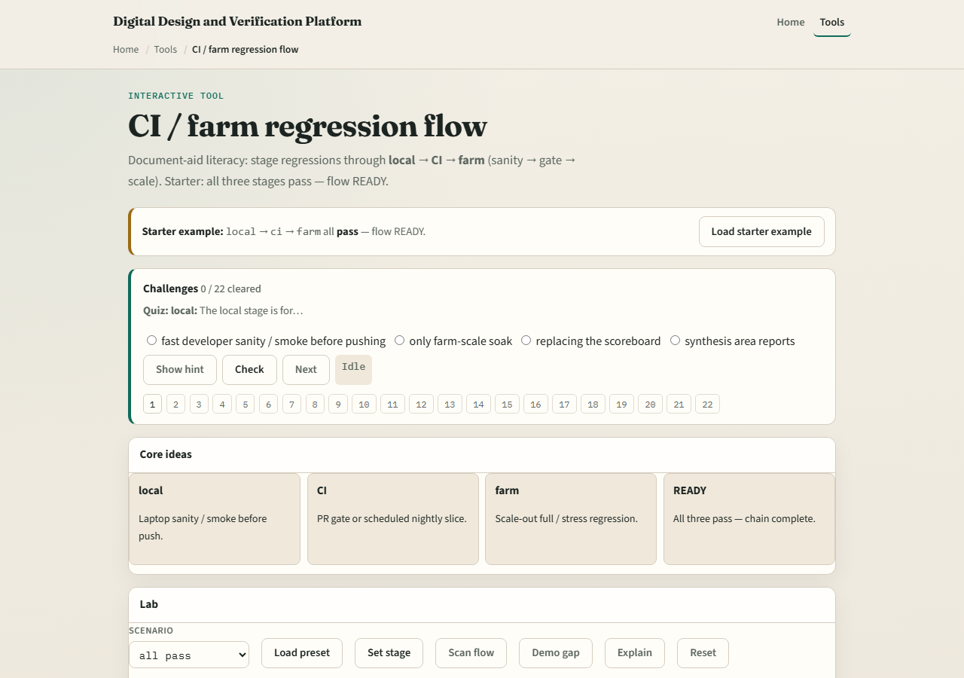
Browser lab
Lab starter
learn_verification_planning_management — ci farm flow
Notes:
In the CI-farm lab, load the starter with local, CI, and farm all pass—ready. Try local fail or skip CI presets and watch blocked or gapped. Set stages deliberately, then scan the flow. Challenges punish promoting past red.

Slide 4
Planning docs practice
Draw three boxes, local, CI, farm, and write what runs in each for your team
Mark yesterday’s real or fictional status pass, fail, open, or skip
If any is fail or skip, write the promotion rule you would enforce
learn_verification_planning_management — ci farm flow
Notes:
Draw three boxes—local, CI, farm—and write what runs in each for your team. Mark yesterday’s real or fictional status pass, fail, open, or skip. If any is fail or skip, write the promotion rule you would enforce.

Slide 5
Pitfalls to watch
Do not skip CI because the farm is “more complete.” Do not ignore local reds
Do not treat one green farm night as a full flow
And do not forget that seed and triage habits feed every stage
learn_verification_planning_management — ci farm flow
Notes:
Do not skip CI because the farm is “more complete.” Do not ignore local reds. Do not treat one green farm night as a full flow. And do not forget that seed and triage habits feed every stage—flow without replay is archaeology.

Slide 6
Your turn
Complete the checklist for at least one track, preferably both
Describe or set a clean local-to-farm chain, then take the quiz and continue to sign-off
learn_verification_planning_management — ci farm flow
Notes:
Complete the checklist for at least one track—preferably both. Describe or set a clean local-to-farm chain, then take the quiz and continue to sign-off.

