Slide 1
Sign-off checklist
Sign-off is a gate, not a vibe
learn_verification_planning_management — signoff checklist
Notes:
Sign-off is a gate, not a vibe. Typical criteria: coverage goal met with no open P0 holes, bug bar clear—often zero sev-one blockers—and a stability window of green nights or an agreed flake bar. Ready means evidence for each criterion, or a documented waiver with owner and expiry.

Slide 2
Met, open, fail, waived
Met means evidence exists
Open means not demonstrated yet
Fail means the criterion is broken, such as a sev-one still open, and the gate is blocked
Waived means a written exception with owner
learn_verification_planning_management — signoff checklist
Notes:
Met means evidence exists. Open means not demonstrated yet. Fail means the criterion is broken—such as a sev-one still open—and the gate is blocked. Waived means a written exception with owner; it can count as closed for ready, but it is not invisible.

Slide 3
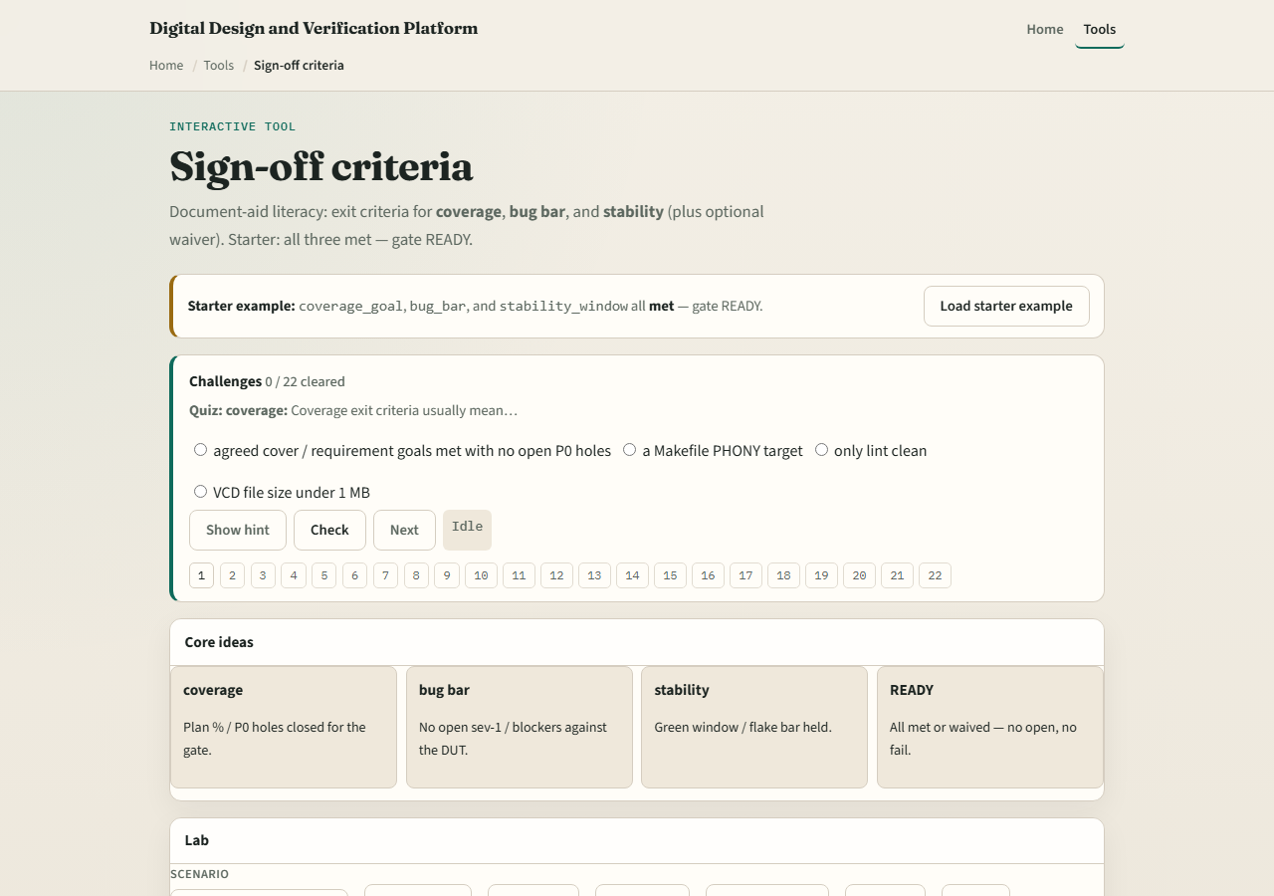
Browser lab
Lab starter
learn_verification_planning_management — signoff checklist
Notes:
In the sign-off lab, load the starter with coverage goal, bug bar, and stability all met—gate ready. Try coverage gap or bug fail presets. Check items off only with a story of evidence. Challenges show that a waived stability line can still be ready when policy allows.

Slide 4
Planning docs practice
Write three exit criteria for a milestone
For each, note what evidence you would attach and who owns a waiver if needed
If any criterion is fail, write what would unblock the gate
learn_verification_planning_management — signoff checklist
Notes:
Write three exit criteria for a milestone. For each, note what evidence you would attach and who owns a waiver if needed. If any criterion is fail, write what would unblock the gate.

Slide 5
Pitfalls to watch
Do not silent-skip failed criteria
Do not waive without owner, reason, and expiry
Do not sign off on coverage percent alone while sev-ones remain
And do not confuse this literacy checklist with your company’s legal release process
learn_verification_planning_management — signoff checklist
Notes:
Do not silent-skip failed criteria. Do not waive without owner, reason, and expiry. Do not sign off on coverage percent alone while sev-ones remain. And do not confuse this literacy checklist with your company’s legal release process—map the ideas, then use the real form.

Slide 6
Your turn
Complete the checklist for at least one track, preferably both
Walk one gate to ready or name what blocks it
learn_verification_planning_management — signoff checklist
Notes:
Complete the checklist for at least one track—preferably both. Walk one gate to ready or name what blocks it, then take the quiz and continue to VIP handoff.

