Slide 1
VIP handoff
A VIP is not handed off when the agent compiles once
learn_verification_planning_management — vip handoff
Notes:
A VIP is not handed off when the agent compiles once. Handoff readiness means consumers can onboard: a docs pack, a clear API surface, and a standalone self-test that proves the VIP runs. Missing any piece blocks a responsible transfer.

Slide 2
Docs, API, self-test
Docs pack means README, quickstart, examples, and known limits
API surface means sequences, config knobs, callbacks
Self-test means a shipped smoke or self-check that runs without the integrator’s full SoC
Met, open, fail, and waived work like the sign-off gate
learn_verification_planning_management — vip handoff
Notes:
Docs pack means README, quickstart, examples, and known limits. API surface means sequences, config knobs, callbacks, and the interface contract are documented. Self-test means a shipped smoke or self-check that runs without the integrator’s full SoC. Met, open, fail, and waived work like the sign-off gate.

Slide 3
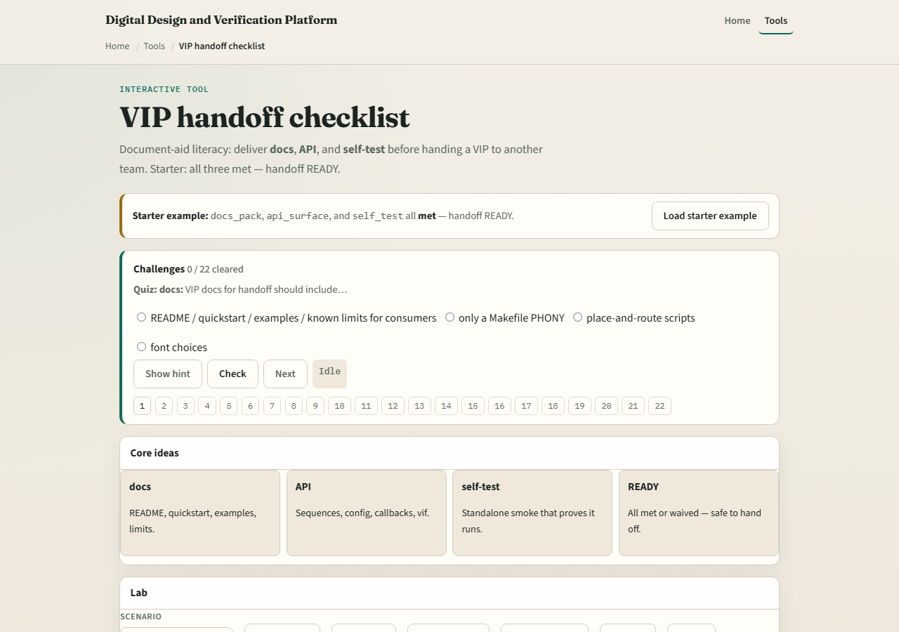
Browser lab
Lab starter
learn_verification_planning_management — vip handoff
Notes:
In the VIP-handoff lab, load the starter with docs, API, and self-test met—handoff ready. Try docs gap or self-test fail presets. Check off the last open deliverable only when you can point to evidence. Challenges show a red self-test blocks ready.

Slide 4
Planning docs practice
For a fictional UART VIP, list the three deliverables and one artifact name under each
Mark any gap you would refuse to hand off with
Optional: note which protocol course module already practiced VIP anatomy so this handoff
learn_verification_planning_management — vip handoff
Notes:
For a fictional UART VIP, list the three deliverables and one artifact name under each. Mark any gap you would refuse to hand off with. Optional: note which protocol course module already practiced VIP anatomy so this handoff checklist has teeth.

Slide 5
Pitfalls to watch
Do not ship without a self-test
Do not call undocumented knobs an API
Do not waive docs silently
And do not confuse handoff ready with chip sign-off
learn_verification_planning_management — vip handoff
Notes:
Do not ship without a self-test. Do not call undocumented knobs an API. Do not waive docs silently. And do not confuse handoff ready with chip sign-off—the VIP can be ready while the SoC gate is still open.

Slide 6
Your turn
Complete the checklist for at least one track, preferably both
Drive a handoff board to ready or name the blocker
learn_verification_planning_management — vip handoff
Notes:
Complete the checklist for at least one track—preferably both. Drive a handoff board to ready or name the blocker, then take the quiz and continue to the wrap.

