Slide 1
Planning path complete
You now have a working map of verification planning and management
learn_verification_planning_management — wrap
Notes:
You now have a working map of verification planning and management: traceability from feature to coverage, taxonomy and matrices, bins and closure, risk and replay cards, triage and metrics, CI-to-farm flow, sign-off criteria, and VIP handoff. Protocol and UVM courses build engines; you learned how to plan, measure, and gate them.

Slide 2
Skills you can reuse
Write plans others can audit
Prefer measurable coverage claims over test-name lists
Mix test tiers on purpose
Close holes with next-test ideas
Prioritize by risk and impact
File fails with seed, config, and tags
learn_verification_planning_management — wrap
Notes:
Write plans others can audit. Prefer measurable coverage claims over test-name lists. Mix test tiers on purpose. Close holes with next-test ideas. Prioritize by risk and impact. File fails with seed, config, and tags. Bucket nightly noise. Track a few honest bars. Promote only through honest stages. Sign off with evidence or owned waivers.

Slide 3
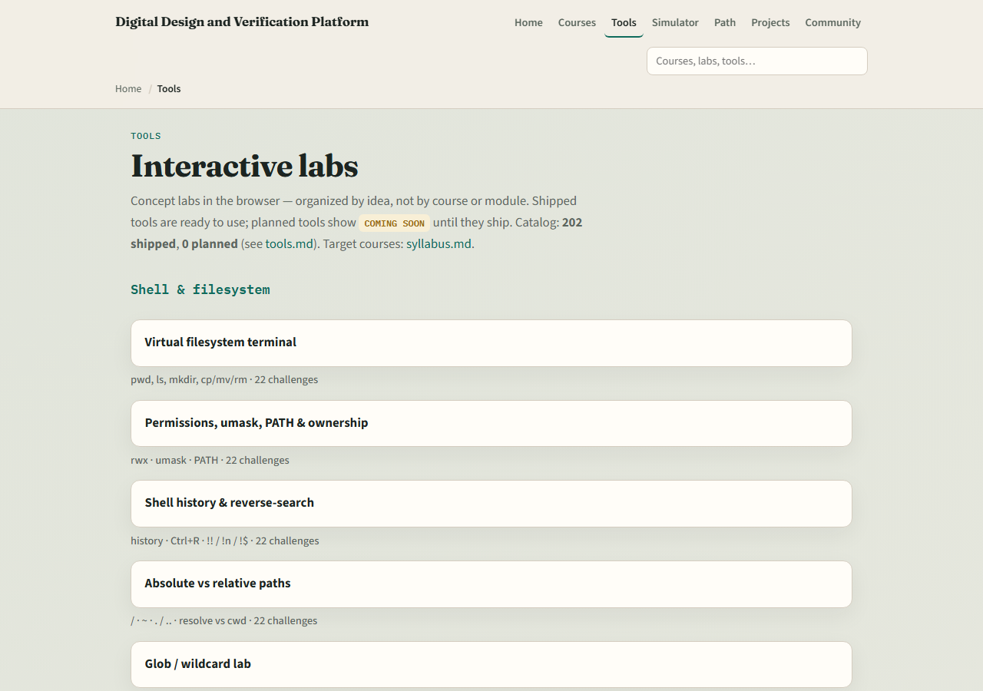
Dual-track recap
If you mainly used browser boards
If you mainly wrote docs, revisit any planning lab for graded challenges
Either way, keep the vocabulary shared with your team
learn_verification_planning_management — wrap
Notes:
If you mainly used browser boards, take one checklist or matrix into markdown for a real block. If you mainly wrote docs, revisit any planning lab for graded challenges. Either way, keep the vocabulary shared with your team.

Slide 4
Where to go next
Return to UART, SPI, or I²C to attach plans to protocol work
Deepen UVM and pyuvm when you need stronger TB engines
Use HDL simulator, Icarus, or Verilator courses when execution fidelity is the bottleneck
Climb the syllabus ladder for the gap you feel most
learn_verification_planning_management — wrap
Notes:
Return to UART, SPI, or I²C to attach plans to protocol work. Deepen UVM and pyuvm when you need stronger TB engines. Use HDL simulator, Icarus, or Verilator courses when execution fidelity is the bottleneck. Climb the syllabus ladder for the gap you feel most.

Slide 5
Mindset to keep
Plans without coverage claims are theater
Coverage without closure actions stalls
Metrics without triage lie
Sign-off without evidence is hope
Small, maintained artifacts beat giant unread spreadsheets
learn_verification_planning_management — wrap
Notes:
Plans without coverage claims are theater. Coverage without closure actions stalls. Metrics without triage lie. Sign-off without evidence is hope. Small, maintained artifacts beat giant unread spreadsheets.

Slide 6
Closing
Check off the wrap checklist
You finished the verification planning and management path
Pick one real project artifact to improve this week
learn_verification_planning_management — wrap
Notes:
Check off the wrap checklist. You finished the verification planning and management path. Pick one real project artifact to improve this week—a matrix row, a run card, or a sign-off line—then continue to the next course that matches your goal.

