Slide 1
Welcome to Verilator
Welcome to learn Verilator
learn_verilator — intro
Notes:
Welcome to learn Verilator. This path treats Verilator as a tool you can rely on every day: lint your RTL, wrap it in a C++ or DPI testbench, capture traces, and read verification metrics. You are not here for a full UVM course—that lives elsewhere. You are here to get fast, cycle-accurate simulation working in a real flow.

Slide 2
What you will build toward
Glance at pass rate and coverage before sign-off
Module ten is an offline build-and-run capstone; module eleven closes the loop
learn_verilator — intro
Notes:
Across the modules you will choose when Verilator beats Icarus, walk the compile-to-run pipeline, clean up lint with intent, host a C++ testbench with an eval loop, generate clock and reset patterns that release cleanly, turn tracing on and dump waves you can actually open, expose only what the host needs, and glance at pass rate and coverage before sign-off. Module ten is an offline build-and-run capstone; module eleven closes the loop.

Slide 3
Two tracks, one idea
Track A is real Verilator on your machine
Metrics ideas
You may do either track, or both
A good rhythm is browser lab first for the vocabulary, then Track A for fidelity
learn_verilator — intro
Notes:
Track A is real Verilator on your machine: a C++ toolchain, Makefiles, and examples in the legacy Verilator course tree. Track B is the platform’s simulation literacy labs—browser challenges for chooser, pipeline, lint, trace, and metrics ideas. You may do either track, or both. A good rhythm is browser lab first for the vocabulary, then Track A for fidelity.

Slide 4
Set up Track A
Install Verilator and confirm the version command works in your shell
Open this course folder and skim module READMEs and EXAMPLES prompts as you go
When a module offers a self-check script, use it to grade checklist items
Keep the sibling Icarus course in mind, you will compare the two tools early on
learn_verilator — intro
Notes:
Install Verilator and confirm the version command works in your shell. Open this course folder and skim module READMEs and EXAMPLES prompts as you go. When a module offers a self-check script, use it to grade checklist items. Keep the sibling Icarus course in mind—you will compare the two tools early on.

Slide 5
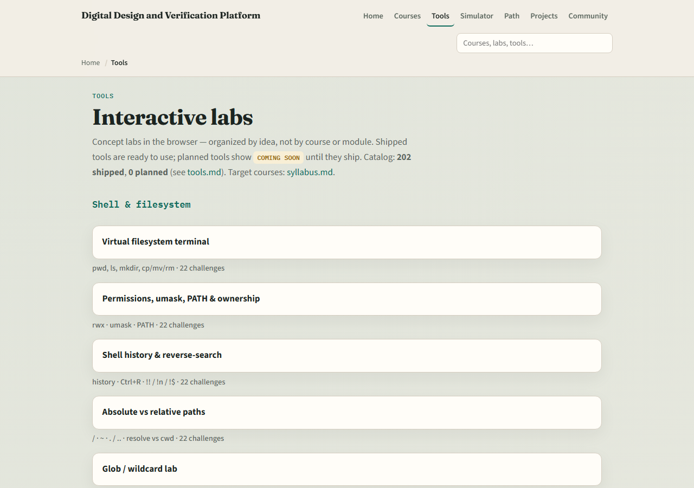
Set up Track B
From the monorepo root
All nine Verilator browser labs ship on the live site too
Confirm you can reach the index
learn_verilator — intro
Notes:
From the monorepo root, serve the platform folder with a simple local web server, then open the tools index and jump to the Simulation literacy section. All nine Verilator browser labs ship on the live site too. Confirm you can reach the index—the next module sends you into the Icarus versus Verilator chooser lab.

Slide 6
How to move through modules
For each module
Prefer Track B when you want graded challenges
When you finish this intro checklist, continue to Icarus versus Verilator
learn_verilator — intro
Notes:
For each module, read the README for the outcome, pick a track—or both—then work the checklist. Prefer Track B when you want graded challenges; prefer Track A when you want install fidelity and real VCD or FST files. When you finish this intro checklist, continue to Icarus versus Verilator.

