Slide 1
iverilog vs Verilator
Before you compile anything, pick the right engine for the job
learn_verilator — iverilog vs verilator
Notes:
Before you compile anything, pick the right engine for the job. Icarus Verilog shines when you need event scheduling, delays, and teaching-friendly SystemVerilog testbenches. Verilator shines when you need long regressions, C++ cosimulation, and cycle-accurate speed. This module trains a job-first choice—not brand loyalty.

Slide 2
Match the scenario
Use Icarus when the lesson is hash delays, initial blocks
Use Verilator when the job is a Makefile regression farm
The browser lab presents matched scenarios: same design idea, different tool fit
Read the scenario before you click a answer
learn_verilator — iverilog vs verilator
Notes:
Use Icarus when the lesson is hash delays, initial blocks, and classic event-driven testbenches. Use Verilator when the job is a Makefile regression farm, a C++ host driving Vtop, or millions of cycles overnight. The browser lab presents matched scenarios: same design idea, different tool fit. Read the scenario before you click a answer.

Slide 3
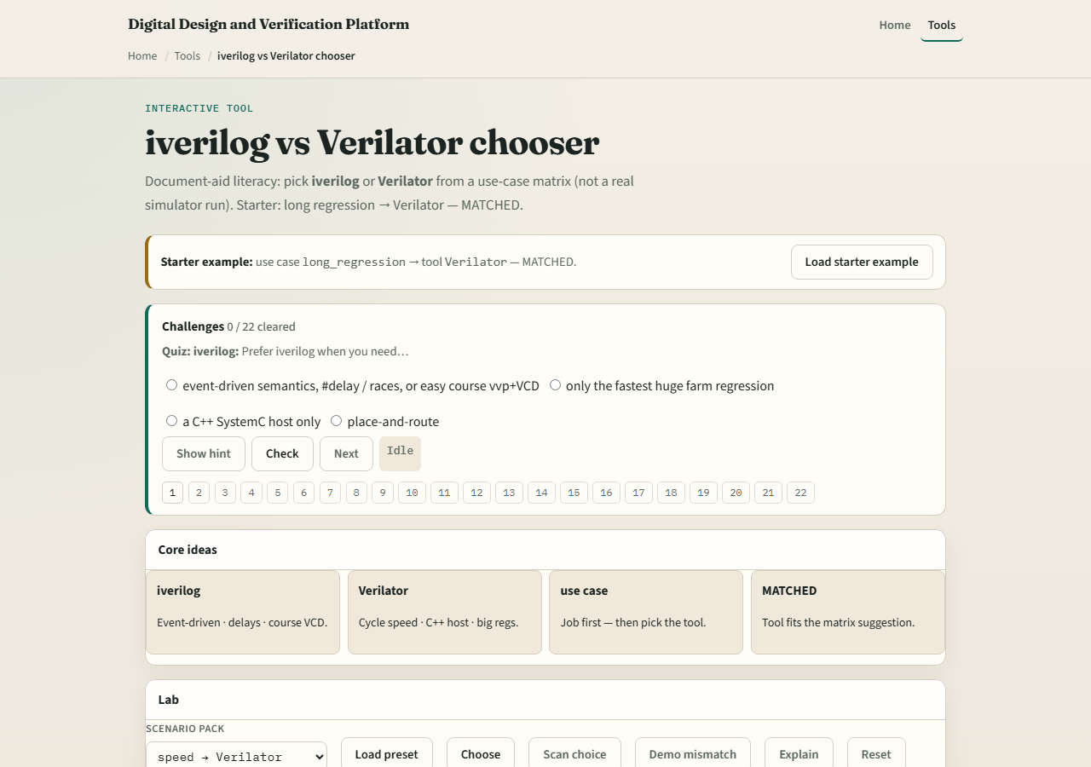
Browser lab
Lab starter
learn_verilator — iverilog vs verilator
Notes:
In the browser chooser lab, load the starter example and work through matched scenarios until status reads ready. Each challenge names a job—teach delays, quick sanity sim, long farm run, C++ cosim—and asks which tool fits. Treat wrong picks as learning: restate why the other tool would hurt that job.

Slide 4
Real Verilator practice
In Track A, open this module’s EXAMPLES prompts and the legacy course tree
Run one tiny design with Icarus for event-style sanity
You do not need a perfect port
learn_verilator — iverilog vs verilator
Notes:
In Track A, open this module’s EXAMPLES prompts and the legacy course tree. Run one tiny design with Icarus for event-style sanity, then sketch how the same block would enter a Verilator compile-to-binary flow. You do not need a perfect port—just articulate what changes when delays disappear and a C++ main appears.

Slide 5
Pitfalls to watch
Do not reach for Verilator when the lesson requires hash delays and timing checks Icarus
Do not reach for Icarus when you need fast cycle regressions at scale
Do not assume “simulator is simulator”, paradigm mismatch wastes afternoons
And do not treat the browser lab as proof your install works; that is Track A’s job
learn_verilator — iverilog vs verilator
Notes:
Do not reach for Verilator when the lesson requires hash delays and timing checks Icarus models cleanly. Do not reach for Icarus when you need fast cycle regressions at scale. Do not assume “simulator is simulator”—paradigm mismatch wastes afternoons. And do not treat the browser lab as proof your install works; that is Track A’s job.

Slide 6
Your turn
Complete the checklist for at least one track, preferably both
In the browser, finish matched scenarios with ready status
In Track A, name one job for each tool from your own work
When you are ready, take the short quiz, then continue to the simulation pipeline
learn_verilator — iverilog vs verilator
Notes:
Complete the checklist for at least one track—preferably both. In the browser, finish matched scenarios with ready status. In Track A, name one job for each tool from your own work. When you are ready, take the short quiz, then continue to the simulation pipeline.

