Slide 1
Verilator lint
Lint is cheap insurance
learn_verilator — verilator lint lab
Notes:
Lint is cheap insurance. Verilator’s linter catches width mismatches, unused signals, inferred latches, and incomplete case statements before you spend an hour in waves. Turn warnings on with wall-class strictness and treat CLEAN, BLIND, and warnings-as-errors as deliberate policy choices—not accidents.

Slide 2
Common warning families
Watch for UNUSED, something you declared but never read
WIDTH, expressions that do not line up
LATCH, inferred storage you did not mean
CASEINCOMPLETE, case statements without a default or full coverage
The literacy lab tags these families so you learn the fix, not only the flag name
learn_verilator — verilator lint lab
Notes:
Watch for UNUSED—something you declared but never read. WIDTH—expressions that do not line up. LATCH—inferred storage you did not mean. CASEINCOMPLETE—case statements without a default or full coverage. The literacy lab tags these families so you learn the fix, not only the flag name.

Slide 3
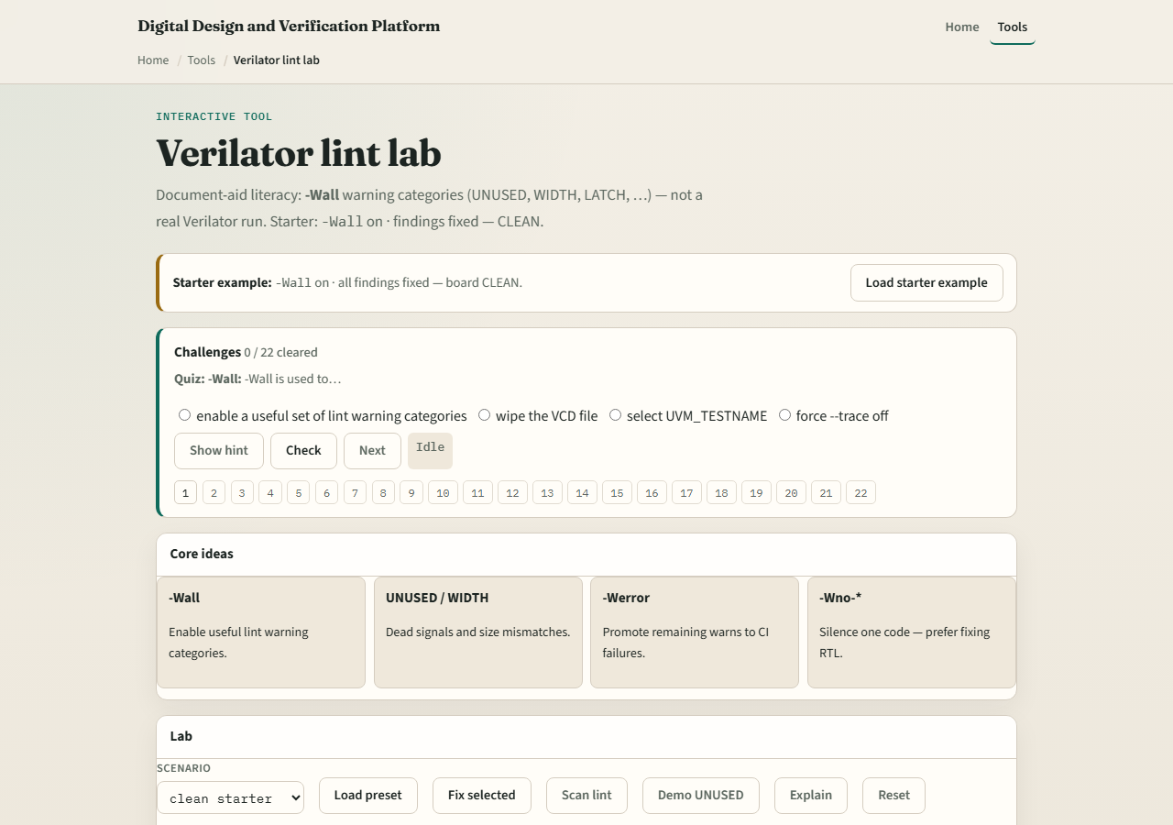
Browser lab
Lab starter
learn_verilator — verilator lint lab
Notes:
In the lint lab, load the starter design and practice CLEAN versus BLIND versus warnings-as-error modes. A BLIND run hides problems; CLEAN surfaces them; treating warnings as errors forces zero tolerance. Challenges ask you to fix RTL—not merely silence with blanket no-warning flags.

Slide 4
Real Verilator practice
In Track A, lint a tiny module with wall-level warnings enabled
Introduce one intentional WIDTH or UNUSED issue
Avoid the reflex to blanket-disable warnings unless you have documented why
Self-check scripts can confirm you reached a clean lint pass
learn_verilator — verilator lint lab
Notes:
In Track A, lint a tiny module with wall-level warnings enabled. Introduce one intentional WIDTH or UNUSED issue, see the message, then fix the RTL properly. Avoid the reflex to blanket-disable warnings unless you have documented why. Self-check scripts can confirm you reached a clean lint pass.

Slide 5
Pitfalls to watch
Do not blanket-disable warnings to greenwash a broken design
Do not confuse BLIND with CLEAN, no output is not the same as no problems
Do not ship with warnings-as-errors until your tree is actually clean
And remember: lint passes do not replace simulation, they narrow the search space
learn_verilator — verilator lint lab
Notes:
Do not blanket-disable warnings to greenwash a broken design. Do not confuse BLIND with CLEAN—no output is not the same as no problems. Do not ship with warnings-as-errors until your tree is actually clean. And remember: lint passes do not replace simulation—they narrow the search space.

Slide 6
Your turn
Complete the checklist for at least one track, preferably both
In the browser, reach CLEAN on at least one challenge without only silencing flags
In Track A, run lint with strict warnings once
When you are ready, take the short quiz, then continue to C++ testbench and DPI
learn_verilator — verilator lint lab
Notes:
Complete the checklist for at least one track—preferably both. In the browser, reach CLEAN on at least one challenge without only silencing flags. In Track A, run lint with strict warnings once. When you are ready, take the short quiz, then continue to C++ testbench and DPI.

