Slide 1
Turning trace on
Waves require two cooperating pieces
learn_verilator — verilator trace
Notes:
Waves require two cooperating pieces: a compile-time trace flag and host code that opens a trace file, dumps cycles, and closes cleanly. Verilator offers VCD and FST-style paths depending on flags. Trace without dump is OPEN— you paid for infrastructure but recorded nothing useful.

Slide 2
Flag plus dump calls
Enable trace at compile with the trace or trace-fst flags as your flow requires
In the host, create a trace pointer, open a file, call dump each eval step you care about,
Dump without the compile flag is BLIND, you wrote files the model never instrumented
Both sides must agree
learn_verilator — verilator trace
Notes:
Enable trace at compile with the trace or trace-fst flags as your flow requires. In the host, create a trace pointer, open a file, call dump each eval step you care about, then close at shutdown. Dump without the compile flag is BLIND—you wrote files the model never instrumented. Both sides must agree.

Slide 3
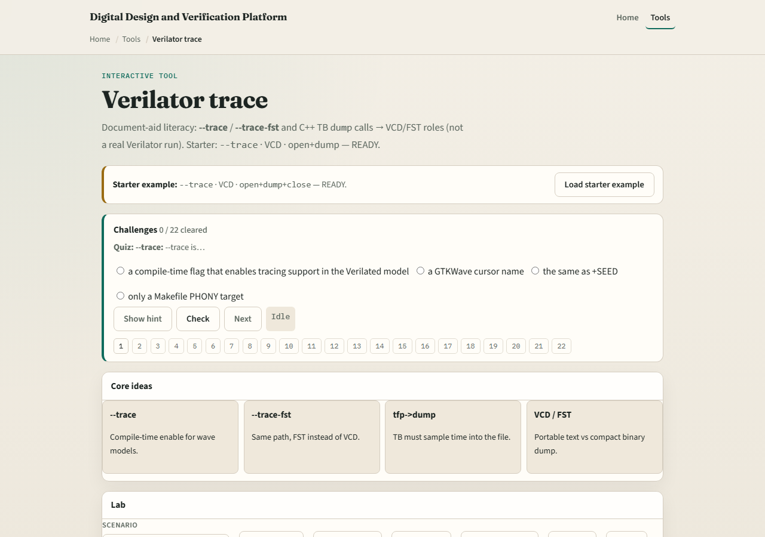
Browser lab
Lab starter
learn_verilator — verilator trace
Notes:
In the trace lab, load the starter and pair compile flags with open, dump, and close steps until status reads ready. Scenarios deliberately show OPEN—flag without dump—and BLIND—dump without flag—so you learn the pairing, not just one magic checkbox.

Slide 4
Real Verilator practice
In Track A, run a tiny design with trace enabled, produce a wave file
Point to the host lines that open and dump
Delete dump temporarily and notice OPEN behavior; compare to a correct run
Keep the file small, this module is trace literacy, not a farm dump
learn_verilator — verilator trace
Notes:
In Track A, run a tiny design with trace enabled, produce a wave file, and open it in a viewer. Point to the host lines that open and dump. Delete dump temporarily and notice OPEN behavior; compare to a correct run. Keep the file small—this module is trace literacy, not a farm dump.

Slide 5
Pitfalls to watch
Do not enable trace and forget dump in the eval loop
Do not dump when compile never enabled trace, BLIND files mislead you
Do not leave trace files unclosed on long runs, flush and close matter
And do not open gigabyte waves when a short window suffices
learn_verilator — verilator trace
Notes:
Do not enable trace and forget dump in the eval loop. Do not dump when compile never enabled trace—BLIND files mislead you. Do not leave trace files unclosed on long runs—flush and close matter. And do not open gigabyte waves when a short window suffices.

Slide 6
Your turn
Complete the checklist for at least one track, preferably both
In the browser, fix OPEN and BLIND scenarios to ready
In Track A, generate one viewable trace from a short run
When you are ready, take the short quiz, then continue to wave dump literacy
learn_verilator — verilator trace
Notes:
Complete the checklist for at least one track—preferably both. In the browser, fix OPEN and BLIND scenarios to ready. In Track A, generate one viewable trace from a short run. When you are ready, take the short quiz, then continue to wave dump literacy.

