Slide 1
Exposing signals to C++
Not every internal net is visible to your C++ testbench by default
learn_verilator — verilator public
Notes:
Not every internal net is visible to your C++ testbench by default. Module ports are already visible at the boundary. Internal signals stay hidden unless you mark them with the Verilator public comment pragma. The design goal is minimal exposure—only what the host truly needs to check or drive.

Slide 2
Public, hidden, and ports
Ports are your contract, no pragma required for normal top-level access patterns
Unmarked internals are HIDDEN from the host’s perspective unless you peek via hierarchy
Mark selectively with the public comment when a scoreboard or checker in C++ must read an
More exposure slows compile and couples TB to implementation details
learn_verilator — verilator public
Notes:
Ports are your contract—no pragma required for normal top-level access patterns. Unmarked internals are HIDDEN from the host’s perspective unless you peek via hierarchy tricks you should not rely on in production. Mark selectively with the public comment when a scoreboard or checker in C++ must read an internal register. More exposure slows compile and couples TB to implementation details.

Slide 3
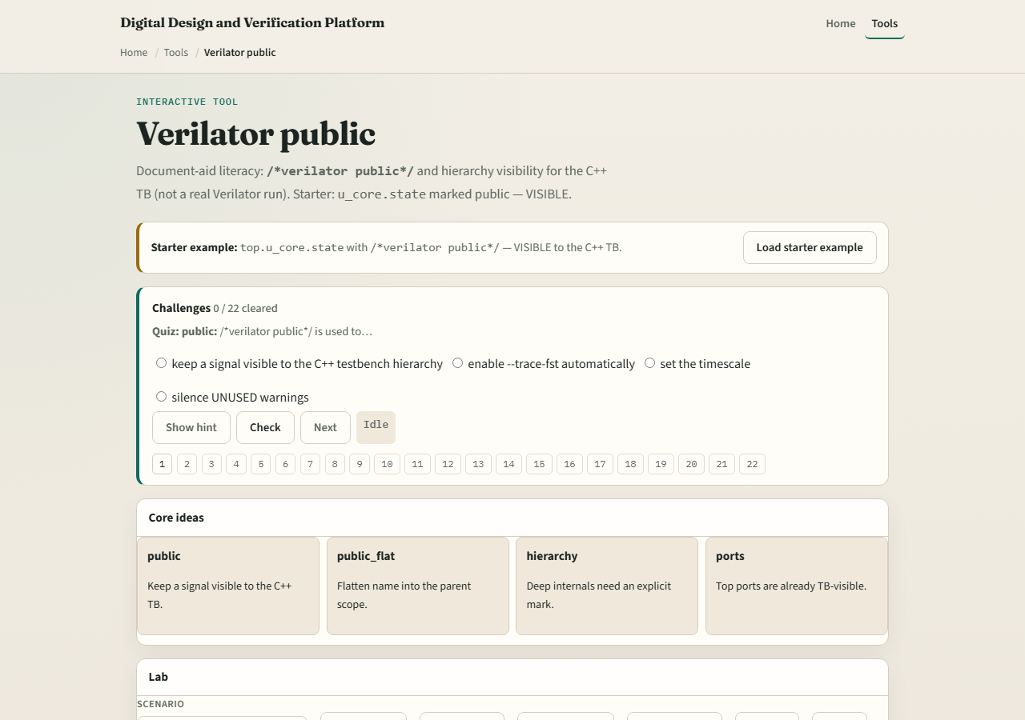
Browser lab
Lab starter
learn_verilator — verilator public
Notes:
In the public visibility lab, load the starter RTL and decide which signals need the public marker for a C++ check. Challenges show over-marked designs—everything public—and under-marked designs where the host cannot see the net under test. Reach ready with minimal marking.

Slide 4
Real Verilator practice
In Track A, take a tiny module with one internal counter
Run once without public markers and note what the host cannot see
Add a public marker on the one net you must observe, recompile, and confirm access
Remove gratuitous markers before you commit, minimal is the rule
learn_verilator — verilator public
Notes:
In Track A, take a tiny module with one internal counter. Run once without public markers and note what the host cannot see. Add a public marker on the one net you must observe, recompile, and confirm access. Remove gratuitous markers before you commit—minimal is the rule.

Slide 5
Pitfalls to watch
Do not mark every signal public to avoid thinking about interfaces
Do not assume ports need the pragma, they already belong to the boundary
Do not hide required check signals and then debug blind in C++
And remember recompile is required after marker changes, this is not a runtime poke
learn_verilator — verilator public
Notes:
Do not mark every signal public to avoid thinking about interfaces. Do not assume ports need the pragma—they already belong to the boundary. Do not hide required check signals and then debug blind in C++. And remember recompile is required after marker changes—this is not a runtime poke.

Slide 6
Your turn
Complete the checklist for at least one track, preferably both
In the browser, pass minimal-marking challenges
In Track A, expose one internal net intentionally and read it from the host
When you are ready, take the short quiz, then continue to verification metrics
learn_verilator — verilator public
Notes:
Complete the checklist for at least one track—preferably both. In the browser, pass minimal-marking challenges. In Track A, expose one internal net intentionally and read it from the host. When you are ready, take the short quiz, then continue to verification metrics.

