Slide 1
Verilator track complete
You now have a working map of Verilator as a tool
learn_verilator — wrap
Notes:
You now have a working map of Verilator as a tool. You can choose versus Icarus for the job, walk compile-elaborate-run, lint with intent, host a C++ testbench with an eval loop, discipline clock and reset, pair trace flags with dump calls, pick VCD or FST wisely, expose only needed internals, read metrics seriously, and run an offline example for real.

Slide 2
Skills you can reuse
Job-first simulator choice transfers to every new block
Lint-before-waves saves hours
The eval-loop mental model survives across designs
Trace flag plus dump is the wave mantra
Minimal public markers keep hosts clean
Metrics vocabulary
learn_verilator — wrap
Notes:
Job-first simulator choice transfers to every new block. Lint-before-waves saves hours. The eval-loop mental model survives across designs. Trace flag plus dump is the wave mantra. Minimal public markers keep hosts clean. Metrics vocabulary—pass rate, coverage, escapes—bridges to planning courses without becoming UVM.

Slide 3
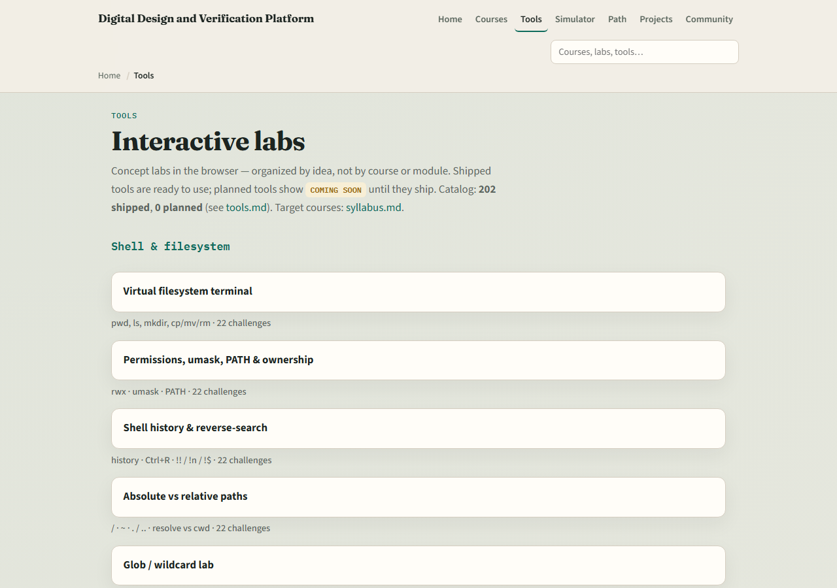
Dual-track recap
If you mainly used browser labs, pick one Track A example and reproduce compile, run
If you mainly used Track A, revisit any browser lab you skipped for graded challenges
Confirm you can open the tools index and name where Simulation literacy lives
learn_verilator — wrap
Notes:
If you mainly used browser labs, pick one Track A example and reproduce compile, run, and a short trace. If you mainly used Track A, revisit any browser lab you skipped for graded challenges. Confirm you can open the tools index and name where Simulation literacy lives.

Slide 4
Where to go next
For event-delay teaching depth, spend time in learn Icarus, the sibling path
For protocol bring-up, UART, SPI
For SystemVerilog language depth, continue learn Verilog modules
For UVM, climb that ladder when you need constrained-random environments, not before you
learn_verilator — wrap
Notes:
For event-delay teaching depth, spend time in learn Icarus—the sibling path. For protocol bring-up, UART, SPI, and I²C courses reuse the same trace and testbench habits. For SystemVerilog language depth, continue learn Verilog modules. For UVM, climb that ladder when you need constrained-random environments—not before you can run a clean Verilator regression.

Slide 5
Mindset to keep
Fix RTL before blanket-disabling warnings
Keep C++ host and SV testbench paradigms straight
Turn dump on when you need waves
Mark public only what you must read
Treat escapes as BLOCKED until addressed
And remember
learn_verilator — wrap
Notes:
Fix RTL before blanket-disabling warnings. Keep C++ host and SV testbench paradigms straight. Turn dump on when you need waves. Mark public only what you must read. Treat escapes as BLOCKED until addressed. And remember: browser labs teach moves; confidence comes from offline runs that pass twice in a row.

Slide 6
Closing
Check off the wrap checklist
You finished the learn Verilator path
Run one small regression or lint-clean example if you want a victory lap
learn_verilator — wrap
Notes:
Check off the wrap checklist. You finished the learn Verilator path. Run one small regression or lint-clean example if you want a victory lap, then pick the next course that matches your goal—language depth, Icarus literacy, protocols, or planning metrics.

