Slide 1
Module 0
Installation and Setup
learn_verilator_iverilog / Module 0

Slide 2
Learning objectives
• Tool Installation: Automated and manual installation
methods for all verification tools
• Environment Setup: Configure your development
environment for efficient verification work
• First Testbenches: Create and run your first "Hello
World" testbenches in both paradigms
• Waveform Analysis: Generate and view waveforms using
GTKWave
• Project Structure: Organize your verification
project following best practices
• Tool Comparison: Understand when to use iverilog vs
Verilator
learn_verilator_iverilog / Module 0

Slide 3
Prerequisites
• Have a Linux, macOS, or Windows (WSL2) system
• Have basic command-line knowledge
• Have Git installed (for cloning the repository)
• Have a C/C++ compiler available (GCC, Clang, or
MSVC)
learn_verilator_iverilog / Module 0

Slide 4

Learning path
Set up verification environment with iverilog and Verilator
learn_verilator_iverilog / Module 0

Slide 5
Overview
• This module covers the complete setup of your
verification environment, including installation of
i…
learn_verilator_iverilog / Module 0

Slide 6
Design architecture
learn_verilator_iverilog / Module 0

Slide 7

1. Verification toolchain layout (1/2)
• Host environment: Linux, macOS,
or WSL2 with GCC/Clang, Make,
and Git
• Icarus path: `iverilog` compiles
RTL + TB → `simv` (or named
binary) executed by `vvp`
• Verilator path: `verilator --cc`
emits C++ model under `obj_dir/`
linked with a C++ testbench
• Waveform path: Simulators write
VCD/FST; GTKWave visualizes
signal transitions
learn_verilator_iverilog / Module 0
Notes:
From MODULE0 Design Architecture.

Slide 8
1. Verification toolchain layout (2/2)
• Course layout: `scripts/install_*.sh`,
`module0/examples/`, `module0/dut/`,
`module0/tests/`
learn_verilator_iverilog / Module 0
Notes:
From MODULE0 Design Architecture.

Slide 9

2. Reference DUT hierarchy (Module 0)
• `module0/dut/simple_gates/`:
Combinational `and_gate`,
`or_gate` — minimal port lists
(a, b, y)
• `module0/dut/counters/`:
`simple_counter` — clocked
sequential logic with enable and
reset
• Hierarchy depth: Flat RTL (no
sub-modules) so install smoke
tests stay fast
• TB attachment: Testbench modules
instantiate DUT at top level; no
bus fabric yet
learn_verilator_iverilog / Module 0
Notes:
From MODULE0 Design Architecture.

Slide 10
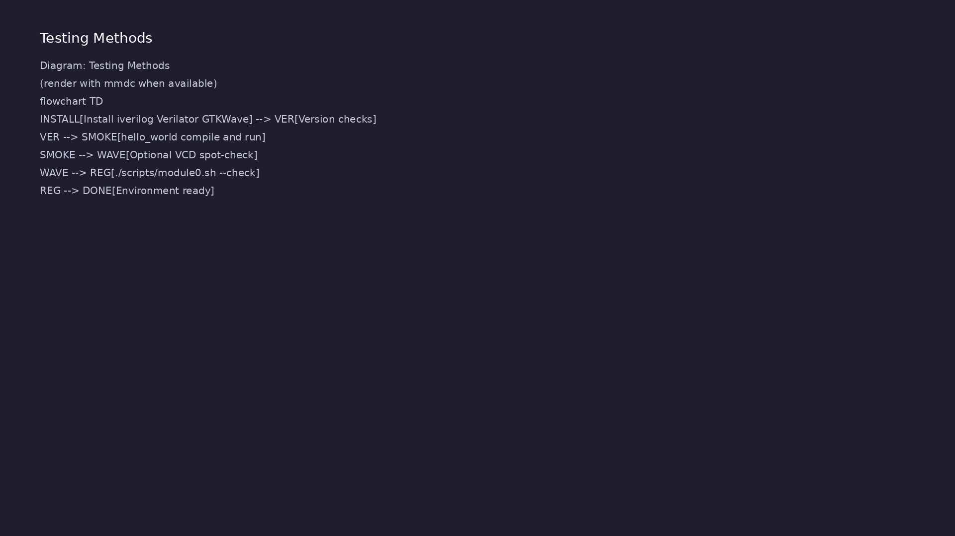
3. First simulation artifact flow
• iverilog: `iverilog -o sim tb.v
dut.v` → `vvp sim` → optional
`$dumpfile` VCD
• Verilator: `verilator --cc
--exe` → `make -C obj_dir` →
`./obj_dir/Vdut`
• Build dirs: Per-example
`Makefile` targets; artifacts
under `build/` or `obj_dir/`
(gitignored)
learn_verilator_iverilog / Module 0
Notes:
From MODULE0 Design Architecture.

Slide 11
RTL block diagram (reference)
Module 0: DUT hierarchy and signal flow.
learn_verilator_iverilog / Module 0

Slide 12
iverilog — compile then simulate
initial begin
// $display is a system task that prints formatted text to
stdout
// Similar to printf() in C or print() in Python
$display("========================================");
$display("Hello World from Icarus Verilog!");
$display("========================================");
$display("If you see this message, iverilog is working
correctly.");
// $time is a system function that returns current simulation
time
// %0t formats it as a decimal number (no leading zeros)
$display("Time: %0t", $time);
$display("========================================");
// #10 introduces a delay of 10 time units
// Default time unit is typically 1ns (can be set with
learn_verilator_iverilog / Module 0
Notes:
Step 1: iverilog -o hello_world hello_world.v. Step 2: vvp hello_world.

Slide 13
Verilator — C++ model and eval()
Verilated::commandArgs(argc, argv);
// Print test header
std::cout << "========================================" <<
std::endl;
std::cout << "Hello World from Verilator!" << std::endl;
std::cout << "========================================" <<
std::endl;
std::cout << "If you see this message, Verilator is working
correctly." << std::endl;
/**
* Create DUT (Design Under Test) Instance
*
* Verilator generates a C++ class for each Verilog module.
* Class naming convention: V<module_name>
*
* For module "hello_world", Verilator generates class
learn_verilator_iverilog / Module 0
Notes:
verilator --cc --exe --build; run ./obj_dir/Vhello_world; dut->eval() each step.

Slide 14
Reference DUT — and_gate
always @(*) begin
// AND operation: y is 1 only when both a and b are 1
// This is the fundamental AND gate behavior
y = a & b;
end
endmodule
learn_verilator_iverilog / Module 0
Notes:
Flat combinational RTL; TB instantiates at top level for smoke tests.

Slide 15
Execution & simulation flow
learn_verilator_iverilog / Module 0

Slide 16
How the example runs (toolchain)
• Makefile: Verilator compiles RTL + SystemVerilog
testbench into a C++ model
• sim_main.cpp: generates clk/rst_n, calls eval()
until $finish
• Directed test (initial block or C++): drive
stimulus, wait for DUT flags
• Self-check: compare outputs; print PASS/FAIL (see
terminal demo slide)
• Repo path: module0/examples/<example>/ — run make
run from that directory
learn_verilator_iverilog / Module 0
Notes:
From MODULE0 — execution and artifact layout.

Slide 17
Directed test execution sequence (1)
• make hello_world
• PASS console message
• optional GTKWave on .vcd
• Install tools
• iverilog -v / verilator --version
learn_verilator_iverilog / Module 0
Notes:
Follow this order when tracing waveforms or debugging.

Slide 18
Directed test execution sequence (2)
• iverilog -o sim tb.v
• vvp sim
• optional $dumpfile VCD
learn_verilator_iverilog / Module 0
Notes:
Follow this order when tracing waveforms or debugging.

Slide 19
Makefile — iverilog hello_world target
hello_world: hello_world.v
@echo "Compiling hello_world..."
# Compile Verilog file into executable
# -o: output filename
$(IVERILOG) -o hello_world hello_world.v
@echo "Running hello_world..."
# Run compiled simulation
$(VVP) hello_world
learn_verilator_iverilog / Module 0
Notes:
make hello_world runs iverilog then vvp from the example directory.

Slide 20
Verilator Makefile — build and run
hello_world: hello_world.v hello_world.cpp
@echo "Compiling hello_world with Verilator..."
# Verilator generates C++ class from Verilog module
# Then compiles C++ testbench with generated code
# Creates executable: ./obj_dir/Vhello_world
$(VERILATOR) $(VERILATOR_FLAGS) hello_world.v hello_world.cpp
@echo "Running hello_world..."
# Execute the compiled simulation
./obj_dir/Vhello_world
learn_verilator_iverilog / Module 0
Notes:
VERILATOR_FLAGS --cc --exe --build; output binary under obj_dir/.

Slide 21
GTKWave example — VCD generation
/**
* GTKWave Usage Example for iverilog
*
* This testbench demonstrates:
* - VCD file generation
* - Multiple signal types (clock, data, control)
* - Signal transitions for waveform analysis
* - GTKWave viewing workflow
*
* Usage:
* iverilog -o gtkwave_example gtkwave_example.v
../../dut/simple_gates/and_gate.v
* vvp gtkwave_example
* gtkwave gtkwave_example.vcd
*/
`timescale 1ns/1ps
# ...
learn_verilator_iverilog / Module 0
Notes:
$dumpfile and $dumpvars create VCD; open with gtkwave for debug.

Slide 22
Verification & testing methods
learn_verilator_iverilog / Module 0

Slide 23
1. Install and environment verification
• Version checks: `iverilog -v`,
`verilator --version`, `gtkwave
--version`
• PATH and compiler: Confirm
`g++`/`gcc` available for
Verilator link step
• Self-check:
`./scripts/module0.sh --check`
validates examples and DUT
compiles
learn_verilator_iverilog / Module 0
Notes:
From MODULE0 Verification & Testing Methods.

Slide 24
2. Hello-world test methodology
• Smoke test: Minimal compile-and-
run per tool (no functional
depth required)
• Pass criteria: Clean compile,
simulation exits 0, expected
`$display` or C++ `printf`
• Waveform spot-check: Open
generated VCD in GTKWave to
confirm clock/reset toggles
learn_verilator_iverilog / Module 0
Notes:
From MODULE0 Verification & Testing Methods.

Slide 25
3. Debugging and regression basics
• Log-first: Capture simulator
stdout; use `-g` / `--trace`
when examples enable it
• Compare tools: Run same DUT with
iverilog vs Verilator to see
flow differences
• Repeatability: Document working
directory and Make target in
`commands_to_try.txt`
learn_verilator_iverilog / Module 0
Notes:
From MODULE0 Verification & Testing Methods.

Slide 26
Install verification — version checks
#!/bin/bash
# Icarus Verilog (iverilog) Installation Script
# Installs iverilog from system package manager or builds from source
# Usage: ./install_iverilog.sh [--system] [--source] [OPTIONS]
set -euo pipefail
# Colors for output
RED='\033[0;31m'
GREEN='\033[0;32m'
YELLOW='\033[1;33m'
BLUE='\033[0;34m'
NC='\033[0m' # No Color
# Get script directory
# ...
learn_verilator_iverilog / Module 0
Notes:
Run install scripts once; verify with iverilog -v and verilator --version.

Slide 27
Syllabus topics
learn_verilator_iverilog / Module 0

Slide 28
Protocol & design details
learn_verilator_iverilog / Module 0

Slide 29
Detail: iverilog Installation Issues (1)
• Cause: iverilog not installed or not in PATH
• Solution:
• Verify: `iverilog -v` should show version
• Cause: SystemVerilog syntax not supported by default
learn_verilator_iverilog / Module 0
Notes:
From MODULE0 Topics Covered — protocol/design depth.

Slide 30
Detail: iverilog Installation Issues (2)
• Solution: Use `-g2012` flag for SystemVerilog
support
• Note: Some SystemVerilog features may still be
limited
• Cause: Missing include path
• Solution: Add include directory with `-I` flag
learn_verilator_iverilog / Module 0
Notes:
From MODULE0 Topics Covered — protocol/design depth.

Slide 31
Detail: Verilator Installation Issues (1)
• Cause: Verilator not installed or not in PATH
• Solution:
• Cause: Installed version is too old
• Solution: Install from source for latest version
learn_verilator_iverilog / Module 0
Notes:
From MODULE0 Topics Covered — protocol/design depth.

Slide 32
Detail: Verilator Installation Issues (2)
• Cause: C++ compiler not installed
• Solution: Install build essentials
• Cause: Verilator headers not found
• Solution: Check Verilator installation and include
paths
learn_verilator_iverilog / Module 0
Notes:
From MODULE0 Topics Covered — protocol/design depth.

Slide 33
Detail: GTKWave Issues (1)
• Cause: GTKWave not installed
• Solution:
• Cause: File format issue or corrupted file
• Solution:
learn_verilator_iverilog / Module 0
Notes:
From MODULE0 Topics Covered — protocol/design depth.

Slide 34
Detail: GTKWave Issues (2)
• Verify VCD file was generated correctly
• Check file permissions
• Try regenerating: `vvp executable` (should create
.vcd file)
learn_verilator_iverilog / Module 0
Notes:
From MODULE0 Topics Covered — protocol/design depth.

Slide 35
Detail: Platform-Specific Issues (1)
• Issue: Package manager version may be outdated
• Solution: Use installation scripts or build from
source
• Issue: Homebrew version may be outdated
• Solution: Use `--source` flag to build from source
learn_verilator_iverilog / Module 0
Notes:
From MODULE0 Topics Covered — protocol/design depth.

Slide 36
Detail: Platform-Specific Issues (2)
• Issue: Some tools may not work in Windows directly
• Solution: Use WSL2 Ubuntu and install there
learn_verilator_iverilog / Module 0
Notes:
From MODULE0 Topics Covered — protocol/design depth.

Slide 37
Detail: Build System Issues
• Issue: `make: *** No targets specified and no
makefile found`
• Solution: Ensure you're in the correct directory
with a Makefile
• Issue: Files not found during compilation
• Solution: Check relative paths and use `-I` flags
correctly
learn_verilator_iverilog / Module 0
Notes:
From MODULE0 Topics Covered — protocol/design depth.

Slide 38
Detail: IDE Issues (1)
• VS Code: Install "SystemVerilog" extension by mshr-h
• Vim: Install vim-systemverilog plugin
• Verification: Open a `.sv` file and check for syntax
highlighting
• Issue: IDE can't find included files
learn_verilator_iverilog / Module 0
Notes:
From MODULE0 Topics Covered — protocol/design depth.

Slide 39
Detail: IDE Issues (2)
• Solution: Configure include paths in IDE settings
• VS Code: Add to `settings.json`:
• Issue: Can't set breakpoints or debug
• Solution:
learn_verilator_iverilog / Module 0
Notes:
From MODULE0 Topics Covered — protocol/design depth.

Slide 40
Verification flow (reference)
Stimulus, DUT response, and check points for this module.
learn_verilator_iverilog / Module 0

Slide 41
1. System Requirements and Prerequisites (1/3)
• Operating System Support
• Linux (Ubuntu/Debian, CentOS/RHEL, Fedora)
• macOS (Intel and Apple Silicon)
• Windows (WSL2 recommended)
• Hardware Requirements
• Minimum 4GB RAM (8GB+ recommended)
learn_verilator_iverilog / Module 0
Notes:
From MODULE0 Topics Covered.

Slide 42
1. System Requirements and Prerequisites (2/3)
• 5GB free disk space
• Multi-core processor recommended
• Software Prerequisites
• C/C++ compiler (GCC 7+, Clang 10+, or MSVC)
• Make or Ninja build system
• Git
learn_verilator_iverilog / Module 0
Notes:
From MODULE0 Topics Covered.

Slide 43
1. System Requirements and Prerequisites (3/3)
• Perl (for some tools)
learn_verilator_iverilog / Module 0
Notes:
From MODULE0 Topics Covered.

Slide 44
2. Icarus Verilog (iverilog) Installation (1/5)
• What is iverilog?
• Open-source Verilog/SystemVerilog simulator
• Good for learning and prototyping
• Supports most Verilog constructs
• Limited SystemVerilog support
• Automated Installation (Recommended)
learn_verilator_iverilog / Module 0
Notes:
From MODULE0 Topics Covered.

Slide 45
2. Icarus Verilog (iverilog) Installation (2/5)
• Using the installation script:
• The script automatically:
• Checks for existing installations
• Installs system dependencies (build tools,
libraries)
• Builds and installs iverilog
• Verifies the installation
learn_verilator_iverilog / Module 0
Notes:
From MODULE0 Topics Covered.

Slide 46
2. Icarus Verilog (iverilog) Installation (3/5)
• Manual Installation Methods
• Linux Installation
• Ubuntu/Debian: `sudo apt-get install iverilog
gtkwave`
• CentOS/RHEL: `sudo yum install iverilog gtkwave`
• Fedora: `sudo dnf install iverilog gtkwave`
• Building from source (latest features)
learn_verilator_iverilog / Module 0
Notes:
From MODULE0 Topics Covered.

Slide 47
2. Icarus Verilog (iverilog) Installation (4/5)
• macOS Installation
• Homebrew installation: `brew install icarus-verilog
gtkwave`
• Building from source
• Windows/WSL2 Installation
• Installing in WSL2 Ubuntu: `sudo apt-get install
iverilog gtkwave`
• Building from source in WSL2
learn_verilator_iverilog / Module 0
Notes:
From MODULE0 Topics Covered.

Slide 48
2. Icarus Verilog (iverilog) Installation (5/5)
• Verification Steps
• Check iverilog version: `iverilog -v`
• Check vvp runtime: `vvp -v`
• Run simple test: `echo 'module test; initial
$display("Hello"); endmodule' | iverilog -o test -
&&…
learn_verilator_iverilog / Module 0
Notes:
From MODULE0 Topics Covered.

Slide 49
3. Verilator Installation (1/5)
• What is Verilator?
• Fast Verilog/SystemVerilog simulator
• Generates C++ code from Verilog
• Excellent performance
• Limited SystemVerilog support (some features)
• Automated Installation (Recommended)
learn_verilator_iverilog / Module 0
Notes:
From MODULE0 Topics Covered.

Slide 50
3. Verilator Installation (2/5)
• Using the installation script:
• The script automatically:
• Checks for existing installations
• Installs system dependencies (build tools,
libraries)
• Sets up git submodule in `tools/verilator/`
• Builds and installs Verilator
learn_verilator_iverilog / Module 0
Notes:
From MODULE0 Topics Covered.

Slide 51
3. Verilator Installation (3/5)
• Verifies the installation
• Manual Installation Methods
• Linux Installation
• Ubuntu/Debian: `sudo apt-get install verilator`
• CentOS/RHEL: `sudo yum install verilator`
• Fedora: `sudo dnf install verilator`
learn_verilator_iverilog / Module 0
Notes:
From MODULE0 Topics Covered.

Slide 52
3. Verilator Installation (4/5)
• Building from source (latest features)
• macOS Installation
• Homebrew installation: `brew install verilator`
• Building from source
• Windows/WSL2 Installation
• Installing in WSL2 Ubuntu: `sudo apt-get install
verilator`
learn_verilator_iverilog / Module 0
Notes:
From MODULE0 Topics Covered.

Slide 53
3. Verilator Installation (5/5)
• Building from source in WSL2
• Verification Steps
• Check Verilator version: `verilator --version`
• Run simple test: Create a minimal Verilog file and
compile with Verilator
learn_verilator_iverilog / Module 0
Notes:
From MODULE0 Topics Covered.

Slide 54
4. GTKWave Installation (1/2)
• What is GTKWave?
• Waveform viewer for VCD and FST files
• Essential for debugging testbenches
• Open-source and cross-platform
• Installation
• Usually installed with iverilog package
learn_verilator_iverilog / Module 0
Notes:
From MODULE0 Topics Covered.

Slide 55
4. GTKWave Installation (2/2)
• Linux: `sudo apt-get install gtkwave` (or included
with iverilog)
• macOS: `brew install gtkwave` (or included with
icarus-verilog)
• Windows: Available as standalone installer
• Verification Steps
• Check GTKWave: `gtkwave --version`
• Open a VCD file: `gtkwave waveform.vcd`
learn_verilator_iverilog / Module 0
Notes:
From MODULE0 Topics Covered.

Slide 56
5. Build System Configuration (1/4)
• Makefile Setup
• Basic Makefile for iverilog
• Basic Makefile for Verilator
• Compilation flags
• Include paths
• Test execution
learn_verilator_iverilog / Module 0
Notes:
From MODULE0 Topics Covered.

Slide 57
5. Build System Configuration (2/4)
• iverilog Compilation
• Compilation command: `iverilog -o output input.v`
• Include paths: `-I<directory>`
• Define macros: `-D<macro>`
• Timescale handling
• Multi-file compilation
learn_verilator_iverilog / Module 0
Notes:
From MODULE0 Topics Covered.

Slide 58
5. Build System Configuration (3/4)
• Verilator Compilation
• Compilation command: `verilator --cc --exe design.v
testbench.cpp`
• SystemVerilog flags: `-sv`, `--timing`
• Include paths: `-I<directory>`
• Optimization flags: `-O0`, `-O1`, `-O2`, `-O3`
• Coverage options: `--coverage`
learn_verilator_iverilog / Module 0
Notes:
From MODULE0 Topics Covered.

Slide 59
5. Build System Configuration (4/4)
• Waveform generation: `--trace`, `--trace-fst`
learn_verilator_iverilog / Module 0
Notes:
From MODULE0 Topics Covered.

Slide 60
6. IDE Setup and Configuration (1/3)
• Recommended IDEs
• VS Code with Verilog/SystemVerilog extension
• Verible (SystemVerilog linter/formatter)
• Vim/Neovim with LSP
• Emacs with Verilog mode
• VS Code Configuration
learn_verilator_iverilog / Module 0
Notes:
From MODULE0 Topics Covered.

Slide 61
6. IDE Setup and Configuration (2/3)
• SystemVerilog extension setup
• iverilog integration
• Verilator integration
• Debugging configuration
• Task runner setup for simulations
• Extension recommendations
learn_verilator_iverilog / Module 0
Notes:
From MODULE0 Topics Covered.

Slide 62
6. IDE Setup and Configuration (3/3)
• Editor Configuration
• SystemVerilog formatting (Verible)
• Linting (Verilator, Verible)
• Code formatting on save
• Syntax highlighting
learn_verilator_iverilog / Module 0
Notes:
From MODULE0 Topics Covered.

Slide 63
7. Project Structure Setup (1/4)
• Directory Structure
• Source code organization
• Test directory structure
• DUT (Design Under Test) organization
• Configuration files
• `tools/` directory for tools (Verilator as git
submodule)
learn_verilator_iverilog / Module 0
Notes:
From MODULE0 Topics Covered.

Slide 64
7. Project Structure Setup (2/4)
• Git Submodules Management
• Verilator is managed as a git submodule in
`tools/verilator/`
• Initialize submodules:
`./scripts/init_submodules.sh` or `git submodule
update --init --recursive`
• Update submodules: `./scripts/update_submodules.sh`
or `git submodule update --remote`
• Add new submodule: `./scripts/add_submodule.sh
<repo_url> <path>`
• Remove submodule: `./scripts/remove_submodule.sh
<path>`
learn_verilator_iverilog / Module 0
Notes:
From MODULE0 Topics Covered.

Slide 65
7. Project Structure Setup (3/4)
• Makefile/Configuration
• Simple Makefile for running tests
• iverilog configuration
• Verilator configuration
• Environment variable management
• Version Control
learn_verilator_iverilog / Module 0
Notes:
From MODULE0 Topics Covered.

Slide 66
7. Project Structure Setup (4/4)
• Git initialization
• .gitignore for Verilog and simulation (include build
artifacts, waveforms)
• Initial commit structure
• Git submodules in `.gitmodules` file
learn_verilator_iverilog / Module 0
Notes:
From MODULE0 Topics Covered.

Slide 67
8. First "Hello World" Verification Test (1/8)
• Prerequisites
• Ensure all tools are installed
• Verify tools are accessible: `iverilog -v` and
`verilator --version`
• iverilog Hello World
• Location:
`module0/examples/iverilog_basics/hello_world.v`
• Purpose: Simplest possible testbench to verify
iverilog installation
learn_verilator_iverilog / Module 0
Notes:
From MODULE0 Topics Covered.

Slide 68
8. First "Hello World" Verification Test (2/8)
• Key Concepts:
• `module` declaration (testbench has no ports)
• `initial` block for procedural code execution
• `$display` system task for output
• `$finish` system task to end simulation
• Time delays with `#delay`
learn_verilator_iverilog / Module 0
Notes:
From MODULE0 Topics Covered.

Slide 69
8. First "Hello World" Verification Test (3/8)
• Compilation: `iverilog -o hello_world hello_world.v`
• Simulation: `vvp hello_world`
• Understanding Output: Console messages confirm
successful execution
• GTKWave Waveform Example
• Location:
`module0/examples/iverilog_basics/gtkwave_example.v`
• Purpose: Comprehensive example demonstrating
waveform generation and analysis
learn_verilator_iverilog / Module 0
Notes:
From MODULE0 Topics Covered.

Slide 70
8. First "Hello World" Verification Test (4/8)
• Key Concepts:
• VCD (Value Change Dump) file generation with
`$dumpfile` and `$dumpvars`
• Clock generation using `forever` loops
• Multiple signal types (clock, data, control signals)
• Signal transitions for timing analysis
• Test phases and patterns
learn_verilator_iverilog / Module 0
Notes:
From MODULE0 Topics Covered.

Slide 71
8. First "Hello World" Verification Test (5/8)
• Compilation: `iverilog -o gtkwave_example
gtkwave_example.v ../../dut/simple_gates/and_gate.v`
• Simulation: `vvp gtkwave_example` (generates
`gtkwave_example.vcd`)
• Viewing: `gtkwave gtkwave_example.vcd` or `make
view_waveforms`
• GTKWave Features Demonstrated:
• Signal hierarchy navigation
• Time marker placement
learn_verilator_iverilog / Module 0
Notes:
From MODULE0 Topics Covered.

Slide 72
8. First "Hello World" Verification Test (6/8)
• Zoom and pan operations
• Save file creation for quick reload
• Verilator Hello World
• Location:
`module0/examples/verilator_basics/hello_world.cpp`
and `hello_world.v`
• Purpose: Simplest possible C++ testbench to verify
Verilator installation
• Key Concepts:
learn_verilator_iverilog / Module 0
Notes:
From MODULE0 Topics Covered.

Slide 73
8. First "Hello World" Verification Test (7/8)
• Verilator compilation process (`verilator --cc --exe
--build`)
• Generated C++ class structure (`V<module_name>`)
• DUT instantiation in C++
• `eval()` method for simulation
• `final()` method for cleanup
• Verilator initialization with
`Verilated::commandArgs()`
learn_verilator_iverilog / Module 0
Notes:
From MODULE0 Topics Covered.

Slide 74
8. First "Hello World" Verification Test (8/8)
• Compilation: `verilator --cc --exe --build
hello_world.v hello_world.cpp`
• Running: `./obj_dir/Vhello_world`
• Understanding Output: Console messages confirm
successful execution
learn_verilator_iverilog / Module 0
Notes:
From MODULE0 Topics Covered.

Slide 75
9. Tool Comparison and Selection Criteria (1/4)
• iverilog Characteristics
• Verilog/SystemVerilog testbenches
• Good for learning
• Easy to use
• Good waveform support
• Moderate performance
learn_verilator_iverilog / Module 0
Notes:
From MODULE0 Topics Covered.

Slide 76
9. Tool Comparison and Selection Criteria (2/4)
• Verilator Characteristics
• C++ testbenches
• Excellent performance
• Good for large designs
• Requires C++ knowledge
• Limited SystemVerilog support
learn_verilator_iverilog / Module 0
Notes:
From MODULE0 Topics Covered.

Slide 77
9. Tool Comparison and Selection Criteria (3/4)
• When to Use Each
• Use iverilog for:
• Learning Verilog testbench concepts
• Quick prototyping
• Simple to medium complexity designs
• When you prefer Verilog syntax
learn_verilator_iverilog / Module 0
Notes:
From MODULE0 Topics Covered.

Slide 78
9. Tool Comparison and Selection Criteria (4/4)
• Use Verilator for:
• High-performance simulation
• Large designs
• Integration with C++ libraries
• Complex testbenches with advanced data structures
learn_verilator_iverilog / Module 0
Notes:
From MODULE0 Topics Covered.

Slide 79
10. Common Pitfalls and Solutions
• Pitfall 1: Installation Script Permissions
• Pitfall 2: Missing Build Dependencies
• Pitfall 3: Verilator Version Too Old
• Pitfall 4: PATH Not Updated
learn_verilator_iverilog / Module 0
Notes:
From MODULE0 Topics Covered.

Slide 80
11. Troubleshooting Common Issues (1/8)
• Cause: iverilog not installed or not in PATH
• Solution:
• Verify: `iverilog -v` should show version
• Cause: SystemVerilog syntax not supported by default
• Solution: Use `-g2012` flag for SystemVerilog
support
• Note: Some SystemVerilog features may still be
limited
learn_verilator_iverilog / Module 0
Notes:
From MODULE0 Topics Covered.

Slide 81
11. Troubleshooting Common Issues (2/8)
• Cause: Missing include path
• Solution: Add include directory with `-I` flag
• Cause: VVP runtime not installed or not in PATH
• Solution: VVP is usually installed with iverilog.
Reinstall if missing:
• Cause: Verilator not installed or not in PATH
• Solution:
learn_verilator_iverilog / Module 0
Notes:
From MODULE0 Topics Covered.

Slide 82
11. Troubleshooting Common Issues (3/8)
• Cause: Installed version is too old
• Solution: Install from source for latest version
• Cause: C++ compiler not installed
• Solution: Install build essentials
• Cause: Verilator headers not found
• Solution: Check Verilator installation and include
paths
learn_verilator_iverilog / Module 0
Notes:
From MODULE0 Topics Covered.

Slide 83
11. Troubleshooting Common Issues (4/8)
• Cause: Missing Verilator library linking
• Solution: Ensure Makefile includes Verilator
libraries
• Cause: GTKWave not installed
• Solution:
• Cause: File format issue or corrupted file
• Solution:
learn_verilator_iverilog / Module 0
Notes:
From MODULE0 Topics Covered.

Slide 84
11. Troubleshooting Common Issues (5/8)
• Verify VCD file was generated correctly
• Check file permissions
• Try regenerating: `vvp executable` (should create
.vcd file)
• Issue: Package manager version may be outdated
• Solution: Use installation scripts or build from
source
• Issue: Homebrew version may be outdated
learn_verilator_iverilog / Module 0
Notes:
From MODULE0 Topics Covered.

Slide 85
11. Troubleshooting Common Issues (6/8)
• Solution: Use `--source` flag to build from source
• Issue: Some tools may not work in Windows directly
• Solution: Use WSL2 Ubuntu and install there
• Issue: `make: *** No targets specified and no
makefile found`
• Solution: Ensure you're in the correct directory
with a Makefile
• Issue: Files not found during compilation
learn_verilator_iverilog / Module 0
Notes:
From MODULE0 Topics Covered.

Slide 86
11. Troubleshooting Common Issues (7/8)
• Solution: Check relative paths and use `-I` flags
correctly
• VS Code: Install "SystemVerilog" extension by mshr-h
• Vim: Install vim-systemverilog plugin
• Verification: Open a `.sv` file and check for syntax
highlighting
• Issue: IDE can't find included files
• Solution: Configure include paths in IDE settings
learn_verilator_iverilog / Module 0
Notes:
From MODULE0 Topics Covered.

Slide 87
11. Troubleshooting Common Issues (8/8)
• VS Code: Add to `settings.json`:
• Issue: Can't set breakpoints or debug
• Solution:
• For Verilator: Use GDB with compiled executable
• For iverilog: Use VCD waveforms for debugging
learn_verilator_iverilog / Module 0
Notes:
From MODULE0 Topics Covered.

Slide 88
12. Verification Checklist (1/3)
• C/C++ compiler installed and working
• iverilog installed and verified
• Using script: `./scripts/install_iverilog.sh`
• Verify: `iverilog -v` and `vvp -v`
• Verilator installed and verified
• Using script: `./scripts/install_verilator.sh`
learn_verilator_iverilog / Module 0
Notes:
From MODULE0 Topics Covered.

Slide 89
12. Verification Checklist (2/3)
• Verify: `verilator --version`
• GTKWave installed and verified
• Verify: `gtkwave --version`
• All tools verified together
• IDE configured and working
• First test runs successfully (both iverilog and
Verilator)
learn_verilator_iverilog / Module 0
Notes:
From MODULE0 Topics Covered.

Slide 90
12. Verification Checklist (3/3)
• Can create and run simple testbench
• Understand basic project structure
• Know how to get help when stuck
• Understand tool differences and when to use each
learn_verilator_iverilog / Module 0
Notes:
From MODULE0 Topics Covered.

Slide 91
Hands-on examples
learn_verilator_iverilog / Module 0

Slide 92
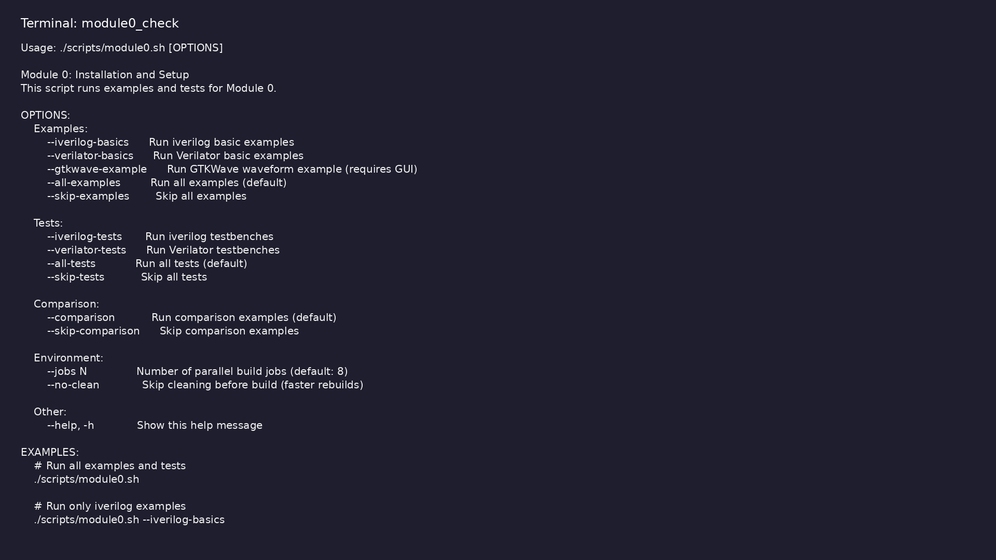
Module 0 self-check
$ ./scripts/module0.sh --help
learn_verilator_iverilog / Module 0
Notes:
Run from course repository root.

Slide 93
Exercise scaffold
./scripts/module0.sh --scaffold
learn_verilator_iverilog / Module 0

Slide 94

Demo: iverilog basics
$ cd module0/examples/iverilog_basics && make hello_world
learn_verilator_iverilog / Module 0
Notes:
Hands-on: module0/examples/iverilog_basics/

Slide 95
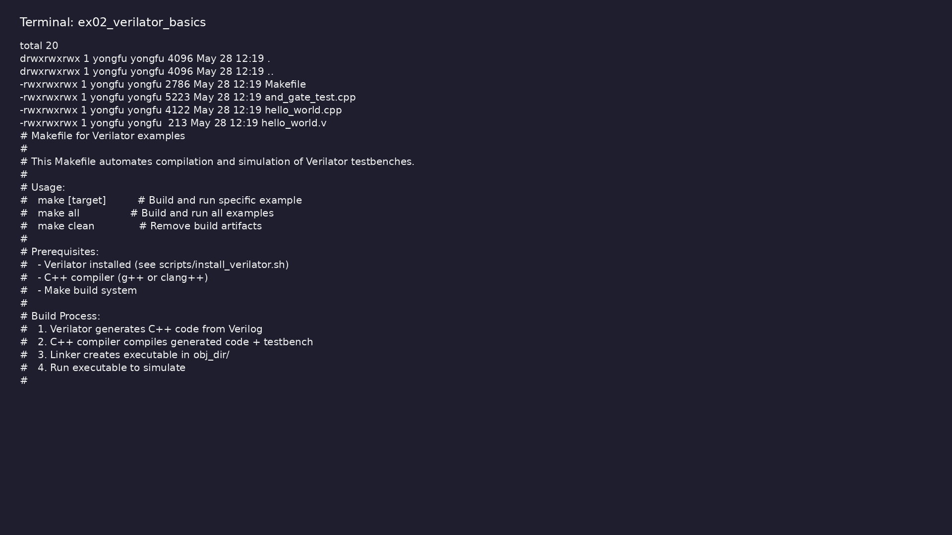
Demo: Verilator basics
$ ls -la module0/examples/verilator_basics && head -20
module0/examples/verilator_basics/Makefile
learn_verilator_iverilog / Module 0
Notes:
Hands-on: module0/examples/verilator_basics/

Slide 96
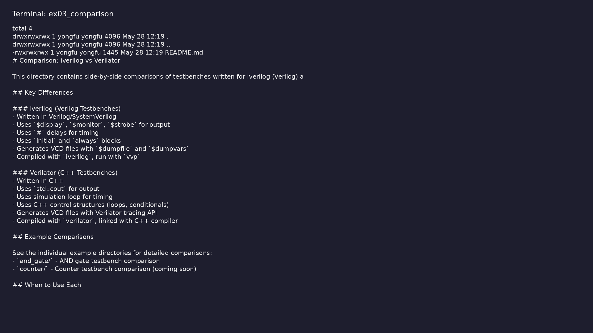
Demo: Tool comparison
$ cd module0/examples/comparison && ls -la && head -30 README.md
2>/dev/null || head -30 Makefile
learn_verilator_iverilog / Module 0
Notes:
Hands-on: module0/examples/comparison/

Slide 97
Practice & assessment
learn_verilator_iverilog / Module 0

Slide 98
What you should know (1/2)
• Install and configure all required tools
• Set up iverilog
• Set up Verilator
• Install and verify GTKWave
• Configure your IDE for verification work
• Create a basic project structure
learn_verilator_iverilog / Module 0
Notes:
From MODULE0 Learning Outcomes.

Slide 99
What you should know (2/2)
• Run simple verification tests with both tools
• Understand tool differences and selection criteria
• Troubleshoot common installation issues
learn_verilator_iverilog / Module 0
Notes:
From MODULE0 Learning Outcomes.

Slide 100
Exercises
• Installation Verification
• Environment Setup
• First Tests
• IDE Configuration
• Project Structure
learn_verilator_iverilog / Module 0

Slide 101
Exercises
• Tool Comparison
learn_verilator_iverilog / Module 0

Slide 102
Assessment checklist
• Can install all required tools independently
• Can set up iverilog
• Can verify iverilog installation
• Can set up Verilator
• Can verify Verilator installation
• Can install and verify GTKWave
learn_verilator_iverilog / Module 0

Slide 103
Summary & next steps
• Set up verification environment with iverilog and
Verilator
• Complete module0/CHECKLIST.md
• Review module0/EXAMPLES.md and run each lab
• Next: Next module in course
learn_verilator_iverilog / Module 0

