Slide 1
Module 1
iverilog Deep Dive
learn_verilator_iverilog / Module 1

Slide 2
Learning objectives
• Master iverilog for Verilog/SystemVerilog testbench
development
learn_verilator_iverilog / Module 1

Slide 3
Prerequisites
• See module README
learn_verilator_iverilog / Module 1

Slide 4

Learning path
Master iverilog for Verilog/SystemVerilog testbench development
learn_verilator_iverilog / Module 1

Slide 5
Overview
• This module provides comprehensive coverage of
Icarus Verilog (iverilog), an open-source Verilog
si…
learn_verilator_iverilog / Module 1

Slide 6
Design architecture
learn_verilator_iverilog / Module 1

Slide 7

1. iverilog compile-and-run architecture
• Sources: RTL under
`module1/dut/` plus testbench
under `examples/` or `tests/`
• Compile: `iverilog` elaborates
modules, produces a VVP bytecode
executable
• Simulate: `vvp` drives the event
scheduler; `$dumpvars` can emit
VCD
• Artifacts: `simv` (or custom
name), `*.vcd`, compile logs in
example directories
learn_verilator_iverilog / Module 1
Notes:
From MODULE1 Design Architecture.

Slide 8

2. Module 1 DUT catalog
• `dut/multiplexers/`: `mux_2to1`,
`mux_4to1` — select lines,
combinational outputs
• `dut/counters/`: `counter_4bit`
— clock, reset, enable, parallel
load
• Interface pattern: Clock + reset
on sequential blocks; data ports
on combinational paths
• Reuse: Same DUTs exercised
across compilation, simulation,
and testbench examples
learn_verilator_iverilog / Module 1
Notes:
From MODULE1 Design Architecture.

Slide 9
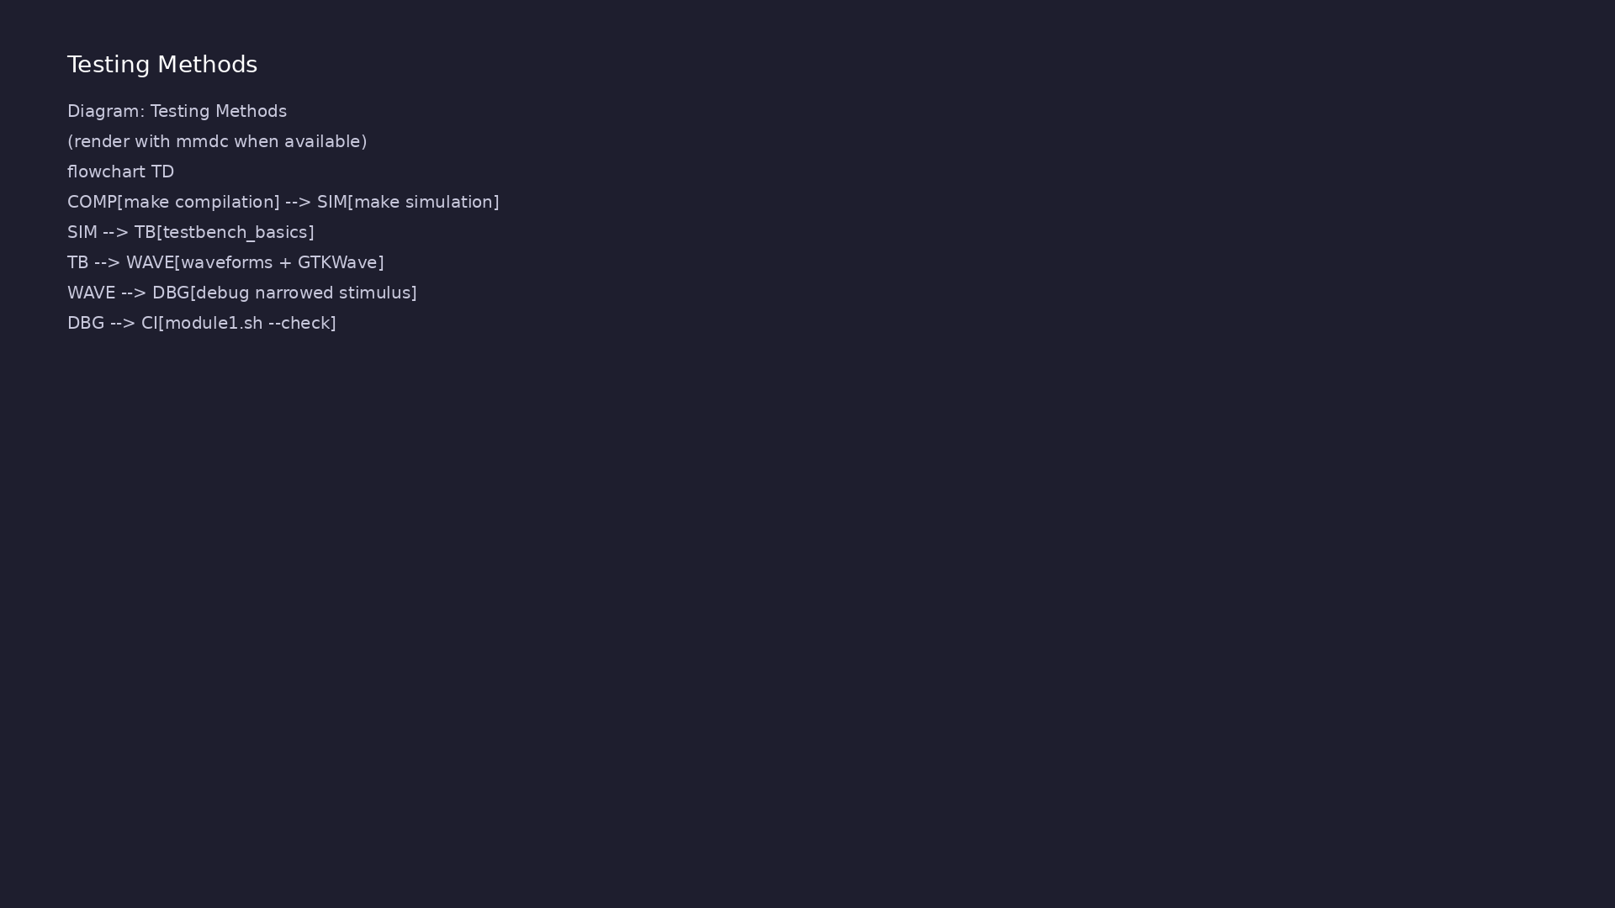
3. Verilog testbench structure (iverilog)
• Top: `module tb;` instantiates
DUT, declares wires/regs for
connectivity
• Stimulus: `initial` blocks and
tasks drive inputs over
simulation time
• Observation: `$display`,
`$monitor`, and VCD for passive
debug
• Closure: `$finish` after
pass/fail counts or explicit
timeout
learn_verilator_iverilog / Module 1
Notes:
From MODULE1 Design Architecture.

Slide 10
RTL block diagram (reference)
Module 1: DUT hierarchy and signal flow.
learn_verilator_iverilog / Module 1

Slide 11
Compilation Makefile — iverilog targets
# Basic compilation
basic_compilation: basic_compilation.v
@echo "=== Basic Compilation ==="
$(IVERILOG) -o basic_compilation basic_compilation.v
$(VVP) basic_compilation
# Compilation with include path
include_path: basic_compilation.v
@echo "=== Compilation with Include Path ==="
$(IVERILOG) -I$(DUT_DIR) -o include_path basic_compilation.v
$(VVP) include_path
# Compilation with macro definition
macro_def: basic_compilation.v
@echo "=== Compilation with Macro Definition ==="
$(IVERILOG) -DDEBUG -o macro_def basic_compilation.v
# ...
learn_verilator_iverilog / Module 1
Notes:
iverilog elaborates RTL+TB into VVP bytecode; vvp runs the event scheduler.

Slide 12
Verilog TB — DUT instantiation
module mux_4to1_test;
//
========================================================================
// Testbench Signal Declarations
//
========================================================================
// These signals connect to the DUT and are controlled by the
testbench
reg [1:0] sel; // Select signal (2-bit, drives DUT input)
reg in0, in1, in2, in3; // Input signals (drive DUT inputs)
wire out; // Output signal (observes DUT output, wire
because it's driven by DUT)
reg clk; // Clock signal (for demonstration, not needed
for combinational logic)
//
learn_verilator_iverilog / Module 1
Notes:
Top module wires regs to DUT ports; initial blocks drive stimulus.

Slide 13
VVP simulation Makefile
vvp_basics: vvp_basics.v
@echo "=== Compiling vvp_basics ==="
$(IVERILOG) -o vvp_basics vvp_basics.v
@echo "=== Running simulation ==="
$(VVP) vvp_basics
@echo "=== Running with verbose mode ==="
$(VVP) -v vvp_basics
learn_verilator_iverilog / Module 1
Notes:
Compile to named binary, then vvp executes the bytecode simulator.

Slide 14
DUT — mux_4to1 select logic
module mux_4to1(
input wire [1:0] sel, // 2-bit select signal
input wire in0, // Input 0
input wire in1, // Input 1
input wire in2, // Input 2
input wire in3, // Input 3
output reg out // Output (must be reg for procedural
assignment)
);
/**
* Combinational Logic: 4-to-1 Multiplexer
*
* This always block implements the multiplexer logic using a case
statement.
* The always @(*) syntax means this block is sensitive to all
signals used
* in the right-hand side (sel, in0, in1, in2, in3), making it
learn_verilator_iverilog / Module 1
Notes:
Combinational case(sel) drives out; exercised by directed vectors.

Slide 15
Execution & simulation flow
learn_verilator_iverilog / Module 1

Slide 16
How the example runs (toolchain)
• Makefile: Verilator compiles RTL + SystemVerilog
testbench into a C++ model
• sim_main.cpp: generates clk/rst_n, calls eval()
until $finish
• Directed test (initial block or C++): drive
stimulus, wait for DUT flags
• Self-check: compare outputs; print PASS/FAIL (see
terminal demo slide)
• Repo path: module1/examples/<example>/ — run make
run from that directory
learn_verilator_iverilog / Module 1
Notes:
From MODULE1 — execution and artifact layout.

Slide 17
Directed test execution sequence (1)
• TB compares expected vs actual
• error count on stdout
• $finish with summary
• Gather RTL from module1/dut/
• iverilog -o sim tb.v dut.v
learn_verilator_iverilog / Module 1
Notes:
Follow this order when tracing waveforms or debugging.

Slide 18
Directed test execution sequence (2)
• vvp sim
• read $display self-check
• $dumpvars VCD
learn_verilator_iverilog / Module 1
Notes:
Follow this order when tracing waveforms or debugging.

Slide 19
Run compilation example
# Basic compilation
basic_compilation: basic_compilation.v
@echo "=== Basic Compilation ==="
$(IVERILOG) -o basic_compilation basic_compilation.v
$(VVP) basic_compilation
learn_verilator_iverilog / Module 1
Notes:
cd module1/examples/compilation && make basic_compilation

Slide 20
VVP runtime invocation
vvp_basics: vvp_basics.v
@echo "=== Compiling vvp_basics ==="
$(IVERILOG) -o vvp_basics vvp_basics.v
@echo "=== Running simulation ==="
$(VVP) vvp_basics
@echo "=== Running with verbose mode ==="
$(VVP) -v vvp_basics
learn_verilator_iverilog / Module 1
Notes:
vvp drives time; use -v for verbose scheduler output when debugging.

Slide 21
Self-checking stimulus loop
//
// Test Strategy:
// - Exhaustive testing: Test all 4 select combinations
// - For each select value, set the corresponding input high, others
low
// - Verify that output matches the selected input
//
// This pattern (stimulus → wait → check) is fundamental to all
verification:
// 1. Apply stimulus (set inputs)
// 2. Wait for propagation (combinational logic settles immediately,
but we wait for clarity)
// 3. Check result (compare output to expected value)
// 4. Report pass/fail
//
// In UVM: This evolves into:
// - Sequences generate transactions (stimulus)
// - Drivers apply transactions to DUT
learn_verilator_iverilog / Module 1
Notes:
Apply sel/in patterns, compare out, increment error count, $finish.

Slide 22
Verification & testing methods
learn_verilator_iverilog / Module 1

Slide 23
1. Directed functional testing
• Vector tables: Apply known (sel,
d0..d3) or (en, load) patterns;
compare `y` or `count`
• Corner cases: Reset during
operation, enable deasserted,
all MUX select values
• Self-check: Inline `if (expected
!== actual)` with error count
and final summary
learn_verilator_iverilog / Module 1
Notes:
From MODULE1 Verification & Testing Methods.

Slide 24
2. File-based and batch testing
• Test vectors: Read stimulus from
files (`file_io` examples) for
regression-style reruns
• Golden logs: Compare simulator
output to expected transcripts
where provided
• Orchestration:
`./scripts/module1.sh` runs
example matrix; `--check` for
CI-style gate
learn_verilator_iverilog / Module 1
Notes:
From MODULE1 Verification & Testing Methods.

Slide 25
3. Waveform and debug methodology
• VCD generation: Enable
`$dumpfile` / `$dumpvars` in TB
or via plusargs where shown
• GTKWave: Align clock edges,
verify reset release, step
through MUX transitions
• Debug flow: Re-run single
example with `make clean &&
make` and narrowed stimulus
learn_verilator_iverilog / Module 1
Notes:
From MODULE1 Verification & Testing Methods.

Slide 26
Self-check — expected vs actual
// Print test table header
$display("\nTesting all select combinations:");
$display("sel | in0 | in1 | in2 | in3 | out | Expected");
$display("----|-----|-----|-----|-----|-----|----------");
//
====================================================================
// Test Case 1: Select in0 (sel=00)
//
====================================================================
// Strategy: Set in0=1, all others=0, sel=00, verify out=in0
sel = 2'b00;
in0 = 1'b1; // Set input 0 high
in1 = 1'b0;
in2 = 1'b0;
in3 = 1'b0;
#5; // Wait for combinational logic to propagate (though it's
instant)
learn_verilator_iverilog / Module 1
Notes:
Inline if (expected !== actual); final summary before $finish.

Slide 27
Syllabus topics
learn_verilator_iverilog / Module 1

Slide 28
1. iverilog Overview (1/5)
• What is iverilog?
• Open-source Verilog/SystemVerilog simulator
• Part of the Icarus Verilog project
• Cross-platform (Linux, macOS, Windows)
• Free and open-source
• iverilog Capabilities and Features
learn_verilator_iverilog / Module 1
Notes:
From MODULE1 Topics Covered.

Slide 29
1. iverilog Overview (2/5)
• Verilog-2001 support
• SystemVerilog support (limited)
• VCD waveform generation
• PLI/VPI support
• Fast compilation and simulation
• Supported Verilog/SystemVerilog Constructs
learn_verilator_iverilog / Module 1
Notes:
From MODULE1 Topics Covered.

Slide 30
1. iverilog Overview (3/5)
• Most Verilog-2001 features
• Basic SystemVerilog features
• Interfaces (limited)
• Classes (limited)
• Assertions (limited)
• Limitations and Workarounds
learn_verilator_iverilog / Module 1
Notes:
From MODULE1 Topics Covered.

Slide 31
1. iverilog Overview (4/5)
• Limited SystemVerilog support
• Some advanced features not supported
• Performance considerations for large designs
• Workarounds for unsupported features
• When to Use iverilog
• Learning Verilog testbench concepts
learn_verilator_iverilog / Module 1
Notes:
From MODULE1 Topics Covered.

Slide 32
1. iverilog Overview (5/5)
• Quick prototyping
• Simple to medium complexity designs
• When you prefer Verilog syntax
• Open-source projects
learn_verilator_iverilog / Module 1
Notes:
From MODULE1 Topics Covered.

Slide 33
2. Compilation Process (1/6)
• **Compilation Command (`iverilog`)
• Basic syntax: `iverilog -o output input.v`
• Output file specification
• Input file handling
• Command-Line Options and Flags
• `-o <file>`: Specify output file
learn_verilator_iverilog / Module 1
Notes:
From MODULE1 Topics Covered.

Slide 34
2. Compilation Process (2/6)
• `-I<directory>`: Add include path
• `-D<macro>=<value>`: Define macro
• `-g<spec>`: Specify language generation
• `-s <top>`: Specify top-level module
• `-t <target>`: Specify target format
• Include Path Management (`-I`)
learn_verilator_iverilog / Module 1
Notes:
From MODULE1 Topics Covered.

Slide 35
2. Compilation Process (3/6)
• Adding include directories
• Multiple include paths
• Relative vs. absolute paths
• Best practices
• Define Macros (`-D`)
• Conditional compilation
learn_verilator_iverilog / Module 1
Notes:
From MODULE1 Topics Covered.

Slide 36
2. Compilation Process (4/6)
• Macro definitions
• Default values
• Usage in testbenches
• Timescale Handling
• `timescale directive
• Default timescale
learn_verilator_iverilog / Module 1
Notes:
From MODULE1 Topics Covered.

Slide 37
2. Compilation Process (5/6)
• Timescale conflicts
• Resolution
• Multi-File Compilation
• Compiling multiple files
• File ordering
• Dependency management
learn_verilator_iverilog / Module 1
Notes:
From MODULE1 Topics Covered.

Slide 38
2. Compilation Process (6/6)
• Library files
• Library Management
• Library files
• Library paths
• Precompiled libraries
• `basic_compilation.v`: Demonstrates basic
compilation, include paths, macros, multi-file
compilation
learn_verilator_iverilog / Module 1
Notes:
From MODULE1 Topics Covered.

Slide 39
3. Simulation Execution (1/4)
• VVP (Icarus Verilog Runtime) Usage
• What is VVP?
• Running simulations: `vvp executable`
• VVP vs. other simulators
• Simulation Command and Options
• Basic execution: `vvp executable`
learn_verilator_iverilog / Module 1
Notes:
From MODULE1 Topics Covered.

Slide 40
3. Simulation Execution (2/4)
• Command-line options
• Runtime flags
• Runtime Flags
• `-v`: Verbose mode
• `-n`: No execution (syntax check)
• `-M <path>`: Module path
learn_verilator_iverilog / Module 1
Notes:
From MODULE1 Topics Covered.

Slide 41
3. Simulation Execution (3/4)
• `-m <module>`: Load module
• Simulation Control
• Starting simulation
• Stopping simulation
• Simulation time
• Event scheduling
learn_verilator_iverilog / Module 1
Notes:
From MODULE1 Topics Covered.

Slide 42
3. Simulation Execution (4/4)
• Performance Considerations
• Simulation speed
• Memory usage
• Large design handling
• Optimization tips
• `vvp_basics.v`: Demonstrates VVP simulation
execution and options
learn_verilator_iverilog / Module 1
Notes:
From MODULE1 Topics Covered.

Slide 43
4. Verilog Testbench Writing for iverilog (1/8)
• Verilog Testbench Structure
• Module-based testbenches (foundation for all
testbenches)
• Top-level testbench module (analogous to UVM test
class)
• DUT instantiation (part of UVM environment)
• Signal declarations (evolve into UVM interfaces and
virtual interfaces)
• Module-Based Testbenches
learn_verilator_iverilog / Module 1
Notes:
From MODULE1 Topics Covered.

Slide 44
4. Verilog Testbench Writing for iverilog (2/8)
• Testbench as a module (no ports needed, self-
contained)
• Internal signal declarations (signals connect DUT to
testbench)
• UVM Connection: In UVM, this structure evolves into
environments with agents, drivers, monitors, an…
• Initial Blocks for Test Sequences
• Test sequence organization (foundation for UVM
sequences)
• Sequential test application (stimulus generation)
learn_verilator_iverilog / Module 1
Notes:
From MODULE1 Topics Covered.

Slide 45
4. Verilog Testbench Writing for iverilog (3/8)
• Timing control (delay and synchronization)
• Multiple initial blocks (concurrent test processes)
• UVM Connection: Initial blocks with test sequences
evolve into UVM sequences that generate transact…
• Always Blocks for Clock Generation
• Clock generation patterns (essential for sequential
logic)
• Continuous clock (runs forever)
learn_verilator_iverilog / Module 1
Notes:
From MODULE1 Topics Covered.

Slide 46
4. Verilog Testbench Writing for iverilog (4/8)
• Gated clock (conditional clock)
• Multiple clocks (multi-clock domain designs)
• UVM Connection: Clock generation in UVM is handled
by clocking blocks and virtual interfaces
• Signal Access and Monitoring
• Reading signals (observing DUT outputs)
• Writing signals (driving DUT inputs)
learn_verilator_iverilog / Module 1
Notes:
From MODULE1 Topics Covered.

Slide 47
4. Verilog Testbench Writing for iverilog (5/8)
• Signal monitoring (continuous observation)
• Signal tracing (debugging)
• UVM Connection: Signal access evolves into UVM
monitors that observe transactions and send them to…
• $display, $monitor, $strobe
• `$display`: Immediate output (prints when called)
• `$monitor`: Continuous monitoring (prints on signal
changes)
learn_verilator_iverilog / Module 1
Notes:
From MODULE1 Topics Covered.

Slide 48
4. Verilog Testbench Writing for iverilog (6/8)
• `$strobe`: End-of-time-step output (prints after all
assignments)
• Formatting options (similar to printf in C)
• When to use each (timing differences matter)
• UVM Connection: These system tasks are used in UVM
for logging and debugging, but UVM also provides…
• File I/O ($readmemh, $readmemb, $fopen, $fwrite)
• Reading memory files: `$readmemh` (hex), `$readmemb`
(binary)
learn_verilator_iverilog / Module 1
Notes:
From MODULE1 Topics Covered.

Slide 49
4. Verilog Testbench Writing for iverilog (7/8)
• Opening files: `$fopen` (returns file handle)
• Writing files: `$fwrite`, `$fdisplay` (formatted
output)
• Closing files: `$fclose` (cleanup)
• File-based testbenches (separate test data from
code)
• UVM Connection: File-based test vectors evolve into
transaction-based verification where sequences…
• `module1/examples/testbench_basics/`:
learn_verilator_iverilog / Module 1
Notes:
From MODULE1 Topics Covered.

Slide 50
4. Verilog Testbench Writing for iverilog (8/8)
• `mux_4to1_test.v`: Demonstrates basic testbench
structure, stimulus generation, and checking
• `counter_test.v`: Demonstrates clock generation,
reset sequences, and sequential logic testing
• `module1/examples/file_io/`: File I/O operations and
file-based test patterns
learn_verilator_iverilog / Module 1
Notes:
From MODULE1 Topics Covered.

Slide 51
5. Waveform Generation (1/4)
• VCD File Generation ($dumpfile, $dumpvars)
• `$dumpfile`: Specify VCD filename
• `$dumpvars`: Select signals to dump
• Dump levels (0, 1, 2, etc.)
• Signal selection
• Signal Selection for Waveforms
learn_verilator_iverilog / Module 1
Notes:
From MODULE1 Topics Covered.

Slide 52
5. Waveform Generation (2/4)
• Dumping all signals
• Dumping specific signals
• Dumping hierarchy levels
• Selective dumping
• GTKWave Compatibility
• VCD file format
learn_verilator_iverilog / Module 1
Notes:
From MODULE1 Topics Covered.

Slide 53
5. Waveform Generation (3/4)
• GTKWave viewing
• Signal organization
• Save files (.gtkw)
• Waveform Analysis
• Viewing waveforms
• Signal timing
learn_verilator_iverilog / Module 1
Notes:
From MODULE1 Topics Covered.

Slide 54
5. Waveform Generation (4/4)
• Timing relationships
• Debugging with waveforms
• `waveform_example.v`: Comprehensive waveform
generation with different dump levels
learn_verilator_iverilog / Module 1
Notes:
From MODULE1 Topics Covered.

Slide 55
6. Debugging with iverilog (1/5)
• Compilation Error Debugging
• Understanding error messages
• Common compilation errors
• Syntax errors
• Missing files
• Include path issues
learn_verilator_iverilog / Module 1
Notes:
From MODULE1 Topics Covered.

Slide 56
6. Debugging with iverilog (2/5)
• Runtime Error Debugging
• Understanding runtime errors
• Simulation errors
• Signal value errors
• Timing errors
• Signal Tracing Techniques
learn_verilator_iverilog / Module 1
Notes:
From MODULE1 Topics Covered.

Slide 57
6. Debugging with iverilog (3/5)
• Using $display for tracing
• Using $monitor for continuous tracing
• VCD file analysis
• Signal value inspection
• Logging Strategies
• Debug levels
learn_verilator_iverilog / Module 1
Notes:
From MODULE1 Topics Covered.

Slide 58
6. Debugging with iverilog (4/5)
• Conditional logging
• File-based logging
• Log organization
• Common Pitfalls and Solutions
• Timescale issues
• Signal initialization
learn_verilator_iverilog / Module 1
Notes:
From MODULE1 Topics Covered.

Slide 59
6. Debugging with iverilog (5/5)
• Race conditions
• Blocking vs. non-blocking
• Common mistakes
• `debug_example.v`: Debugging techniques, logging
strategies, error handling
learn_verilator_iverilog / Module 1
Notes:
From MODULE1 Topics Covered.

Slide 60
7. Advanced iverilog Features (1/5)
• PLI/VPI Basics
• What is PLI/VPI?
• When to use PLI/VPI
• Basic PLI/VPI usage
• Limitations
• System Tasks and Functions
learn_verilator_iverilog / Module 1
Notes:
From MODULE1 Topics Covered.

Slide 61
7. Advanced iverilog Features (2/5)
• Built-in system tasks
• Custom system tasks
• Task vs. function
• Usage examples
• User-Defined System Tasks
• Creating custom tasks
learn_verilator_iverilog / Module 1
Notes:
From MODULE1 Topics Covered.

Slide 62
7. Advanced iverilog Features (3/5)
• Task registration
• Task implementation
• Integration
• Performance Optimization
• Compilation optimization
• Simulation optimization
learn_verilator_iverilog / Module 1
Notes:
From MODULE1 Topics Covered.

Slide 63
7. Advanced iverilog Features (4/5)
• Memory optimization
• Speed optimization
• Large Design Handling
• Compiling large designs
• Memory management
• Incremental compilation
learn_verilator_iverilog / Module 1
Notes:
From MODULE1 Topics Covered.

Slide 64
7. Advanced iverilog Features (5/5)
• Design partitioning
learn_verilator_iverilog / Module 1
Notes:
From MODULE1 Topics Covered.

Slide 65
8. Project Organization (1/11)
• Makefile Integration
• Basic Makefile structure
• Compilation rules
• Test execution
• Clean targets
• Dependency management
learn_verilator_iverilog / Module 1
Notes:
From MODULE1 Topics Covered.

Slide 66
8. Project Organization (2/11)
• Scripting for Automation
• Shell scripts for automation
• Batch processing
• Test automation
• Result collection
• Batch Simulation
learn_verilator_iverilog / Module 1
Notes:
From MODULE1 Topics Covered.

Slide 67
8. Project Organization (3/11)
• Running multiple tests
• Test selection
• Parallel execution
• Result aggregation
• Regression Testing Setup
• Test suite organization
learn_verilator_iverilog / Module 1
Notes:
From MODULE1 Topics Covered.

Slide 68
8. Project Organization (4/11)
• Regression test structure
• Pass/fail reporting
• Test result tracking
• Location:
`module0/examples/iverilog_basics/and_gate_test.v`
• Demonstrates: Basic testbench structure, signal
driving, output monitoring
• Key Concepts: DUT instantiation, stimulus
application, response checking
learn_verilator_iverilog / Module 1
Notes:
From MODULE1 Topics Covered.

Slide 69
8. Project Organization (5/11)
• UVM Connection: Foundation for UVM environment and
driver/monitor patterns
• Location:
`module1/examples/testbench_basics/mux_4to1_test.v`
• Demonstrates:
• Module-based testbench structure
• System tasks: `$display`, `$monitor`, `$strobe`
(timing differences)
• Self-checking testbench (automatic pass/fail
detection)
learn_verilator_iverilog / Module 1
Notes:
From MODULE1 Topics Covered.

Slide 70
8. Project Organization (6/11)
• Combinational logic testing patterns
• Key Concepts: Stimulus generation, response
checking, signal monitoring
• UVM Connection: Patterns evolve into UVM sequences
(stimulus) and scoreboards (checking)
• Location:
`module1/examples/testbench_basics/counter_test.v`
• Demonstrates:
• Clock generation with `always` blocks (essential for
sequential logic)
learn_verilator_iverilog / Module 1
Notes:
From MODULE1 Topics Covered.

Slide 71
8. Project Organization (7/11)
• Reset sequences (synchronous reset patterns)
• Enable signal control (testing control signals)
• Sequential logic testing (state machine
verification)
• Key Concepts: Clock generation, reset sequences,
timing verification
• UVM Connection: Clock generation handled by UVM
clocking blocks; reset sequences become UVM sequenc…
• Location:
`module1/examples/file_io/file_read_test.v`
learn_verilator_iverilog / Module 1
Notes:
From MODULE1 Topics Covered.

Slide 72
8. Project Organization (8/11)
• Demonstrates:
• Reading test vectors from files (`$readmemh`,
`$readmemb`)
• Writing results to files (`$fopen`, `$fwrite`,
`$fclose`)
• File-based testbench patterns (scalable testing)
• Key Concepts: Separating test data from code,
automated test vector application
• UVM Connection: File-based testing evolves into
transaction-based verification where sequences gene…
learn_verilator_iverilog / Module 1
Notes:
From MODULE1 Topics Covered.

Slide 73
8. Project Organization (9/11)
• Location: See compilation examples
(`module1/examples/compilation/`)
• Demonstrates: Multi-file compilation, include paths,
library management
• Key Concepts: Project organization, dependency
management
• UVM Connection: Multi-file organization is essential
for UVM's component-based architecture
• Location:
`module1/tests/basic_tests/test_mux_4to1.v`
• Demonstrates:
learn_verilator_iverilog / Module 1
Notes:
From MODULE1 Topics Covered.

Slide 74
8. Project Organization (10/11)
• Reusable test tasks (modular test organization)
• Comprehensive test coverage (multiple test patterns)
• Automatic pass/fail tracking (test statistics)
• Error reporting (detailed failure messages)
• Test result summary (overall test status)
• Key Concepts: Task-based organization, test
statistics, exit codes
learn_verilator_iverilog / Module 1
Notes:
From MODULE1 Topics Covered.

Slide 75
8. Project Organization (11/11)
• UVM Connection: Tasks evolve into UVM sequences;
test statistics become UVM test reporting
learn_verilator_iverilog / Module 1
Notes:
From MODULE1 Topics Covered.

Slide 76
Hands-on examples
learn_verilator_iverilog / Module 1

Slide 77
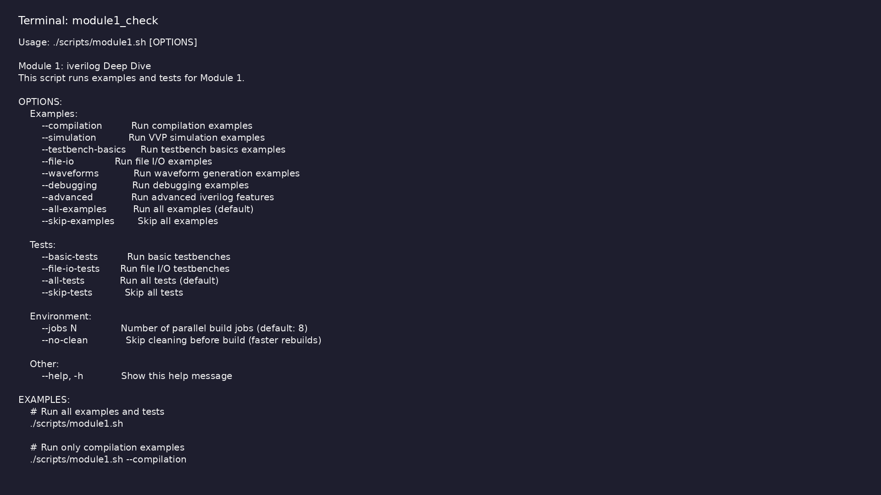
Module 1 self-check
$ ./scripts/module1.sh --help
learn_verilator_iverilog / Module 1
Notes:
Run from course repository root.

Slide 78
Exercise scaffold
./scripts/module1.sh --scaffold
learn_verilator_iverilog / Module 1

Slide 79

Demo: Compilation
$ cd module1/examples/compilation && make basic_compilation
learn_verilator_iverilog / Module 1
Notes:
Hands-on: module1/examples/compilation/

Slide 80
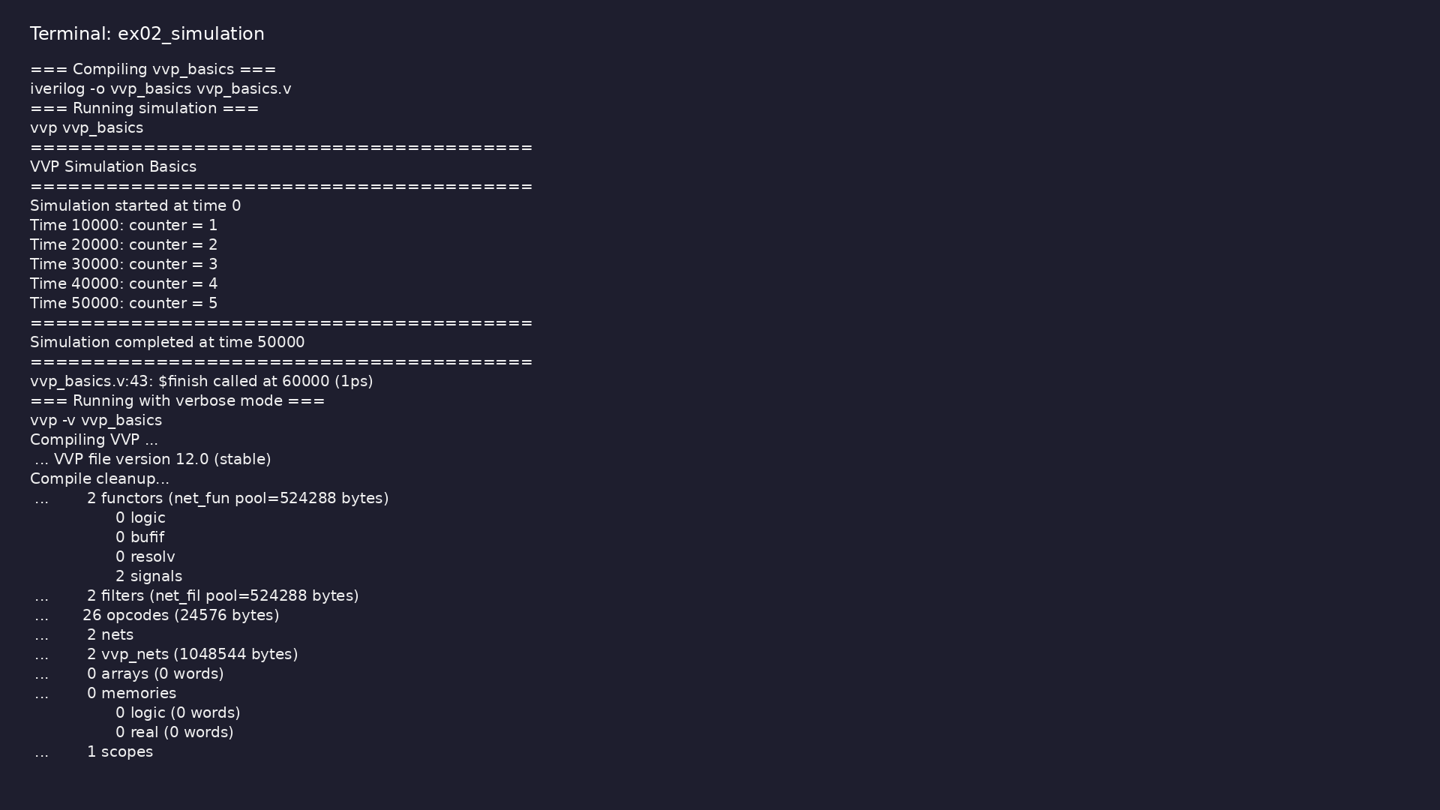
Demo: Simulation
$ cd module1/examples/simulation && make all
learn_verilator_iverilog / Module 1
Notes:
Hands-on: module1/examples/simulation/

Slide 81
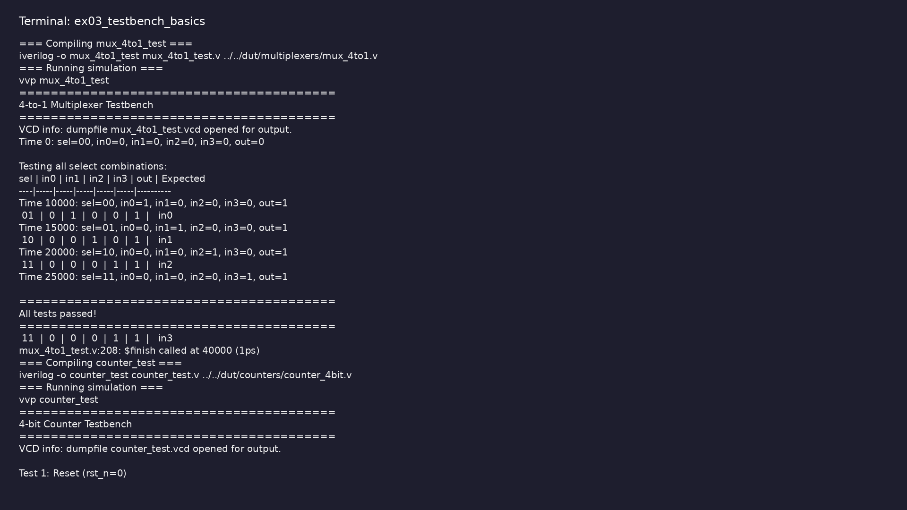
Demo: Testbench basics
$ cd module1/examples/testbench_basics && make all
learn_verilator_iverilog / Module 1
Notes:
Hands-on: module1/examples/testbench_basics/

Slide 82
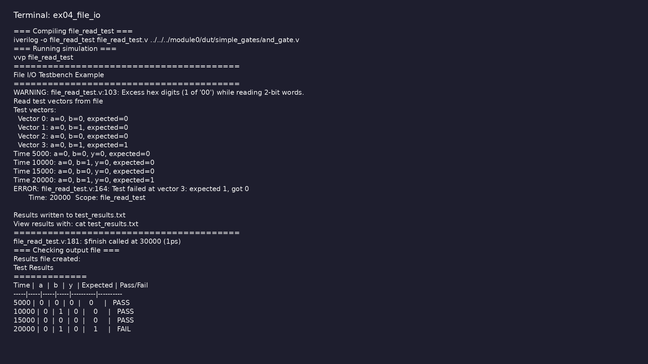
Demo: File I/O
$ cd module1/examples/file_io && make all
learn_verilator_iverilog / Module 1
Notes:
Hands-on: module1/examples/file_io/

Slide 83
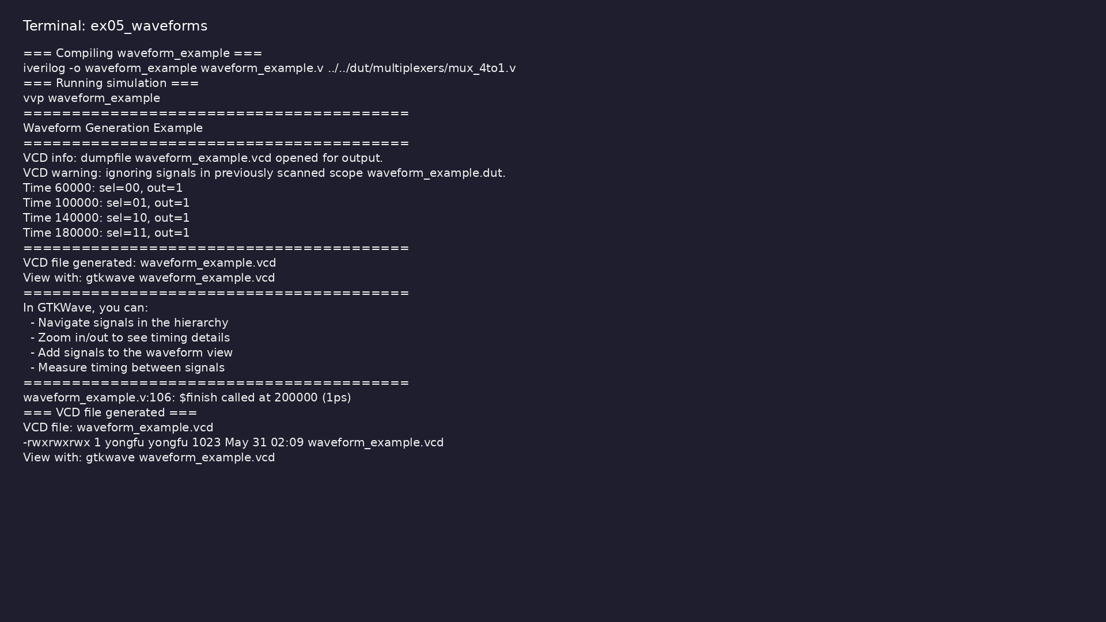
Demo: Waveforms
$ cd module1/examples/waveforms && make all
learn_verilator_iverilog / Module 1
Notes:
Hands-on: module1/examples/waveforms/

Slide 84
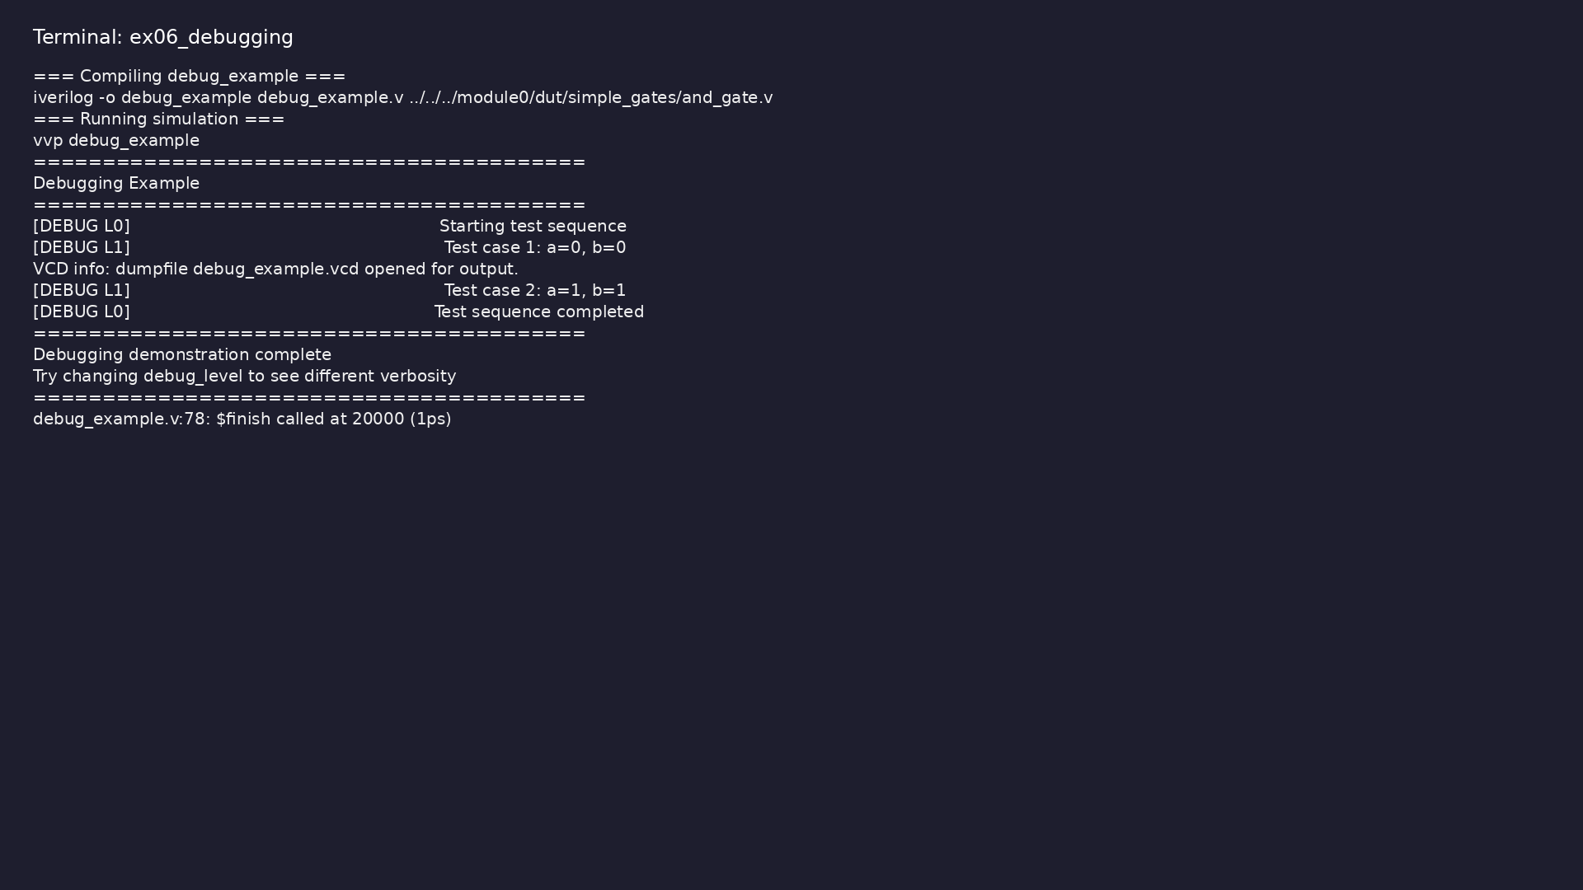
Demo: Debugging
$ cd module1/examples/debugging && make all
learn_verilator_iverilog / Module 1
Notes:
Hands-on: module1/examples/debugging/

Slide 85
Practice & assessment
learn_verilator_iverilog / Module 1

Slide 86
What you should know (1/8)
• Compile Verilog designs with iverilog
• Execute simulations with vvp
• Write Verilog testbenches compatible with iverilog
• Generate and analyze waveforms
• Debug iverilog compilation and simulation issues
• Organize projects using iverilog
learn_verilator_iverilog / Module 1
Notes:
From MODULE1 Learning Outcomes.

Slide 87
What you should know (2/8)
• Automate verification flows with iverilog
• Use compilation examples
• Try different compilation options
• Understand compilation process
• Complete testbench for 4-to-1 multiplexer
• Test all input combinations
learn_verilator_iverilog / Module 1
Notes:
From MODULE1 Learning Outcomes.

Slide 88
What you should know (3/8)
• Verify correct operation
• Read test vectors from file
• Apply vectors to DUT
• Write results to file
• Compare expected vs. actual
• Generate VCD files
learn_verilator_iverilog / Module 1
Notes:
From MODULE1 Learning Outcomes.

Slide 89
What you should know (4/8)
• View waveforms in GTKWave
• Analyze signal timing
• Debug using waveforms
• Create Makefile for compilation
• Add test execution rules
• Implement clean targets
learn_verilator_iverilog / Module 1
Notes:
From MODULE1 Learning Outcomes.

Slide 90
What you should know (5/8)
• Organize project structure
• Can compile Verilog designs with various iverilog
options
• Can execute simulations with vvp
• Can write complete Verilog testbenches
• Can use file I/O in testbenches
• Can generate and view waveforms
learn_verilator_iverilog / Module 1
Notes:
From MODULE1 Learning Outcomes.

Slide 91
What you should know (6/8)
• Can debug compilation and simulation errors
• Can organize projects with Makefiles
• Can automate verification flows
• Prerequisites: [Module 0: Installation and
Setup](MODULE0.md)
• Next Steps: [Module 2: Verilator Deep
Dive](MODULE2.md) - Master Verilator for C++
testbench develo…
• Next Steps: [Module 3: Testbench
Fundamentals](MODULE3.md) - Learn fundamental
testbench concepts f…
learn_verilator_iverilog / Module 1
Notes:
From MODULE1 Learning Outcomes.

Slide 92
What you should know (7/8)
• UVM Connection: [UVM Core
Repository](https://github.com/universal-
verification-methodology/core)
• Module 2: Verilator Deep Dive - Master Verilator for
C++ testbench development
• Module 3: Testbench Fundamentals (Verilog and C++) -
Learn fundamental testbench concepts for both…
• Icarus Verilog Documentation:
http://iverilog.wikia.com/
• GTKWave Documentation:
http://gtkwave.sourceforge.net/
• IEEE 1364-2005 Standard: Verilog Hardware
Description Language
learn_verilator_iverilog / Module 1
Notes:
From MODULE1 Learning Outcomes.

Slide 93
What you should know (8/8)
• IEEE 1800-2017 Standard: SystemVerilog Language
Reference Manual
learn_verilator_iverilog / Module 1
Notes:
From MODULE1 Learning Outcomes.

Slide 94
Assessment checklist
• Can compile Verilog designs with various iverilog
options
• Can execute simulations with vvp
• Can write complete Verilog testbenches
• Can use file I/O in testbenches
• Can generate and view waveforms
• Can debug compilation and simulation errors
learn_verilator_iverilog / Module 1

Slide 95
Summary & next steps
• Master iverilog for Verilog/SystemVerilog testbench
development
• Complete module1/CHECKLIST.md
• Review module1/EXAMPLES.md and run each lab
• Next: Next module in course
learn_verilator_iverilog / Module 1

