Slide 1
Module 2
Verilator Deep Dive
learn_verilator_iverilog / Module 2

Slide 2
Learning objectives
• Verilator Fundamentals: Understanding how Verilator
converts Verilog to C++
• Compilation Process: Mastering Verilator compilation
flags and options
• C++ Testbench Writing: Creating effective
testbenches using C++ and Verilator's API
• Waveform Generation: Creating VCD/FST files for
debugging
• File I/O: Managing test vectors and results with
files
• Debugging Techniques: Strategies for debugging
Verilator testbenches
learn_verilator_iverilog / Module 2

Slide 3
Prerequisites
• See module README
learn_verilator_iverilog / Module 2

Slide 4

Learning path
Master Verilator for C++ testbench development
learn_verilator_iverilog / Module 2

Slide 5
Overview
• This module provides comprehensive coverage of
Verilator, a fast Verilog/SystemVerilog simulator
th…
learn_verilator_iverilog / Module 2

Slide 6
Design architecture
learn_verilator_iverilog / Module 2

Slide 7
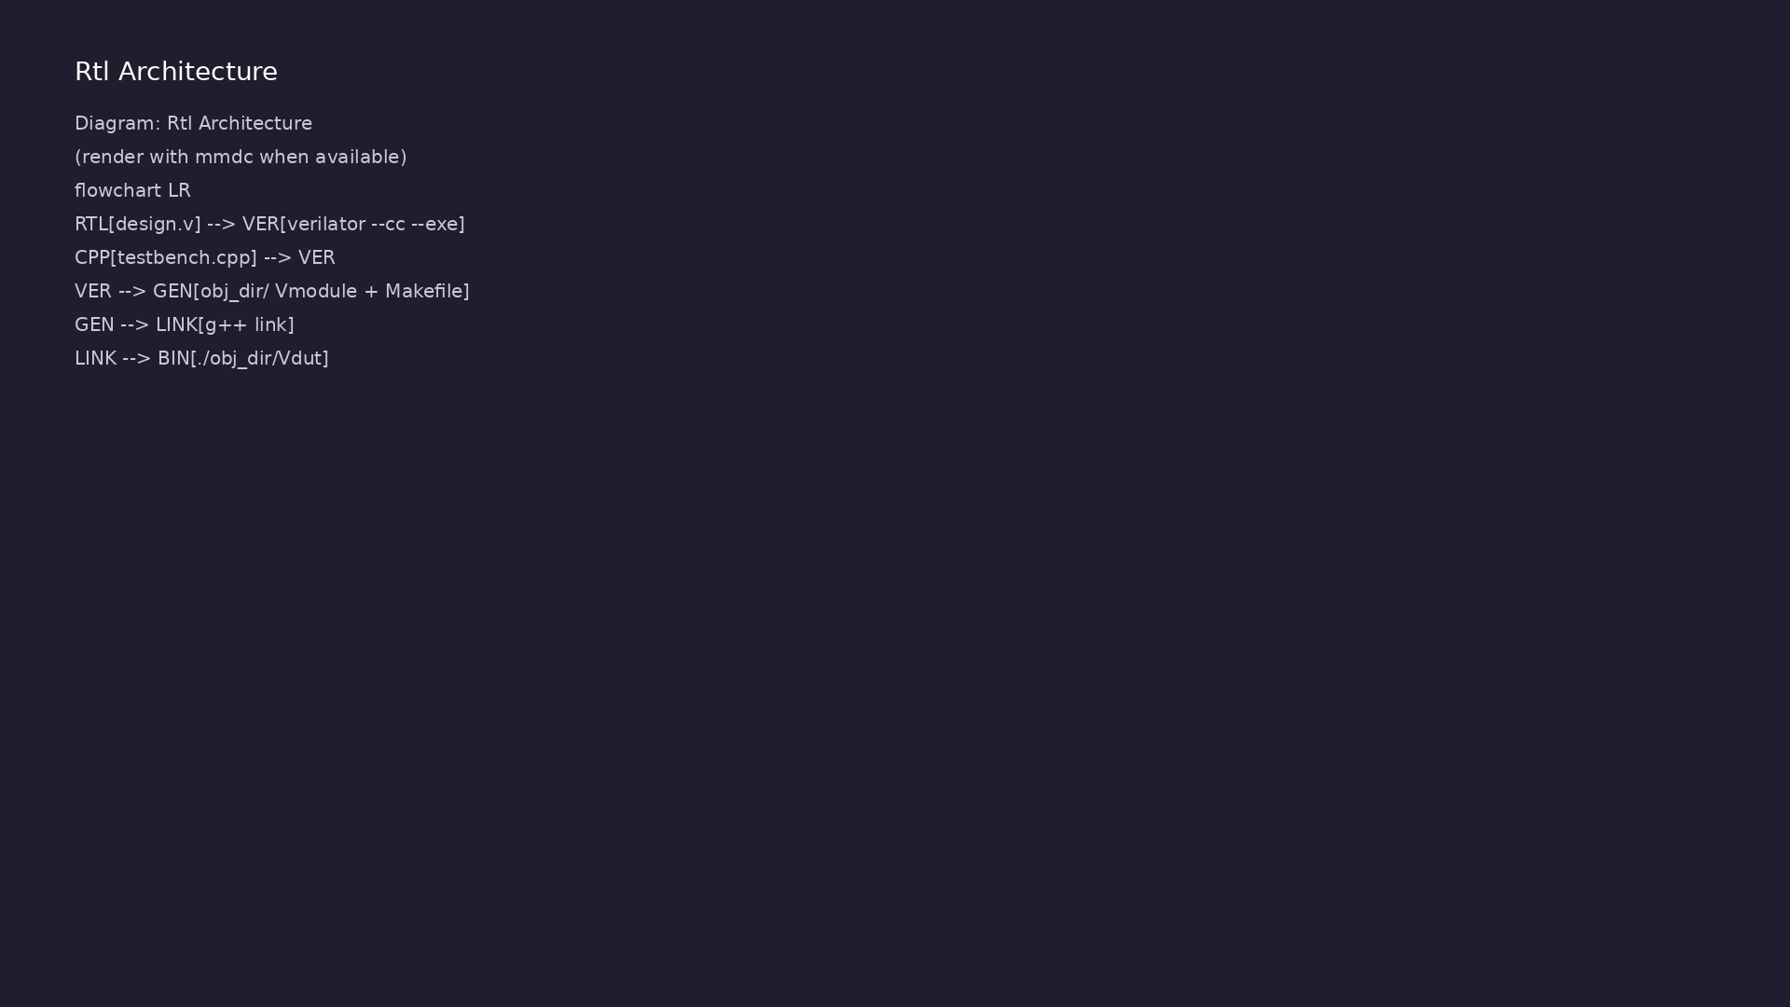
1. Verilator compilation model
• Input: Verilog/SystemVerilog RTL
+ optional `--timing` / lint
flags per example
• Output: C++ classes (`V<top>`)
in `obj_dir/` with fast cycle-
accurate `eval()`
• Linkage: C++ `main()` or test
class calls `dut->eval()` each
cycle or on events
• Tracing: `--trace` / `--trace-
fst` for waveform dumps from the
C++ side
learn_verilator_iverilog / Module 2
Notes:
From MODULE2 Design Architecture.

Slide 8
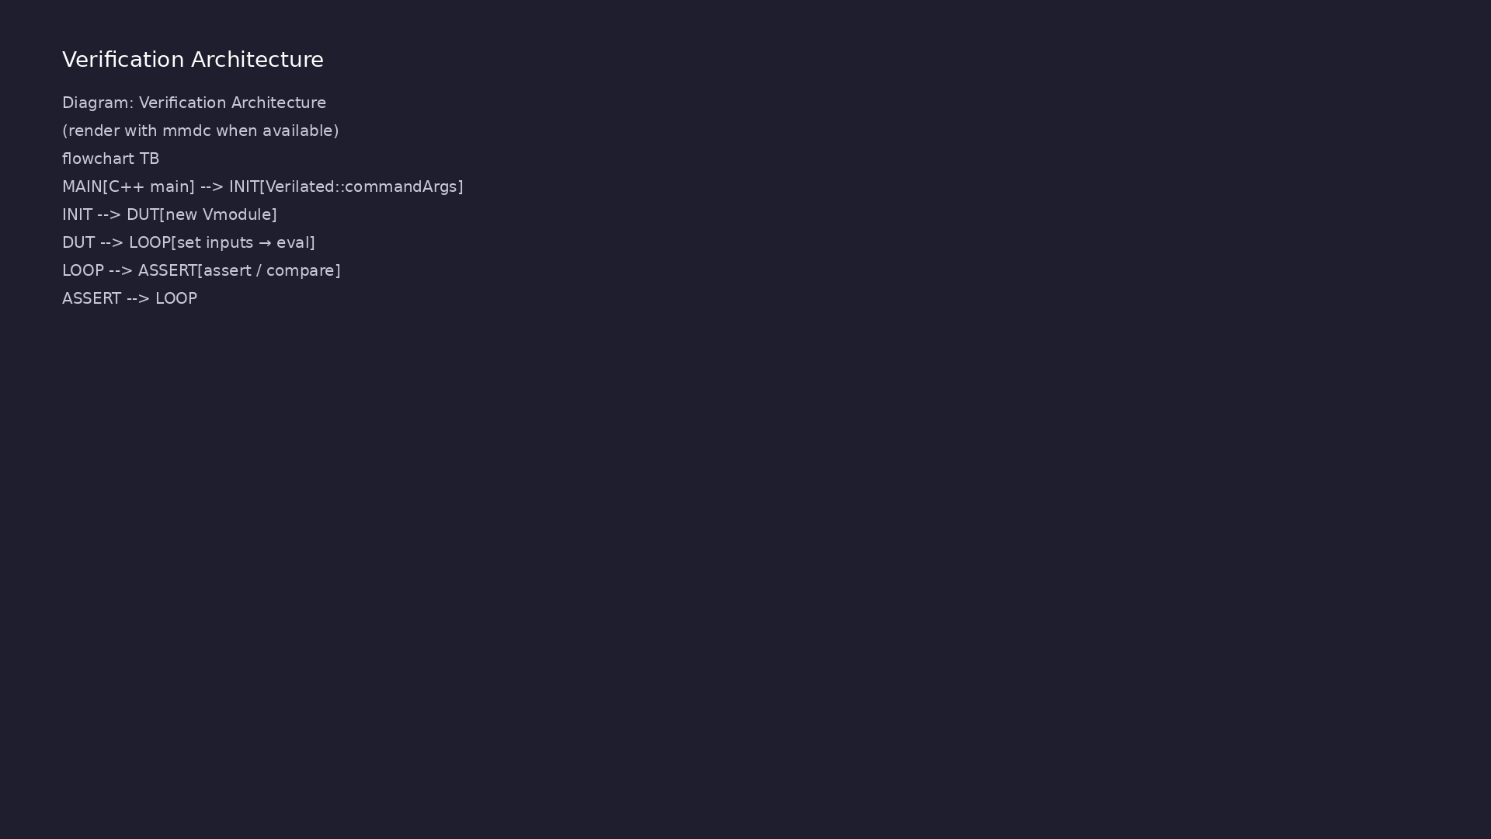
2. Module 2 DUT catalog
• `dut/multiplexers/`: Same MUX
family as Module 1 — cross-tool
comparison baseline
• `dut/counters/`: `counter_4bit`
— exercises sequential C++
drive/monitor loops
• Port mapping: Verilator flattens
ports to struct members
(`dut->clk`, `dut->count`)
• Performance: Large test suites
favor Verilator’s compiled model
over interpreted VVP
learn_verilator_iverilog / Module 2
Notes:
From MODULE2 Design Architecture.

Slide 9
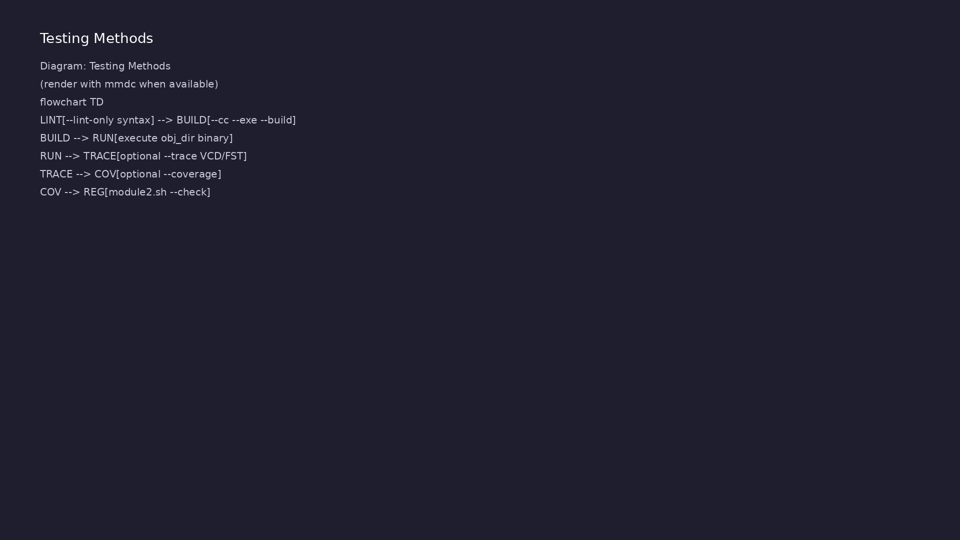
3. C++ testbench architecture
• Top-level `main`: Allocates
`Vtop`, applies reset sequence,
runs clock loop
• Stimulus loop: `for`/`while`
sets inputs then `eval()`
advances time
• Optional OOP: Advanced tests
organize Driver/Monitor/Checker
as C++ classes
• Build: Generated `Vtop.mk` plus
user `Makefile` link testbench
and model
learn_verilator_iverilog / Module 2
Notes:
From MODULE2 Design Architecture.

Slide 10
RTL block diagram (reference)
Module 2: DUT hierarchy and signal flow.
learn_verilator_iverilog / Module 2

Slide 11
Verification / testbench diagram (reference)
Module 2: stimulus, observation, and checking.
learn_verilator_iverilog / Module 2

Slide 12
Verilator compile flags
VERILATOR = verilator
DUT_DIR = ../../dut
# Common flags for compilation targets (not used for linting)
VERILATOR_FLAGS = --cc --exe --build
# Default target: run all compilation examples
all: basic_compilation optimization tracing coverage linting
# ======================================================================
======
# Basic Compilation
# ======================================================================
======
# Minimal compilation with only required flags.
# This is the simplest way to compile a Verilator testbench.
basic_compilation: basic_compilation.v basic_compilation.cpp
@echo "=== Basic Compilation ==="
learn_verilator_iverilog / Module 2
Notes:
verilator --cc --exe --build emits obj_dir/ with Vmodule and Makefile.

Slide 13
C++ TB — init, eval, final
int main(int argc, char** argv) {
//
========================================================================
// STEP 1: Initialize Verilator
//
========================================================================
// Verilated::commandArgs() processes command-line arguments that
Verilator
// understands (e.g., --trace, --coverage). This must be called
before
// creating any Verilator objects. It's safe to pass argc/argv even
if
// you don't use Verilator-specific arguments.
Verilated::commandArgs(argc, argv);
std::cout << "========================================" <<
std::endl;
std::cout << "4-to-1 Multiplexer C++ Testbench" << std::endl;
learn_verilator_iverilog / Module 2
Notes:
Verilated::commandArgs, new Vmodule, dut->eval(), dut->final().

Slide 14
obj_dir layout after verilator
# ======================================================================
======
# Multiplexer Testbench Target
# ======================================================================
======
# Builds and runs the 4-to-1 multiplexer testbench.
#
# Build steps:
# 1. Verilator generates C++ wrapper from mux_4to1.v
# 2. Compiles testbench with generated wrapper
# 3. Links into executable: obj_dir/Vmux_4to1
# 4. Runs the executable
mux_4to1_test: mux_4to1_test.cpp
@echo "=== Compiling mux_4to1_test ==="
# -I flag adds include directory for `include directives in
Verilog
# Use full path to file, -I points to parent directory for
includes
learn_verilator_iverilog / Module 2
Notes:
make mux_4to1_test compiles and runs ./obj_dir/Vmux_4to1.

Slide 15
DUT ports as C++ members
//
// Note: For sequential logic (flip-flops, counters), we need clock
cycles.
// See counter_test.cpp for sequential logic examples.
std::cout << "\nTesting all select combinations:" << std::endl;
std::cout << "sel | in0 | in1 | in2 | in3 | out | Expected" <<
std::endl;
std::cout << "----|-----|-----|-----|-----|-----|----------" <<
std::endl;
//
========================================================================
// TEST CASE 1: sel=00 (binary), select in0
//
========================================================================
// Strategy: Set only in0=1, others=0. If mux works, out should
equal in0.
learn_verilator_iverilog / Module 2
Notes:
Write dut->sel and inputs, call eval(), read dut->out.

Slide 16
Execution & simulation flow
learn_verilator_iverilog / Module 2

Slide 17
How the example runs (toolchain)
• Makefile: Verilator compiles RTL + SystemVerilog
testbench into a C++ model
• sim_main.cpp: generates clk/rst_n, calls eval()
until $finish
• Directed test (initial block or C++): drive
stimulus, wait for DUT flags
• Self-check: compare outputs; print PASS/FAIL (see
terminal demo slide)
• Repo path: module2/examples/<example>/ — run make
run from that directory
learn_verilator_iverilog / Module 2
Notes:
From MODULE2 — execution and artifact layout.

Slide 18
Directed test execution sequence (1)
• C++ assert or compare after each eval
• final "All tests passed" message
• verilator --cc --exe --build rtl.v tb.cpp
• inspect obj_dir/
• run Vtop
learn_verilator_iverilog / Module 2
Notes:
Follow this order when tracing waveforms or debugging.

Slide 19
Directed test execution sequence (2)
• eval() each cycle
• optional --trace VCD
• ./scripts/module2.sh --check
learn_verilator_iverilog / Module 2
Notes:
Follow this order when tracing waveforms or debugging.

Slide 20
Build C++ testbench target
mux_4to1_test: mux_4to1_test.cpp
@echo "=== Compiling mux_4to1_test ==="
# -I flag adds include directory for `include directives in
Verilog
# Use full path to file, -I points to parent directory for
includes
$(VERILATOR) $(VERILATOR_FLAGS) -I$(DUT_DIR)/multiplexers \
$(DUT_DIR)/multiplexers/mux_4to1.v mux_4to1_test.cpp
@echo "=== Running simulation ==="
# Executable is in obj_dir/ with name V<module_name>
./obj_dir/Vmux_4to1
learn_verilator_iverilog / Module 2
Notes:
From module2/examples/cpp_testbench: make mux_4to1_test

Slide 21
Verilator --trace for waveforms
# Makefile for waveform examples
VERILATOR = verilator
DUT_DIR = ../../../module1/dut
VERILATOR_FLAGS = --cc --exe --build --trace
all: waveform_example
waveform_example: waveform_example.cpp
@echo "=== Compiling waveform_example ==="
$(VERILATOR) $(VERILATOR_FLAGS) -I$(DUT_DIR)/multiplexers \
$(DUT_DIR)/multiplexers/mux_4to1.v waveform_example.cpp
@echo "=== Running simulation ==="
./obj_dir/Vmux_4to1
@echo "=== VCD file generated ==="
@if [ -f waveform_example.vcd ]; then \
# ...
learn_verilator_iverilog / Module 2
Notes:
Add --trace or --trace-fst; open VCD/FST in GTKWave after run.

Slide 22
Sequential eval loop — counter
std::cout << "Time " << sim_time << ": count = " << (int)dut->count <<
std::endl;
}
}
//
========================================================================
// TEST 3: Enable/Disable Control
//
========================================================================
// Verify that when en=0, counter holds its value (doesn't
increment).
std::cout << "\nTest 3: Disable counting (en=0)" << std::endl;
dut->en = 0; // Disable counter
int count_before = dut->count; // Capture current count value
// Clock several times with enable off. Counter should hold value.
for (int i = 0; i < 4; i++) {
learn_verilator_iverilog / Module 2
Notes:
Toggle clk, eval(), check count — manual clock in C++ loop.

Slide 23
Verification & testing methods
learn_verilator_iverilog / Module 2

Slide 24
1. Cycle-based C++ testing
• Clock generation: Toggle clock
in loop with `eval()` between
edges
• Reset sequence: Hold `rst_n` low
N cycles, release, verify known
state
• Checking: `assert()` or explicit
compare with `std::cerr` on
mismatch
learn_verilator_iverilog / Module 2
Notes:
From MODULE2 Verification & Testing Methods.

Slide 25
2. Tracing and performance checks
• Waveforms: Enable Verilator
trace API; view in GTKWave for
debug examples
• Printf debug: Structured logging
before/after `eval()` for signal
snapshots
• Regression:
`./scripts/module2.sh --all-
tests` batches compile+run
across examples
learn_verilator_iverilog / Module 2
Notes:
From MODULE2 Verification & Testing Methods.

Slide 26
3. File I/O and scalable stimulus
• Vector files: Read test data in
C++ (`file_io` examples) for
long sequences
• Repeatability: Fixed seeds and
deterministic loops for
comparable runs
• Failure isolation: Run single
`obj_dir` binary with minimal
stimulus to bisect bugs
learn_verilator_iverilog / Module 2
Notes:
From MODULE2 Verification & Testing Methods.

Slide 27
Assert-based checking
// Assertion: If condition is false, program aborts with error message.
// This is a simple but effective way to catch bugs early.
// In production testbenches, you might want more sophisticated
checking.
assert(dut->out == dut->in0 && "Test failed: sel=00 should select
in0");
//
========================================================================
// TEST CASE 2: sel=01 (binary), select in1
//
========================================================================
dut->sel = 1; // 2-bit select: 01 selects in1
dut->in0 = 0; dut->in1 = 1; dut->in2 = 0; dut->in3 = 0;
dut->eval(); // Evaluate combinational logic
std::cout << " " << (int)dut->sel << " | " << (int)dut->in0
<< " | " << (int)dut->in1 << " | " << (int)dut->in2
<< " | " << (int)dut->in3 << " | " << (int)dut->out
learn_verilator_iverilog / Module 2
Notes:
assert() on mismatch; All tests passed on stdout at end.

Slide 28
Syllabus topics
learn_verilator_iverilog / Module 2

Slide 29
1. Verilator Overview (1/6)
• What is Verilator?
• Fast Verilog/SystemVerilog simulator
• Generates C++ code from Verilog
• Open-source and free
• Excellent performance
• Verilator's Compilation Model
learn_verilator_iverilog / Module 2
Notes:
From MODULE2 Topics Covered.

Slide 30
1. Verilator Overview (2/6)
• Two-stage compilation
• Verilog → C++ conversion
• C++ compilation and linking
• Generated wrapper classes
• C++ Wrapper Generation
• Top module class structure
learn_verilator_iverilog / Module 2
Notes:
From MODULE2 Topics Covered.

Slide 31
1. Verilator Overview (3/6)
• Signal access methods
• Evaluation methods
• Tracing support
• Verilator Capabilities and Features
• Fast simulation
• Good Verilog-2001 support
learn_verilator_iverilog / Module 2
Notes:
From MODULE2 Topics Covered.

Slide 32
1. Verilator Overview (4/6)
• Limited SystemVerilog support
• Coverage support
• Waveform generation
• Supported Verilog/SystemVerilog Constructs
• Most Verilog-2001 features
• Basic SystemVerilog features
learn_verilator_iverilog / Module 2
Notes:
From MODULE2 Topics Covered.

Slide 33
1. Verilator Overview (5/6)
• Interfaces (limited)
• Classes (limited)
• Assertions (limited)
• Limitations and Workarounds
• Limited SystemVerilog support
• Some advanced features not supported
learn_verilator_iverilog / Module 2
Notes:
From MODULE2 Topics Covered.

Slide 34
1. Verilator Overview (6/6)
• Workarounds for unsupported features
• When to Use Verilator
• High-performance simulation
• Large designs
• Integration with C++ libraries
• Complex testbenches with advanced data structures
learn_verilator_iverilog / Module 2
Notes:
From MODULE2 Topics Covered.

Slide 35
2. Compilation Process (1/8)
• Verilator Compilation Command
• Basic syntax: `verilator --cc --exe design.v
testbench.cpp`
• Output generation
• Build process
• Compilation Flags and Options
• `--cc`: Generate C++ code
learn_verilator_iverilog / Module 2
Notes:
From MODULE2 Topics Covered.

Slide 36
2. Compilation Process (2/8)
• `--exe`: Generate executable
• `--build`: Build automatically
• `-I<directory>`: Add include path
• `-D<macro>`: Define macro
• `-O0, -O1, -O2, -O3`: Optimization levels
• `--trace`: Generate VCD tracing
learn_verilator_iverilog / Module 2
Notes:
From MODULE2 Topics Covered.

Slide 37
2. Compilation Process (3/8)
• `--trace-fst`: Generate FST tracing
• `--coverage`: Enable coverage
• `--lint-only`: Lint without compilation
• Optimization Levels (-O0, -O1, -O2, -O3)
• `-O0`: No optimization (fastest compilation)
• `-O1`: Basic optimization
learn_verilator_iverilog / Module 2
Notes:
From MODULE2 Topics Covered.

Slide 38
2. Compilation Process (4/8)
• `-O2`: More optimization (default)
• `-O3`: Maximum optimization (slowest compilation,
fastest simulation)
• Coverage Options (--coverage)
• Code coverage generation
• Coverage analysis
• Coverage reporting
learn_verilator_iverilog / Module 2
Notes:
From MODULE2 Topics Covered.

Slide 39
2. Compilation Process (5/8)
• Linting Capabilities (--lint-only)
• Syntax checking
• Design rule checking
• No simulation generation
• Waveform Generation (--trace, --trace-fst)
• `--trace`: Generate VCD files
learn_verilator_iverilog / Module 2
Notes:
From MODULE2 Topics Covered.

Slide 40
2. Compilation Process (6/8)
• `--trace-fst`: Generate FST files (smaller, faster)
• Signal selection
• GTKWave compatibility
• Include Path Management
• Adding include directories
• Multiple include paths
learn_verilator_iverilog / Module 2
Notes:
From MODULE2 Topics Covered.

Slide 41
2. Compilation Process (7/8)
• Relative vs. absolute paths
• Define Macros
• Conditional compilation
• Macro definitions
• Usage in designs
• Multi-File Compilation
learn_verilator_iverilog / Module 2
Notes:
From MODULE2 Topics Covered.

Slide 42
2. Compilation Process (8/8)
• Compiling multiple files
• File ordering
• Dependency management
• `basic_compilation.cpp`: Demonstrates basic
compilation, optimization, tracing, coverage,
linting
learn_verilator_iverilog / Module 2
Notes:
From MODULE2 Topics Covered.

Slide 43
3. C++ Testbench Structure (1/7)
• C++ Main Function
• Entry point
• Verilator initialization
• DUT instantiation
• Test sequence
• Cleanup
learn_verilator_iverilog / Module 2
Notes:
From MODULE2 Topics Covered.

Slide 44
3. C++ Testbench Structure (2/7)
• Verilator-Generated Class Usage
• Class naming (V<module_name>)
• Instance creation
• Method calls
• Signal access
• DUT Instantiation in C++
learn_verilator_iverilog / Module 2
Notes:
From MODULE2 Topics Covered.

Slide 45
3. C++ Testbench Structure (3/7)
• Creating DUT object
• Memory management
• Lifetime management
• Signal Access (Reading and Writing)
• Reading signals: `dut->signal_name`
• Writing signals: `dut->signal_name = value`
learn_verilator_iverilog / Module 2
Notes:
From MODULE2 Topics Covered.

Slide 46
3. C++ Testbench Structure (4/7)
• Signal types
• Multi-bit signals
• Clock Generation in C++
• Simulation loop
• Clock toggling
• Clock period control
learn_verilator_iverilog / Module 2
Notes:
From MODULE2 Topics Covered.

Slide 47
3. C++ Testbench Structure (5/7)
• Multiple clocks
• Reset Generation in C++
• Reset sequences
• Synchronous reset
• Asynchronous reset
• Reset timing
learn_verilator_iverilog / Module 2
Notes:
From MODULE2 Topics Covered.

Slide 48
3. C++ Testbench Structure (6/7)
• Simulation Loop
• Time management
• Event scheduling
• Loop structure
• Termination
• `mux_4to1_test.cpp`: Basic C++ testbench structure
learn_verilator_iverilog / Module 2
Notes:
From MODULE2 Topics Covered.

Slide 49
3. C++ Testbench Structure (7/7)
• `counter_test.cpp`: Clock and reset generation,
simulation loop
learn_verilator_iverilog / Module 2
Notes:
From MODULE2 Topics Covered.

Slide 50
4. C++ Testbench Writing (1/6)
• Basic C++ Testbench Template
• Standard structure
• Common patterns
• Best practices
• Signal Access Methods
• Direct access
learn_verilator_iverilog / Module 2
Notes:
From MODULE2 Topics Covered.

Slide 51
4. C++ Testbench Writing (2/6)
• Signal reading
• Signal writing
• Signal monitoring
• Clock and Reset Patterns
• Standard clock patterns
• Reset patterns
learn_verilator_iverilog / Module 2
Notes:
From MODULE2 Topics Covered.

Slide 52
4. C++ Testbench Writing (3/6)
• Clock/reset coordination
• Stimulus Generation in C++
• Test vector generation
• Pattern generation
• Sequential stimulus
• Random stimulus
learn_verilator_iverilog / Module 2
Notes:
From MODULE2 Topics Covered.

Slide 53
4. C++ Testbench Writing (4/6)
• Response Monitoring in C++
• Output monitoring
• Real-time monitoring
• Post-processing
• Logging
• Result Checking
learn_verilator_iverilog / Module 2
Notes:
From MODULE2 Topics Covered.

Slide 54
4. C++ Testbench Writing (5/6)
• Expected value calculation
• Output comparison
• Error detection
• Assertions
• Error Reporting
• Error messages
learn_verilator_iverilog / Module 2
Notes:
From MODULE2 Topics Covered.

Slide 55
4. C++ Testbench Writing (6/6)
• Exit codes
• Test summaries
• Failure reporting
learn_verilator_iverilog / Module 2
Notes:
From MODULE2 Topics Covered.

Slide 56
5. Verilator C++ API (1/5)
• Top Module Class Structure
• Class name: `V<module_name>`
• Constructor/destructor
• Methods
• Signals
• Signal Access Methods
learn_verilator_iverilog / Module 2
Notes:
From MODULE2 Topics Covered.

Slide 57
5. Verilator C++ API (2/5)
• Direct member access
• Signal types
• Multi-bit signals
• Array signals
• Evaluation Method (eval())
• What eval() does
learn_verilator_iverilog / Module 2
Notes:
From MODULE2 Topics Covered.

Slide 58
5. Verilator C++ API (3/5)
• When to call eval()
• Timing considerations
• Multiple evaluations
• Time Management
• Simulation time
• Time tracking
learn_verilator_iverilog / Module 2
Notes:
From MODULE2 Topics Covered.

Slide 59
5. Verilator C++ API (4/5)
• Time advancement
• Time-based events
• Tracing API
• VerilatedVcdC class
• trace() method
• dump() method
learn_verilator_iverilog / Module 2
Notes:
From MODULE2 Topics Covered.

Slide 60
5. Verilator C++ API (5/5)
• File management
• Coverage API
• Coverage collection
• Coverage reporting
• Coverage analysis
learn_verilator_iverilog / Module 2
Notes:
From MODULE2 Topics Covered.

Slide 61
6. Waveform Generation (1/5)
• VCD File Generation
• Using --trace flag
• VerilatedVcdC class
• trace() method
• dump() method
• File management
learn_verilator_iverilog / Module 2
Notes:
From MODULE2 Topics Covered.

Slide 62
6. Waveform Generation (2/5)
• FST File Generation
• Using --trace-fst flag
• FST advantages
• GTKWave compatibility
• Signal Selection for Tracing
• trace() method levels
learn_verilator_iverilog / Module 2
Notes:
From MODULE2 Topics Covered.

Slide 63
6. Waveform Generation (3/5)
• Selective tracing
• Hierarchy levels
• GTKWave Compatibility
• VCD format
• FST format
• GTKWave viewing
learn_verilator_iverilog / Module 2
Notes:
From MODULE2 Topics Covered.

Slide 64
6. Waveform Generation (4/5)
• Signal organization
• Waveform Analysis
• Viewing waveforms
• Signal timing
• Timing relationships
• Debugging with waveforms
learn_verilator_iverilog / Module 2
Notes:
From MODULE2 Topics Covered.

Slide 65
6. Waveform Generation (5/5)
• `waveform_example.cpp`: Comprehensive waveform
generation using Verilator tracing API
learn_verilator_iverilog / Module 2
Notes:
From MODULE2 Topics Covered.

Slide 66
7. Debugging with Verilator (1/6)
• Compilation Error Debugging
• Understanding Verilator errors
• Common compilation errors
• Syntax errors
• Missing files
• C++ Compilation Errors
learn_verilator_iverilog / Module 2
Notes:
From MODULE2 Topics Covered.

Slide 67
7. Debugging with Verilator (2/6)
• Understanding C++ errors
• Linker errors
• Template errors
• Common mistakes
• Runtime Debugging
• Understanding runtime errors
learn_verilator_iverilog / Module 2
Notes:
From MODULE2 Topics Covered.

Slide 68
7. Debugging with Verilator (3/6)
• Signal inspection
• GDB debugging
• Valgrind debugging
• Signal Inspection
• Printing signal values
• Signal monitoring
learn_verilator_iverilog / Module 2
Notes:
From MODULE2 Topics Covered.

Slide 69
7. Debugging with Verilator (4/6)
• VCD file analysis
• Debug output
• Logging Strategies
• Debug levels
• Conditional logging
• File-based logging
learn_verilator_iverilog / Module 2
Notes:
From MODULE2 Topics Covered.

Slide 70
7. Debugging with Verilator (5/6)
• Log organization
• Common Pitfalls and Solutions
• Forgetting to call eval()
• Signal initialization
• Memory leaks
• Timing issues
learn_verilator_iverilog / Module 2
Notes:
From MODULE2 Topics Covered.

Slide 71
7. Debugging with Verilator (6/6)
• Common mistakes
• `debug_example.cpp`: C++ debugging techniques,
logging strategies, error handling
learn_verilator_iverilog / Module 2
Notes:
From MODULE2 Topics Covered.

Slide 72
8. Advanced Verilator Features (1/4)
• Multi-Threaded Simulation Basics
• Thread safety
• Parallel simulation
• Synchronization
• Performance Optimization
• Compilation optimization
learn_verilator_iverilog / Module 2
Notes:
From MODULE2 Topics Covered.

Slide 73
8. Advanced Verilator Features (2/4)
• Simulation optimization
• Memory optimization
• Speed optimization
• Large Design Handling
• Compiling large designs
• Memory management
learn_verilator_iverilog / Module 2
Notes:
From MODULE2 Topics Covered.

Slide 74
8. Advanced Verilator Features (3/4)
• Incremental compilation
• Design partitioning
• Custom C++ Integration
• Integrating C++ libraries
• External interfaces
• Custom functions
learn_verilator_iverilog / Module 2
Notes:
From MODULE2 Topics Covered.

Slide 75
8. Advanced Verilator Features (4/4)
• System integration
• SystemC Integration Basics
• SystemC support
• SystemC integration
• When to use SystemC
learn_verilator_iverilog / Module 2
Notes:
From MODULE2 Topics Covered.

Slide 76
9. Project Organization (1/7)
• Makefile Integration
• Basic Makefile structure
• Verilator compilation rules
• Test execution
• Clean targets
• Dependency management
learn_verilator_iverilog / Module 2
Notes:
From MODULE2 Topics Covered.

Slide 77
9. Project Organization (2/7)
• CMake Integration
• CMake setup
• Verilator integration
• Build configuration
• Scripting for Automation
• Shell scripts for automation
learn_verilator_iverilog / Module 2
Notes:
From MODULE2 Topics Covered.

Slide 78
9. Project Organization (3/7)
• Batch processing
• Test automation
• Result collection
• Batch Simulation
• Running multiple tests
• Test selection
learn_verilator_iverilog / Module 2
Notes:
From MODULE2 Topics Covered.

Slide 79
9. Project Organization (4/7)
• Parallel execution
• Result aggregation
• Regression Testing Setup
• Test suite organization
• Regression test structure
• Pass/fail reporting
learn_verilator_iverilog / Module 2
Notes:
From MODULE2 Topics Covered.

Slide 80
9. Project Organization (5/7)
• Test result tracking
• Location: `module0/examples/verilator_basics/and_gat
e_test.cpp`
• Demonstrates: Basic C++ testbench structure, signal
access
• Location:
`module2/examples/cpp_testbench/mux_4to1_test.cpp`
• Demonstrates: Complete C++ testbench, signal access,
test patterns
• Location:
`module2/examples/cpp_testbench/counter_test.cpp`
learn_verilator_iverilog / Module 2
Notes:
From MODULE2 Topics Covered.

Slide 81
9. Project Organization (6/7)
• Demonstrates: Clock generation, reset sequences,
simulation loop
• Location:
`module2/examples/file_io/file_io_test.cpp`
• Demonstrates: Reading test vectors from files,
writing results
• Location: See compilation examples
• Demonstrates: Multi-file compilation, include paths
• Location:
`module2/tests/basic_tests/test_mux_4to1.cpp`
learn_verilator_iverilog / Module 2
Notes:
From MODULE2 Topics Covered.

Slide 82
9. Project Organization (7/7)
• Demonstrates: Class-based organization,
comprehensive testing
learn_verilator_iverilog / Module 2
Notes:
From MODULE2 Topics Covered.

Slide 83
Hands-on examples
learn_verilator_iverilog / Module 2

Slide 84
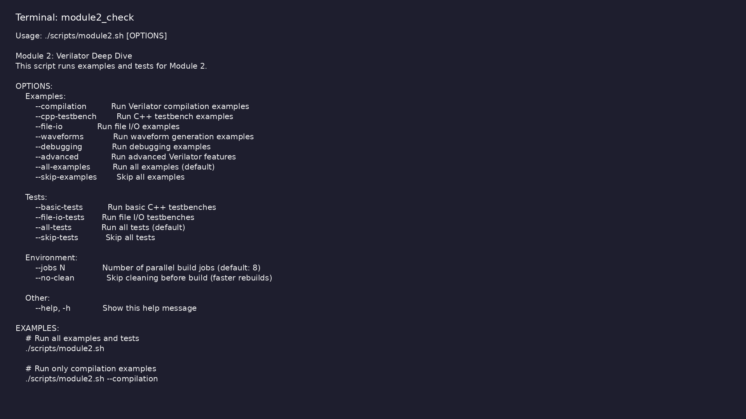
Module 2 self-check
$ ./scripts/module2.sh --help
learn_verilator_iverilog / Module 2
Notes:
Run from course repository root.

Slide 85
Exercise scaffold
./scripts/module2.sh --scaffold
learn_verilator_iverilog / Module 2

Slide 86
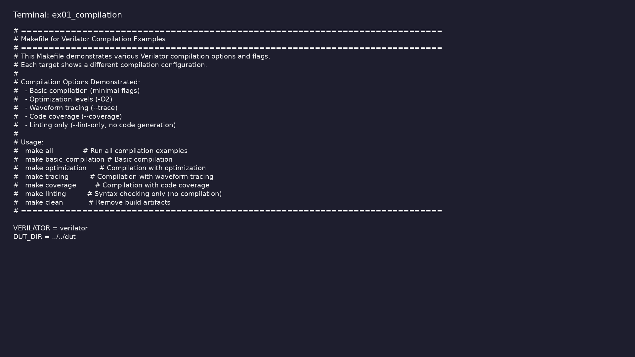
Demo: Compilation
$ head -25 module2/examples/compilation/Makefile
learn_verilator_iverilog / Module 2
Notes:
Hands-on: module2/examples/compilation/

Slide 87
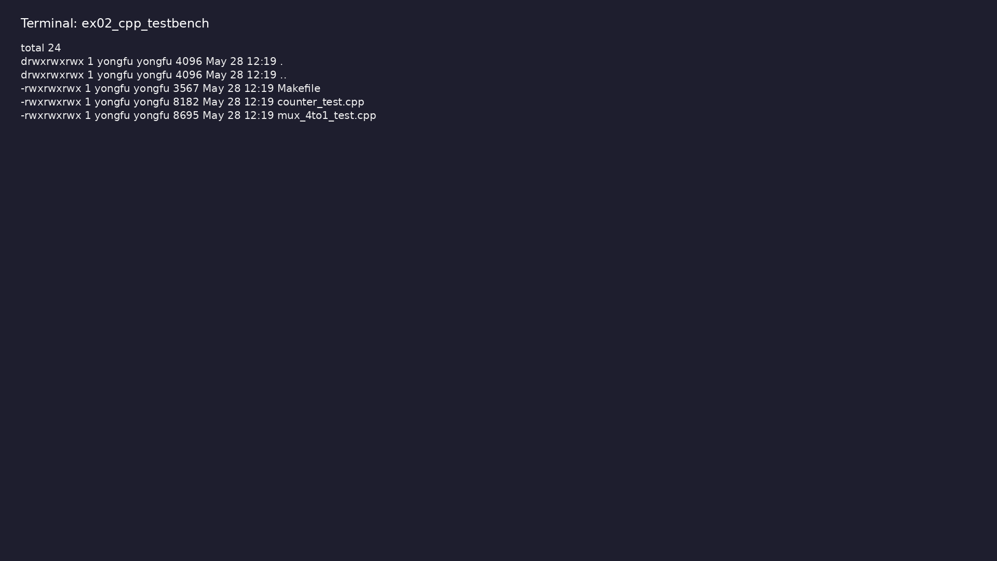
Demo: C++ testbench
$ ls -la module2/examples/cpp_testbench
learn_verilator_iverilog / Module 2
Notes:
Hands-on: module2/examples/cpp_testbench/

Slide 88

Demo: File I/O
$ ls -la module2/examples/file_io
learn_verilator_iverilog / Module 2
Notes:
Hands-on: module2/examples/file_io/

Slide 89
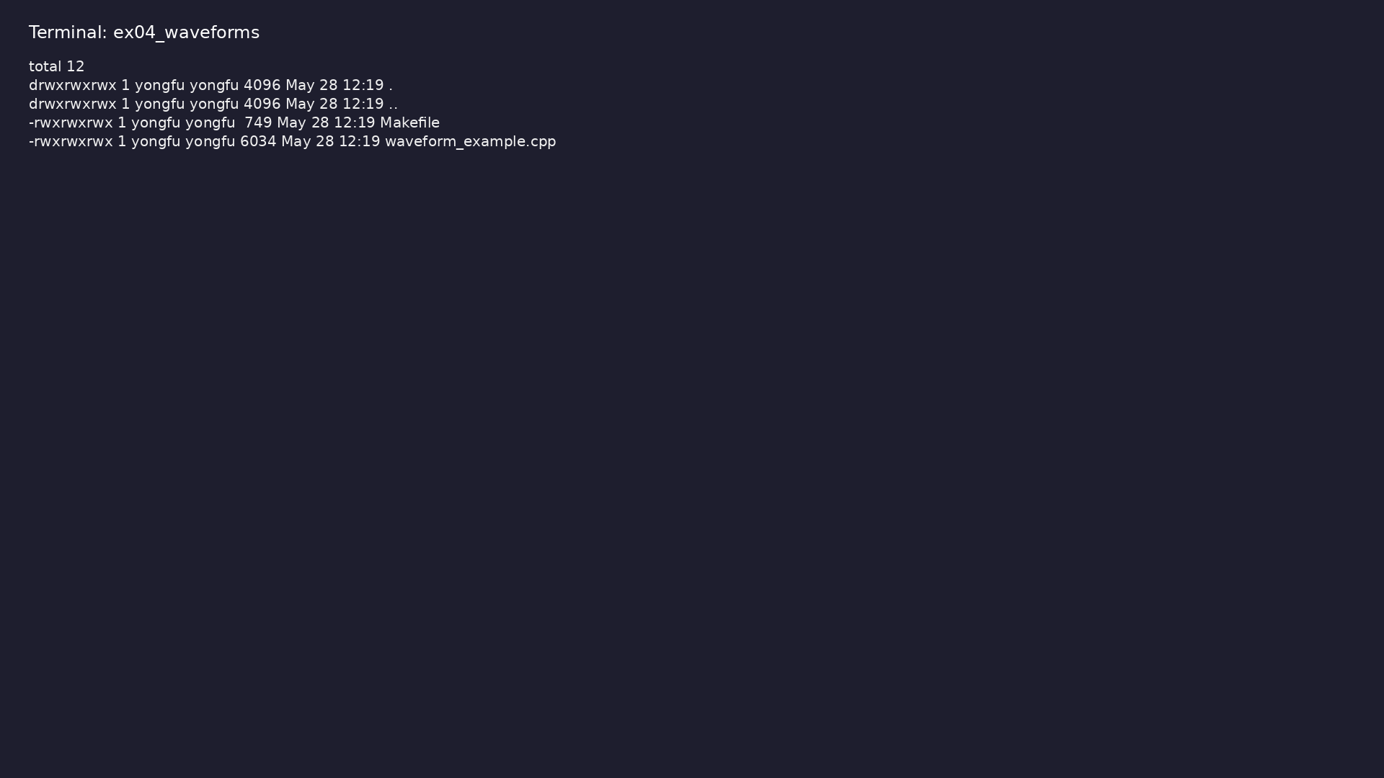
Demo: Waveforms
$ ls -la module2/examples/waveforms
learn_verilator_iverilog / Module 2
Notes:
Hands-on: module2/examples/waveforms/

Slide 90

Demo: Debugging
$ ls -la module2/examples/debugging
learn_verilator_iverilog / Module 2
Notes:
Hands-on: module2/examples/debugging/

Slide 91
Key concepts
learn_verilator_iverilog / Module 2

Slide 92
1. Verilator compilation model
• Input: Verilog/SystemVerilog RTL + optional
`--timing` / lint flags per example
• Output: C++ classes (`V<top>`) in `obj_dir/` with
fast cycle-accurate `eval()`
• Linkage: C++ `main()` or test class calls
`dut->eval()` each cycle or on events
• Tracing: `--trace` / `--trace-fst` for waveform
dumps from the C++ side
learn_verilator_iverilog / Module 2
Notes:
From MODULE2 Key Concepts.

Slide 93
2. Module 2 DUT catalog
• `dut/multiplexers/`: Same MUX family as Module 1 —
cross-tool comparison baseline
• `dut/counters/`: `counter_4bit` — exercises
sequential C++ drive/monitor loops
• Port mapping: Verilator flattens ports to struct
members (`dut->clk`, `dut->count`)
• Performance: Large test suites favor Verilator’s
compiled model over interpreted VVP
learn_verilator_iverilog / Module 2
Notes:
From MODULE2 Key Concepts.

Slide 94
3. C++ testbench architecture
• Top-level `main`: Allocates `Vtop`, applies reset
sequence, runs clock loop
• Stimulus loop: `for`/`while` sets inputs then
`eval()` advances time
• Optional OOP: Advanced tests organize
Driver/Monitor/Checker as C++ classes
• Build: Generated `Vtop.mk` plus user `Makefile` link
testbench and model
learn_verilator_iverilog / Module 2
Notes:
From MODULE2 Key Concepts.

Slide 95
1. Cycle-based C++ testing
• Clock generation: Toggle clock in loop with `eval()`
between edges
• Reset sequence: Hold `rst_n` low N cycles, release,
verify known state
• Checking: `assert()` or explicit compare with
`std::cerr` on mismatch
learn_verilator_iverilog / Module 2
Notes:
From MODULE2 Key Concepts.

Slide 96
2. Tracing and performance checks
• Waveforms: Enable Verilator trace API; view in
GTKWave for debug examples
• Printf debug: Structured logging before/after
`eval()` for signal snapshots
• Regression: `./scripts/module2.sh --all-tests`
batches compile+run across examples
learn_verilator_iverilog / Module 2
Notes:
From MODULE2 Key Concepts.

Slide 97
3. File I/O and scalable stimulus
• Vector files: Read test data in C++ (`file_io`
examples) for long sequences
• Repeatability: Fixed seeds and deterministic loops
for comparable runs
• Failure isolation: Run single `obj_dir` binary with
minimal stimulus to bisect bugs
learn_verilator_iverilog / Module 2
Notes:
From MODULE2 Key Concepts.

Slide 98
1. Verilator Overview (1/6)
• What is Verilator?
• Fast Verilog/SystemVerilog simulator
• Generates C++ code from Verilog
• Open-source and free
• Excellent performance
• Verilator's Compilation Model
learn_verilator_iverilog / Module 2
Notes:
From MODULE2 Key Concepts.

Slide 99
1. Verilator Overview (2/6)
• Two-stage compilation
• Verilog → C++ conversion
• C++ compilation and linking
• Generated wrapper classes
• C++ Wrapper Generation
• Top module class structure
learn_verilator_iverilog / Module 2
Notes:
From MODULE2 Key Concepts.

Slide 100
1. Verilator Overview (3/6)
• Signal access methods
• Evaluation methods
• Tracing support
• Verilator Capabilities and Features
• Fast simulation
• Good Verilog-2001 support
learn_verilator_iverilog / Module 2
Notes:
From MODULE2 Key Concepts.

Slide 101
1. Verilator Overview (4/6)
• Limited SystemVerilog support
• Coverage support
• Waveform generation
• Supported Verilog/SystemVerilog Constructs
• Most Verilog-2001 features
• Basic SystemVerilog features
learn_verilator_iverilog / Module 2
Notes:
From MODULE2 Key Concepts.

Slide 102
1. Verilator Overview (5/6)
• Interfaces (limited)
• Classes (limited)
• Assertions (limited)
• Limitations and Workarounds
• Limited SystemVerilog support
• Some advanced features not supported
learn_verilator_iverilog / Module 2
Notes:
From MODULE2 Key Concepts.

Slide 103
1. Verilator Overview (6/6)
• Workarounds for unsupported features
• When to Use Verilator
• High-performance simulation
• Large designs
• Integration with C++ libraries
• Complex testbenches with advanced data structures
learn_verilator_iverilog / Module 2
Notes:
From MODULE2 Key Concepts.

Slide 104
2. Compilation Process (1/8)
• Verilator Compilation Command
• Basic syntax: `verilator --cc --exe design.v
testbench.cpp`
• Output generation
• Build process
• Compilation Flags and Options
• `--cc`: Generate C++ code
learn_verilator_iverilog / Module 2
Notes:
From MODULE2 Key Concepts.

Slide 105
2. Compilation Process (2/8)
• `--exe`: Generate executable
• `--build`: Build automatically
• `-I<directory>`: Add include path
• `-D<macro>`: Define macro
• `-O0, -O1, -O2, -O3`: Optimization levels
• `--trace`: Generate VCD tracing
learn_verilator_iverilog / Module 2
Notes:
From MODULE2 Key Concepts.

Slide 106
2. Compilation Process (3/8)
• `--trace-fst`: Generate FST tracing
• `--coverage`: Enable coverage
• `--lint-only`: Lint without compilation
• Optimization Levels (-O0, -O1, -O2, -O3)
• `-O0`: No optimization (fastest compilation)
• `-O1`: Basic optimization
learn_verilator_iverilog / Module 2
Notes:
From MODULE2 Key Concepts.

Slide 107
2. Compilation Process (4/8)
• `-O2`: More optimization (default)
• `-O3`: Maximum optimization (slowest compilation,
fastest simulation)
• Coverage Options (--coverage)
• Code coverage generation
• Coverage analysis
• Coverage reporting
learn_verilator_iverilog / Module 2
Notes:
From MODULE2 Key Concepts.

Slide 108
2. Compilation Process (5/8)
• Linting Capabilities (--lint-only)
• Syntax checking
• Design rule checking
• No simulation generation
• Waveform Generation (--trace, --trace-fst)
• `--trace`: Generate VCD files
learn_verilator_iverilog / Module 2
Notes:
From MODULE2 Key Concepts.

Slide 109
2. Compilation Process (6/8)
• `--trace-fst`: Generate FST files (smaller, faster)
• Signal selection
• GTKWave compatibility
• Include Path Management
• Adding include directories
• Multiple include paths
learn_verilator_iverilog / Module 2
Notes:
From MODULE2 Key Concepts.

Slide 110
2. Compilation Process (7/8)
• Relative vs. absolute paths
• Define Macros
• Conditional compilation
• Macro definitions
• Usage in designs
• Multi-File Compilation
learn_verilator_iverilog / Module 2
Notes:
From MODULE2 Key Concepts.

Slide 111
2. Compilation Process (8/8)
• Compiling multiple files
• File ordering
• Dependency management
• `basic_compilation.cpp`: Demonstrates basic
compilation, optimization, tracing, coverage,
linting
learn_verilator_iverilog / Module 2
Notes:
From MODULE2 Key Concepts.

Slide 112
3. C++ Testbench Structure (1/7)
• C++ Main Function
• Entry point
• Verilator initialization
• DUT instantiation
• Test sequence
• Cleanup
learn_verilator_iverilog / Module 2
Notes:
From MODULE2 Key Concepts.

Slide 113
3. C++ Testbench Structure (2/7)
• Verilator-Generated Class Usage
• Class naming (V<module_name>)
• Instance creation
• Method calls
• Signal access
• DUT Instantiation in C++
learn_verilator_iverilog / Module 2
Notes:
From MODULE2 Key Concepts.

Slide 114
3. C++ Testbench Structure (3/7)
• Creating DUT object
• Memory management
• Lifetime management
• Signal Access (Reading and Writing)
• Reading signals: `dut->signal_name`
• Writing signals: `dut->signal_name = value`
learn_verilator_iverilog / Module 2
Notes:
From MODULE2 Key Concepts.

Slide 115
3. C++ Testbench Structure (4/7)
• Signal types
• Multi-bit signals
• Clock Generation in C++
• Simulation loop
• Clock toggling
• Clock period control
learn_verilator_iverilog / Module 2
Notes:
From MODULE2 Key Concepts.

Slide 116
3. C++ Testbench Structure (5/7)
• Multiple clocks
• Reset Generation in C++
• Reset sequences
• Synchronous reset
• Asynchronous reset
• Reset timing
learn_verilator_iverilog / Module 2
Notes:
From MODULE2 Key Concepts.

Slide 117
3. C++ Testbench Structure (6/7)
• Simulation Loop
• Time management
• Event scheduling
• Loop structure
• Termination
• `mux_4to1_test.cpp`: Basic C++ testbench structure
learn_verilator_iverilog / Module 2
Notes:
From MODULE2 Key Concepts.

Slide 118
3. C++ Testbench Structure (7/7)
• `counter_test.cpp`: Clock and reset generation,
simulation loop
learn_verilator_iverilog / Module 2
Notes:
From MODULE2 Key Concepts.

Slide 119
4. C++ Testbench Writing (1/6)
• Basic C++ Testbench Template
• Standard structure
• Common patterns
• Best practices
• Signal Access Methods
• Direct access
learn_verilator_iverilog / Module 2
Notes:
From MODULE2 Key Concepts.

Slide 120
4. C++ Testbench Writing (2/6)
• Signal reading
• Signal writing
• Signal monitoring
• Clock and Reset Patterns
• Standard clock patterns
• Reset patterns
learn_verilator_iverilog / Module 2
Notes:
From MODULE2 Key Concepts.

Slide 121
4. C++ Testbench Writing (3/6)
• Clock/reset coordination
• Stimulus Generation in C++
• Test vector generation
• Pattern generation
• Sequential stimulus
• Random stimulus
learn_verilator_iverilog / Module 2
Notes:
From MODULE2 Key Concepts.

Slide 122
4. C++ Testbench Writing (4/6)
• Response Monitoring in C++
• Output monitoring
• Real-time monitoring
• Post-processing
• Logging
• Result Checking
learn_verilator_iverilog / Module 2
Notes:
From MODULE2 Key Concepts.

Slide 123
4. C++ Testbench Writing (5/6)
• Expected value calculation
• Output comparison
• Error detection
• Assertions
• Error Reporting
• Error messages
learn_verilator_iverilog / Module 2
Notes:
From MODULE2 Key Concepts.

Slide 124
4. C++ Testbench Writing (6/6)
• Exit codes
• Test summaries
• Failure reporting
learn_verilator_iverilog / Module 2
Notes:
From MODULE2 Key Concepts.

Slide 125
5. Verilator C++ API (1/5)
• Top Module Class Structure
• Class name: `V<module_name>`
• Constructor/destructor
• Methods
• Signals
• Signal Access Methods
learn_verilator_iverilog / Module 2
Notes:
From MODULE2 Key Concepts.

Slide 126
5. Verilator C++ API (2/5)
• Direct member access
• Signal types
• Multi-bit signals
• Array signals
• Evaluation Method (eval())
• What eval() does
learn_verilator_iverilog / Module 2
Notes:
From MODULE2 Key Concepts.

Slide 127
5. Verilator C++ API (3/5)
• When to call eval()
• Timing considerations
• Multiple evaluations
• Time Management
• Simulation time
• Time tracking
learn_verilator_iverilog / Module 2
Notes:
From MODULE2 Key Concepts.

Slide 128
5. Verilator C++ API (4/5)
• Time advancement
• Time-based events
• Tracing API
• VerilatedVcdC class
• trace() method
• dump() method
learn_verilator_iverilog / Module 2
Notes:
From MODULE2 Key Concepts.

Slide 129
5. Verilator C++ API (5/5)
• File management
• Coverage API
• Coverage collection
• Coverage reporting
• Coverage analysis
learn_verilator_iverilog / Module 2
Notes:
From MODULE2 Key Concepts.

Slide 130
6. Waveform Generation (1/5)
• VCD File Generation
• Using --trace flag
• VerilatedVcdC class
• trace() method
• dump() method
• File management
learn_verilator_iverilog / Module 2
Notes:
From MODULE2 Key Concepts.

Slide 131
6. Waveform Generation (2/5)
• FST File Generation
• Using --trace-fst flag
• FST advantages
• GTKWave compatibility
• Signal Selection for Tracing
• trace() method levels
learn_verilator_iverilog / Module 2
Notes:
From MODULE2 Key Concepts.

Slide 132
6. Waveform Generation (3/5)
• Selective tracing
• Hierarchy levels
• GTKWave Compatibility
• VCD format
• FST format
• GTKWave viewing
learn_verilator_iverilog / Module 2
Notes:
From MODULE2 Key Concepts.

Slide 133
6. Waveform Generation (4/5)
• Signal organization
• Waveform Analysis
• Viewing waveforms
• Signal timing
• Timing relationships
• Debugging with waveforms
learn_verilator_iverilog / Module 2
Notes:
From MODULE2 Key Concepts.

Slide 134
6. Waveform Generation (5/5)
• `waveform_example.cpp`: Comprehensive waveform
generation using Verilator tracing API
learn_verilator_iverilog / Module 2
Notes:
From MODULE2 Key Concepts.

Slide 135
7. Debugging with Verilator (1/6)
• Compilation Error Debugging
• Understanding Verilator errors
• Common compilation errors
• Syntax errors
• Missing files
• C++ Compilation Errors
learn_verilator_iverilog / Module 2
Notes:
From MODULE2 Key Concepts.

Slide 136
7. Debugging with Verilator (2/6)
• Understanding C++ errors
• Linker errors
• Template errors
• Common mistakes
• Runtime Debugging
• Understanding runtime errors
learn_verilator_iverilog / Module 2
Notes:
From MODULE2 Key Concepts.

Slide 137
7. Debugging with Verilator (3/6)
• Signal inspection
• GDB debugging
• Valgrind debugging
• Signal Inspection
• Printing signal values
• Signal monitoring
learn_verilator_iverilog / Module 2
Notes:
From MODULE2 Key Concepts.

Slide 138
7. Debugging with Verilator (4/6)
• VCD file analysis
• Debug output
• Logging Strategies
• Debug levels
• Conditional logging
• File-based logging
learn_verilator_iverilog / Module 2
Notes:
From MODULE2 Key Concepts.

Slide 139
7. Debugging with Verilator (5/6)
• Log organization
• Common Pitfalls and Solutions
• Forgetting to call eval()
• Signal initialization
• Memory leaks
• Timing issues
learn_verilator_iverilog / Module 2
Notes:
From MODULE2 Key Concepts.

Slide 140
7. Debugging with Verilator (6/6)
• Common mistakes
• `debug_example.cpp`: C++ debugging techniques,
logging strategies, error handling
learn_verilator_iverilog / Module 2
Notes:
From MODULE2 Key Concepts.

Slide 141
8. Advanced Verilator Features (1/4)
• Multi-Threaded Simulation Basics
• Thread safety
• Parallel simulation
• Synchronization
• Performance Optimization
• Compilation optimization
learn_verilator_iverilog / Module 2
Notes:
From MODULE2 Key Concepts.

Slide 142
8. Advanced Verilator Features (2/4)
• Simulation optimization
• Memory optimization
• Speed optimization
• Large Design Handling
• Compiling large designs
• Memory management
learn_verilator_iverilog / Module 2
Notes:
From MODULE2 Key Concepts.

Slide 143
8. Advanced Verilator Features (3/4)
• Incremental compilation
• Design partitioning
• Custom C++ Integration
• Integrating C++ libraries
• External interfaces
• Custom functions
learn_verilator_iverilog / Module 2
Notes:
From MODULE2 Key Concepts.

Slide 144
8. Advanced Verilator Features (4/4)
• System integration
• SystemC Integration Basics
• SystemC support
• SystemC integration
• When to use SystemC
learn_verilator_iverilog / Module 2
Notes:
From MODULE2 Key Concepts.

Slide 145
9. Project Organization (1/11)
• Makefile Integration
• Basic Makefile structure
• Verilator compilation rules
• Test execution
• Clean targets
• Dependency management
learn_verilator_iverilog / Module 2
Notes:
From MODULE2 Key Concepts.

Slide 146
9. Project Organization (2/11)
• CMake Integration
• CMake setup
• Verilator integration
• Build configuration
• Scripting for Automation
• Shell scripts for automation
learn_verilator_iverilog / Module 2
Notes:
From MODULE2 Key Concepts.

Slide 147
9. Project Organization (3/11)
• Batch processing
• Test automation
• Result collection
• Batch Simulation
• Running multiple tests
• Test selection
learn_verilator_iverilog / Module 2
Notes:
From MODULE2 Key Concepts.

Slide 148
9. Project Organization (4/11)
• Parallel execution
• Result aggregation
• Regression Testing Setup
• Test suite organization
• Regression test structure
• Pass/fail reporting
learn_verilator_iverilog / Module 2
Notes:
From MODULE2 Key Concepts.

Slide 149
9. Project Organization (5/11)
• Test result tracking
• Location: `module0/examples/verilator_basics/and_gat
e_test.cpp`
• Demonstrates: Basic C++ testbench structure, signal
access
• Location:
`module2/examples/cpp_testbench/mux_4to1_test.cpp`
• Demonstrates: Complete C++ testbench, signal access,
test patterns
• Location:
`module2/examples/cpp_testbench/counter_test.cpp`
learn_verilator_iverilog / Module 2
Notes:
From MODULE2 Key Concepts.

Slide 150
9. Project Organization (6/11)
• Demonstrates: Clock generation, reset sequences,
simulation loop
• Location:
`module2/examples/file_io/file_io_test.cpp`
• Demonstrates: Reading test vectors from files,
writing results
• Location: See compilation examples
• Demonstrates: Multi-file compilation, include paths
• Location:
`module2/tests/basic_tests/test_mux_4to1.cpp`
learn_verilator_iverilog / Module 2
Notes:
From MODULE2 Key Concepts.

Slide 151
9. Project Organization (7/11)
• Demonstrates: Class-based organization,
comprehensive testing
• Compile Verilog designs with Verilator
• Write C++ testbenches for Verilator
• Use Verilator C++ API effectively
• Generate and analyze waveforms
• Debug Verilator compilation and simulation issues
learn_verilator_iverilog / Module 2
Notes:
From MODULE2 Key Concepts.

Slide 152
9. Project Organization (8/11)
• Organize projects using Verilator
• Optimize Verilator-based testbenches
• Use compilation examples
• Try different compilation options
• Understand compilation process
• Complete C++ testbench for 4-to-1 multiplexer
learn_verilator_iverilog / Module 2
Notes:
From MODULE2 Key Concepts.

Slide 153
9. Project Organization (9/11)
• Test all input combinations
• Verify correct operation
• Read test vectors from file
• Apply vectors to DUT
• Write results to file
• Compare expected vs. actual
learn_verilator_iverilog / Module 2
Notes:
From MODULE2 Key Concepts.

Slide 154
9. Project Organization (10/11)
• Generate VCD files with Verilator
• View waveforms in GTKWave
• Analyze signal timing
• Debug using waveforms
• Create Makefile for compilation
• Add test execution rules
learn_verilator_iverilog / Module 2
Notes:
From MODULE2 Key Concepts.

Slide 155
9. Project Organization (11/11)
• Implement clean targets
• Organize project structure
learn_verilator_iverilog / Module 2
Notes:
From MODULE2 Key Concepts.

Slide 156
Practice & assessment
learn_verilator_iverilog / Module 2

Slide 157
What you should know (1/7)
• Compile Verilog designs with Verilator
• Write C++ testbenches for Verilator
• Use Verilator C++ API effectively
• Generate and analyze waveforms
• Debug Verilator compilation and simulation issues
• Organize projects using Verilator
learn_verilator_iverilog / Module 2
Notes:
From MODULE2 Learning Outcomes.

Slide 158
What you should know (2/7)
• Optimize Verilator-based testbenches
• Use compilation examples
• Try different compilation options
• Understand compilation process
• Complete C++ testbench for 4-to-1 multiplexer
• Test all input combinations
learn_verilator_iverilog / Module 2
Notes:
From MODULE2 Learning Outcomes.

Slide 159
What you should know (3/7)
• Verify correct operation
• Read test vectors from file
• Apply vectors to DUT
• Write results to file
• Compare expected vs. actual
• Generate VCD files with Verilator
learn_verilator_iverilog / Module 2
Notes:
From MODULE2 Learning Outcomes.

Slide 160
What you should know (4/7)
• View waveforms in GTKWave
• Analyze signal timing
• Debug using waveforms
• Create Makefile for compilation
• Add test execution rules
• Implement clean targets
learn_verilator_iverilog / Module 2
Notes:
From MODULE2 Learning Outcomes.

Slide 161
What you should know (5/7)
• Organize project structure
• Can compile Verilog designs with various Verilator
options
• Can write complete C++ testbenches
• Can use Verilator C++ API effectively
• Can use file I/O in C++ testbenches
• Can generate and view waveforms
learn_verilator_iverilog / Module 2
Notes:
From MODULE2 Learning Outcomes.

Slide 162
What you should know (6/7)
• Can debug compilation and simulation errors
• Can organize projects with Makefiles
• Can optimize Verilator-based testbenches
• Prerequisites: [Module 0: Installation and
Setup](MODULE0.md) and [Module 1: iverilog Deep
Dive](MO…
• Next Steps: [Module 3: Testbench
Fundamentals](MODULE3.md) - Learn fundamental
testbench concepts f…
• UVM Connection: [UVM Core
Repository](https://github.com/universal-
verification-methodology/core)
learn_verilator_iverilog / Module 2
Notes:
From MODULE2 Learning Outcomes.

Slide 163
What you should know (7/7)
• Module 3: Testbench Fundamentals (Verilog and C++) -
Learn fundamental testbench concepts for both…
• Module 4: Basic Testbench Construction - Master
structured testbench construction
• Verilator Documentation: https://verilator.org/
• GTKWave Documentation:
http://gtkwave.sourceforge.net/
• IEEE 1364-2005 Standard: Verilog Hardware
Description Language
• IEEE 1800-2017 Standard: SystemVerilog Language
Reference Manual
learn_verilator_iverilog / Module 2
Notes:
From MODULE2 Learning Outcomes.

Slide 164
Assessment checklist
• Can compile Verilog designs with various Verilator
options
• Can write complete C++ testbenches
• Can use Verilator C++ API effectively
• Can use file I/O in C++ testbenches
• Can generate and view waveforms
• Can debug compilation and simulation errors
learn_verilator_iverilog / Module 2

Slide 165
Summary & next steps
• Master Verilator for C++ testbench development
• Complete module2/CHECKLIST.md
• Review module2/EXAMPLES.md and run each lab
• Next: Next module in course
learn_verilator_iverilog / Module 2

