Slide 1
Module 3
Testbench Fundamentals (Verilog and C++)
learn_verilator_iverilog / Module 3

Slide 2
Learning objectives
• Understand testbench architecture and basic
verification concepts for both Verilog and C++
testbenc…
learn_verilator_iverilog / Module 3

Slide 3
Prerequisites
• See module README
learn_verilator_iverilog / Module 3

Slide 4

Learning path
Understand testbench architecture and basic verification concepts for both Verilog and C++ testbenches
learn_verilator_iverilog / Module 3

Slide 5
Overview
• This module introduces the fundamental concepts of
testbench design for both Verilog (iverilog) and…
learn_verilator_iverilog / Module 3

Slide 6
Design architecture
learn_verilator_iverilog / Module 3

Slide 7
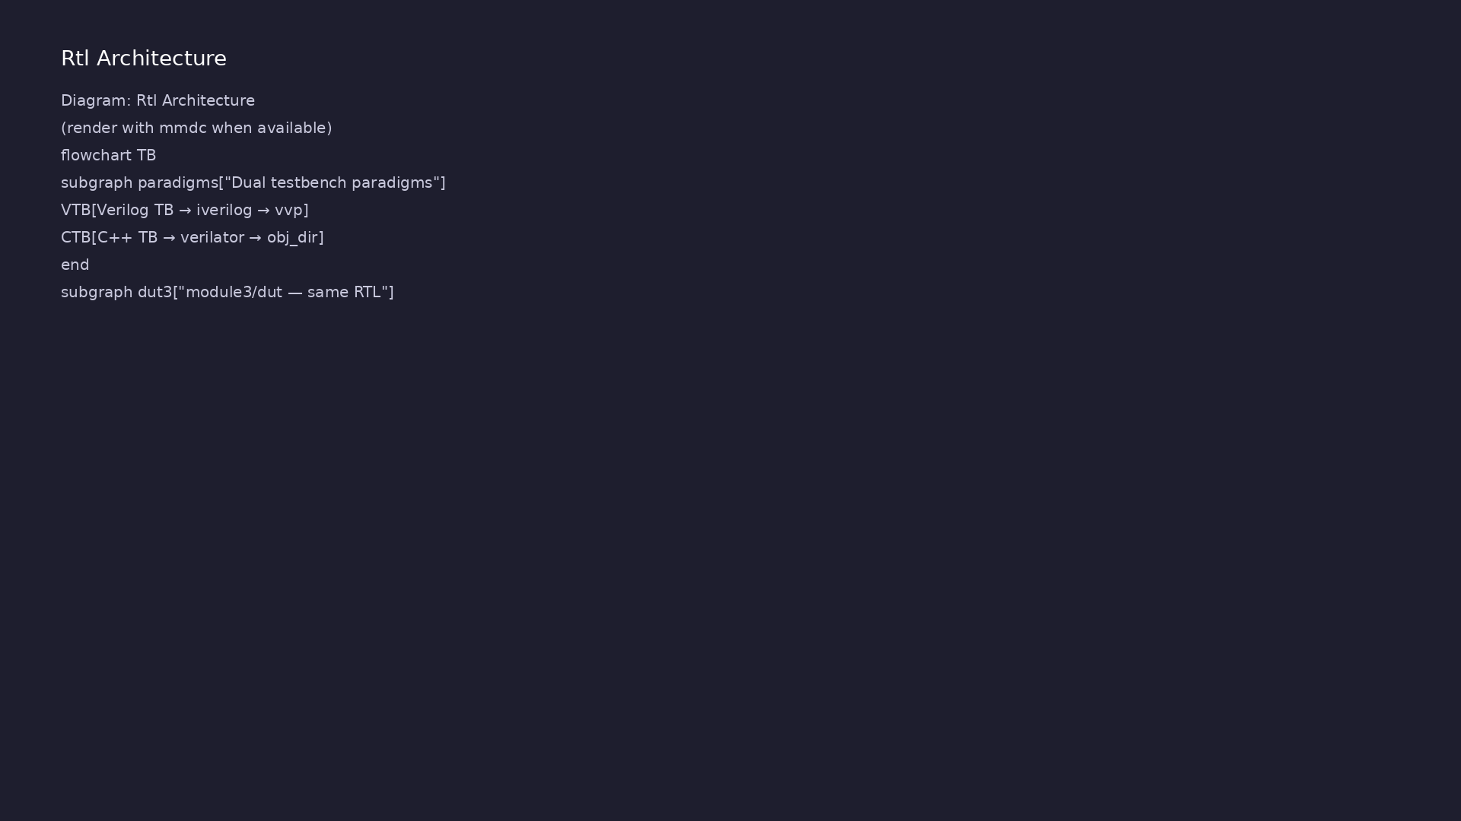
1. Canonical testbench–DUT boundary
• DUT: Device Under Test in
`module3/dut/` (gates,
multiplexers, counters)
• TB wrapper: Encapsulates
instantiation, clock/reset, and
test program only
• Signals: Explicit wires/regs
(Verilog) or model ports (C++) —
no hidden coupling
• Lifecycle: Build → reset → run
tests → report → `$finish` /
`return` exit code
learn_verilator_iverilog / Module 3
Notes:
From MODULE3 Design Architecture.

Slide 8
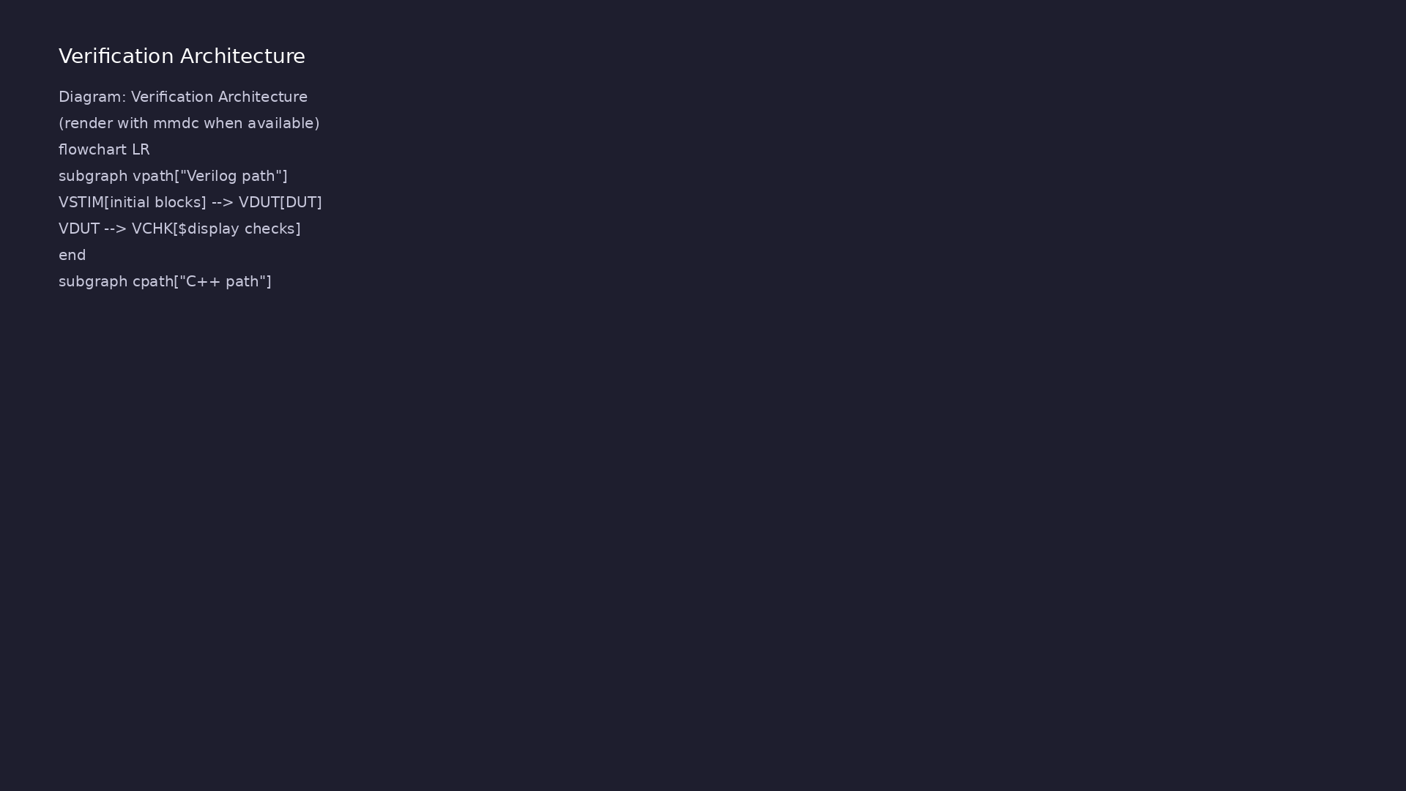
2. Dual-paradigm environment architecture
• Verilog TB (`examples/verilog_te
stbenches/`): Event-driven
`initial`/`always`
• C++ TB
(`examples/cpp_testbenches/`):
`eval()` loop with Verilator
model
• Shared DUT: Same RTL verified
two ways — highlights tool-
specific TB idioms
• Comparison guide:
`examples/comparison/` documents
mapping between styles
learn_verilator_iverilog / Module 3
Notes:
From MODULE3 Design Architecture.

Slide 9
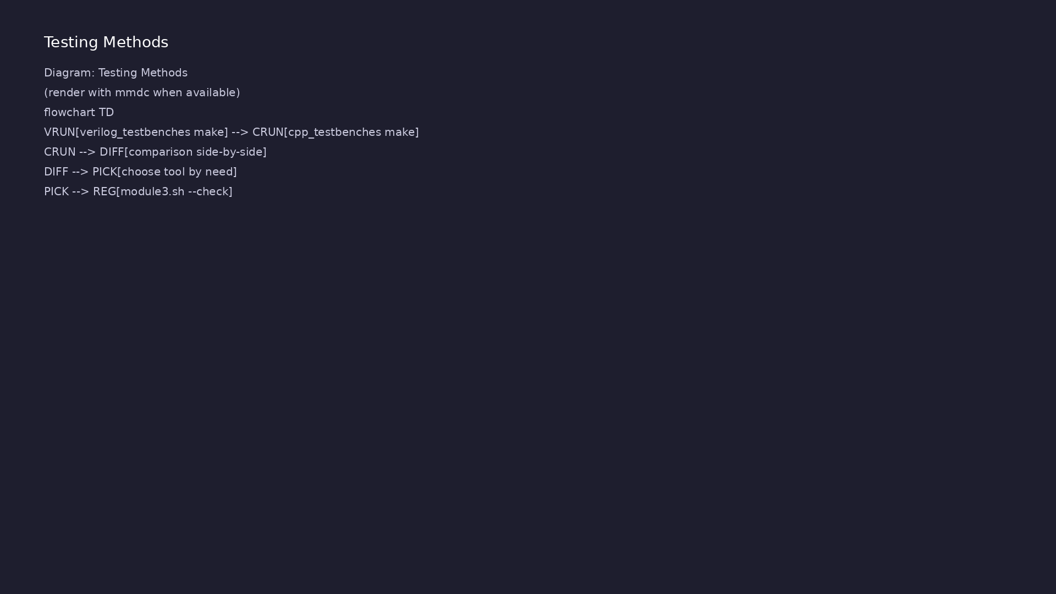
3. Verification component roles (UVM-aligned)
• Driver: Applies stimulus
(assignments before `eval` or
`#delay`)
• Monitor: Samples outputs; logs
transactions or pin values
• Scoreboard: Compares actual vs
expected; increments pass/fail
• Clock/reset agents: Reusable
blocks generating periodic clock
and reset sequences
learn_verilator_iverilog / Module 3
Notes:
From MODULE3 Design Architecture.

Slide 10
RTL block diagram (reference)
Module 3: DUT hierarchy and signal flow.
learn_verilator_iverilog / Module 3

Slide 11
Verification / testbench diagram (reference)
Module 3: stimulus, observation, and checking.
learn_verilator_iverilog / Module 3

Slide 12
Verilog TB Makefile — counter_test
counter_test: counter_test.v
@echo "=== Compiling counter_test ==="
$(IVERILOG) -o counter_test counter_test.v
$(DUT_DIR_MODULE1)/counters/counter_4bit.v
@echo "=== Running simulation ==="
$(VVP) counter_test
learn_verilator_iverilog / Module 3
Notes:
iverilog links TB + counter_4bit.v; vvp runs event-driven simulation.

Slide 13
Verilog TB — clock and reset
module counter_test;
//
========================================================================
// TESTBENCH SIGNAL DECLARATIONS
//
========================================================================
// Clock signal - driven by always block (continuous clock
generation)
reg clk;
// Reset signal (active-low: 0 = reset, 1 = normal operation)
// Active-low resets are common in digital design
reg rst_n;
// Enable signal (1 = count, 0 = hold current value)
reg en;
learn_verilator_iverilog / Module 3
Notes:
always #half clk=~clk; reset sequence in initial block.

Slide 14
Shared DUT — counter_4bit
/**
* 4-bit Counter Design Under Test (DUT)
*
* This is a synchronous 4-bit counter with reset and enable, used for
learning
* testbench development. This module demonstrates sequential logic,
which requires
* clock-based testbench patterns and is more complex to verify than
combinational logic.
*
* Verification Context:
* - Sequential logic requires clock generation and timing control in
testbenches
* - Demonstrates reset sequences, enable control, and state observation
* - In UVM, sequential logic like counters are used to learn
transaction-based
* verification, clocking blocks, and sequence generation
* - This counter can count from 0 to 15 (2^4 - 1), then wraps to 0
learn_verilator_iverilog / Module 3
Notes:
Same RTL verified by both Verilog and C++ testbench paradigms.

Slide 15
Execution & simulation flow
learn_verilator_iverilog / Module 3

Slide 16
How the example runs (toolchain)
• Makefile: Verilator compiles RTL + SystemVerilog
testbench into a C++ model
• sim_main.cpp: generates clk/rst_n, calls eval()
until $finish
• Directed test (initial block or C++): drive
stimulus, wait for DUT flags
• Self-check: compare outputs; print PASS/FAIL (see
terminal demo slide)
• Repo path: module3/examples/<example>/ — run make
run from that directory
learn_verilator_iverilog / Module 3
Notes:
From MODULE3 — execution and artifact layout.

Slide 17
Directed test execution sequence (1)
• Both paradigms count errors locally
• same PASS criteria without manual waveform grading
• Instantiate DUT in Verilog TB
• iverilog compile
• vvp
learn_verilator_iverilog / Module 3
Notes:
Follow this order when tracing waveforms or debugging.

Slide 18
Directed test execution sequence (2)
• repeat with C++ TB and Verilator
• review comparison/ mapping guide
• cd module3/examples/verilog_testbenches && make
counter_test
learn_verilator_iverilog / Module 3
Notes:
Follow this order when tracing waveforms or debugging.

Slide 19
C++ TB Makefile — Verilator build
counter_test: counter_test.cpp
@echo "=== Compiling counter_test ==="
$(VERILATOR) $(VERILATOR_FLAGS) -I$(DUT_DIR_MODULE1)/counters \
$(DUT_DIR_MODULE1)/counters/counter_4bit.v
counter_test.cpp
@echo "=== Running simulation ==="
./obj_dir/Vcounter_4bit
learn_verilator_iverilog / Module 3
Notes:
cd module3/examples/cpp_testbenches && make counter_test

Slide 20
C++ TB — DUT init and reset test
int main(int argc, char** argv) {
//
========================================================================
// VERILATOR INITIALIZATION
//
========================================================================
Verilated::commandArgs(argc, argv);
//
========================================================================
// TEST HEADER
//
========================================================================
std::cout << "========================================" <<
std::endl;
std::cout << "4-bit Counter C++ Testbench" << std::endl;
std::cout << "========================================" <<
std::endl;
learn_verilator_iverilog / Module 3
Notes:
new Vcounter_4bit; drive rst_n low; eval loop verifies count==0.

Slide 21
Verification & testing methods
learn_verilator_iverilog / Module 3

Slide 22
1. Structured test flow (build–connect–run)
• Build: Compile RTL + TB;
elaborate hierarchy
• Connect: Port map DUT; tie off
unused inputs
• Run: Execute directed cases (AND
truth table, counter wrap, MUX
exhaust)
• Cleanup: Close files, print
summary, non-zero exit on
failure
learn_verilator_iverilog / Module 3
Notes:
From MODULE3 Verification & Testing Methods.

Slide 23
2. Directed and exhaustive patterns
• Truth-table tests: All input
combinations for small
combinational DUTs
• Sequential tests: Known count
sequences after reset deassert
• Assertions: `assert` (C++) or
immediate checks (Verilog) on
each vector
learn_verilator_iverilog / Module 3
Notes:
From MODULE3 Verification & Testing Methods.

Slide 24
3. Cross-paradigm verification discipline
• Same spec, two TBs: Document
expected behavior once;
implement in Verilog and C++
• Self-checking: Both paradigms
count errors locally — no manual
waveform grading
• Orchestration:
`./scripts/module3.sh --verilog-
testbenches` vs `--cpp-
testbenches`
learn_verilator_iverilog / Module 3
Notes:
From MODULE3 Verification & Testing Methods.

Slide 25
Paradigm comparison checklist
// missing source file: module3/examples/comparison/README.md
learn_verilator_iverilog / Module 3
Notes:
Side-by-side: initial blocks vs eval loop; same pass criteria.

Slide 26
Syllabus topics
learn_verilator_iverilog / Module 3

Slide 27
Protocol & design details
learn_verilator_iverilog / Module 3

Slide 28
1. Verification Fundamentals (1/5)
• What is verification?
• Ensuring design correctness
• Finding bugs before production
• Verification vs. validation
• Testbench Purpose and Role
• Stimulus generation
learn_verilator_iverilog / Module 3
Notes:
From MODULE3 Topics Covered.

Slide 29
1. Verification Fundamentals (2/5)
• Response monitoring
• Result checking
• Testbench as verification environment
• Design Under Test (DUT) Concept
• What is DUT?
• DUT instantiation
learn_verilator_iverilog / Module 3
Notes:
From MODULE3 Topics Covered.

Slide 30
1. Verification Fundamentals (3/5)
• DUT interface
• DUT testing
• Verification vs. Validation
• Verification: Does it work correctly?
• Validation: Does it meet requirements?
• Differences and overlap
learn_verilator_iverilog / Module 3
Notes:
From MODULE3 Topics Covered.

Slide 31
1. Verification Fundamentals (4/5)
• Verification Flow and Methodology
• Test plan creation
• Testbench development
• Test execution
• Result analysis
• Verilog Testbench vs. C++ Testbench Comparison
learn_verilator_iverilog / Module 3
Notes:
From MODULE3 Topics Covered.

Slide 32
1. Verification Fundamentals (5/5)
• Similarities
• Differences
• When to use each
• Performance considerations
learn_verilator_iverilog / Module 3
Notes:
From MODULE3 Topics Covered.

Slide 33
2. Testbench Architecture (1/6)
• Verilog Testbench Module Structure
• Module declaration
• Signal declarations
• DUT instantiation
• Test sequence
• Module-based organization
learn_verilator_iverilog / Module 3
Notes:
From MODULE3 Topics Covered.

Slide 34
2. Testbench Architecture (2/6)
• C++ Testbench Structure
• Main function
• Verilator initialization
• DUT instantiation
• Test sequence
• Class-based organization (optional)
learn_verilator_iverilog / Module 3
Notes:
From MODULE3 Topics Covered.

Slide 35
2. Testbench Architecture (3/6)
• DUT Instantiation (Both Paradigms)
• Verilog: Module instantiation
• C++: Object creation
• Signal connectivity
• Port mapping
• Signal Connectivity
learn_verilator_iverilog / Module 3
Notes:
From MODULE3 Topics Covered.

Slide 36
2. Testbench Architecture (4/6)
• Input signals
• Output signals
• Bidirectional signals
• Signal naming
• Testbench Hierarchy
• Top-level testbench
learn_verilator_iverilog / Module 3
Notes:
From MODULE3 Topics Covered.

Slide 37
2. Testbench Architecture (5/6)
• DUT hierarchy
• Testbench components
• Organization patterns
• Top-Level Testbench Organization
• Single testbench file
• Multiple file organization
learn_verilator_iverilog / Module 3
Notes:
From MODULE3 Topics Covered.

Slide 38
2. Testbench Architecture (6/6)
• Include files
• Library organization
• `module3/examples/verilog_testbenches/` - Verilog
testbench structure
• `module3/examples/cpp_testbenches/` - C++ testbench
structure
learn_verilator_iverilog / Module 3
Notes:
From MODULE3 Topics Covered.

Slide 39
3. Basic Testbench Components (1/6)
• Clock Generation (Verilog and C++)
• Verilog: Always blocks for continuous clock
• C++: Simulation loop for clock toggling
• Clock period control
• Multiple clocks
• Reset Generation (Verilog and C++)
learn_verilator_iverilog / Module 3
Notes:
From MODULE3 Topics Covered.

Slide 40
3. Basic Testbench Components (2/6)
• Verilog: Initial blocks for reset sequences
• C++: Reset in C++ code
• Synchronous reset
• Asynchronous reset
• Reset timing
• Stimulus Generation (Both Paradigms)
learn_verilator_iverilog / Module 3
Notes:
From MODULE3 Topics Covered.

Slide 41
3. Basic Testbench Components (3/6)
• Test vector generation
• Pattern application
• Sequential stimulus
• Timing control
• Response Monitoring (Both Paradigms)
• Output monitoring
learn_verilator_iverilog / Module 3
Notes:
From MODULE3 Topics Covered.

Slide 42
3. Basic Testbench Components (4/6)
• Real-time monitoring
• Post-processing
• Monitoring strategies
• Result Checking (Both Paradigms)
• Expected value calculation
• Output comparison
learn_verilator_iverilog / Module 3
Notes:
From MODULE3 Topics Covered.

Slide 43
3. Basic Testbench Components (5/6)
• Error detection
• Pass/fail reporting
• Simulation Control
• Starting simulation
• Stopping simulation
• Simulation termination
learn_verilator_iverilog / Module 3
Notes:
From MODULE3 Topics Covered.

Slide 44
3. Basic Testbench Components (6/6)
• Control flow
• `counter_test.v` / `counter_test.cpp` - Clock and
reset generation
learn_verilator_iverilog / Module 3
Notes:
From MODULE3 Topics Covered.

Slide 45
4. Signal Access and Monitoring (1/5)
• Verilog: Signal Reading and Writing
• Direct signal access
• Signal assignment
• Signal reading
• Signal types
• C++: Signal Access via Verilator API
learn_verilator_iverilog / Module 3
Notes:
From MODULE3 Topics Covered.

Slide 46
4. Signal Access and Monitoring (2/5)
• DUT object access
• Signal reading: `dut->signal`
• Signal writing: `dut->signal = value`
• Signal types
• Verilog: $display, $monitor, $strobe
• `$display`: Immediate output
learn_verilator_iverilog / Module 3
Notes:
From MODULE3 Topics Covered.

Slide 47
4. Signal Access and Monitoring (3/5)
• `$monitor`: Continuous monitoring
• `$strobe`: End-of-time-step output
• Formatting options
• C++: std::cout, Logging Libraries
• `std::cout` for output
• Formatting with iomanip
learn_verilator_iverilog / Module 3
Notes:
From MODULE3 Topics Covered.

Slide 48
4. Signal Access and Monitoring (4/5)
• Logging libraries
• File output
• Formatting Output (Both Paradigms)
• Verilog: Format specifiers
• C++: Stream manipulators
• Table formatting
learn_verilator_iverilog / Module 3
Notes:
From MODULE3 Topics Covered.

Slide 49
4. Signal Access and Monitoring (5/5)
• Readable output
• Timing of Display Statements
• When output occurs
• Event scheduling
• Timing considerations
• Debugging output
learn_verilator_iverilog / Module 3
Notes:
From MODULE3 Topics Covered.

Slide 50
5. Simulation Control (1/5)
• Verilog: Time Management (# delays)
• Delay control: `#10`
• Time advancement
• Event scheduling
• Timing accuracy
• C++: Time Management (Simulation Loop)
learn_verilator_iverilog / Module 3
Notes:
From MODULE3 Topics Covered.

Slide 51
5. Simulation Control (2/5)
• Simulation loop
• Time tracking
• Clock cycle counting
• Time advancement
• Event Scheduling Concepts
• Event-driven simulation
learn_verilator_iverilog / Module 3
Notes:
From MODULE3 Topics Covered.

Slide 52
5. Simulation Control (3/5)
• Event queue
• Scheduling order
• Timing relationships
• Simulation Termination
• Verilog: `$finish`
• C++: `return` statement
learn_verilator_iverilog / Module 3
Notes:
From MODULE3 Topics Covered.

Slide 53
5. Simulation Control (4/5)
• Cleanup procedures
• Resource management
• Debugging Basics (Both Tools)
• Compilation debugging
• Runtime debugging
• Signal inspection
learn_verilator_iverilog / Module 3
Notes:
From MODULE3 Topics Covered.

Slide 54
5. Simulation Control (5/5)
• Waveform analysis
• `counter_test.v` / `counter_test.cpp` - Time
management
learn_verilator_iverilog / Module 3
Notes:
From MODULE3 Topics Covered.

Slide 55
6. Simple Verification Patterns (1/5)
• Directed Testing (Both Paradigms)
• Specific test cases
• Known input/output pairs
• Exhaustive testing
• Corner case testing
• Test Vector Application
learn_verilator_iverilog / Module 3
Notes:
From MODULE3 Topics Covered.

Slide 56
6. Simple Verification Patterns (2/5)
• Test vector format
• Vector application
• Sequential application
• Batch testing
• Expected vs. Actual Comparison
• Expected value calculation
learn_verilator_iverilog / Module 3
Notes:
From MODULE3 Topics Covered.

Slide 57
6. Simple Verification Patterns (3/5)
• Actual value reading
• Comparison logic
• Error detection
• Pass/Fail Reporting
• Test result tracking
• Pass/fail determination
learn_verilator_iverilog / Module 3
Notes:
From MODULE3 Topics Covered.

Slide 58
6. Simple Verification Patterns (4/5)
• Result reporting
• Summary generation
• Basic Error Detection
• Error detection methods
• Error reporting
• Error handling
learn_verilator_iverilog / Module 3
Notes:
From MODULE3 Topics Covered.

Slide 59
6. Simple Verification Patterns (5/5)
• Debugging aids
learn_verilator_iverilog / Module 3
Notes:
From MODULE3 Topics Covered.

Slide 60
7. Paradigm Comparison
• Side-by-Side Comparison Table
learn_verilator_iverilog / Module 3
Notes:
From MODULE3 Topics Covered.

Slide 61
Hands-on examples
learn_verilator_iverilog / Module 3

Slide 62
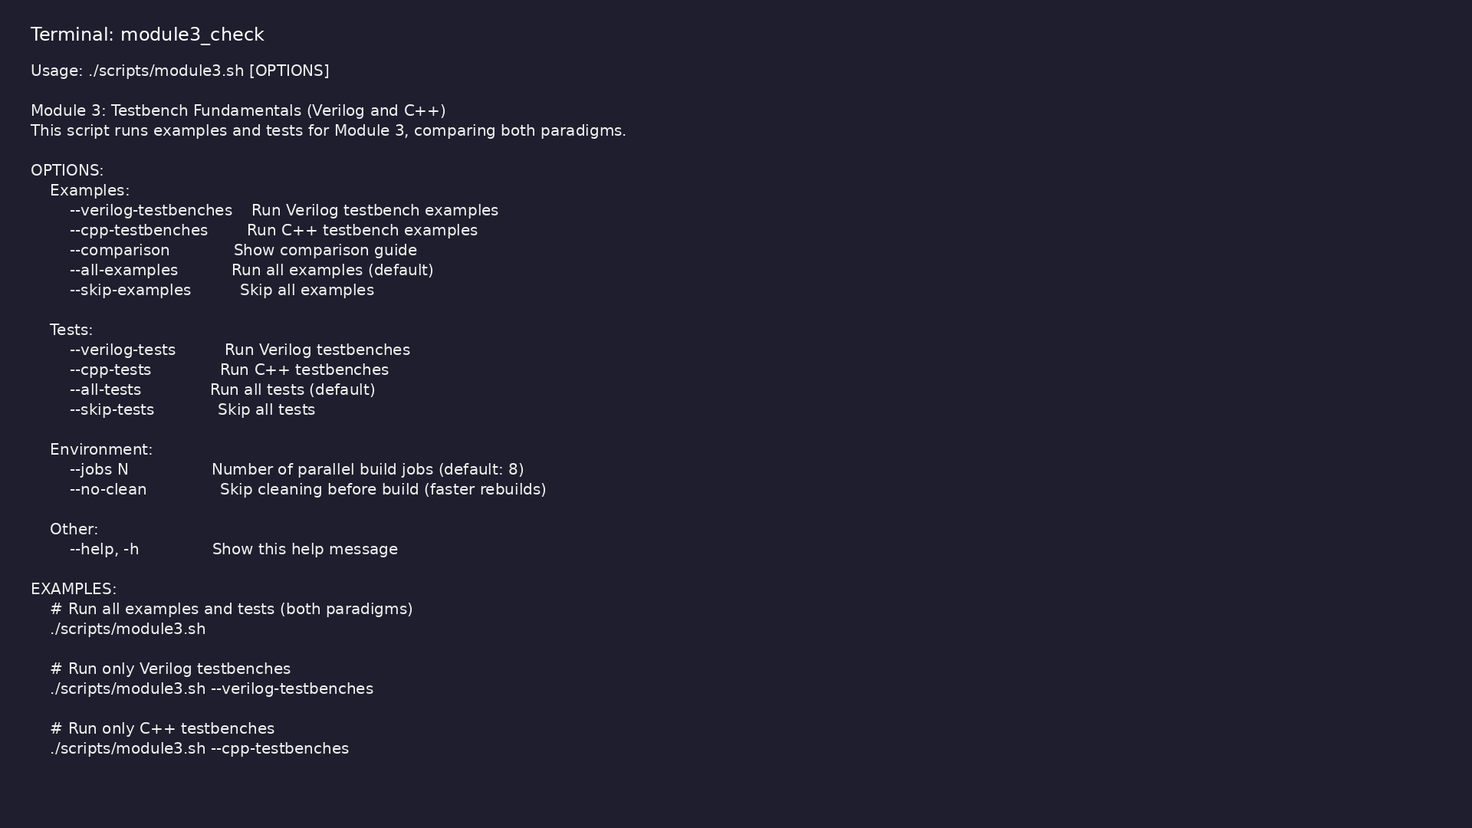
Module 3 self-check
$ ./scripts/module3.sh --help
learn_verilator_iverilog / Module 3
Notes:
Run from course repository root.

Slide 63
Exercise scaffold
./scripts/module3.sh --scaffold
learn_verilator_iverilog / Module 3

Slide 64
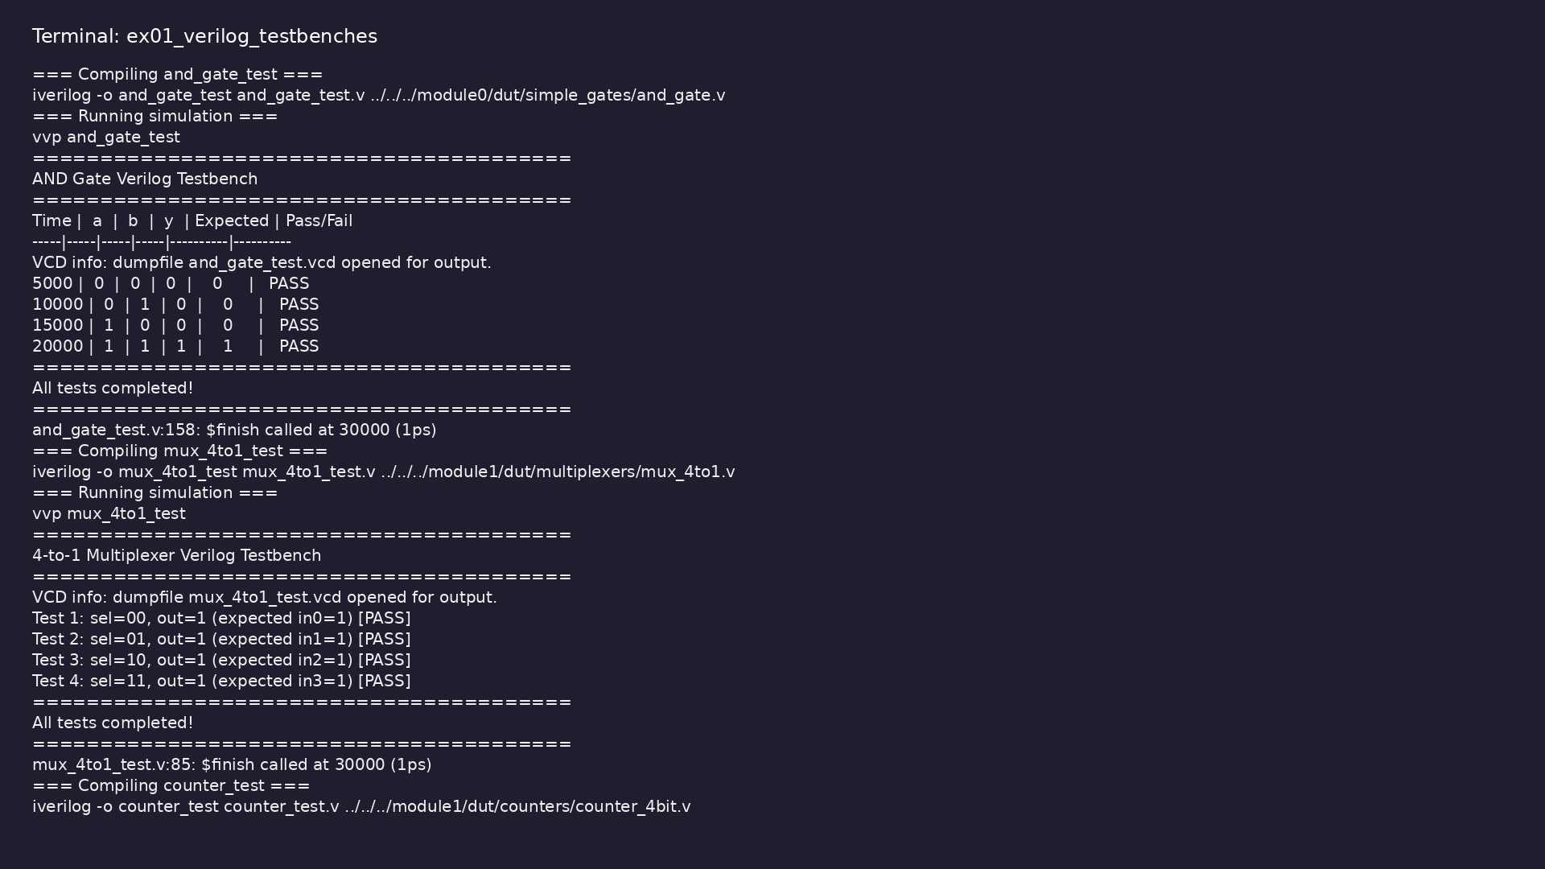
Demo: Verilog testbenches
$ cd module3/examples/verilog_testbenches && make all
learn_verilator_iverilog / Module 3
Notes:
Hands-on: module3/examples/verilog_testbenches/

Slide 65
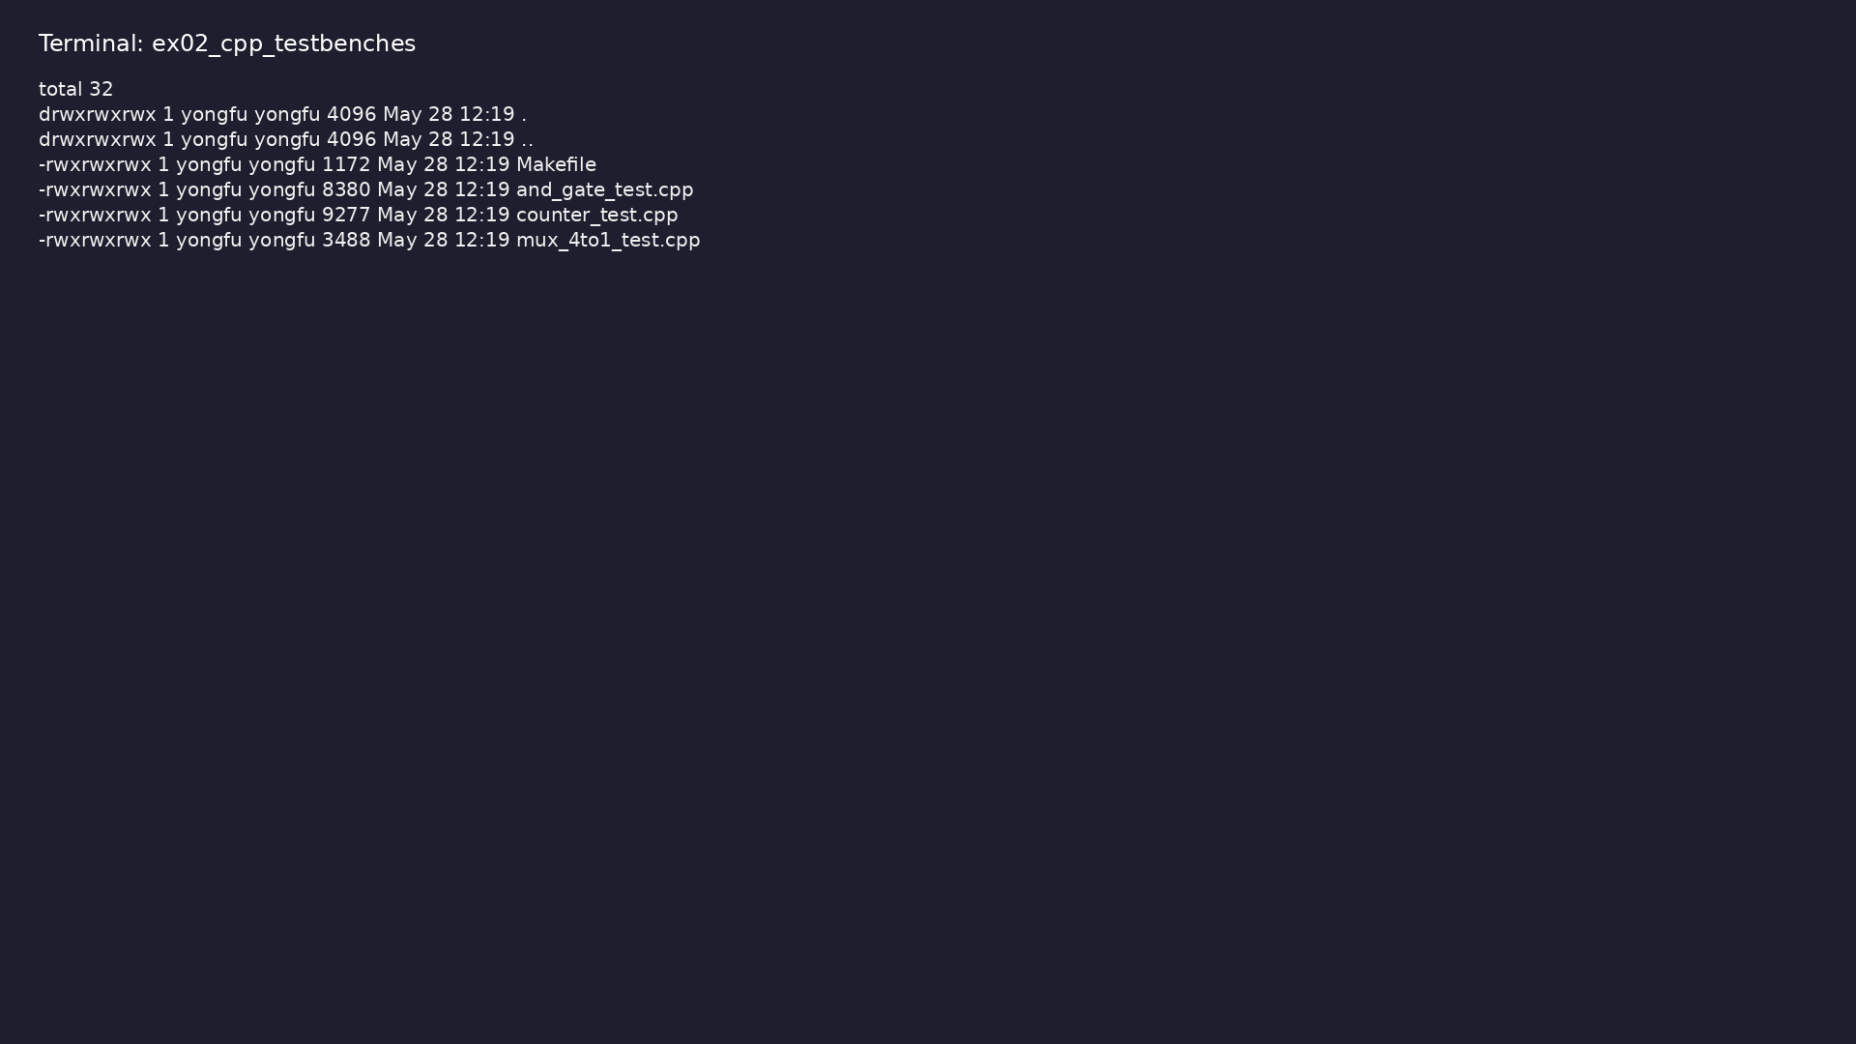
Demo: C++ testbenches
$ ls -la module3/examples/cpp_testbenches
learn_verilator_iverilog / Module 3
Notes:
Hands-on: module3/examples/cpp_testbenches/

Slide 66
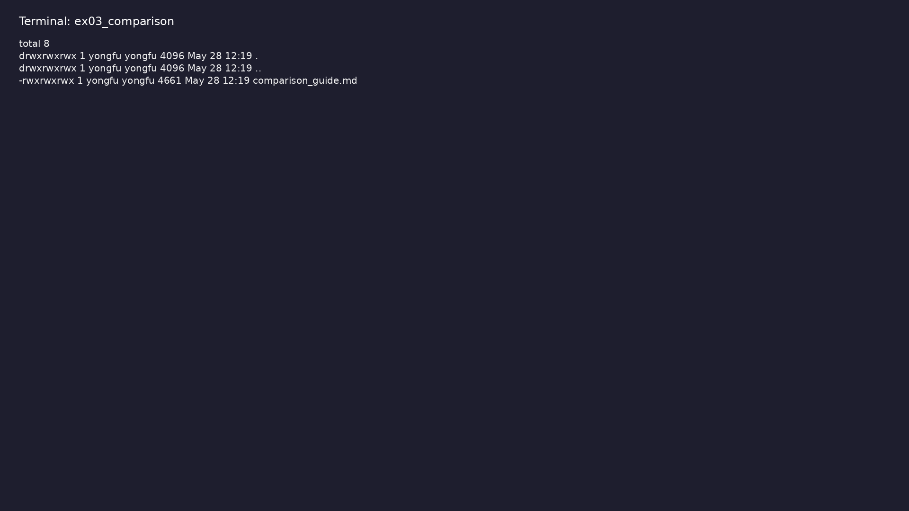
Demo: Paradigm comparison
$ ls -la module3/examples/comparison
learn_verilator_iverilog / Module 3
Notes:
Hands-on: module3/examples/comparison/

Slide 67
Key concepts
learn_verilator_iverilog / Module 3

Slide 68
1. Canonical testbench–DUT boundary
• DUT: Device Under Test in `module3/dut/` (gates,
multiplexers, counters)
• TB wrapper: Encapsulates instantiation, clock/reset,
and test program only
• Signals: Explicit wires/regs (Verilog) or model
ports (C++) — no hidden coupling
• Lifecycle: Build → reset → run tests → report →
`$finish` / `return` exit code
learn_verilator_iverilog / Module 3
Notes:
From MODULE3 Key Concepts.

Slide 69
2. Dual-paradigm environment architecture
• Verilog TB (`examples/verilog_testbenches/`): Event-
driven `initial`/`always`
• C++ TB (`examples/cpp_testbenches/`): `eval()` loop
with Verilator model
• Shared DUT: Same RTL verified two ways — highlights
tool-specific TB idioms
• Comparison guide: `examples/comparison/` documents
mapping between styles
learn_verilator_iverilog / Module 3
Notes:
From MODULE3 Key Concepts.

Slide 70
3. Verification component roles (UVM-aligned)
• Driver: Applies stimulus (assignments before `eval`
or `#delay`)
• Monitor: Samples outputs; logs transactions or pin
values
• Scoreboard: Compares actual vs expected; increments
pass/fail
• Clock/reset agents: Reusable blocks generating
periodic clock and reset sequences
learn_verilator_iverilog / Module 3
Notes:
From MODULE3 Key Concepts.

Slide 71
1. Structured test flow (build–connect–run)
• Build: Compile RTL + TB; elaborate hierarchy
• Connect: Port map DUT; tie off unused inputs
• Run: Execute directed cases (AND truth table,
counter wrap, MUX exhaust)
• Cleanup: Close files, print summary, non-zero exit
on failure
learn_verilator_iverilog / Module 3
Notes:
From MODULE3 Key Concepts.

Slide 72
2. Directed and exhaustive patterns
• Truth-table tests: All input combinations for small
combinational DUTs
• Sequential tests: Known count sequences after reset
deassert
• Assertions: `assert` (C++) or immediate checks
(Verilog) on each vector
learn_verilator_iverilog / Module 3
Notes:
From MODULE3 Key Concepts.

Slide 73
3. Cross-paradigm verification discipline
• Same spec, two TBs: Document expected behavior once;
implement in Verilog and C++
• Self-checking: Both paradigms count errors locally —
no manual waveform grading
• Orchestration: `./scripts/module3.sh --verilog-
testbenches` vs `--cpp-testbenches`
learn_verilator_iverilog / Module 3
Notes:
From MODULE3 Key Concepts.

Slide 74
1. Verification Fundamentals (1/5)
• What is verification?
• Ensuring design correctness
• Finding bugs before production
• Verification vs. validation
• Testbench Purpose and Role
• Stimulus generation
learn_verilator_iverilog / Module 3
Notes:
From MODULE3 Key Concepts.

Slide 75
1. Verification Fundamentals (2/5)
• Response monitoring
• Result checking
• Testbench as verification environment
• Design Under Test (DUT) Concept
• What is DUT?
• DUT instantiation
learn_verilator_iverilog / Module 3
Notes:
From MODULE3 Key Concepts.

Slide 76
1. Verification Fundamentals (3/5)
• DUT interface
• DUT testing
• Verification vs. Validation
• Verification: Does it work correctly?
• Validation: Does it meet requirements?
• Differences and overlap
learn_verilator_iverilog / Module 3
Notes:
From MODULE3 Key Concepts.

Slide 77
1. Verification Fundamentals (4/5)
• Verification Flow and Methodology
• Test plan creation
• Testbench development
• Test execution
• Result analysis
• Verilog Testbench vs. C++ Testbench Comparison
learn_verilator_iverilog / Module 3
Notes:
From MODULE3 Key Concepts.

Slide 78
1. Verification Fundamentals (5/5)
• Similarities
• Differences
• When to use each
• Performance considerations
learn_verilator_iverilog / Module 3
Notes:
From MODULE3 Key Concepts.

Slide 79
2. Testbench Architecture (1/6)
• Verilog Testbench Module Structure
• Module declaration
• Signal declarations
• DUT instantiation
• Test sequence
• Module-based organization
learn_verilator_iverilog / Module 3
Notes:
From MODULE3 Key Concepts.

Slide 80
2. Testbench Architecture (2/6)
• C++ Testbench Structure
• Main function
• Verilator initialization
• DUT instantiation
• Test sequence
• Class-based organization (optional)
learn_verilator_iverilog / Module 3
Notes:
From MODULE3 Key Concepts.

Slide 81
2. Testbench Architecture (3/6)
• DUT Instantiation (Both Paradigms)
• Verilog: Module instantiation
• C++: Object creation
• Signal connectivity
• Port mapping
• Signal Connectivity
learn_verilator_iverilog / Module 3
Notes:
From MODULE3 Key Concepts.

Slide 82
2. Testbench Architecture (4/6)
• Input signals
• Output signals
• Bidirectional signals
• Signal naming
• Testbench Hierarchy
• Top-level testbench
learn_verilator_iverilog / Module 3
Notes:
From MODULE3 Key Concepts.

Slide 83
2. Testbench Architecture (5/6)
• DUT hierarchy
• Testbench components
• Organization patterns
• Top-Level Testbench Organization
• Single testbench file
• Multiple file organization
learn_verilator_iverilog / Module 3
Notes:
From MODULE3 Key Concepts.

Slide 84
2. Testbench Architecture (6/6)
• Include files
• Library organization
• `module3/examples/verilog_testbenches/` - Verilog
testbench structure
• `module3/examples/cpp_testbenches/` - C++ testbench
structure
learn_verilator_iverilog / Module 3
Notes:
From MODULE3 Key Concepts.

Slide 85
3. Basic Testbench Components (1/6)
• Clock Generation (Verilog and C++)
• Verilog: Always blocks for continuous clock
• C++: Simulation loop for clock toggling
• Clock period control
• Multiple clocks
• Reset Generation (Verilog and C++)
learn_verilator_iverilog / Module 3
Notes:
From MODULE3 Key Concepts.

Slide 86
3. Basic Testbench Components (2/6)
• Verilog: Initial blocks for reset sequences
• C++: Reset in C++ code
• Synchronous reset
• Asynchronous reset
• Reset timing
• Stimulus Generation (Both Paradigms)
learn_verilator_iverilog / Module 3
Notes:
From MODULE3 Key Concepts.

Slide 87
3. Basic Testbench Components (3/6)
• Test vector generation
• Pattern application
• Sequential stimulus
• Timing control
• Response Monitoring (Both Paradigms)
• Output monitoring
learn_verilator_iverilog / Module 3
Notes:
From MODULE3 Key Concepts.

Slide 88
3. Basic Testbench Components (4/6)
• Real-time monitoring
• Post-processing
• Monitoring strategies
• Result Checking (Both Paradigms)
• Expected value calculation
• Output comparison
learn_verilator_iverilog / Module 3
Notes:
From MODULE3 Key Concepts.

Slide 89
3. Basic Testbench Components (5/6)
• Error detection
• Pass/fail reporting
• Simulation Control
• Starting simulation
• Stopping simulation
• Simulation termination
learn_verilator_iverilog / Module 3
Notes:
From MODULE3 Key Concepts.

Slide 90
3. Basic Testbench Components (6/6)
• Control flow
• `counter_test.v` / `counter_test.cpp` - Clock and
reset generation
learn_verilator_iverilog / Module 3
Notes:
From MODULE3 Key Concepts.

Slide 91
4. Signal Access and Monitoring (1/5)
• Verilog: Signal Reading and Writing
• Direct signal access
• Signal assignment
• Signal reading
• Signal types
• C++: Signal Access via Verilator API
learn_verilator_iverilog / Module 3
Notes:
From MODULE3 Key Concepts.

Slide 92
4. Signal Access and Monitoring (2/5)
• DUT object access
• Signal reading: `dut->signal`
• Signal writing: `dut->signal = value`
• Signal types
• Verilog: $display, $monitor, $strobe
• `$display`: Immediate output
learn_verilator_iverilog / Module 3
Notes:
From MODULE3 Key Concepts.

Slide 93
4. Signal Access and Monitoring (3/5)
• `$monitor`: Continuous monitoring
• `$strobe`: End-of-time-step output
• Formatting options
• C++: std::cout, Logging Libraries
• `std::cout` for output
• Formatting with iomanip
learn_verilator_iverilog / Module 3
Notes:
From MODULE3 Key Concepts.

Slide 94
4. Signal Access and Monitoring (4/5)
• Logging libraries
• File output
• Formatting Output (Both Paradigms)
• Verilog: Format specifiers
• C++: Stream manipulators
• Table formatting
learn_verilator_iverilog / Module 3
Notes:
From MODULE3 Key Concepts.

Slide 95
4. Signal Access and Monitoring (5/5)
• Readable output
• Timing of Display Statements
• When output occurs
• Event scheduling
• Timing considerations
• Debugging output
learn_verilator_iverilog / Module 3
Notes:
From MODULE3 Key Concepts.

Slide 96
5. Simulation Control (1/5)
• Verilog: Time Management (# delays)
• Delay control: `#10`
• Time advancement
• Event scheduling
• Timing accuracy
• C++: Time Management (Simulation Loop)
learn_verilator_iverilog / Module 3
Notes:
From MODULE3 Key Concepts.

Slide 97
5. Simulation Control (2/5)
• Simulation loop
• Time tracking
• Clock cycle counting
• Time advancement
• Event Scheduling Concepts
• Event-driven simulation
learn_verilator_iverilog / Module 3
Notes:
From MODULE3 Key Concepts.

Slide 98
5. Simulation Control (3/5)
• Event queue
• Scheduling order
• Timing relationships
• Simulation Termination
• Verilog: `$finish`
• C++: `return` statement
learn_verilator_iverilog / Module 3
Notes:
From MODULE3 Key Concepts.

Slide 99
5. Simulation Control (4/5)
• Cleanup procedures
• Resource management
• Debugging Basics (Both Tools)
• Compilation debugging
• Runtime debugging
• Signal inspection
learn_verilator_iverilog / Module 3
Notes:
From MODULE3 Key Concepts.

Slide 100
5. Simulation Control (5/5)
• Waveform analysis
• `counter_test.v` / `counter_test.cpp` - Time
management
learn_verilator_iverilog / Module 3
Notes:
From MODULE3 Key Concepts.

Slide 101
6. Simple Verification Patterns (1/5)
• Directed Testing (Both Paradigms)
• Specific test cases
• Known input/output pairs
• Exhaustive testing
• Corner case testing
• Test Vector Application
learn_verilator_iverilog / Module 3
Notes:
From MODULE3 Key Concepts.

Slide 102
6. Simple Verification Patterns (2/5)
• Test vector format
• Vector application
• Sequential application
• Batch testing
• Expected vs. Actual Comparison
• Expected value calculation
learn_verilator_iverilog / Module 3
Notes:
From MODULE3 Key Concepts.

Slide 103
6. Simple Verification Patterns (3/5)
• Actual value reading
• Comparison logic
• Error detection
• Pass/Fail Reporting
• Test result tracking
• Pass/fail determination
learn_verilator_iverilog / Module 3
Notes:
From MODULE3 Key Concepts.

Slide 104
6. Simple Verification Patterns (4/5)
• Result reporting
• Summary generation
• Basic Error Detection
• Error detection methods
• Error reporting
• Error handling
learn_verilator_iverilog / Module 3
Notes:
From MODULE3 Key Concepts.

Slide 105
6. Simple Verification Patterns (5/5)
• Debugging aids
learn_verilator_iverilog / Module 3
Notes:
From MODULE3 Key Concepts.

Slide 106
7. Paradigm Comparison
• See docs/MODULE3.md
learn_verilator_iverilog / Module 3
Notes:
From MODULE3 Key Concepts.

Slide 107
Practice & assessment
learn_verilator_iverilog / Module 3

Slide 108
What you should know (1/8)
• Understand testbench purpose and structure
• Create basic Verilog testbench modules
• Create basic C++ testbenches
• Generate clocks and resets in both paradigms
• Apply stimulus to DUT (both paradigms)
• Monitor DUT outputs (both paradigms)
learn_verilator_iverilog / Module 3
Notes:
From MODULE3 Learning Outcomes.

Slide 109
What you should know (2/8)
• Perform basic result checking
• Control simulation execution
• Choose appropriate testbench paradigm
• Use `and_gate_test.v` as reference
• Test all input combinations
• Verify correct operation
learn_verilator_iverilog / Module 3
Notes:
From MODULE3 Learning Outcomes.

Slide 110
What you should know (3/8)
• Use `and_gate_test.cpp` as reference
• Compare with Verilog version
• Understand differences
• Create Verilog testbench
• Create C++ testbench
• Compare approaches
learn_verilator_iverilog / Module 3
Notes:
From MODULE3 Learning Outcomes.

Slide 111
What you should know (4/8)
• Implement clock generation
• Implement reset sequences
• Compare timing approaches
• Review comparison guide
• Understand when to use each
• Identify key differences
learn_verilator_iverilog / Module 3
Notes:
From MODULE3 Learning Outcomes.

Slide 112
What you should know (5/8)
• Can explain testbench purpose and structure
• Can create basic Verilog testbench modules
• Can create basic C++ testbenches
• Can generate clocks and resets (both paradigms)
• Can apply stimulus to DUT (both paradigms)
• Can monitor DUT outputs (both paradigms)
learn_verilator_iverilog / Module 3
Notes:
From MODULE3 Learning Outcomes.

Slide 113
What you should know (6/8)
• Can perform basic result checking
• Can control simulation execution
• Can choose appropriate testbench paradigm
• Prerequisites: [Module 1: iverilog Deep
Dive](MODULE1.md) and [Module 2: Verilator Deep
Dive](MODUL…
• Next Steps: [Module 4: Basic Testbench
Construction](MODULE4.md) - Master structured
testbench cons…
• Advanced: [Module 6: SystemVerilog Testbench
Features](MODULE6.md) - Advanced testbench features
learn_verilator_iverilog / Module 3
Notes:
From MODULE3 Learning Outcomes.

Slide 114
What you should know (7/8)
• UVM Connection: [UVM Core
Repository](https://github.com/universal-
verification-methodology/core)
• Module 4: Basic Testbench Construction - Master
structured testbench construction
• Module 5: Procedural Testbench Writing - Learn
procedural testbench patterns
• Icarus Verilog Documentation:
http://iverilog.wikia.com/
• Verilator Documentation: https://verilator.org/
• GTKWave Documentation:
http://gtkwave.sourceforge.net/
learn_verilator_iverilog / Module 3
Notes:
From MODULE3 Learning Outcomes.

Slide 115
What you should know (8/8)
• IEEE 1364-2005 Standard: Verilog Hardware
Description Language
learn_verilator_iverilog / Module 3
Notes:
From MODULE3 Learning Outcomes.

Slide 116
Assessment checklist
• Can explain testbench purpose and structure
• Can create basic Verilog testbench modules
• Can create basic C++ testbenches
• Can generate clocks and resets (both paradigms)
• Can apply stimulus to DUT (both paradigms)
• Can monitor DUT outputs (both paradigms)
learn_verilator_iverilog / Module 3

Slide 117
Summary & next steps
• Understand testbench architecture and basic
verification concepts for both Verilog and C++
testbenc…
• Complete module3/CHECKLIST.md
• Review module3/EXAMPLES.md and run each lab
• Next: Next module in course
learn_verilator_iverilog / Module 3

