Slide 1
Module 4
Basic Testbench Construction
learn_verilator_iverilog / Module 4

Slide 2
Learning objectives
• Master construction of structured testbenches with
proper organization
learn_verilator_iverilog / Module 4

Slide 3
Prerequisites
• See module README
learn_verilator_iverilog / Module 4

Slide 4

Learning path
Master construction of structured testbenches with proper organization
learn_verilator_iverilog / Module 4

Slide 5
Overview
• This module focuses on building well-structured
testbenches for both Verilog and C++ paradigms. You…
learn_verilator_iverilog / Module 4

Slide 6
Design architecture
learn_verilator_iverilog / Module 4

Slide 7

1. Structured DUT portfolio (Module 4)
• `dut/alus/simple_alu.v`:
Combinational ALU — op select,
result, zero flag
• `dut/fifos/simple_fifo.v`: Queue
storage with full/empty and
pointer logic
• `dut/registers/register_file.v`:
Multi-port register file —
read/write ports, clocked
updates
• Complexity step: Moves from
gates/counters to datapath
blocks needing organized TBs
learn_verilator_iverilog / Module 4
Notes:
From MODULE4 Design Architecture.

Slide 8
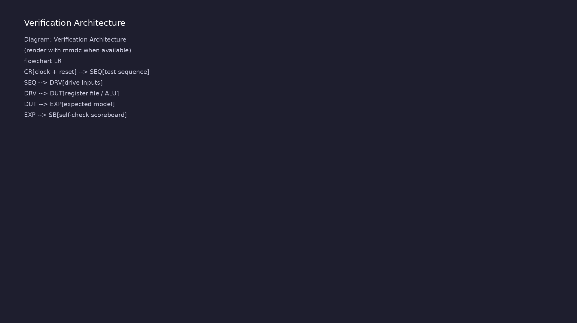
2. Modular testbench architecture
• Separation: Stimulus generator,
monitor, checker/scoreboard as
distinct modules or classes
• Clock/reset generator: Dedicated
block (`clock_reset` examples) —
configurable period
• Hierarchy: Top TB instantiates
agents + DUT; connects via named
interfaces (wires)
• C++ mirror: Same roles as C++
classes with methods `drive()`,
`sample()`, `check()`
learn_verilator_iverilog / Module 4
Notes:
From MODULE4 Design Architecture.

Slide 9
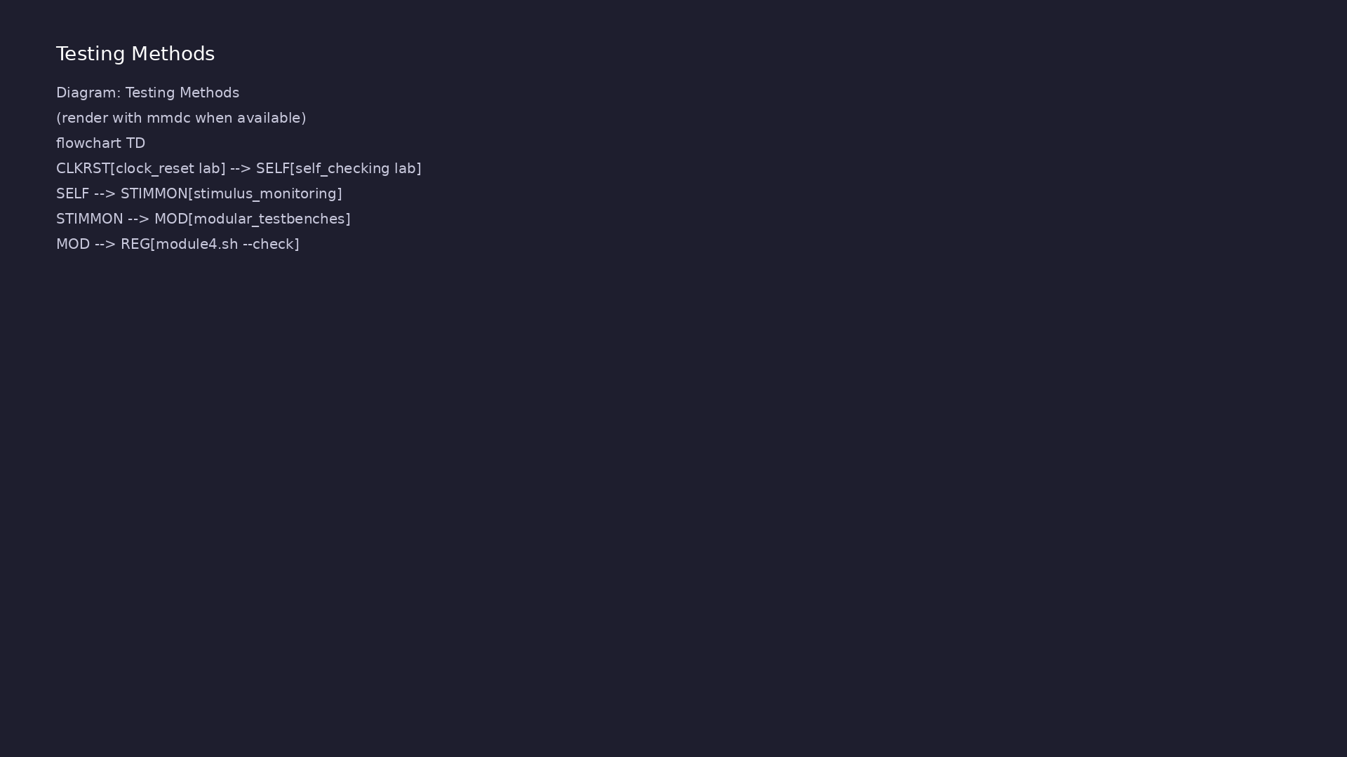
3. Reference model placement
• Golden model: Software replica
of ALU/FIFO/register behavior in
TB
• Self-checking path: DUT output
compared to reference each cycle
or transaction
• Config: Parameters for width,
depth, and clock period without
editing DUT RTL
learn_verilator_iverilog / Module 4
Notes:
From MODULE4 Design Architecture.

Slide 10
RTL block diagram (reference)
Module 4: DUT hierarchy and signal flow.
learn_verilator_iverilog / Module 4

Slide 11
Verification / testbench diagram (reference)
Module 4: stimulus, observation, and checking.
learn_verilator_iverilog / Module 4

Slide 12
Clock/reset Makefile target
configurable_clock_reset_verilog: configurable_clock_reset_verilog.v
@echo "=== Compiling Verilog clock/reset example ==="
$(IVERILOG) -o configurable_clock_reset
configurable_clock_reset_verilog.v
@echo "=== Running simulation ==="
$(VVP) configurable_clock_reset
learn_verilator_iverilog / Module 4
Notes:
Parameterize period; compile and vvp in one make target.

Slide 13
Configurable clock generation
parameter CLK_PERIOD_1 = 20; // 20ns period = 50MHz
parameter CLK_PERIOD_2 = 40; // 40ns period = 25MHz
parameter RST_DURATION = 100; // Reset duration in ns (5 clock
cycles at 50MHz)
// ========================================
// Signal Declarations
// ========================================
/**
* Clock Signals
*
* Two independent clock signals for multi-clock domain testing.
* Each clock has its own period and runs independently.
*/
reg clk1; // Clock 1 (50MHz by default)
reg clk2; // Clock 2 (25MHz by default)
# ...
learn_verilator_iverilog / Module 4
Notes:
forever #(PERIOD/2) clk=~clk; coordinated reset release.

Slide 14
Self-checking ALU ports
module alu_self_checking_verilog;
// ========================================
// Signal Declarations
// ========================================
/**
* DUT Input Signals
*
* These signals drive the ALU inputs.
*/
reg [7:0] a, b; // Operands A and B (8 bits each)
reg [1:0] op; // Operation code (00=ADD, 01=SUB, 10=AND, 11=OR)
/**
* DUT Output Signals
*
# ...
learn_verilator_iverilog / Module 4
Notes:
simple_alu instantiated; wires for a, b, op, result, zero.

Slide 15
Execution & simulation flow
learn_verilator_iverilog / Module 4

Slide 16
How the example runs (toolchain)
• Makefile: Verilator compiles RTL + SystemVerilog
testbench into a C++ model
• sim_main.cpp: generates clk/rst_n, calls eval()
until $finish
• Directed test (initial block or C++): drive
stimulus, wait for DUT flags
• Self-check: compare outputs; print PASS/FAIL (see
terminal demo slide)
• Repo path: module4/examples/<example>/ — run make
run from that directory
learn_verilator_iverilog / Module 4
Notes:
From MODULE4 — execution and artifact layout.

Slide 17
Directed test execution sequence (1)
• Reference model in TB
• compare each cycle
• aggregate pass/fail before $finish
• Build clk/rst generators
• connect DUT
learn_verilator_iverilog / Module 4
Notes:
Follow this order when tracing waveforms or debugging.

Slide 18
Directed test execution sequence (2)
• drive ALU/FIFO vectors
• reference model compare
• wire agents at top
learn_verilator_iverilog / Module 4
Notes:
Follow this order when tracing waveforms or debugging.

Slide 19
Self-checking example build
# Makefile for self-checking testbench examples
IVERILOG = iverilog
VVP = vvp
VERILATOR = verilator
DUT_DIR = ../../../module4/dut
all: alu_self_checking_verilog alu_self_checking_cpp
alu_self_checking_verilog: alu_self_checking_verilog.v
@echo "=== Compiling Verilog self-checking testbench ==="
$(IVERILOG) -o alu_self_checking alu_self_checking_verilog.v
$(DUT_DIR)/alus/simple_alu.v
@echo "=== Running simulation ==="
$(VVP) alu_self_checking
alu_self_checking_cpp: alu_self_checking_cpp.cpp
# ...
learn_verilator_iverilog / Module 4
Notes:
cd module4/examples/self_checking && make

Slide 20
Reference model function
/**
* Design Under Test (DUT)
*
* Instantiate the ALU module being verified.
* All signals are connected by name for clarity.
*/
simple_alu dut (
.a(a),
.b(b),
.op(op),
.result(result),
.zero(zero)
);
// ========================================
// Reference Model
# ...
learn_verilator_iverilog / Module 4
Notes:
calculate_expected(op,a,b) — golden model in TB.

Slide 21
Verification & testing methods
learn_verilator_iverilog / Module 4

Slide 22
1. Component-level verification
• Stimulus module: Encapsulates
write sequences to FIFO or
register ports
• Monitor module: Captures read
data and status flags passively
• Checker: Flags protocol
violations (overflow, X on
outputs, wrong opcode result)
learn_verilator_iverilog / Module 4
Notes:
From MODULE4 Verification & Testing Methods.

Slide 23
2. Scenario-based testing
• Scenarios: Reset + fill FIFO;
ALU op sweep; register R/W
hazard patterns
• Tasks/methods: Each scenario is
a callable task — reusable
across tests
• Aggregation: Single report
summarizing scenarios run and
failures
learn_verilator_iverilog / Module 4
Notes:
From MODULE4 Verification & Testing Methods.

Slide 24
3. Structured debug and closure
• Modular debug: Isolate failing
agent by disabling others in top
TB
• Waveform on demand: Trigger
dumps only when checker fires
• Regression:
`./scripts/module4.sh --self-
checking` and `--all-tests` for
batch sign-off
learn_verilator_iverilog / Module 4
Notes:
From MODULE4 Verification & Testing Methods.

Slide 25
Modular TB — checker module
/**
* Modular Register File Verilog Testbench
*
* This testbench demonstrates the UVM-inspired separation of concerns
pattern,
* where testbench functionality is divided into distinct, reusable
components:
* - Stimulus Generator: Drives inputs to the DUT
* - Monitor: Observes and logs DUT behavior
* - Checker: Validates DUT outputs against expected values
*
* Learning Objectives:
* - Understand modular testbench architecture
* - Learn separation of concerns in verification
* - Master Verilog module-based testbench organization
* - Understand stimulus generation patterns
* - Learn monitoring and checking strategies
*
learn_verilator_iverilog / Module 4
Notes:
Separate stimulus, monitor, and checker blocks wired at top.

Slide 26
Syllabus topics
learn_verilator_iverilog / Module 4

Slide 27
1. Testbench Organization (1/7)
• Modular Testbench Structure (Verilog and C++)
• Separating concerns
• Component-based design
• Reusability principles
• Maintainability
• Separate Stimulus, Monitor, and Checker Components
learn_verilator_iverilog / Module 4
Notes:
From MODULE4 Topics Covered.

Slide 28
1. Testbench Organization (2/7)
• Stimulus generation module/class
• Response monitoring module/class
• Result checking module/class
• Component interaction
• Verilog: Module-Based Organization
• Module hierarchy
learn_verilator_iverilog / Module 4
Notes:
From MODULE4 Topics Covered.

Slide 29
1. Testbench Organization (3/7)
• Module instantiation
• Signal connectivity
• Module reusability
• C++: Class-Based Organization
• Class hierarchy
• Class instantiation
learn_verilator_iverilog / Module 4
Notes:
From MODULE4 Topics Covered.

Slide 30
1. Testbench Organization (4/7)
• Method organization
• Class reusability
• Testbench Component Organization
• Component placement
• Signal routing
• Hierarchy design
learn_verilator_iverilog / Module 4
Notes:
From MODULE4 Topics Covered.

Slide 31
1. Testbench Organization (5/7)
• Organization patterns
• Reusable Testbench Components
• Component design
• Parameterization
• Configuration
• Reuse strategies
learn_verilator_iverilog / Module 4
Notes:
From MODULE4 Topics Covered.

Slide 32
1. Testbench Organization (6/7)
• Configuration and Parameters
• Parameter passing
• Configuration management
• Runtime configuration
• Build-time configuration
• `register_file_test_verilog.v`: Structured Verilog
testbench with separate modules
learn_verilator_iverilog / Module 4
Notes:
From MODULE4 Topics Covered.

Slide 33
1. Testbench Organization (7/7)
• `register_file_test_cpp.cpp`: Structured C++
testbench with separate classes
learn_verilator_iverilog / Module 4
Notes:
From MODULE4 Topics Covered.

Slide 34
2. Clock and Reset Generation (1/8)
• Verilog: Clock Generation Patterns (Always Blocks)
• Continuous clock generation
• Configurable periods
• Multiple clocks
• Clock gating
• C++: Clock Generation Patterns (Simulation Loop)
learn_verilator_iverilog / Module 4
Notes:
From MODULE4 Topics Covered.

Slide 35
2. Clock and Reset Generation (2/8)
• Clock toggling in loop
• Configurable periods
• Multiple clocks
• Clock coordination
• Configurable Clock Periods (Both Paradigms)
• Parameter-based configuration
learn_verilator_iverilog / Module 4
Notes:
From MODULE4 Topics Covered.

Slide 36
2. Clock and Reset Generation (3/8)
• Runtime configuration
• Clock period calculation
• Frequency control
• Multiple Clock Domains
• Independent clocks
• Clock relationships
learn_verilator_iverilog / Module 4
Notes:
From MODULE4 Topics Covered.

Slide 37
2. Clock and Reset Generation (4/8)
• Domain crossing
• Synchronization
• Reset Generation (Synchronous, Asynchronous)
• Synchronous reset
• Asynchronous reset
• Reset timing
learn_verilator_iverilog / Module 4
Notes:
From MODULE4 Topics Covered.

Slide 38
2. Clock and Reset Generation (5/8)
• Reset sequences
• Verilog: Reset in Initial Blocks
• Initial block reset
• Reset timing control
• Reset sequences
• Reset coordination
learn_verilator_iverilog / Module 4
Notes:
From MODULE4 Topics Covered.

Slide 39
2. Clock and Reset Generation (6/8)
• C++: Reset in C++ Code
• Reset in simulation loop
• Reset timing control
• Reset sequences
• Reset coordination
• Reset Sequences and Timing
learn_verilator_iverilog / Module 4
Notes:
From MODULE4 Topics Covered.

Slide 40
2. Clock and Reset Generation (7/8)
• Reset assertion
• Reset deassertion
• Reset duration
• Reset timing
• Clock and Reset Coordination
• Clock/reset relationship
learn_verilator_iverilog / Module 4
Notes:
From MODULE4 Topics Covered.

Slide 41
2. Clock and Reset Generation (8/8)
• Reset synchronization
• Timing coordination
• Best practices
• `configurable_clock_reset_verilog.v`: Configurable
clock and reset in Verilog
• `configurable_clock_reset_cpp.cpp`: Configurable
clock and reset in C++
learn_verilator_iverilog / Module 4
Notes:
From MODULE4 Topics Covered.

Slide 42
3. Stimulus Generation (1/5)
• Test Vector Generation
• Vector format
• Vector generation
• Vector storage
• Vector application
• Pattern Generation
learn_verilator_iverilog / Module 4
Notes:
From MODULE4 Topics Covered.

Slide 43
3. Stimulus Generation (2/5)
• Pattern types
• Pattern generation
• Pattern application
• Pattern verification
• Sequential Stimulus Application
• Sequential application
learn_verilator_iverilog / Module 4
Notes:
From MODULE4 Topics Covered.

Slide 44
3. Stimulus Generation (3/5)
• Timing control
• Application order
• Synchronization
• Stimulus Timing Control
• Timing accuracy
• Timing relationships
learn_verilator_iverilog / Module 4
Notes:
From MODULE4 Topics Covered.

Slide 45
3. Stimulus Generation (4/5)
• Timing control
• Timing verification
• Stimulus Verification
• Stimulus validation
• Stimulus checking
• Error detection
learn_verilator_iverilog / Module 4
Notes:
From MODULE4 Topics Covered.

Slide 46
3. Stimulus Generation (5/5)
• Verification strategies
learn_verilator_iverilog / Module 4
Notes:
From MODULE4 Topics Covered.

Slide 47
4. Response Monitoring (1/5)
• Output Monitoring Strategies
• Real-time monitoring
• Post-processing monitoring
• Event-driven monitoring
• Continuous monitoring
• Real-Time Monitoring
learn_verilator_iverilog / Module 4
Notes:
From MODULE4 Topics Covered.

Slide 48
4. Response Monitoring (2/5)
• Immediate monitoring
• Live updates
• Real-time analysis
• Performance considerations
• Post-Processing Monitoring
• Delayed analysis
learn_verilator_iverilog / Module 4
Notes:
From MODULE4 Topics Covered.

Slide 49
4. Response Monitoring (3/5)
• Batch processing
• Data collection
• Analysis strategies
• Monitoring Timing
• When to monitor
• Timing accuracy
learn_verilator_iverilog / Module 4
Notes:
From MODULE4 Topics Covered.

Slide 50
4. Response Monitoring (4/5)
• Timing relationships
• Timing control
• Event-Driven Monitoring
• Event triggers
• Event-based monitoring
• Event handling
learn_verilator_iverilog / Module 4
Notes:
From MODULE4 Topics Covered.

Slide 51
4. Response Monitoring (5/5)
• Event coordination
learn_verilator_iverilog / Module 4
Notes:
From MODULE4 Topics Covered.

Slide 52
5. Result Checking (1/5)
• Expected Value Calculation
• Expected value computation
• Reference models
• Calculation methods
• Accuracy
• Output Comparison
learn_verilator_iverilog / Module 4
Notes:
From MODULE4 Topics Covered.

Slide 53
5. Result Checking (2/5)
• Value comparison
• Comparison methods
• Comparison timing
• Comparison accuracy
• Error Detection and Reporting
• Error detection
learn_verilator_iverilog / Module 4
Notes:
From MODULE4 Topics Covered.

Slide 54
5. Result Checking (3/5)
• Error reporting
• Error handling
• Error analysis
• Assertion-Based Checking
• Assertion types
• Assertion implementation
learn_verilator_iverilog / Module 4
Notes:
From MODULE4 Topics Covered.

Slide 55
5. Result Checking (4/5)
• Assertion organization
• Assertion best practices
• Self-Checking Testbenches
• Automatic checking
• Self-verification
• Result aggregation
learn_verilator_iverilog / Module 4
Notes:
From MODULE4 Topics Covered.

Slide 56
5. Result Checking (5/5)
• Pass/fail determination
• `alu_self_checking_verilog.v`: Self-checking ALU
testbench in Verilog
• `alu_self_checking_cpp.cpp`: Self-checking ALU
testbench in C++
learn_verilator_iverilog / Module 4
Notes:
From MODULE4 Topics Covered.

Slide 57
6. Test Scenarios (1/7)
• Test Case Organization
• Test case structure
• Test case organization
• Test case management
• Test case documentation
• Multiple Test Scenarios
learn_verilator_iverilog / Module 4
Notes:
From MODULE4 Topics Covered.

Slide 58
6. Test Scenarios (2/7)
• Scenario definition
• Scenario organization
• Scenario selection
• Scenario execution
• Test Sequencing
• Test order
learn_verilator_iverilog / Module 4
Notes:
From MODULE4 Topics Covered.

Slide 59
6. Test Scenarios (3/7)
• Test dependencies
• Test sequencing
• Test coordination
• Test Selection Mechanisms
• Test selection
• Test filtering
learn_verilator_iverilog / Module 4
Notes:
From MODULE4 Topics Covered.

Slide 60
6. Test Scenarios (4/7)
• Test prioritization
• Test management
• Test Result Aggregation
• Result collection
• Result aggregation
• Result analysis
learn_verilator_iverilog / Module 4
Notes:
From MODULE4 Topics Covered.

Slide 61
6. Test Scenarios (5/7)
• Result reporting
• Location: `module4/examples/modular_testbenches/regi
ster_file_test_verilog.v`
• Demonstrates: Modular structure, separate
stimulus/monitor/checker modules
• Location: `module4/examples/modular_testbenches/regi
ster_file_test_cpp.cpp`
• Demonstrates: Class-based organization, separate
stimulus/monitor/checker classes
• Location: (Coming soon)
learn_verilator_iverilog / Module 4
Notes:
From MODULE4 Topics Covered.

Slide 62
6. Test Scenarios (6/7)
• Demonstrates: Multiple test scenarios, test
sequencing
• Location: (Coming soon)
• Demonstrates: Multiple test scenarios, test
sequencing
• Location: `module4/examples/self_checking/`
• Demonstrates: Self-checking testbenches,
comprehensive testing
• Location: (Coming soon)
learn_verilator_iverilog / Module 4
Notes:
From MODULE4 Topics Covered.

Slide 63
6. Test Scenarios (7/7)
• Demonstrates: State machine testing, state coverage
• Location: `module4/examples/clock_reset/`
• Demonstrates: Configurable clock/reset,
parameterization
learn_verilator_iverilog / Module 4
Notes:
From MODULE4 Topics Covered.

Slide 64
Hands-on examples
learn_verilator_iverilog / Module 4

Slide 65
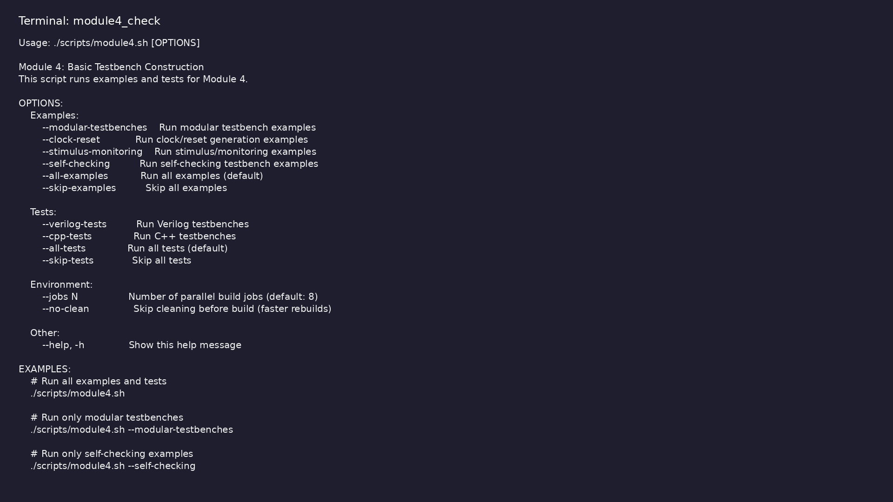
Module 4 self-check
$ ./scripts/module4.sh --help
learn_verilator_iverilog / Module 4
Notes:
Run from course repository root.

Slide 66
Exercise scaffold
./scripts/module4.sh --scaffold
learn_verilator_iverilog / Module 4

Slide 67
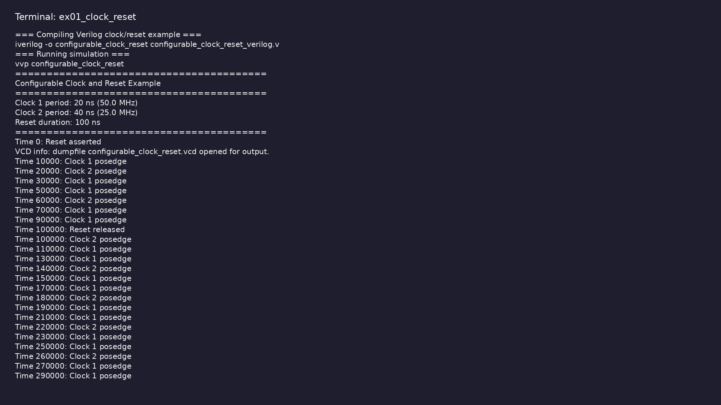
Demo: Clock and reset
$ cd module4/examples/clock_reset && make all
learn_verilator_iverilog / Module 4
Notes:
Hands-on: module4/examples/clock_reset/

Slide 68
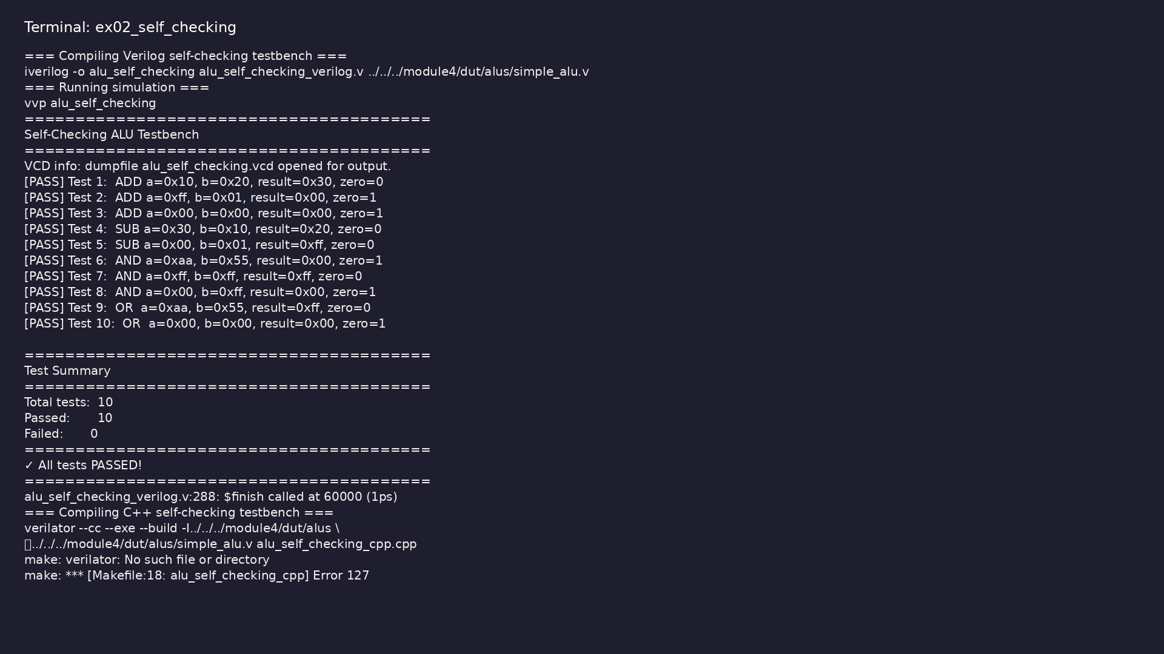
Demo: Self-checking
$ cd module4/examples/self_checking && make all
learn_verilator_iverilog / Module 4
Notes:
Hands-on: module4/examples/self_checking/

Slide 69

Demo: Stimulus and monitoring
$ cd module4/examples/stimulus_monitoring && make all
learn_verilator_iverilog / Module 4
Notes:
Hands-on: module4/examples/stimulus_monitoring/

Slide 70
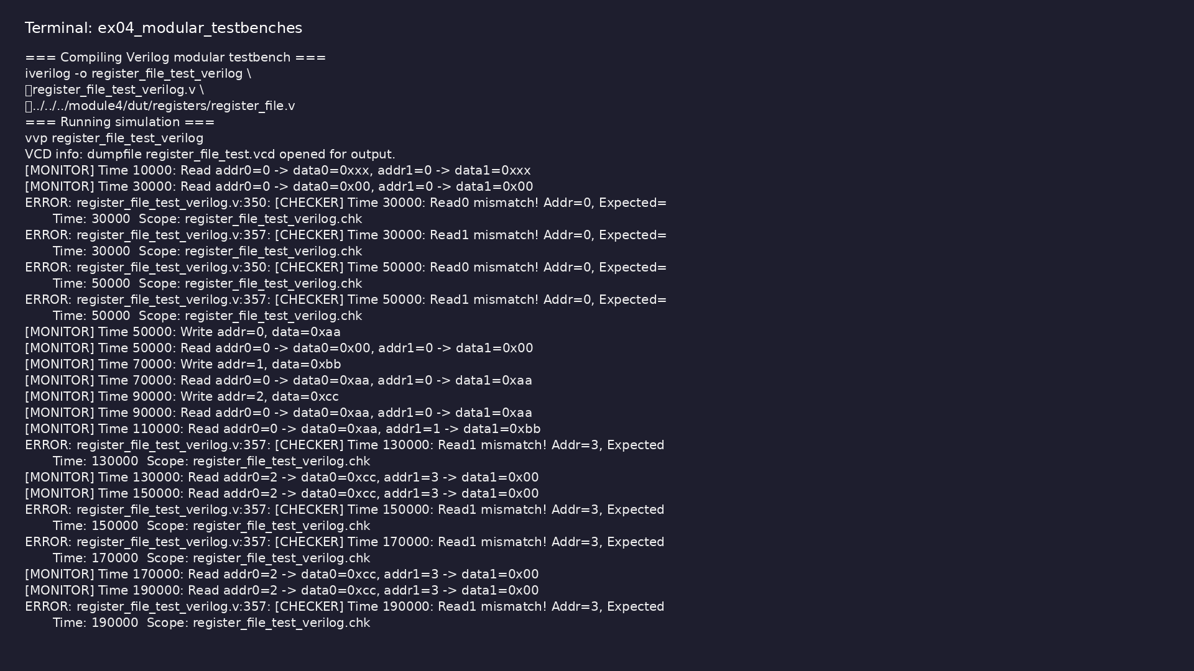
Demo: Modular testbenches
$ cd module4/examples/modular_testbenches && make all
learn_verilator_iverilog / Module 4
Notes:
Hands-on: module4/examples/modular_testbenches/

Slide 71
Common pitfalls
learn_verilator_iverilog / Module 4

Slide 72
Mixing Concerns
• Don't combine stimulus and checking in the same
module/class
• Don't drive signals from monitor or checker
components
learn_verilator_iverilog / Module 4
Notes:
From MODULE4 Common Pitfalls.

Slide 73
Hardcoded Values
• Use parameters/constants for timing and
configuration
• Avoid magic numbers in code
learn_verilator_iverilog / Module 4
Notes:
From MODULE4 Common Pitfalls.

Slide 74
Insufficient Checking
• Don't rely on manual inspection of waveforms
• Always implement automatic checking
learn_verilator_iverilog / Module 4
Notes:
From MODULE4 Common Pitfalls.

Slide 75
Poor Error Messages
• Include enough context to debug failures
• Use consistent error message format
learn_verilator_iverilog / Module 4
Notes:
From MODULE4 Common Pitfalls.

Slide 76
Inadequate Documentation
• Document component purpose and interfaces
• Explain complex logic and timing relationships
learn_verilator_iverilog / Module 4
Notes:
From MODULE4 Common Pitfalls.

Slide 77
Practice & assessment
learn_verilator_iverilog / Module 4

Slide 78
What you should know (1/11)
• Organize testbenches modularly (both paradigms)
• Generate clocks and resets properly (Verilog and
C++)
• Create structured stimulus (both paradigms)
• Implement monitoring strategies (both paradigms)
• Build self-checking testbenches (both paradigms)
• Organize multiple test scenarios
learn_verilator_iverilog / Module 4
Notes:
From MODULE4 Learning Outcomes.

Slide 79
What you should know (2/11)
• Choose appropriate organization style
• Separate stimulus, monitor, and checker modules
• Organize components properly
• Verify functionality
• Use class-based organization
• Separate stimulus, monitor, and checker classes
learn_verilator_iverilog / Module 4
Notes:
From MODULE4 Learning Outcomes.

Slide 80
What you should know (3/11)
• Compare with Verilog approach
• Make clock period configurable
• Implement reset sequences
• Test different configurations
• Organize test cases
• Implement test sequencing
learn_verilator_iverilog / Module 4
Notes:
From MODULE4 Learning Outcomes.

Slide 81
What you should know (4/11)
• Aggregate results
• Calculate expected values
• Compare automatically
• Report results
• Design reusable modules/classes
• Parameterize components
learn_verilator_iverilog / Module 4
Notes:
From MODULE4 Learning Outcomes.

Slide 82
What you should know (5/11)
• Test reusability
• Can organize testbenches modularly (both paradigms)
• Can generate configurable clocks and resets (Verilog
and C++)
• Can create structured stimulus (both paradigms)
• Can implement monitoring strategies (both paradigms)
• Can build self-checking testbenches (both paradigms)
learn_verilator_iverilog / Module 4
Notes:
From MODULE4 Learning Outcomes.

Slide 83
What you should know (6/11)
• Can organize multiple test scenarios
• Can choose appropriate organization style
• Module 5: Procedural Testbench Writing - Master
procedural testbench construction
• Module 6: SystemVerilog Testbench Features - Learn
SystemVerilog enhancements
• Keep stimulus, monitoring, and checking separate
• Each component should have a single, well-defined
responsibility
learn_verilator_iverilog / Module 4
Notes:
From MODULE4 Learning Outcomes.

Slide 84
What you should know (7/11)
• This makes testbenches easier to understand,
maintain, and debug
• Design components to be reusable across multiple
testbenches
• Use parameters/configuration for flexibility
• Create library components for common functionality
(clocks, resets, etc.)
• Always implement automatic result checking
• Use reference models to calculate expected values
learn_verilator_iverilog / Module 4
Notes:
From MODULE4 Learning Outcomes.

Slide 85
What you should know (8/11)
• Report pass/fail status clearly
• Comment code thoroughly, especially complex logic
• Document component interfaces and responsibilities
• Include usage examples in comments
• Provide clear, informative error messages
• Include context (time, signal values, expected vs
actual)
learn_verilator_iverilog / Module 4
Notes:
From MODULE4 Learning Outcomes.

Slide 86
What you should know (9/11)
• Aggregate errors for summary reporting
• Don't combine stimulus and checking in the same
module/class
• Don't drive signals from monitor or checker
components
• Use parameters/constants for timing and
configuration
• Avoid magic numbers in code
• Don't rely on manual inspection of waveforms
learn_verilator_iverilog / Module 4
Notes:
From MODULE4 Learning Outcomes.

Slide 87
What you should know (10/11)
• Always implement automatic checking
• Include enough context to debug failures
• Use consistent error message format
• Document component purpose and interfaces
• Explain complex logic and timing relationships
• Icarus Verilog Documentation:
http://iverilog.wikia.com/
learn_verilator_iverilog / Module 4
Notes:
From MODULE4 Learning Outcomes.

Slide 88
What you should know (11/11)
• Verilator Documentation: https://verilator.org/
• GTKWave Documentation:
http://gtkwave.sourceforge.net/
• UVM Core Repository: https://github.com/universal-
verification-methodology/core
• UVM User's Guide: IEEE 1800.2-2020 Standard
• Verification Methodology: Best practices from
industry verification teams
learn_verilator_iverilog / Module 4
Notes:
From MODULE4 Learning Outcomes.

Slide 89
Assessment checklist
• Can organize testbenches modularly (both paradigms)
• Can generate configurable clocks and resets (Verilog
and C++)
• Can create structured stimulus (both paradigms)
• Can implement monitoring strategies (both paradigms)
• Can build self-checking testbenches (both paradigms)
• Can organize multiple test scenarios
learn_verilator_iverilog / Module 4

Slide 90
Summary & next steps
• Master construction of structured testbenches with
proper organization
• Complete module4/CHECKLIST.md
• Review module4/EXAMPLES.md and run each lab
• Next: Next module in course
learn_verilator_iverilog / Module 4

