Slide 1
Module 5
Procedural Testbench Writing
learn_verilator_iverilog / Module 5

Slide 2
Learning objectives
• Procedural Constructs: Master `initial` and `always`
blocks in Verilog, and control flow in C++
• Timing Control: Understand delay control, event
control, and wait statements
• Reusable Routines: Create tasks/functions in Verilog
and functions/classes in C++ for code organiza…
• File I/O: Read test vectors from files and write
results for automated testing
• Test Sequences: Build complex, multi-step test
sequences
• Advanced Patterns: Implement state machines,
protocols, and transaction-based testbenches
learn_verilator_iverilog / Module 5

Slide 3
Prerequisites
• See module README
learn_verilator_iverilog / Module 5

Slide 4

Learning path
Master procedural testbench construction using Verilog procedural blocks and C++ control flow
learn_verilator_iverilog / Module 5

Slide 5
Overview
• This module covers procedural testbench writing
using Verilog's procedural blocks and C++ control s…
learn_verilator_iverilog / Module 5

Slide 6
Design architecture
learn_verilator_iverilog / Module 5

Slide 7

1. Protocol-oriented DUT (Module 5)
• `dut/uart/simple_uart.v`: TX FSM
— idle, start, data bits, stop;
`tx_done` handshake
• Clock domain: Single `clk` with
active-low `rst_n`; serial `tx`
output
• Future DUTs: SPI/I2C examples
extend the same procedural TB
patterns
• Interface contract: `tx_start`
pulse, `tx_data[7:0]`, wait for
`tx_done` before next byte
learn_verilator_iverilog / Module 5
Notes:
From MODULE5 Design Architecture.

Slide 8

2. Procedural testbench control architecture
• Verilog: `initial` sequences
call tasks; `always` blocks for
clock and monitors
• C++: `main` or test class
methods encode multi-step
protocols with loops and waits
• Timing: `#delay` (Verilog) or
counted `eval()` cycles
(Verilator) align to bit times
• State alignment: TB FSM tracks
UART phases while DUT FSM runs
in RTL
learn_verilator_iverilog / Module 5
Notes:
From MODULE5 Design Architecture.

Slide 9
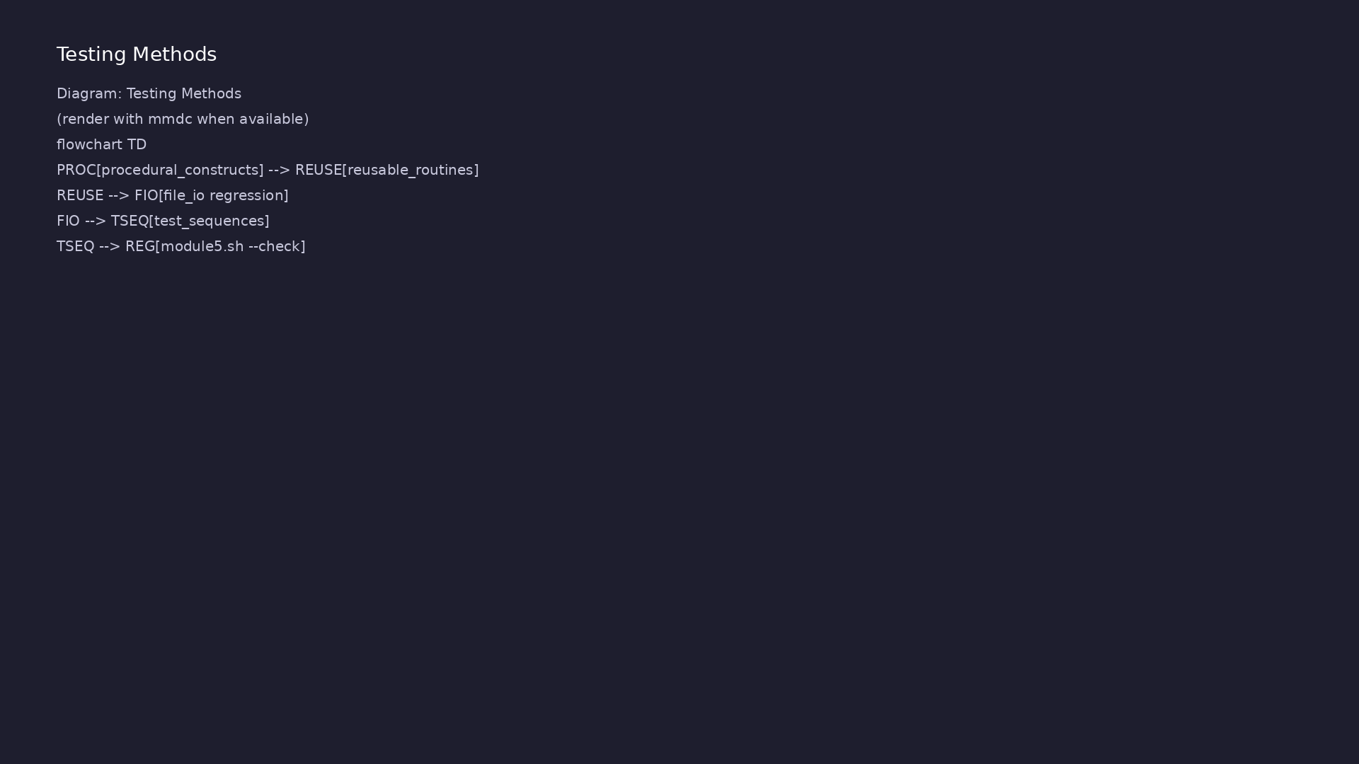
3. Reusable routine layer
• Tasks/functions: `send_byte`,
`wait_tx_done`, `apply_reset` —
shared across tests
• C++ helpers: Same operations as
methods on a `UartDriver` helper
class
• File-driven layer: Sequences can
be loaded from vector files for
long regressions
learn_verilator_iverilog / Module 5
Notes:
From MODULE5 Design Architecture.

Slide 10
RTL block diagram (reference)
Module 5: DUT hierarchy and signal flow.
learn_verilator_iverilog / Module 5

Slide 11
Verification / testbench diagram (reference)
Module 5: stimulus, observation, and checking.
learn_verilator_iverilog / Module 5

Slide 12
Task/function Makefile
task_function_test_verilog: task_function_test_verilog.v
@echo "=== Compiling Verilog task/function example ==="
$(IVERILOG) -o task_function_test task_function_test_verilog.v
$(DUT_DIR)/alus/simple_alu.v
@echo "=== Running simulation ==="
$(VVP) task_function_test
learn_verilator_iverilog / Module 5
Notes:
Links ALU DUT; vvp runs procedural task-based test sequence.

Slide 13
Task — apply stimulus and check
task test_alu_operation;
input [7:0] a_val, b_val;
input [1:0] op_val;
begin
// Get operation name from op code
task_op_name = get_op_name(op_val);
// Step 1: Apply test vector to DUT inputs
// This drives the DUT with the test stimulus
a = a_val;
b = b_val;
op = op_val;
// Step 2: Wait for combinational logic to propagate
// #5 delay ensures output has stabilized before checking
// For sequential logic, would wait for clock edge instead
# ...
learn_verilator_iverilog / Module 5
Notes:
test_alu_operation task: drive inputs, #delay, compare, log result.

Slide 14
Function — expected ALU result
function [7:0] calculate_expected;
input [7:0] a_val, b_val;
input [1:0] op_val;
begin
// Case statement implements operation selection
// This is a common pattern for ALU operations
case (op_val)
2'b00: calculate_expected = a_val + b_val; // ADD:
arithmetic addition
2'b01: calculate_expected = a_val - b_val; // SUB:
arithmetic subtraction
2'b10: calculate_expected = a_val & b_val; // AND:
bitwise AND
2'b11: calculate_expected = a_val | b_val; // OR:
bitwise OR
default: calculate_expected = 8'h00; // Default: return
0 for invalid op
endcase
learn_verilator_iverilog / Module 5
Notes:
calculate_expected encodes reference model for each opcode.

Slide 15
Execution & simulation flow
learn_verilator_iverilog / Module 5

Slide 16
How the example runs (toolchain)
• Makefile: Verilator compiles RTL + SystemVerilog
testbench into a C++ model
• sim_main.cpp: generates clk/rst_n, calls eval()
until $finish
• Directed test (initial block or C++): drive
stimulus, wait for DUT flags
• Self-check: compare outputs; print PASS/FAIL (see
terminal demo slide)
• Repo path: module5/examples/<example>/ — run make
run from that directory
learn_verilator_iverilog / Module 5
Notes:
From MODULE5 — execution and artifact layout.

Slide 17
Directed test execution sequence (1)
• task/function computes expected
• compare DUT output
• write pass/fail to log file
• Define tasks/functions
• call from initial block
learn_verilator_iverilog / Module 5
Notes:
Follow this order when tracing waveforms or debugging.

Slide 18
Directed test execution sequence (2)
• load file vectors
• log results
• ./scripts/module5.sh --check
learn_verilator_iverilog / Module 5
Notes:
Follow this order when tracing waveforms or debugging.

Slide 19
File I/O regression build
# Makefile for file I/O examples
IVERILOG = iverilog
VVP = vvp
VERILATOR = verilator
DUT_DIR = ../../../module4/dut
all: file_based_test_verilog file_based_test_cpp
file_based_test_verilog: file_based_test_verilog.v test_vectors.hex
expected_results.hex
@echo "=== Compiling Verilog file-based testbench ==="
$(IVERILOG) -o file_based_test file_based_test_verilog.v
$(DUT_DIR)/alus/simple_alu.v
@echo "=== Running simulation ==="
$(VVP) file_based_test
@echo "=== Checking output file ==="
@if [ -f test_results.txt ]; then \
learn_verilator_iverilog / Module 5
Notes:
cd module5/examples/file_io && make — reads vectors from file.

Slide 20
File read and test loop
/**
* Main Test Sequence
*
* This initial block orchestrates the file-based testbench:
* 1. Read test vectors from input files
* 2. Open output file for results
* 3. Apply test vectors and check results
* 4. Write results to file
* 5. Close file and finish
*
* File I/O in Verilog:
* - $readmemh: Read hex format file into memory array
* - $readmemb: Read binary format file into memory array
* - $fopen: Open file for writing (returns file handle)
* - $fwrite: Write formatted data to file
* - $fclose: Close file handle
# ...
learn_verilator_iverilog / Module 5
Notes:
$fopen/$fscanf load vectors; loop until EOF; write results log.

Slide 21
Test sequence orchestration
begin
$display("========================================");
$display("Running ALU Test Suite");
$display("========================================");
// Test ADD
test_alu_operation(8'h10, 8'h20, 2'b00);
test_alu_operation(8'hFF, 8'h01, 2'b00);
// Test SUB
test_alu_operation(8'h30, 8'h10, 2'b01);
test_alu_operation(8'h00, 8'h01, 2'b01);
// Test AND
test_alu_operation(8'hAA, 8'h55, 2'b10);
test_alu_operation(8'hFF, 8'hFF, 2'b10);
# ...
learn_verilator_iverilog / Module 5
Notes:
initial block calls tasks for each opcode; prints final summary.

Slide 22
Verification & testing methods
learn_verilator_iverilog / Module 5

Slide 23
1. Sequence-based stimulus
• Multi-step tests: Reset →
configure → send N bytes → check
`tx` bit timing
• Handshaking: Poll `tx_done` or
use timeout counters to detect
stuck FSM
• Negative tests: Start without
reset, back-to-back `tx_start` —
expect defined errors
learn_verilator_iverilog / Module 5
Notes:
From MODULE5 Verification & Testing Methods.

Slide 24
2. Timing and synchronization checks
• Bit period: Verify one `eval()`
or time step per bit cell in
examples
• Setup/hold: Ensure `tx_data`
stable before `tx_start` per
README contracts
• Waveform review: UART frame
visible on `tx` in VCD — start
bit, LSB-first data
learn_verilator_iverilog / Module 5
Notes:
From MODULE5 Verification & Testing Methods.

Slide 25
3. Reuse and regression methodology
• Routine library: Centralize
protocol steps; tests only
describe high-level scenarios
• File I/O regression: Replay
captured stimulus files across
tool releases
• Orchestration:
`./scripts/module5.sh --test-
sequences` and `--file-io` for
focused runs
learn_verilator_iverilog / Module 5
Notes:
From MODULE5 Verification & Testing Methods.

Slide 26
Procedural control — initial/always
/**
* Task and Function Example - Verilog
*
* Demonstrates:
* - Task definitions for test sequences
* - Function definitions for calculations
* - Parameter passing
* - Reusable verification routines
*
* Usage:
* iverilog -o task_function_test task_function_test_verilog.v
../../dut/alus/simple_alu.v
* vvp task_function_test
*/
`timescale 1ns/1ps
# ...
learn_verilator_iverilog / Module 5
Notes:
initial for sequences; tasks encapsulate multi-step protocol.

Slide 27
Result logging to file
* $readmemh reads hexadecimal values from file into memory array.
* File format: One hex value per line (e.g., "aabbcc" for
24-bit value)
*
* test_vector format: [a[7:0], b[7:0], op[1:0]] = 18 bits total
* - Bits [17:10]: Input A (8 bits)
* - Bits [9:2]: Input B (8 bits)
* - Bits [1:0]: Operation code (2 bits)
*
* expected format: Expected result value (8 bits)
*/
$readmemh("test_vectors.hex", test_vector);
$readmemh("expected_results.hex", expected);
$display("Read test vectors from file");
// Note: $size() is not supported by iverilog for memory arrays
// Using a fixed size or counting manually would be needed
# ...
learn_verilator_iverilog / Module 5
Notes:
$fwrite pass/fail lines; archive for regression diff.

Slide 28
Syllabus topics
learn_verilator_iverilog / Module 5

Slide 29
1. Procedural Constructs (1/6)
• Verilog: Initial Blocks for Test Sequences
• Initial block usage
• Sequential execution
• Multiple initial blocks
• Initial block organization
• Verilog: Always Blocks for Continuous Behavior
learn_verilator_iverilog / Module 5
Notes:
From MODULE5 Topics Covered.

Slide 30
1. Procedural Constructs (2/6)
• Always block usage
• Continuous execution
• Clock generation
• Continuous monitoring
• C++: Main Function and Control Flow
• Main function structure
learn_verilator_iverilog / Module 5
Notes:
From MODULE5 Topics Covered.

Slide 31
1. Procedural Constructs (3/6)
• Control flow
• Sequential execution
• Function organization
• C++: Loops and Conditionals
• For loops
• While loops
learn_verilator_iverilog / Module 5
Notes:
From MODULE5 Topics Covered.

Slide 32
1. Procedural Constructs (4/6)
• If-else statements
• Switch statements
• Verilog: Blocking vs. Non-Blocking Assignments in
Testbenches
• Blocking assignments (=)
• Non-blocking assignments (<=)
• When to use each
learn_verilator_iverilog / Module 5
Notes:
From MODULE5 Topics Covered.

Slide 33
1. Procedural Constructs (5/6)
• Best practices
• Procedural Timing Control (Both Paradigms)
• Timing control methods
• Timing accuracy
• Timing relationships
• Timing best practices
learn_verilator_iverilog / Module 5
Notes:
From MODULE5 Topics Covered.

Slide 34
1. Procedural Constructs (6/6)
• Verilog: Event Control (@, wait)
• Event control (@)
• Wait statements
• Event-based execution
• Event coordination
learn_verilator_iverilog / Module 5
Notes:
From MODULE5 Topics Covered.

Slide 35
2. Timing Control (1/7)
• Verilog: Delay Control (# delays)
• Delay syntax
• Delay timing
• Delay accuracy
• Delay best practices
• **Verilog: Event Control (@posedge, @negedge, @*)**
learn_verilator_iverilog / Module 5
Notes:
From MODULE5 Topics Covered.

Slide 36
2. Timing Control (2/7)
• Posedge control
• Negedge control
• Wildcard control
• Event-based timing
• C++: Time Management in Simulation Loop
• Simulation loop
learn_verilator_iverilog / Module 5
Notes:
From MODULE5 Topics Covered.

Slide 37
2. Timing Control (3/7)
• Time tracking
• Time advancement
• Time management
• C++: Clock Cycle Counting
• Cycle counting
• Cycle-based timing
learn_verilator_iverilog / Module 5
Notes:
From MODULE5 Topics Covered.

Slide 38
2. Timing Control (4/7)
• Cycle accuracy
• Cycle management
• Verilog: Wait Statements
• Wait syntax
• Wait conditions
• Wait timing
learn_verilator_iverilog / Module 5
Notes:
From MODULE5 Topics Covered.

Slide 39
2. Timing Control (5/7)
• Wait best practices
• Timing Accuracy (Both Paradigms)
• Timing precision
• Timing relationships
• Timing verification
• Timing debugging
learn_verilator_iverilog / Module 5
Notes:
From MODULE5 Topics Covered.

Slide 40
2. Timing Control (6/7)
• Race Condition Avoidance
• Race conditions
• Avoidance techniques
• Best practices
• Debugging
• `timing_control_verilog.v`: Delay control, event
control, wait statements
learn_verilator_iverilog / Module 5
Notes:
From MODULE5 Topics Covered.

Slide 41
2. Timing Control (7/7)
• `timing_control_cpp.cpp`: Time management in
simulation loop
learn_verilator_iverilog / Module 5
Notes:
From MODULE5 Topics Covered.

Slide 42
3. Test Sequences (1/5)
• Sequential Test Application
• Test ordering
• Sequential execution
• Test dependencies
• Test coordination
• Test Step Implementation
learn_verilator_iverilog / Module 5
Notes:
From MODULE5 Topics Covered.

Slide 43
3. Test Sequences (2/5)
• Step definition
• Step execution
• Step timing
• Step verification
• Sequence Timing
• Sequence timing
learn_verilator_iverilog / Module 5
Notes:
From MODULE5 Topics Covered.

Slide 44
3. Test Sequences (3/5)
• Timing control
• Timing accuracy
• Timing verification
• Synchronization with DUT
• DUT synchronization
• Timing relationships
learn_verilator_iverilog / Module 5
Notes:
From MODULE5 Topics Covered.

Slide 45
3. Test Sequences (4/5)
• Synchronization methods
• Synchronization verification
• Sequence Verification
• Sequence checking
• Sequence validation
• Sequence debugging
learn_verilator_iverilog / Module 5
Notes:
From MODULE5 Topics Covered.

Slide 46
3. Test Sequences (5/5)
• Sequence best practices
learn_verilator_iverilog / Module 5
Notes:
From MODULE5 Topics Covered.

Slide 47
4. Reusable Routines (1/6)
• Verilog: Task Definitions for Test Sequences
• Task syntax
• Task usage
• Task parameters
• Task organization
• Verilog: Function Definitions for Calculations
learn_verilator_iverilog / Module 5
Notes:
From MODULE5 Topics Covered.

Slide 48
4. Reusable Routines (2/6)
• Function syntax
• Function usage
• Function return values
• Function organization
• C++: Function Definitions for Test Sequences
• Function syntax
learn_verilator_iverilog / Module 5
Notes:
From MODULE5 Topics Covered.

Slide 49
4. Reusable Routines (3/6)
• Function usage
• Function parameters
• Function organization
• C++: Class Methods for Organization
• Class methods
• Method organization
learn_verilator_iverilog / Module 5
Notes:
From MODULE5 Topics Covered.

Slide 50
4. Reusable Routines (4/6)
• Method reusability
• Method best practices
• Parameter Passing (Both Paradigms)
• Parameter syntax
• Parameter types
• Parameter passing
learn_verilator_iverilog / Module 5
Notes:
From MODULE5 Topics Covered.

Slide 51
4. Reusable Routines (5/6)
• Parameter best practices
• Reusable Verification Routines
• Routine design
• Routine organization
• Routine reusability
• Routine library
learn_verilator_iverilog / Module 5
Notes:
From MODULE5 Topics Covered.

Slide 52
4. Reusable Routines (6/6)
• `task_function_test_verilog.v`: Tasks and functions
for reusable test sequences
• `function_class_test_cpp.cpp`: Functions and classes
for reusable test sequences
learn_verilator_iverilog / Module 5
Notes:
From MODULE5 Topics Covered.

Slide 53
5. Loops and Control Flow (1/5)
• For Loops in Testbenches
• For loop syntax
• For loop usage
• Loop-based testing
• Loop best practices
• While Loops
learn_verilator_iverilog / Module 5
Notes:
From MODULE5 Topics Covered.

Slide 54
5. Loops and Control Flow (2/5)
• While loop syntax
• While loop usage
• Conditional loops
• Loop termination
• Repeat Loops
• Repeat syntax
learn_verilator_iverilog / Module 5
Notes:
From MODULE5 Topics Covered.

Slide 55
5. Loops and Control Flow (3/5)
• Repeat usage
• Fixed iteration
• Repeat best practices
• Conditional Execution
• If-else statements
• Switch statements
learn_verilator_iverilog / Module 5
Notes:
From MODULE5 Topics Covered.

Slide 56
5. Loops and Control Flow (4/5)
• Conditional logic
• Conditional best practices
• Loop-Based Test Generation
• Test generation
• Loop-based patterns
• Generation strategies
learn_verilator_iverilog / Module 5
Notes:
From MODULE5 Topics Covered.

Slide 57
5. Loops and Control Flow (5/5)
• Generation best practices
learn_verilator_iverilog / Module 5
Notes:
From MODULE5 Topics Covered.

Slide 58
6. File I/O (1/7)
• Verilog: File Reading ($readmemh, $readmemb)
• $readmemh syntax
• $readmemb syntax
• File reading
• Memory initialization
• Verilog: File Writing ($fopen, $fwrite, $fclose)
learn_verilator_iverilog / Module 5
Notes:
From MODULE5 Topics Covered.

Slide 59
6. File I/O (2/7)
• $fopen syntax
• $fwrite syntax
• $fclose syntax
• File writing
• C++: File I/O (fstream, ifstream, ofstream)
• fstream usage
learn_verilator_iverilog / Module 5
Notes:
From MODULE5 Topics Covered.

Slide 60
6. File I/O (3/7)
• ifstream usage
• ofstream usage
• File operations
• C++: Reading Test Vectors
• Vector reading
• Vector parsing
learn_verilator_iverilog / Module 5
Notes:
From MODULE5 Topics Covered.

Slide 61
6. File I/O (4/7)
• Vector storage
• Vector application
• C++: Writing Results
• Result writing
• Result formatting
• Result storage
learn_verilator_iverilog / Module 5
Notes:
From MODULE5 Topics Covered.

Slide 62
6. File I/O (5/7)
• Result analysis
• Test Vector File Formats
• Format types
• Format selection
• Format parsing
• Format best practices
learn_verilator_iverilog / Module 5
Notes:
From MODULE5 Topics Covered.

Slide 63
6. File I/O (6/7)
• Result Logging to Files
• Logging methods
• Logging formats
• Logging organization
• Logging best practices
• File-Based Testbenches (Both Paradigms)
learn_verilator_iverilog / Module 5
Notes:
From MODULE5 Topics Covered.

Slide 64
6. File I/O (7/7)
• File-based design
• File-based patterns
• File-based best practices
• File-based examples
• `file_based_test_verilog.v`: File-based testbench
using $readmemh and $fwrite
• `file_based_test_cpp.cpp`: File-based testbench
using C++ file streams
learn_verilator_iverilog / Module 5
Notes:
From MODULE5 Topics Covered.

Slide 65
7. Advanced Procedural Patterns (1/6)
• State Machine-Based Testbenches
• State machine design
• State transitions
• State verification
• State machine patterns
• Protocol-Based Testbenches
learn_verilator_iverilog / Module 5
Notes:
From MODULE5 Topics Covered.

Slide 66
7. Advanced Procedural Patterns (2/6)
• Protocol modeling
• Protocol sequences
• Protocol verification
• Protocol patterns
• Transaction-Based Patterns
• Transaction modeling
learn_verilator_iverilog / Module 5
Notes:
From MODULE5 Topics Covered.

Slide 67
7. Advanced Procedural Patterns (3/6)
• Transaction sequences
• Transaction verification
• Transaction patterns
• Layered Testbench Structure
• Layer organization
• Layer interaction
learn_verilator_iverilog / Module 5
Notes:
From MODULE5 Topics Covered.

Slide 68
7. Advanced Procedural Patterns (4/6)
• Layer verification
• Layer patterns
• Location: (Coming soon)
• Demonstrates: Protocol testbench, procedural
sequences
• Location: (Coming soon)
• Demonstrates: Protocol testbench, C++ control flow
learn_verilator_iverilog / Module 5
Notes:
From MODULE5 Topics Covered.

Slide 69
7. Advanced Procedural Patterns (5/6)
• Location: `module5/examples/file_io/`
• Demonstrates: File I/O, test vector reading, result
writing
• Location: `module5/examples/reusable_routines/task_f
unction_test_verilog.v`
• Demonstrates: Tasks and functions for reusable test
sequences
• Location: `module5/examples/reusable_routines/functi
on_class_test_cpp.cpp`
• Demonstrates: Functions and classes for reusable
test sequences
learn_verilator_iverilog / Module 5
Notes:
From MODULE5 Topics Covered.

Slide 70
7. Advanced Procedural Patterns (6/6)
• Location: (Coming soon)
• Demonstrates: State machine-based testbench patterns
• Location: (Coming soon)
• Demonstrates: Protocol testbench patterns
learn_verilator_iverilog / Module 5
Notes:
From MODULE5 Topics Covered.

Slide 71
Hands-on examples
learn_verilator_iverilog / Module 5

Slide 72
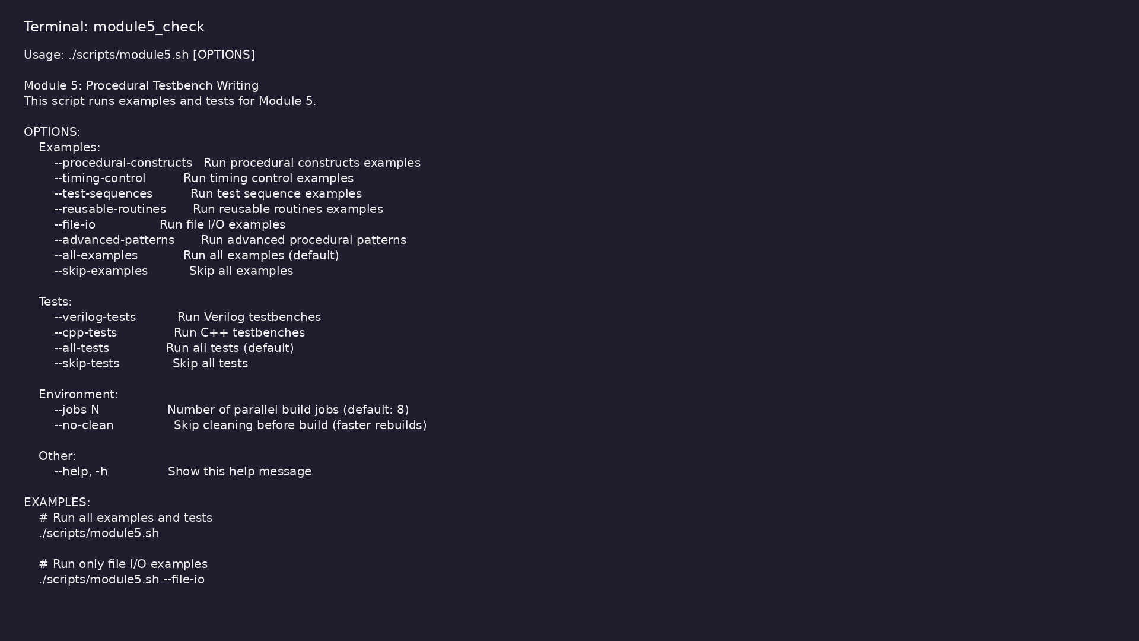
Module 5 self-check
$ ./scripts/module5.sh --help
learn_verilator_iverilog / Module 5
Notes:
Run from course repository root.

Slide 73
Exercise scaffold
./scripts/module5.sh --scaffold
learn_verilator_iverilog / Module 5

Slide 74
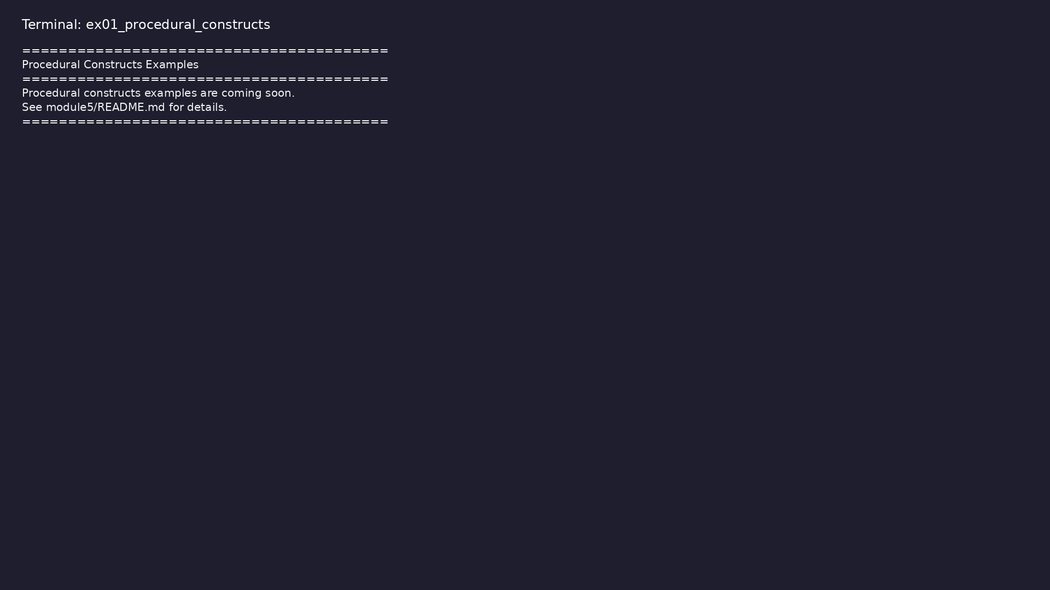
Demo: Procedural constructs
$ cd module5/examples/procedural_constructs && make all
learn_verilator_iverilog / Module 5
Notes:
Hands-on: module5/examples/procedural_constructs/

Slide 75
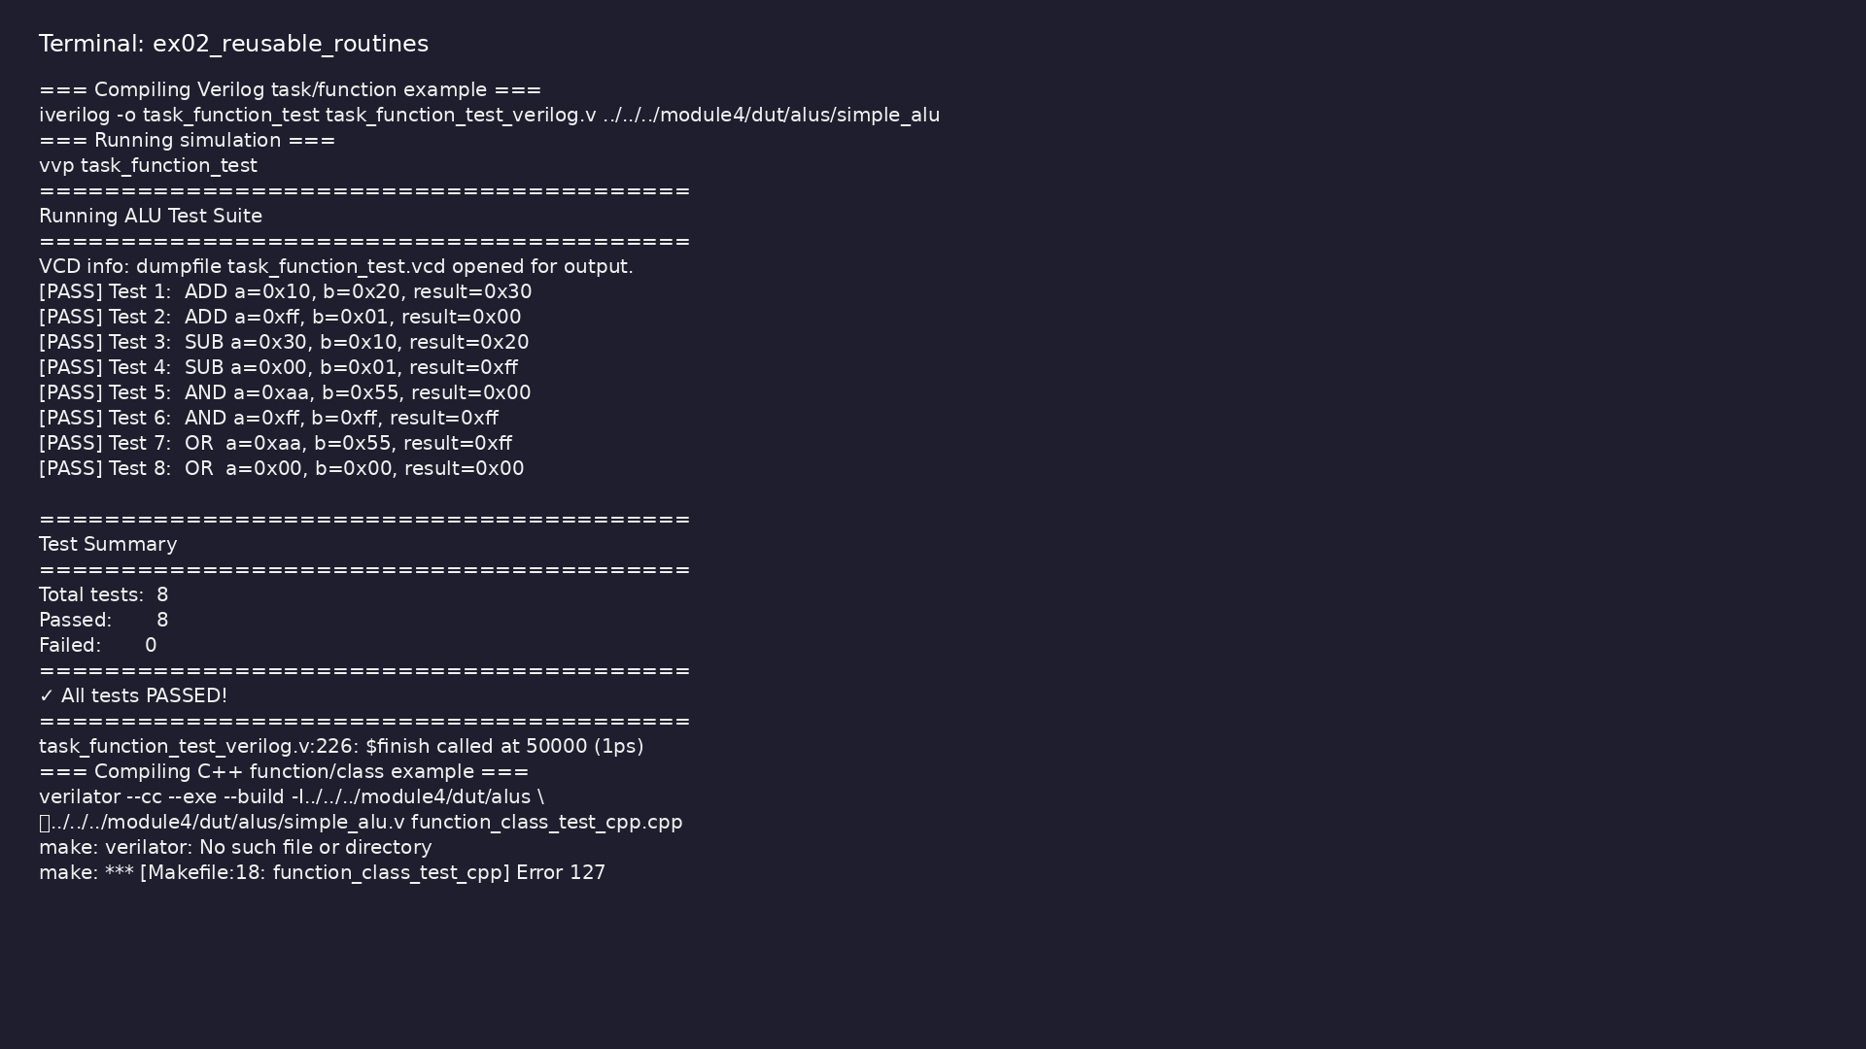
Demo: Reusable routines
$ cd module5/examples/reusable_routines && make all
learn_verilator_iverilog / Module 5
Notes:
Hands-on: module5/examples/reusable_routines/

Slide 76
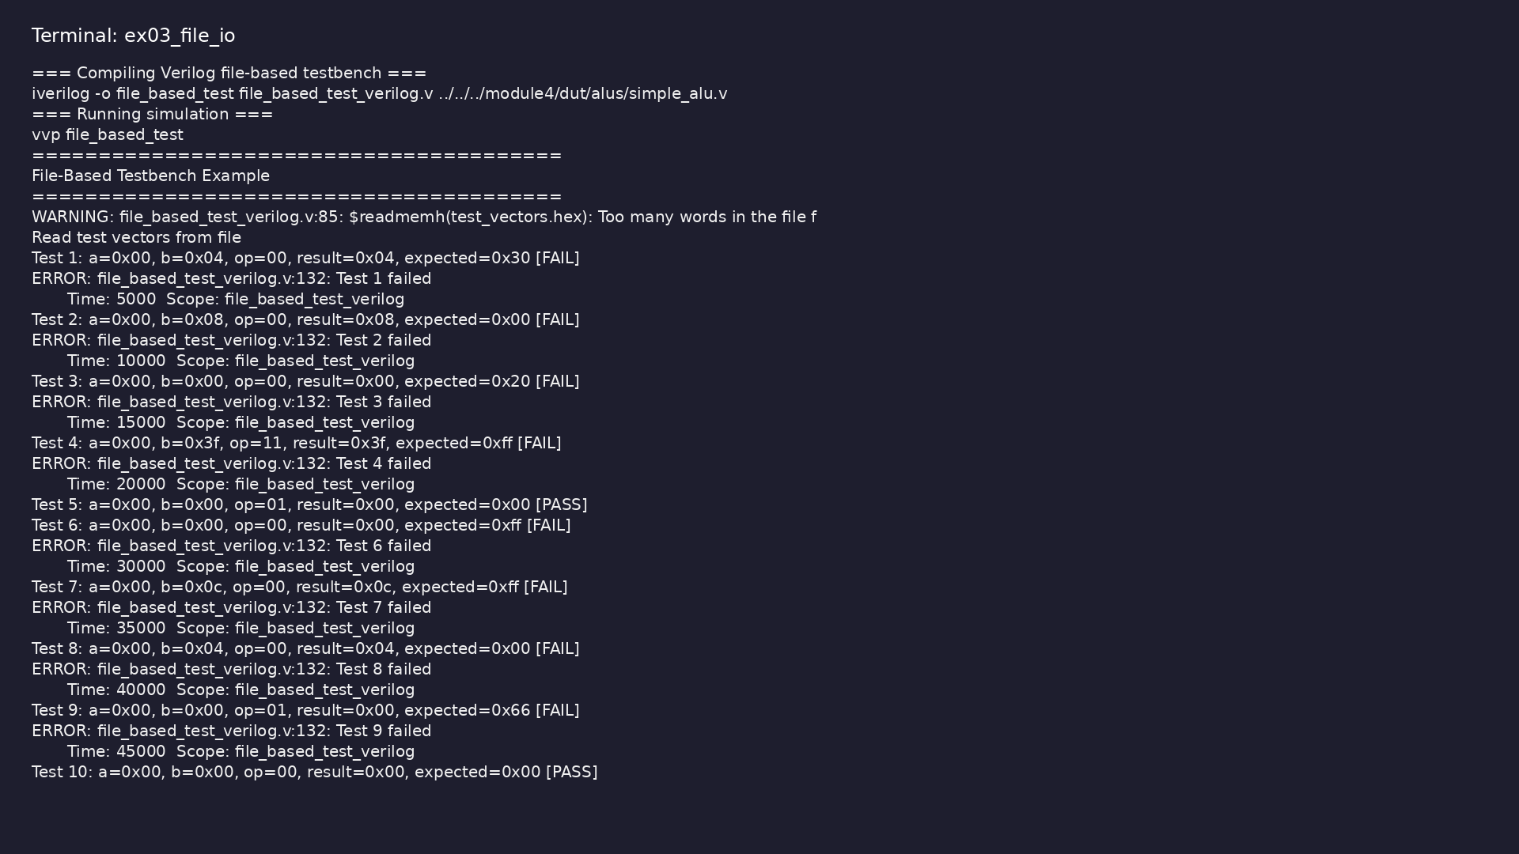
Demo: File I/O
$ cd module5/examples/file_io && make all
learn_verilator_iverilog / Module 5
Notes:
Hands-on: module5/examples/file_io/

Slide 77

Demo: Test sequences
$ cd module5/examples/test_sequences && make all
learn_verilator_iverilog / Module 5
Notes:
Hands-on: module5/examples/test_sequences/

Slide 78
Practice & assessment
learn_verilator_iverilog / Module 5

Slide 79
What you should know (1/11)
• Write procedural testbenches effectively (both
paradigms)
• Control timing in testbenches (Verilog and C++)
• Create complex test sequences (both paradigms)
• Use tasks/functions (Verilog) and functions/classes
(C++) for organization
• Implement file-based testing (both paradigms)
• Build protocol testbenches (both paradigms)
learn_verilator_iverilog / Module 5
Notes:
From MODULE5 Learning Outcomes.

Slide 80
What you should know (2/11)
• Define tasks for test sequences
• Use functions for calculations
• Organize code with reusable routines
• Define functions for test sequences
• Use classes for organization
• Compare with Verilog approach
learn_verilator_iverilog / Module 5
Notes:
From MODULE5 Learning Outcomes.

Slide 81
What you should know (3/11)
• Read test vectors from files
• Write results to files
• Implement file-based testing
• Implement protocol sequences
• Handle timing requirements
• Verify protocol compliance
learn_verilator_iverilog / Module 5
Notes:
From MODULE5 Learning Outcomes.

Slide 82
What you should know (4/11)
• Model testbench as state machine
• Implement state transitions
• Verify state coverage
• Design reusable components
• Parameterize routines
• Build verification library
learn_verilator_iverilog / Module 5
Notes:
From MODULE5 Learning Outcomes.

Slide 83
What you should know (5/11)
• Can write procedural testbenches effectively (both
paradigms)
• Can control timing in testbenches (Verilog and C++)
• Can create complex test sequences (both paradigms)
• Can use tasks/functions (Verilog) and
functions/classes (C++) for organization
• Can implement file-based testing (both paradigms)
• Can build protocol testbenches (both paradigms)
learn_verilator_iverilog / Module 5
Notes:
From MODULE5 Learning Outcomes.

Slide 84
What you should know (6/11)
• Module 6: SystemVerilog Testbench Features - Learn
SystemVerilog enhancements
• Module 7: Coverage and Assertions - Master coverage
and assertion-based verification
• File Headers: Every file includes comprehensive
header documentation:
• Purpose and learning objectives
• Key concepts explained
• Compilation and execution instructions
learn_verilator_iverilog / Module 5
Notes:
From MODULE5 Learning Outcomes.

Slide 85
What you should know (7/11)
• Usage examples
• Inline Comments: Detailed comments explain:
• Why code is written a certain way (not just what it
does)
• Procedural block behavior and timing
• Task/function usage and parameter passing
• File I/O operations and formats
learn_verilator_iverilog / Module 5
Notes:
From MODULE5 Learning Outcomes.

Slide 86
What you should know (8/11)
• Timing control mechanisms
• Code Organization: Comments group related code:
• Signal declarations
• DUT instantiation
• Reusable routines (tasks/functions)
• Test sequences
learn_verilator_iverilog / Module 5
Notes:
From MODULE5 Learning Outcomes.

Slide 87
What you should know (9/11)
• File operations
• Icarus Verilog Documentation:
http://iverilog.wikia.com/
• Verilator Documentation: https://verilator.org/
• GTKWave Documentation:
http://gtkwave.sourceforge.net/
• IEEE 1364-2005 Standard: Verilog Hardware
Description Language
• IEEE 1800-2017 Standard: SystemVerilog Language
Reference Manual
learn_verilator_iverilog / Module 5
Notes:
From MODULE5 Learning Outcomes.

Slide 88
What you should know (10/11)
• Universal Verification Methodology (UVM):
https://accellera.org/downloads/standards/uvm
• UVM Core Repository: https://github.com/universal-
verification-methodology/core
• Official UVM library with examples of:
• Reusable components (agents, drivers, monitors)
• Sequence-based stimulus generation
• Configuration management
learn_verilator_iverilog / Module 5
Notes:
From MODULE5 Learning Outcomes.

Slide 89
What you should know (11/11)
• Phase-based testbench control
learn_verilator_iverilog / Module 5
Notes:
From MODULE5 Learning Outcomes.

Slide 90
Assessment checklist
• Can write procedural testbenches effectively (both
paradigms)
• Can control timing in testbenches (Verilog and C++)
• Can create complex test sequences (both paradigms)
• Can use tasks/functions (Verilog) and
functions/classes (C++) for organization
• Can implement file-based testing (both paradigms)
• Can build protocol testbenches (both paradigms)
learn_verilator_iverilog / Module 5

Slide 91
Summary & next steps
• Master procedural testbench construction using
Verilog procedural blocks and C++ control flow
• Complete module5/CHECKLIST.md
• Review module5/EXAMPLES.md and run each lab
• Next: Next module in course
learn_verilator_iverilog / Module 5

