Slide 1
Module 6
SystemVerilog Testbench Features
learn_verilator_iverilog / Module 6

Slide 2
Learning objectives
• Master SystemVerilog features for advanced testbench
development (primarily for iverilog, with Veri…
learn_verilator_iverilog / Module 6

Slide 3
Prerequisites
• See module README
learn_verilator_iverilog / Module 6

Slide 4

Learning path
Master SystemVerilog features for advanced testbench development (primarily for iverilog, with Verilator considerations)
learn_verilator_iverilog / Module 6

Slide 5
Overview
• This module introduces SystemVerilog features that
enhance testbench capabilities. You'll learn abo…
learn_verilator_iverilog / Module 6

Slide 6
Design architecture
learn_verilator_iverilog / Module 6

Slide 7
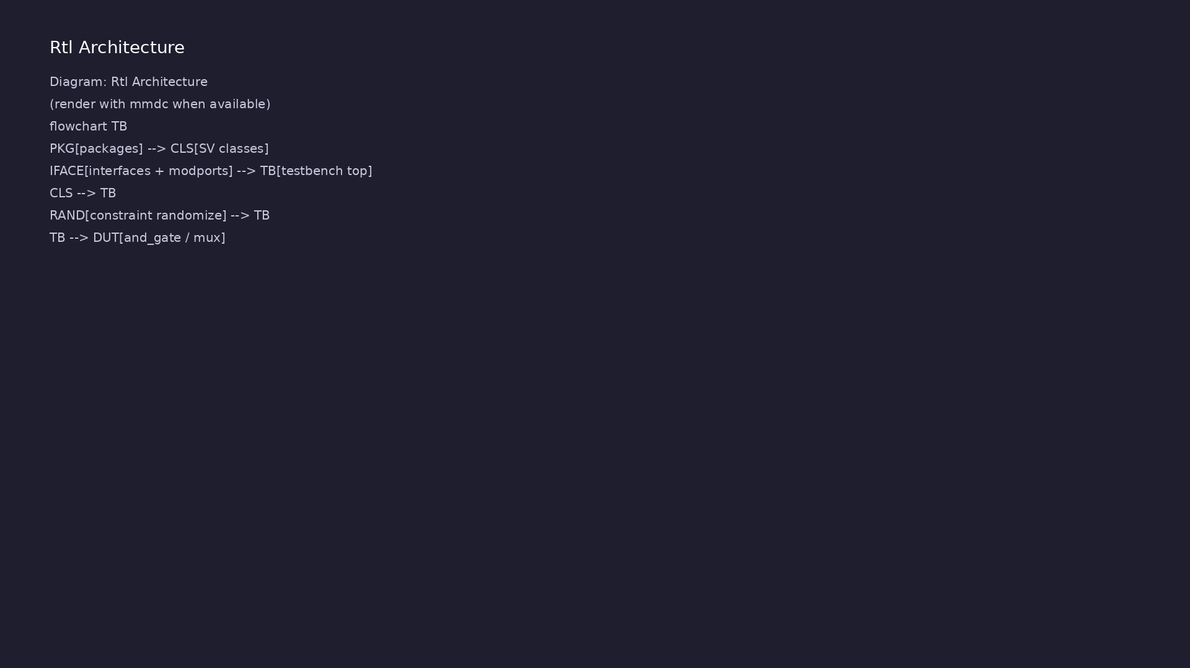
1. SystemVerilog testbench layer
• Classes: Encapsulate
transactions, drivers, and test
state (`sv_classes` examples)
• Interfaces: Bundle DUT-facing
signals; connect TB components
via modports
• Packages: Shared types,
parameters, and class
declarations across compilation
units
• Randomization: Constraint blocks
on transaction fields for varied
legal stimulus
learn_verilator_iverilog / Module 6
Notes:
From MODULE6 Design Architecture.

Slide 8

2. DUT and tool considerations
• `dut/simple_gates/`,
`dut/multiplexers/`: RTL
exercised with SV TB features
• iverilog: Primary target for
classes, interfaces, and
`randomize()`
• Verilator: Limited SV —
`equivalent_cpp/` documents C++
workarounds for unsupported
constructs
• Compilation order: Package →
interface → classes → TB top
(see example Makefiles)
learn_verilator_iverilog / Module 6
Notes:
From MODULE6 Design Architecture.

Slide 9
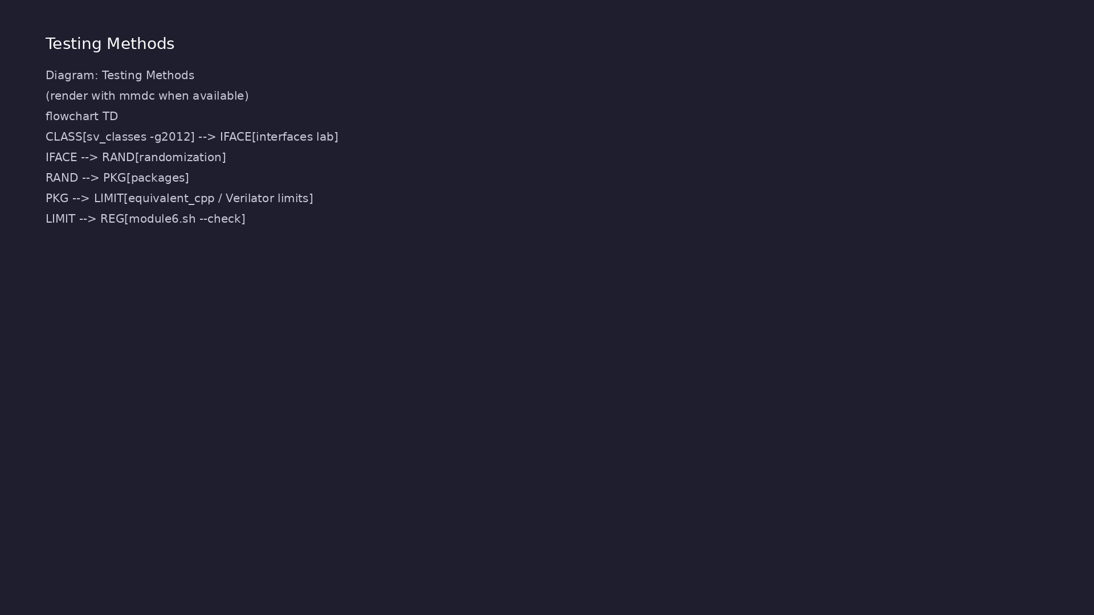
3. Object-oriented TB topology
• Transaction item: Data class
holding addr, data, or opcode
fields
• Driver class: `randomize()`
item, drive interface signals,
wait for handshake
• Test class: Builds environment,
runs sequences, reports `uvm-
style` summary without UVM libs
learn_verilator_iverilog / Module 6
Notes:
From MODULE6 Design Architecture.

Slide 10
RTL block diagram (reference)
Module 6: DUT hierarchy and signal flow.
learn_verilator_iverilog / Module 6

Slide 11
Verification / testbench diagram (reference)
Module 6: stimulus, observation, and checking.
learn_verilator_iverilog / Module 6

Slide 12
SV compile — iverilog -g2012
class_based_testbench: class_based_testbench.sv
@echo "=== Compiling SystemVerilog class-based testbench
(iverilog) ==="
$(IVERILOG) -g2012 -o class_based_testbench
class_based_testbench.sv $(DUT_DIR)/simple_gates/and_gate.v
@echo "=== Running simulation ==="
$(VVP) class_based_testbench
learn_verilator_iverilog / Module 6
Notes:
SystemVerilog classes require -g2012; package order matters.

Slide 13
Transaction class definition
class transaction;
// Randomizable input signals (can be randomized with randomize()
method)
// rand keyword makes these variables eligible for constrained
randomization
rand bit a; // First input to AND gate
rand bit b; // Second input to AND gate
// Non-randomizable output (calculated, not randomized)
bit expected; // Expected output value (calculated in
post_randomize)
/**
* Constructor - Called automatically when object is created
*
* Initializes all class properties to default values.
* In SystemVerilog, new() is the constructor function.
*
learn_verilator_iverilog / Module 6
Notes:
rand fields, post_randomize(), new() — UVM sequence_item pattern.

Slide 14
Interface — signal bundle
/**
* AND Gate Interface Definition
*
* This interface encapsulates all signals for the AND gate:
* - Input signals: a, b
* - Output signal: y
*
* Interfaces provide:
* 1. Signal grouping: Related signals in one place
* 2. Direction control: Modports define who can drive/read which
signals
* 3. Reusability: Same interface can be used in multiple testbenches
*
* UVM Pattern: Similar to UVM virtual interfaces, which allow classes
* to access RTL signals through interface handles.
*/
interface and_gate_if;
# ...
learn_verilator_iverilog / Module 6
Notes:
interface and_gate_if; modport driver and monitor directions.

Slide 15
Execution & simulation flow
learn_verilator_iverilog / Module 6

Slide 16
How the example runs (toolchain)
• Makefile: Verilator + UVM_HOME compile RTL,
interface, and test_*.sv
• UVM phases: build → connect → run_test → report
(same pattern as Module 2)
• Sequence → driver → DUT → monitor → scoreboard (read
SCOREBOARD at end)
• Typical command: make SIM=verilator TEST=test_* (see
module6 demo slide)
• Loopback / hooks connect monitor observations to
scoreboard checks
learn_verilator_iverilog / Module 6
Notes:
From MODULE6 — execution and artifact layout.

Slide 17
Directed test execution sequence (1)
• post_randomize() sets expected
• driver applies transaction
• compare before next randomize
• Package
• interface
learn_verilator_iverilog / Module 6
Notes:
Follow this order when tracing waveforms or debugging.

Slide 18
Directed test execution sequence (2)
• class
• randomize()
• -g2012 compile
learn_verilator_iverilog / Module 6
Notes:
Follow this order when tracing waveforms or debugging.

Slide 19
Interface-based TB build
# Makefile for interface examples
IVERILOG = iverilog
VVP = vvp
VERILATOR = verilator
DUT_DIR = ../../dut
all: interface_based_testbench interface_based_testbench_cpp
# SystemVerilog interface-based testbench (iverilog)
interface_based_testbench: interface_based_testbench.sv
@echo "=== Compiling SystemVerilog interface-based testbench
(iverilog) ==="
$(IVERILOG) -g2012 -o interface_based_testbench
interface_based_testbench.sv $(DUT_DIR)/simple_gates/and_gate.v
@echo "=== Running simulation ==="
$(VVP) interface_based_testbench
learn_verilator_iverilog / Module 6
Notes:
Compile interface + TB + DUT; vvp runs class-driven test.

Slide 20
Test class run method
fail_count++;
$error("[FAIL] Test %0d: a=%b, b=%b, result=%b,
expected=%b",
test_count, a, b, result, expected);
end
endfunction
/**
* Print Summary Method - Display test results summary
*
* Displays a formatted summary of all test results including:
* - Total number of tests executed
* - Number of passing tests
* - Number of failing tests
*
* UVM Pattern: Similar to UVM's end_of_elaboration_phase() or
* report_phase() where test results are summarized and reported.
# ...
learn_verilator_iverilog / Module 6
Notes:
and_gate_test.run() randomizes transactions and checks DUT.

Slide 21
Constraint randomization
/**
* Randomized Testbench - SystemVerilog (iverilog)
*
* This example demonstrates constrained randomization, a powerful
verification technique
* inspired by UVM (Universal Verification Methodology). Constrained
randomization allows
* you to generate large numbers of test vectors automatically while
ensuring they meet
* specific requirements through constraints.
*
* Learning Objectives:
* - Understand SystemVerilog randomization (rand, randc keywords)
* - Learn constraint-based randomization (constraint blocks)
* - Master post_randomize() callback for derived value calculation
* - Understand seed control for reproducible random tests
* - Learn random test generation strategies
*
learn_verilator_iverilog / Module 6
Notes:
randomize() with constraints; rerun for varied legal stimulus.

Slide 22
Verification & testing methods
learn_verilator_iverilog / Module 6

Slide 23
1. Constrained-random stimulus
• Constraints: Legal opcodes,
address ranges, and timing gaps
enforced in class
• Seeds: Repeatable runs with
`srandom(seed)` for debug vs
random exploration
• Coverage of space: Many
transactions from few lines of
sequence code
learn_verilator_iverilog / Module 6
Notes:
From MODULE6 Verification & Testing Methods.

Slide 24
2. Interface-based checking
• Modports: Driver drives
`DUT_MP`; monitor samples
`MON_MP` on same interface
• Scoreboard hook: Monitor pushes
observed transactions to checker
class
• Encapsulation: DUT port list
changes localized to interface
definition
learn_verilator_iverilog / Module 6
Notes:
From MODULE6 Verification & Testing Methods.

Slide 25
3. SV vs C++ equivalence verification
• Dual implementation: Compare SV
class TB behavior to C++
equivalent where Verilator used
• Limitation tests: Document
constructs that fail Verilator
lint — plan tool split
• Regression:
`./scripts/module6.sh` runs
iverilog-first examples then C++
equivalents
learn_verilator_iverilog / Module 6
Notes:
From MODULE6 Verification & Testing Methods.

Slide 26
Package import pattern
/**
* Package Example - SystemVerilog (iverilog)
*
* This example demonstrates how to use SystemVerilog packages to
organize
* and share definitions across multiple testbenches. It shows package
import,
* usage of package-defined types, functions, and tasks.
*
* Learning Objectives:
* - Understand package import syntax
* - Learn how to use package-defined types
* - Master package function and task usage
* - Understand namespace management with packages
*
* UVM Concepts Demonstrated:
* - Package organization: Similar to UVM's package structure
* - Shared definitions: Types, functions, tasks shared across
learn_verilator_iverilog / Module 6
Notes:
Shared types in package; import before TB top compilation.

Slide 27
Syllabus topics
learn_verilator_iverilog / Module 6

Slide 28
1. SystemVerilog Classes (1/6)
• SystemVerilog classes → UVM base classes
(`uvm_object`, `uvm_component`, `uvm_sequence_item`)
• Transaction classes → UVM sequence items (data
structures for verification)
• Testbench classes → UVM test classes (test
orchestration)
• Class hierarchy → UVM component hierarchy
• Class Basics for Testbenches
• Class declaration syntax
learn_verilator_iverilog / Module 6
Notes:
From MODULE6 Topics Covered.

Slide 29
1. SystemVerilog Classes (2/6)
• Class properties (data members)
• Class methods (functions and tasks)
• Class instantiation (object creation)
• Constructor (`new()` function)
• Class Methods and Properties
• Method declaration and implementation
learn_verilator_iverilog / Module 6
Notes:
From MODULE6 Topics Covered.

Slide 30
1. SystemVerilog Classes (3/6)
• Property declaration and initialization
• Access modifiers (public, protected, local)
• Method overloading concepts
• Class Instantiation
• Object creation: `class_name obj = new();`
• Object lifetime management
learn_verilator_iverilog / Module 6
Notes:
From MODULE6 Topics Covered.

Slide 31
1. SystemVerilog Classes (4/6)
• Automatic garbage collection
• Memory management best practices
• Object-Oriented Testbenches
• OOP principles in verification
• Encapsulation: Data and methods together
• Inheritance: Base classes and derived classes
learn_verilator_iverilog / Module 6
Notes:
From MODULE6 Topics Covered.

Slide 32
1. SystemVerilog Classes (5/6)
• Polymorphism: Virtual methods and dynamic dispatch
• Class-Based Testbench Organization
• Transaction classes: Model test data
• Testbench classes: Orchestrate tests
• Class hierarchy design
• Reusability patterns
learn_verilator_iverilog / Module 6
Notes:
From MODULE6 Topics Covered.

Slide 33
1. SystemVerilog Classes (6/6)
• Maintainability best practices
• `class_based_testbench.sv`: Comprehensive class-
based testbench with detailed comments
• Transaction class with `post_randomize()` callback
• Testbench class for test orchestration
• Object instantiation and usage patterns
• `class_based_testbench_cpp.cpp`: C++ equivalent for
Verilator
learn_verilator_iverilog / Module 6
Notes:
From MODULE6 Topics Covered.

Slide 34
2. Randomization (1/7)
• SystemVerilog randomization → UVM's constrained
random framework
• Constraint blocks → UVM constraint blocks in
sequence items
• Random test generation → UVM sequence generation
• Seed control → UVM command-line seed control
(`+seed`)
• Random Variable Generation
• `$random()`: Signed random integer
learn_verilator_iverilog / Module 6
Notes:
From MODULE6 Topics Covered.

Slide 35
2. Randomization (2/7)
• `$urandom()`: Unsigned random integer
• `$urandom_range()`: Random value in range
• Seed control: `$urandom(seed)` for reproducibility
• Constrained Randomization Basics
• `rand` keyword: Random variable (can repeat)
• `randc` keyword: Cyclic random variable (no repeats
until all used)
learn_verilator_iverilog / Module 6
Notes:
From MODULE6 Topics Covered.

Slide 36
2. Randomization (3/7)
• Constraint blocks: Define valid value ranges
• Constraint solving: Automatic constraint
satisfaction
• `randomize()` method: Generate random values
• Constraint Syntax
• Post-Randomization Callbacks
• `post_randomize()`: Called after successful
randomization
learn_verilator_iverilog / Module 6
Notes:
From MODULE6 Topics Covered.

Slide 37
2. Randomization (4/7)
• Calculate derived values based on randomized inputs
• UVM pattern: Similar to `post_randomize()` in UVM
sequence items
• Random Test Generation
• Generate thousands of test vectors automatically
• Ensure test vectors meet design requirements
• Achieve better coverage with less manual effort
learn_verilator_iverilog / Module 6
Notes:
From MODULE6 Topics Covered.

Slide 38
2. Randomization (5/7)
• Random sequences and patterns
• Seed Control
• Seed setting: `$urandom(seed)` for reproducible
tests
• Seed management: Track seeds for debugging
• Reproducibility: Same seed = same test sequence
• Seed strategies: Random vs. fixed seeds
learn_verilator_iverilog / Module 6
Notes:
From MODULE6 Topics Covered.

Slide 39
2. Randomization (6/7)
• Randomization Strategies
• Constraint design: Balance between flexibility and
control
• Coverage-driven randomization: Guide randomization
toward coverage goals
• Weighted distributions: Control probability of
values
• Best practices: Keep constraints simple and
maintainable
• `randomized_testbench.sv`: Comprehensive randomized
testbench with:
learn_verilator_iverilog / Module 6
Notes:
From MODULE6 Topics Covered.

Slide 40
2. Randomization (7/7)
• Constraint blocks for valid value ranges
• `post_randomize()` callback for derived values
• Seed control and reproducibility
• Random test generation loop
• `randomized_testbench_cpp.cpp`: C++ equivalent using
`<random>` library
learn_verilator_iverilog / Module 6
Notes:
From MODULE6 Topics Covered.

Slide 41
3. SystemVerilog Interfaces (1/6)
• SystemVerilog interfaces → UVM virtual interfaces
• Modports → UVM interface modports (driver, monitor,
etc.)
• Interface-based testbenches → UVM testbench
structure
• Virtual interfaces → UVM's way to connect classes to
RTL
• Interface Declaration and Usage
• Interface syntax: `interface name; ... endinterface`
learn_verilator_iverilog / Module 6
Notes:
From MODULE6 Topics Covered.

Slide 42
3. SystemVerilog Interfaces (2/6)
• Signal grouping: Related signals together
• Interface instantiation: `interface_name
instance();`
• Interface connection: Pass to modules via modports
• Modports for Direction Control
• Modport syntax: `modport name(input sig1, output
sig2);`
• Direction control: Define who can drive/read which
signals
learn_verilator_iverilog / Module 6
Notes:
From MODULE6 Topics Covered.

Slide 43
3. SystemVerilog Interfaces (3/6)
• Multiple modports: Different views for different
users
• Type safety: Prevents incorrect signal connections
• Interface in Testbenches
• Interface-based testbenches: Clean signal
organization
• DUT wrapping: Connect DUT to interface via wrapper
• Interface reusability: Same interface for multiple
testbenches
learn_verilator_iverilog / Module 6
Notes:
From MODULE6 Topics Covered.

Slide 44
3. SystemVerilog Interfaces (4/6)
• Interface best practices: Clear naming, proper
modports
• Virtual Interfaces (Advanced)
• Virtual interface syntax: `virtual interface_name
vif;`
• Virtual interface usage: Interface handles in
classes
• Dynamic interfaces: Runtime interface assignment
• Virtual interface patterns: UVM-style class-to-RTL
connection
learn_verilator_iverilog / Module 6
Notes:
From MODULE6 Topics Covered.

Slide 45
3. SystemVerilog Interfaces (5/6)
• Interface-Based Testbenches
• Interface design: Group related signals
• Interface patterns: Common interface structures
• Interface organization: Hierarchical interfaces
• Interface best practices: Modports, naming,
documentation
• `interface_based_testbench.sv`: Comprehensive
interface-based testbench with:
learn_verilator_iverilog / Module 6
Notes:
From MODULE6 Topics Covered.

Slide 46
3. SystemVerilog Interfaces (6/6)
• Interface definition with modports (dut, tb)
• DUT wrapper module
• Testbench using interface
• Detailed comments on modport usage
• `interface_based_testbench_cpp.cpp`: C++ equivalent
using structs
learn_verilator_iverilog / Module 6
Notes:
From MODULE6 Topics Covered.

Slide 47
4. Advanced Data Types (1/5)
• Structures and Unions
• Structure syntax
• Union syntax
• Packed structures
• Unpacked structures
• Enumerated Types
learn_verilator_iverilog / Module 6
Notes:
From MODULE6 Topics Covered.

Slide 48
4. Advanced Data Types (2/5)
• Enum syntax
• Enum usage
• Enum values
• Enum best practices
• Dynamic Arrays
• Dynamic array syntax
learn_verilator_iverilog / Module 6
Notes:
From MODULE6 Topics Covered.

Slide 49
4. Advanced Data Types (3/5)
• Dynamic array operations
• Dynamic array usage
• Dynamic array best practices
• Associative Arrays
• Associative array syntax
• Associative array operations
learn_verilator_iverilog / Module 6
Notes:
From MODULE6 Topics Covered.

Slide 50
4. Advanced Data Types (4/5)
• Associative array usage
• Associative array best practices
• Queues
• Queue syntax
• Queue operations
• Queue usage
learn_verilator_iverilog / Module 6
Notes:
From MODULE6 Topics Covered.

Slide 51
4. Advanced Data Types (5/5)
• Queue best practices
• `advanced_data_types.sv`: Demonstrates structures,
unions, arrays, queues (iverilog)
• `advanced_data_types_cpp.cpp`: C++ equivalent using
STL containers
learn_verilator_iverilog / Module 6
Notes:
From MODULE6 Topics Covered.

Slide 52
5. SystemVerilog Operators (1/4)
• Streaming Operators
• Streaming operator syntax
• Streaming operator usage
• Packing/unpacking
• Streaming patterns
• Set Membership Operators
learn_verilator_iverilog / Module 6
Notes:
From MODULE6 Topics Covered.

Slide 53
5. SystemVerilog Operators (2/4)
• Inside operator
• Set membership
• Constraint usage
• Set operations
• SystemVerilog-Specific Operators
• Unique operator
learn_verilator_iverilog / Module 6
Notes:
From MODULE6 Topics Covered.

Slide 54
5. SystemVerilog Operators (3/4)
• Priority operator
• SystemVerilog operators
• Operator usage
• Operator Overloading Concepts
• Overloading concepts
• Overloading patterns
learn_verilator_iverilog / Module 6
Notes:
From MODULE6 Topics Covered.

Slide 55
5. SystemVerilog Operators (4/4)
• Overloading best practices
learn_verilator_iverilog / Module 6
Notes:
From MODULE6 Topics Covered.

Slide 56
6. Packages and Namespaces (1/7)
• SystemVerilog packages → UVM packages (`uvm_pkg`)
• Shared definitions → UVM base classes and utilities
• Namespace management → UVM's `uvm_*` namespace
• Package organization → UVM library structure
• Package Organization
• Package syntax: `package name; ... endpackage`
learn_verilator_iverilog / Module 6
Notes:
From MODULE6 Topics Covered.

Slide 57
6. Packages and Namespaces (2/7)
• Package declaration: Define shared items
• Package organization: Group related definitions
• Package best practices: Clear naming, logical
grouping
• Shared Definitions
• Shared types: `typedef` declarations
• Shared functions: Reusable computation logic
learn_verilator_iverilog / Module 6
Notes:
From MODULE6 Topics Covered.

Slide 58
6. Packages and Namespaces (3/7)
• Shared tasks: Reusable procedural code
• Shared constants: `parameter` and `const`
declarations
• Package Import
• Wildcard import: `import pkg::*;` (imports all)
• Explicit import: `import pkg::name;` (imports
specific)
• Fully qualified: `pkg::name` (no import needed)
learn_verilator_iverilog / Module 6
Notes:
From MODULE6 Topics Covered.

Slide 59
6. Packages and Namespaces (4/7)
• Import scope: Module-level or package-level
• Namespace Management
• Avoid naming conflicts: Packages provide namespaces
• Explicit vs. wildcard: Trade-offs in clarity vs.
convenience
• Namespace organization: Hierarchical package
structure
• Namespace best practices: Clear package naming
learn_verilator_iverilog / Module 6
Notes:
From MODULE6 Topics Covered.

Slide 60
6. Packages and Namespaces (5/7)
• Testbench Library Organization
• Library structure: Organize packages by
functionality
• Library organization: Common utilities, types,
functions
• Library reusability: Share across projects
• Library best practices: Documentation, versioning
• `testbench_pkg.sv`: Comprehensive package with:
learn_verilator_iverilog / Module 6
Notes:
From MODULE6 Topics Covered.

Slide 61
6. Packages and Namespaces (6/7)
• Type definitions (struct)
• Function definitions (automatic functions)
• Task definitions (automatic tasks)
• Constants and parameters
• `package_example.sv`: Demonstrates package usage:
• Package import (wildcard and explicit)
learn_verilator_iverilog / Module 6
Notes:
From MODULE6 Topics Covered.

Slide 62
6. Packages and Namespaces (7/7)
• Using package types, functions, tasks
• Namespace management
learn_verilator_iverilog / Module 6
Notes:
From MODULE6 Topics Covered.

Slide 63
7. SystemVerilog Procedural Blocks (1/5)
• Always_comb, Always_ff, Always_latch
• Always_comb syntax
• Always_ff syntax
• Always_latch syntax
• Block usage
• Unique and Priority Case
learn_verilator_iverilog / Module 6
Notes:
From MODULE6 Topics Covered.

Slide 64
7. SystemVerilog Procedural Blocks (2/5)
• Unique case syntax
• Priority case syntax
• Case usage
• Case best practices
• SystemVerilog-Specific Constructs
• SystemVerilog constructs
learn_verilator_iverilog / Module 6
Notes:
From MODULE6 Topics Covered.

Slide 65
7. SystemVerilog Procedural Blocks (3/5)
• Construct usage
• Construct best practices
• Location: `module6/examples/sv_classes/class_based_t
estbench.sv`
• Demonstrates: SystemVerilog classes, object-oriented
testbenches
• Location: `module6/examples/randomization/randomized
_testbench.sv`
• Demonstrates: Randomization, constraints, random
test generation
learn_verilator_iverilog / Module 6
Notes:
From MODULE6 Topics Covered.

Slide 66
7. SystemVerilog Procedural Blocks (4/5)
• Location: `module6/examples/interfaces/interface_bas
ed_testbench.sv`
• Demonstrates: Interfaces, modports, interface-based
testbenches
• Location: (Coming soon)
• Demonstrates: Transaction classes, transaction
sequences
• Location: All examples
• Demonstrates: SystemVerilog features in testbenches
learn_verilator_iverilog / Module 6
Notes:
From MODULE6 Topics Covered.

Slide 67
7. SystemVerilog Procedural Blocks (5/5)
• Location: `module6/examples/equivalent_cpp/`
• Demonstrates: C++ equivalents for SystemVerilog
features
learn_verilator_iverilog / Module 6
Notes:
From MODULE6 Topics Covered.

Slide 68
Hands-on examples
learn_verilator_iverilog / Module 6

Slide 69
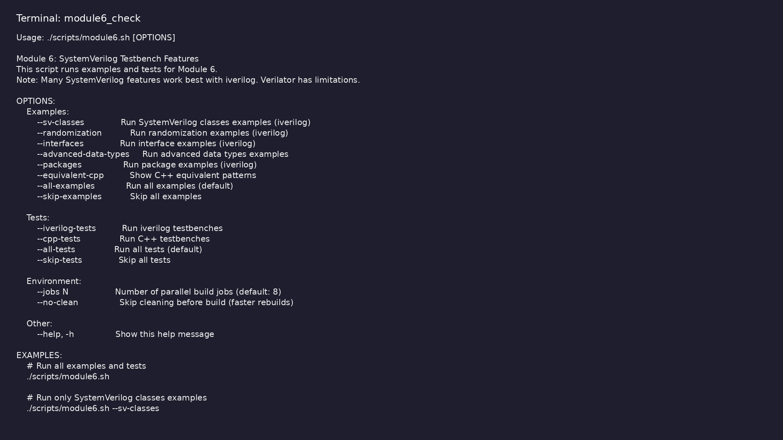
Module 6 self-check
$ ./scripts/module6.sh --help
learn_verilator_iverilog / Module 6
Notes:
Run from course repository root.

Slide 70
Exercise scaffold
./scripts/module6.sh --scaffold
learn_verilator_iverilog / Module 6

Slide 71
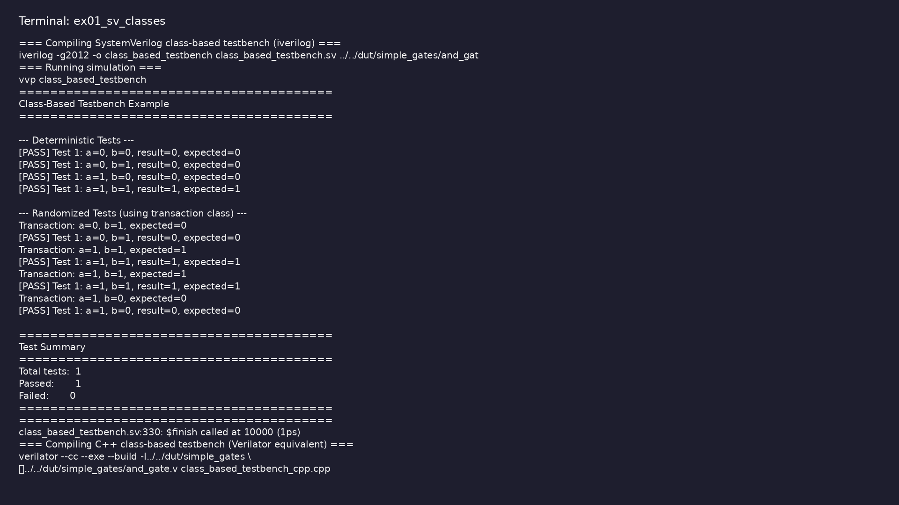
Demo: SV classes
$ cd module6/examples/sv_classes && make all
learn_verilator_iverilog / Module 6
Notes:
Hands-on: module6/examples/sv_classes/

Slide 72
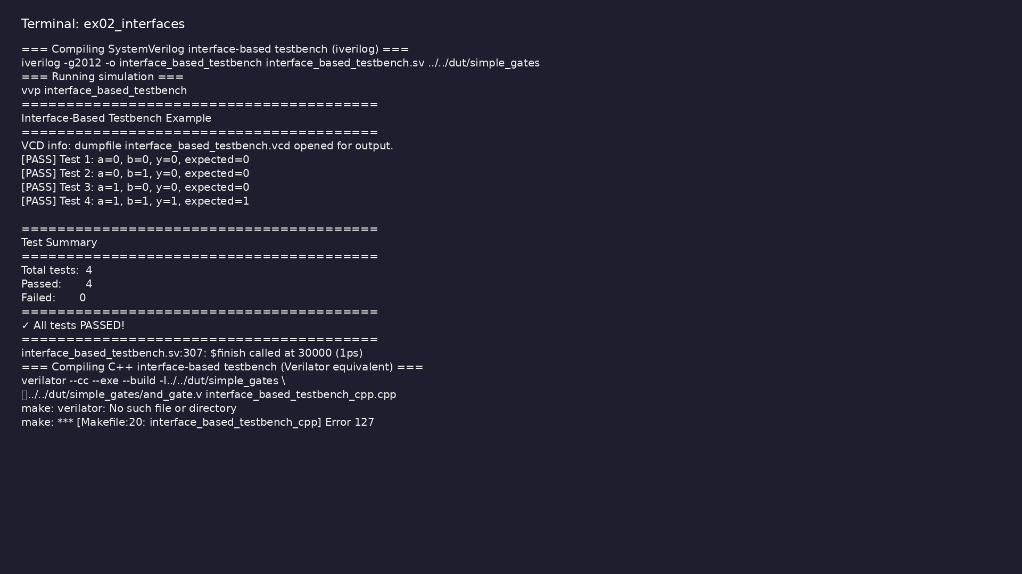
Demo: Interfaces
$ cd module6/examples/interfaces && make all
learn_verilator_iverilog / Module 6
Notes:
Hands-on: module6/examples/interfaces/

Slide 73
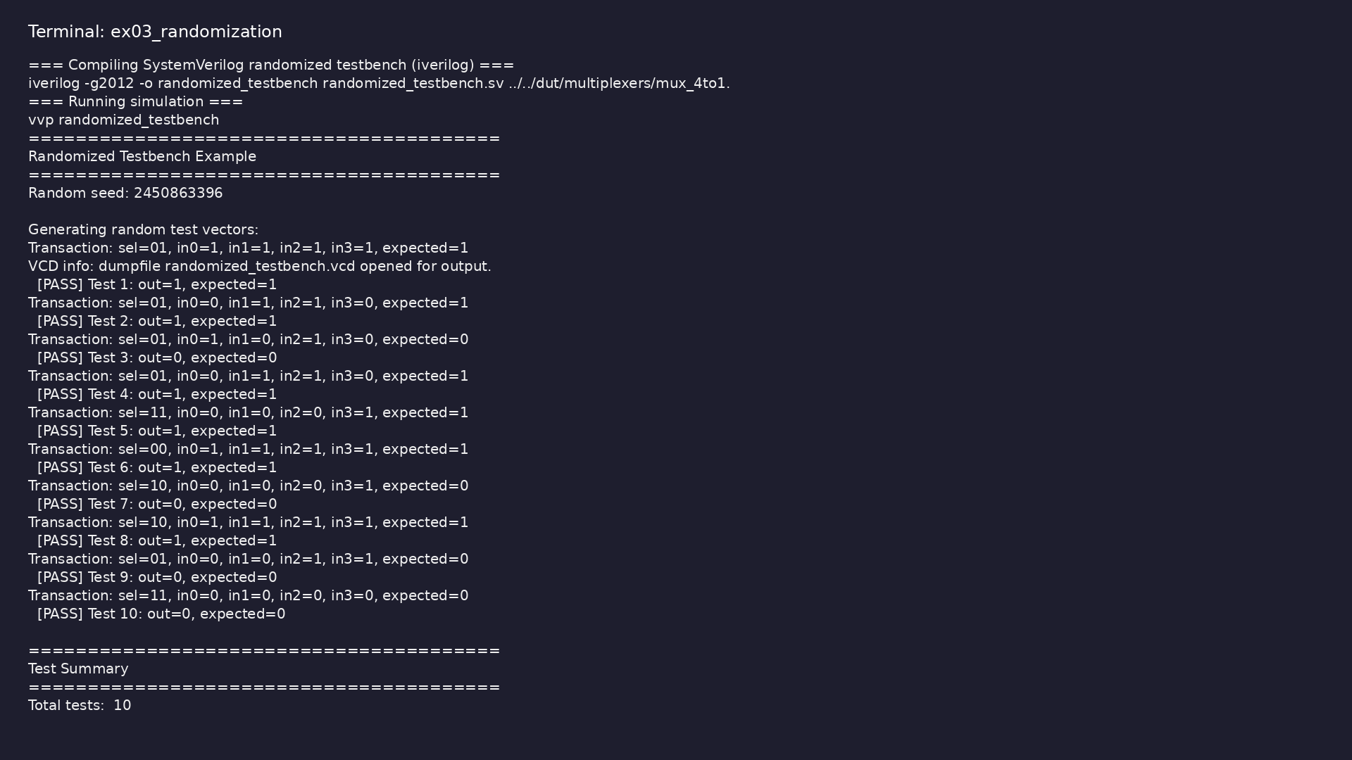
Demo: Randomization
$ cd module6/examples/randomization && make all
learn_verilator_iverilog / Module 6
Notes:
Hands-on: module6/examples/randomization/

Slide 74
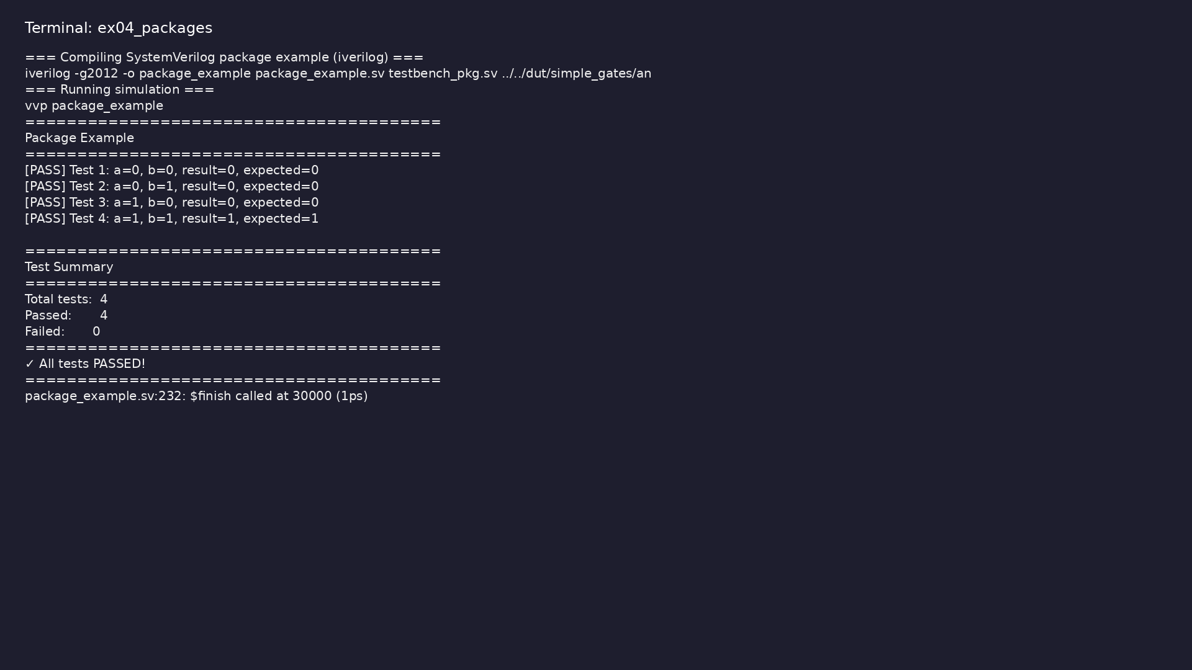
Demo: Packages
$ cd module6/examples/packages && make all
learn_verilator_iverilog / Module 6
Notes:
Hands-on: module6/examples/packages/

Slide 75
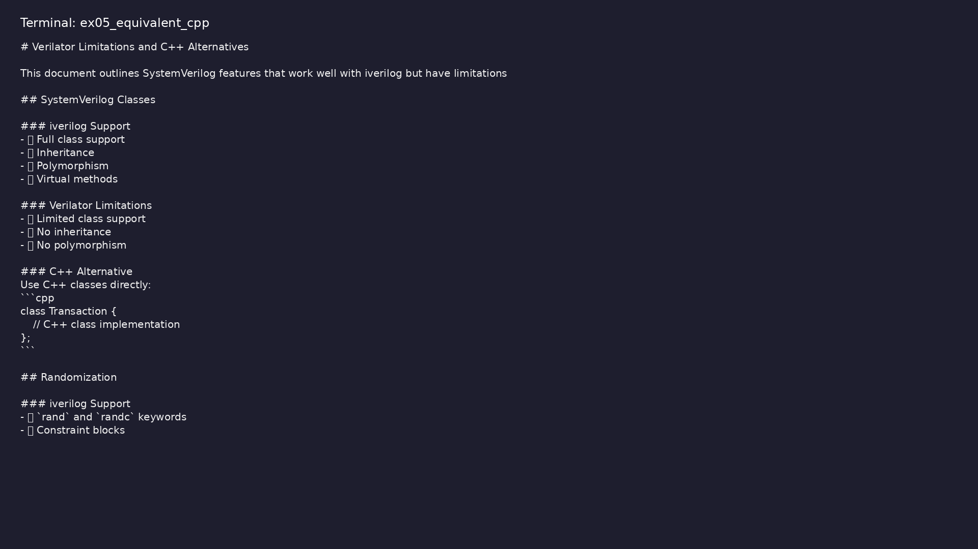
Demo: Equivalent C++
$ head -30 module6/examples/equivalent_cpp/verilator_limitations.md
learn_verilator_iverilog / Module 6
Notes:
Hands-on: module6/examples/equivalent_cpp/

Slide 76
Practice & assessment
learn_verilator_iverilog / Module 6

Slide 77
What you should know (1/9)
• Use SystemVerilog classes in testbenches (iverilog)
• Implement randomization (iverilog)
• Use interfaces effectively (iverilog)
• Apply advanced data types
• Organize code with packages
• Write modern SystemVerilog testbenches
learn_verilator_iverilog / Module 6
Notes:
From MODULE6 Learning Outcomes.

Slide 78
What you should know (2/9)
• Understand Verilator limitations and alternatives
• Use SystemVerilog classes
• Organize testbench with classes
• Compare with procedural approach
• Use rand variables
• Add constraints
learn_verilator_iverilog / Module 6
Notes:
From MODULE6 Learning Outcomes.

Slide 79
What you should know (3/9)
• Generate random tests
• Define interfaces
• Use modports
• Connect DUT via interface
• Use classes for transactions
• Implement transaction sequences
learn_verilator_iverilog / Module 6
Notes:
From MODULE6 Learning Outcomes.

Slide 80
What you should know (4/9)
• Verify transactions
• Create packages
• Share definitions
• Manage namespaces
• Use C++ classes
• Use C++ random number generators
learn_verilator_iverilog / Module 6
Notes:
From MODULE6 Learning Outcomes.

Slide 81
What you should know (5/9)
• Use C++ structs for interfaces
• ✅ Full SystemVerilog class support
• ✅ Randomization support
• ✅ Interface support
• ✅ Package support
• ✅ Advanced data types
learn_verilator_iverilog / Module 6
Notes:
From MODULE6 Learning Outcomes.

Slide 82
What you should know (6/9)
• ❌ Limited SystemVerilog class support
• ❌ Limited randomization support
• ❌ Limited interface support
• ❌ Limited package support
• ✅ Use C++ equivalents instead
• Can use SystemVerilog classes in testbenches
(iverilog)
learn_verilator_iverilog / Module 6
Notes:
From MODULE6 Learning Outcomes.

Slide 83
What you should know (7/9)
• Can implement randomization (iverilog)
• Can use interfaces effectively (iverilog)
• Can apply advanced data types
• Can organize code with packages
• Can write modern SystemVerilog testbenches
• Can understand Verilator limitations and
alternatives
learn_verilator_iverilog / Module 6
Notes:
From MODULE6 Learning Outcomes.

Slide 84
What you should know (8/9)
• Module 7: Coverage and Assertions - Master coverage
and assertion-based verification
• Module 8: Verification Methodology and Best
Practices - Learn industry best practices
• UVM Core Repository: https://github.com/universal-
verification-methodology/core
• Official UVM implementation
• Examples and testbenches
• Documentation and best practices
learn_verilator_iverilog / Module 6
Notes:
From MODULE6 Learning Outcomes.

Slide 85
What you should know (9/9)
• Reference implementations of UVM patterns
learn_verilator_iverilog / Module 6
Notes:
From MODULE6 Learning Outcomes.

Slide 86
Assessment checklist
• Can use SystemVerilog classes in testbenches
(iverilog)
• Can implement randomization (iverilog)
• Can use interfaces effectively (iverilog)
• Can apply advanced data types
• Can organize code with packages
• Can write modern SystemVerilog testbenches
learn_verilator_iverilog / Module 6

Slide 87
Summary & next steps
• Master SystemVerilog features for advanced testbench
development (primarily for iverilog, with Veri…
• Complete module6/CHECKLIST.md
• Review module6/EXAMPLES.md and run each lab
• Next: Next module in course
learn_verilator_iverilog / Module 6

