Slide 1
Module 7
Coverage and Assertions
learn_verilator_iverilog / Module 7

Slide 2
Learning objectives
• Master basic coverage analysis and assertion-based
verification without SystemVerilog dependencies
learn_verilator_iverilog / Module 7

Slide 3
Prerequisites
• See module README
learn_verilator_iverilog / Module 7

Slide 4

Learning path
Master basic coverage analysis and assertion-based verification without SystemVerilog dependencies
learn_verilator_iverilog / Module 7

Slide 5
Overview
• This module covers fundamental coverage analysis and
assertion-based verification using basic Veril…
learn_verilator_iverilog / Module 7

Slide 6
Design architecture
learn_verilator_iverilog / Module 7

Slide 7

1. Observability-focused DUT set
• `dut/simple_gates/`,
`dut/multiplexers/`,
`dut/counters/`: Familiar blocks
for assertion and covera…
• Checkpoints: Internal signals
(count, select, flags) exposed
for bind-style or inline
assertions
• Tool split: Assertions in
SV/Verilog for iverilog; C++
`assert` paths in Verilator
examples
learn_verilator_iverilog / Module 7
Notes:
From MODULE7 Design Architecture.

Slide 8

2. Assertion architecture
• Immediate assertions: `$display`
+ `if` checks in procedural TB
(baseline)
• Concurrent-style patterns:
Properties described in examples
where SVA subset supported
• Assertion libraries: Reusable
check macros/modules in
`assertion_libraries/` examples
• Failure action: `$error` /
`fatal` or abort simulation with
non-zero status
learn_verilator_iverilog / Module 7
Notes:
From MODULE7 Design Architecture.

Slide 9

3. Coverage model architecture
• Functional coverage points:
User-defined bins on opcodes,
states, or cross terms
• Code coverage: Line/branch
awareness via simulator reports
where available
• Feedback loop: Coverage holes
drive new directed or random
tests (documented in guides)
learn_verilator_iverilog / Module 7
Notes:
From MODULE7 Design Architecture.

Slide 10
RTL block diagram (reference)
Module 7: DUT hierarchy and signal flow.
learn_verilator_iverilog / Module 7

Slide 11
Verification / testbench diagram (reference)
Module 7: stimulus, observation, and checking.
learn_verilator_iverilog / Module 7

Slide 12
Assertions Makefile — compile DUT+TB
basic_assertions_verilog: basic_assertions_verilog.v
@echo "=== Compiling Verilog assertions example ==="
$(IVERILOG) -g2012 -o basic_assertions
basic_assertions_verilog.v $(DUT_DIR)/counters/counter_4bit.v
@echo "=== Running simulation ==="
$(VVP) basic_assertions
learn_verilator_iverilog / Module 7
Notes:
iverilog -g2012 links counter DUT with assertion TB.

Slide 13
Clocked assertion check
// Clock generation
initial begin
clk = 0;
forever #10 clk = ~clk;
end
// Assertion: Reset should clear counter
always @(posedge clk) begin
if (!rst_n) begin
assertion_count = assertion_count + 1;
if (count == 4'b0000) begin
assertion_pass = assertion_pass + 1;
$display("[ASSERT PASS] Reset assertion: count is 0 when
rst_n=0");
end else begin
assertion_fail = assertion_fail + 1;
$display("[ASSERT FAIL] Reset assertion: count should be
0 when rst_n=0, got %0d", count);
learn_verilator_iverilog / Module 7
Notes:
always @(posedge clk) verify property; count pass/fail.

Slide 14
DUT under assertion test
// Instantiate DUT
counter_4bit dut (
.clk(clk),
.rst_n(rst_n),
.en(en),
.count(count)
);
learn_verilator_iverilog / Module 7
Notes:
counter_4bit instantiated; assertions observe count and reset.

Slide 15
Execution & simulation flow
learn_verilator_iverilog / Module 7

Slide 16
How the example runs (toolchain)
• Makefile: Verilator compiles RTL + SystemVerilog
testbench into a C++ model
• sim_main.cpp: generates clk/rst_n, calls eval()
until $finish
• Directed test (initial block or C++): drive
stimulus, wait for DUT flags
• Self-check: compare outputs; print PASS/FAIL (see
terminal demo slide)
• Repo path: module7/examples/<example>/ — run make
run from that directory
learn_verilator_iverilog / Module 7
Notes:
From MODULE7 — execution and artifact layout.

Slide 17
Directed test execution sequence (1)
• Clocked assertions on posedge
• summary block before $finish
• non-zero fail triggers debug
• Embed checks in TB
• run simulation
learn_verilator_iverilog / Module 7
Notes:
Follow this order when tracing waveforms or debugging.

Slide 18
Directed test execution sequence (2)
• collect assertion_pass/fail
• analyze coverage gaps
• ./scripts/module7.sh --check
learn_verilator_iverilog / Module 7
Notes:
Follow this order when tracing waveforms or debugging.

Slide 19
Run assertion example
basic_assertions_verilog: basic_assertions_verilog.v
@echo "=== Compiling Verilog assertions example ==="
$(IVERILOG) -g2012 -o basic_assertions
basic_assertions_verilog.v $(DUT_DIR)/counters/counter_4bit.v
@echo "=== Running simulation ==="
$(VVP) basic_assertions
learn_verilator_iverilog / Module 7
Notes:
cd module7/examples/assertions && make basic_assertions_verilog

Slide 20
Reset assertion property
// Assertion: Reset should clear counter
always @(posedge clk) begin
if (!rst_n) begin
assertion_count = assertion_count + 1;
if (count == 4'b0000) begin
assertion_pass = assertion_pass + 1;
$display("[ASSERT PASS] Reset assertion: count is 0 when
rst_n=0");
end else begin
assertion_fail = assertion_fail + 1;
$display("[ASSERT FAIL] Reset assertion: count should be
0 when rst_n=0, got %0d", count);
end
end
end
learn_verilator_iverilog / Module 7
Notes:
When !rst_n, count must be 0; log ASSERT PASS or FAIL.

Slide 21
Verification & testing methods
learn_verilator_iverilog / Module 7

Slide 22
1. Assertion-based verification (ABV)
• Property targets: Reset
behavior, one-hot select,
counter monotonicity, no X on
outputs
• Assume/guarantee mindset:
Environment assumptions vs DUT
guarantees in examples
• Debug: Assertion name and time
stamp in failure message — rerun
with VCD at failure cycle
learn_verilator_iverilog / Module 7
Notes:
From MODULE7 Verification & Testing Methods.

Slide 23
2. Coverage-driven closure
• Goals: Target 100% on critical
crosses; accept waived bins with
documented rationale
• Sampling: Coverpoints updated
each transaction or clock in TB
code
• Reports: Text summaries from
`coverage_analysis` examples —
gap list for next tests
learn_verilator_iverilog / Module 7
Notes:
From MODULE7 Verification & Testing Methods.

Slide 24
3. Metrics and sign-off prep
• Pass/fail plus coverage: Exit
criteria require zero assertion
failures and met coverage goals
• Regression: Re-run assertion
suite after RTL/TB edits —
`./scripts/module7.sh --check`
• Bridge to Module 8: Metrics feed
verification plan and sign-off
checklist
learn_verilator_iverilog / Module 7
Notes:
From MODULE7 Verification & Testing Methods.

Slide 25
Assertion library module
/**
* Assertion Library Example - Verilog
*
* Demonstrates:
* - Reusable assertion functions/tasks
* - Assertion organization
* - Assertion library patterns
*
* Usage:
* iverilog -g2012 -o assertion_lib assertion_lib_verilog.v
../dut/simple_gates/and_gate.v
* vvp assertion_lib
*/
`timescale 1ns/1ps
// Assertion library
# ...
learn_verilator_iverilog / Module 7
Notes:
Reusable check macros; include in multiple TBs.

Slide 26
Coverage analysis workflow
# Makefile for coverage analysis examples
# Note: Coverage analysis examples are coming soon
all:
@echo "========================================"
@echo "Coverage Analysis Examples"
@echo "========================================"
@echo "Coverage analysis examples are coming soon."
@echo "See module7/README.md for details."
@echo "========================================"
clean:
@echo "No build artifacts to clean"
.PHONY: all clean
learn_verilator_iverilog / Module 7
Notes:
Run coverage example; review bins for untested select values.

Slide 27
Assertion summary before $finish
// Print assertion summary
$display("");
$display("========================================");
$display("Assertion Summary");
$display("========================================");
$display("Total assertions: %0d", assertion_count);
$display("Passed: %0d", assertion_pass);
$display("Failed: %0d", assertion_fail);
$display("========================================");
if (assertion_fail == 0) begin
$display("✓ All assertions PASSED!");
end else begin
$display("✗ Some assertions FAILED!");
end
# ...
learn_verilator_iverilog / Module 7
Notes:
Print assertion_pass/fail totals; non-zero fail → debug waveforms.

Slide 28
Syllabus topics
learn_verilator_iverilog / Module 7

Slide 29
1. Coverage Fundamentals (1/5)
• What is Coverage?
• Verification completeness
• Coverage metrics
• Coverage goals
• Coverage-driven verification
• Coverage Types (Code, Functional, Toggle)
learn_verilator_iverilog / Module 7
Notes:
From MODULE7 Topics Covered.

Slide 30
1. Coverage Fundamentals (2/5)
• Code coverage
• Functional coverage
• Toggle coverage
• Coverage relationships
• Coverage Metrics
• Coverage percentage
learn_verilator_iverilog / Module 7
Notes:
From MODULE7 Topics Covered.

Slide 31
1. Coverage Fundamentals (3/5)
• Coverage bins
• Coverage goals
• Coverage closure
• Coverage Goals
• Setting coverage targets
• Coverage planning
learn_verilator_iverilog / Module 7
Notes:
From MODULE7 Topics Covered.

Slide 32
1. Coverage Fundamentals (4/5)
• Coverage achievement
• Coverage sign-off
• Coverage-Driven Verification
• Using coverage to guide testing
• Coverage-directed test generation
• Coverage optimization
learn_verilator_iverilog / Module 7
Notes:
From MODULE7 Topics Covered.

Slide 33
1. Coverage Fundamentals (5/5)
• Coverage best practices
learn_verilator_iverilog / Module 7
Notes:
From MODULE7 Topics Covered.

Slide 34
2. Code Coverage (1/6)
• Line Coverage
• Line execution
• Line coverage metrics
• Line coverage analysis
• Branch Coverage
• Branch execution
learn_verilator_iverilog / Module 7
Notes:
From MODULE7 Topics Covered.

Slide 35
2. Code Coverage (2/6)
• Branch coverage metrics
• Branch coverage analysis
• Condition Coverage
• Condition execution
• Condition coverage metrics
• Condition coverage analysis
learn_verilator_iverilog / Module 7
Notes:
From MODULE7 Topics Covered.

Slide 36
2. Code Coverage (3/6)
• Path Coverage
• Path execution
• Path coverage metrics
• Path coverage analysis
• iverilog Coverage Capabilities
• Built-in coverage
learn_verilator_iverilog / Module 7
Notes:
From MODULE7 Topics Covered.

Slide 37
2. Code Coverage (4/6)
• Coverage limitations
• Coverage tools
• Coverage analysis
• Verilator Coverage Capabilities (--coverage)
• Coverage flag
• Coverage generation
learn_verilator_iverilog / Module 7
Notes:
From MODULE7 Topics Covered.

Slide 38
2. Code Coverage (5/6)
• Coverage data
• Coverage analysis
• Coverage Tools and Analysis
• Coverage tools
• Coverage analysis
• Coverage reporting
learn_verilator_iverilog / Module 7
Notes:
From MODULE7 Topics Covered.

Slide 39
2. Code Coverage (6/6)
• Coverage best practices
• `code_coverage_iverilog.v`: Manual code coverage
tracking with iverilog
• `code_coverage_verilator.cpp`: Code coverage with
Verilator (--coverage flag)
learn_verilator_iverilog / Module 7
Notes:
From MODULE7 Topics Covered.

Slide 40
3. Functional Coverage (Manual Implementation) (1/7)
• Functional Coverage Concepts
• Functional coverage definition
• Coverage bins
• Coverage goals
• Coverage metrics
• Manual Functional Coverage Using Counters
learn_verilator_iverilog / Module 7
Notes:
From MODULE7 Topics Covered.

Slide 41
3. Functional Coverage (Manual Implementation) (2/7)
• Counter-based tracking
• Coverage bin implementation
• Coverage collection
• Coverage analysis
• Coverage Bins Implementation (Verilog and C++)
• Bin definition
learn_verilator_iverilog / Module 7
Notes:
From MODULE7 Topics Covered.

Slide 42
3. Functional Coverage (Manual Implementation) (3/7)
• Bin tracking
• Bin coverage
• Bin analysis
• Cross Coverage Using Manual Tracking
• Cross coverage definition
• Cross coverage tracking
learn_verilator_iverilog / Module 7
Notes:
From MODULE7 Topics Covered.

Slide 43
3. Functional Coverage (Manual Implementation) (4/7)
• Cross coverage analysis
• Cross coverage best practices
• Coverage Collection and Analysis
• Coverage collection
• Coverage storage
• Coverage analysis
learn_verilator_iverilog / Module 7
Notes:
From MODULE7 Topics Covered.

Slide 44
3. Functional Coverage (Manual Implementation) (5/7)
• Coverage reporting
• Verilog: Using $display/$monitor for Coverage
Tracking
• Display-based tracking
• Monitor-based tracking
• Coverage logging
• Coverage analysis
learn_verilator_iverilog / Module 7
Notes:
From MODULE7 Topics Covered.

Slide 45
3. Functional Coverage (Manual Implementation) (6/7)
• C++: Using Variables and Data Structures for
Coverage Tracking
• Variable-based tracking
• Data structure tracking
• Coverage storage
• Coverage analysis
• `functional_coverage_verilog.v`: Manual functional
coverage using counters
learn_verilator_iverilog / Module 7
Notes:
From MODULE7 Topics Covered.

Slide 46
3. Functional Coverage (Manual Implementation) (7/7)
• `functional_coverage_cpp.cpp`: Functional coverage
using C++ data structures
learn_verilator_iverilog / Module 7
Notes:
From MODULE7 Topics Covered.

Slide 47
4. Toggle Coverage (1/4)
• Signal Toggling
• Toggle definition
• Toggle tracking
• Toggle metrics
• Toggle analysis
• Toggle Coverage Metrics
learn_verilator_iverilog / Module 7
Notes:
From MODULE7 Topics Covered.

Slide 48
4. Toggle Coverage (2/4)
• Toggle percentage
• Toggle goals
• Toggle closure
• Toggle best practices
• Toggle Analysis
• Toggle identification
learn_verilator_iverilog / Module 7
Notes:
From MODULE7 Topics Covered.

Slide 49
4. Toggle Coverage (3/4)
• Toggle gaps
• Toggle optimization
• Toggle best practices
• Coverage Reporting
• Toggle reports
• Toggle visualization
learn_verilator_iverilog / Module 7
Notes:
From MODULE7 Topics Covered.

Slide 50
4. Toggle Coverage (4/4)
• Toggle documentation
• Toggle best practices
learn_verilator_iverilog / Module 7
Notes:
From MODULE7 Topics Covered.

Slide 51
5. Basic Assertion Concepts (1/7)
• What are Assertions?
• Assertion definition
• Assertion purpose
• Assertion benefits
• Assertion types
• Assertion Purpose and Benefits
learn_verilator_iverilog / Module 7
Notes:
From MODULE7 Topics Covered.

Slide 52
5. Basic Assertion Concepts (2/7)
• Design verification
• Bug detection
• Documentation
• Debugging aid
• Simple Assertion Patterns
• Equality assertions
learn_verilator_iverilog / Module 7
Notes:
From MODULE7 Topics Covered.

Slide 53
5. Basic Assertion Concepts (3/7)
• Range assertions
• Boolean assertions
• Timing assertions
• Verilog: Using if-else for Assertions
• If-else patterns
• Assertion implementation
learn_verilator_iverilog / Module 7
Notes:
From MODULE7 Topics Covered.

Slide 54
5. Basic Assertion Concepts (4/7)
• Error reporting
• Assertion best practices
• Verilog: Using $assert (if supported)
• $assert syntax
• $assert usage
• $assert limitations
learn_verilator_iverilog / Module 7
Notes:
From MODULE7 Topics Covered.

Slide 55
5. Basic Assertion Concepts (5/7)
• $assert best practices
• C++: Using assert() Macro
• assert() syntax
• assert() usage
• assert() limitations
• assert() best practices
learn_verilator_iverilog / Module 7
Notes:
From MODULE7 Topics Covered.

Slide 56
5. Basic Assertion Concepts (6/7)
• C++: Using Custom Assertion Functions
• Custom function design
• Custom function implementation
• Custom function usage
• Custom function best practices
• Error Reporting in Assertions
learn_verilator_iverilog / Module 7
Notes:
From MODULE7 Topics Covered.

Slide 57
5. Basic Assertion Concepts (7/7)
• Error messages
• Error logging
• Error handling
• Error best practices
• `basic_assertions_verilog.v`: Basic assertions using
if-else patterns
• `basic_assertions_cpp.cpp`: Basic assertions using
assert() and custom functions
learn_verilator_iverilog / Module 7
Notes:
From MODULE7 Topics Covered.

Slide 58
6. Assertion Implementation Patterns (1/7)
• Clock-Based Assertions
• Clock synchronization
• Clock-based checks
• Clock assertion patterns
• Clock assertion best practices
• Reset Assertions
learn_verilator_iverilog / Module 7
Notes:
From MODULE7 Topics Covered.

Slide 59
6. Assertion Implementation Patterns (2/7)
• Reset checks
• Reset assertion patterns
• Reset assertion timing
• Reset assertion best practices
• Data Validity Assertions
• Data range checks
learn_verilator_iverilog / Module 7
Notes:
From MODULE7 Topics Covered.

Slide 60
6. Assertion Implementation Patterns (3/7)
• Data validity patterns
• Data assertion implementation
• Data assertion best practices
• Protocol Assertions (Basic Patterns)
• Protocol checks
• Protocol assertion patterns
learn_verilator_iverilog / Module 7
Notes:
From MODULE7 Topics Covered.

Slide 61
6. Assertion Implementation Patterns (4/7)
• Protocol assertion implementation
• Protocol assertion best practices
• Assertion Organization
• Assertion placement
• Assertion grouping
• Assertion hierarchy
learn_verilator_iverilog / Module 7
Notes:
From MODULE7 Topics Covered.

Slide 62
6. Assertion Implementation Patterns (5/7)
• Assertion organization best practices
• Reusable Assertion Functions/Tasks
• Assertion library design
• Assertion library implementation
• Assertion library usage
• Assertion library best practices
learn_verilator_iverilog / Module 7
Notes:
From MODULE7 Topics Covered.

Slide 63
6. Assertion Implementation Patterns (6/7)
• Verilog: Assertion Tasks and Functions
• Task-based assertions
• Function-based assertions
• Assertion organization
• Assertion best practices
• C++: Assertion Helper Functions and Classes
learn_verilator_iverilog / Module 7
Notes:
From MODULE7 Topics Covered.

Slide 64
6. Assertion Implementation Patterns (7/7)
• Function-based assertions
• Class-based assertions
• Assertion organization
• Assertion best practices
• `assertion_lib_verilog.v`: Reusable assertion
library in Verilog
• `assertion_lib_cpp.cpp`: Reusable assertion library
in C++
learn_verilator_iverilog / Module 7
Notes:
From MODULE7 Topics Covered.

Slide 65
7. Coverage Analysis (1/5)
• Coverage Collection
• Coverage data collection
• Coverage storage
• Coverage management
• Coverage best practices
• Coverage Reporting
learn_verilator_iverilog / Module 7
Notes:
From MODULE7 Topics Covered.

Slide 66
7. Coverage Analysis (2/5)
• Coverage report generation
• Coverage report format
• Coverage report analysis
• Coverage report best practices
• Coverage Analysis
• Coverage gap identification
learn_verilator_iverilog / Module 7
Notes:
From MODULE7 Topics Covered.

Slide 67
7. Coverage Analysis (3/5)
• Coverage analysis methods
• Coverage optimization
• Coverage best practices
• Coverage Gaps Identification
• Gap identification
• Gap analysis
learn_verilator_iverilog / Module 7
Notes:
From MODULE7 Topics Covered.

Slide 68
7. Coverage Analysis (4/5)
• Gap closure
• Gap best practices
• Coverage Closure Strategies
• Closure planning
• Closure methods
• Closure achievement
learn_verilator_iverilog / Module 7
Notes:
From MODULE7 Topics Covered.

Slide 69
7. Coverage Analysis (5/5)
• Closure best practices
learn_verilator_iverilog / Module 7
Notes:
From MODULE7 Topics Covered.

Slide 70
8. Coverage-Driven Test Generation (1/6)
• Using Coverage to Guide Testing
• Coverage-directed testing
• Coverage-based test selection
• Coverage optimization
• Coverage best practices
• Coverage-Directed Test Generation
learn_verilator_iverilog / Module 7
Notes:
From MODULE7 Topics Covered.

Slide 71
8. Coverage-Driven Test Generation (2/6)
• Test generation methods
• Test generation strategies
• Test generation optimization
• Test generation best practices
• Coverage Optimization
• Coverage improvement
learn_verilator_iverilog / Module 7
Notes:
From MODULE7 Topics Covered.

Slide 72
8. Coverage-Driven Test Generation (3/6)
• Coverage optimization methods
• Coverage optimization strategies
• Coverage optimization best practices
• Test Selection Based on Coverage
• Test selection methods
• Test selection strategies
learn_verilator_iverilog / Module 7
Notes:
From MODULE7 Topics Covered.

Slide 73
8. Coverage-Driven Test Generation (4/6)
• Test selection optimization
• Test selection best practices
• Location: `module7/examples/code_coverage/`
• Demonstrates: Code coverage tracking and analysis
• Location: `module7/examples/functional_coverage/`
• Demonstrates: Manual functional coverage
implementation
learn_verilator_iverilog / Module 7
Notes:
From MODULE7 Topics Covered.

Slide 74
8. Coverage-Driven Test Generation (5/6)
• Location: `module7/examples/assertions/`
• Demonstrates: Basic assertion patterns and
implementation
• Location: See coverage examples
• Demonstrates: Coverage-driven test generation
• Location: `module7/examples/coverage_analysis/`
(coming soon)
• Demonstrates: Coverage analysis and closure
learn_verilator_iverilog / Module 7
Notes:
From MODULE7 Topics Covered.

Slide 75
8. Coverage-Driven Test Generation (6/6)
• Location: `module7/examples/assertion_libraries/`
• Demonstrates: Reusable assertion libraries
learn_verilator_iverilog / Module 7
Notes:
From MODULE7 Topics Covered.

Slide 76
Hands-on examples
learn_verilator_iverilog / Module 7

Slide 77

Module 7 self-check
$ ./scripts/module7.sh --help
learn_verilator_iverilog / Module 7
Notes:
Run from course repository root.

Slide 78
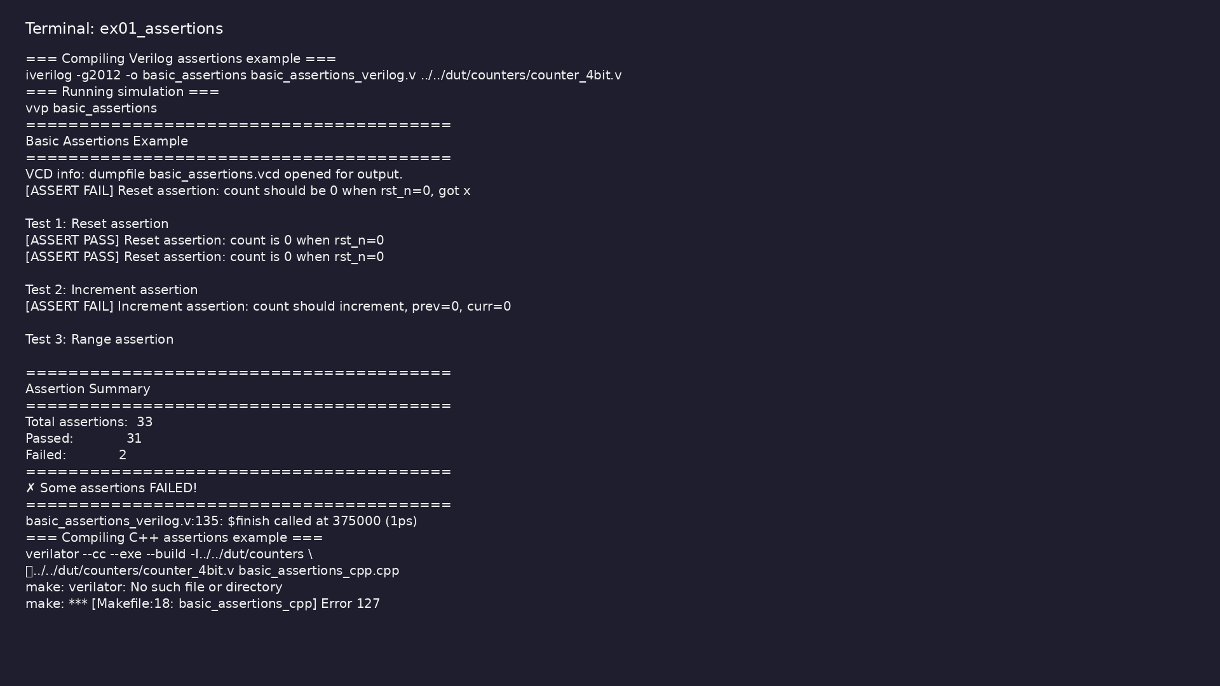
Demo: Assertions
$ cd module7/examples/assertions && make all
learn_verilator_iverilog / Module 7
Notes:
Hands-on: module7/examples/assertions/

Slide 79
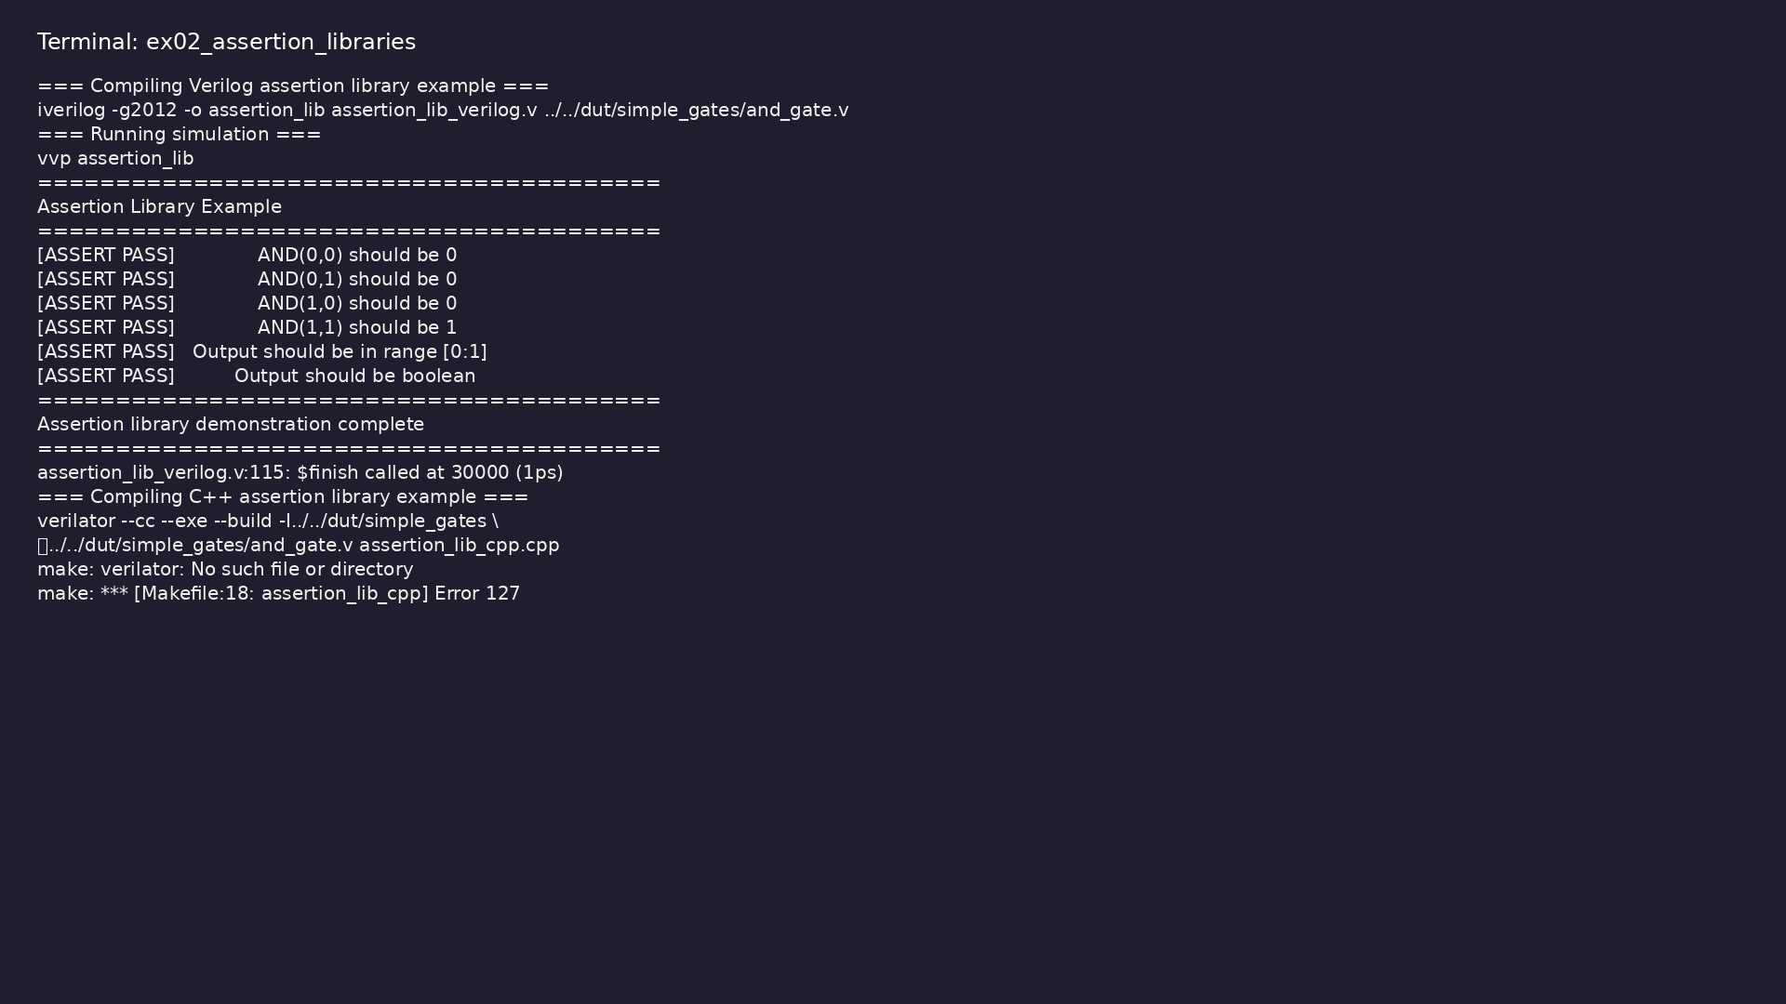
Demo: Assertion libraries
$ cd module7/examples/assertion_libraries && make all
learn_verilator_iverilog / Module 7
Notes:
Hands-on: module7/examples/assertion_libraries/

Slide 80

Demo: Coverage analysis
$ ls -la module7/examples/coverage_analysis
learn_verilator_iverilog / Module 7
Notes:
Hands-on: module7/examples/coverage_analysis/

Slide 81
Practice & assessment
learn_verilator_iverilog / Module 7

Slide 82
What you should know (1/8)
• Understand fundamental coverage concepts
• Measure code coverage with both tools
• Implement manual functional coverage (both
paradigms)
• Write basic assertions in Verilog and C++
• Organize assertions effectively
• Analyze coverage reports
learn_verilator_iverilog / Module 7
Notes:
From MODULE7 Learning Outcomes.

Slide 83
What you should know (2/8)
• Use coverage to guide verification
• Achieve basic coverage closure
• Apply assertion-based verification patterns
• Use tool-specific coverage flags
• Track coverage manually
• Analyze coverage reports
learn_verilator_iverilog / Module 7
Notes:
From MODULE7 Learning Outcomes.

Slide 84
What you should know (3/8)
• Create coverage bins
• Track coverage manually
• Generate coverage reports
• Use C++ data structures
• Track coverage manually
• Generate coverage reports
learn_verilator_iverilog / Module 7
Notes:
From MODULE7 Learning Outcomes.

Slide 85
What you should know (4/8)
• Use if-else patterns
• Create assertion tasks
• Organize assertions
• Use assert() macro
• Create custom assertion functions
• Organize assertions
learn_verilator_iverilog / Module 7
Notes:
From MODULE7 Learning Outcomes.

Slide 86
What you should know (5/8)
• Design reusable assertions
• Organize assertion library
• Use assertion library
• Identify coverage gaps
• Plan coverage closure
• Achieve coverage goals
learn_verilator_iverilog / Module 7
Notes:
From MODULE7 Learning Outcomes.

Slide 87
What you should know (6/8)
• Use coverage to guide testing
• Generate tests based on coverage
• Optimize test selection
• Can understand fundamental coverage concepts
• Can measure code coverage with both tools
• Can implement manual functional coverage (both
paradigms)
learn_verilator_iverilog / Module 7
Notes:
From MODULE7 Learning Outcomes.

Slide 88
What you should know (7/8)
• Can write basic assertions in Verilog and C++
• Can organize assertions effectively
• Can analyze coverage reports
• Can use coverage to guide verification
• Can achieve basic coverage closure
• Can apply assertion-based verification patterns
learn_verilator_iverilog / Module 7
Notes:
From MODULE7 Learning Outcomes.

Slide 89
What you should know (8/8)
• Module 8: Verification Methodology and Best
Practices - Learn industry best practices and
verificat…
• Icarus Verilog Documentation:
http://iverilog.wikia.com/
• Verilator Documentation: https://verilator.org/
• GTKWave Documentation:
http://gtkwave.sourceforge.net/
• IEEE 1364-2005 Standard: Verilog Hardware
Description Language
learn_verilator_iverilog / Module 7
Notes:
From MODULE7 Learning Outcomes.

Slide 90
Assessment checklist
• Can understand fundamental coverage concepts
• Can measure code coverage with both tools
• Can implement manual functional coverage (both
paradigms)
• Can write basic assertions in Verilog and C++
• Can organize assertions effectively
• Can analyze coverage reports
learn_verilator_iverilog / Module 7

Slide 91
Summary & next steps
• Master basic coverage analysis and assertion-based
verification without SystemVerilog dependencies
• Complete module7/CHECKLIST.md
• Review module7/EXAMPLES.md and run each lab
• Next: Next module in course
learn_verilator_iverilog / Module 7

