Slide 1
Module 8
Verification Methodology and Best Practices
learn_verilator_iverilog / Module 8

Slide 2
Learning objectives
• Master verification methodology and industry best
practices
learn_verilator_iverilog / Module 8

Slide 3
Prerequisites
• See module README
learn_verilator_iverilog / Module 8

Slide 4

Learning path
Master verification methodology and industry best practices
learn_verilator_iverilog / Module 8

Slide 5
Overview
• This module focuses on verification methodology,
best practices, and preparing for real-world verif…
learn_verilator_iverilog / Module 8

Slide 6
Design architecture
learn_verilator_iverilog / Module 8

Slide 7

1. End-to-end verification program architecture
• DUT portfolio: Gates, counters,
multiplexers — representative of
prior modules
• TB styles: Modular Verilog TBs
and C++ Verilator TBs under
`tests/`
• Knowledge base: Guides in
`examples/` (planning, metrics,
sign-off, industry practices)
• Automation:
`./scripts/module8.sh`
orchestrates methodology demos,
not just RTL compiles
learn_verilator_iverilog / Module 8
Notes:
From MODULE8 Design Architecture.

Slide 8

2. Layered testbench architecture (production pattern)
• Test layer: Selects scenario,
configures plusargs, sets pass
criteria
• Environment layer: Agents,
scoreboard, coverage collectors
— reusable per project
• DUT layer: RTL with assertions
and optional bind modules
• Tool layer: Simulator choice
(iverilog vs Verilator) per
block complexity and SV needs
learn_verilator_iverilog / Module 8
Notes:
From MODULE8 Design Architecture.

Slide 9

3. Verification infrastructure
• Regression shell: Scripts batch
examples; logs archived for
trend analysis
• Documentation: Test plans,
coding standards, tool
comparison guides in-repo
• Metrics store: Example formats
for coverage/assertion summaries
before sign-off
learn_verilator_iverilog / Module 8
Notes:
From MODULE8 Design Architecture.

Slide 10
RTL block diagram (reference)
Module 8: DUT hierarchy and signal flow.
learn_verilator_iverilog / Module 8

Slide 11
Verification / testbench diagram (reference)
Module 8: stimulus, observation, and checking.
learn_verilator_iverilog / Module 8

Slide 12
Modular TB Makefile
modular_testbench_verilog: modular_testbench_verilog.v
@echo "=== Compiling Verilog modular testbench example ==="
$(IVERILOG) -o modular_testbench modular_testbench_verilog.v
$(DUT_DIR)/multiplexers/mux_4to1.v
@echo "=== Running simulation ==="
$(VVP) modular_testbench
learn_verilator_iverilog / Module 8
Notes:
Compiles reusable generator modules + mux DUT + top TB.

Slide 13
Reusable clock/reset generators
// =====================================================================
=======
// Clock Generator Module (Reusable)
// =====================================================================
=======
module clock_generator #(
parameter PERIOD = 20 // Clock period in ns
)(
output reg clk
);
initial clk = 0;
always #(PERIOD/2) clk = ~clk;
endmodule
// =====================================================================
=======
// Reset Generator Module (Reusable)
// =====================================================================
learn_verilator_iverilog / Module 8
Notes:
Separate clock_generator and reset_generator parameterized modules.

Slide 14
Top TB — wire agents to DUT
module modular_testbench_verilog;
// Parameters (Configurability)
parameter CLOCK_PERIOD = 20;
parameter RESET_DURATION = 100;
parameter NUM_TESTS = 16;
// Signals
wire clk;
wire rst_n;
wire [1:0] sel;
wire [3:0] inputs;
wire out;
wire valid;
wire done;
wire error;
# ...
learn_verilator_iverilog / Module 8
Notes:
clk_gen, rst_gen, stim_gen, dut, monitor, checker, scoreboard hierarchy.

Slide 15
Execution & simulation flow
learn_verilator_iverilog / Module 8

Slide 16
How the example runs (toolchain)
• Makefile: Verilator compiles RTL + SystemVerilog
testbench into a C++ model
• sim_main.cpp: generates clk/rst_n, calls eval()
until $finish
• Directed test (initial block or C++): drive
stimulus, wait for DUT flags
• Self-check: compare outputs; print PASS/FAIL (see
terminal demo slide)
• Repo path: module8/examples/<example>/ — run make
run from that directory
learn_verilator_iverilog / Module 8
Notes:
From MODULE8 — execution and artifact layout.

Slide 17
Directed test execution sequence (1)
• scoreboard aggregates checker results
• metrics tracker reports pass rate and coverage bins
• Plan tests
• run modular environment
• track metrics
learn_verilator_iverilog / Module 8
Notes:
Follow this order when tracing waveforms or debugging.

Slide 18
Directed test execution sequence (2)
• apply tool selection guide
• ./scripts/module8.sh --check for sign-off readiness
• cd module8/examples/testbench_architecture && make
modular_testbench_verilog
learn_verilator_iverilog / Module 8
Notes:
Follow this order when tracing waveforms or debugging.

Slide 19
Metrics tracker build
# Makefile for verification metrics examples
IVERILOG = iverilog
VVP = vvp
VERILATOR = verilator
DUT_DIR = ../../dut
all: metrics_tracker_verilog metrics_tracker_cpp
metrics_tracker_verilog: metrics_tracker_verilog.v
@echo "=== Compiling Verilog metrics tracker example ==="
$(IVERILOG) -o metrics_tracker metrics_tracker_verilog.v
$(DUT_DIR)/simple_gates/and_gate.v
@echo "=== Running simulation ==="
$(VVP) metrics_tracker
metrics_tracker_cpp: metrics_tracker_cpp.cpp
# ...
learn_verilator_iverilog / Module 8
Notes:
cd module8/examples/verification_metrics && make

Slide 20
Checker module — expected vs actual
module checker (
input clk,
input rst_n,
input [1:0] sel,
input [3:0] inputs,
input out,
input valid,
output reg error
);
reg [3:0] expected;
always @(*) begin
if (rst_n && valid) begin
case (sel)
2'b00: expected = inputs[0];
2'b01: expected = inputs[1];
# ...
learn_verilator_iverilog / Module 8
Notes:
checker samples on posedge clk; $error on mismatch.

Slide 21
Verification & testing methods
learn_verilator_iverilog / Module 8

Slide 22
1. Verification planning and strategy
• Test plan: Features → test cases
→ priority → owner → status
• Strategy selection: Directed vs
random vs assertion-heavy per
risk area
• Entry/exit criteria: Definition
of done per milestone (smoke,
feature, full regression)
learn_verilator_iverilog / Module 8
Notes:
From MODULE8 Verification & Testing Methods.

Slide 23
2. Metrics, regression, and debug methodology
• Metrics: Functional coverage,
assertion pass rate, test count,
bug find rate
• Regression: Nightly
`./scripts/module8.sh` style
runs; compare logs to golden
• Debug process: Reproduce →
minimize → fix → add regression
test (examples in
`debugging_methodology…
learn_verilator_iverilog / Module 8
Notes:
From MODULE8 Verification & Testing Methods.

Slide 24
3. Sign-off and industry practice
• Sign-off checklist: Coverage
goals met, zero outstanding
sev-1 assertions, plan executed
• Tool selection: Decision matrix
(iverilog vs Verilator) from
`tool_selection/` guide
• Maintainability: Coding
standards and modular TB rules
for team-scale projects
learn_verilator_iverilog / Module 8
Notes:
From MODULE8 Verification & Testing Methods.

Slide 25
Metrics — test counters
// Metrics tracking
integer total_tests = 0;
integer passed_tests = 0;
integer failed_tests = 0;
integer coverage_bins[0:3];
integer bugs_found = 0;
real start_time;
real end_time;
// Instantiate DUT
and_gate dut (.a(a), .b(b), .y(y));
// Function to calculate coverage
// Note: Verilog requires functions to have at least one input port
function real calculate_coverage;
input dummy; // Dummy input to satisfy Verilog requirement
# ...
learn_verilator_iverilog / Module 8
Notes:
total_tests, passed_tests, failed_tests, coverage_bins tracking.

Slide 26
Tool selection criteria
# Tool Selection and Integration Guide
This guide helps you choose between iverilog and Verilator for your
verification projects.
## When to Use iverilog
### Advantages
- **Full Verilog/SystemVerilog Support**: Supports most Verilog and
SystemVerilog features
- **Standard Compliance**: Better compliance with IEEE standards
- **Interactive Debugging**: Better support for interactive debugging
- **Waveform Generation**: Built-in VCD generation
- **SystemVerilog Features**: Supports classes, interfaces, packages,
etc.
### Best For
- SystemVerilog testbenches
learn_verilator_iverilog / Module 8
Notes:
When iverilog vs Verilator; SV feature needs vs performance.

Slide 27
Sign-off metrics report
$display(" Coverage: %.1f%%", coverage);
bin_count = 0;
for (i = 0; i < 4; i = i + 1) begin
if (coverage_bins[i]) bin_count = bin_count + 1;
end
$display(" Coverage bins: %0d/4", bin_count);
$display("");
$display("Bug Metrics:");
$display(" Bugs found: %0d", bugs_found);
$display("");
$display("Quality Metrics:");
$display(" Test time: %.1f ns", test_time);
$display(" Tests/sec: %.1f", total_tests / (test_time
/ 1000.0));
$display("========================================");
end
endtask
# ...
learn_verilator_iverilog / Module 8
Notes:
Final $display of pass rate and coverage before regression sign-off.

Slide 28
Syllabus topics
learn_verilator_iverilog / Module 8

Slide 29
1. Verification Planning (1/5)
• Test Plan Development
• Test plan structure
• Test plan content
• Test plan review
• Test plan maintenance
• Verification Strategy
learn_verilator_iverilog / Module 8
Notes:
From MODULE8 Topics Covered.

Slide 30
1. Verification Planning (2/5)
• Strategy definition
• Strategy selection
• Strategy implementation
• Strategy evaluation
• Test Case Identification
• Test case types
learn_verilator_iverilog / Module 8
Notes:
From MODULE8 Topics Covered.

Slide 31
1. Verification Planning (3/5)
• Test case identification
• Test case prioritization
• Test case documentation
• Coverage Planning
• Coverage goals
• Coverage strategy
learn_verilator_iverilog / Module 8
Notes:
From MODULE8 Topics Covered.

Slide 32
1. Verification Planning (4/5)
• Coverage tracking
• Coverage closure
• Resource Estimation
• Resource planning
• Resource allocation
• Resource tracking
learn_verilator_iverilog / Module 8
Notes:
From MODULE8 Topics Covered.

Slide 33
1. Verification Planning (5/5)
• Resource optimization
learn_verilator_iverilog / Module 8
Notes:
From MODULE8 Topics Covered.

Slide 34
2. Testbench Architecture Best Practices (1/5)
• Modular Design Principles
• Module separation
• Interface definition
• Module communication
• Module testing
• Reusability Strategies
learn_verilator_iverilog / Module 8
Notes:
From MODULE8 Topics Covered.

Slide 35
2. Testbench Architecture Best Practices (2/5)
• Reusable components
• Component libraries
• Component configuration
• Component documentation
• Configurability
• Parameterization
learn_verilator_iverilog / Module 8
Notes:
From MODULE8 Topics Covered.

Slide 36
2. Testbench Architecture Best Practices (3/5)
• Configuration management
• Configuration testing
• Configuration documentation
• Maintainability
• Code organization
• Code documentation
learn_verilator_iverilog / Module 8
Notes:
From MODULE8 Topics Covered.

Slide 37
2. Testbench Architecture Best Practices (4/5)
• Code review
• Code refactoring
• Scalability
• Scalable architecture
• Performance optimization
• Resource management
learn_verilator_iverilog / Module 8
Notes:
From MODULE8 Topics Covered.

Slide 38
2. Testbench Architecture Best Practices (5/5)
• Growth planning
• `modular_testbench_verilog.v`: Well-structured
modular testbench in Verilog
• `modular_testbench_cpp.cpp`: Well-structured modular
testbench in C++
learn_verilator_iverilog / Module 8
Notes:
From MODULE8 Topics Covered.

Slide 39
3. Coding Standards for Testbenches (1/5)
• Naming Conventions
• Module naming
• Signal naming
• Parameter naming
• Function/task naming
• Code Organization
learn_verilator_iverilog / Module 8
Notes:
From MODULE8 Topics Covered.

Slide 40
3. Coding Standards for Testbenches (2/5)
• File structure
• Module organization
• Function organization
• Code layout
• Commenting Standards
• Header comments
learn_verilator_iverilog / Module 8
Notes:
From MODULE8 Topics Covered.

Slide 41
3. Coding Standards for Testbenches (3/5)
• Inline comments
• Section comments
• Documentation comments
• Documentation Practices
• README files
• Code documentation
learn_verilator_iverilog / Module 8
Notes:
From MODULE8 Topics Covered.

Slide 42
3. Coding Standards for Testbenches (4/5)
• Test documentation
• User guides
• Style Guides
• Verilog style
• C++ style
• Consistency
learn_verilator_iverilog / Module 8
Notes:
From MODULE8 Topics Covered.

Slide 43
3. Coding Standards for Testbenches (5/5)
• Tools
• `coding_standards_guide.md`: Comprehensive coding
standards guide
learn_verilator_iverilog / Module 8
Notes:
From MODULE8 Topics Covered.

Slide 44
4. Verification Metrics (1/5)
• Coverage Metrics
• Code coverage
• Functional coverage
• Toggle coverage
• Coverage analysis
• Bug Metrics
learn_verilator_iverilog / Module 8
Notes:
From MODULE8 Topics Covered.

Slide 45
4. Verification Metrics (2/5)
• Bug tracking
• Bug analysis
• Bug closure
• Bug reporting
• Test Metrics
• Test count
learn_verilator_iverilog / Module 8
Notes:
From MODULE8 Topics Covered.

Slide 46
4. Verification Metrics (3/5)
• Test pass rate
• Test execution time
• Test efficiency
• Progress Tracking
• Progress measurement
• Progress reporting
learn_verilator_iverilog / Module 8
Notes:
From MODULE8 Topics Covered.

Slide 47
4. Verification Metrics (4/5)
• Progress analysis
• Progress optimization
• Quality Metrics
• Quality measurement
• Quality analysis
• Quality improvement
learn_verilator_iverilog / Module 8
Notes:
From MODULE8 Topics Covered.

Slide 48
4. Verification Metrics (5/5)
• Quality reporting
• `metrics_tracker_verilog.v`: Metrics tracking in
Verilog
• `metrics_tracker_cpp.cpp`: Metrics tracking in C++
learn_verilator_iverilog / Module 8
Notes:
From MODULE8 Topics Covered.

Slide 49
5. Debugging Methodology (1/5)
• Systematic Debugging Approach
• Debugging process
• Debugging steps
• Debugging techniques
• Debugging best practices
• Debugging Tools and Techniques
learn_verilator_iverilog / Module 8
Notes:
From MODULE8 Topics Covered.

Slide 50
5. Debugging Methodology (2/5)
• Waveform viewers
• Logging tools
• Debugging utilities
• Debugging scripts
• Logging Strategies
• Log levels
learn_verilator_iverilog / Module 8
Notes:
From MODULE8 Topics Covered.

Slide 51
5. Debugging Methodology (3/5)
• Log format
• Log management
• Log analysis
• Error Reporting
• Error messages
• Error logging
learn_verilator_iverilog / Module 8
Notes:
From MODULE8 Topics Covered.

Slide 52
5. Debugging Methodology (4/5)
• Error tracking
• Error analysis
• Root Cause Analysis
• Problem identification
• Cause analysis
• Solution development
learn_verilator_iverilog / Module 8
Notes:
From MODULE8 Topics Covered.

Slide 53
5. Debugging Methodology (5/5)
• Solution verification
learn_verilator_iverilog / Module 8
Notes:
From MODULE8 Topics Covered.

Slide 54
6. Regression Testing (1/5)
• Regression Test Suite Organization
• Test suite structure
• Test organization
• Test categorization
• Test maintenance
• Test Selection Strategies
learn_verilator_iverilog / Module 8
Notes:
From MODULE8 Topics Covered.

Slide 55
6. Regression Testing (2/5)
• Test selection methods
• Test prioritization
• Test optimization
• Test efficiency
• Automation
• Test automation
learn_verilator_iverilog / Module 8
Notes:
From MODULE8 Topics Covered.

Slide 56
6. Regression Testing (3/5)
• Build automation
• Report automation
• Automation tools
• Continuous Integration
• CI setup
• CI workflows
learn_verilator_iverilog / Module 8
Notes:
From MODULE8 Topics Covered.

Slide 57
6. Regression Testing (4/5)
• CI best practices
• CI maintenance
• Regression Analysis
• Regression detection
• Regression analysis
• Regression reporting
learn_verilator_iverilog / Module 8
Notes:
From MODULE8 Topics Covered.

Slide 58
6. Regression Testing (5/5)
• Regression closure
learn_verilator_iverilog / Module 8
Notes:
From MODULE8 Topics Covered.

Slide 59
7. Verification Sign-Off (1/5)
• Sign-Off Criteria
• Criteria definition
• Criteria measurement
• Criteria achievement
• Criteria documentation
• Coverage Closure
learn_verilator_iverilog / Module 8
Notes:
From MODULE8 Topics Covered.

Slide 60
7. Verification Sign-Off (2/5)
• Coverage goals
• Coverage achievement
• Coverage verification
• Coverage documentation
• Bug Closure
• Bug resolution
learn_verilator_iverilog / Module 8
Notes:
From MODULE8 Topics Covered.

Slide 61
7. Verification Sign-Off (3/5)
• Bug verification
• Bug documentation
• Bug closure process
• Documentation Requirements
• Documentation types
• Documentation content
learn_verilator_iverilog / Module 8
Notes:
From MODULE8 Topics Covered.

Slide 62
7. Verification Sign-Off (4/5)
• Documentation review
• Documentation maintenance
• Review Process
• Review preparation
• Review execution
• Review follow-up
learn_verilator_iverilog / Module 8
Notes:
From MODULE8 Topics Covered.

Slide 63
7. Verification Sign-Off (5/5)
• Review closure
learn_verilator_iverilog / Module 8
Notes:
From MODULE8 Topics Covered.

Slide 64
8. Tool Selection and Integration (1/6)
• When to Use iverilog
• Use cases
• Advantages
• Limitations
• Best practices
• When to Use Verilator
learn_verilator_iverilog / Module 8
Notes:
From MODULE8 Topics Covered.

Slide 65
8. Tool Selection and Integration (2/6)
• Use cases
• Advantages
• Limitations
• Best practices
• Tool Comparison and Trade-offs
• Feature comparison
learn_verilator_iverilog / Module 8
Notes:
From MODULE8 Topics Covered.

Slide 66
8. Tool Selection and Integration (3/6)
• Performance comparison
• Cost comparison
• Selection criteria
• Performance Considerations
• Simulation speed
• Memory usage
learn_verilator_iverilog / Module 8
Notes:
From MODULE8 Topics Covered.

Slide 67
8. Tool Selection and Integration (4/6)
• Compilation time
• Optimization
• Feature Comparison
• Verilog support
• SystemVerilog support
• Testbench support
learn_verilator_iverilog / Module 8
Notes:
From MODULE8 Topics Covered.

Slide 68
8. Tool Selection and Integration (5/6)
• Coverage support
• Hybrid Approaches
• Tool combination
• Workflow integration
• Best practices
• Examples
learn_verilator_iverilog / Module 8
Notes:
From MODULE8 Topics Covered.

Slide 69
8. Tool Selection and Integration (6/6)
• `tool_comparison_guide.md`: Tool selection and
comparison guide
learn_verilator_iverilog / Module 8
Notes:
From MODULE8 Topics Covered.

Slide 70
9. Project Management (1/5)
• Verification Project Planning
• Project planning
• Project structure
• Project execution
• Project closure
• Resource Management
learn_verilator_iverilog / Module 8
Notes:
From MODULE8 Topics Covered.

Slide 71
9. Project Management (2/5)
• Resource planning
• Resource allocation
• Resource tracking
• Resource optimization
• Schedule Management
• Schedule planning
learn_verilator_iverilog / Module 8
Notes:
From MODULE8 Topics Covered.

Slide 72
9. Project Management (3/5)
• Schedule tracking
• Schedule optimization
• Schedule reporting
• Risk Management
• Risk identification
• Risk analysis
learn_verilator_iverilog / Module 8
Notes:
From MODULE8 Topics Covered.

Slide 73
9. Project Management (4/5)
• Risk mitigation
• Risk monitoring
• Communication and Reporting
• Communication plan
• Reporting structure
• Reporting frequency
learn_verilator_iverilog / Module 8
Notes:
From MODULE8 Topics Covered.

Slide 74
9. Project Management (5/5)
• Reporting tools
learn_verilator_iverilog / Module 8
Notes:
From MODULE8 Topics Covered.

Slide 75
10. Industry Practices (1/7)
• Open-Source Verification Tools
• Tool ecosystem
• Tool selection
• Tool integration
• Tool maintenance
• Industry Standards
learn_verilator_iverilog / Module 8
Notes:
From MODULE8 Topics Covered.

Slide 76
10. Industry Practices (2/7)
• IEEE standards
• Industry practices
• Compliance
• Certification
• Tool Ecosystems
• Tool integration
learn_verilator_iverilog / Module 8
Notes:
From MODULE8 Topics Covered.

Slide 77
10. Industry Practices (3/7)
• Tool workflows
• Tool best practices
• Tool evolution
• Career Development
• Skill development
• Career paths
learn_verilator_iverilog / Module 8
Notes:
From MODULE8 Topics Covered.

Slide 78
10. Industry Practices (4/7)
• Professional growth
• Continuing education
• Continuing Education
• Learning resources
• Training programs
• Certifications
learn_verilator_iverilog / Module 8
Notes:
From MODULE8 Topics Covered.

Slide 79
10. Industry Practices (5/7)
• Professional development
• Transition to Commercial Tools
• Tool evaluation
• Tool migration
• Tool training
• Tool adoption
learn_verilator_iverilog / Module 8
Notes:
From MODULE8 Topics Covered.

Slide 80
10. Industry Practices (6/7)
• Location: See testbench architecture examples
• Demonstrates: Complete verification environment
following best practices
• Location: `module8/examples/testbench_architecture/`
• Demonstrates: Modular, reusable, configurable
testbench architecture
• Location: See coding standards and guides
• Demonstrates: Comprehensive documentation practices
learn_verilator_iverilog / Module 8
Notes:
From MODULE8 Topics Covered.

Slide 81
10. Industry Practices (7/7)
• Location: See verification metrics examples
• Demonstrates: Metrics tracking and sign-off criteria
• Location: Various example directories
• Demonstrates: Best practices and methodologies
learn_verilator_iverilog / Module 8
Notes:
From MODULE8 Topics Covered.

Slide 82
Hands-on examples
learn_verilator_iverilog / Module 8

Slide 83
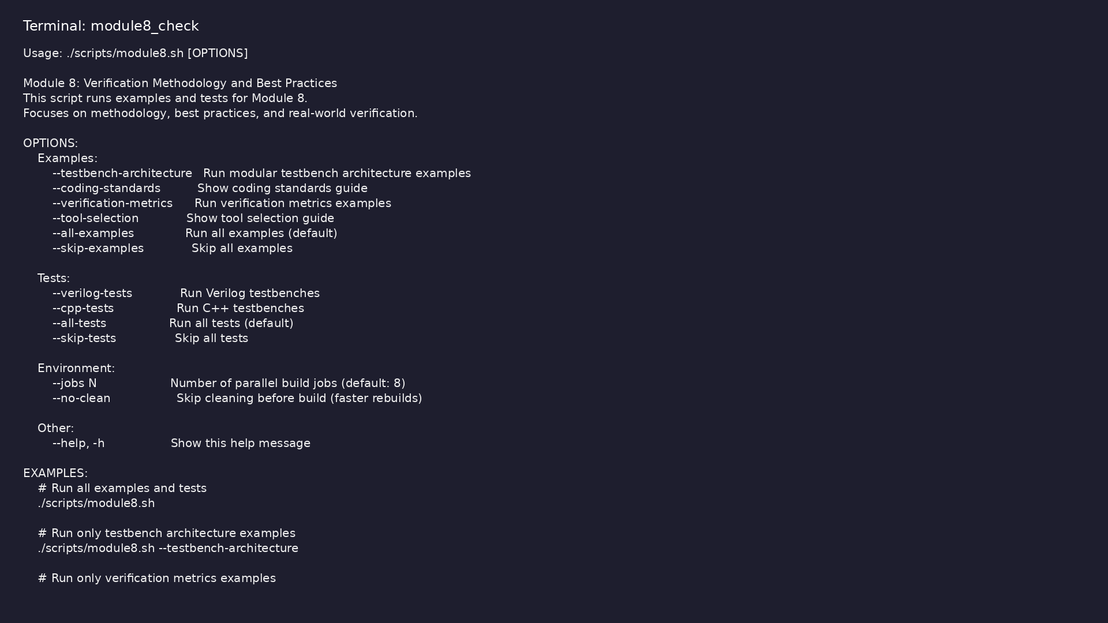
Module 8 self-check
$ ./scripts/module8.sh --help
learn_verilator_iverilog / Module 8
Notes:
Run from course repository root.

Slide 84
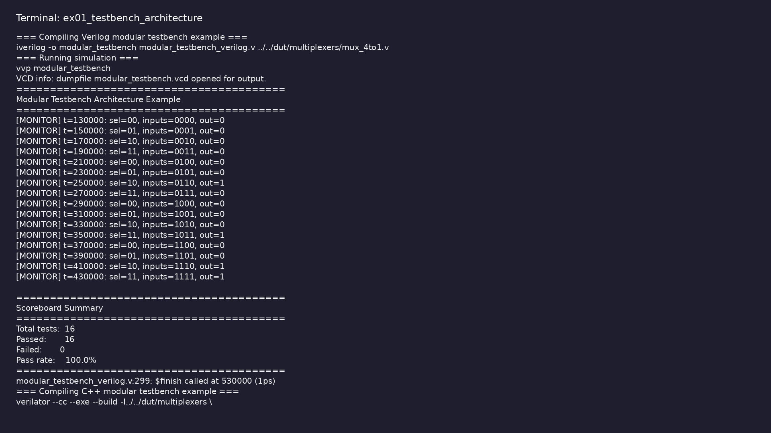
Demo: Testbench architecture
$ cd module8/examples/testbench_architecture && make all
learn_verilator_iverilog / Module 8
Notes:
Hands-on: module8/examples/testbench_architecture/

Slide 85

Demo: Verification metrics
$ cd module8/examples/verification_metrics && make all
learn_verilator_iverilog / Module 8
Notes:
Hands-on: module8/examples/verification_metrics/

Slide 86

Demo: Tool selection
$ head -25 module8/examples/tool_selection/tool_comparison_guide.md
learn_verilator_iverilog / Module 8
Notes:
Hands-on: module8/examples/tool_selection/

Slide 87

Demo: Coding standards
$ head -25 module8/examples/coding_standards/coding_standards_guide.md
learn_verilator_iverilog / Module 8
Notes:
Hands-on: module8/examples/coding_standards/

Slide 88
Practice & assessment
learn_verilator_iverilog / Module 8

Slide 89
What you should know (1/9)
• Plan verification projects
• Apply best practices
• Measure verification progress
• Debug systematically
• Manage regression testing
• Achieve verification sign-off
learn_verilator_iverilog / Module 8
Notes:
From MODULE8 Learning Outcomes.

Slide 90
What you should know (2/9)
• Apply industry methodologies
• Develop test plan
• Identify test cases
• Plan coverage
• Estimate resources
• Apply modular design
learn_verilator_iverilog / Module 8
Notes:
From MODULE8 Learning Outcomes.

Slide 91
What you should know (3/9)
• Follow coding standards
• Implement reusable components
• Document thoroughly
• Organize test suite
• Automate execution
• Track results
learn_verilator_iverilog / Module 8
Notes:
From MODULE8 Learning Outcomes.

Slide 92
What you should know (4/9)
• Analyze regressions
• Document test plan
• Document testbenches
• Document results
• Create sign-off package
• Achieve coverage closure
learn_verilator_iverilog / Module 8
Notes:
From MODULE8 Learning Outcomes.

Slide 93
What you should know (5/9)
• Close all bugs
• Complete documentation
• Review and sign-off
• Can plan verification projects
• Can apply best practices
• Can measure verification progress
learn_verilator_iverilog / Module 8
Notes:
From MODULE8 Learning Outcomes.

Slide 94
What you should know (6/9)
• Can debug systematically
• Can manage regression testing
• Can achieve verification sign-off
• Can apply industry methodologies
• UVM Methodology: Advanced verification with UVM (see
learn_uvm2017_sv_verilator repository)
• Formal Verification: Property-based verification
learn_verilator_iverilog / Module 8
Notes:
From MODULE8 Learning Outcomes.

Slide 95
What you should know (7/9)
• Advanced Topics: Power verification, performance
verification
• Industry Projects: Apply skills to real-world
projects
• Commercial Tools: Transition to VCS, QuestaSim,
Xcelium
• Icarus Verilog Documentation:
http://iverilog.wikia.com/
• Verilator Documentation: https://verilator.org/
• GTKWave Documentation:
http://gtkwave.sourceforge.net/
learn_verilator_iverilog / Module 8
Notes:
From MODULE8 Learning Outcomes.

Slide 96
What you should know (8/9)
• IEEE 1364-2005 Standard: Verilog Hardware
Description Language
• IEEE 1800-2017 Standard: SystemVerilog Language
Reference Manual
• Write effective testbenches in Verilog and C++
• Use both iverilog and Verilator
• Apply verification best practices
• Plan and execute verification projects
learn_verilator_iverilog / Module 8
Notes:
From MODULE8 Learning Outcomes.

Slide 97
What you should know (9/9)
• Achieve verification sign-off
learn_verilator_iverilog / Module 8
Notes:
From MODULE8 Learning Outcomes.

Slide 98
Assessment checklist
• Can plan verification projects
• Can apply best practices
• Can measure verification progress
• Can debug systematically
• Can manage regression testing
• Can achieve verification sign-off
learn_verilator_iverilog / Module 8

Slide 99
Summary & next steps
• Master verification methodology and industry best
practices
• Complete module8/CHECKLIST.md
• Review module8/EXAMPLES.md and run each lab
• Next: Next module in course
learn_verilator_iverilog / Module 8

