Slide 1
Module 1
IEEE 1364-1995 (Verilog-95)
learn_verilog_systemverilog / Module 1

Slide 2
Learning objectives
• Master the first standardized Verilog language (IEEE
1364-1995) and its core syntax for RTL design…
learn_verilog_systemverilog / Module 1

Slide 3
Prerequisites
• See module README
learn_verilog_systemverilog / Module 1

Slide 4
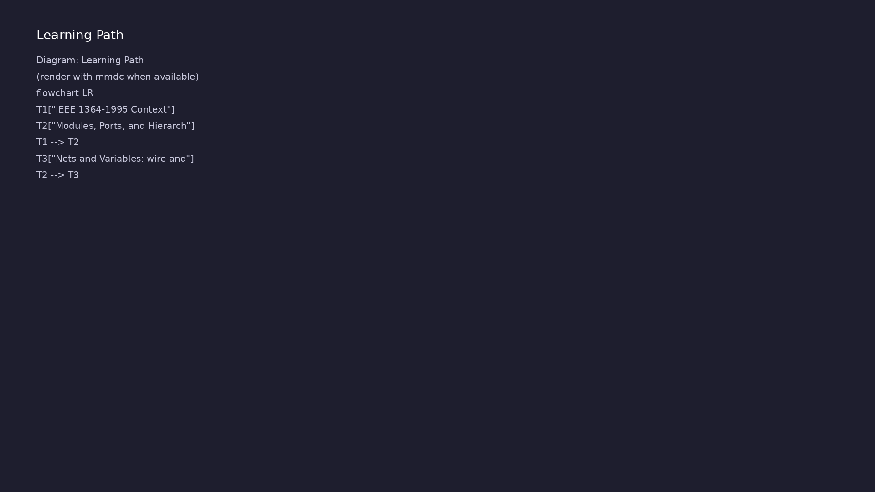
Learning path
Master the first standardized Verilog language (IEEE 1364-1995) and its core syntax for RTL design and simulation.
learn_verilog_systemverilog / Module 1

Slide 5
Overview
• This module establishes the foundation for the
Verilog/SystemVerilog version-centric course.
You'll…
learn_verilog_systemverilog / Module 1

Slide 6
How to learn this module
learn_verilog_systemverilog / Module 1

Slide 7
Suggested learning path (1/2)
• Skim this document — Goal, Overview, and Topics
Covered set the IEEE scope for Module 1.
• Study design architecture — See how DUTs, examples,
and testbenches fit together under `module1/`.
• Work through labs in order — Open
`module1/EXAMPLES.md` and run each `make clean &&
make run` from…
• Run the full module script — `./scripts/module1.sh`
from the repo root to simulate all examples and…
• Complete the exercises — Try each exercise in this
document before reading solutions or peeking at…
learn_verilog_systemverilog / Module 1
Notes:
From docs/MODULE1.md — read guides before running demos.

Slide 8
Suggested learning path (2/2)
• Review Common Pitfalls — Can you explain each
mistake and the fix?
• Self-check — Use `module1/CHECKLIST.md` before
starting the next module.
learn_verilog_systemverilog / Module 1
Notes:
From docs/MODULE1.md — read guides before running demos.

Slide 9
Design architecture
learn_verilog_systemverilog / Module 1

Slide 10

1. Repository layout (module1/) (1/2)
• docs/MODULE1.md — syllabus,
pitfalls, and exercises
• module1/examples/ — nine hands-
on labs, each with Makefile and
README
• module1/dut/simple_gates/ —
reference AND/OR/NOT gates in
1995 style
• module1/tests/ — standalone
testbenches (and_gate, mux2)
learn_verilog_systemverilog / Module 1
Notes:
From MODULE1 Design Architecture.

Slide 11
1. Repository layout (module1/) (2/2)
• scripts/module1.sh — runs every example and test
from the repo root
learn_verilog_systemverilog / Module 1
Notes:
From MODULE1 Design Architecture.

Slide 12
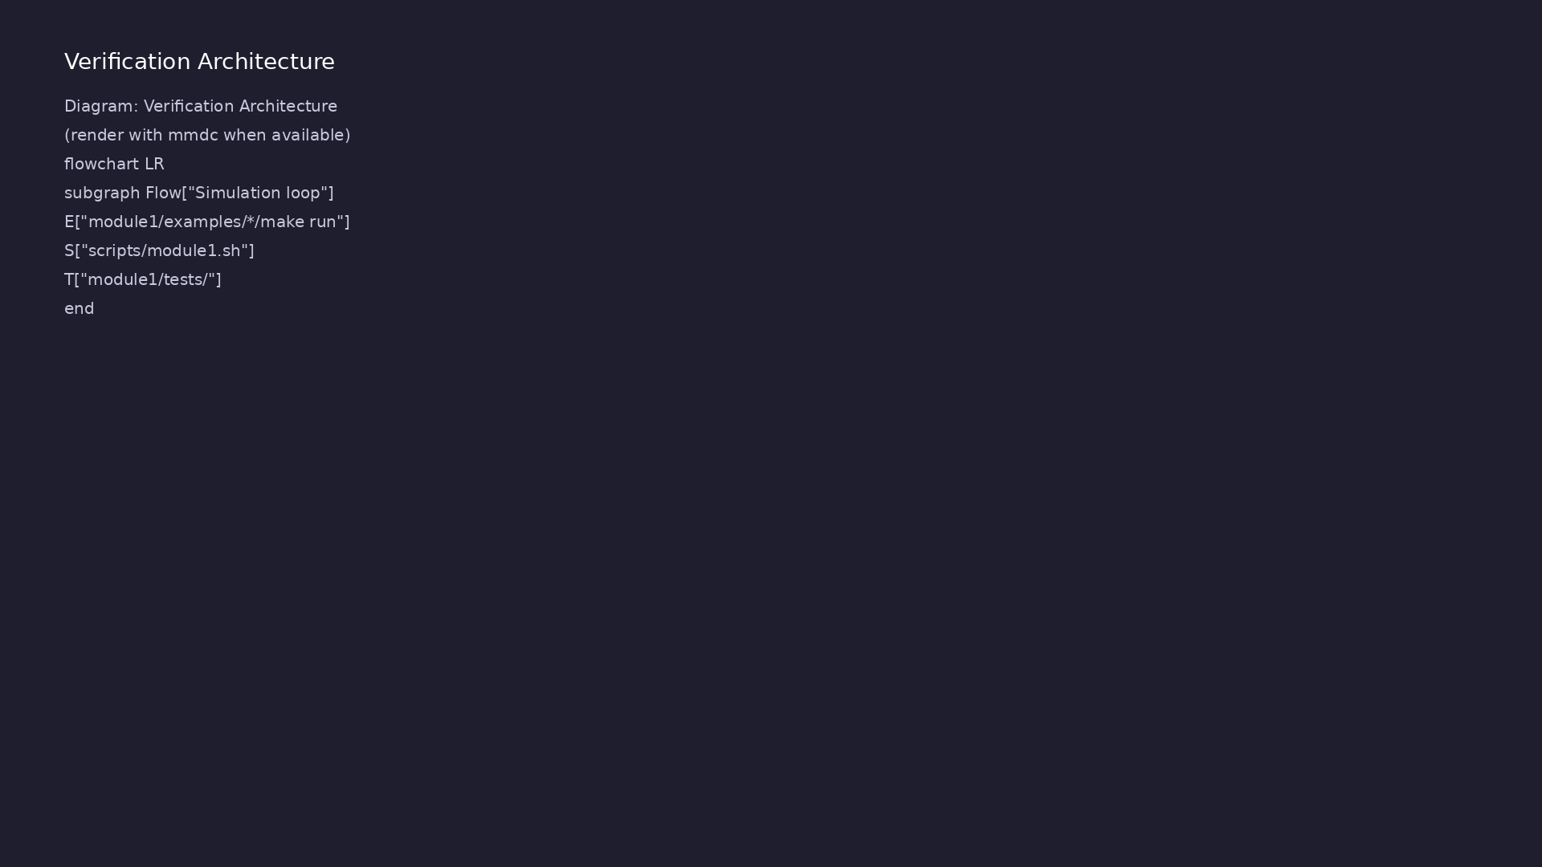
2. RTL hierarchy and signal flow (1/2)
• Leaf modules (and_gate, mux2,
dff) expose ports; top or
testbench wires them
• Inputs driven by reg in
initial/always; outputs observed
as wire
• Combinational logic uses assign
or always @(a or b …) with
blocking =
• Sequential logic uses always
@(posedge clk) with nonblocking
<=
learn_verilog_systemverilog / Module 1
Notes:
From MODULE1 Design Architecture.

Slide 13
2. RTL hierarchy and signal flow (2/2)
• See rtl_architecture.png — testbench stimulus flows
into DUT, checks via $display
learn_verilog_systemverilog / Module 1
Notes:
From MODULE1 Design Architecture.

Slide 14
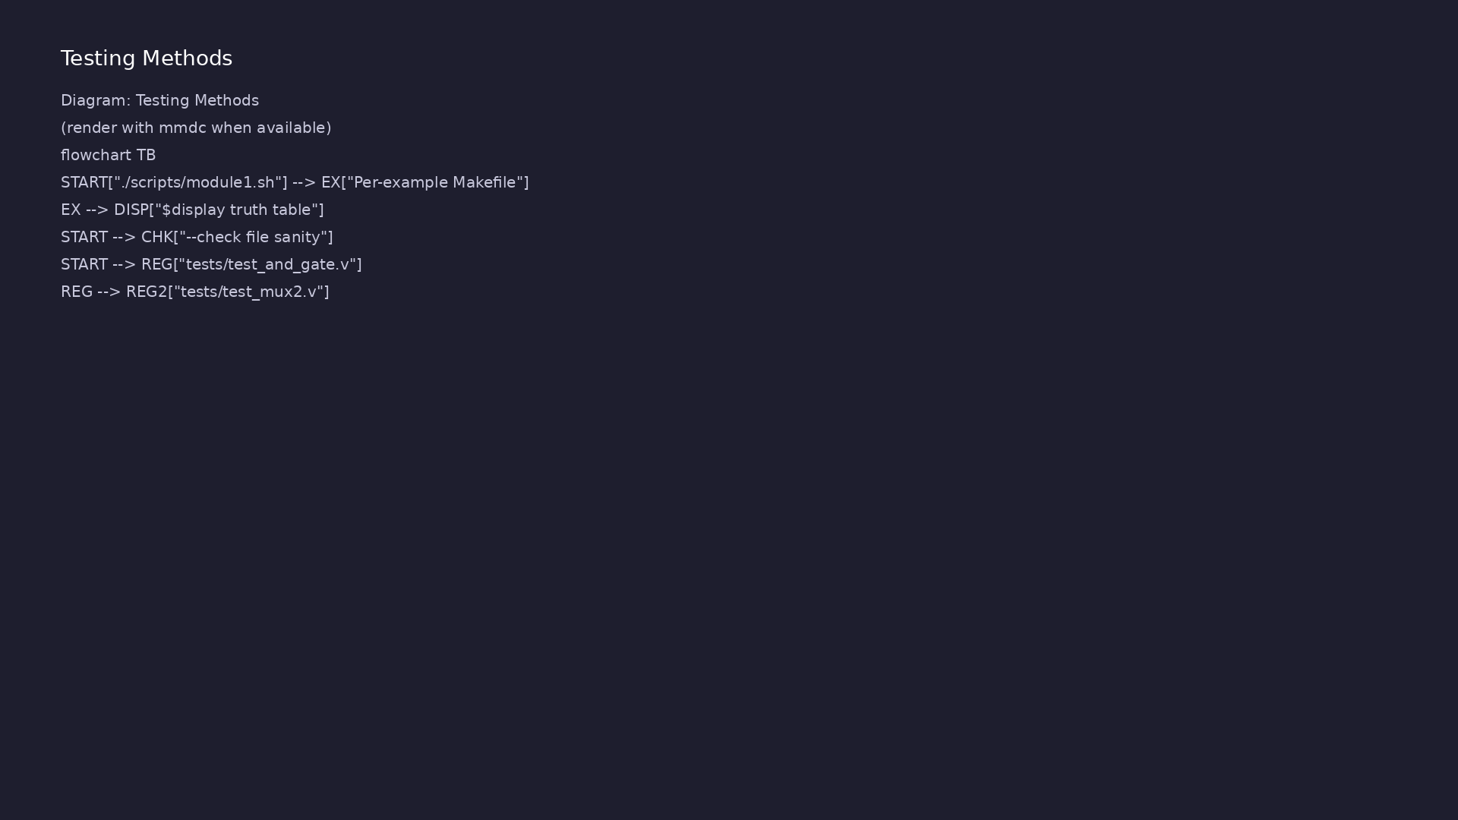
3. Simulation toolchain (Icarus Verilog)
• iverilog -o top file.v … —
compile Verilog-95 sources to
VVP bytecode
• vvp top — run simulation;
$display prints waveforms as
text
• $finish — required to stop;
without it the simulator runs
forever
• Per lab: cd
module1/examples/<name> && make
clean && make run
learn_verilog_systemverilog / Module 1
Notes:
From MODULE1 Design Architecture.

Slide 15
RTL block diagram (reference)
Module 1: DUT hierarchy and signal flow.
learn_verilog_systemverilog / Module 1

Slide 16
DUT example — and_gate (1995 style)
module and_gate(a, b, y);
input a;
input b;
output y;
wire a, b;
reg y;
always @(a or b)
y = a & b;
endmodule
learn_verilog_systemverilog / Module 1
Notes:
Non-ANSI port list; output y is reg because always drives it.

Slide 17
Testbench — stimulus and $finish
reg a, b;
wire y;
and_gate u_dut (.a(a), .b(b), .y(y));
initial begin
$display("a b y");
a = 0; b = 0; #10 $display("%b %b %b", a, b, y);
a = 0; b = 1; #10 $display("%b %b %b", a, b, y);
a = 1; b = 0; #10 $display("%b %b %b", a, b, y);
a = 1; b = 1; #10 $display("%b %b %b", a, b, y);
$finish;
end
learn_verilog_systemverilog / Module 1
Notes:
reg drives inputs; wire observes output; initial applies all input combos.

Slide 18
Execution & simulation flow
learn_verilog_systemverilog / Module 1

Slide 19
How the example runs (toolchain)
• Makefile: Verilator compiles RTL + SystemVerilog
testbench into a C++ model
• sim_main.cpp: generates clk/rst_n, calls eval()
until $finish
• Directed test (initial block or C++): drive
stimulus, wait for DUT flags
• Self-check: compare outputs; print PASS/FAIL (see
terminal demo slide)
• Repo path: module1/examples/<example>/ — run make
run from that directory
learn_verilog_systemverilog / Module 1
Notes:
From MODULE1 — execution and artifact layout.

Slide 20
Key files to study
learn_verilog_systemverilog / Module 1

Slide 21
Open these in the repo
• module1/examples/modules_ports/and_gate.v — 1995
ports + always @(a or b)
• module1/examples/continuous_assign/mux2.v — assign-
based combinational mux
• module1/examples/sequential_dff/dff.v — clocked
always with async reset
• module1/examples/testbenches/test_and_gate.v —
minimal TB pattern
• module1/tests/test_mux2.v — directed test with
delay-based stimulus
• scripts/module1.sh — one-command regression for all
labs
learn_verilog_systemverilog / Module 1
Notes:
Trace while running module1/EXAMPLES.md labs.

Slide 22
Verification & testing methods
learn_verilog_systemverilog / Module 1

Slide 23
1. Example execution flow
• make run invokes iverilog then
vvp (see each example Makefile)
• Full module sweep:
./scripts/module1.sh (checks
iverilog first)
• Build artifact (top) is
gitignored; make clean removes
it
learn_verilog_systemverilog / Module 1
Notes:
From MODULE1 Verification & Testing Methods.

Slide 24
2. Testbench structure (1364-1995)
• test_and_gate.v — reg stimulus,
wire outputs, named DUT
instantiation
• initial block applies vectors
with # delays between changes
• Exhaustive 2-input tests print
truth table; $finish ends
simulation
learn_verilog_systemverilog / Module 1
Notes:
From MODULE1 Verification & Testing Methods.

Slide 25
3. What “passing” looks like
• Simulation exits after $finish
(no hang at time limit)
• Printed a/b/y rows match
expected AND or mux truth table
• module1/CHECKLIST.md confirms
concepts before Module 2
learn_verilog_systemverilog / Module 1
Notes:
From MODULE1 Verification & Testing Methods.

Slide 26
Build and run (Makefile)
# Build and run modules_ports example (1364-1995)
# Requires: iverilog (or compatible simulator)
SIM ?= iverilog
TOP ?= top
.PHONY: run clean
run: $(TOP)
vvp $(TOP)
$(TOP): and_gate.v
iverilog -o $(TOP) and_gate.v
clean:
rm -f $(TOP)
learn_verilog_systemverilog / Module 1
Notes:
iverilog compiles to top; vvp runs the simulation executable.

Slide 27
Syllabus topics
learn_verilog_systemverilog / Module 1

Slide 28
Protocol & design details
learn_verilog_systemverilog / Module 1

Slide 29
Detail: What 1364-1995 Includes (1)
• Modules and hierarchy: Module declaration, port
list, instantiation
• Nets: `wire` (and `wand`, `wor`, `tri`; rarely used
in RTL)
• Variables: `reg` for procedural assignment outputs
• Continuous assignment: `assign` for combinational
logic
learn_verilog_systemverilog / Module 1
Notes:
From MODULE1 Topics Covered — protocol/design depth.

Slide 30
Detail: What 1364-1995 Includes (2)
• Procedural blocks: `always`, `initial` with explicit
sensitivity lists
• Delays and timing: `#`, `@`, `wait`
• Tasks and functions: Non-ANSI style (declarations
separate from port list)
• System tasks: `$display`, `$monitor`, `$finish`,
`$stop`, `$time`
learn_verilog_systemverilog / Module 1
Notes:
From MODULE1 Topics Covered — protocol/design depth.

Slide 31
Detail: What 1364-1995 Does Not Include (1)
• No ANSI-style port declarations (added in 1364-2001)
• No **`always @*`** (added in 1364-2001)
• No generate (added in 1364-2001)
• No signed keyword, no multi-dimensional arrays
(1364-2001)
learn_verilog_systemverilog / Module 1
Notes:
From MODULE1 Topics Covered — protocol/design depth.

Slide 32
Detail: What 1364-1995 Does Not Include (2)
• No SystemVerilog: no `logic`, `always_comb`,
`always_ff`, interfaces, packages
learn_verilog_systemverilog / Module 1
Notes:
From MODULE1 Topics Covered — protocol/design depth.

Slide 33
Detail: Module Declaration (1995 Style)
• Port list: Only port names: `(a, b, y)`.
• Port direction: Declared inside the module: `input`,
`output`.
• Port type: Declared inside the module: `wire` or
`reg` (default for `input` is `wire`; for `output`…
learn_verilog_systemverilog / Module 1
Notes:
From MODULE1 Topics Covered — protocol/design depth.

Slide 34
Detail: Module Instantiation (1995 Style)
• Named port connection: `.port_name(signal_name)` —
recommended for readability.
• Positional: Order must match port list.
learn_verilog_systemverilog / Module 1
Notes:
From MODULE1 Topics Covered — protocol/design depth.

Slide 35
Detail: wire (Net)
• Represents a physical connection between components.
• Driven by continuous assignment (`assign`) or by
module output.
• Cannot be assigned inside `always` or `initial` (use
`reg` for that).
learn_verilog_systemverilog / Module 1
Notes:
From MODULE1 Topics Covered — protocol/design depth.

Slide 36
Detail: reg (Variable)
• Holds a value; can be assigned in `always` or
`initial`.
• Does not imply a flip-flop; flip-flops come from
`always @(posedge clk)` (or similar).
• Used for outputs that are driven procedurally.
learn_verilog_systemverilog / Module 1
Notes:
From MODULE1 Topics Covered — protocol/design depth.

Slide 37
Detail: 4-State Logic (1364-1995)
• Both `wire` and `reg` are 4-state: `0`, `1`, `X`
(unknown), `Z` (high-impedance).
learn_verilog_systemverilog / Module 1
Notes:
From MODULE1 Topics Covered — protocol/design depth.

Slide 38
Detail: always Block
• Repeated execution; sensitivity list defines when it
runs.
• 1364-1995: Sensitivity list is mandatory and
explicit — no `@*`.
• Use blocking `=` for combinational, nonblocking `<=`
for sequential (flip-flops).
• Example (D flip-flop):
`module1/examples/sequential_dff/dff.v`
learn_verilog_systemverilog / Module 1
Notes:
From MODULE1 Topics Covered — protocol/design depth.

Slide 39
Detail: initial Block
• Runs once at time zero. Used for testbenches:
stimulus, `$display`, `$finish`.
learn_verilog_systemverilog / Module 1
Notes:
From MODULE1 Topics Covered — protocol/design depth.

Slide 40
Verification flow (reference)
Stimulus, DUT response, and check points for this module.
learn_verilog_systemverilog / Module 1

Slide 41
1. IEEE 1364-1995 Context (1/3)
• Modules and hierarchy: Module declaration, port
list, instantiation
• Nets: `wire` (and `wand`, `wor`, `tri`; rarely used
in RTL)
• Variables: `reg` for procedural assignment outputs
• Continuous assignment: `assign` for combinational
logic
• Procedural blocks: `always`, `initial` with explicit
sensitivity lists
• Delays and timing: `#`, `@`, `wait`
learn_verilog_systemverilog / Module 1
Notes:
From MODULE1 Topics Covered.

Slide 42
1. IEEE 1364-1995 Context (2/3)
• Tasks and functions: Non-ANSI style (declarations
separate from port list)
• System tasks: `$display`, `$monitor`, `$finish`,
`$stop`, `$time`
• No ANSI-style port declarations (added in 1364-2001)
• No **`always @*`** (added in 1364-2001)
• No generate (added in 1364-2001)
• No signed keyword, no multi-dimensional arrays
(1364-2001)
learn_verilog_systemverilog / Module 1
Notes:
From MODULE1 Topics Covered.

Slide 43
1. IEEE 1364-1995 Context (3/3)
• No SystemVerilog: no `logic`, `always_comb`,
`always_ff`, interfaces, packages
learn_verilog_systemverilog / Module 1
Notes:
From MODULE1 Topics Covered.

Slide 44
2. Modules, Ports, and Hierarchy (1364-1995)
• Port list: Only port names: `(a, b, y)`.
• Port direction: Declared inside the module: `input`,
`output`.
• Port type: Declared inside the module: `wire` or
`reg` (default for `input` is `wire`; for `output`…
• Named port connection: `.port_name(signal_name)` —
recommended for readability.
• Positional: Order must match port list.
learn_verilog_systemverilog / Module 1
Notes:
From MODULE1 Topics Covered.

Slide 45
3. Nets and Variables: wire and reg (1/2)
• Represents a physical connection between components.
• Driven by continuous assignment (`assign`) or by
module output.
• Cannot be assigned inside `always` or `initial` (use
`reg` for that).
• Holds a value; can be assigned in `always` or
`initial`.
• Does not imply a flip-flop; flip-flops come from
`always @(posedge clk)` (or similar).
• Used for outputs that are driven procedurally.
learn_verilog_systemverilog / Module 1
Notes:
From MODULE1 Topics Covered.

Slide 46
3. Nets and Variables: wire and reg (2/2)
• Both `wire` and `reg` are 4-state: `0`, `1`, `X`
(unknown), `Z` (high-impedance).
learn_verilog_systemverilog / Module 1
Notes:
From MODULE1 Topics Covered.

Slide 47
4. Continuous Assignment (assign)
• Right-hand side: Any expression of `wire`/`reg` and
operators.
• Left-hand side: Must be a `wire` (or similar net).
learn_verilog_systemverilog / Module 1
Notes:
From MODULE1 Topics Covered.

Slide 48
5. Procedural Blocks: always and initial (1364-1995)
• Repeated execution; sensitivity list defines when it
runs.
• 1364-1995: Sensitivity list is mandatory and
explicit — no `@*`.
• Use blocking `=` for combinational, nonblocking `<=`
for sequential (flip-flops).
• Example (D flip-flop):
`module1/examples/sequential_dff/dff.v`
• Runs once at time zero. Used for testbenches:
stimulus, `$display`, `$finish`.
learn_verilog_systemverilog / Module 1
Notes:
From MODULE1 Topics Covered.

Slide 49
6. Delays and Timing
• `#n`: Delay by `n` time units (e.g. `#10`).
• `@(event)`: Wait for event (e.g. `@(posedge clk)`).
• `wait(condition)`: Wait until condition is true.
learn_verilog_systemverilog / Module 1
Notes:
From MODULE1 Topics Covered.

Slide 50
7. Tasks and Functions (1995 Style)
• Function: Returns a single value; no delays (zero-
time).
• Task: Can have delays and multiple outputs
(output/inout args).
learn_verilog_systemverilog / Module 1
Notes:
From MODULE1 Topics Covered.

Slide 51
8. Simple Testbench (1364-1995)
• `$display`: Print once.
• `$monitor`: Print whenever a listed signal changes
(optional).
• `$finish`: End simulation.
learn_verilog_systemverilog / Module 1
Notes:
From MODULE1 Topics Covered.

Slide 52
Hands-on examples
learn_verilog_systemverilog / Module 1

Slide 53
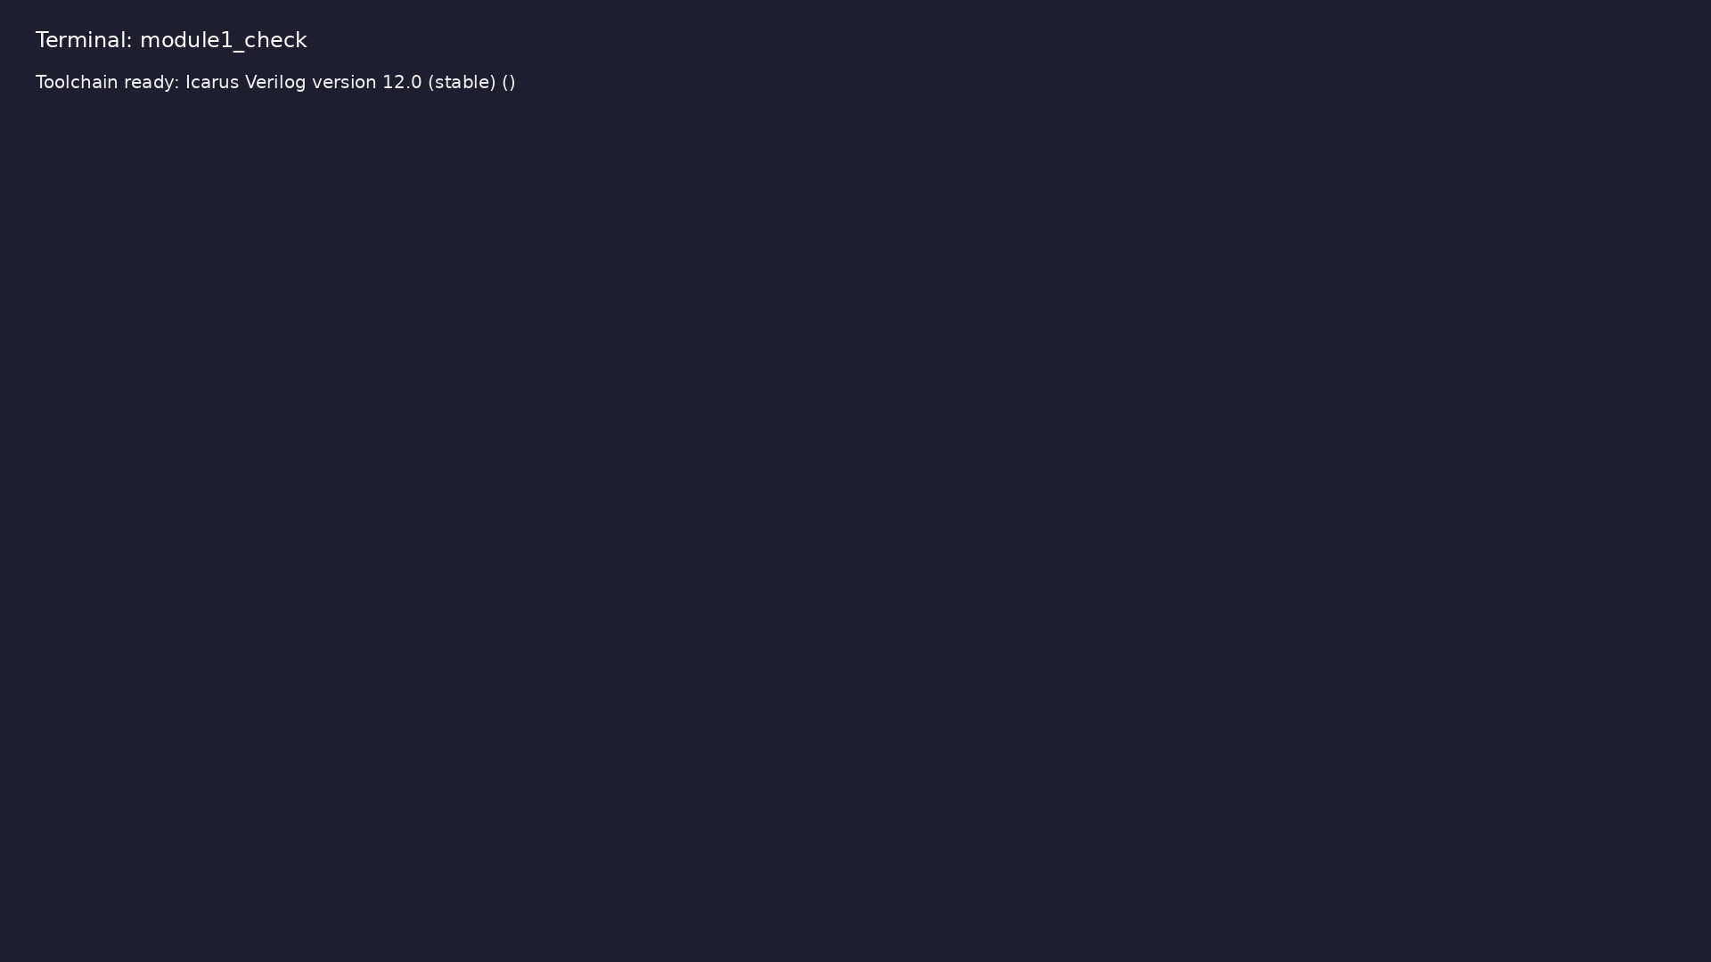
Module 1 toolchain check
$ command -v iverilog >/dev/null && echo "Toolchain ready: $(iverilog
-V 2>&1 | head -1)"
learn_verilog_systemverilog / Module 1
Notes:
Requires iverilog on PATH (apt install iverilog).

Slide 54
Example 1: 1995-style module declaration and port list
• Named and positional instantiation
• Non-ANSI ports, separate direction/type declarations
learn_verilog_systemverilog / Module 1
Notes:
module1/examples/modules_ports/README.md

Slide 55
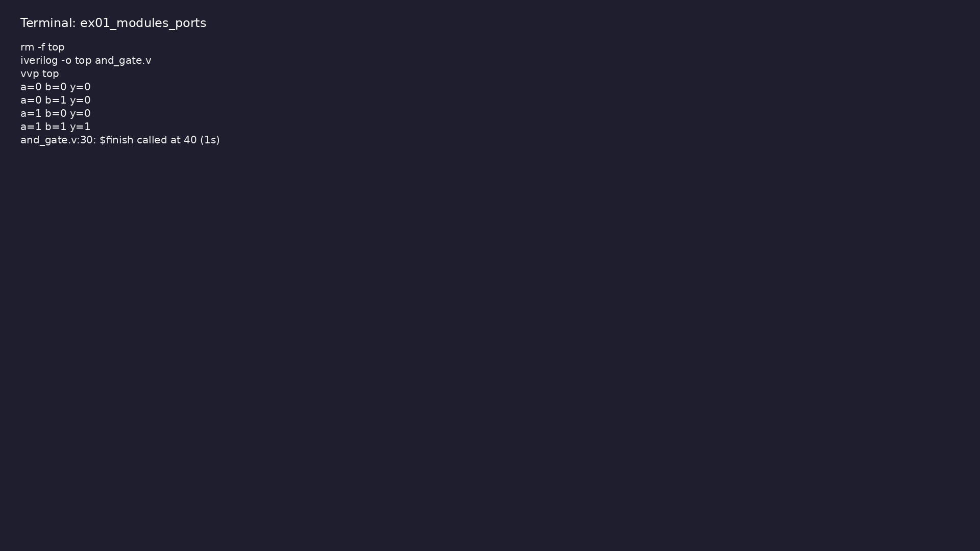
Demo: 1995-style module declaration and port list
$ cd module1/examples/modules_ports && make clean && make run
learn_verilog_systemverilog / Module 1
Notes:
Hands-on: module1/examples/modules_ports/

Slide 56
Example 2: `wire` vs `reg`, vectors, 4-state values
• When to use wire vs reg, single driver per net
learn_verilog_systemverilog / Module 1
Notes:
module1/examples/nets_variables/README.md

Slide 57
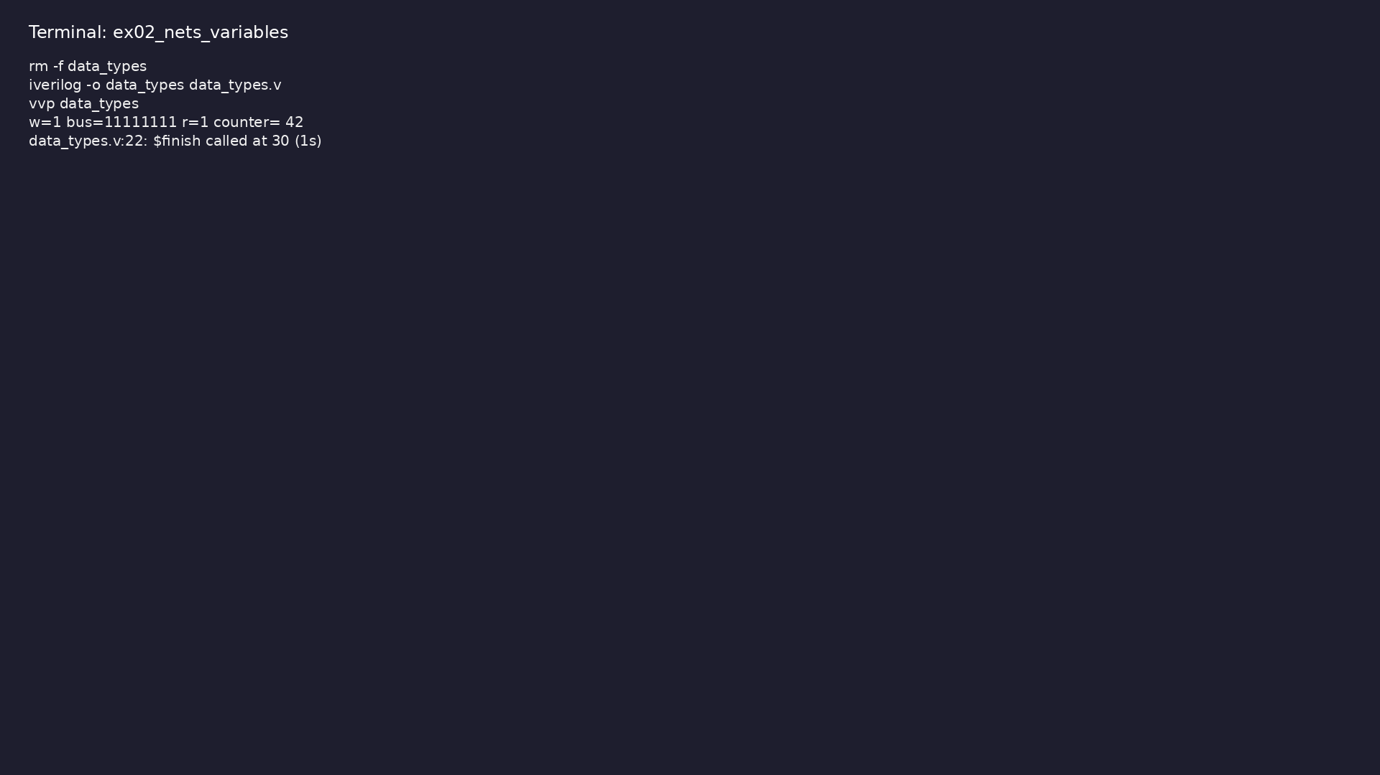
Demo: `wire` vs `reg`, vectors, 4-state values
$ cd module1/examples/nets_variables && make clean && make run
learn_verilog_systemverilog / Module 1
Notes:
Hands-on: module1/examples/nets_variables/

Slide 58
Example 3: `assign` for combinational logic (2:1 mux)
• Left-hand side must be net; expression on right
learn_verilog_systemverilog / Module 1
Notes:
module1/examples/continuous_assign/README.md

Slide 59
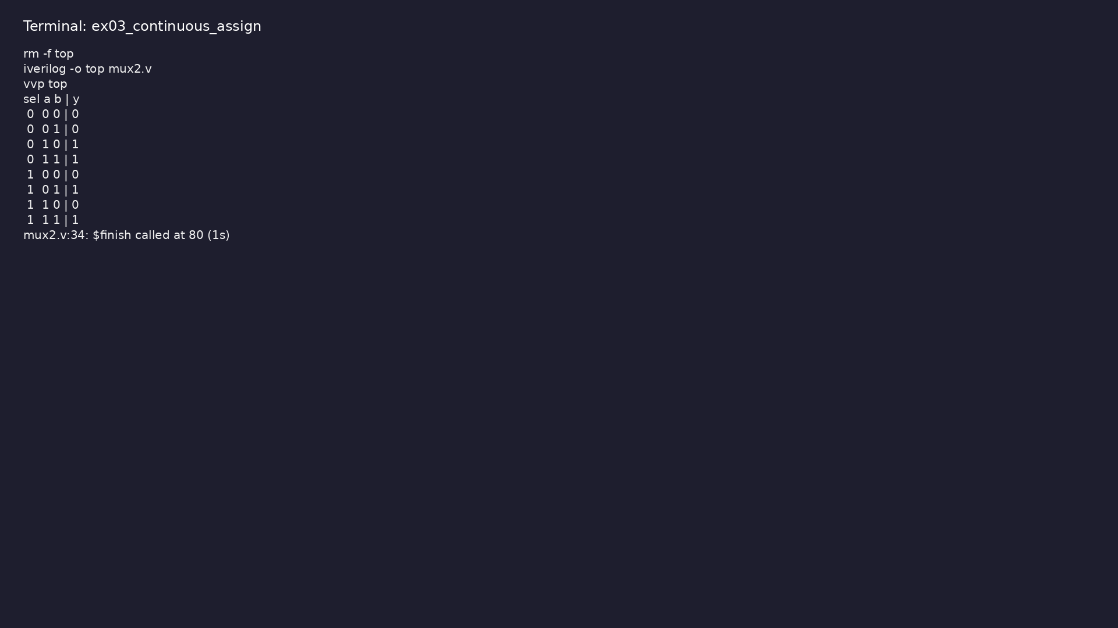
Demo: `assign` for combinational logic (2:1 mux)
$ cd module1/examples/continuous_assign && make clean && make run
learn_verilog_systemverilog / Module 1
Notes:
Hands-on: module1/examples/continuous_assign/

Slide 60
Example 4: XOR, NAND, NOR with `assign`
• Same as above; multiple gates in one example
learn_verilog_systemverilog / Module 1
Notes:
module1/examples/continuous_assign_gates/README.md

Slide 61
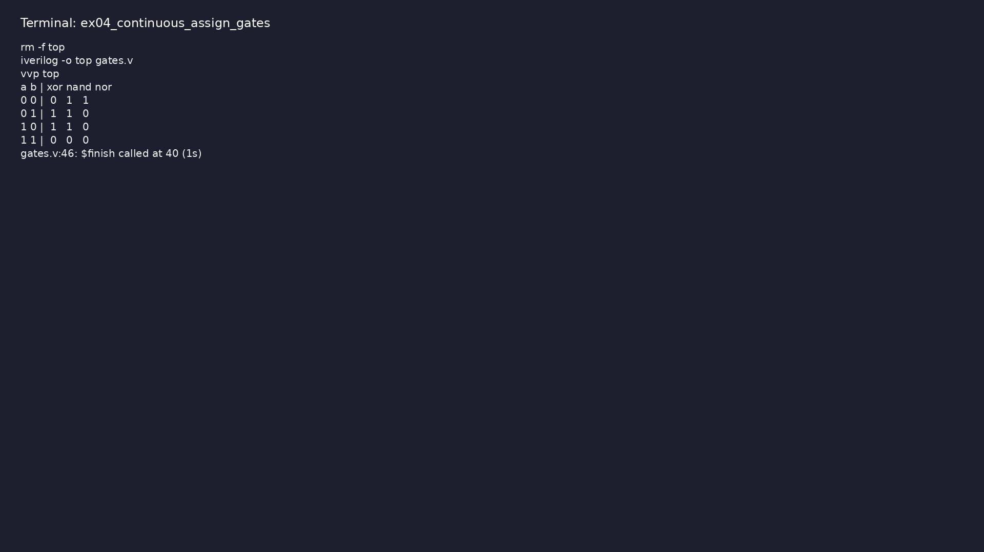
Demo: XOR, NAND, NOR with `assign`
$ cd module1/examples/continuous_assign_gates && make clean && make
run
learn_verilog_systemverilog / Module 1
Notes:
Hands-on: module1/examples/continuous_assign_gates/

Slide 62
Example 5: Half adder and full adder with `assign` (sum and carry)
• Multi-output combinational logic; wire for all
outputs
learn_verilog_systemverilog / Module 1
Notes:
module1/examples/adder/README.md

Slide 63
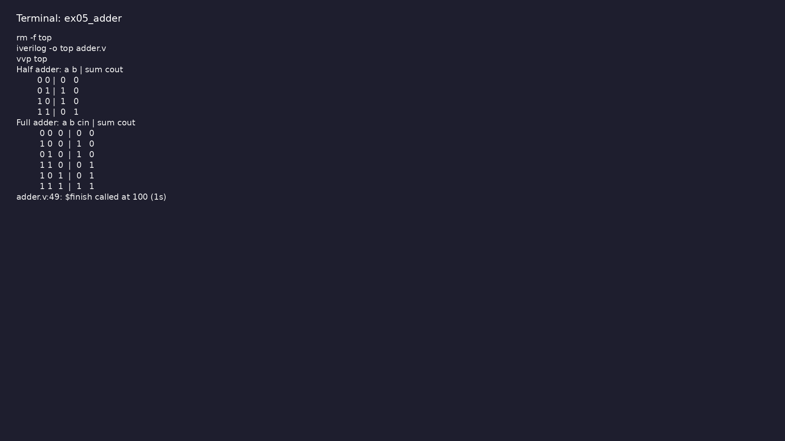
Demo: Half adder and full adder with `assign` (sum and carry)
$ cd module1/examples/adder && make clean && make run
learn_verilog_systemverilog / Module 1
Notes:
Hands-on: module1/examples/adder/

Slide 64
Example 6: `always @(inputs)` and `always @(posedge clk)` with explic…
• initial for testbench; 1995-style task/function
• No `always @*`; blocking vs nonblocking
learn_verilog_systemverilog / Module 1
Notes:
module1/examples/procedural/README.md

Slide 65
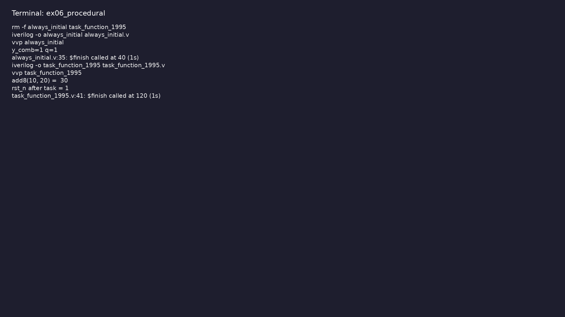
Demo: `always @(inputs)` and `always @(posedge clk)` with explicit se…
$ cd module1/examples/procedural && make clean && make run
learn_verilog_systemverilog / Module 1
Notes:
Hands-on: module1/examples/procedural/

Slide 66
Example 7: D flip-flop with async reset: `always @(posedge clk or neg…
• Edge-sensitive always; nonblocking for sequential
logic
learn_verilog_systemverilog / Module 1
Notes:
module1/examples/sequential_dff/README.md

Slide 67
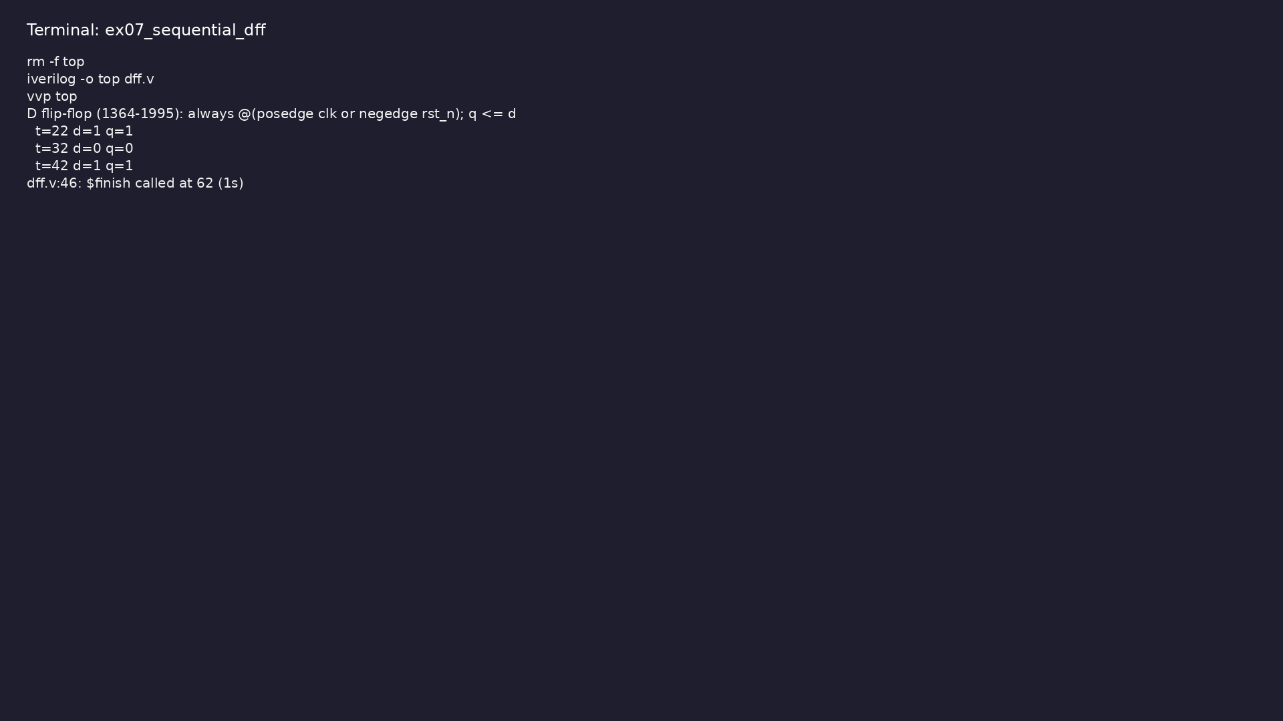
Demo: D flip-flop with async reset: `always @(posedge clk or negedge…
$ cd module1/examples/sequential_dff && make clean && make run
learn_verilog_systemverilog / Module 1
Notes:
Hands-on: module1/examples/sequential_dff/

Slide 68
Example 8: `#n`, `@(posedge clk)`, `wait(condition)`; clock generatio…
• Delay-based and event-based timing in testbenches
learn_verilog_systemverilog / Module 1
Notes:
module1/examples/delays_timing/README.md

Slide 69
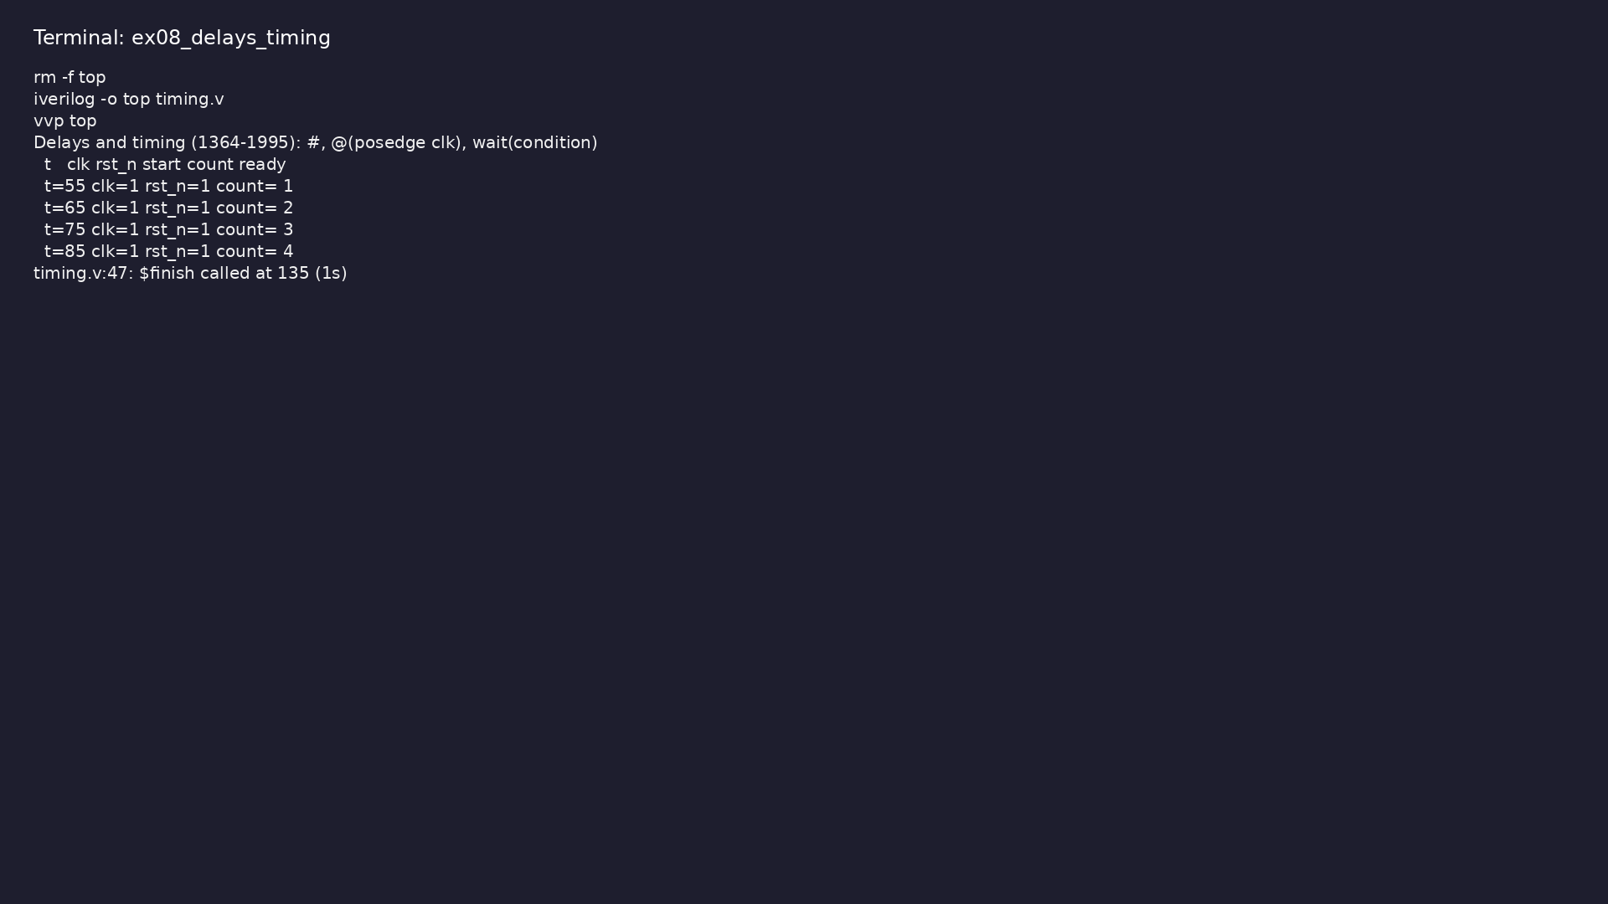
Demo: `#n`, `@(posedge clk)`, `wait(condition)`; clock generation wit…
$ cd module1/examples/delays_timing && make clean && make run
learn_verilog_systemverilog / Module 1
Notes:
Hands-on: module1/examples/delays_timing/

Slide 70
Example 9: Minimal testbench with `initial`, `#`, `$display`, `$finis…
• Stimulus generation, termination with `$finish`
learn_verilog_systemverilog / Module 1
Notes:
module1/examples/testbenches/README.md

Slide 71
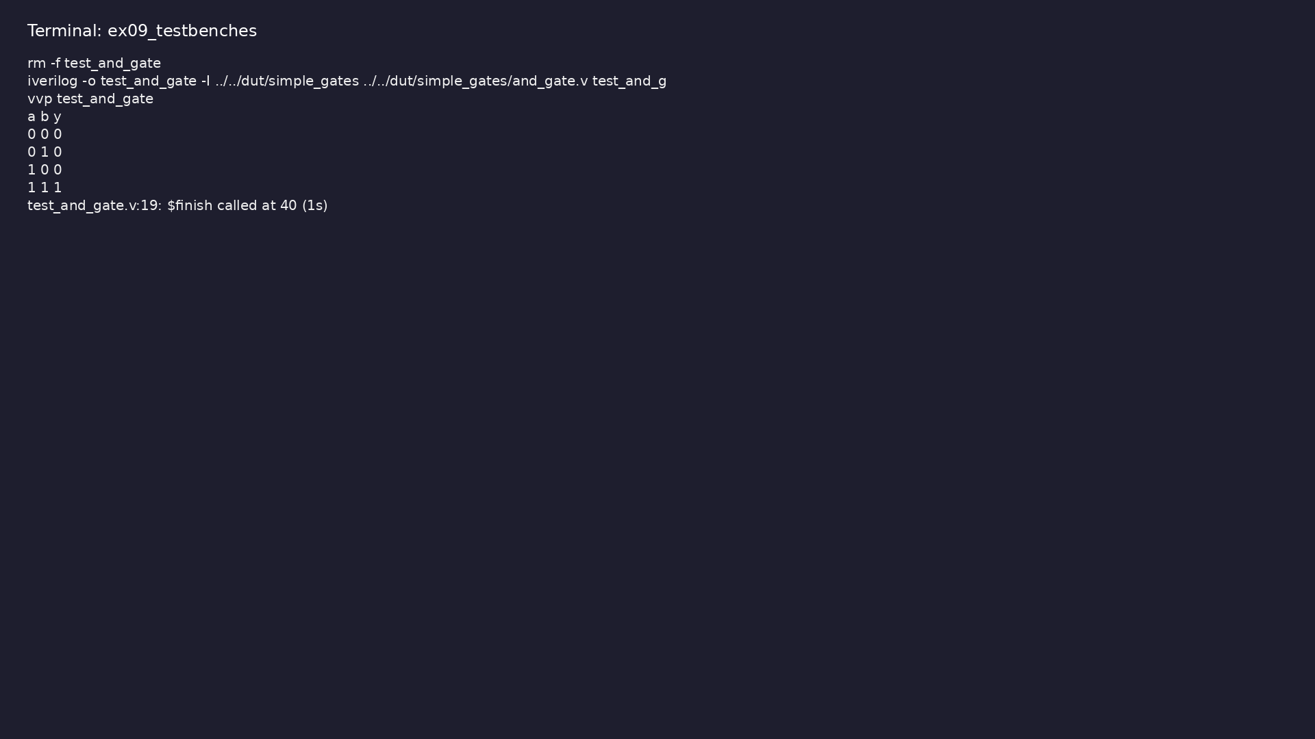
Demo: Minimal testbench with `initial`, `#`, `$display`, `$finish`
$ cd module1/examples/testbenches && make clean && make run
learn_verilog_systemverilog / Module 1
Notes:
Hands-on: module1/examples/testbenches/

Slide 72
Common pitfalls
learn_verilog_systemverilog / Module 1

Slide 73
Incomplete Sensitivity List
• Mistake: `always @(sel) y = sel ? b : a;` (missing
`a` and `b`)
• Reality: In 1364-1995 you must list every input that
the block reads
• Correct: `always @(a or b or sel) y = sel ? b : a;`
• Why: Incomplete lists cause simulation/synthesis
mismatches and inferred latches
learn_verilog_systemverilog / Module 1
Notes:
From MODULE1 Common Pitfalls.

Slide 74
Port Type Mismatch
• Mistake: Declaring as `wire` an output that is
assigned in `always`
• Reality: Outputs driven in procedural blocks must be
`reg`
• Correct: `output y; reg y;` when `y` is assigned in
`always`
• Why: `wire` cannot be the target of procedural
assignment
learn_verilog_systemverilog / Module 1
Notes:
From MODULE1 Common Pitfalls.

Slide 75
Simulation Never Ends
• Mistake: Testbench without `$finish`
• Correct: Always call `$finish` after stimulus (e.g.
`#1000; $finish;`)
• Why: Simulator runs until explicit termination or
limit
learn_verilog_systemverilog / Module 1
Notes:
From MODULE1 Common Pitfalls.

Slide 76
Using 2001/SystemVerilog Constructs in 1995
• Mistake: Writing `always @*` or ANSI ports and
assuming 1995
• Reality: `always @*` and ANSI ports are 1364-2001;
`logic`/`always_comb` are SystemVerilog
• Correct: For strict 1995, use explicit sensitivity
and non-ANSI ports
• Why: Keeps code portable to 1995-only tools and
clarifies version scope
learn_verilog_systemverilog / Module 1
Notes:
From MODULE1 Common Pitfalls.

Slide 77
Confusing reg with Registers
• Mistake: Thinking `reg` creates a flip-flop
• Reality: `reg` is a variable type; flip-flops come
from `always @(posedge clk)` with `<=`
• Correct: Use `reg` for any procedural output; use
clocked `always` for sequential logic
• Why: Clarifies design intent and avoids synthesis
surprises
learn_verilog_systemverilog / Module 1
Notes:
From MODULE1 Common Pitfalls.

Slide 78
Practice & assessment
learn_verilog_systemverilog / Module 1

Slide 79
What you should know (1/2)
• ✓ Write modules in IEEE 1364-1995 style (non-ANSI
ports, explicit sensitivity)
• ✓ Use `wire` and `reg` correctly for nets and
procedural outputs
• ✓ Describe combinational logic with `assign` and
`always @(inputs)`
• ✓ Describe sequential logic with `always @(posedge
clk)` and nonblocking assignment
• ✓ Use `initial`, `#`, `@`, and `wait` for
testbenches
• ✓ Use 1364-1995 tasks and functions (non-ANSI form)
learn_verilog_systemverilog / Module 1
Notes:
From MODULE1 Learning Outcomes.

Slide 80
What you should know (2/2)
• ✓ State what 1364-1995 does not include (ANSI, `@*`,
generate, SystemVerilog)
learn_verilog_systemverilog / Module 1
Notes:
From MODULE1 Learning Outcomes.

Slide 81
Exercises
• Module and Ports (1995)
• wire vs reg
• Simple Testbench
• Limitations
• Incomplete Sensitivity List
learn_verilog_systemverilog / Module 1

Slide 82
Exercises
• Port Type Mismatch
• Simulation Never Ends
• Using 2001/SystemVerilog Constructs in 1995
• Confusing reg with Registers
learn_verilog_systemverilog / Module 1

Slide 83
Summary & next steps
• Master the first standardized Verilog language (IEEE
1364-1995) and its core syntax for RTL design…
• Complete module1/CHECKLIST.md
• Review module1/EXAMPLES.md and run each lab
• Next: Next module in course
learn_verilog_systemverilog / Module 1

