Slide 1
Module 2
IEEE 1364-2001 (Verilog-2001)
learn_verilog_systemverilog / Module 2

Slide 2
Learning objectives
• Master the major Verilog update (IEEE 1364-2001) and
its additions over 1364-1995: ANSI ports, impl…
learn_verilog_systemverilog / Module 2

Slide 3
Prerequisites
• See module README
learn_verilog_systemverilog / Module 2

Slide 4
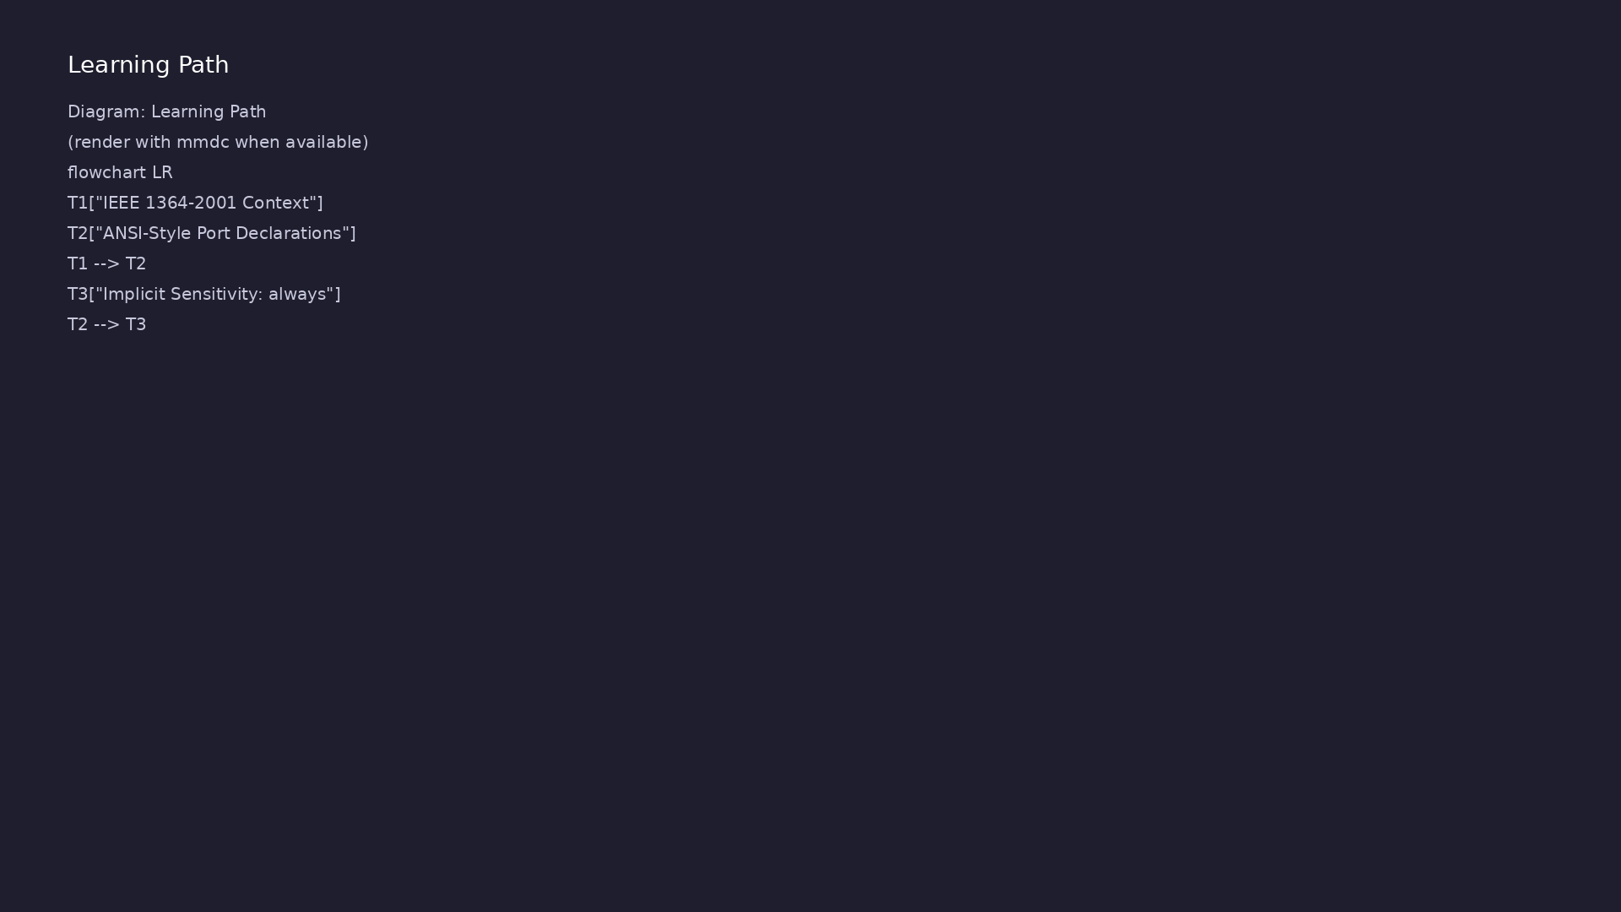
Learning path
Master the major Verilog update (IEEE 1364-2001) and its additions over 1364-1995: ANSI ports, implicit sensitivity, generate, signed...
learn_verilog_systemverilog / Module 2

Slide 5
Overview
• This module covers IEEE Std 1364-2001
(Verilog-2001), the first major revision of the
Verilog stand…
learn_verilog_systemverilog / Module 2

Slide 6
How to learn this module
learn_verilog_systemverilog / Module 2

Slide 7
Suggested learning path (1/2)
• Skim this document — Goal, Overview, and Topics
Covered set the IEEE scope for Module 2.
• Study design architecture — See how DUTs, examples,
and testbenches fit together under `module2/`.
• Work through labs in order — Open
`module2/EXAMPLES.md` and run each `make clean &&
make run` from…
• Run the full module script — `./scripts/module2.sh`
from the repo root to simulate all examples and…
• Complete the exercises — Try each exercise in this
document before reading solutions or peeking at…
learn_verilog_systemverilog / Module 2
Notes:
From docs/MODULE2.md — read guides before running demos.

Slide 8
Suggested learning path (2/2)
• Review Common Pitfalls — Can you explain each
mistake and the fix?
• Self-check — Use `module2/CHECKLIST.md` before
starting the next module.
learn_verilog_systemverilog / Module 2
Notes:
From docs/MODULE2.md — read guides before running demos.

Slide 9
Design architecture
learn_verilog_systemverilog / Module 2

Slide 10
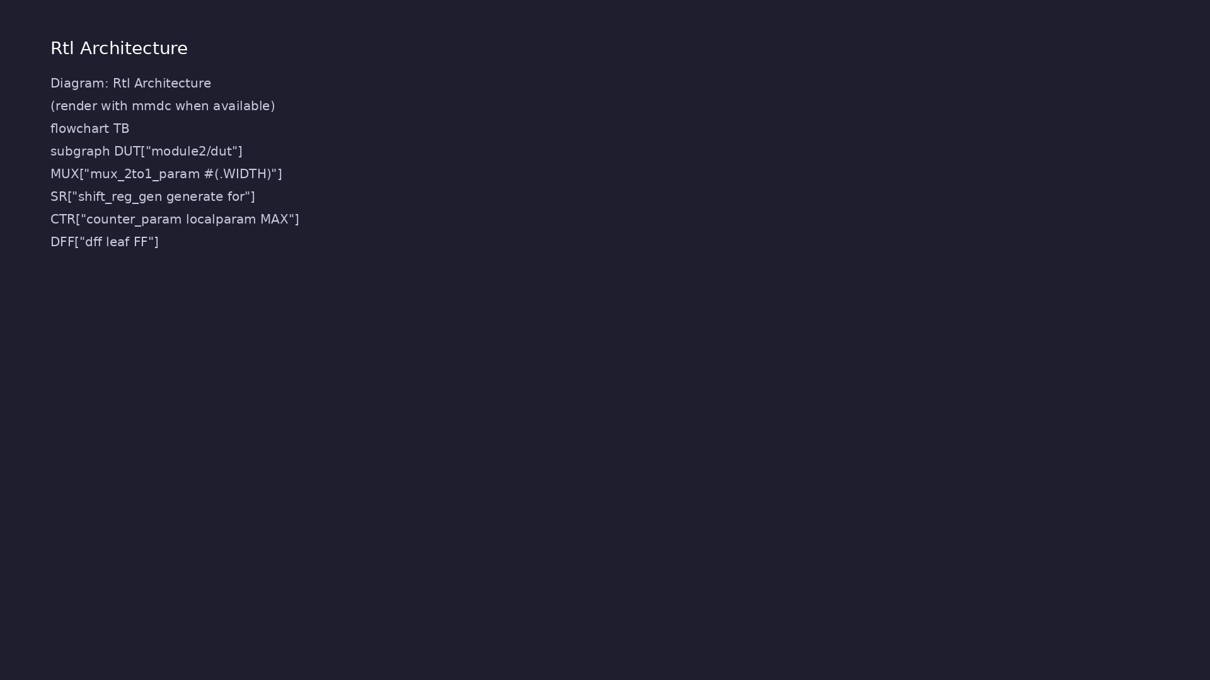
1. Repository layout (module2/)
• Builds on Module 1 — same
examples + tests pattern under
module2/
• Examples highlight 2001
additions: ANSI ports, always
@*, generate, signed
• module2/dut/ — reference gates
and parameterized blocks
• scripts/module2.sh — batch run
all 2001-feature labs
learn_verilog_systemverilog / Module 2
Notes:
From MODULE2 Design Architecture.

Slide 11
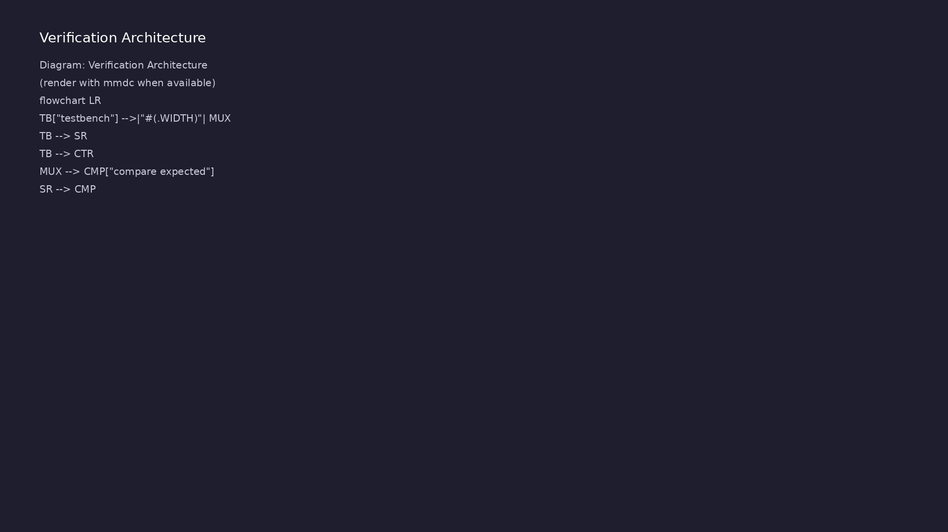
2. 2001 RTL patterns vs 1995
• ANSI ports combine direction,
type, and width in the port list
• always @* replaces manual
sensitivity lists for
combinational logic
• generate if/for creates
replicated or conditional
hardware
• signed keyword and $signed
enable two's-complement
arithmetic
learn_verilog_systemverilog / Module 2
Notes:
From MODULE2 Design Architecture.

Slide 12
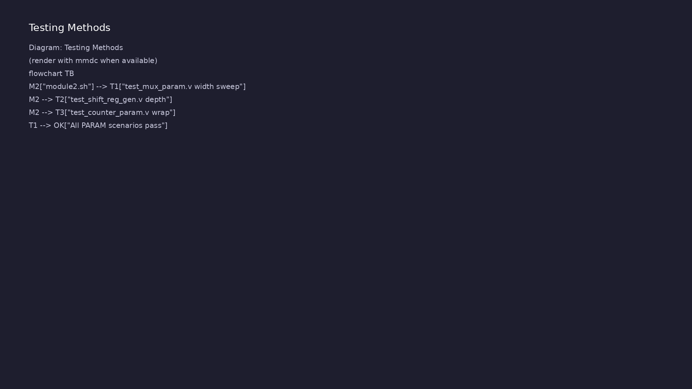
3. Hierarchy with generate
• param_mux and ripple_adder show
parameterized instantiation
• gen_if demonstrates conditional
generate blocks
• Parent passes parameters; child
modules scale without copy-paste
learn_verilog_systemverilog / Module 2
Notes:
From MODULE2 Design Architecture.

Slide 13
RTL block diagram (reference)
Module 2: DUT hierarchy and signal flow.
learn_verilog_systemverilog / Module 2

Slide 14
Verification / testbench diagram (reference)
Module 2: stimulus, observation, and checking.
learn_verilog_systemverilog / Module 2

Slide 15
ANSI ports — mux2 (2001)
/*
* 2:1 multiplexer - IEEE 1364-2001 ANSI style
*
* Port direction and type in port list (no separate declarations).
*/
module mux2_2001 (
input wire a,
input wire b,
input wire sel,
output reg y
);
always @(a or b or sel)
y = sel ? b : a;
endmodule
# ...
learn_verilog_systemverilog / Module 2

Slide 16
always @* combinational block
/*
* always @* - IEEE 1364-2001 implicit sensitivity
*
* Sensitive to every signal read in the block; no manual list.
*/
module comb_demo (
input wire a,
input wire b,
input wire c,
input wire sel,
output reg y_comb,
output reg mux_out
);
/* Implicit sensitivity: tool infers a, b, c and sel, a, b */
always @* begin
# ...
learn_verilog_systemverilog / Module 2

Slide 17
Execution & simulation flow
learn_verilog_systemverilog / Module 2

Slide 18
How the example runs (toolchain)
• Makefile: Verilator + UVM_HOME compile RTL,
interface, and test_*.sv
• UVM phases: build → connect → run_test → report
(same pattern as Module 2)
• Sequence → driver → DUT → monitor → scoreboard (read
SCOREBOARD at end)
• Typical command: make SIM=verilator TEST=test_* (see
module2 demo slide)
• Loopback / hooks connect monitor observations to
scoreboard checks
learn_verilog_systemverilog / Module 2
Notes:
From MODULE2 — execution and artifact layout.

Slide 19
Key files to study
learn_verilog_systemverilog / Module 2

Slide 20
Open these in the repo
• module2/examples/ansi_ports/mux2.v — ANSI port list
pattern
• module2/examples/procedural/always_star.v — implicit
sensitivity
• module2/examples/generate/param_mux.v — generate for
loop
• module2/examples/signed/adder_signed.v — signed
arithmetic
• scripts/module2.sh — full module execution
learn_verilog_systemverilog / Module 2
Notes:
Trace while running module2/EXAMPLES.md labs.

Slide 21
Verification & testing methods
learn_verilog_systemverilog / Module 2

Slide 22
1. Running labs and tests
• Each example: cd
module2/examples/<name> && make
clean && make run
• ./scripts/module2.sh runs the
full module regression
• Compare output with MODULE2.md
expected behavior notes
learn_verilog_systemverilog / Module 2
Notes:
From MODULE2 Verification & Testing Methods.

Slide 23
2. What to verify per feature
• ANSI ports — compile without
separate input/output
declarations
• always @* — output updates when
any input toggles (no latch
inference)
• generate — instance count
matches parameter; signed adder
handles negatives
learn_verilog_systemverilog / Module 2
Notes:
From MODULE2 Verification & Testing Methods.

Slide 24
Generate block — parameterized mux
/*
* Parameterized mux with generate if - IEEE 1364-2001
* generate for / generate if; elaboration-time logic.
*/
module mux_wide #(parameter WIDTH = 8) (
input wire [WIDTH-1:0] a,
input wire [WIDTH-1:0] b,
input wire sel,
output wire [WIDTH-1:0] y
);
generate
if (WIDTH == 1)
assign y = sel ? b : a;
else
assign y = sel ? b : a;
# ...
learn_verilog_systemverilog / Module 2

Slide 25
Syllabus topics
learn_verilog_systemverilog / Module 2

Slide 26
Protocol & design details
learn_verilog_systemverilog / Module 2

Slide 27
Detail: What 1364-2001 Adds Over 1995 (1)
• ANSI-style port declarations: Direction and type
(and size) in the port list
• **`always @*`**: Implicit sensitivity for
combinational logic (no manual list)
• generate: Conditional and loop-based instantiation
and logic
• signed: Signed arithmetic and signed nets/variables
learn_verilog_systemverilog / Module 2
Notes:
From MODULE2 Topics Covered — protocol/design depth.

Slide 28
Detail: What 1364-2001 Adds Over 1995 (2)
• Multi-dimensional arrays: e.g. `reg [7:0] mem
[0:255]`
• localparam: Named constants that cannot be
overridden
• ANSI-style task/function: Input/output in the header
• Other: File I/O improvements, `$signed`/`$unsigned`,
attribute syntax, etc.
learn_verilog_systemverilog / Module 2
Notes:
From MODULE2 Topics Covered — protocol/design depth.

Slide 29
Detail: What 1364-2001 Still Does Not Include
• No SystemVerilog: no `logic`,
`always_comb`/`always_ff`, interfaces, packages,
classes
• No type parameters or interfaces (those are 1800)
learn_verilog_systemverilog / Module 2
Notes:
From MODULE2 Topics Covered — protocol/design depth.

Slide 30
Detail: ANSI-C Style Ports
• input wire: Default for input; can omit `wire` (e.g.
`input [7:0] a`).
• output reg: Required when the output is driven in
`always`/`initial`.
• output wire: When the output is driven only by
`assign` or submodule.
learn_verilog_systemverilog / Module 2
Notes:
From MODULE2 Topics Covered — protocol/design depth.

Slide 31
Detail: Comparison: 1995 vs 2001 Port Style
• Same behavior; 2001 is more concise and keeps port
and type in one place.
learn_verilog_systemverilog / Module 2
Notes:
From MODULE2 Topics Covered — protocol/design depth.

Slide 32
Detail: always @* Syntax
• **`@*` (or `@(*)`**): Sensitive to every signal read
in the block (RHS and conditions).
• Use for combinational logic only; do not use for
sequential (use `always @(posedge clk)`).
learn_verilog_systemverilog / Module 2
Notes:
From MODULE2 Topics Covered — protocol/design depth.

Slide 33
Detail: When to Use @* vs Explicit List
• **Prefer `@*`**: For combinational blocks; fewer
errors, easier to maintain.
• Explicit list: When targeting strict 1995
compatibility or when a tool does not support `@*`.
learn_verilog_systemverilog / Module 2
Notes:
From MODULE2 Topics Covered — protocol/design depth.

Slide 34
Detail: generate / endgenerate
• genvar: Loop variable for generate loops; not a
runtime variable.
• generate for: Replicates logic/instances; index must
be constant at elaboration.
learn_verilog_systemverilog / Module 2
Notes:
From MODULE2 Topics Covered — protocol/design depth.

Slide 35
Detail: Conditional Generate
• generate if / else: Choose one of several
implementations at elaboration.
learn_verilog_systemverilog / Module 2
Notes:
From MODULE2 Topics Covered — protocol/design depth.

Slide 36
Detail: signed Wire and reg
• signed: Affects arithmetic and comparison in
expressions involving that net/reg.
• Unsigned (default): No sign extension; values 0 to
2^N-1.
learn_verilog_systemverilog / Module 2
Notes:
From MODULE2 Topics Covered — protocol/design depth.

Slide 37
Detail: Declaration and Usage
• Packed (left): `[7:0]` — contiguous bits, can be
used as a single vector.
• Unpacked (right): `[0:255]` — array of elements;
select with one index at a time in 2001.
learn_verilog_systemverilog / Module 2
Notes:
From MODULE2 Topics Covered — protocol/design depth.

Slide 38
Detail: Task (2001 ANSI)
• automatic: Optional; gives automatic storage (re-
entrant). Useful for recursive or concurrent calls.
• input/output in header: Cleaner than 1995 style;
avoids duplicate declarations.
• Note: In 1364-2001 use `output reg` (not `output
logic`; `logic` is SystemVerilog).
learn_verilog_systemverilog / Module 2
Notes:
From MODULE2 Topics Covered — protocol/design depth.

Slide 39
Verification flow (reference)
Stimulus, DUT response, and check points for this module.
learn_verilog_systemverilog / Module 2

Slide 40
1. IEEE 1364-2001 Context (1/2)
• ANSI-style port declarations: Direction and type
(and size) in the port list
• **`always @*`**: Implicit sensitivity for
combinational logic (no manual list)
• generate: Conditional and loop-based instantiation
and logic
• signed: Signed arithmetic and signed nets/variables
• Multi-dimensional arrays: e.g. `reg [7:0] mem
[0:255]`
• localparam: Named constants that cannot be
overridden
learn_verilog_systemverilog / Module 2
Notes:
From MODULE2 Topics Covered.

Slide 41
1. IEEE 1364-2001 Context (2/2)
• ANSI-style task/function: Input/output in the header
• Other: File I/O improvements, `$signed`/`$unsigned`,
attribute syntax, etc.
• No SystemVerilog: no `logic`,
`always_comb`/`always_ff`, interfaces, packages,
classes
• No type parameters or interfaces (those are 1800)
learn_verilog_systemverilog / Module 2
Notes:
From MODULE2 Topics Covered.

Slide 42
2. ANSI-Style Port Declarations (2001)
• input wire: Default for input; can omit `wire` (e.g.
`input [7:0] a`).
• output reg: Required when the output is driven in
`always`/`initial`.
• output wire: When the output is driven only by
`assign` or submodule.
• Same behavior; 2001 is more concise and keeps port
and type in one place.
learn_verilog_systemverilog / Module 2
Notes:
From MODULE2 Topics Covered.

Slide 43
3. Implicit Sensitivity: always @* (2001)
• **`@*` (or `@(*)`**): Sensitive to every signal read
in the block (RHS and conditions).
• Use for combinational logic only; do not use for
sequential (use `always @(posedge clk)`).
• **Prefer `@*`**: For combinational blocks; fewer
errors, easier to maintain.
• Explicit list: When targeting strict 1995
compatibility or when a tool does not support `@*`.
learn_verilog_systemverilog / Module 2
Notes:
From MODULE2 Topics Covered.

Slide 44
4. Generate (2001)
• genvar: Loop variable for generate loops; not a
runtime variable.
• generate for: Replicates logic/instances; index must
be constant at elaboration.
• generate if / else: Choose one of several
implementations at elaboration.
• generate / endgenerate
• Conditional Generate
learn_verilog_systemverilog / Module 2
Notes:
From MODULE2 Topics Covered.

Slide 45
5. Signed Types (2001)
• signed: Affects arithmetic and comparison in
expressions involving that net/reg.
• Unsigned (default): No sign extension; values 0 to
2^N-1.
• signed Wire and reg
• $signed and $unsigned
learn_verilog_systemverilog / Module 2
Notes:
From MODULE2 Topics Covered.

Slide 46
6. Multi-Dimensional Arrays (2001)
• Packed (left): `[7:0]` — contiguous bits, can be
used as a single vector.
• Unpacked (right): `[0:255]` — array of elements;
select with one index at a time in 2001.
• Declaration and Usage
learn_verilog_systemverilog / Module 2
Notes:
From MODULE2 Topics Covered.

Slide 47
7. localparam (2001)
• parameter: Can be overridden: `#(.WIDTH(16))`.
• localparam: Cannot be overridden; often derived from
parameters or fixed.
learn_verilog_systemverilog / Module 2
Notes:
From MODULE2 Topics Covered.

Slide 48
8. ANSI-Style Tasks and Functions (2001)
• automatic: Optional; gives automatic storage (re-
entrant). Useful for recursive or concurrent calls.
• input/output in header: Cleaner than 1995 style;
avoids duplicate declarations.
• Note: In 1364-2001 use `output reg` (not `output
logic`; `logic` is SystemVerilog).
• Function (2001 ANSI)
• Task (2001 ANSI)
learn_verilog_systemverilog / Module 2
Notes:
From MODULE2 Topics Covered.

Slide 49
Hands-on examples
learn_verilog_systemverilog / Module 2

Slide 50
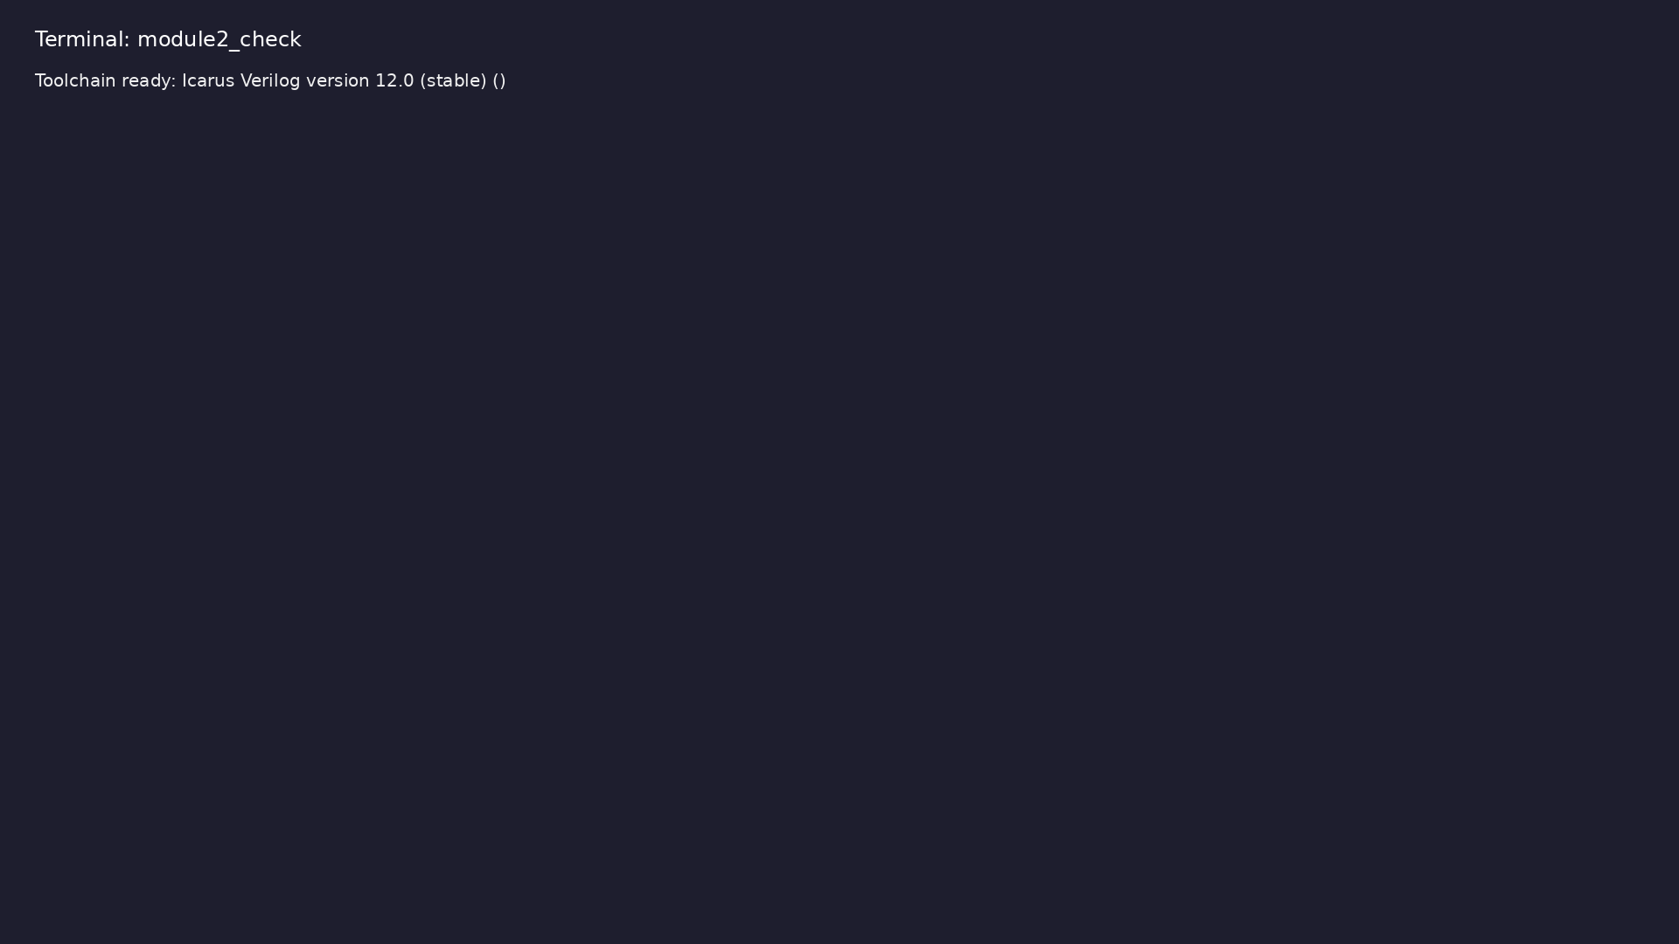
Module 2 toolchain check
$ command -v iverilog >/dev/null && echo "Toolchain ready: $(iverilog
-V 2>&1 | head -1)"
learn_verilog_systemverilog / Module 2
Notes:
Requires iverilog on PATH (apt install iverilog).

Slide 51
Example 1: Module and instantiation with ANSI-style ports
• Port direction and type in port list
learn_verilog_systemverilog / Module 2
Notes:
module2/examples/ansi_ports/README.md

Slide 52
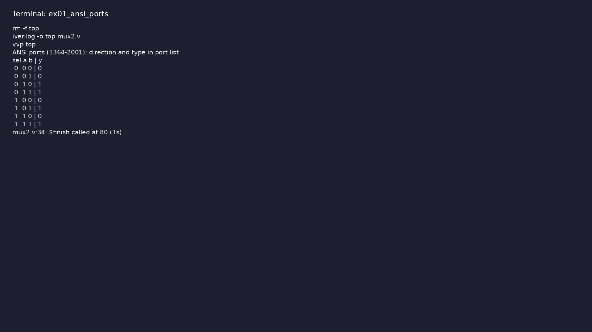
Demo: Module and instantiation with ANSI-style ports
$ cd module2/examples/ansi_ports && make clean && make run
learn_verilog_systemverilog / Module 2
Notes:
Hands-on: module2/examples/ansi_ports/

Slide 53
Example 2: Combinational blocks with implicit sensitivity
• No manual sensitivity list; tool infers from RHS
learn_verilog_systemverilog / Module 2
Notes:
module2/examples/procedural/README.md

Slide 54
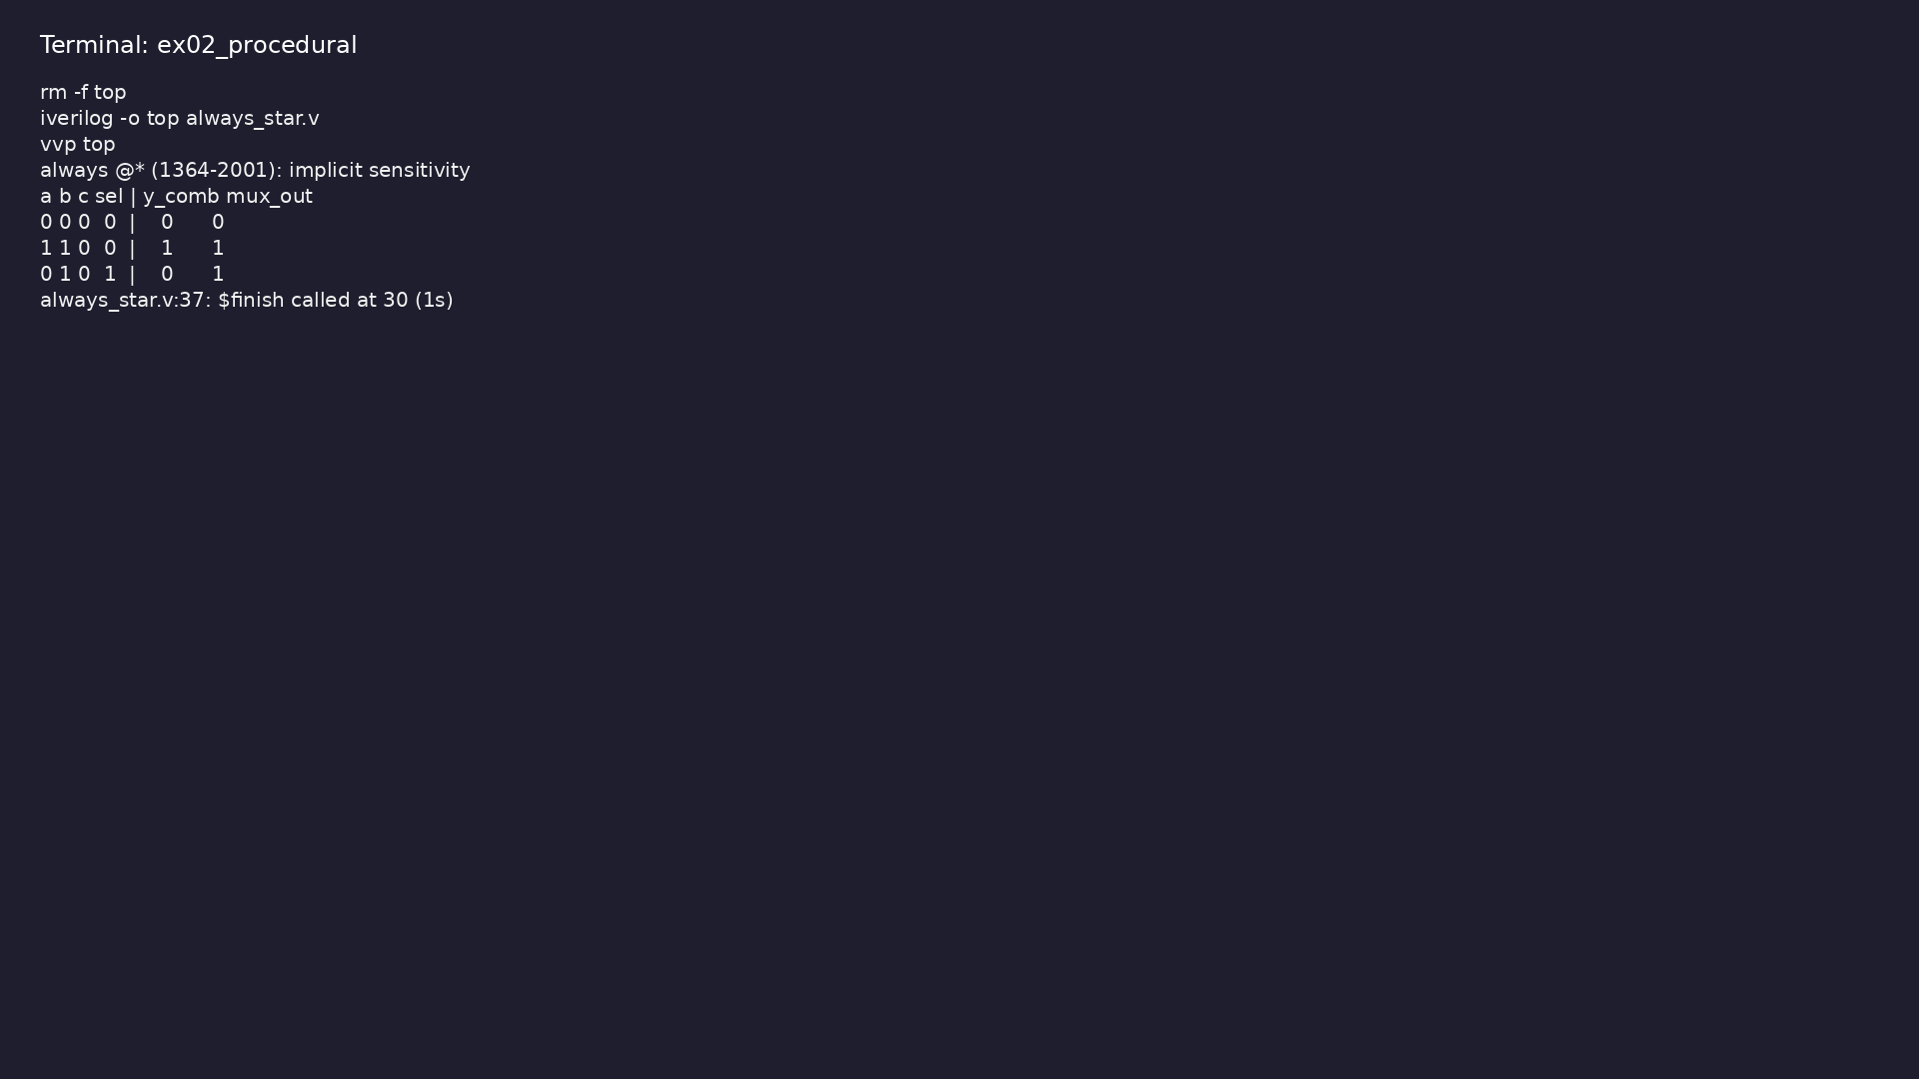
Demo: Combinational blocks with implicit sensitivity
$ cd module2/examples/procedural && make clean && make run
learn_verilog_systemverilog / Module 2
Notes:
Hands-on: module2/examples/procedural/

Slide 55
Example 3: Parameterized mux; generate-style parameterization
• genvar, elaboration-time logic
learn_verilog_systemverilog / Module 2
Notes:
module2/examples/generate/README.md

Slide 56
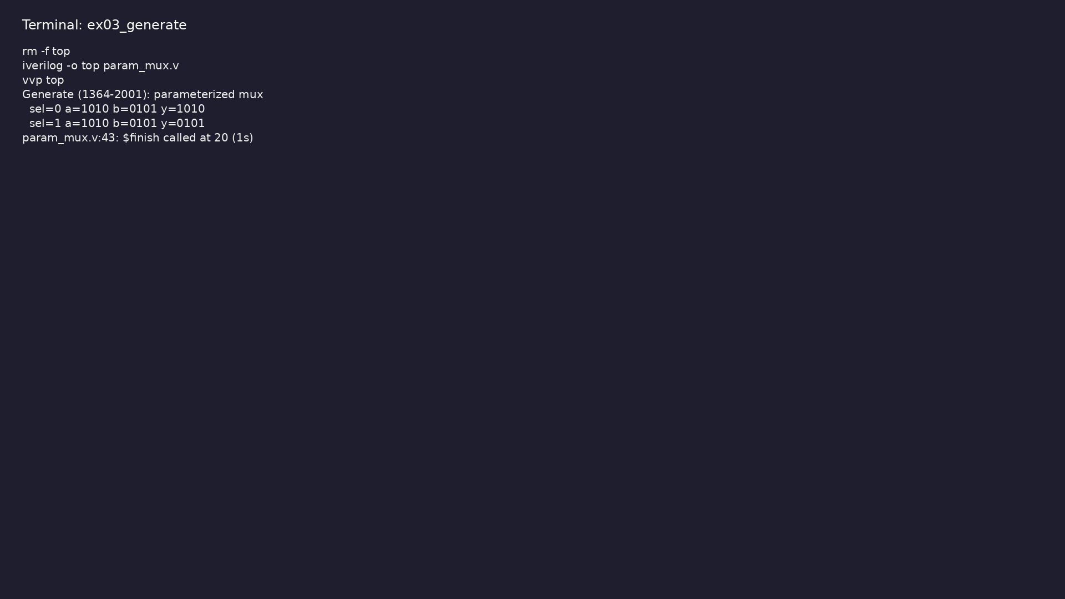
Demo: Parameterized mux; generate-style parameterization
$ cd module2/examples/generate && make clean && make run
learn_verilog_systemverilog / Module 2
Notes:
Hands-on: module2/examples/generate/

Slide 57
Example 4: Conditional implementation by parameter (e.g. USE_CLIP wra…
• generate if/else at elaboration
learn_verilog_systemverilog / Module 2
Notes:
module2/examples/generate_if/README.md

Slide 58
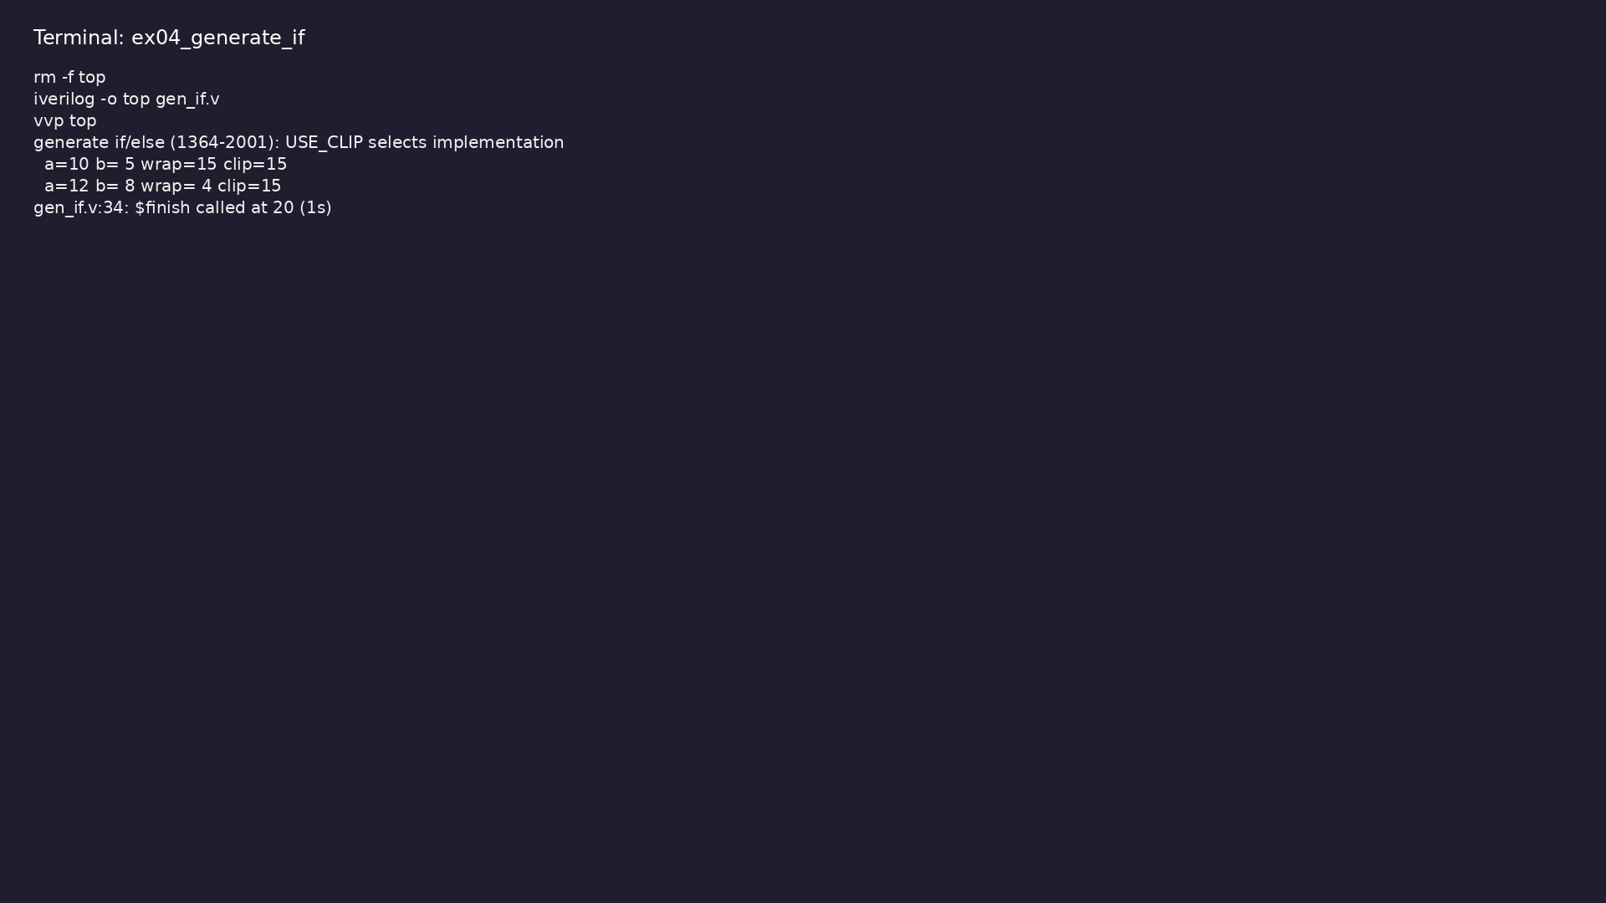
Demo: Conditional implementation by parameter (e.g. USE_CLIP wrap vs…
$ cd module2/examples/generate_if && make clean && make run
learn_verilog_systemverilog / Module 2
Notes:
Hands-on: module2/examples/generate_if/

Slide 59
Example 5: N-bit ripple-carry adder using generate for (full_adder in…
• genvar loop, replicated hierarchy
learn_verilog_systemverilog / Module 2
Notes:
module2/examples/generate_ripple_adder/README.md

Slide 60
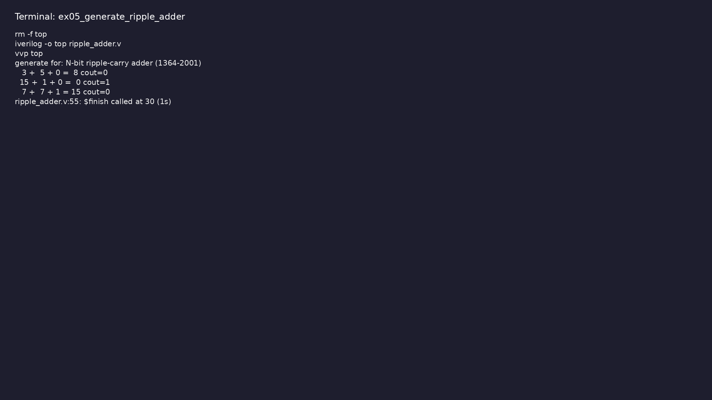
Demo: N-bit ripple-carry adder using generate for (full_adder instanc…
$ cd module2/examples/generate_ripple_adder && make clean && make run
learn_verilog_systemverilog / Module 2
Notes:
Hands-on: module2/examples/generate_ripple_adder/

Slide 61
Example 6: signed reg/wire, $signed/$unsigned
• Two's complement arithmetic in RTL
learn_verilog_systemverilog / Module 2
Notes:
module2/examples/signed/README.md

Slide 62
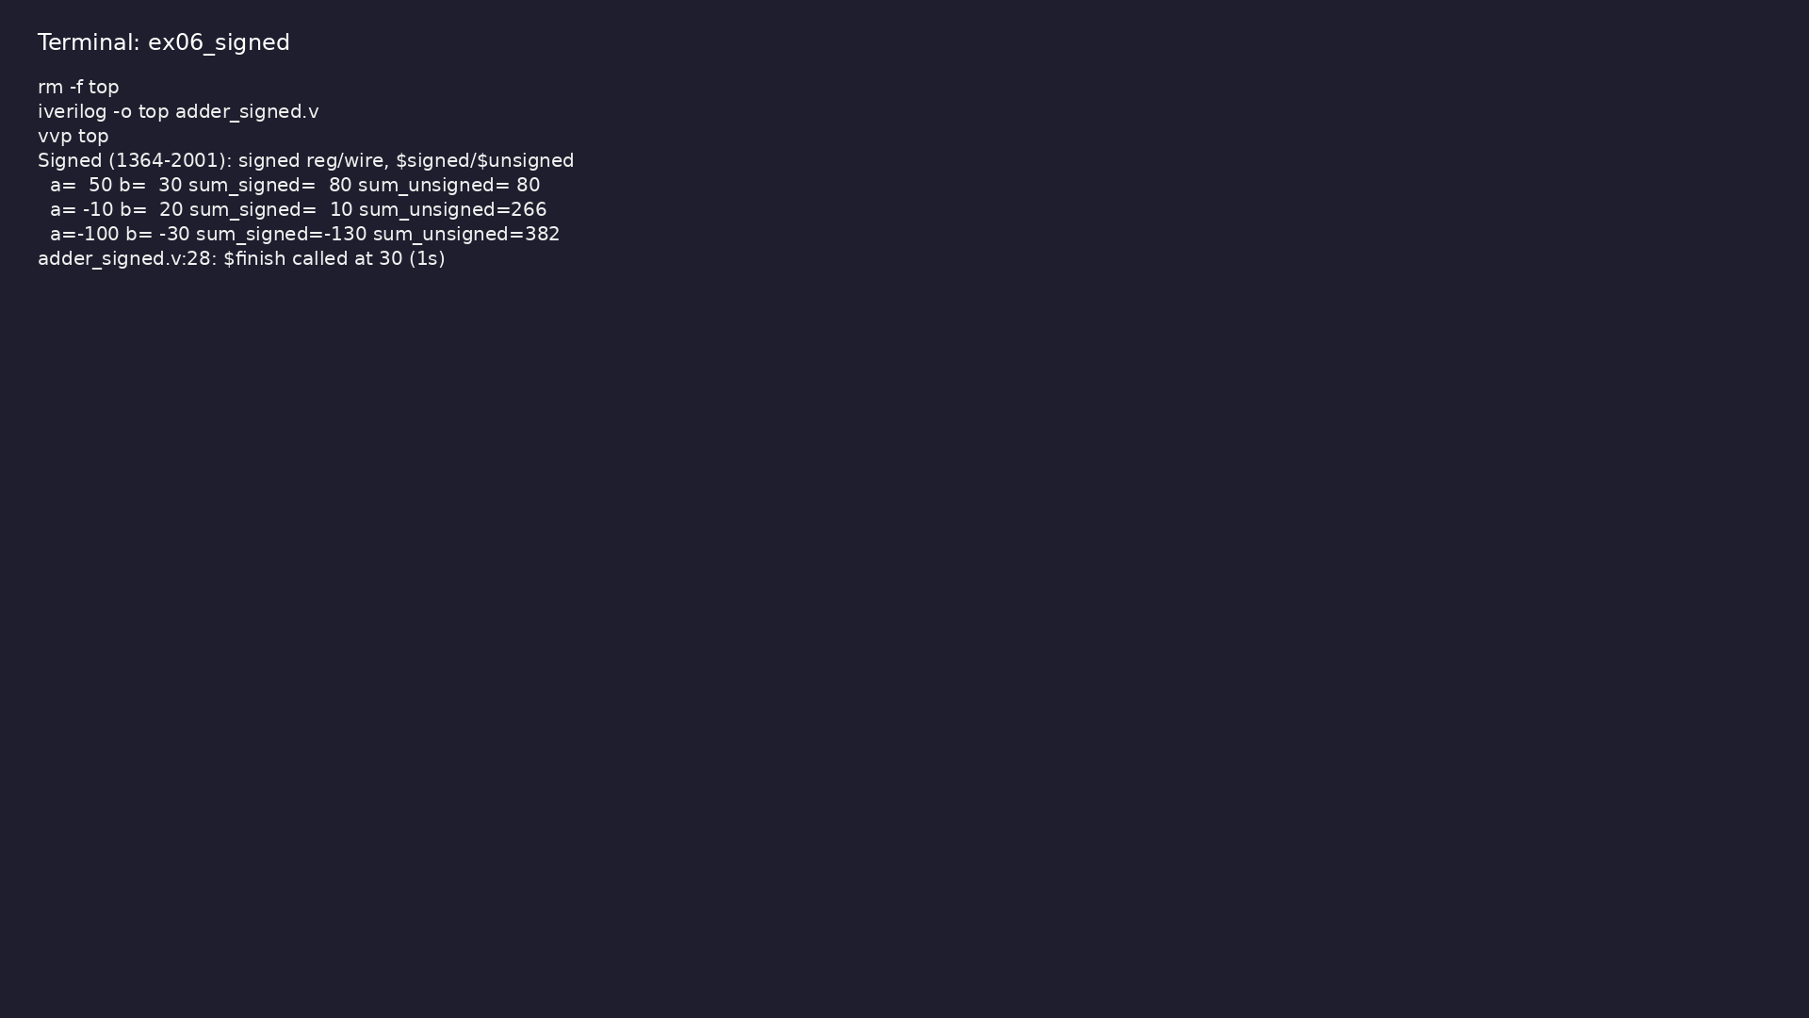
Demo: signed reg/wire, $signed/$unsigned
$ cd module2/examples/signed && make clean && make run
learn_verilog_systemverilog / Module 2
Notes:
Hands-on: module2/examples/signed/

Slide 63
Example 7: $signed() in expressions; a &lt; b unsigned vs signed
• Cast in expressions without changing declaration
learn_verilog_systemverilog / Module 2
Notes:
module2/examples/signed_compare/README.md

Slide 64
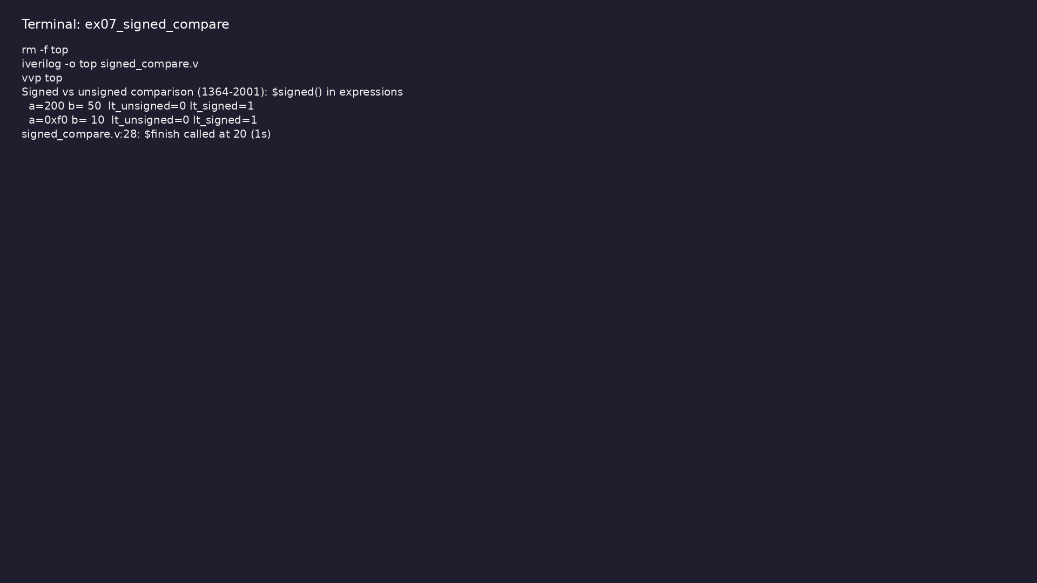
Demo: $signed() in expressions; a &lt; b unsigned vs signed
$ cd module2/examples/signed_compare && make clean && make run
learn_verilog_systemverilog / Module 2
Notes:
Hands-on: module2/examples/signed_compare/

Slide 65
Example 8: 2:4 decoder with ANSI ports and always @* (case)
• Combinational case; one-hot output
learn_verilog_systemverilog / Module 2
Notes:
module2/examples/decoder/README.md

Slide 66
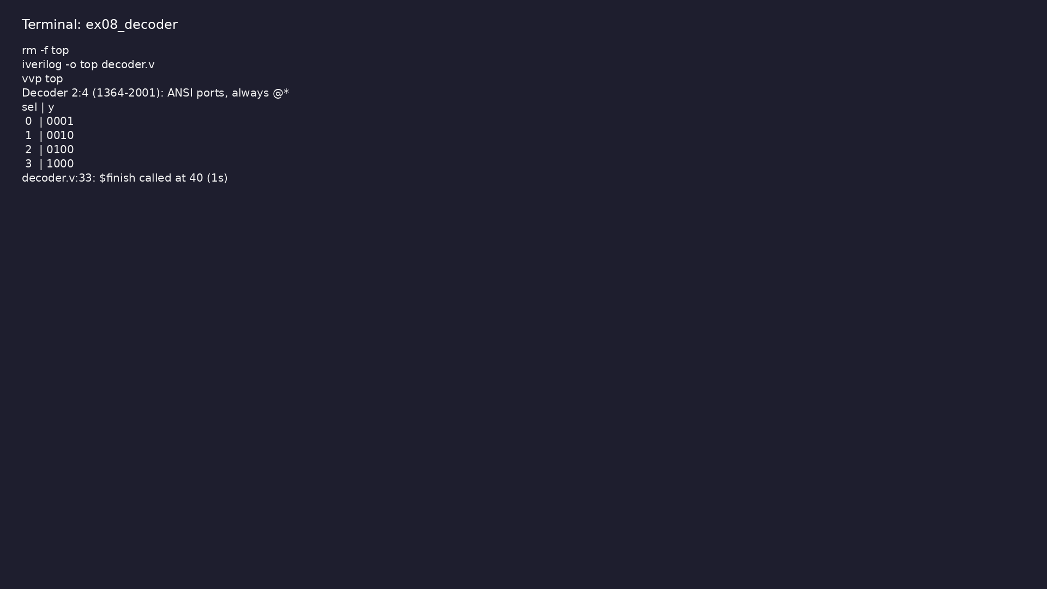
Demo: 2:4 decoder with ANSI ports and always @* (case)
$ cd module2/examples/decoder && make clean && make run
learn_verilog_systemverilog / Module 2
Notes:
Hands-on: module2/examples/decoder/

Slide 67
Example 9: Memory-style arrays (reg [7:0] mem [0:255]), indexing
• Packed vs unpacked; array indexing rules in 2001
learn_verilog_systemverilog / Module 2
Notes:
module2/examples/arrays/README.md

Slide 68
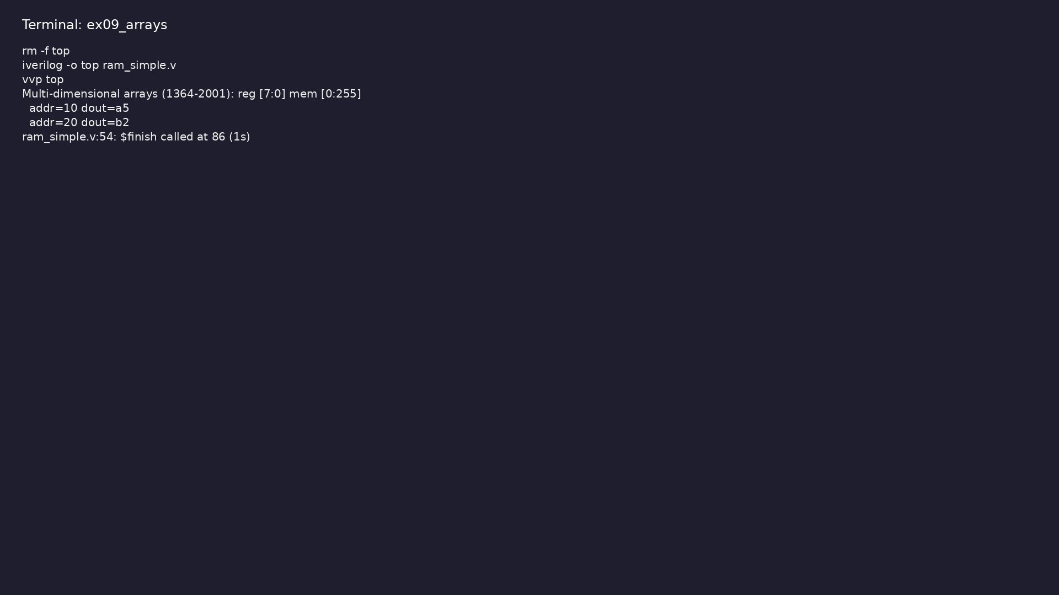
Demo: Memory-style arrays (reg [7:0] mem [0:255]), indexing
$ cd module2/examples/arrays && make clean && make run
learn_verilog_systemverilog / Module 2
Notes:
Hands-on: module2/examples/arrays/

Slide 69
Example 10: 2x4 buffer using 1D array indexed as row*4+col
• Emulating 2D with 1D array; index expression
learn_verilog_systemverilog / Module 2
Notes:
module2/examples/multi_dim_arrays/README.md

Slide 70
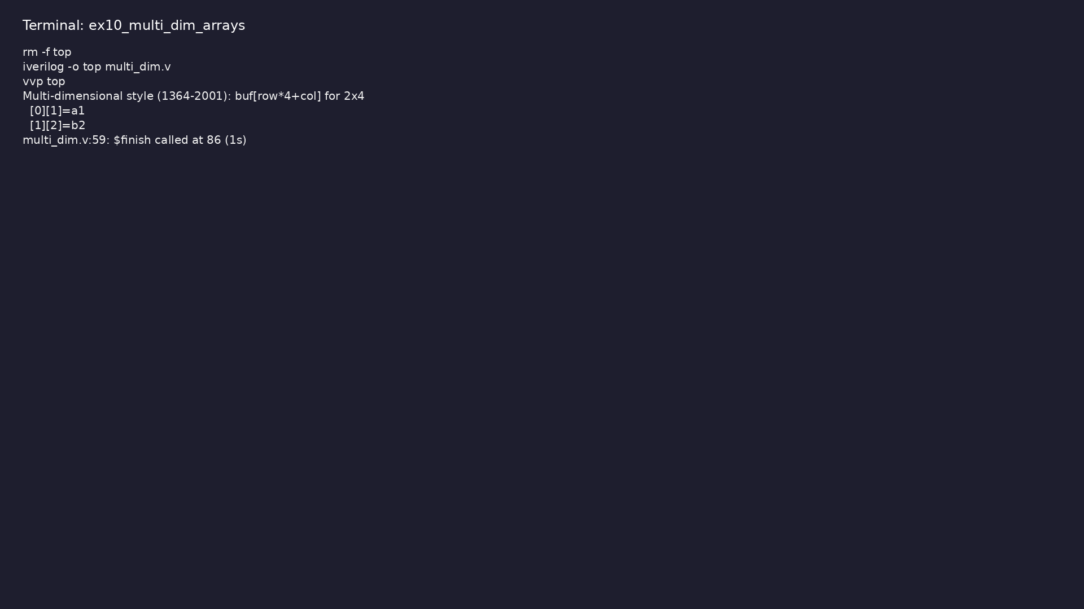
Demo: 2x4 buffer using 1D array indexed as row*4+col
$ cd module2/examples/multi_dim_arrays && make clean && make run
learn_verilog_systemverilog / Module 2
Notes:
Hands-on: module2/examples/multi_dim_arrays/

Slide 71
Example 11: Parameter override, localparam for derived constants
• When to use parameter vs localparam
learn_verilog_systemverilog / Module 2
Notes:
module2/examples/parameters/README.md

Slide 72
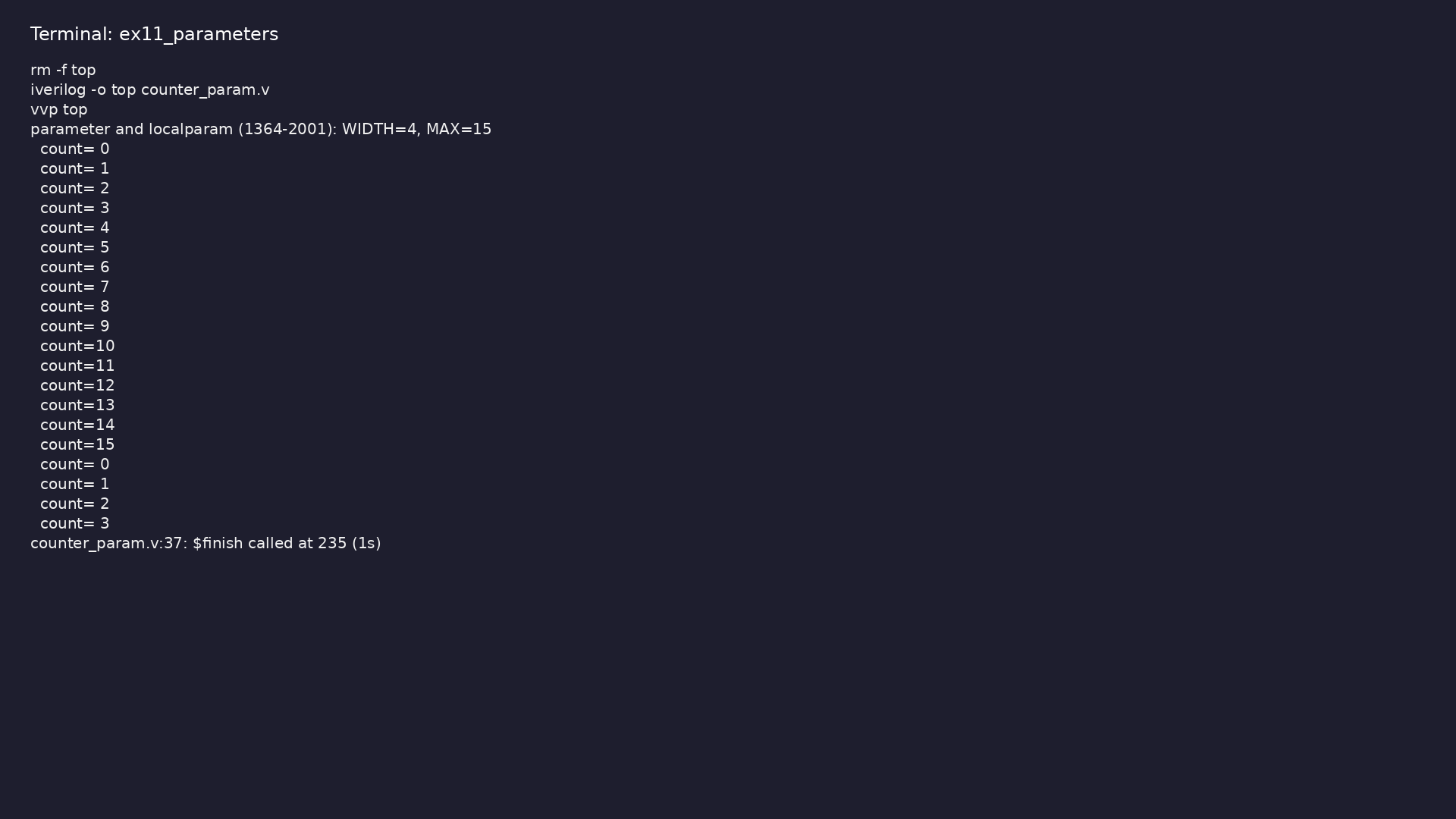
Demo: Parameter override, localparam for derived constants
$ cd module2/examples/parameters && make clean && make run
learn_verilog_systemverilog / Module 2
Notes:
Hands-on: module2/examples/parameters/

Slide 73
Example 12: Input/output in header, automatic functions
• 2001 style vs 1995 style
learn_verilog_systemverilog / Module 2
Notes:
module2/examples/tasks_functions/README.md

Slide 74
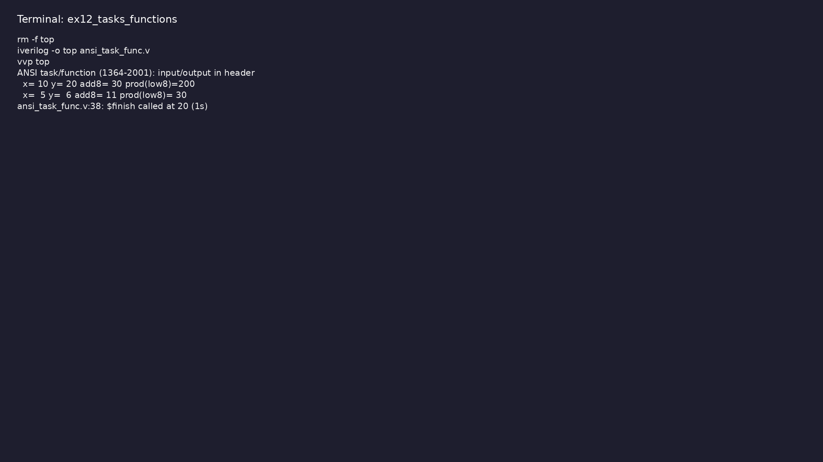
Demo: Input/output in header, automatic functions
$ cd module2/examples/tasks_functions && make clean && make run
learn_verilog_systemverilog / Module 2
Notes:
Hands-on: module2/examples/tasks_functions/

Slide 75
Example 13: task automatic apply_reset(output reg rn); begin/end body
• Task with output argument; testbench reset pattern
learn_verilog_systemverilog / Module 2
Notes:
module2/examples/task_ansi/README.md

Slide 76
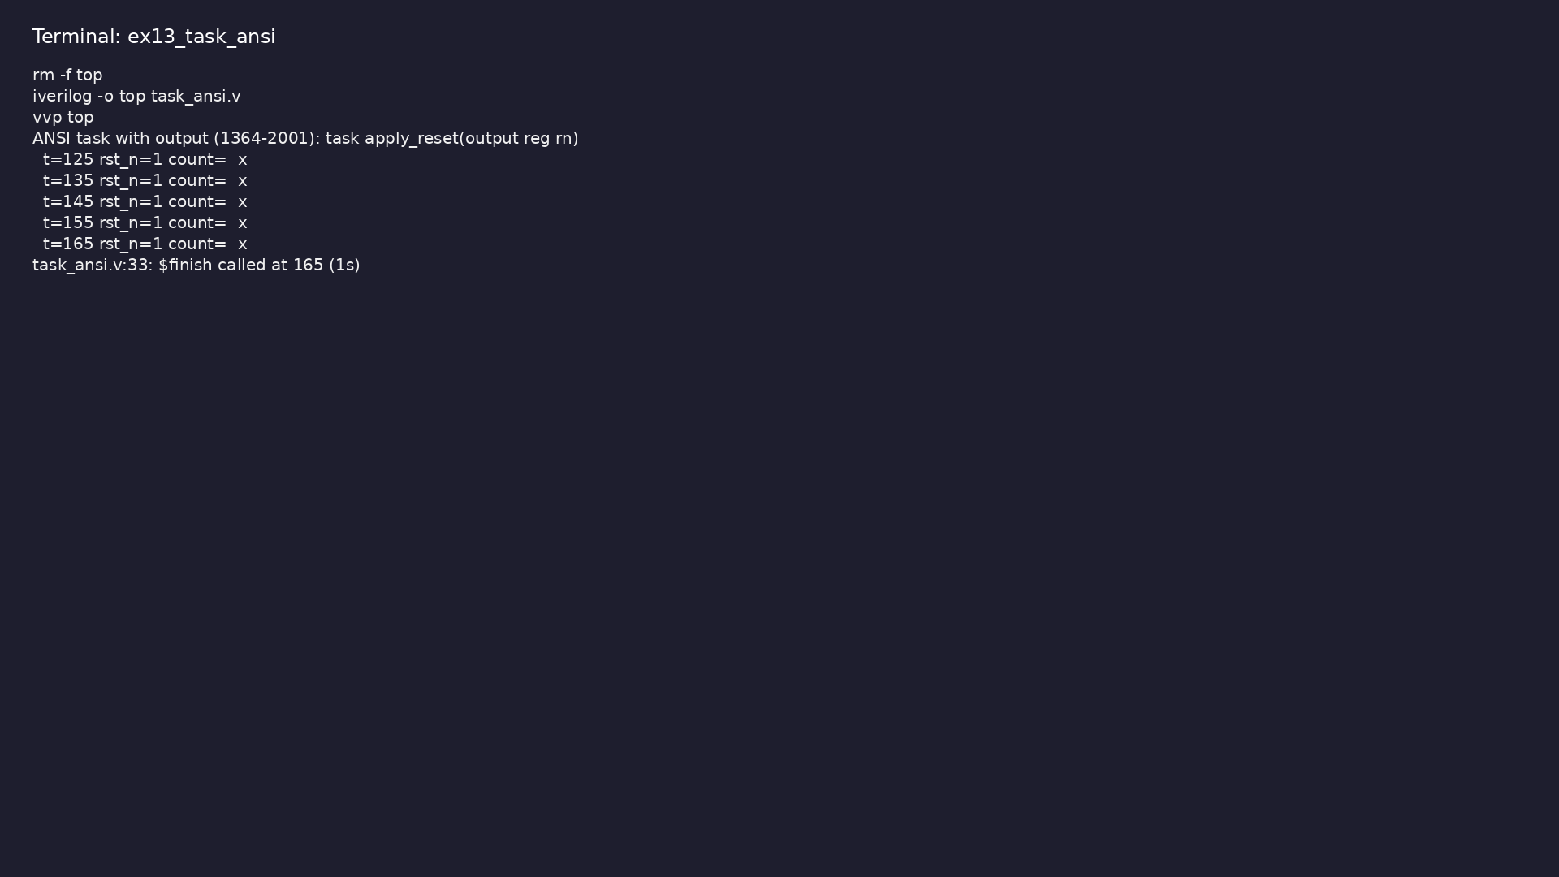
Demo: task automatic apply_reset(output reg rn); begin/end body
$ cd module2/examples/task_ansi && make clean && make run
learn_verilog_systemverilog / Module 2
Notes:
Hands-on: module2/examples/task_ansi/

Slide 77
Common pitfalls
learn_verilog_systemverilog / Module 2

Slide 78
Using always @* for Sequential Logic
• Mistake: `always @* q <= d;` intending a flip-flop.
• Reality: `@*` is for combinational logic; it does
not create a clock edge.
• Correct: Use `always @(posedge clk)` (and `<=`) for
sequential logic.
• Why: Mixing the two causes simulation/synthesis
mismatches and unintended latches.
learn_verilog_systemverilog / Module 2
Notes:
From MODULE2 Common Pitfalls.

Slide 79
genvar in Normal Code
• Mistake: Using genvar in an always block or initial
block.
• Reality: genvar is only for generate loops; it does
not exist at runtime.
• Correct: Use integer or reg for runtime loops; use
genvar only inside generate for.
• Why: genvar is elaborated away; it is not a
simulation variable.
learn_verilog_systemverilog / Module 2
Notes:
From MODULE2 Common Pitfalls.

Slide 80
Overriding localparam
• Mistake: Trying to override localparam at
instantiation (e.g. `#(.MAX(100))`).
• Reality: localparam cannot be overridden.
• Correct: Use parameter for values that must be
overridden; use localparam for fixed or derived
cons…
• Why: The standard does not allow localparam in the
parameter list.
learn_verilog_systemverilog / Module 2
Notes:
From MODULE2 Common Pitfalls.

Slide 81
Signed vs Unsigned Mix
• Mistake: Mixing signed and unsigned in one
expression without $signed/$unsigned and expecting a
par…
• Reality: Rules for sign extension and comparison
depend on operands.
• Correct: Be explicit: use signed types or
$signed/$unsigned and verify with testbenches.
• Why: Implicit mixing leads to wrong arithmetic and
comparison results.
learn_verilog_systemverilog / Module 2
Notes:
From MODULE2 Common Pitfalls.

Slide 82
Generate Block Scope
• Mistake: Referencing generate block names or genvar
at runtime.
• Reality: Generate blocks are elaborated at compile
time; names are for hierarchy.
• Correct: Use generate for structure; use normal
variables and blocks for runtime behavior.
• Why: Generate is not “runtime”; it only affects what
gets instantiated.
learn_verilog_systemverilog / Module 2
Notes:
From MODULE2 Common Pitfalls.

Slide 83
Practice & assessment
learn_verilog_systemverilog / Module 2

Slide 84
What you should know (1/2)
• ✓ Write modules with ANSI-style port declarations
(1364-2001)
• ✓ Use `always @*` for combinational logic and avoid
sensitivity-list errors
• ✓ Use generate (for, if/else) for parameterized and
conditional RTL
• ✓ Use signed types and $signed/$unsigned for signed
arithmetic
• ✓ Declare and use multi-dimensional arrays (e.g.
memories)
• ✓ Use localparam for constants that must not be
overridden
learn_verilog_systemverilog / Module 2
Notes:
From MODULE2 Learning Outcomes.

Slide 85
What you should know (2/2)
• ✓ Write ANSI-style tasks and functions
• ✓ Compare 1364-1995 and 1364-2001 and list what 2001
adds
learn_verilog_systemverilog / Module 2
Notes:
From MODULE2 Learning Outcomes.

Slide 86
Exercises
• ANSI Ports
• always @
• Generate
• Signed
• Arrays and localparam
learn_verilog_systemverilog / Module 2

Slide 87
Exercises
• Using always @* for Sequential Logic
• genvar in Normal Code
• Overriding localparam
• Signed vs Unsigned Mix
• Generate Block Scope
learn_verilog_systemverilog / Module 2

Slide 88
Summary & next steps
• Master the major Verilog update (IEEE 1364-2001) and
its additions over 1364-1995: ANSI ports, impl…
• Complete module2/CHECKLIST.md
• Review module2/EXAMPLES.md and run each lab
• Next: Next module in course
learn_verilog_systemverilog / Module 2

