Slide 1
Module 3
IEEE 1364-2005 (Verilog-2005)
learn_verilog_systemverilog / Module 3

Slide 2
Learning objectives
• Master the final Verilog-only standard (IEEE
1364-2005), its clarifications over 2001, and the
synt…
learn_verilog_systemverilog / Module 3

Slide 3
Prerequisites
• See module README
learn_verilog_systemverilog / Module 3

Slide 4

Learning path
Master the final Verilog-only standard (IEEE 1364-2005), its clarifications over 2001, and the synthesizable subset as a stable baseline...
learn_verilog_systemverilog / Module 3

Slide 5
Overview
• This module covers IEEE Std 1364-2005
(Verilog-2005), the last standard that defines
Verilog alone…
learn_verilog_systemverilog / Module 3

Slide 6
How to learn this module
learn_verilog_systemverilog / Module 3

Slide 7
Suggested learning path (1/2)
• Skim this document — Goal, Overview, and Topics
Covered set the IEEE scope for Module 3.
• Study design architecture — See how DUTs, examples,
and testbenches fit together under `module3/`.
• Work through labs in order — Open
`module3/EXAMPLES.md` and run each `make clean &&
make run` from…
• Run the full module script — `./scripts/module3.sh`
from the repo root to simulate all examples and…
• Complete the exercises — Try each exercise in this
document before reading solutions or peeking at…
learn_verilog_systemverilog / Module 3
Notes:
From docs/MODULE3.md — read guides before running demos.

Slide 8
Suggested learning path (2/2)
• Review Common Pitfalls — Can you explain each
mistake and the fix?
• Self-check — Use `module3/CHECKLIST.md` before
starting the next module.
learn_verilog_systemverilog / Module 3
Notes:
From docs/MODULE3.md — read guides before running demos.

Slide 9
Design architecture
learn_verilog_systemverilog / Module 3

Slide 10
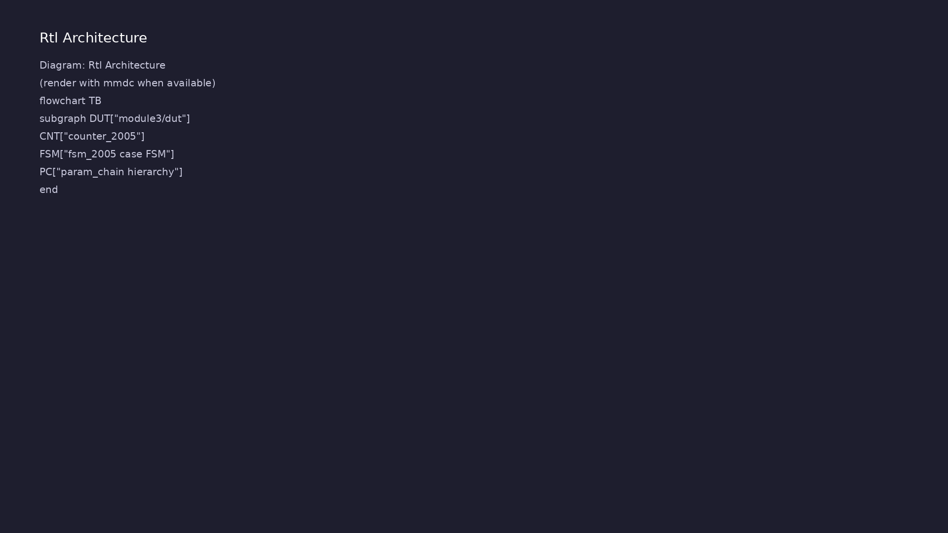
1. Repository layout (module3/)
• 1364-2005 clarifications and
deprecations over 2001
• Focus: avoid defparam, use
localparam, understand 2005 vs
2001 deltas
• module3/examples/ — migration
and best-practice labs
• scripts/module3.sh — run all
2005-focused examples
learn_verilog_systemverilog / Module 3
Notes:
From MODULE3 Design Architecture.

Slide 11
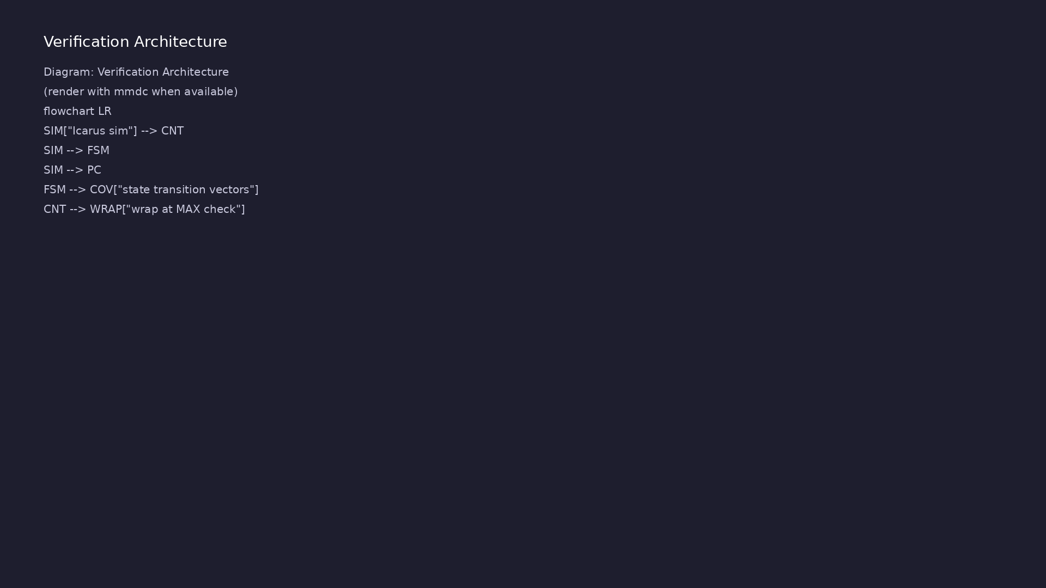
2. Parameter and constant flow
• localparam — named constants
inside module, not overridable
• Parameter override at
instantiation #(.WIDTH(n))
preferred over defparam
• 2005 standard marks defparam as
deprecated
learn_verilog_systemverilog / Module 3
Notes:
From MODULE3 Design Architecture.

Slide 12
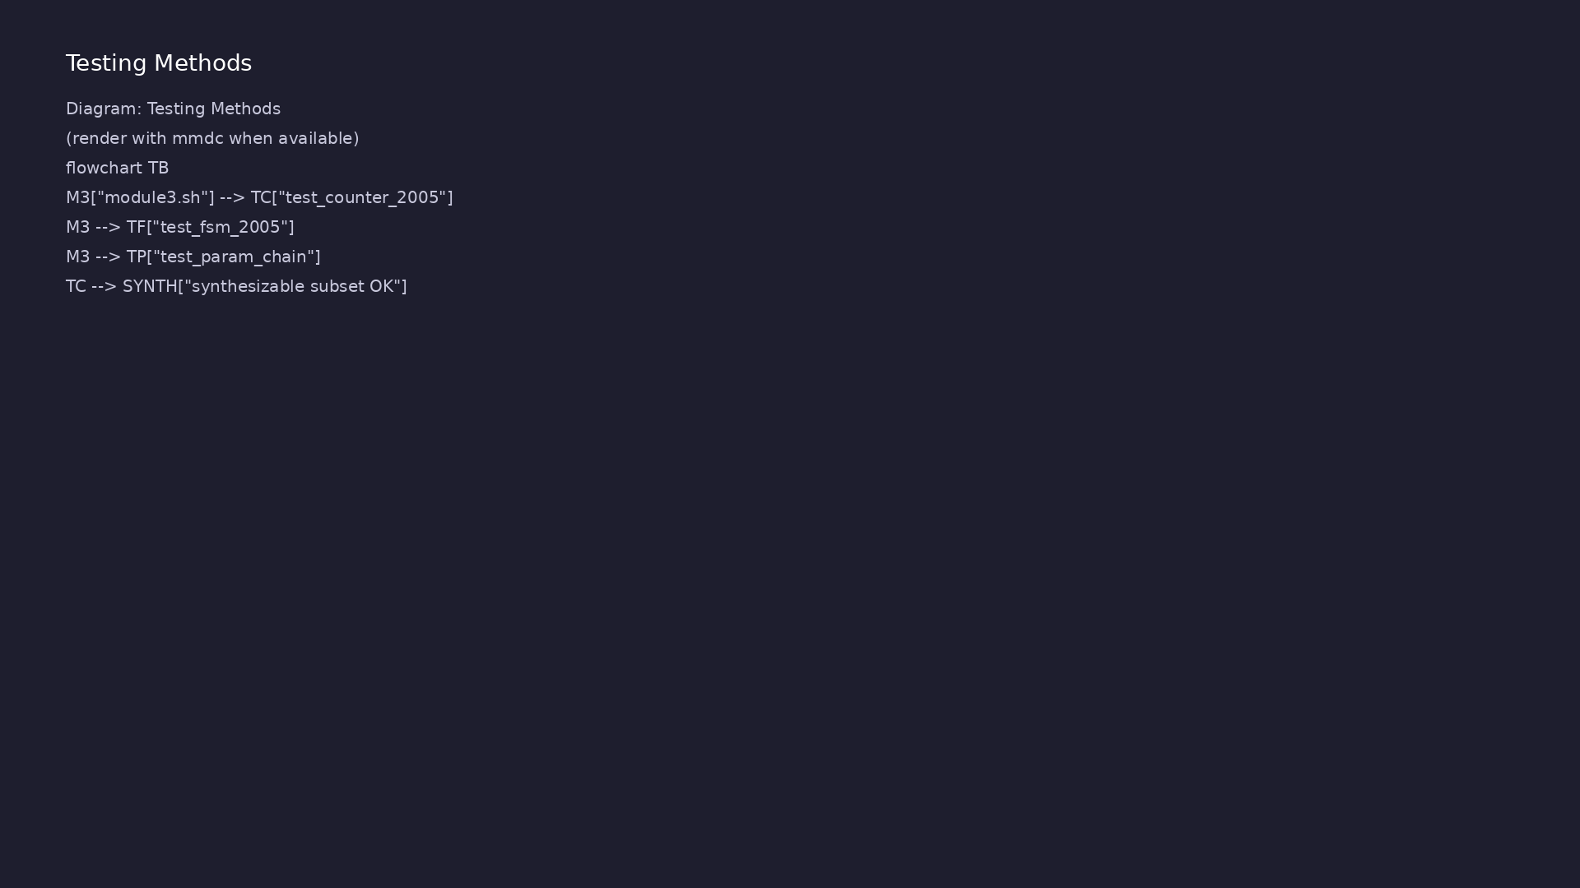
3. Design intent unchanged from 2001
• Same ANSI, @*, generate, signed
features as Module 2
• 2005 adds LRM clarifications —
behavior you already use stays
valid
• Migration labs show 2001 → 2005
style tweaks only
learn_verilog_systemverilog / Module 3
Notes:
From MODULE3 Design Architecture.

Slide 13
RTL block diagram (reference)
Module 3: DUT hierarchy and signal flow.
learn_verilog_systemverilog / Module 3

Slide 14
Verification / testbench diagram (reference)
Module 3: stimulus, observation, and checking.
learn_verilog_systemverilog / Module 3

Slide 15
Parameter override at instantiation
/*
* Parameter override at instantiation - IEEE 1364-2005
* No defparam (deprecated); use #(.PARAM(value)) at instantiation only.
*/
module adder #(parameter WIDTH = 8) (
input wire [WIDTH-1:0] a,
input wire [WIDTH-1:0] b,
output wire [WIDTH-1:0] y
);
assign y = a + b;
endmodule
module top;
reg [3:0] a4, b4;
reg [7:0] a8, b8;
# ...
learn_verilog_systemverilog / Module 3

Slide 16
Execution & simulation flow
learn_verilog_systemverilog / Module 3

Slide 17
How the example runs (toolchain)
• Makefile: Verilator compiles RTL + SystemVerilog
testbench into a C++ model
• sim_main.cpp: generates clk/rst_n, calls eval()
until $finish
• Directed test (initial block or C++): drive
stimulus, wait for DUT flags
• Self-check: compare outputs; print PASS/FAIL (see
terminal demo slide)
• Repo path: module3/examples/<example>/ — run make
run from that directory
learn_verilog_systemverilog / Module 3
Notes:
From MODULE3 — execution and artifact layout.

Slide 18
Key files to study
learn_verilog_systemverilog / Module 3

Slide 19
Open these in the repo
• module3/examples/no_defparam/ — replace defparam
with #() override
• module3/examples/parameters/ — parameter override at
instantiation
• scripts/module3.sh
learn_verilog_systemverilog / Module 3
Notes:
Trace while running module3/EXAMPLES.md labs.

Slide 20
Verification & testing methods
learn_verilog_systemverilog / Module 3

Slide 21
1. Execution and regression
• make run per example;
./scripts/module3.sh for full
sweep
• Watch for defparam warnings when
running deprecated-style labs
learn_verilog_systemverilog / Module 3
Notes:
From MODULE3 Verification & Testing Methods.

Slide 22
2. Migration checks
• Replace defparam with #()
override at instantiation
• Confirm localparam names match
across parent and child
learn_verilog_systemverilog / Module 3
Notes:
From MODULE3 Verification & Testing Methods.

Slide 23
Avoid defparam — use #() instead
/*
* No defparam - IEEE 1364-2005
* defparam is deprecated; override only at instantiation.
* This example shows correct hierarchy: parent passes parameter to
child at inst.
*/
module child #(parameter W = 4) (
input wire [W-1:0] a,
output wire [W-1:0] y
);
assign y = a;
endmodule
module parent #(parameter W = 4) (
input wire [W-1:0] a,
output wire [W-1:0] y
# ...
learn_verilog_systemverilog / Module 3

Slide 24
Syllabus topics
learn_verilog_systemverilog / Module 3

Slide 25
Protocol & design details
learn_verilog_systemverilog / Module 3

Slide 26
Detail: What 1364-2005 Is
• Final Verilog-only standard: No SystemVerilog (no
`logic`, interfaces, packages, classes).
• Clarifications: Refined wording and examples for
2001 features (e.g. generate, signed, scheduling).
• Minor additions: Additional system tasks and small
syntax clarifications.
• Stable baseline: Many synthesis and style guides
treat 1364-2005 as the Verilog baseline.
learn_verilog_systemverilog / Module 3
Notes:
From MODULE3 Topics Covered — protocol/design depth.

Slide 27
Detail: What 1364-2005 Adds or Clarifies Over 2001 (1)
• Clarifications: Scheduling, blocking vs nonblocking
semantics, and generate behavior.
• System tasks: Additional or clarified tasks (e.g.
`$realtime`, file I/O behavior).
• Deprecations: e.g. defparam is deprecated (use
instantiation parameter override instead).
• Attributes: Clarified syntax and usage for tool-
specific attributes.
learn_verilog_systemverilog / Module 3
Notes:
From MODULE3 Topics Covered — protocol/design depth.

Slide 28
Detail: What 1364-2005 Adds or Clarifies Over 2001 (2)
• No major new language features: The big step to new
features is 1800 (Module 4).
learn_verilog_systemverilog / Module 3
Notes:
From MODULE3 Topics Covered — protocol/design depth.

Slide 29
Detail: What 1364-2005 Still Does Not Include
• No SystemVerilog: no `logic`,
`always_comb`/`always_ff`, interfaces, packages,
classes, assertions…
• No interfaces or type parameters (those are 1800).
learn_verilog_systemverilog / Module 3
Notes:
From MODULE3 Topics Covered — protocol/design depth.

Slide 30
Detail: Why defparam Is Deprecated
• Problem: Overrides a parameter deep in hierarchy
from outside; hard to trace and tool-dependent.
• Preferred: Override at instantiation: `sub
#(.WIDTH(16)) u_sub (...);`
learn_verilog_systemverilog / Module 3
Notes:
From MODULE3 Topics Covered — protocol/design depth.

Slide 31
Detail: Correct Practice: Parameter Override at Instantiation
• Recommendation: Do not use defparam in new RTL; use
named parameter override in the instantiation.
learn_verilog_systemverilog / Module 3
Notes:
From MODULE3 Topics Covered — protocol/design depth.

Slide 32
Detail: Generally Synthesizable (RTL Subset) (1)
• Modules: ANSI ports, parameter, localparam.
• Nets and variables: wire, reg (with correct usage).
• assign: Combinational logic; single driver per net.
• always: Combinational with `always @*`; sequential
with `always @(posedge clk)` (or negedge) and no…
learn_verilog_systemverilog / Module 3
Notes:
From MODULE3 Topics Covered — protocol/design depth.

Slide 33
Detail: Generally Synthesizable (RTL Subset) (2)
• generate: generate for, generate if/else for
structure.
• Operators: Arithmetic, logical, bitwise, relational,
shift, concatenation, conditional (`? :`).
• case / casez / casex: With care (full case, parallel
case, or tool directives).
• Tasks and functions: Without delays; used for
combinational or single-cycle helpers.
learn_verilog_systemverilog / Module 3
Notes:
From MODULE3 Topics Covered — protocol/design depth.

Slide 34
Detail: Generally Not Synthesizable (or Tool-Specific) (1)
• Delays: `#n` in RTL (used for testbenches only).
• initial: Except for initialization of reg/mem in
FPGAs (tool-dependent).
• Event controls: `@(posedge clk)` is fine; complex
event lists may not map.
• Fork/join: Usually testbench-only.
learn_verilog_systemverilog / Module 3
Notes:
From MODULE3 Topics Covered — protocol/design depth.

Slide 35
Detail: Generally Not Synthesizable (or Tool-Specific) (2)
• System tasks: e.g. `$display`, `$finish` —
testbench/simulation only.
• Pure latch inference: Unintended latches from
incomplete case/if; use full case or default.
learn_verilog_systemverilog / Module 3
Notes:
From MODULE3 Topics Covered — protocol/design depth.

Slide 36
Detail: Best Practices for Synthesis (1364-2005)
• Combinational: Use `always @*` and blocking `=`;
assign all outputs in all branches (or default) to…
• Sequential: Use `always @(posedge clk)` (and
optionally `negedge rst_n`) and nonblocking `<=`; do
n…
• One driver per net: No multiple assign to the same
wire; no multiple always driving the same reg in…
• Avoid latches: In combinational always, cover all
cases or use a default assignment.
learn_verilog_systemverilog / Module 3
Notes:
From MODULE3 Topics Covered — protocol/design depth.

Slide 37
Detail: Rules of Thumb
• Combinational always (`always @*`): Use blocking
`=`. Order of statements can matter (same simulati…
• Sequential always (`always @(posedge clk)`): Use
nonblocking `<=`. Order does not matter within the…
• Do not mix blocking and nonblocking for the same
variable in the same always block.
learn_verilog_systemverilog / Module 3
Notes:
From MODULE3 Topics Covered — protocol/design depth.

Slide 38
Detail: full_case (Tool-Dependent)
• Intent: “Every possible case value is covered; no
latch.”
• Syntax: Often an attribute, e.g. `(* full_case *)`
or tool-specific comment.
• Use: When the designer guarantees all cases are
covered (e.g. one-hot state encoding).
learn_verilog_systemverilog / Module 3
Notes:
From MODULE3 Topics Covered — protocol/design depth.

Slide 39
Detail: parallel_case (Tool-Dependent)
• Intent: “At most one case arm matches; can be
implemented as parallel mux.”
• Syntax: Often an attribute, e.g. `(* parallel_case
*)` or tool-specific.
• Use: When at most one branch is true (e.g. one-hot);
misuse can hide bugs.
learn_verilog_systemverilog / Module 3
Notes:
From MODULE3 Topics Covered — protocol/design depth.

Slide 40
Verification flow (reference)
Stimulus, DUT response, and check points for this module.
learn_verilog_systemverilog / Module 3

Slide 41
1. IEEE 1364-2005 Context (1/2)
• Final Verilog-only standard: No SystemVerilog (no
`logic`, interfaces, packages, classes).
• Clarifications: Refined wording and examples for
2001 features (e.g. generate, signed, scheduling).
• Minor additions: Additional system tasks and small
syntax clarifications.
• Stable baseline: Many synthesis and style guides
treat 1364-2005 as the Verilog baseline.
• Clarifications: Scheduling, blocking vs nonblocking
semantics, and generate behavior.
• System tasks: Additional or clarified tasks (e.g.
`$realtime`, file I/O behavior).
learn_verilog_systemverilog / Module 3
Notes:
From MODULE3 Topics Covered.

Slide 42
1. IEEE 1364-2005 Context (2/2)
• Deprecations: e.g. defparam is deprecated (use
instantiation parameter override instead).
• Attributes: Clarified syntax and usage for tool-
specific attributes.
• No major new language features: The big step to new
features is 1800 (Module 4).
• No SystemVerilog: no `logic`,
`always_comb`/`always_ff`, interfaces, packages,
classes, assertions…
• No interfaces or type parameters (those are 1800).
learn_verilog_systemverilog / Module 3
Notes:
From MODULE3 Topics Covered.

Slide 43
2. defparam Deprecation (2005)
• Problem: Overrides a parameter deep in hierarchy
from outside; hard to trace and tool-dependent.
• Preferred: Override at instantiation: `sub
#(.WIDTH(16)) u_sub (...);`
• Recommendation: Do not use defparam in new RTL; use
named parameter override in the instantiation.
• Why defparam Is Deprecated
• Correct Practice: Parameter Override at
Instantiation
learn_verilog_systemverilog / Module 3
Notes:
From MODULE3 Topics Covered.

Slide 44
3. Synthesizable Subset (1364-2005) (1/4)
• Modules: ANSI ports, parameter, localparam.
• Nets and variables: wire, reg (with correct usage).
• assign: Combinational logic; single driver per net.
• always: Combinational with `always @*`; sequential
with `always @(posedge clk)` (or negedge) and no…
• generate: generate for, generate if/else for
structure.
• Operators: Arithmetic, logical, bitwise, relational,
shift, concatenation, conditional (`? :`).
learn_verilog_systemverilog / Module 3
Notes:
From MODULE3 Topics Covered.

Slide 45
3. Synthesizable Subset (1364-2005) (2/4)
• case / casez / casex: With care (full case, parallel
case, or tool directives).
• Tasks and functions: Without delays; used for
combinational or single-cycle helpers.
• Signed: signed types and $signed/$unsigned as
supported by the tool.
• Delays: `#n` in RTL (used for testbenches only).
• initial: Except for initialization of reg/mem in
FPGAs (tool-dependent).
• Event controls: `@(posedge clk)` is fine; complex
event lists may not map.
learn_verilog_systemverilog / Module 3
Notes:
From MODULE3 Topics Covered.

Slide 46
3. Synthesizable Subset (1364-2005) (3/4)
• Fork/join: Usually testbench-only.
• System tasks: e.g. `$display`, `$finish` —
testbench/simulation only.
• Pure latch inference: Unintended latches from
incomplete case/if; use full case or default.
• Combinational: Use `always @*` and blocking `=`;
assign all outputs in all branches (or default) to…
• Sequential: Use `always @(posedge clk)` (and
optionally `negedge rst_n`) and nonblocking `<=`; do
n…
• One driver per net: No multiple assign to the same
wire; no multiple always driving the same reg in…
learn_verilog_systemverilog / Module 3
Notes:
From MODULE3 Topics Covered.

Slide 47
3. Synthesizable Subset (1364-2005) (4/4)
• Avoid latches: In combinational always, cover all
cases or use a default assignment.
learn_verilog_systemverilog / Module 3
Notes:
From MODULE3 Topics Covered.

Slide 48
4. Blocking vs Nonblocking (Clarified in 2005)
• Combinational always (`always @*`): Use blocking
`=`. Order of statements can matter (same simulati…
• Sequential always (`always @(posedge clk)`): Use
nonblocking `<=`. Order does not matter within the…
• Do not mix blocking and nonblocking for the same
variable in the same always block.
• Rules of Thumb
learn_verilog_systemverilog / Module 3
Notes:
From MODULE3 Topics Covered.

Slide 49
5. Full Case and Parallel Case (Synthesis Hints)
• Intent: “Every possible case value is covered; no
latch.”
• Syntax: Often an attribute, e.g. `(* full_case *)`
or tool-specific comment.
• Use: When the designer guarantees all cases are
covered (e.g. one-hot state encoding).
• Intent: “At most one case arm matches; can be
implemented as parallel mux.”
• Syntax: Often an attribute, e.g. `(* parallel_case
*)` or tool-specific.
• Use: When at most one branch is true (e.g. one-hot);
misuse can hide bugs.
learn_verilog_systemverilog / Module 3
Notes:
From MODULE3 Topics Covered.

Slide 50
6. Summary: 1364 Evolution (1995 → 2001 → 2005)
• See docs/MODULE3.md
learn_verilog_systemverilog / Module 3
Notes:
From MODULE3 Topics Covered.

Slide 51
Hands-on examples
learn_verilog_systemverilog / Module 3

Slide 52
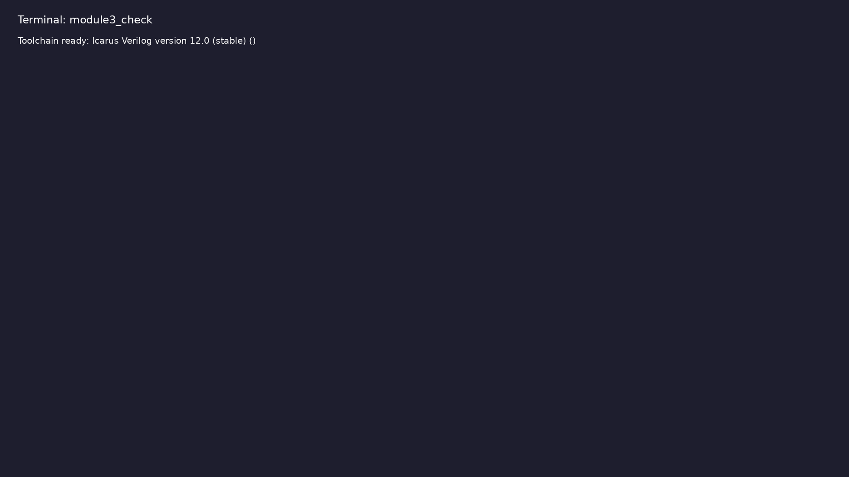
Module 3 toolchain check
$ command -v iverilog >/dev/null && echo "Toolchain ready: $(iverilog
-V 2>&1 | head -1)"
learn_verilog_systemverilog / Module 3
Notes:
Requires iverilog on PATH (apt install iverilog).

Slide 53
Example 1: No defparam; override at instantiation only
• defparam deprecated; use `#(.PARAM(value))` at
instantiation
learn_verilog_systemverilog / Module 3
Notes:
module3/examples/parameters/README.md

Slide 54
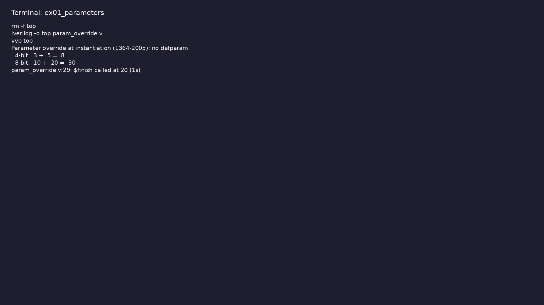
Demo: No defparam; override at instantiation only
$ cd module3/examples/parameters && make clean && make run
learn_verilog_systemverilog / Module 3
Notes:
Hands-on: module3/examples/parameters/

Slide 55
Example 2: Parameter passed through hierarchy (parent → child) at ins…
• No defparam anywhere; override only at inst
learn_verilog_systemverilog / Module 3
Notes:
module3/examples/no_defparam/README.md

Slide 56
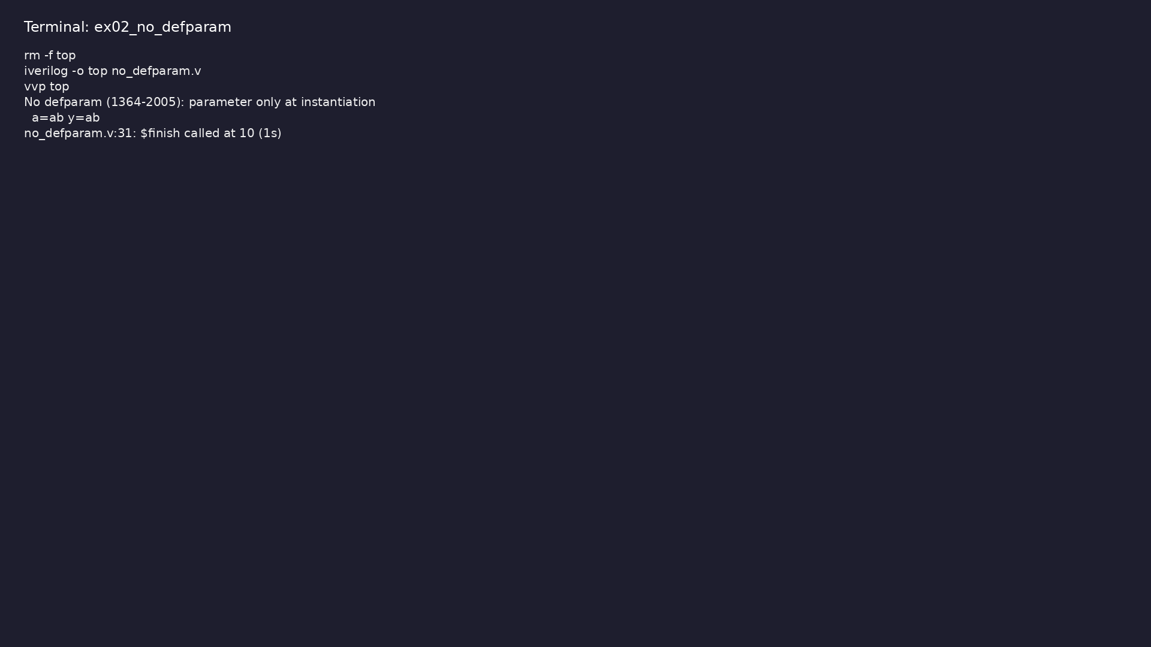
Demo: Parameter passed through hierarchy (parent → child) at instanti…
$ cd module3/examples/no_defparam && make clean && make run
learn_verilog_systemverilog / Module 3
Notes:
Hands-on: module3/examples/no_defparam/

Slide 57
Example 3: Combinational (always @*, blocking) and sequential (posedg…
• One driver per net; avoid latches; no delays in RTL
learn_verilog_systemverilog / Module 3
Notes:
module3/examples/synthesizable/README.md

Slide 58
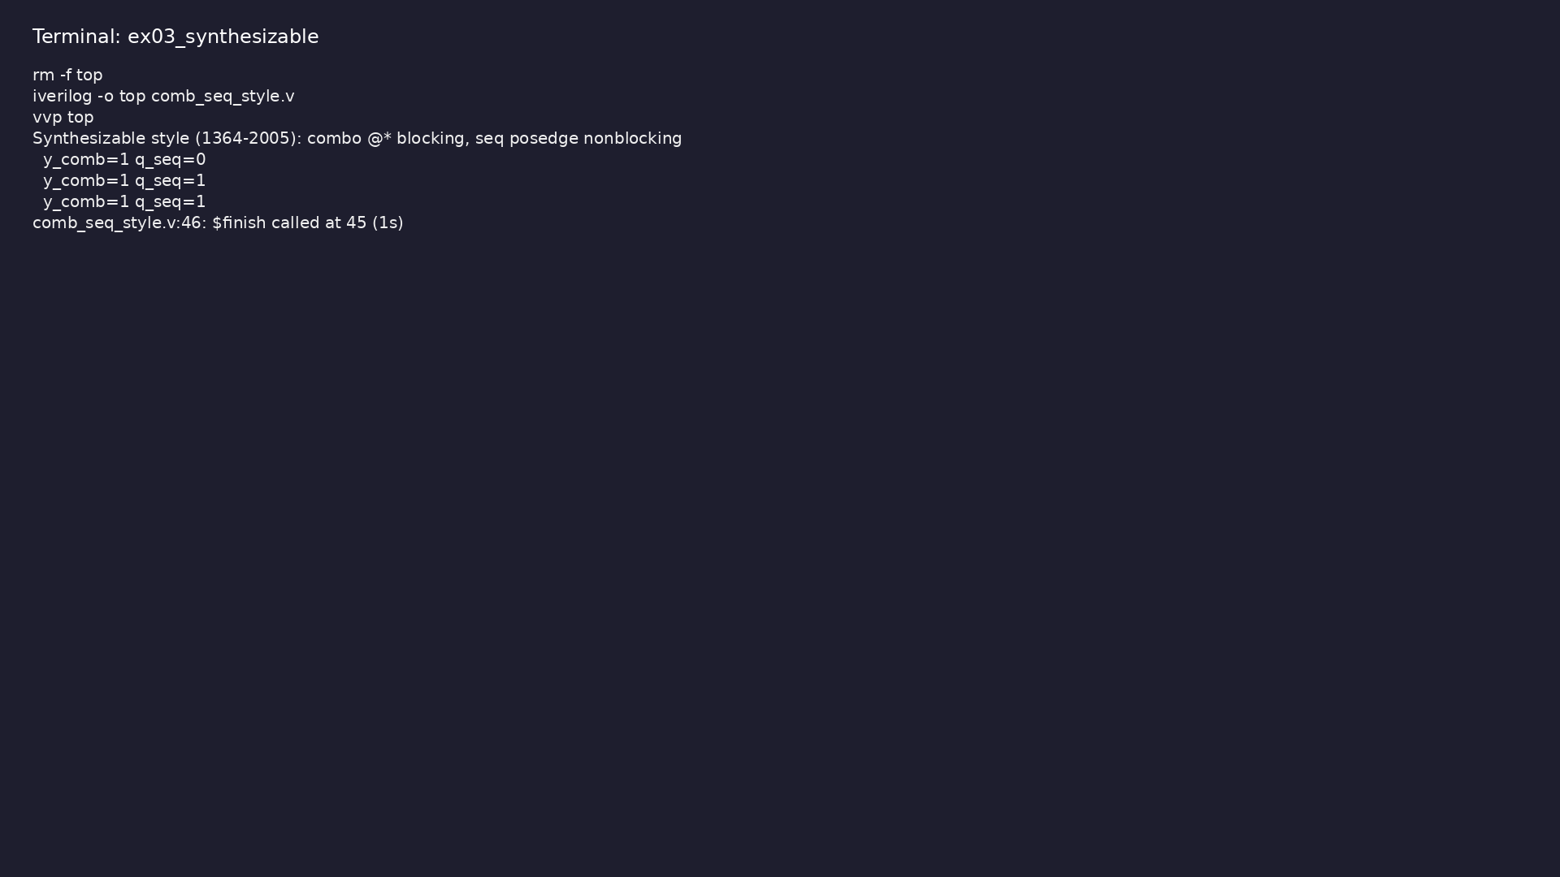
Demo: Combinational (always @*, blocking) and sequential (posedge clk…
$ cd module3/examples/synthesizable && make clean && make run
learn_verilog_systemverilog / Module 3
Notes:
Hands-on: module3/examples/synthesizable/

Slide 59
Example 4: Single assign to wire; single always driving reg
• No multiple drivers per net
learn_verilog_systemverilog / Module 3
Notes:
module3/examples/one_driver/README.md

Slide 60
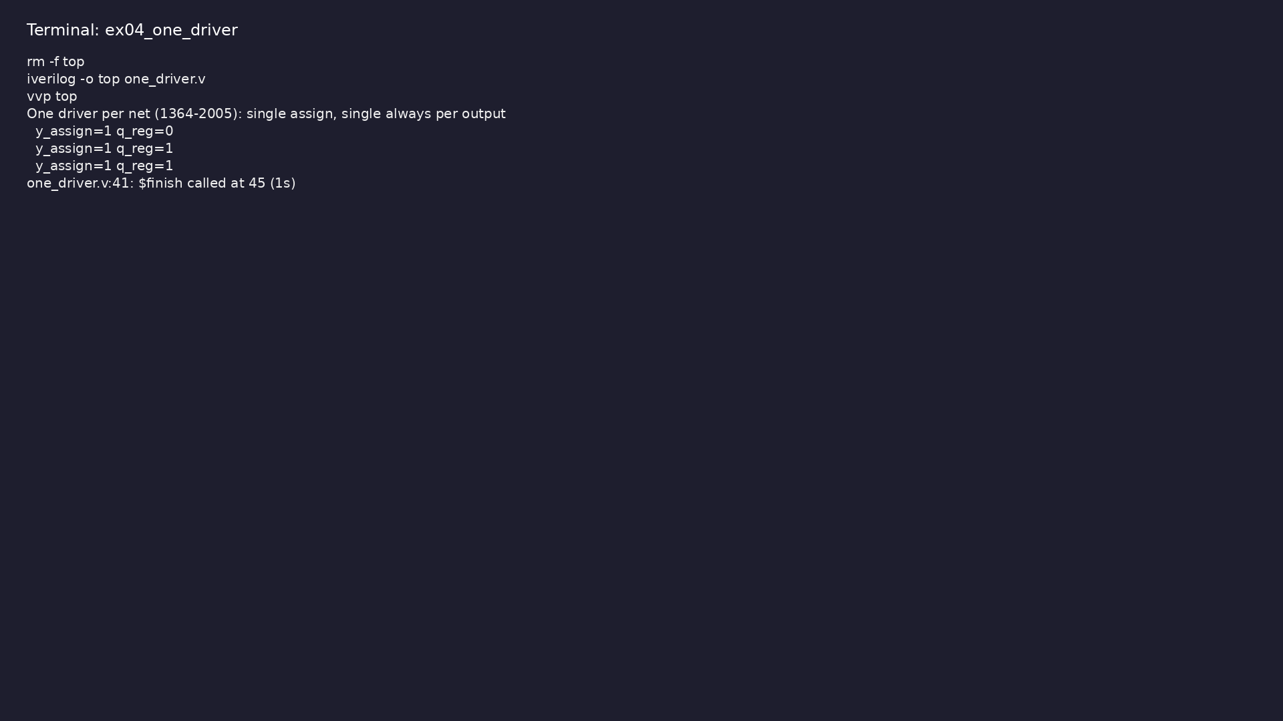
Demo: Single assign to wire; single always driving reg
$ cd module3/examples/one_driver && make clean && make run
learn_verilog_systemverilog / Module 3
Notes:
Hands-on: module3/examples/one_driver/

Slide 61
Example 5: Side-by-side combinational vs sequential blocks with corre…
• = in combinational; <= in sequential; do not mix for
same variable
learn_verilog_systemverilog / Module 3
Notes:
module3/examples/procedural/README.md

Slide 62
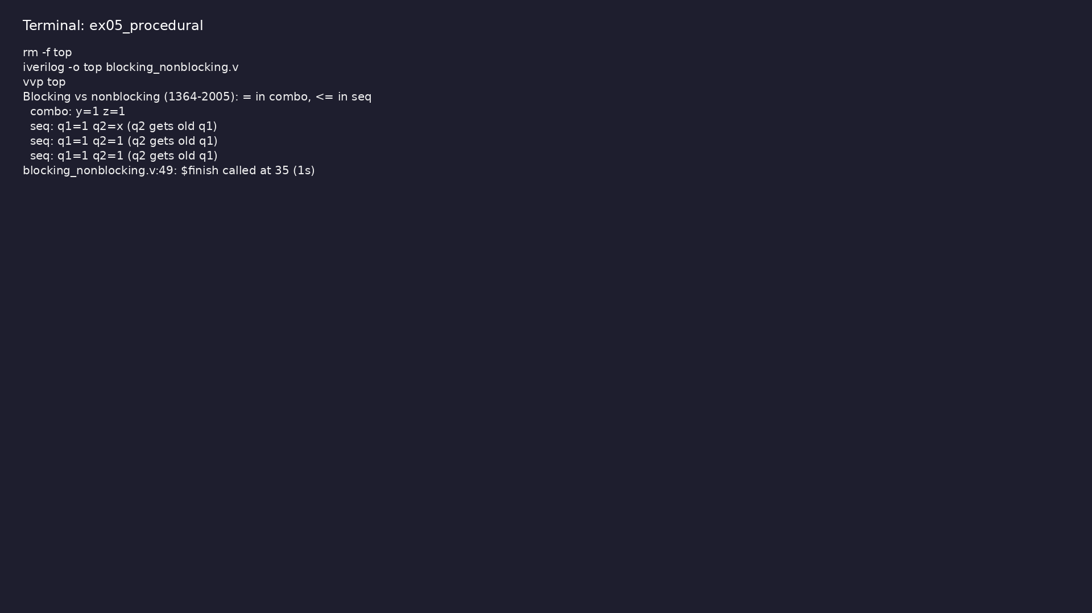
Demo: Side-by-side combinational vs sequential blocks with correct as…
$ cd module3/examples/procedural && make clean && make run
learn_verilog_systemverilog / Module 3
Notes:
Hands-on: module3/examples/procedural/

Slide 63
Example 6: Two-stage pipeline: q1 <= d; q2 <= q1 (nonblocking only)
• q2 gets old q1 (previous cycle); sequential block
only
learn_verilog_systemverilog / Module 3
Notes:
module3/examples/pipeline/README.md

Slide 64
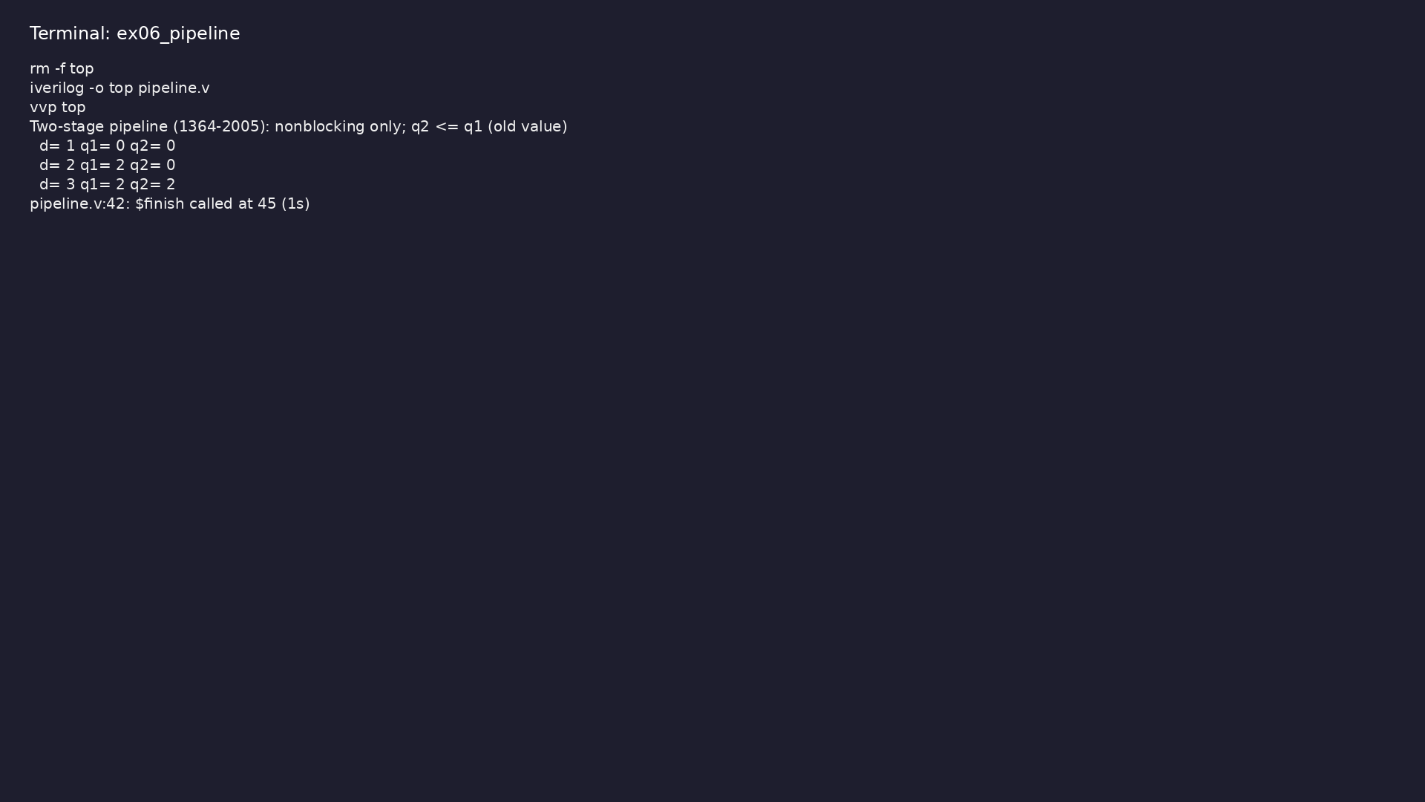
Demo: Two-stage pipeline: q1 <= d; q2 <= q1 (nonblocking only)
$ cd module3/examples/pipeline && make clean && make run
learn_verilog_systemverilog / Module 3
Notes:
Hands-on: module3/examples/pipeline/

Slide 65
Example 7: full_case / parallel_case attributes (or tool pragmas) whe…
• Synthesis hints only; 1364-2005 has no
unique/priority case
learn_verilog_systemverilog / Module 3
Notes:
module3/examples/case_styles/README.md

Slide 66
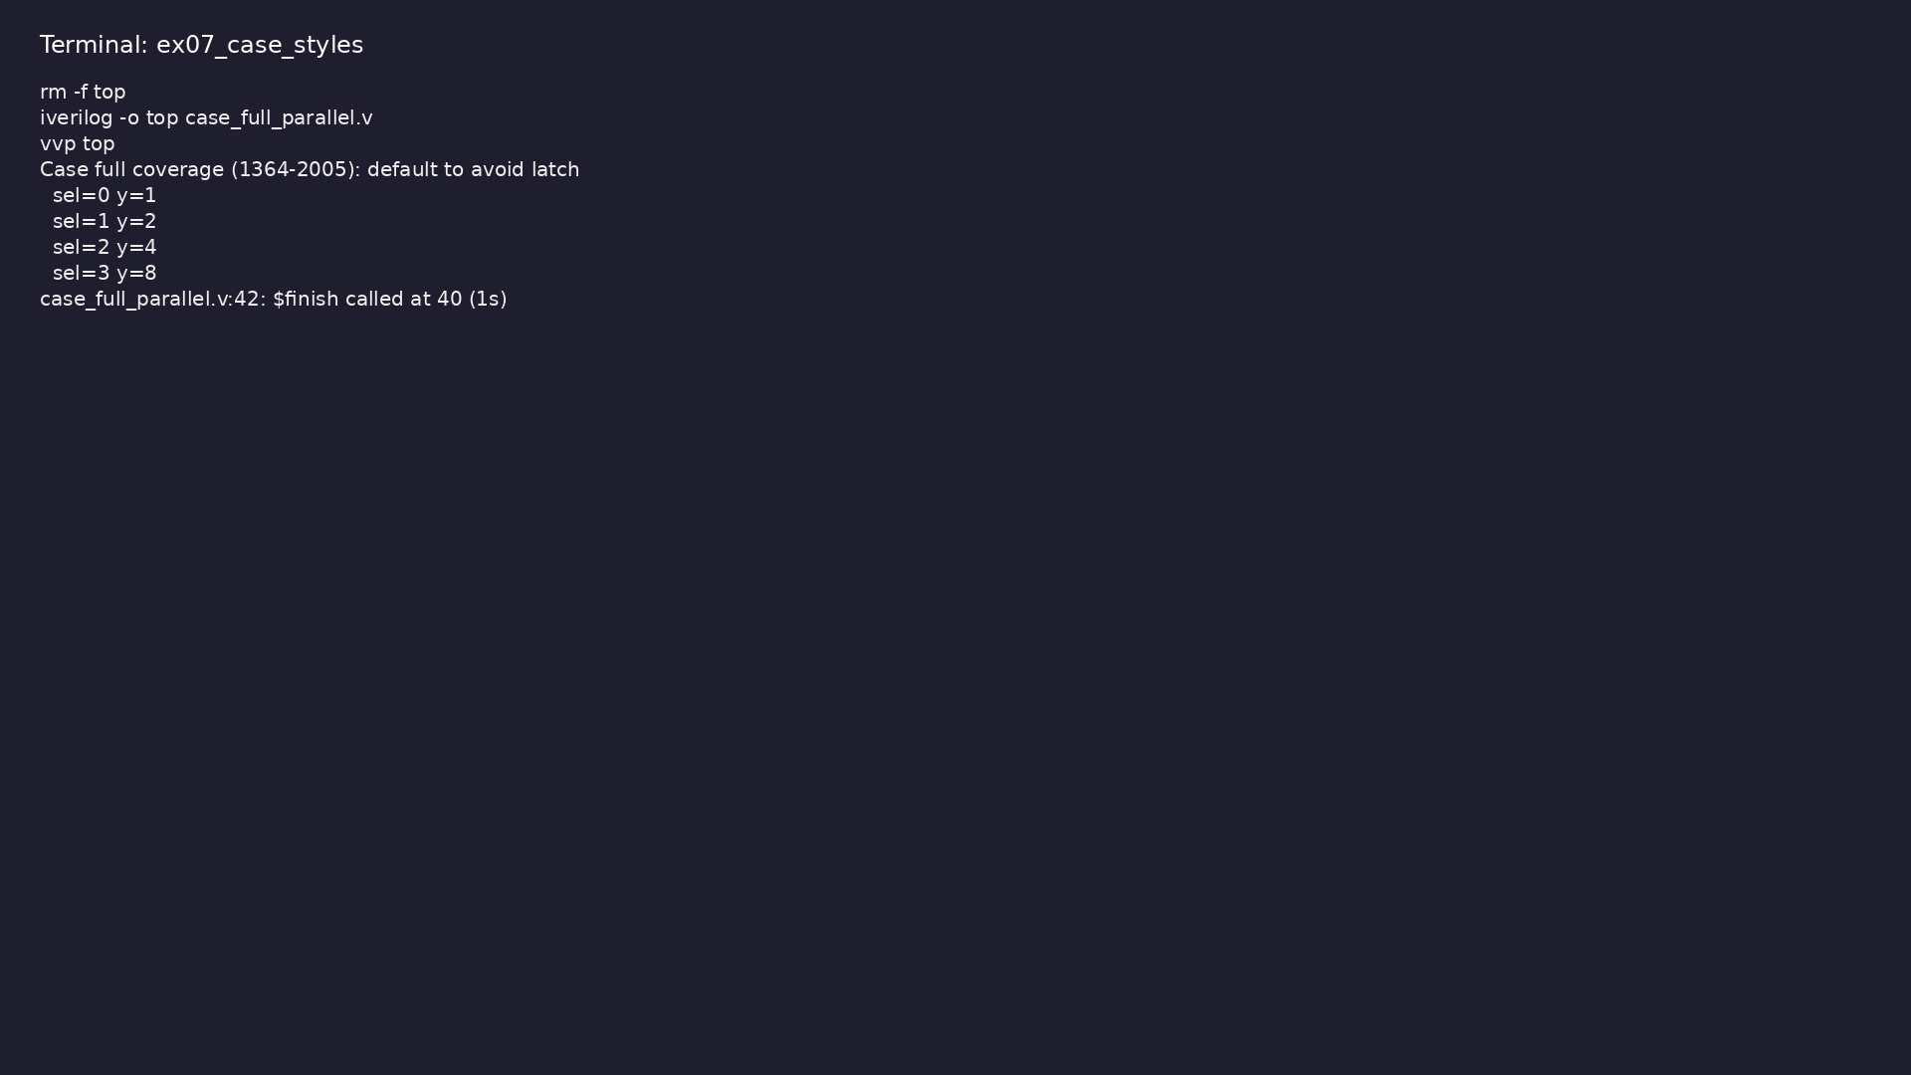
Demo: full_case / parallel_case attributes (or tool pragmas) where su…
$ cd module3/examples/case_styles && make clean && make run
learn_verilog_systemverilog / Module 3
Notes:
Hands-on: module3/examples/case_styles/

Slide 67
Example 8: Default before case; all paths assign output
• No latch from incomplete case/if
learn_verilog_systemverilog / Module 3
Notes:
module3/examples/avoid_latch/README.md

Slide 68
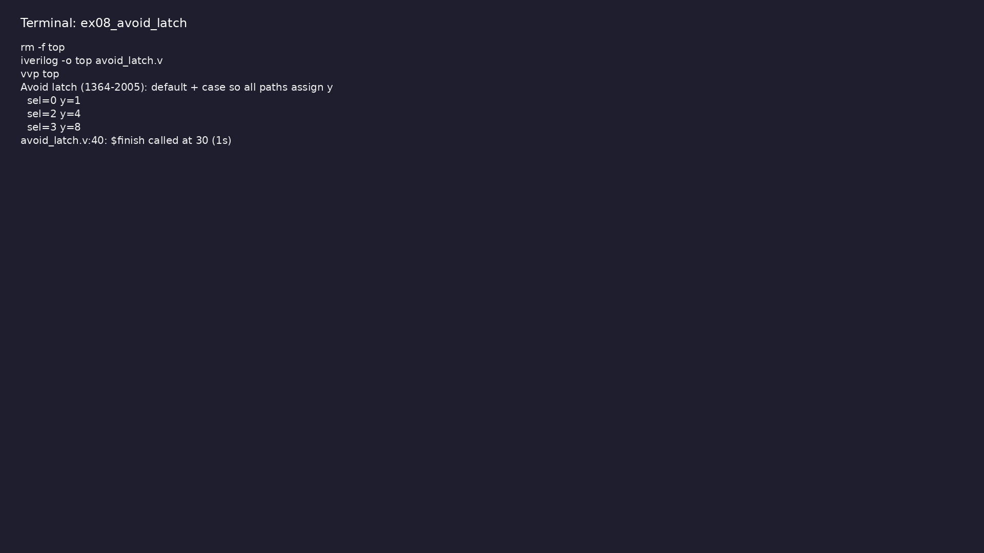
Demo: Default before case; all paths assign output
$ cd module3/examples/avoid_latch && make clean && make run
learn_verilog_systemverilog / Module 3
Notes:
Hands-on: module3/examples/avoid_latch/

Slide 69
Example 9: Function without delays used in always @* (e.g. min)
• Combinational helper; no delays in RTL
learn_verilog_systemverilog / Module 3
Notes:
module3/examples/function_synth/README.md

Slide 70
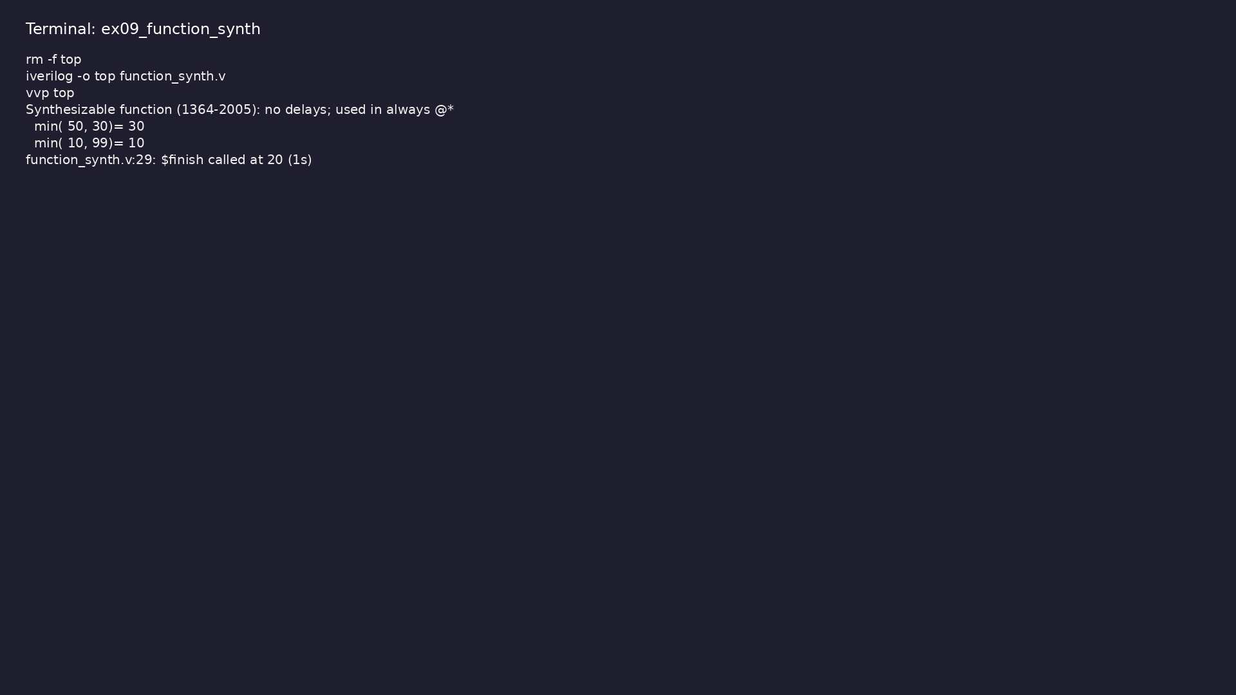
Demo: Function without delays used in always @* (e.g. min)
$ cd module3/examples/function_synth && make clean && make run
learn_verilog_systemverilog / Module 3
Notes:
Hands-on: module3/examples/function_synth/

Slide 71
Example 10: Small design using only 1364-2005 features (no 1800)
• Checklist for “pure Verilog” RTL
learn_verilog_systemverilog / Module 3
Notes:
module3/examples/summary/README.md

Slide 72
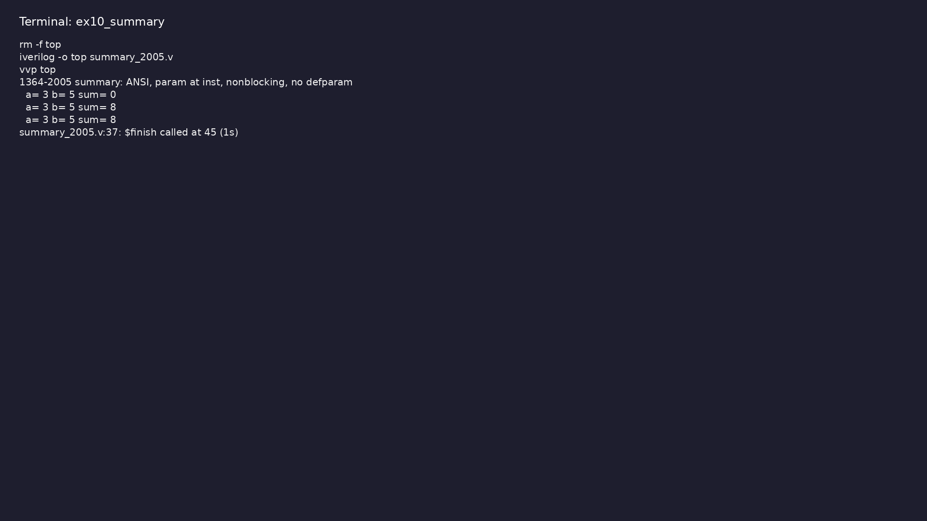
Demo: Small design using only 1364-2005 features (no 1800)
$ cd module3/examples/summary && make clean && make run
learn_verilog_systemverilog / Module 3
Notes:
Hands-on: module3/examples/summary/

Slide 73
Common pitfalls
learn_verilog_systemverilog / Module 3

Slide 74
Using defparam in New Code
• Mistake: Overriding parameters with defparam for
convenience.
• Reality: defparam is deprecated in 1364-2005; tools
may warn or restrict.
• Correct: Override at instantiation: `sub
#(.WIDTH(16)) u_sub (...);`
• Why: Clear, hierarchical parameter flow; better for
synthesis and maintenance.
learn_verilog_systemverilog / Module 3
Notes:
From MODULE3 Common Pitfalls.

Slide 75
Mixing Blocking and Nonblocking for Same Variable
• Mistake: Using both `=` and `<=` for the same reg in
one always block.
• Reality: Leads to simulation/synthesis mismatch and
race conditions.
• Correct: Use only `=` in combinational always; only
`<=` in sequential always for that variable.
• Why: 1364-2005 semantics assume consistent use;
mixing is undefined in practice.
learn_verilog_systemverilog / Module 3
Notes:
From MODULE3 Common Pitfalls.

Slide 76
Assuming unique/priority case in 1364-2005
• Mistake: Writing `unique case` or `priority case`
(SystemVerilog) and expecting 1364-2005 tools to…
• Reality: Those keywords are in IEEE 1800, not 1364.
• Correct: Use full_case/parallel_case attributes if
the tool supports them; otherwise ensure full co…
• Why: Avoids tool errors and clarifies design intent.
learn_verilog_systemverilog / Module 3
Notes:
From MODULE3 Common Pitfalls.

Slide 77
Latches from Incomplete case/if
• Mistake: Combinational always with case or if that
does not assign in all paths.
• Reality: Synthesis infers a latch; simulation may
hold previous value.
• Correct: Assign default before case, or cover all
cases; avoid incomplete if/else.
• Why: Latches are rarely intended in synchronous RTL;
explicit defaults avoid them.
learn_verilog_systemverilog / Module 3
Notes:
From MODULE3 Common Pitfalls.

Slide 78
Using SystemVerilog in “1364-2005” Project
• Mistake: Using `logic`, `always_comb`, or interfaces
while targeting “Verilog only.”
• Reality: Those are 1800 (SystemVerilog); 1364-2005
does not define them.
• Correct: Use wire/reg and always @* / always
@(posedge clk) for strict 1364-2005.
• Why: Keeps tool and project consistently on one
standard.
learn_verilog_systemverilog / Module 3
Notes:
From MODULE3 Common Pitfalls.

Slide 79
Practice & assessment
learn_verilog_systemverilog / Module 3

Slide 80
What you should know
• ✓ Describe what 1364-2005 adds or clarifies over
1364-2001 (no major new constructs)
• ✓ Avoid defparam and use instantiation parameter
override only
• ✓ Apply the synthesizable subset of 1364-2005
(combinational vs sequential, one driver, no
latches)
• ✓ Use blocking assignment in combinational always
and nonblocking in sequential always
• ✓ Use tool-supported full_case/parallel_case (or
equivalent) where appropriate
• ✓ Summarize 1364 evolution (1995 → 2001 → 2005) and
when to stay Verilog-only vs adopt 1800
learn_verilog_systemverilog / Module 3
Notes:
From MODULE3 Learning Outcomes.

Slide 81
Exercises
• Remove defparam
• Synthesizable Checklist
• Blocking vs Nonblocking
• Case and Latches
• 1364-2005 Summary
learn_verilog_systemverilog / Module 3

Slide 82
Exercises
• Using defparam in New Code
• Mixing Blocking and Nonblocking for Same Variable
• Assuming unique/priority case in 1364-2005
• Latches from Incomplete case/if
• Using SystemVerilog in “1364-2005” Project
learn_verilog_systemverilog / Module 3

Slide 83
Summary & next steps
• Master the final Verilog-only standard (IEEE
1364-2005), its clarifications over 2001, and the
synt…
• Complete module3/CHECKLIST.md
• Review module3/EXAMPLES.md and run each lab
• Next: Next module in course
learn_verilog_systemverilog / Module 3

