Slide 1
Module 4
IEEE 1800-2005 (SystemVerilog Design Subset)
learn_verilog_systemverilog / Module 4

Slide 2
Learning objectives
• Master the first SystemVerilog standard (IEEE
1800-2005) for RTL design: logic types,
always_comb/a…
learn_verilog_systemverilog / Module 4

Slide 3
Prerequisites
• See module README
learn_verilog_systemverilog / Module 4

Slide 4

Learning path
Master the first SystemVerilog standard (IEEE 1800-2005) for RTL design: logic types, always_comb/always_ff, interfaces, packages, and...
learn_verilog_systemverilog / Module 4

Slide 5
Overview
• This module covers IEEE Std 1800-2005, the first
SystemVerilog standard. It extends Verilog (IEEE 1…
learn_verilog_systemverilog / Module 4

Slide 6
How to learn this module
learn_verilog_systemverilog / Module 4

Slide 7
Suggested learning path (1/2)
• Skim this document — Goal, Overview, and Topics
Covered set the IEEE scope for Module 4.
• Study design architecture — See how DUTs, examples,
and testbenches fit together under `module4/`.
• Work through labs in order — Open
`module4/EXAMPLES.md` and run each `make clean &&
make run` from…
• Run the full module script — `./scripts/module4.sh`
from the repo root to simulate all examples and…
• Complete the exercises — Try each exercise in this
document before reading solutions or peeking at…
learn_verilog_systemverilog / Module 4
Notes:
From docs/MODULE4.md — read guides before running demos.

Slide 8
Suggested learning path (2/2)
• Review Common Pitfalls — Can you explain each
mistake and the fix?
• Self-check — Use `module4/CHECKLIST.md` before
starting the next module.
learn_verilog_systemverilog / Module 4
Notes:
From docs/MODULE4.md — read guides before running demos.

Slide 9
Design architecture
learn_verilog_systemverilog / Module 4

Slide 10

1. Repository layout (module4/) (1/2)
• First SystemVerilog module — .sv
sources and design subset focus
• logic replaces wire/reg for
single-driver RTL in most
examples
• always_comb / always_ff /
always_latch — explicit
procedural intent
• interfaces and packages —
connectivity and shared types
learn_verilog_systemverilog / Module 4
Notes:
From MODULE4 Design Architecture.

Slide 11
1. Repository layout (module4/) (2/2)
• scripts/module4.sh — requires simulator with SV
design subset
learn_verilog_systemverilog / Module 4
Notes:
From MODULE4 Design Architecture.

Slide 12

2. SystemVerilog design layering
• Packages hold typedefs,
constants, functions — import in
modules
• Interfaces bundle signals;
modports define direction per
connection
• always_comb infers sensitivity;
always_ff targets flip-flops
• unique/priority case — standard
semantics for full case checking
learn_verilog_systemverilog / Module 4
Notes:
From MODULE4 Design Architecture.

Slide 13
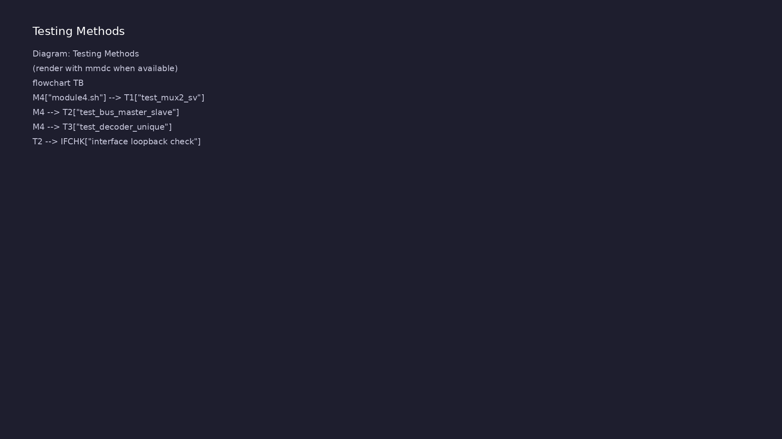
3. File and compilation units
• .sv extension signals
SystemVerilog to the tool
• Package before import; interface
before modport connection
• See
verification_architecture.png —
TB still drives DUT via ports or
interface
learn_verilog_systemverilog / Module 4
Notes:
From MODULE4 Design Architecture.

Slide 14
RTL block diagram (reference)
Module 4: DUT hierarchy and signal flow.
learn_verilog_systemverilog / Module 4

Slide 15
Verification / testbench diagram (reference)
Module 4: stimulus, observation, and checking.
learn_verilog_systemverilog / Module 4

Slide 16
logic ports and always_comb
/*
* always_comb and always_ff - IEEE 1800-2005
* Combinational: always_comb (inferred sensitivity). Sequential:
always_ff (one clock).
*/
module always_comb_ff_demo (
input logic clk,
input logic rst_n,
input logic a,
input logic b,
input logic c,
input logic d,
output logic y_comb,
output logic z_comb,
output logic q
);
# ...
learn_verilog_systemverilog / Module 4

Slide 17
Interface + modport connection
/*
* Interface and modports - IEEE 1800-2005
* One bundle; modports define direction per role.
*/
interface simple_bus_if;
logic [7:0] data;
logic valid;
logic ready;
logic clk;
logic rst_n;
modport master (output data, valid, input ready, clk, rst_n);
modport slave (input data, valid, output ready, input clk, rst_n);
endinterface
# ...
learn_verilog_systemverilog / Module 4

Slide 18
Execution & simulation flow
learn_verilog_systemverilog / Module 4

Slide 19
How the example runs (toolchain)
• Makefile: Verilator + UVM_HOME compile RTL,
interface, and test_*.sv
• UVM phases: build → connect → run_test → report
(same pattern as Module 2)
• Sequence → driver → DUT → monitor → scoreboard (read
SCOREBOARD at end)
• Typical command: make SIM=verilator TEST=test_* (see
module4 demo slide)
• Loopback / hooks connect monitor observations to
scoreboard checks
learn_verilog_systemverilog / Module 4
Notes:
From MODULE4 — execution and artifact layout.

Slide 20
Key files to study
learn_verilog_systemverilog / Module 4

Slide 21
Open these in the repo
• module4/examples/logic_ports/logic_ports.sv
• module4/examples/procedural/always_comb_ff.sv
• module4/examples/interfaces/bus_if_example.sv
• module4/examples/packages/pkg_util.sv
• scripts/module4.sh
learn_verilog_systemverilog / Module 4
Notes:
Trace while running module4/EXAMPLES.md labs.

Slide 22
Verification & testing methods
learn_verilog_systemverilog / Module 4

Slide 23
1. Running SystemVerilog labs
• cd module4/examples/<name> &&
make clean && make run
• ./scripts/module4.sh — full
module; some labs need full SV
support
• iverilog supports subset; check
build.log if a feature is
unsupported
learn_verilog_systemverilog / Module 4
Notes:
From MODULE4 Verification & Testing Methods.

Slide 24
2. What to check in simulation
• logic ports compile without
separate wire/reg declarations
• always_comb blocks reject
clock/reset inside (tool error =
correct)
• Interface examples connect via
modport, not dozens of scalar
ports
learn_verilog_systemverilog / Module 4
Notes:
From MODULE4 Verification & Testing Methods.

Slide 25
Package import pattern
/*
* Package and import - IEEE 1800-2005
* Shared types, parameters, functions.
*/
package pkg_util;
parameter int WIDTH = 8;
typedef logic [WIDTH-1:0] word_t;
function automatic logic [7:0] parity(input logic [31:0] v);
parity = ^v;
endfunction
endpackage
module alu (
input logic [31:0] a,
# ...
learn_verilog_systemverilog / Module 4

Slide 26
Syllabus topics
learn_verilog_systemverilog / Module 4

Slide 27
Protocol & design details
learn_verilog_systemverilog / Module 4

Slide 28
Detail: What 1800-2005 Adds Over 1364-2005 (Design Subset) (1)
• logic: Single type for single-driver nets/variables
(replaces wire/reg in most RTL)
• 2-state types: `bit`, `int`, `byte`, etc. (mainly
for testbenches; some RTL use)
• always_comb, always_ff, always_latch: Explicit
procedural blocks with tool checks
• Interfaces and modports: Bundle signals and define
direction per connection
learn_verilog_systemverilog / Module 4
Notes:
From MODULE4 Topics Covered — protocol/design depth.

Slide 29
Detail: What 1800-2005 Adds Over 1364-2005 (Design Subset) (2)
• Packages and import: Shared types, constants, and
functions across modules
• unique case, priority case: Standard semantics for
case statements (no tool-specific attributes)
• Operators: `inside`, wildcard `==?`, and other
enhancements
• Verification: Classes, assertions (SVA), coverage,
etc. (covered in later modules or other courses)
learn_verilog_systemverilog / Module 4
Notes:
From MODULE4 Topics Covered — protocol/design depth.

Slide 30
Detail: What This Module Emphasizes
• Design/RTL: logic, always_comb/always_ff,
interfaces, packages, unique/priority case
• Not in depth: Classes, SVA, coverage, constrained
random (those are verification-focused)
learn_verilog_systemverilog / Module 4
Notes:
From MODULE4 Topics Covered — protocol/design depth.

Slide 31
Detail: Relation to 1364-2005
• 1364-2005 (Verilog) is a subset of 1800-2005
(SystemVerilog).
• Valid 1364-2005 RTL is valid 1800-2005 RTL; you can
migrate incrementally (e.g. wire→logic, always…
learn_verilog_systemverilog / Module 4
Notes:
From MODULE4 Topics Covered — protocol/design depth.

Slide 32
Detail: logic (4-State, Single Driver) (1)
• logic: Replaces `wire` and `reg` when there is a
single driver; can be used in both continuous and…
• Rule: A `logic` variable must have exactly one
driver (one assign, or one always block, or one
port…
• 4-state: 0, 1, X, Z (same as wire/reg).
• Ports: `input logic`, `output logic`; no need to
choose wire vs reg for single-driver ports.
learn_verilog_systemverilog / Module 4
Notes:
From MODULE4 Topics Covered — protocol/design depth.

Slide 33
Detail: logic (4-State, Single Driver) (2)
• Internal: Use `logic` for single-driver signals; use
`wire` only when needed (e.g. multiple drivers…
learn_verilog_systemverilog / Module 4
Notes:
From MODULE4 Topics Covered — protocol/design depth.

Slide 34
Detail: bit and 2-State Types (1800)
• bit: 2-state (0, 1); no X or Z. Often used in
testbenches and for indices.
• int, byte, shortint, longint: Integer types; 2-state
unless declared with a 4-state base.
• Use in RTL: Optional (e.g. loop indices,
parameters); many RTL designs use `logic` and
`integer`/`r…
learn_verilog_systemverilog / Module 4
Notes:
From MODULE4 Topics Covered — protocol/design depth.

Slide 35
Detail: always_comb
• Intent: Combinational logic; no storage; outputs are
a function of inputs only.
• Sensitivity: Automatically inferred (like `always
@*`); must not contain latches.
• Tool check: Simulator/synthesis can warn if the
block implies storage or is sensitive to clock edge…
• Prefer over `always @*` when the tool supports it:
clearer intent and better checking.
learn_verilog_systemverilog / Module 4
Notes:
From MODULE4 Topics Covered — protocol/design depth.

Slide 36
Detail: always_ff
• Intent: Sequential logic (flip-flops); use
nonblocking assignment (`<=`) only.
• Sensitivity: Must list exactly one clock (and
optionally async reset); no other event controls.
• Tool check: Can warn if blocking assignment or
incomplete sensitivity is used.
learn_verilog_systemverilog / Module 4
Notes:
From MODULE4 Topics Covered — protocol/design depth.

Slide 37
Detail: always_latch
• Intent: Explicit latch (level-sensitive storage).
Use sparingly; usually latches are unintended.
• When: When a latch is truly intended (e.g.
transparent latch); otherwise use always_comb or
always_…
• Recommendation: Prefer always_comb or always_ff; use
always_latch only when a latch is desired.
learn_verilog_systemverilog / Module 4
Notes:
From MODULE4 Topics Covered — protocol/design depth.

Slide 38
Detail: Interface Declaration
• Signals: Declared once inside the interface; shared
by all modules that use it.
• modport: Defines a view (direction) for a given role
(e.g. master sees data as output, slave sees d…
learn_verilog_systemverilog / Module 4
Notes:
From MODULE4 Topics Covered — protocol/design depth.

Slide 39
Detail: Using an Interface in a Module
• Port: Single interface port with a modport (e.g.
`bus_if.master bus`).
• Access: `bus.signal_name`; direction is enforced by
the modport.
learn_verilog_systemverilog / Module 4
Notes:
From MODULE4 Topics Covered — protocol/design depth.

Slide 40
Detail: Top-Level Connection
• One interface instance: Connects master and slave;
no long port lists.
learn_verilog_systemverilog / Module 4
Notes:
From MODULE4 Topics Covered — protocol/design depth.

Slide 41
Detail: Package Declaration
• Contents: parameter, localparam, typedef, function,
task, etc. (no always blocks).
• Scope: Items are in namespace `pkg_util::` until
imported.
learn_verilog_systemverilog / Module 4
Notes:
From MODULE4 Topics Covered — protocol/design depth.

Slide 42
Detail: Import and Use
• import pkg_util::*: Import all names from the
package (can cause name clashes).
• import pkg_util::item: Import specific items; safer
when many packages are used.
learn_verilog_systemverilog / Module 4
Notes:
From MODULE4 Topics Covered — protocol/design depth.

Slide 43
Detail: unique case
• Semantics: At most one case item must match at
runtime; if none or more than one matches, a
runtime…
• Use: When the design guarantees at most one match
(e.g. one-hot encoding, mutually exclusive condit…
• Synthesis: Can be implemented as parallel priority
logic; no inferred priority order.
learn_verilog_systemverilog / Module 4
Notes:
From MODULE4 Topics Covered — protocol/design depth.

Slide 44
Detail: priority case
• Semantics: The first matching item has priority; if
no item matches, a runtime error can be reporte…
• Use: When priority order is intended (e.g. interrupt
mask).
• Synthesis: Can be implemented as a priority chain
(if-then-else or similar).
learn_verilog_systemverilog / Module 4
Notes:
From MODULE4 Topics Covered — protocol/design depth.

Slide 45
Verification flow (reference)
Stimulus, DUT response, and check points for this module.
learn_verilog_systemverilog / Module 4

Slide 46
1. IEEE 1800-2005 Context (1/2)
• logic: Single type for single-driver nets/variables
(replaces wire/reg in most RTL)
• 2-state types: `bit`, `int`, `byte`, etc. (mainly
for testbenches; some RTL use)
• always_comb, always_ff, always_latch: Explicit
procedural blocks with tool checks
• Interfaces and modports: Bundle signals and define
direction per connection
• Packages and import: Shared types, constants, and
functions across modules
• unique case, priority case: Standard semantics for
case statements (no tool-specific attributes)
learn_verilog_systemverilog / Module 4
Notes:
From MODULE4 Topics Covered.

Slide 47
1. IEEE 1800-2005 Context (2/2)
• Operators: `inside`, wildcard `==?`, and other
enhancements
• Verification: Classes, assertions (SVA), coverage,
etc. (covered in later modules or other courses)
• Design/RTL: logic, always_comb/always_ff,
interfaces, packages, unique/priority case
• Not in depth: Classes, SVA, coverage, constrained
random (those are verification-focused)
• 1364-2005 (Verilog) is a subset of 1800-2005
(SystemVerilog).
• Valid 1364-2005 RTL is valid 1800-2005 RTL; you can
migrate incrementally (e.g. wire→logic, always…
learn_verilog_systemverilog / Module 4
Notes:
From MODULE4 Topics Covered.

Slide 48
2. logic and 2-State Types (1800) (1/2)
• logic: Replaces `wire` and `reg` when there is a
single driver; can be used in both continuous and…
• Rule: A `logic` variable must have exactly one
driver (one assign, or one always block, or one
port…
• 4-state: 0, 1, X, Z (same as wire/reg).
• Ports: `input logic`, `output logic`; no need to
choose wire vs reg for single-driver ports.
• Internal: Use `logic` for single-driver signals; use
`wire` only when needed (e.g. multiple drivers…
• bit: 2-state (0, 1); no X or Z. Often used in
testbenches and for indices.
learn_verilog_systemverilog / Module 4
Notes:
From MODULE4 Topics Covered.

Slide 49
2. logic and 2-State Types (1800) (2/2)
• int, byte, shortint, longint: Integer types; 2-state
unless declared with a 4-state base.
• Use in RTL: Optional (e.g. loop indices,
parameters); many RTL designs use `logic` and
`integer`/`r…
learn_verilog_systemverilog / Module 4
Notes:
From MODULE4 Topics Covered.

Slide 50
3. always_comb, always_ff, always_latch (1800) (1/2)
• Intent: Combinational logic; no storage; outputs are
a function of inputs only.
• Sensitivity: Automatically inferred (like `always
@*`); must not contain latches.
• Tool check: Simulator/synthesis can warn if the
block implies storage or is sensitive to clock edge…
• Prefer over `always @*` when the tool supports it:
clearer intent and better checking.
• Intent: Sequential logic (flip-flops); use
nonblocking assignment (`<=`) only.
• Sensitivity: Must list exactly one clock (and
optionally async reset); no other event controls.
learn_verilog_systemverilog / Module 4
Notes:
From MODULE4 Topics Covered.

Slide 51
3. always_comb, always_ff, always_latch (1800) (2/2)
• Tool check: Can warn if blocking assignment or
incomplete sensitivity is used.
• Intent: Explicit latch (level-sensitive storage).
Use sparingly; usually latches are unintended.
• When: When a latch is truly intended (e.g.
transparent latch); otherwise use always_comb or
always_…
• Recommendation: Prefer always_comb or always_ff; use
always_latch only when a latch is desired.
learn_verilog_systemverilog / Module 4
Notes:
From MODULE4 Topics Covered.

Slide 52
4. Interfaces and Modports (1800)
• Signals: Declared once inside the interface; shared
by all modules that use it.
• modport: Defines a view (direction) for a given role
(e.g. master sees data as output, slave sees d…
• Port: Single interface port with a modport (e.g.
`bus_if.master bus`).
• Access: `bus.signal_name`; direction is enforced by
the modport.
• One interface instance: Connects master and slave;
no long port lists.
learn_verilog_systemverilog / Module 4
Notes:
From MODULE4 Topics Covered.

Slide 53
5. Packages and import (1800)
• Contents: parameter, localparam, typedef, function,
task, etc. (no always blocks).
• Scope: Items are in namespace `pkg_util::` until
imported.
• import pkg_util::*: Import all names from the
package (can cause name clashes).
• import pkg_util::item: Import specific items; safer
when many packages are used.
learn_verilog_systemverilog / Module 4
Notes:
From MODULE4 Topics Covered.

Slide 54
6. unique case and priority case (1800)
• Semantics: At most one case item must match at
runtime; if none or more than one matches, a
runtime…
• Use: When the design guarantees at most one match
(e.g. one-hot encoding, mutually exclusive condit…
• Synthesis: Can be implemented as parallel priority
logic; no inferred priority order.
• Semantics: The first matching item has priority; if
no item matches, a runtime error can be reporte…
• Use: When priority order is intended (e.g. interrupt
mask).
• Synthesis: Can be implemented as a priority chain
(if-then-else or similar).
learn_verilog_systemverilog / Module 4
Notes:
From MODULE4 Topics Covered.

Slide 55
7. Comparison: 1364-2005 vs 1800-2005 (Design)
• See docs/MODULE4.md
learn_verilog_systemverilog / Module 4
Notes:
From MODULE4 Topics Covered.

Slide 56
Hands-on examples
learn_verilog_systemverilog / Module 4

Slide 57
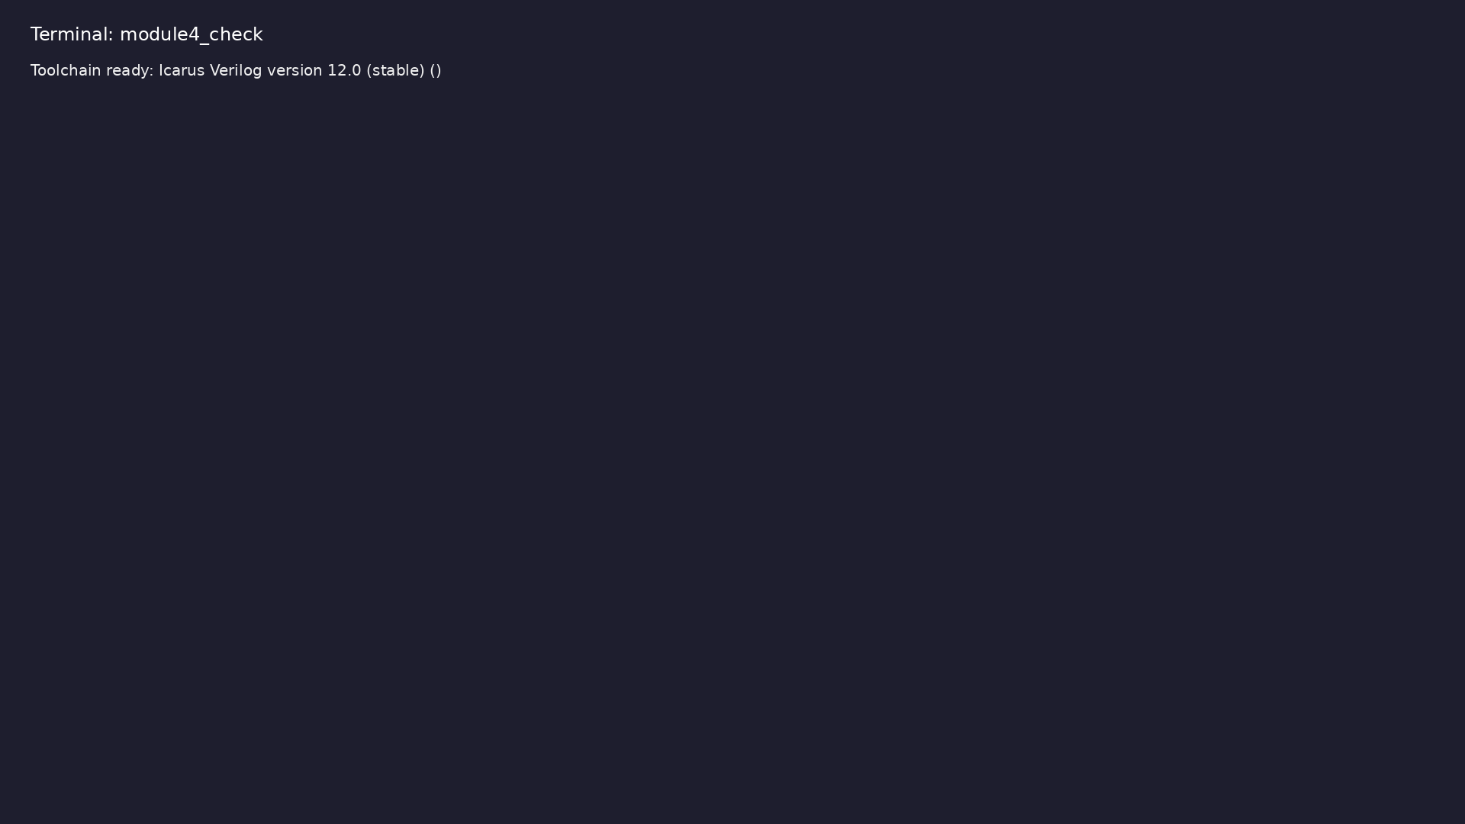
Module 4 toolchain check
$ command -v iverilog >/dev/null && echo "Toolchain ready: $(iverilog
-V 2>&1 | head -1)"
learn_verilog_systemverilog / Module 4
Notes:
Requires iverilog on PATH (apt install iverilog).

Slide 58
Example 1: logic for ports and internal single-driver signals
• Single driver for logic; 4-state
learn_verilog_systemverilog / Module 4
Notes:
module4/examples/data_types/README.md

Slide 59
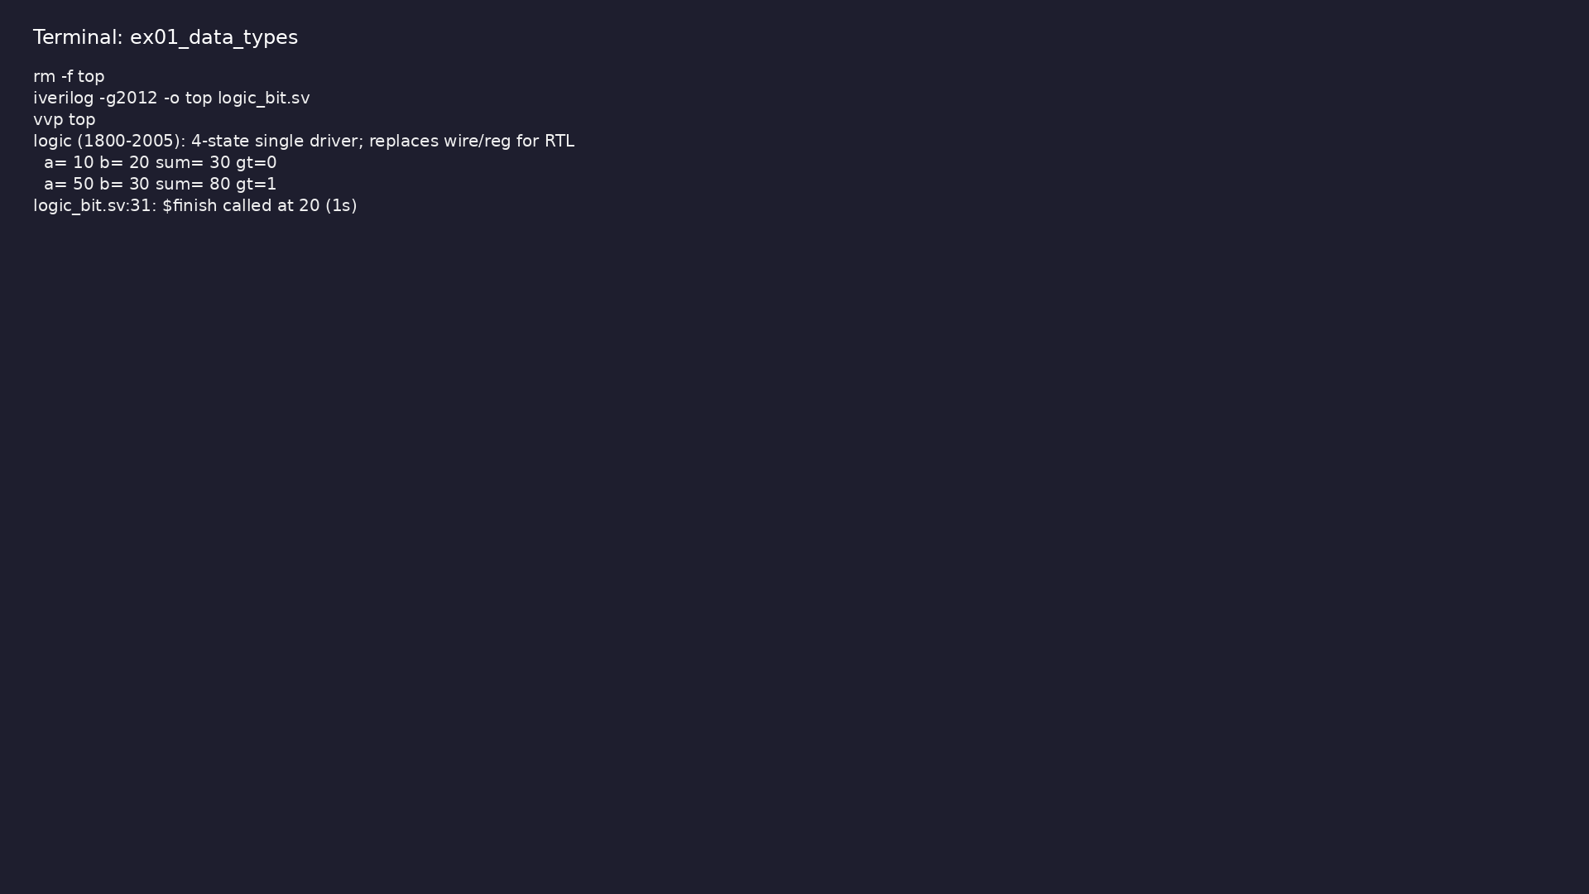
Demo: logic for ports and internal single-driver signals
$ cd module4/examples/data_types && make clean && make run
learn_verilog_systemverilog / Module 4
Notes:
Hands-on: module4/examples/data_types/

Slide 60
Example 2: All ports logic (mux, adder); no wire/reg choice
• assign and always_comb can drive output logic
learn_verilog_systemverilog / Module 4
Notes:
module4/examples/logic_ports/README.md

Slide 61
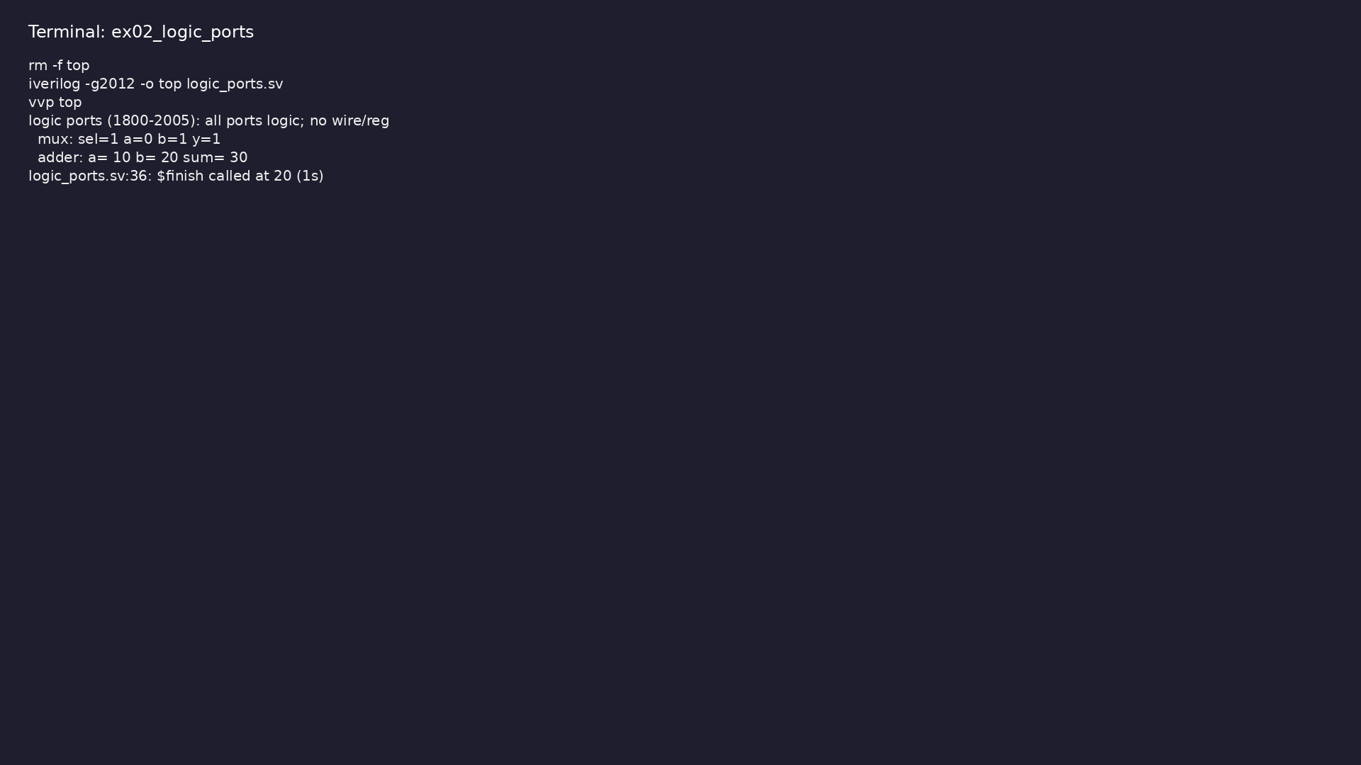
Demo: All ports logic (mux, adder); no wire/reg choice
$ cd module4/examples/logic_ports && make clean && make run
learn_verilog_systemverilog / Module 4
Notes:
Hands-on: module4/examples/logic_ports/

Slide 62
Example 3: Combinational with always_comb; sequential with always_ff
• Explicit intent; tool checks; no latch in
always_comb
learn_verilog_systemverilog / Module 4
Notes:
module4/examples/procedural/README.md

Slide 63
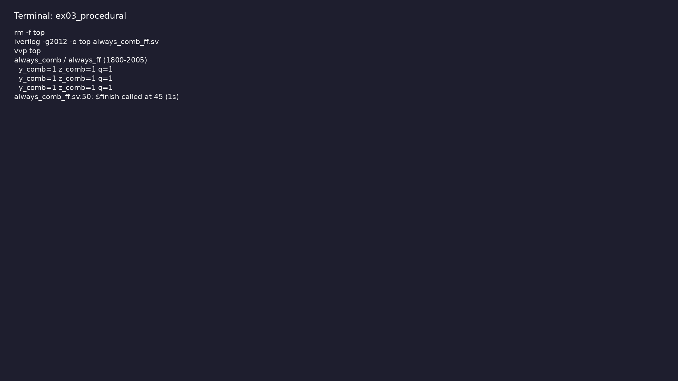
Demo: Combinational with always_comb; sequential with always_ff
$ cd module4/examples/procedural && make clean && make run
learn_verilog_systemverilog / Module 4
Notes:
Hands-on: module4/examples/procedural/

Slide 64
Example 4: Explicit latch when intended (e.g. transparent latch)
• Use when latch is desired; prefer
always_comb/always_ff otherwise
learn_verilog_systemverilog / Module 4
Notes:
module4/examples/always_latch/README.md

Slide 65
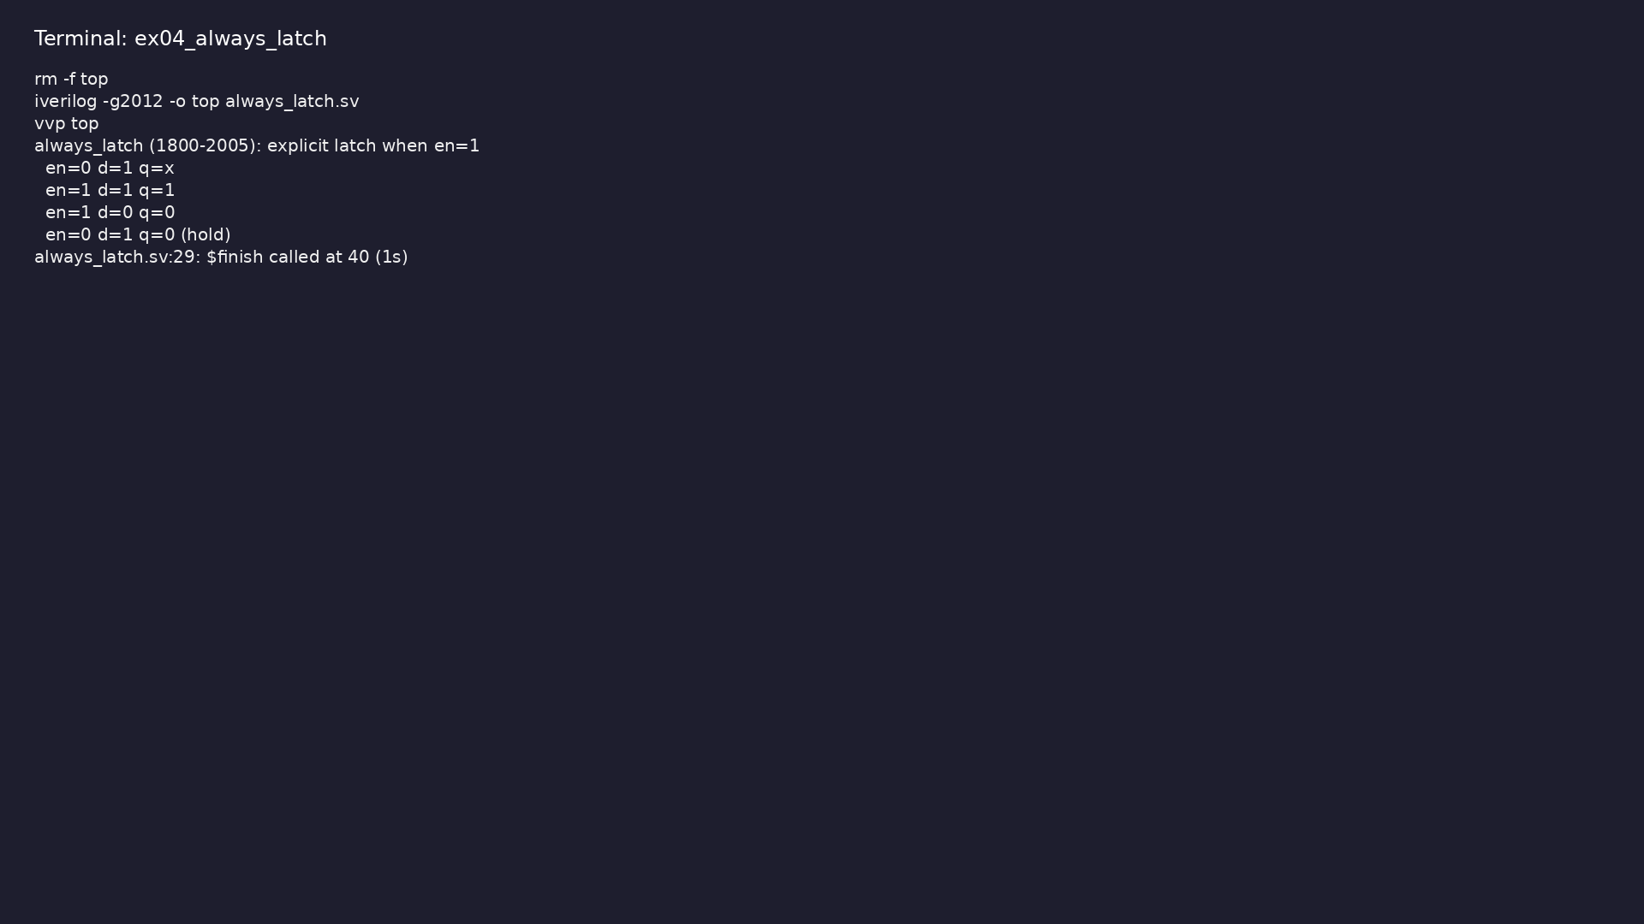
Demo: Explicit latch when intended (e.g. transparent latch)
$ cd module4/examples/always_latch && make clean && make run
learn_verilog_systemverilog / Module 4
Notes:
Hands-on: module4/examples/always_latch/

Slide 66
Example 5: Single assign to one output; single always_ff to another
• logic must have exactly one driver
learn_verilog_systemverilog / Module 4
Notes:
module4/examples/one_driver_logic/README.md

Slide 67
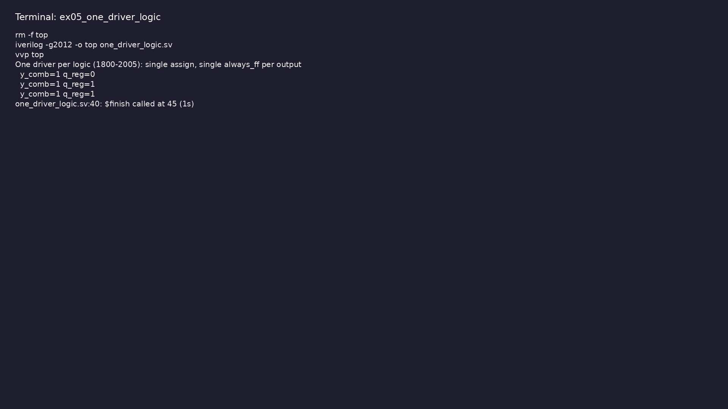
Demo: Single assign to one output; single always_ff to another
$ cd module4/examples/one_driver_logic && make clean && make run
learn_verilog_systemverilog / Module 4
Notes:
Hands-on: module4/examples/one_driver_logic/

Slide 68
Example 6: typedef in module (e.g. byte_t = logic [7:0])
• User-defined types for clarity
learn_verilog_systemverilog / Module 4
Notes:
module4/examples/typedef_sv/README.md

Slide 69
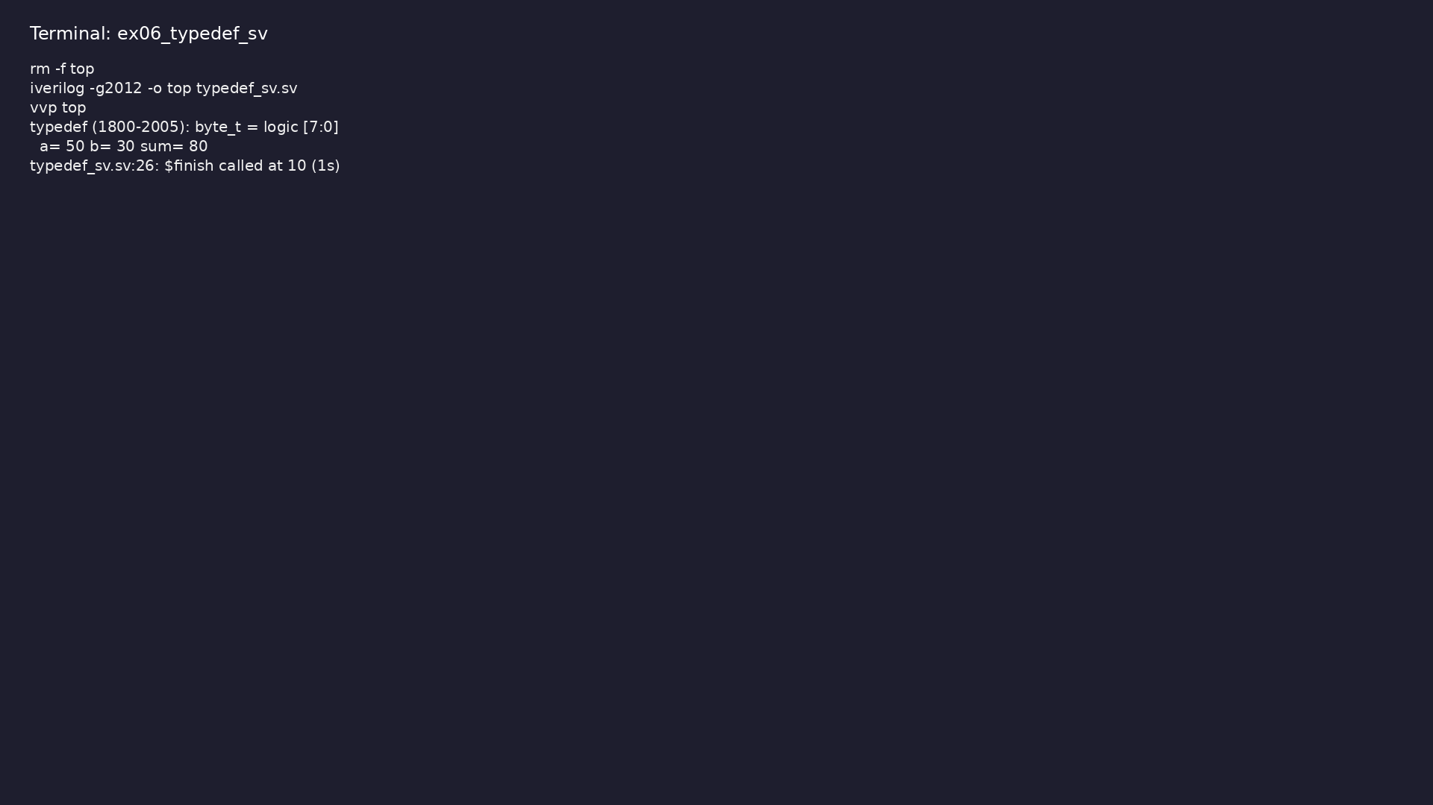
Demo: typedef in module (e.g. byte_t = logic [7:0])
$ cd module4/examples/typedef_sv && make clean && make run
learn_verilog_systemverilog / Module 4
Notes:
Hands-on: module4/examples/typedef_sv/

Slide 70
Example 7: Interface definition, modports, connection in top
• One bundle per connection; direction per modport
learn_verilog_systemverilog / Module 4
Notes:
module4/examples/interfaces/README.md

Slide 71
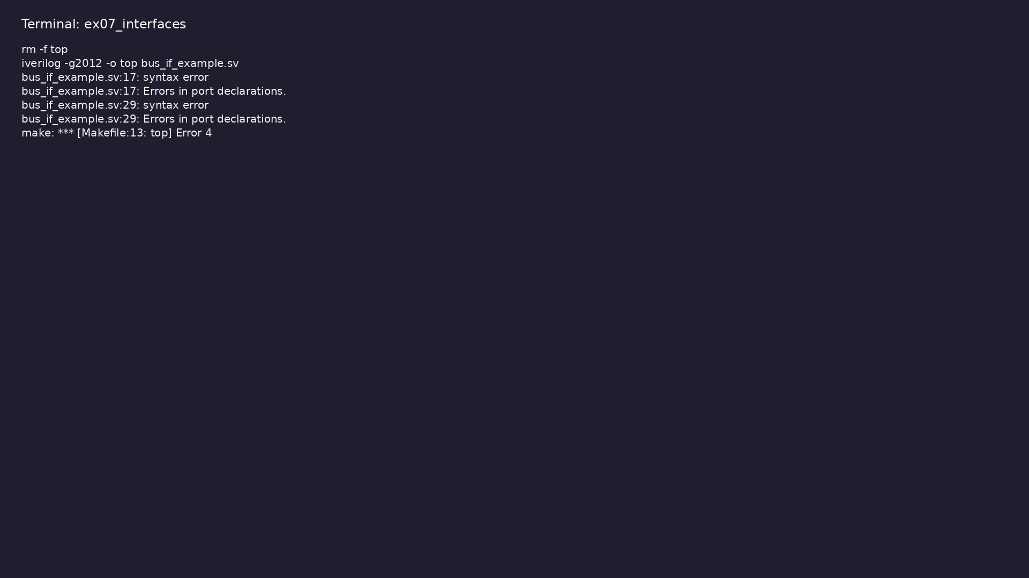
Demo: Interface definition, modports, connection in top
$ cd module4/examples/interfaces && make clean && make run
learn_verilog_systemverilog / Module 4
Notes:
Hands-on: module4/examples/interfaces/

Slide 72
Example 8: Package with types/params/functions; import in modules
• Namespace; wildcard vs specific import
learn_verilog_systemverilog / Module 4
Notes:
module4/examples/packages/README.md

Slide 73

Demo: Package with types/params/functions; import in modules
$ cd module4/examples/packages && make clean && make run
learn_verilog_systemverilog / Module 4
Notes:
Hands-on: module4/examples/packages/

Slide 74
Example 9: Package with typedef and min_word function; import in ALU
• Shared types and helpers across modules
learn_verilog_systemverilog / Module 4
Notes:
module4/examples/package_typedef/README.md

Slide 75
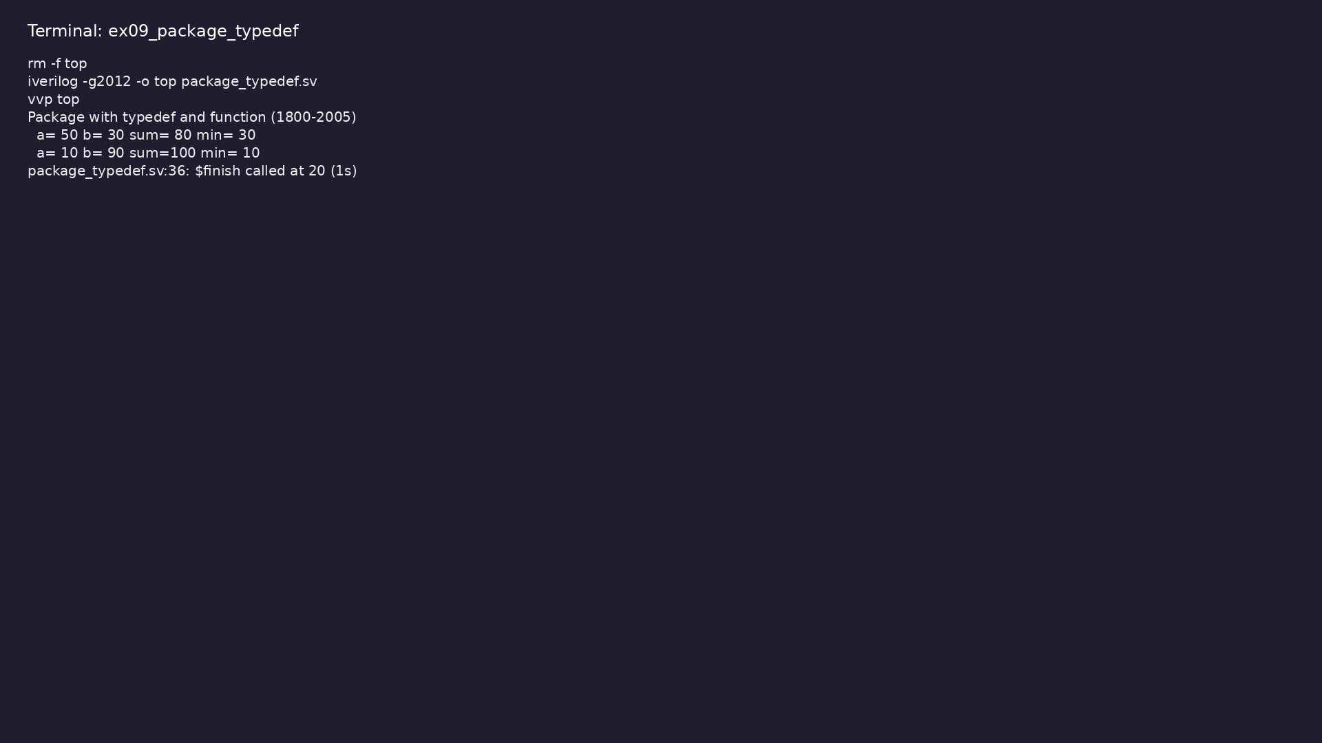
Demo: Package with typedef and min_word function; import in ALU
$ cd module4/examples/package_typedef && make clean && make run
learn_verilog_systemverilog / Module 4
Notes:
Hands-on: module4/examples/package_typedef/

Slide 76
Example 10: unique case (at most one match); priority case (first mat…
• Standard semantics; synthesis and simulation
behavior
learn_verilog_systemverilog / Module 4
Notes:
module4/examples/case_unique_priority/README.md

Slide 77
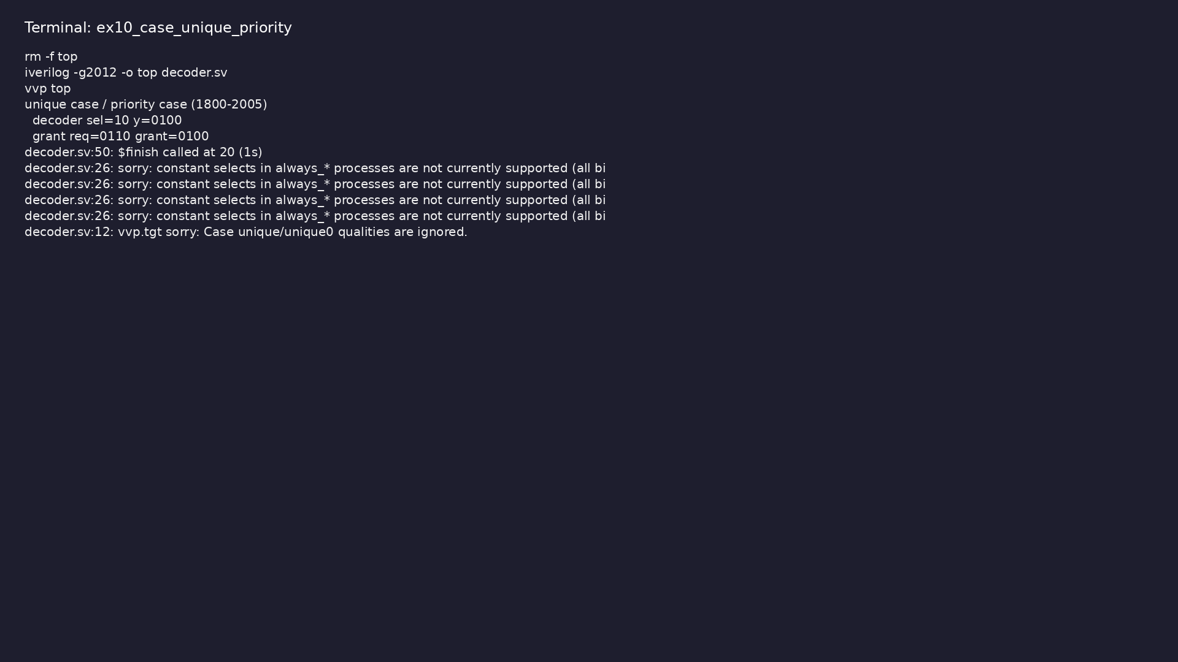
Demo: unique case (at most one match); priority case (first match)
$ cd module4/examples/case_unique_priority && make clean && make run
learn_verilog_systemverilog / Module 4
Notes:
Hands-on: module4/examples/case_unique_priority/

Slide 78
Example 11: Arbiter with priority case (first req wins)
• priority case for arbiter, interrupt mask
learn_verilog_systemverilog / Module 4
Notes:
module4/examples/priority_case/README.md

Slide 79
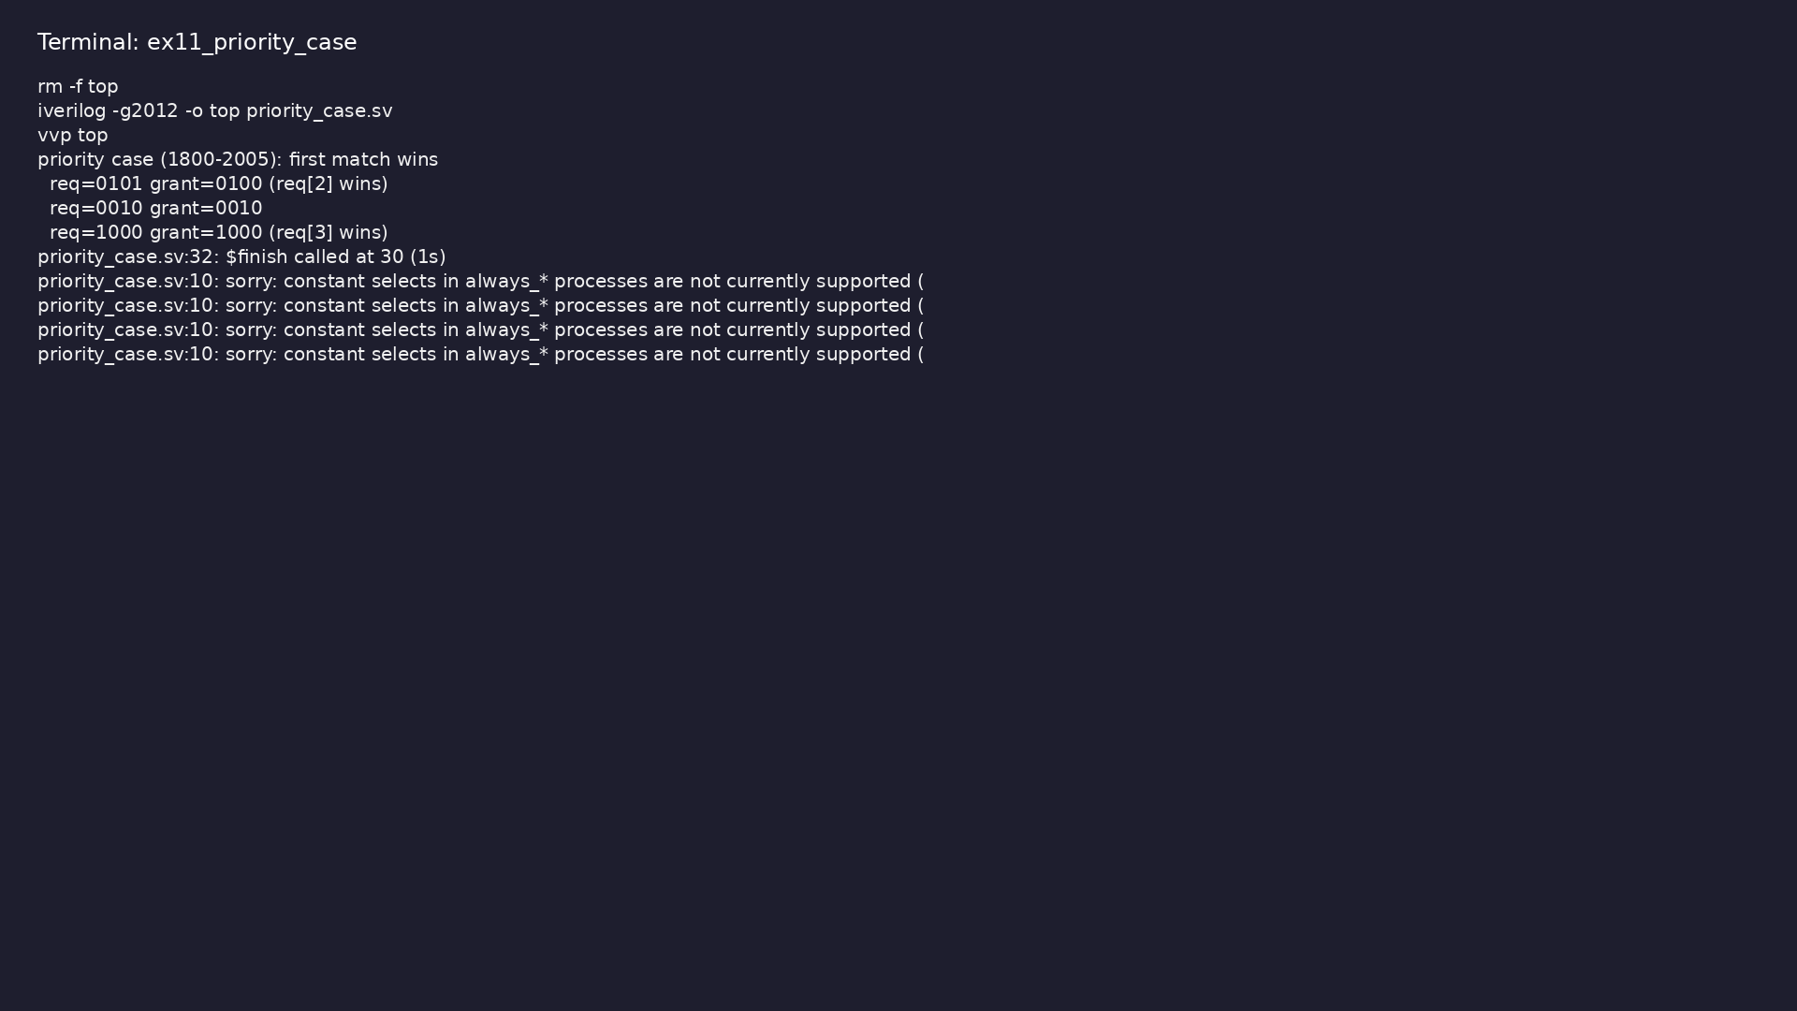
Demo: Arbiter with priority case (first req wins)
$ cd module4/examples/priority_case && make clean && make run
learn_verilog_systemverilog / Module 4
Notes:
Hands-on: module4/examples/priority_case/

Slide 80
Example 12: Same small design in 1364-2005 style vs 1800-2005 style
• wire/reg→logic, always @*→always_comb, always
@(posedge clk)→always_ff
learn_verilog_systemverilog / Module 4
Notes:
module4/examples/migration/README.md

Slide 81
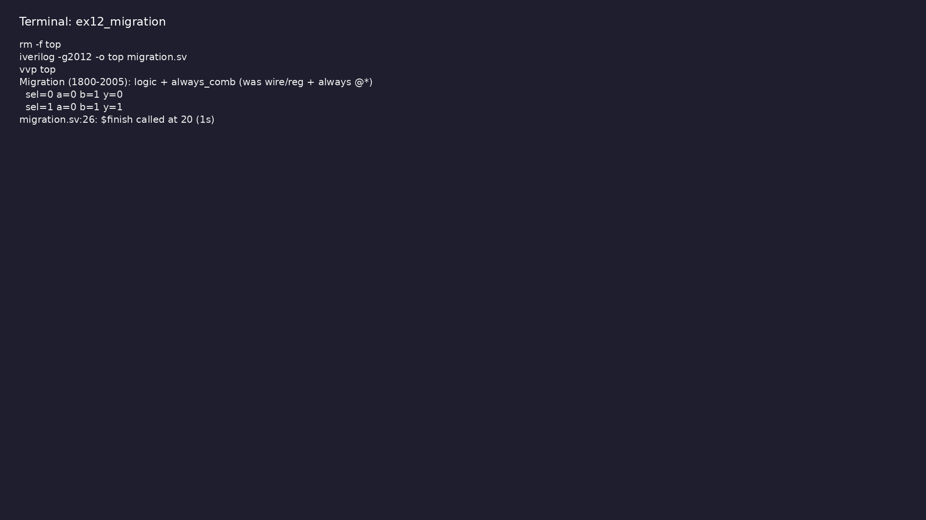
Demo: Same small design in 1364-2005 style vs 1800-2005 style
$ cd module4/examples/migration && make clean && make run
learn_verilog_systemverilog / Module 4
Notes:
Hands-on: module4/examples/migration/

Slide 82
Common pitfalls
learn_verilog_systemverilog / Module 4

Slide 83
Multiple Drivers on logic
• Mistake: Driving the same logic from two assign
statements or two always blocks.
• Reality: logic allows only one driver; multiple
drivers are illegal or undefined.
• Correct: Use one assign or one always per logic; for
multiple drivers use wire (e.g. tri-state).
• Why: logic is for single-driver RTL; wire is for
resolved (multi-driver) nets.
learn_verilog_systemverilog / Module 4
Notes:
From MODULE4 Common Pitfalls.

Slide 84
Using always_comb with Latched Behavior
• Mistake: Incomplete branches in always_comb (e.g. no
default in case) and expecting no latch.
• Reality: Tools may infer a latch or report a
warning.
• Correct: Assign every output in every path, or
provide default before case.
• Why: always_comb is intended for pure combinational
logic; latches require always_latch if desired.
learn_verilog_systemverilog / Module 4
Notes:
From MODULE4 Common Pitfalls.

Slide 85
Wrong Modport or Direction
• Mistake: Driving an input in a modport or reading an
output that is not in the modport.
• Reality: Compiler or elaboration error; or wrong
connectivity.
• Correct: Use the modport that matches the module
role (master vs slave); check direction in the int…
• Why: Modports enforce direction; using the wrong
view breaks the contract.
learn_verilog_systemverilog / Module 4
Notes:
From MODULE4 Common Pitfalls.

Slide 86
Forgetting to import Package
• Mistake: Using a package type or function without
importing.
• Reality: Identifier not found; compile error.
• Correct: Add `import pkg_name::*;` or `import
pkg_name::item;` before use.
• Why: Package names are in a separate namespace until
imported.
learn_verilog_systemverilog / Module 4
Notes:
From MODULE4 Common Pitfalls.

Slide 87
unique case with Multiple Matches
• Mistake: Writing unique case when two items can
match (e.g. overlapping or X in select).
• Reality: Runtime error or undefined behavior.
• Correct: Use unique case only when at most one item
can match; use default for catch-all; or use pr…
• Why: unique case has well-defined semantics;
violating them breaks verification and synthesis.
learn_verilog_systemverilog / Module 4
Notes:
From MODULE4 Common Pitfalls.

Slide 88
Practice & assessment
learn_verilog_systemverilog / Module 4

Slide 89
What you should know (1/2)
• ✓ Use logic for single-driver nets and variables in
RTL
• ✓ Use always_comb for combinational logic and
always_ff for sequential logic
• ✓ Define and use interfaces with modports for
bundled connectivity
• ✓ Define packages and import them in modules
• ✓ Use unique case and priority case with correct
semantics
• ✓ Compare 1364-2005 and 1800-2005 design constructs
and migrate simple RTL from Verilog to SystemVe…
learn_verilog_systemverilog / Module 4
Notes:
From MODULE4 Learning Outcomes.

Slide 90
What you should know (2/2)
• ✓ Decide when to adopt 1800 design features vs stay
with 1364
learn_verilog_systemverilog / Module 4
Notes:
From MODULE4 Learning Outcomes.

Slide 91
Exercises
• logic and always_comb/always_ff
• Interface
• Package
• unique case
• Migration Summary
learn_verilog_systemverilog / Module 4

Slide 92
Exercises
• Multiple Drivers on logic
• Using always_comb with Latched Behavior
• Wrong Modport or Direction
• Forgetting to import Package
• unique case with Multiple Matches
learn_verilog_systemverilog / Module 4

Slide 93
Summary & next steps
• Master the first SystemVerilog standard (IEEE
1800-2005) for RTL design: logic types,
always_comb/a…
• Complete module4/CHECKLIST.md
• Review module4/EXAMPLES.md and run each lab
• Next: Next module in course
learn_verilog_systemverilog / Module 4

