Slide 1
Module 5
IEEE 1800-2009 and 1800-2012
learn_verilog_systemverilog / Module 5

Slide 2
Learning objectives
• Master the SystemVerilog revisions IEEE 1800-2009
and 1800-2012: interface and type refinements, op…
learn_verilog_systemverilog / Module 5

Slide 3
Prerequisites
• See module README
learn_verilog_systemverilog / Module 5

Slide 4

Learning path
Master the SystemVerilog revisions IEEE 1800-2009 and 1800-2012: interface and type refinements, operator and array enhancements, and...
learn_verilog_systemverilog / Module 5

Slide 5
Overview
• This module covers IEEE Std 1800-2009 and IEEE Std
1800-2012, the first two major revisions of Syst…
learn_verilog_systemverilog / Module 5

Slide 6
How to learn this module
learn_verilog_systemverilog / Module 5

Slide 7
Suggested learning path (1/2)
• Skim this document — Goal, Overview, and Topics
Covered set the IEEE scope for Module 5.
• Study design architecture — See how DUTs, examples,
and testbenches fit together under `module5/`.
• Work through labs in order — Open
`module5/EXAMPLES.md` and run each `make clean &&
make run` from…
• Run the full module script — `./scripts/module5.sh`
from the repo root to simulate all examples and…
• Complete the exercises — Try each exercise in this
document before reading solutions or peeking at…
learn_verilog_systemverilog / Module 5
Notes:
From docs/MODULE5.md — read guides before running demos.

Slide 8
Suggested learning path (2/2)
• Review Common Pitfalls — Can you explain each
mistake and the fix?
• Self-check — Use `module5/CHECKLIST.md` before
starting the next module.
learn_verilog_systemverilog / Module 5
Notes:
From docs/MODULE5.md — read guides before running demos.

Slide 9
Design architecture
learn_verilog_systemverilog / Module 5

Slide 10

1. Repository layout (module5/)
• IEEE 1800-2009 and 1800-2012
refinements on the 2005 base
• Assertions, checkers, and type
refinements in examples
• module5/dut/ — designs used by
assertion and checker labs
• scripts/module5.sh — run
assertion-focused examples
learn_verilog_systemverilog / Module 5
Notes:
From MODULE5 Design Architecture.

Slide 11

2. Assertion and checker placement
• immediate assertions in
procedural code — zero-time
checks
• concurrent assertions (SVA) —
temporal properties on clocks
• checker encapsulation — reusable
verification modules
• Assertions sit alongside RTL;
failures stop simulation with
message
learn_verilog_systemverilog / Module 5
Notes:
From MODULE5 Design Architecture.

Slide 12
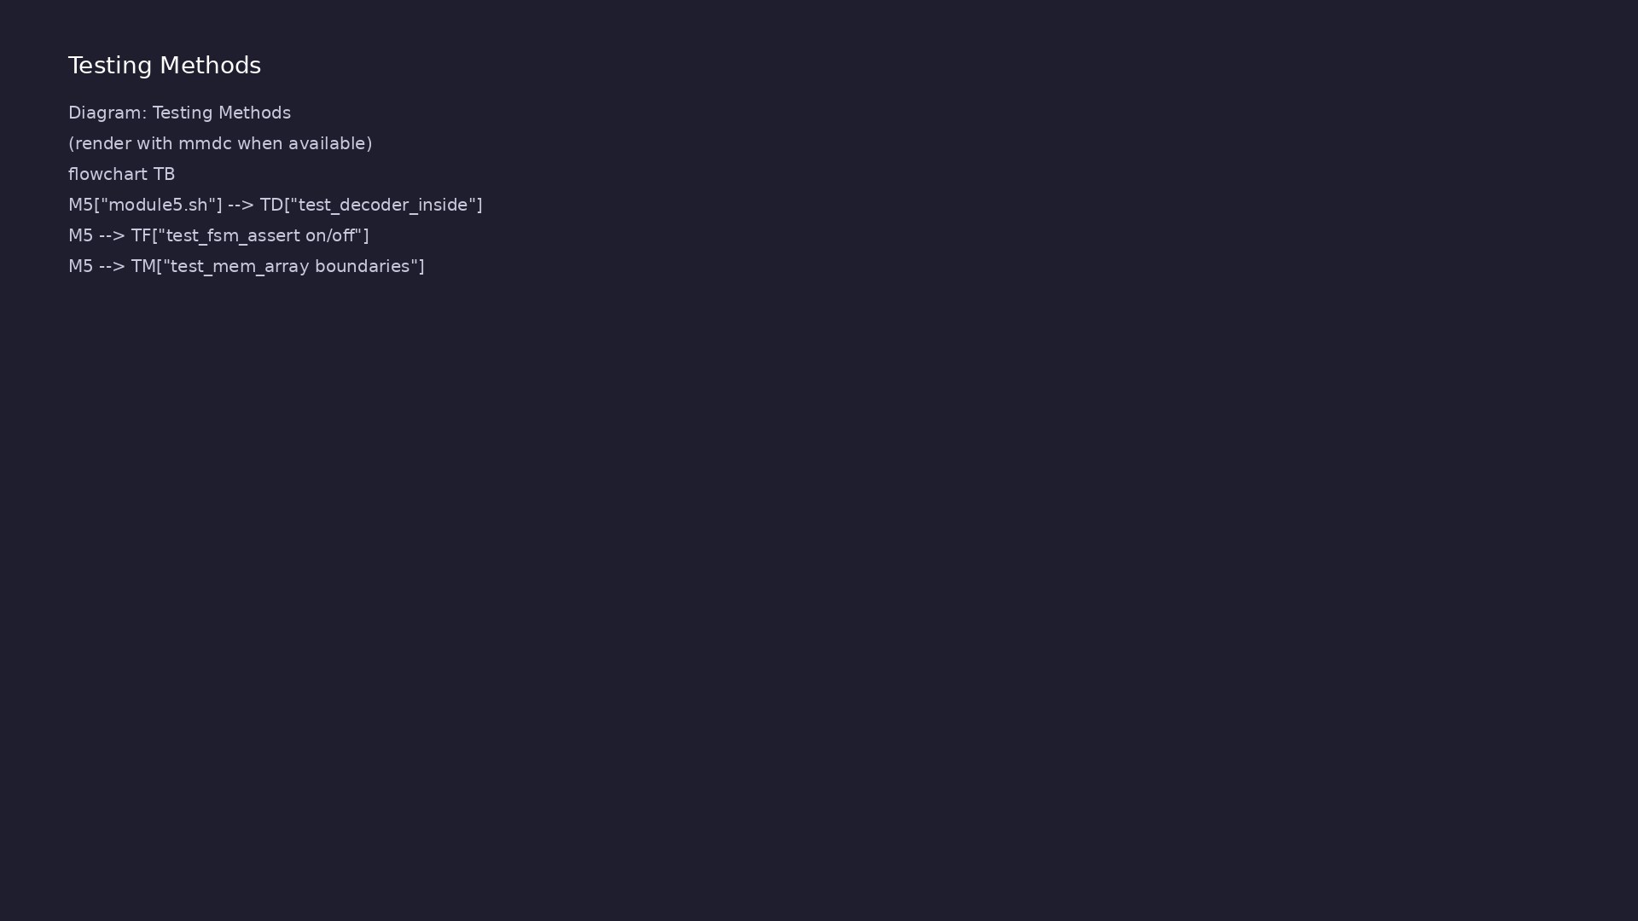
3. 2009/2012 vs 2005 delta
• Interface and type
clarifications — same patterns,
clearer LRM
• 1800-2012 checker keyword —
structured verification
component
• Design RTL from Module 4 remains
valid; add assertions
incrementally
learn_verilog_systemverilog / Module 5
Notes:
From MODULE5 Design Architecture.

Slide 13
RTL block diagram (reference)
Module 5: DUT hierarchy and signal flow.
learn_verilog_systemverilog / Module 5

Slide 14
Verification / testbench diagram (reference)
Module 5: stimulus, observation, and checking.
learn_verilog_systemverilog / Module 5

Slide 15
Embedded assertion example
/*
* Immediate assertion for valid encoding - IEEE 1800-2009/2012
* assert (valid_op) else $error; use for opcode or state encoding.
*/
module alu_op (
input logic [2:0] op,
output logic [7:0] y
);
/* Valid opcodes: 0=add, 1=sub, 2=and, 3=or; others invalid */
logic valid_op;
always_comb begin
valid_op = (op == 3'd0 || op == 3'd1 || op == 3'd2 || op ==
3'd3);
assert (valid_op) else $error("alu_op: invalid opcode %d", op);
end
# ...
learn_verilog_systemverilog / Module 5

Slide 16
Execution & simulation flow
learn_verilog_systemverilog / Module 5

Slide 17
How the example runs (toolchain)
• Makefile: Verilator compiles RTL + SystemVerilog
testbench into a C++ model
• sim_main.cpp: generates clk/rst_n, calls eval()
until $finish
• Directed test (initial block or C++): drive
stimulus, wait for DUT flags
• Self-check: compare outputs; print PASS/FAIL (see
terminal demo slide)
• Repo path: module5/examples/<example>/ — run make
run from that directory
learn_verilog_systemverilog / Module 5
Notes:
From MODULE5 — execution and artifact layout.

Slide 18
Key files to study
learn_verilog_systemverilog / Module 5

Slide 19
Open these in the repo
• module5/examples/assert_valid_encoding/
• module5/examples/checkers/
• module5/examples/assert_invariant/
• scripts/module5.sh
learn_verilog_systemverilog / Module 5
Notes:
Trace while running module5/EXAMPLES.md labs.

Slide 20
Verification & testing methods
learn_verilog_systemverilog / Module 5

Slide 21
1. Running assertion labs
• make run per example; failing
assertion prints SVA message
• ./scripts/module5.sh runs
designs with embedded checkers
learn_verilog_systemverilog / Module 5
Notes:
From MODULE5 Verification & Testing Methods.

Slide 22
2. Closure mindset
• Pass = no assertion failures and
expected $display output
• Use assert examples to learn
what to monitor before UVM
scoreboards
learn_verilog_systemverilog / Module 5
Notes:
From MODULE5 Verification & Testing Methods.

Slide 23
Immediate assertion in procedural code
/*
* Immediate assertion - IEEE 1800-2009/2012
* assert (condition) else $error("..."); checked when executed.
*/
module onehot_check (
input logic [3:0] sig,
output logic valid
);
/* Immediate assertion: at most one bit set (one-hot or zero) */
always_comb begin
valid = ($countones(sig) <= 1);
assert (valid) else $error("onehot_check: sig not one-hot or
zero: %b", sig);
end
endmodule
# ...
learn_verilog_systemverilog / Module 5

Slide 24
Syllabus topics
learn_verilog_systemverilog / Module 5

Slide 25
Protocol & design details
learn_verilog_systemverilog / Module 5

Slide 26
Detail: What 1800-2009 Adds or Clarifies (1)
• Interfaces: Modport expressions, virtual interface
type (for testbenches), interface inheritance
• Types and operators: Clarifications; additional
operators and built-in methods
• Assertions: SVA enhancements; checker concept
(preview)
• DPI: Refinements for C/C++ interop
learn_verilog_systemverilog / Module 5
Notes:
From MODULE5 Topics Covered — protocol/design depth.

Slide 27
Detail: What 1800-2009 Adds or Clarifies (2)
• Coverage: Coverage option and syntax clarifications
• Clarifications: Scheduling, generate, and other 2005
semantics
learn_verilog_systemverilog / Module 5
Notes:
From MODULE5 Topics Covered — protocol/design depth.

Slide 28
Detail: What 1800-2012 Adds or Clarifies (1)
• Checkers: Checker construct for reusable
assertion/coverage logic
• Arrays: Array manipulation methods; array assignment
and ordering clarifications
• Strings: String methods and behavior
• Compilation units: Refined rules for $unit and
compilation-unit scope
learn_verilog_systemverilog / Module 5
Notes:
From MODULE5 Topics Covered — protocol/design depth.

Slide 29
Detail: What 1800-2012 Adds or Clarifies (2)
• Assertions and coverage: Further SVA and coverage
features
• Clarifications: Numerous editorial and semantic
clarifications across the LRM
learn_verilog_systemverilog / Module 5
Notes:
From MODULE5 Topics Covered — protocol/design depth.

Slide 30
Detail: Relation to 1800-2005
• 1800-2005 RTL remains valid in 1800-2009 and
1800-2012.
• New features are additive; you adopt them when the
tool and project support the revision.
learn_verilog_systemverilog / Module 5
Notes:
From MODULE5 Topics Covered — protocol/design depth.

Slide 31
Detail: Modport Expressions (2009)
• Use: When the same interface is used with different
signal subsets or derived signals; check tool s…
• Benefit: Fewer duplicate interface definitions;
clearer connection contract.
learn_verilog_systemverilog / Module 5
Notes:
From MODULE5 Topics Covered — protocol/design depth.

Slide 32
Detail: Virtual Interface (2009)
• Design: Rarely used in RTL; RTL typically connects
to a concrete interface instance.
• Verification: Common in UVM and other OOP
testbenches; allows one driver class to work with
any ins…
learn_verilog_systemverilog / Module 5
Notes:
From MODULE5 Topics Covered — protocol/design depth.

Slide 33
Detail: Integer Types and Sizes
• byte, shortint, int, longint: 8, 16, 32, 64 bits;
signed by default.
• byte unsigned, int unsigned: Unsigned variants.
• Clarifications in 2012: Representation and
conversion rules; use in RTL for constants and
parameter…
learn_verilog_systemverilog / Module 5
Notes:
From MODULE5 Topics Covered — protocol/design depth.

Slide 34
Detail: Operators Added or Clarified
• inside: Already in 2005; 2009/2012 clarify set
membership and use with ranges.
• Wildcard equality `==?`: X/Z in the right-hand side
act as “don’t care” in comparisons.
• Set membership and case (inside): Used in case
statements and constraints; semantics clarified in
2…
learn_verilog_systemverilog / Module 5
Notes:
From MODULE5 Topics Covered — protocol/design depth.

Slide 35
Detail: Array Methods (2012)
• Array methods: `.size()`, `.delete()`, `.sort()`,
`.reverse()`, etc. (exact set is revision-depende…
• Queues: `.push_back()`, `.pop_front()`, `.insert()`,
etc.
• Use in RTL: Limited (arrays in RTL are often fixed);
methods are common in testbenches and checkers.
learn_verilog_systemverilog / Module 5
Notes:
From MODULE5 Topics Covered — protocol/design depth.

Slide 36
Detail: Array Assignment and Ordering
• Packed vs unpacked: Assignment rules and ordering
(row-major, etc.) are clarified.
• Array copy: Whole-array assignment and copying;
compatibility of dimensions.
• Use in RTL: Multi-dimensional arrays (e.g. memories)
and parameterized dimensions; follow tool-supp…
learn_verilog_systemverilog / Module 5
Notes:
From MODULE5 Topics Covered — protocol/design depth.

Slide 37
Detail: String Methods
• Strings: `string` type; methods such as `.len()`,
`.substr()`, `.atoi()`, etc. (as defined in 2012).
• Use in RTL: Rare (strings are mainly for messages
and file I/O in testbenches).
• Use in testbenches: Logging, report generation, file
names.
learn_verilog_systemverilog / Module 5
Notes:
From MODULE5 Topics Covered — protocol/design depth.

Slide 38
Detail: Assertions in Design (Brief)
• immediate assertions: `assert (condition) else
$error("...");` — checked when executed (like an
if-…
• concurrent assertions: `assert property (@(posedge
clk) (a |-> b));` — checked over time; typically…
• Use in RTL: Immediate assertions for invariants
(e.g. one-hot, valid encodings); concurrent asserti…
learn_verilog_systemverilog / Module 5
Notes:
From MODULE5 Topics Covered — protocol/design depth.

Slide 39
Detail: Checker (2012)
• checker: A reusable unit that can contain
assertions, assumptions, coverage, and helper logic;
can…
• Use: Encapsulate a set of properties (e.g. protocol
rules) and reuse across modules or hierarchies.
• Design: Checkers can be bound to RTL modules; they
do not change RTL functionality, only add checki…
• Synthesis: Checkers are typically not synthesized;
they are for simulation and formal tools.
learn_verilog_systemverilog / Module 5
Notes:
From MODULE5 Topics Covered — protocol/design depth.

Slide 40
Detail: Compilation Unit
• Compilation unit: The scope of one or more source
files compiled together (tool-defined).
• $unit: The compilation-unit scope; declarations in
$unit are visible across the unit without import.
• Best practice: Prefer packages and explicit import
over $unit to avoid hidden dependencies and name…
learn_verilog_systemverilog / Module 5
Notes:
From MODULE5 Topics Covered — protocol/design depth.

Slide 41
Detail: Package and Import
• Import: `import pkg::*` or `import pkg::item`; 2012
clarifies visibility and search order.
• Use: Keep shared types and functions in packages;
import where needed; avoid relying on $unit for n…
learn_verilog_systemverilog / Module 5
Notes:
From MODULE5 Topics Covered — protocol/design depth.

Slide 42
Verification flow (reference)
Stimulus, DUT response, and check points for this module.
learn_verilog_systemverilog / Module 5

Slide 43
1. IEEE 1800-2009 and 1800-2012 Context (1/3)
• Interfaces: Modport expressions, virtual interface
type (for testbenches), interface inheritance
• Types and operators: Clarifications; additional
operators and built-in methods
• Assertions: SVA enhancements; checker concept
(preview)
• DPI: Refinements for C/C++ interop
• Coverage: Coverage option and syntax clarifications
• Clarifications: Scheduling, generate, and other 2005
semantics
learn_verilog_systemverilog / Module 5
Notes:
From MODULE5 Topics Covered.

Slide 44
1. IEEE 1800-2009 and 1800-2012 Context (2/3)
• Checkers: Checker construct for reusable
assertion/coverage logic
• Arrays: Array manipulation methods; array assignment
and ordering clarifications
• Strings: String methods and behavior
• Compilation units: Refined rules for $unit and
compilation-unit scope
• Assertions and coverage: Further SVA and coverage
features
• Clarifications: Numerous editorial and semantic
clarifications across the LRM
learn_verilog_systemverilog / Module 5
Notes:
From MODULE5 Topics Covered.

Slide 45
1. IEEE 1800-2009 and 1800-2012 Context (3/3)
• 1800-2005 RTL remains valid in 1800-2009 and
1800-2012.
• New features are additive; you adopt them when the
tool and project support the revision.
learn_verilog_systemverilog / Module 5
Notes:
From MODULE5 Topics Covered.

Slide 46
2. Interface Refinements (2009)
• Use: When the same interface is used with different
signal subsets or derived signals; check tool s…
• Benefit: Fewer duplicate interface definitions;
clearer connection contract.
• Design: Rarely used in RTL; RTL typically connects
to a concrete interface instance.
• Verification: Common in UVM and other OOP
testbenches; allows one driver class to work with
any ins…
learn_verilog_systemverilog / Module 5
Notes:
From MODULE5 Topics Covered.

Slide 47
3. Type and Operator Enhancements (2009/2012) (1/2)
• byte, shortint, int, longint: 8, 16, 32, 64 bits;
signed by default.
• byte unsigned, int unsigned: Unsigned variants.
• Clarifications in 2012: Representation and
conversion rules; use in RTL for constants and
parameter…
• inside: Already in 2005; 2009/2012 clarify set
membership and use with ranges.
• Wildcard equality `==?`: X/Z in the right-hand side
act as “don’t care” in comparisons.
• Set membership and case (inside): Used in case
statements and constraints; semantics clarified in
2…
learn_verilog_systemverilog / Module 5
Notes:
From MODULE5 Topics Covered.

Slide 48
3. Type and Operator Enhancements (2009/2012) (2/2)
• Array methods: `.size()`, `.delete()`, `.sort()`,
`.reverse()`, etc. (exact set is revision-depende…
• Queues: `.push_back()`, `.pop_front()`, `.insert()`,
etc.
• Use in RTL: Limited (arrays in RTL are often fixed);
methods are common in testbenches and checkers.
learn_verilog_systemverilog / Module 5
Notes:
From MODULE5 Topics Covered.

Slide 49
4. Array and String Refinements (2012)
• Packed vs unpacked: Assignment rules and ordering
(row-major, etc.) are clarified.
• Array copy: Whole-array assignment and copying;
compatibility of dimensions.
• Use in RTL: Multi-dimensional arrays (e.g. memories)
and parameterized dimensions; follow tool-supp…
• Strings: `string` type; methods such as `.len()`,
`.substr()`, `.atoi()`, etc. (as defined in 2012).
• Use in RTL: Rare (strings are mainly for messages
and file I/O in testbenches).
• Use in testbenches: Logging, report generation, file
names.
learn_verilog_systemverilog / Module 5
Notes:
From MODULE5 Topics Covered.

Slide 50
5. Assertions and Checkers in Context (2009/2012) (1/2)
• immediate assertions: `assert (condition) else
$error("...");` — checked when executed (like an
if-…
• concurrent assertions: `assert property (@(posedge
clk) (a |-> b));` — checked over time; typically…
• Use in RTL: Immediate assertions for invariants
(e.g. one-hot, valid encodings); concurrent asserti…
• checker: A reusable unit that can contain
assertions, assumptions, coverage, and helper logic;
can…
• Use: Encapsulate a set of properties (e.g. protocol
rules) and reuse across modules or hierarchies.
• Design: Checkers can be bound to RTL modules; they
do not change RTL functionality, only add checki…
learn_verilog_systemverilog / Module 5
Notes:
From MODULE5 Topics Covered.

Slide 51
5. Assertions and Checkers in Context (2009/2012) (2/2)
• Synthesis: Checkers are typically not synthesized;
they are for simulation and formal tools.
learn_verilog_systemverilog / Module 5
Notes:
From MODULE5 Topics Covered.

Slide 52
6. Compilation Units and Scope (2012)
• Compilation unit: The scope of one or more source
files compiled together (tool-defined).
• $unit: The compilation-unit scope; declarations in
$unit are visible across the unit without import.
• Best practice: Prefer packages and explicit import
over $unit to avoid hidden dependencies and name…
• Import: `import pkg::*` or `import pkg::item`; 2012
clarifies visibility and search order.
• Use: Keep shared types and functions in packages;
import where needed; avoid relying on $unit for n…
learn_verilog_systemverilog / Module 5
Notes:
From MODULE5 Topics Covered.

Slide 53
7. Summary: 1800-2005 vs 2009 vs 2012 (Design-Relevant)
• See docs/MODULE5.md
learn_verilog_systemverilog / Module 5
Notes:
From MODULE5 Topics Covered.

Slide 54
Hands-on examples
learn_verilog_systemverilog / Module 5

Slide 55
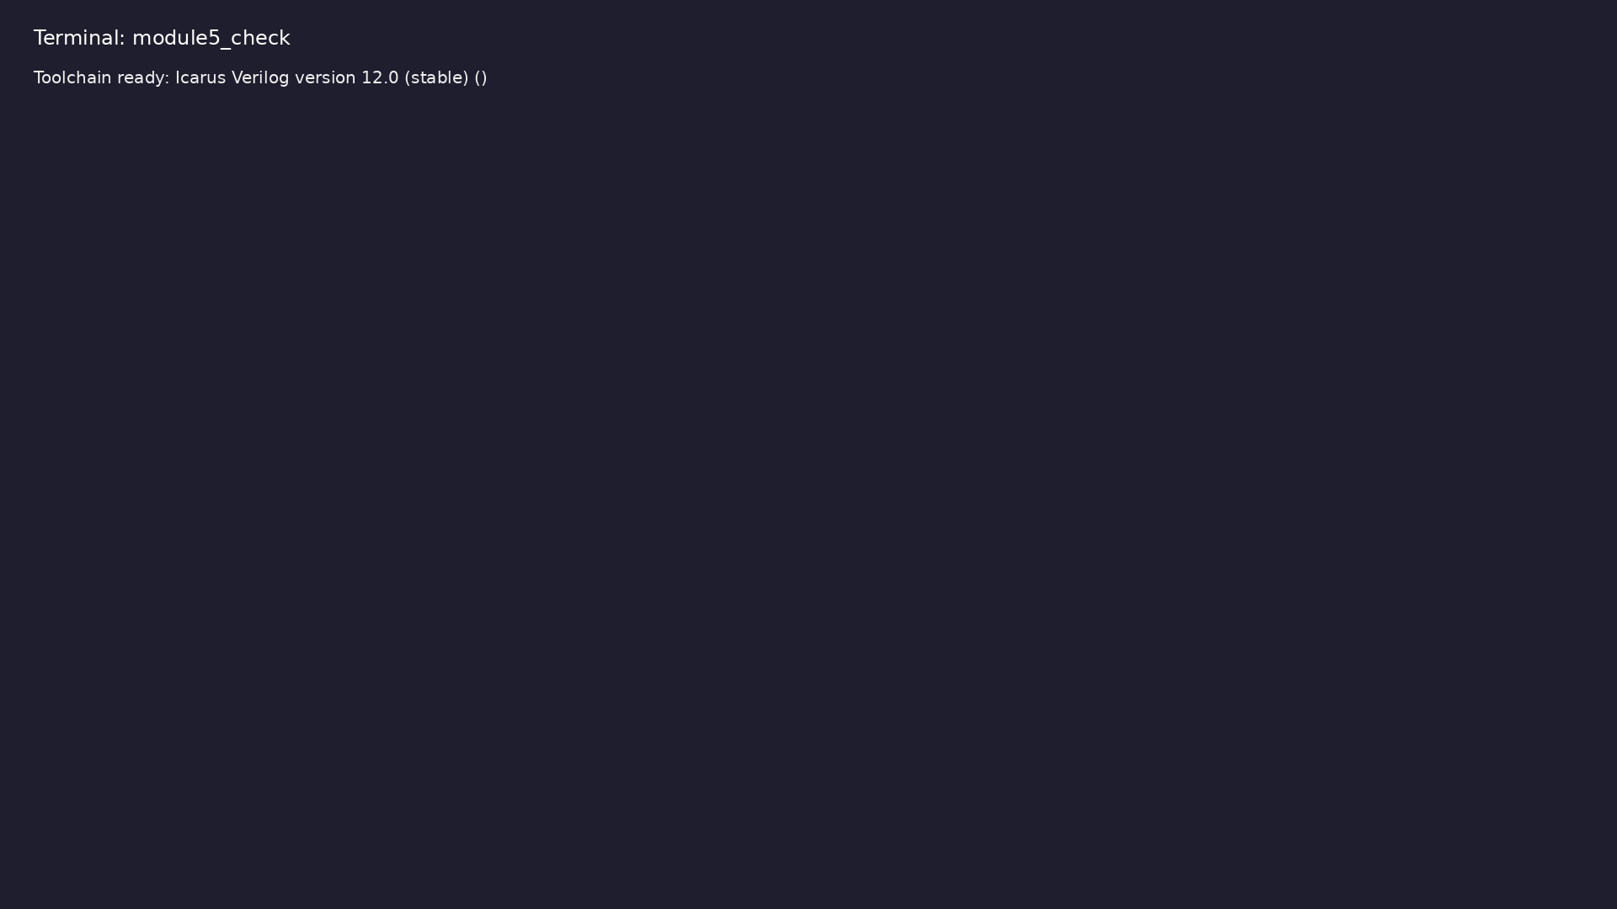
Module 5 toolchain check
$ command -v iverilog >/dev/null && echo "Toolchain ready: $(iverilog
-V 2>&1 | head -1)"
learn_verilog_systemverilog / Module 5
Notes:
Requires iverilog on PATH (apt install iverilog).

Slide 56
Example 1: `inside` with ranges and sets; `==?` wildcard (fallback fo…
• Set membership; don’t-care in comparison
learn_verilog_systemverilog / Module 5
Notes:
module5/examples/operators/README.md

Slide 57

Demo: `inside` with ranges and sets; `==?` wildcard (fallback for too…
$ cd module5/examples/operators && make clean && make run
learn_verilog_systemverilog / Module 5
Notes:
Hands-on: module5/examples/operators/

Slide 58
Example 2: Dedicated `==?` wildcard equality (X/Z as don't care)
• Wildcard match in RTL/testbench
learn_verilog_systemverilog / Module 5
Notes:
module5/examples/wildcard_only/README.md

Slide 59

Demo: Dedicated `==?` wildcard equality (X/Z as don't care)
$ cd module5/examples/wildcard_only && make clean && make run
learn_verilog_systemverilog / Module 5
Notes:
Hands-on: module5/examples/wildcard_only/

Slide 60
Example 3: Range membership (e.g. value inside `[0:127]`); fallback t…
• `inside` with ranges; 2009/2012 operator use
learn_verilog_systemverilog / Module 5
Notes:
module5/examples/range_check/README.md

Slide 61
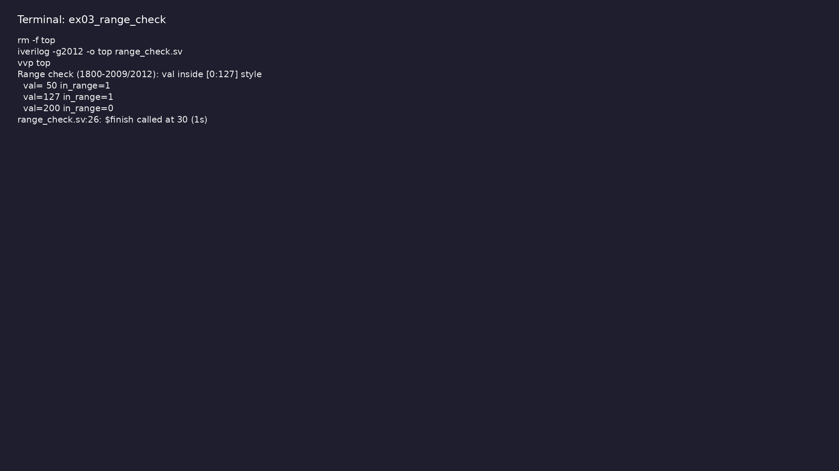
Demo: Range membership (e.g. value inside `[0:127]`); fallback to exp…
$ cd module5/examples/range_check && make clean && make run
learn_verilog_systemverilog / Module 5
Notes:
Hands-on: module5/examples/range_check/

Slide 62
Example 4: Fixed memory with parameterized DEPTH/WIDTH; 2012 array se…
• Array indexing; synthesis-safe subset
learn_verilog_systemverilog / Module 5
Notes:
module5/examples/arrays/README.md

Slide 63

Demo: Fixed memory with parameterized DEPTH/WIDTH; 2012 array semanti…
$ cd module5/examples/arrays && make clean && make run
learn_verilog_systemverilog / Module 5
Notes:
Hands-on: module5/examples/arrays/

Slide 64
Example 5: Parameterized memory using `$clog2(DEPTH)` for address wid…
• Parameterized arrays; 2012 clarifications
learn_verilog_systemverilog / Module 5
Notes:
module5/examples/array_param/README.md

Slide 65

Demo: Parameterized memory using `$clog2(DEPTH)` for address width
$ cd module5/examples/array_param && make clean && make run
learn_verilog_systemverilog / Module 5
Notes:
Hands-on: module5/examples/array_param/

Slide 66
Example 6: Immediate assertion (e.g. one-hot) using `$countones` or s…
• assert in design; immediate assertion in RTL
learn_verilog_systemverilog / Module 5
Notes:
module5/examples/checkers/README.md

Slide 67
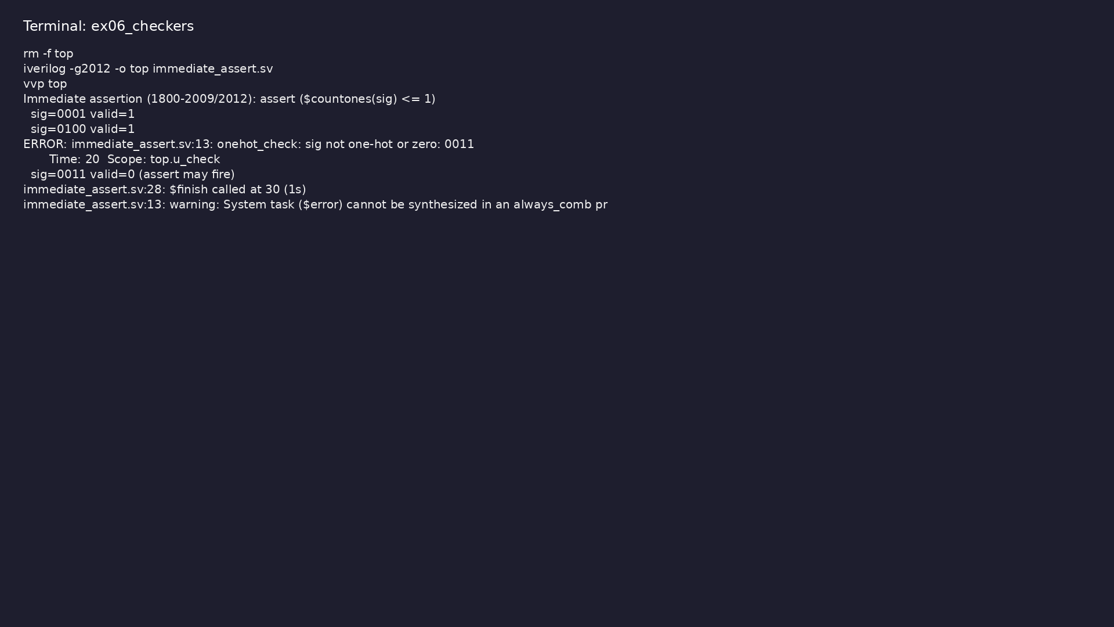
Demo: Immediate assertion (e.g. one-hot) using `$countones` or similar
$ cd module5/examples/checkers && make clean && make run
learn_verilog_systemverilog / Module 5
Notes:
Hands-on: module5/examples/checkers/

Slide 68
Example 7: Immediate assertion for valid opcode/encoding
• Invariant checking; assert for valid encodings
learn_verilog_systemverilog / Module 5
Notes:
module5/examples/assert_valid_encoding/README.md

Slide 69
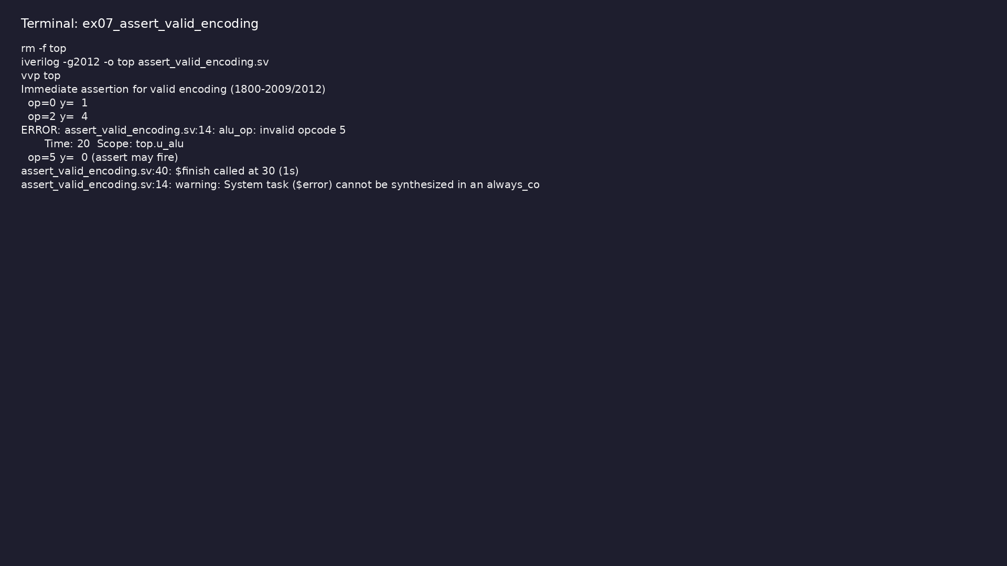
Demo: Immediate assertion for valid opcode/encoding
$ cd module5/examples/assert_valid_encoding && make clean && make run
learn_verilog_systemverilog / Module 5
Notes:
Hands-on: module5/examples/assert_valid_encoding/

Slide 70
Example 8: Immediate assertion for one-hot grant (e.g. arbiter)
• One-hot invariant; assert in RTL
learn_verilog_systemverilog / Module 5
Notes:
module5/examples/assert_invariant/README.md

Slide 71
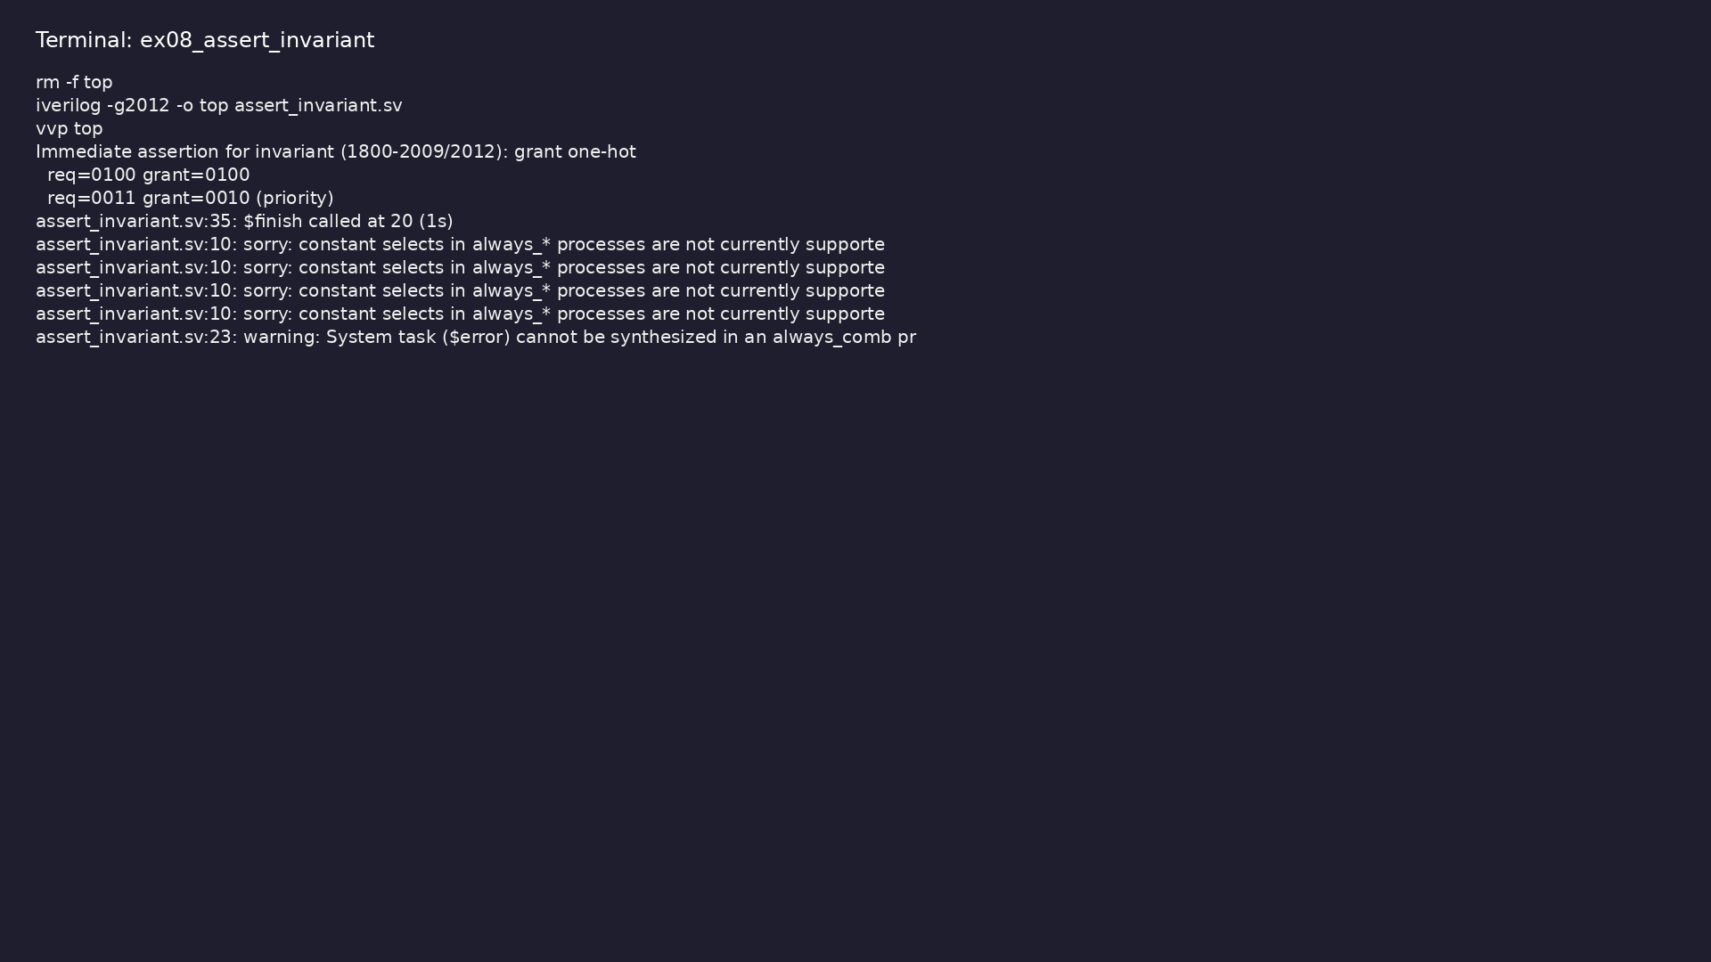
Demo: Immediate assertion for one-hot grant (e.g. arbiter)
$ cd module5/examples/assert_invariant && make clean && make run
learn_verilog_systemverilog / Module 5
Notes:
Hands-on: module5/examples/assert_invariant/

Slide 72
Example 9: Comparison of 2005 vs 2009/2012 features in a small design
• Backward compatibility; when to adopt new features
learn_verilog_systemverilog / Module 5
Notes:
module5/examples/summary/README.md

Slide 73

Demo: Comparison of 2005 vs 2009/2012 features in a small design
$ cd module5/examples/summary && make clean && make run
learn_verilog_systemverilog / Module 5
Notes:
Hands-on: module5/examples/summary/

Slide 74
Common pitfalls
learn_verilog_systemverilog / Module 5

Slide 75
Assuming 2009/2012 Features in an 2005-Only Flow
• Mistake: Using virtual interface, checker, or 2012
array methods when the project or tool is 1800-2…
• Reality: Compile or elaboration errors; or undefined
behavior.
• Correct: Confirm project standard and tool revision;
use only features of that revision.
• Why: Backward compatibility is 2005→2009→2012; tools
may not implement all newer features.
learn_verilog_systemverilog / Module 5
Notes:
From MODULE5 Common Pitfalls.

Slide 76
Virtual Interface in RTL
• Mistake: Using a virtual interface in synthesizable
RTL.
• Reality: Virtual interfaces are for dynamic binding
(testbench); not for hardware.
• Correct: Use concrete interface instances in RTL;
use virtual interface only in testbench classes.
• Why: Synthesis does not support virtual interface;
it is a simulation construct.
learn_verilog_systemverilog / Module 5
Notes:
From MODULE5 Common Pitfalls.

Slide 77
Checker Synthesis
• Mistake: Expecting a checker to be synthesized like
a module.
• Reality: Checkers are for assertion/coverage;
typically not synthesized.
• Correct: Use checkers for verification; keep RTL in
modules.
• Why: Checker semantics are for checking, not for
netlist generation.
learn_verilog_systemverilog / Module 5
Notes:
From MODULE5 Common Pitfalls.

Slide 78
Array Methods in RTL
• Mistake: Using dynamic array or queue methods (e.g.
.push_back) in synthesizable RTL.
• Reality: Many such methods are not synthesizable or
are tool-specific.
• Correct: In RTL use fixed-size or parameterized
arrays and indexing; use methods in testbenches or…
• Why: Synthesis subset of SystemVerilog is smaller
than the full language.
learn_verilog_systemverilog / Module 5
Notes:
From MODULE5 Common Pitfalls.

Slide 79
$unit vs Package
• Mistake: Putting shared types or functions in $unit
and relying on compilation order.
• Reality: $unit visibility and order are tool-
dependent; can cause subtle bugs.
• Correct: Put shared items in packages; use explicit
import.
• Why: Packages give a clear namespace and import
order; 2012 clarifies compilation unit but packages…
learn_verilog_systemverilog / Module 5
Notes:
From MODULE5 Common Pitfalls.

Slide 80
Practice & assessment
learn_verilog_systemverilog / Module 5

Slide 81
What you should know
• ✓ Describe what 1800-2009 and 1800-2012 add or
clarify over 1800-2005 (interfaces, types, arrays,
a…
• ✓ Use interface refinements (modport expressions,
virtual interface) when the project and tool supp…
• ✓ Use `inside` and `==?` appropriately in RTL or
testbenches
• ✓ Apply array and string refinements (2012) in
testbenches or checkers; know the synthesizable
subs…
• ✓ Use immediate assertions in RTL for simple
invariants; understand checker (2012) as reusable
prop…
• ✓ Summarize 1800-2005 vs 2009 vs 2012 and choose a
standard based on tool and project
learn_verilog_systemverilog / Module 5
Notes:
From MODULE5 Learning Outcomes.

Slide 82
Exercises
• inside and ==?
• Interface (2009)
• Immediate Assertion
• Checker (2012)
• Version Table
learn_verilog_systemverilog / Module 5

Slide 83
Exercises
• Assuming 2009/2012 Features in an 2005-Only Flow
• Virtual Interface in RTL
• Checker Synthesis
• Array Methods in RTL
• $unit vs Package
learn_verilog_systemverilog / Module 5

Slide 84
Summary & next steps
• Master the SystemVerilog revisions IEEE 1800-2009
and 1800-2012: interface and type refinements, op…
• Complete module5/CHECKLIST.md
• Review module5/EXAMPLES.md and run each lab
• Next: Next module in course
learn_verilog_systemverilog / Module 5

