Slide 1
Module 6
IEEE 1800-2017 (Current SystemVerilog)
learn_verilog_systemverilog / Module 6

Slide 2
Learning objectives
• Master the current SystemVerilog standard (IEEE
1800-2017): unified LRM, merged Verilog and SystemV…
learn_verilog_systemverilog / Module 6

Slide 3
Prerequisites
• See module README
learn_verilog_systemverilog / Module 6

Slide 4
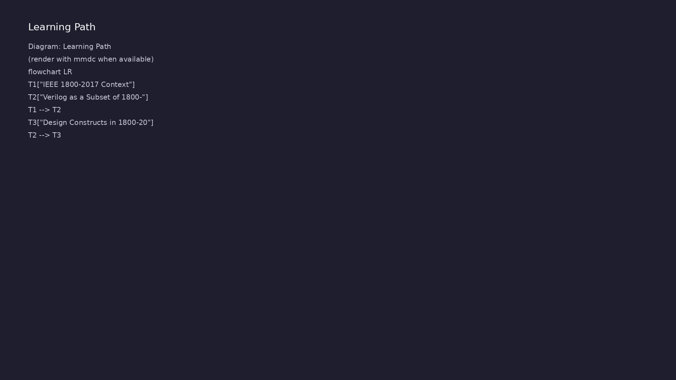
Learning path
Master the current SystemVerilog standard (IEEE 1800-2017): unified LRM, merged Verilog and SystemVerilog, and design/verification overview.
learn_verilog_systemverilog / Module 6

Slide 5
Overview
• This module covers IEEE Std 1800-2017, the current
SystemVerilog standard. In 1800-2017, the Verilo…
learn_verilog_systemverilog / Module 6

Slide 6
How to learn this module
learn_verilog_systemverilog / Module 6

Slide 7
Suggested learning path (1/2)
• Skim this document — Goal, Overview, and Topics
Covered set the IEEE scope for Module 6.
• Study design architecture — See how DUTs, examples,
and testbenches fit together under `module6/`.
• Work through labs in order — Open
`module6/EXAMPLES.md` and run each `make clean &&
make run` from…
• Run the full module script — `./scripts/module6.sh`
from the repo root to simulate all examples and…
• Complete the exercises — Try each exercise in this
document before reading solutions or peeking at…
learn_verilog_systemverilog / Module 6
Notes:
From docs/MODULE6.md — read guides before running demos.

Slide 8
Suggested learning path (2/2)
• Review Common Pitfalls — Can you explain each
mistake and the fix?
• Self-check — Use `module6/CHECKLIST.md` before
starting the next module.
learn_verilog_systemverilog / Module 6
Notes:
From docs/MODULE6.md — read guides before running demos.

Slide 9
Design architecture
learn_verilog_systemverilog / Module 6

Slide 10

1. Repository layout (module6/)
• IEEE 1800-2017 — current unified
SystemVerilog LRM
• Summarizes design subset plus
2017 language updates
• module6/examples/ — version
summary, migration, assertions
recap
• scripts/module6.sh — current-
standard lab sweep
learn_verilog_systemverilog / Module 6
Notes:
From MODULE6 Design Architecture.

Slide 11
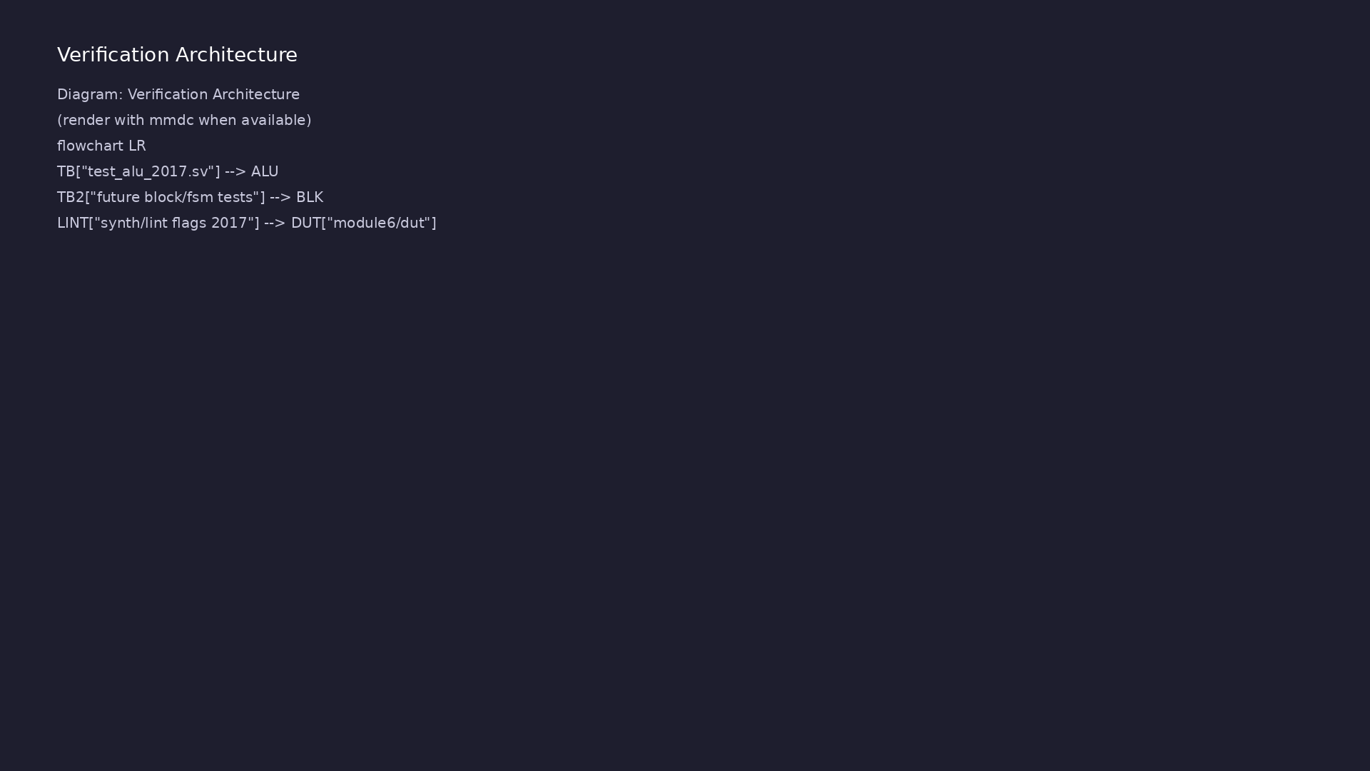
2. 2017 standard in practice
• Verilog is a subset of
SystemVerilog in the 2017 LRM
• logic, always_comb/ff, packages,
interfaces — production RTL
baseline
• unique case, priority case —
prefer over vendor attributes
• Course maps 2017 features back
to Modules 4–5 introductions
learn_verilog_systemverilog / Module 6
Notes:
From MODULE6 Design Architecture.

Slide 12
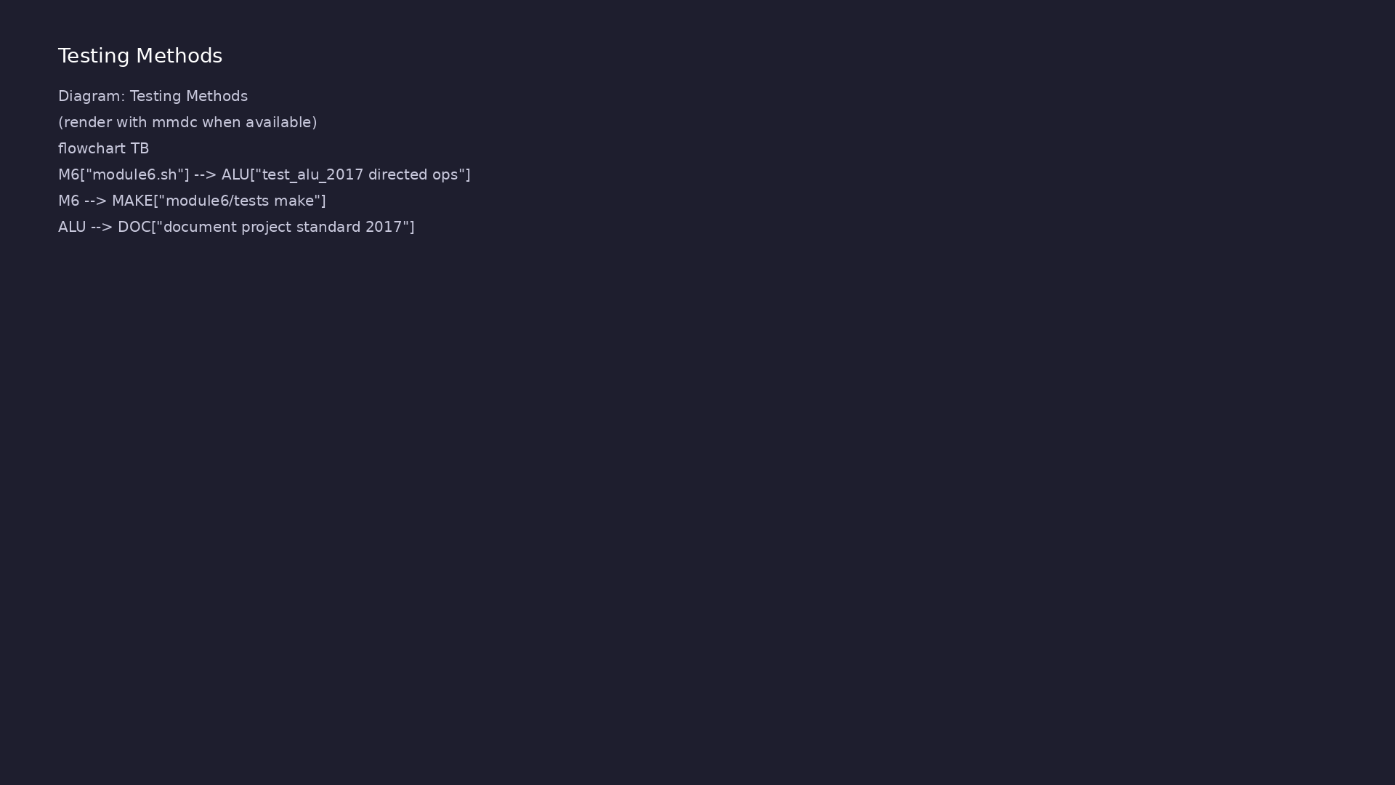
3. Single-driver and type discipline
• logic enforces one driver per
net in synthesizable RTL
• Package import :: scope — shared
enums and parameters
• See rtl_architecture.png — same
DUT/TB split as earlier modules
learn_verilog_systemverilog / Module 6
Notes:
From MODULE6 Design Architecture.

Slide 13
RTL block diagram (reference)
Module 6: DUT hierarchy and signal flow.
learn_verilog_systemverilog / Module 6

Slide 14
Verification / testbench diagram (reference)
Module 6: stimulus, observation, and checking.
learn_verilog_systemverilog / Module 6

Slide 15
logic single-driver pattern
/*
* IEEE 1800-2017: logic and single driver (2017 clarified)
* logic must have exactly one driver; comb and seq in separate blocks.
*/
module comb_block (
input logic [7:0] a,
input logic [7:0] b,
output logic [7:0] sum,
output logic eq
);
assign sum = a + b;
always_comb eq = (a == b);
endmodule
module seq_block (
# ...
learn_verilog_systemverilog / Module 6

Slide 16
Execution & simulation flow
learn_verilog_systemverilog / Module 6

Slide 17
How the example runs (toolchain)
• Makefile: Verilator compiles RTL + SystemVerilog
testbench into a C++ model
• sim_main.cpp: generates clk/rst_n, calls eval()
until $finish
• Directed test (initial block or C++): drive
stimulus, wait for DUT flags
• Self-check: compare outputs; print PASS/FAIL (see
terminal demo slide)
• Repo path: module6/examples/<example>/ — run make
run from that directory
learn_verilog_systemverilog / Module 6
Notes:
From MODULE6 — execution and artifact layout.

Slide 18
Key files to study
learn_verilog_systemverilog / Module 6

Slide 19
Open these in the repo
• module6/examples/subsets/
• module6/examples/design_recap/
• module6/examples/version_summary/
• scripts/module6.sh
learn_verilog_systemverilog / Module 6
Notes:
Trace while running module6/EXAMPLES.md labs.

Slide 20
Verification & testing methods
learn_verilog_systemverilog / Module 6

Slide 21
1. Execution flow
• make run per lab;
./scripts/module6.sh for full
module
• version_summary example prints
construct-by-standard table
learn_verilog_systemverilog / Module 6
Notes:
From MODULE6 Verification & Testing Methods.

Slide 22
2. Regression before Module 7
• Confirm all 2017-subset examples
compile with your simulator
• Review CHECKLIST.md — ready to
compare versions in Module 7
learn_verilog_systemverilog / Module 6
Notes:
From MODULE6 Verification & Testing Methods.

Slide 23
Version summary runner
/*
* IEEE 1800-2017: Version timeline summary (1995 -> 2017)
* Small design using 2017 subset; display reminds which standard added
what.
*/
module mux_2017 (
input logic [1:0] sel,
input logic [7:0] a,
input logic [7:0] b,
input logic [7:0] c,
input logic [7:0] d,
output logic [7:0] y
);
always_comb begin
unique case (sel)
2'b00: y = a;
# ...
learn_verilog_systemverilog / Module 6

Slide 24
Syllabus topics
learn_verilog_systemverilog / Module 6

Slide 25
Protocol & design details
learn_verilog_systemverilog / Module 6

Slide 26
Detail: Unified LRM (2017)
• Before 2017: IEEE 1364 defined Verilog; IEEE 1800
defined SystemVerilog (extending 1364). Two docum…
• 1800-2017: One LRM (IEEE 1800-2017) defines both the
Verilog subset and SystemVerilog. IEEE 1364 is…
• Implication: When you say "IEEE 1800-2017," you are
referring to the full language (Verilog + Syste…
learn_verilog_systemverilog / Module 6
Notes:
From MODULE6 Topics Covered — protocol/design depth.

Slide 27
Detail: What 1800-2017 Adds or Clarifies Over 2012 (1)
• Structure: Single LRM; consistent numbering and
cross-references; Verilog and SystemVerilog in one…
• Clarifications: Scheduling, generate, interfaces,
assertions, coverage, DPI, and many other areas r…
• Corrections: Errata and ambiguous cases addressed.
• Additions: Any new or clarified features in the 2017
edition (check LRM for specifics; often increm…
learn_verilog_systemverilog / Module 6
Notes:
From MODULE6 Topics Covered — protocol/design depth.

Slide 28
Detail: What 1800-2017 Adds or Clarifies Over 2012 (2)
• No separate 1364: For new work, use 1800-2017;
legacy "1364-only" is the subset of 1800 that omits…
learn_verilog_systemverilog / Module 6
Notes:
From MODULE6 Topics Covered — protocol/design depth.

Slide 29
Detail: Backward Compatibility
• RTL and testbenches written for 1364-1995 through
1800-2012 remain valid in 1800-2017 when they use…
• Adopt 2017 as the reference standard for new
projects unless a project or tool explicitly targets
a…
learn_verilog_systemverilog / Module 6
Notes:
From MODULE6 Topics Covered — protocol/design depth.

Slide 30
Detail: Verilog Subset (Design)
• Modules, ports: ANSI or non-ANSI (1364-1995 style);
wire, reg.
• Procedural blocks: always, initial; always @*
(2001); explicit sensitivity (1995).
• No SystemVerilog-only: No logic,
always_comb/always_ff, interfaces, packages,
unique/priority case…
• Use: When the flow or legacy code requires "Verilog
only" (e.g. synthesis or IP that does not accep…
learn_verilog_systemverilog / Module 6
Notes:
From MODULE6 Topics Covered — protocol/design depth.

Slide 31
Detail: SystemVerilog Design Subset (1800) (1)
• logic, always_comb, always_ff, always_latch.
• Interfaces and modports.
• Packages and import.
• unique case, priority case.
learn_verilog_systemverilog / Module 6
Notes:
From MODULE6 Topics Covered — protocol/design depth.

Slide 32
Detail: SystemVerilog Design Subset (1800) (2)
• 2-state types (bit, int, etc.) where useful.
• Use: When the flow supports SystemVerilog; preferred
for new RTL for clarity and tool checking.
learn_verilog_systemverilog / Module 6
Notes:
From MODULE6 Topics Covered — protocol/design depth.

Slide 33
Detail: Choosing a Subset
• Verilog-only (1364 subset): Maximum portability; use
when tools or IP are Verilog-only.
• SystemVerilog design (1800 subset): Better
expressiveness and checking; use when the flow
supports…
learn_verilog_systemverilog / Module 6
Notes:
From MODULE6 Topics Covered — protocol/design depth.

Slide 34
Detail: logic and Single Driver
• Rule: logic must have exactly one driver (one
assign, one always block, or one port connection).
• 2017: Semantics of multiple drivers, resolution, and
connection rules are clarified in the LRM.
learn_verilog_systemverilog / Module 6
Notes:
From MODULE6 Topics Covered — protocol/design depth.

Slide 35
Detail: always_comb, always_ff, always_latch
• Intent: Combinational, sequential (flip-flop), or
latch; tools can check and warn.
• 2017: Execution order, sensitivity, and interaction
with other processes are clarified.
learn_verilog_systemverilog / Module 6
Notes:
From MODULE6 Topics Covered — protocol/design depth.

Slide 36
Detail: Interfaces and Modports
• Use: Bundle signals; modports define direction per
role.
• 2017: Interface connection, parameterization, and
modport rules are refined.
learn_verilog_systemverilog / Module 6
Notes:
From MODULE6 Topics Covered — protocol/design depth.

Slide 37
Detail: Packages and import
• Use: Shared types, constants, functions; explicit
namespace.
• 2017: Import scope, search order, and compilation-
unit interaction are clarified.
learn_verilog_systemverilog / Module 6
Notes:
From MODULE6 Topics Covered — protocol/design depth.

Slide 38
Detail: unique case and priority case
• Semantics: At most one match (unique) or first match
wins (priority); runtime checks possible.
• 2017: Case statement semantics and synthesis mapping
are clarified.
learn_verilog_systemverilog / Module 6
Notes:
From MODULE6 Topics Covered — protocol/design depth.

Slide 39
Detail: Immediate and Concurrent Assertions
• Immediate: `assert (condition);` — executed when
reached; useful for invariants in RTL.
• Concurrent: `assert property (...);` — temporal;
used in verification and bind files.
• 2017: Property syntax, scheduling, and binding are
clarified.
learn_verilog_systemverilog / Module 6
Notes:
From MODULE6 Topics Covered — protocol/design depth.

Slide 40
Detail: Checkers
• Checker: Reusable block of
assertions/assumptions/coverage (from 2012);
instantiated or bound.
• 2017: Checker semantics and instantiation are
clarified.
learn_verilog_systemverilog / Module 6
Notes:
From MODULE6 Topics Covered — protocol/design depth.

Slide 41
Detail: Coverage
• Covergroups, coverpoints: Defined in 1800; used in
verification.
• 2017: Coverage options and semantics are refined.
learn_verilog_systemverilog / Module 6
Notes:
From MODULE6 Topics Covered — protocol/design depth.

Slide 42
Detail: Synthesizable Subset
• Generally supported: logic, always_comb, always_ff,
interfaces, packages, generate, parameter, loca…
• Often not supported or tool-specific: Classes, full
SVA, dynamic arrays/queues in RTL, virtual inte…
• Check tool docs: Each vendor defines the exact
synthesizable subset for 1800-2017.
learn_verilog_systemverilog / Module 6
Notes:
From MODULE6 Topics Covered — protocol/design depth.

Slide 43
Detail: Simulation Support
• 1800-2017: Most commercial and several open-source
simulators support a large subset of 1800-2017.
• Revisions: Tools may support 2005, 2009, 2012, or
2017; choose project standard to match tool and I…
learn_verilog_systemverilog / Module 6
Notes:
From MODULE6 Topics Covered — protocol/design depth.

Slide 44
Detail: Linting and Formal
• Lint: Many tools check 1800-2017 syntax and common
RTL rules (e.g. single driver, blocking/nonblock…
• Formal: Assertions and checkers are used with formal
tools; 2017 clarifies semantics for consistenc…
learn_verilog_systemverilog / Module 6
Notes:
From MODULE6 Topics Covered — protocol/design depth.

Slide 45
Detail: Choosing a Standard
• Legacy or Verilog-only flow: Use 1364-2005 subset
(no SystemVerilog) or document "Verilog as per 18…
• New RTL with SystemVerilog: Use 1800-2017 (or
2012/2009 if tool lags); adopt logic,
always_comb/alw…
• Verification: Use 1800-2017 (or supported revision)
for SVA, checkers, coverage, classes.
• Single revision: Prefer one stated revision (e.g.
"1800-2017") for the project to avoid mixed seman…
learn_verilog_systemverilog / Module 6
Notes:
From MODULE6 Topics Covered — protocol/design depth.

Slide 46
Detail: Migration (Brief)
• 1364 → 1800 design: Replace wire/reg with logic
(single driver); always @* → always_comb; always @(…
• Older 1800 → 2017: Most code remains valid; adopt
2017 clarifications and any new features the proj…
• Tool support: Confirm simulator and synthesis
support for the chosen revision before locking the
st…
learn_verilog_systemverilog / Module 6
Notes:
From MODULE6 Topics Covered — protocol/design depth.

Slide 47
Verification flow (reference)
Stimulus, DUT response, and check points for this module.
learn_verilog_systemverilog / Module 6

Slide 48
1. IEEE 1800-2017 Context (1/2)
• Before 2017: IEEE 1364 defined Verilog; IEEE 1800
defined SystemVerilog (extending 1364). Two docum…
• 1800-2017: One LRM (IEEE 1800-2017) defines both the
Verilog subset and SystemVerilog. IEEE 1364 is…
• Implication: When you say "IEEE 1800-2017," you are
referring to the full language (Verilog + Syste…
• Structure: Single LRM; consistent numbering and
cross-references; Verilog and SystemVerilog in one…
• Clarifications: Scheduling, generate, interfaces,
assertions, coverage, DPI, and many other areas r…
• Corrections: Errata and ambiguous cases addressed.
learn_verilog_systemverilog / Module 6
Notes:
From MODULE6 Topics Covered.

Slide 49
1. IEEE 1800-2017 Context (2/2)
• Additions: Any new or clarified features in the 2017
edition (check LRM for specifics; often increm…
• No separate 1364: For new work, use 1800-2017;
legacy "1364-only" is the subset of 1800 that omits…
• RTL and testbenches written for 1364-1995 through
1800-2012 remain valid in 1800-2017 when they use…
• Adopt 2017 as the reference standard for new
projects unless a project or tool explicitly targets
a…
learn_verilog_systemverilog / Module 6
Notes:
From MODULE6 Topics Covered.

Slide 50
2. Verilog as a Subset of 1800-2017 (1/2)
• Modules, ports: ANSI or non-ANSI (1364-1995 style);
wire, reg.
• Procedural blocks: always, initial; always @*
(2001); explicit sensitivity (1995).
• No SystemVerilog-only: No logic,
always_comb/always_ff, interfaces, packages,
unique/priority case…
• Use: When the flow or legacy code requires "Verilog
only" (e.g. synthesis or IP that does not accep…
• logic, always_comb, always_ff, always_latch.
• Interfaces and modports.
learn_verilog_systemverilog / Module 6
Notes:
From MODULE6 Topics Covered.

Slide 51
2. Verilog as a Subset of 1800-2017 (2/2)
• Packages and import.
• unique case, priority case.
• 2-state types (bit, int, etc.) where useful.
• Use: When the flow supports SystemVerilog; preferred
for new RTL for clarity and tool checking.
• Verilog-only (1364 subset): Maximum portability; use
when tools or IP are Verilog-only.
• SystemVerilog design (1800 subset): Better
expressiveness and checking; use when the flow
supports…
learn_verilog_systemverilog / Module 6
Notes:
From MODULE6 Topics Covered.

Slide 52
3. Design Constructs in 1800-2017 (Recap and Clarifications) (1/2)
• Rule: logic must have exactly one driver (one
assign, one always block, or one port connection).
• 2017: Semantics of multiple drivers, resolution, and
connection rules are clarified in the LRM.
• Intent: Combinational, sequential (flip-flop), or
latch; tools can check and warn.
• 2017: Execution order, sensitivity, and interaction
with other processes are clarified.
• Use: Bundle signals; modports define direction per
role.
• 2017: Interface connection, parameterization, and
modport rules are refined.
learn_verilog_systemverilog / Module 6
Notes:
From MODULE6 Topics Covered.

Slide 53
3. Design Constructs in 1800-2017 (Recap and Clarifications) (2/2)
• Use: Shared types, constants, functions; explicit
namespace.
• 2017: Import scope, search order, and compilation-
unit interaction are clarified.
• Semantics: At most one match (unique) or first match
wins (priority); runtime checks possible.
• 2017: Case statement semantics and synthesis mapping
are clarified.
learn_verilog_systemverilog / Module 6
Notes:
From MODULE6 Topics Covered.

Slide 54
4. Assertions and Verification in 1800-2017 (Context) (1/2)
• Immediate: `assert (condition);` — executed when
reached; useful for invariants in RTL.
• Concurrent: `assert property (...);` — temporal;
used in verification and bind files.
• 2017: Property syntax, scheduling, and binding are
clarified.
• Checker: Reusable block of
assertions/assumptions/coverage (from 2012);
instantiated or bound.
• 2017: Checker semantics and instantiation are
clarified.
• Covergroups, coverpoints: Defined in 1800; used in
verification.
learn_verilog_systemverilog / Module 6
Notes:
From MODULE6 Topics Covered.

Slide 55
4. Assertions and Verification in 1800-2017 (Context) (2/2)
• 2017: Coverage options and semantics are refined.
learn_verilog_systemverilog / Module 6
Notes:
From MODULE6 Topics Covered.

Slide 56
5. Synthesis and Tool Support (1800-2017) (1/2)
• Generally supported: logic, always_comb, always_ff,
interfaces, packages, generate, parameter, loca…
• Often not supported or tool-specific: Classes, full
SVA, dynamic arrays/queues in RTL, virtual inte…
• Check tool docs: Each vendor defines the exact
synthesizable subset for 1800-2017.
• 1800-2017: Most commercial and several open-source
simulators support a large subset of 1800-2017.
• Revisions: Tools may support 2005, 2009, 2012, or
2017; choose project standard to match tool and I…
• Lint: Many tools check 1800-2017 syntax and common
RTL rules (e.g. single driver, blocking/nonblock…
learn_verilog_systemverilog / Module 6
Notes:
From MODULE6 Topics Covered.

Slide 57
5. Synthesis and Tool Support (1800-2017) (2/2)
• Formal: Assertions and checkers are used with formal
tools; 2017 clarifies semantics for consistenc…
learn_verilog_systemverilog / Module 6
Notes:
From MODULE6 Topics Covered.

Slide 58
6. Version Timeline Summary (1995 → 2017)
• Design migration: 1364-1995 → 2001 → 2005 (Verilog);
then 1800-2005 → 2009 → 2012 → 2017 (SystemVer…
learn_verilog_systemverilog / Module 6
Notes:
From MODULE6 Topics Covered.

Slide 59
7. Choosing a Standard and Migration (1/2)
• Legacy or Verilog-only flow: Use 1364-2005 subset
(no SystemVerilog) or document "Verilog as per 18…
• New RTL with SystemVerilog: Use 1800-2017 (or
2012/2009 if tool lags); adopt logic,
always_comb/alw…
• Verification: Use 1800-2017 (or supported revision)
for SVA, checkers, coverage, classes.
• Single revision: Prefer one stated revision (e.g.
"1800-2017") for the project to avoid mixed seman…
• 1364 → 1800 design: Replace wire/reg with logic
(single driver); always @* → always_comb; always @(…
• Older 1800 → 2017: Most code remains valid; adopt
2017 clarifications and any new features the proj…
learn_verilog_systemverilog / Module 6
Notes:
From MODULE6 Topics Covered.

Slide 60
7. Choosing a Standard and Migration (2/2)
• Tool support: Confirm simulator and synthesis
support for the chosen revision before locking the
st…
learn_verilog_systemverilog / Module 6
Notes:
From MODULE6 Topics Covered.

Slide 61
8. 1800-2017 as the Single Reference (1/5)
• One LRM: For any question on Verilog or
SystemVerilog syntax/semantics, 1800-2017 is the
single ref…
• Subsets: Define project subsets explicitly (e.g.
"1800-2017 design subset, no SVA in RTL") so that…
• Future revisions: New IEEE 1800 revisions (e.g.
2024+) will extend 2017; the version-centric approa…
• Same small design: one file using only 1364-style
(wire/reg, always @*), one using 1800 design (log…
• Key Concepts: 1364 subset vs 1800 design subset
within 1800-2017
• One module using logic, always_comb, always_ff,
package, unique case (all 1800-2017 compliant)
learn_verilog_systemverilog / Module 6
Notes:
From MODULE6 Topics Covered.

Slide 62
8. 1800-2017 as the Single Reference (2/5)
• Key Concepts: Current standard design subset in one
place
• Simple invariant (e.g. one-hot state) with assert in
design
• Key Concepts: Synthesizable RTL + assertion; 2017
semantics
• Table or script that lists which construct belongs
to which standard (1995–2017)
• Key Concepts: Full version timeline; choosing a
standard
• Same 4:1 mux in 1364-2005 style vs 1800-2017 style
(wire/reg→logic, always @*→always_comb, unique c…
learn_verilog_systemverilog / Module 6
Notes:
From MODULE6 Topics Covered.

Slide 63
8. 1800-2017 as the Single Reference (3/5)
• Key Concepts: Step-by-step migration from 1364 to
1800 design subset
• Comb and seq blocks; each logic has exactly one
driver (2017 clarified)
• Key Concepts: Single driver for logic; assign,
always_comb, always_ff
• Priority encoder using priority case (first match
wins)
• Key Concepts: priority case; 2017 semantics for
encoders/arbiters
• Shared types and parameters in package; import in
module and top
learn_verilog_systemverilog / Module 6
Notes:
From MODULE6 Topics Covered.

Slide 64
8. 1800-2017 as the Single Reference (4/5)
• Key Concepts: Package and import; 2017 scope and
search order clarifications
• Decoder with unique case and default (no latch)
• Key Concepts: unique case; at most one match; 2017
clarified
• alu_2017.sv: Small ALU with logic, always_comb,
package type, optional immediate assertion
• Example: Current standard design subset; no legacy
1364-only constructs
• design_block_2017.sv: Block using 1800-2017 design
constructs (logic, always_comb/always_ff, packag…
learn_verilog_systemverilog / Module 6
Notes:
From MODULE6 Topics Covered.

Slide 65
8. 1800-2017 as the Single Reference (5/5)
• Example: Interface-style or block-level
connectivity; 2017 design subset
• fsm_2017.sv: FSM with unique case and one immediate
assertion (state encoding)
• Example: 1800-2017 RTL; assertion for invariant
• test_alu_2017.sv: ALU testbench (1800-2017
compatible)
• Key Features: Exercises `dut/alu_2017.sv`; no use of
deprecated or non-2017 constructs
learn_verilog_systemverilog / Module 6
Notes:
From MODULE6 Topics Covered.

Slide 66
Hands-on examples
learn_verilog_systemverilog / Module 6

Slide 67
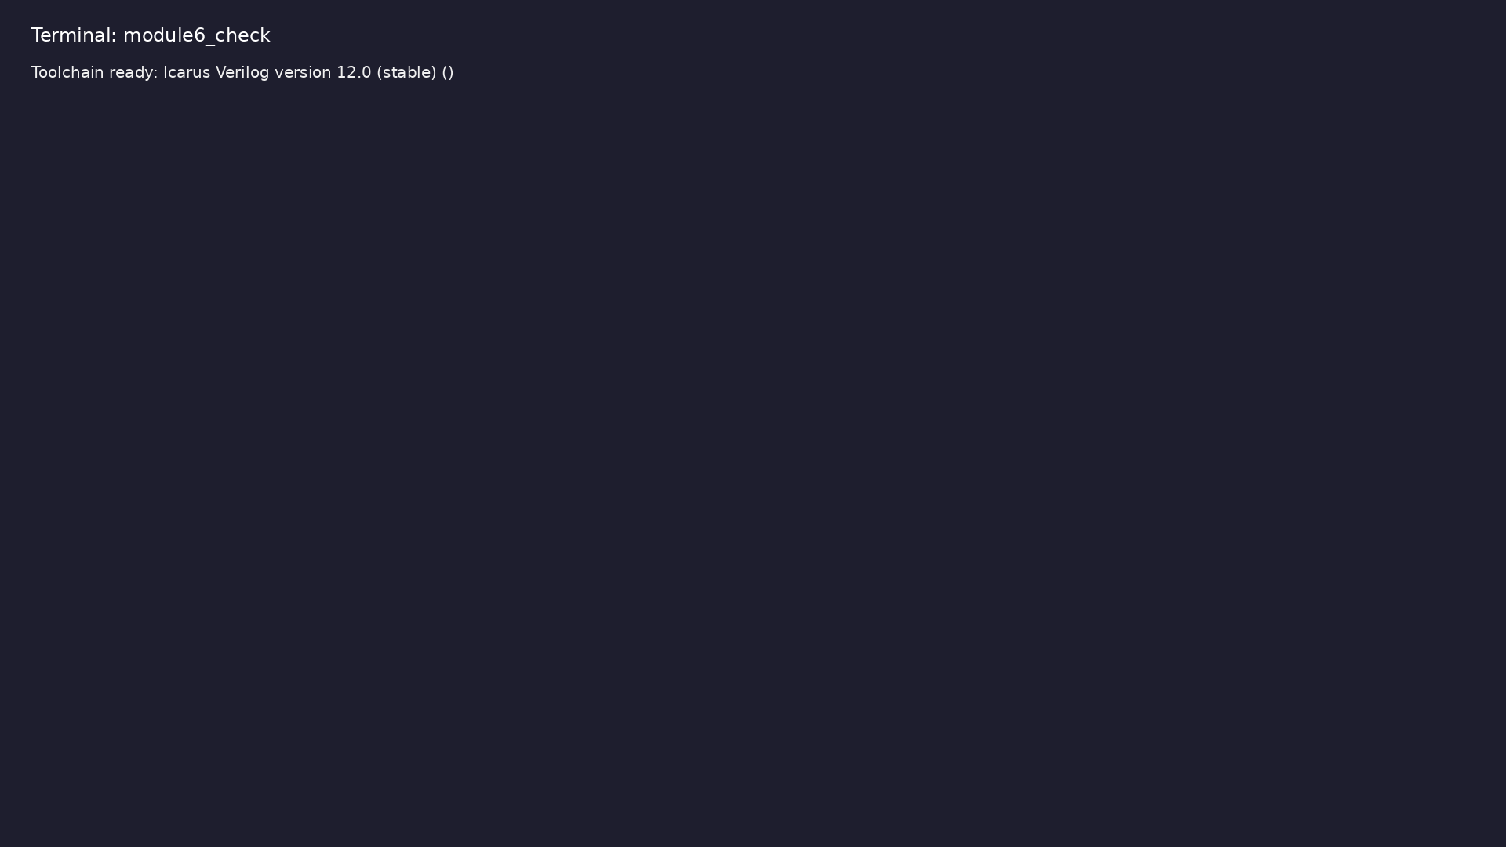
Module 6 toolchain check
$ command -v iverilog >/dev/null && echo "Toolchain ready: $(iverilog
-V 2>&1 | head -1)"
learn_verilog_systemverilog / Module 6
Notes:
Requires iverilog on PATH (apt install iverilog).

Slide 68
Example 1: Same small design: one file using only 1364-style (wire/re…
• 1364 subset vs 1800 design subset within 1800-2017
learn_verilog_systemverilog / Module 6
Notes:
module6/examples/subsets/README.md

Slide 69
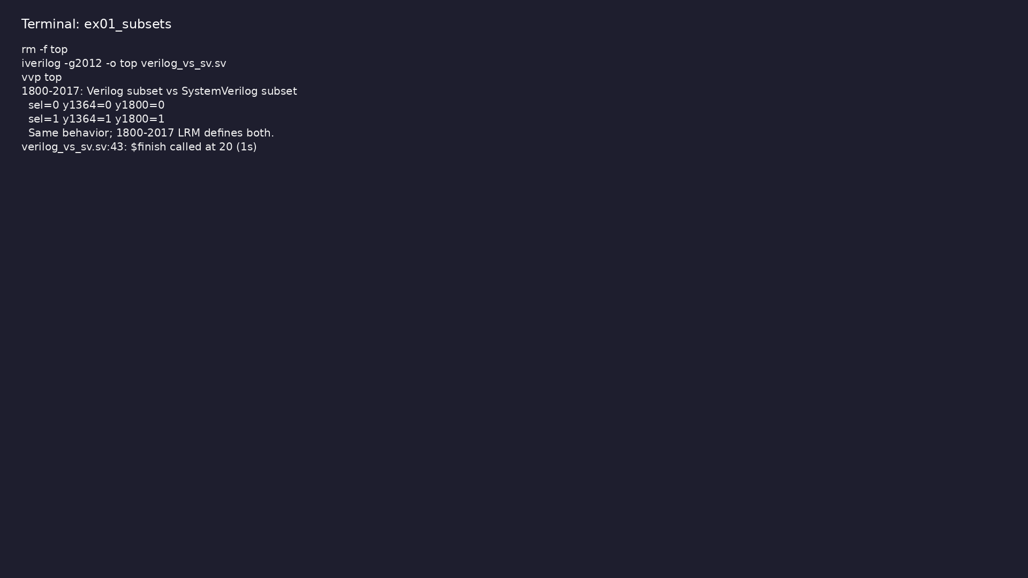
Demo: Same small design: one file using only 1364-style (wire/reg, al…
$ cd module6/examples/subsets && make clean && make run
learn_verilog_systemverilog / Module 6
Notes:
Hands-on: module6/examples/subsets/

Slide 70
Example 2: One module using logic, always_comb, always_ff, package, u…
• Current standard design subset in one place
learn_verilog_systemverilog / Module 6
Notes:
module6/examples/design_recap/README.md

Slide 71
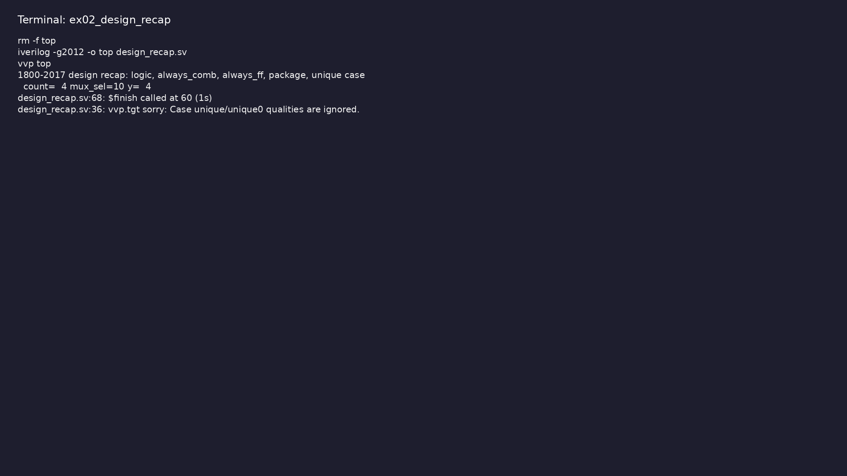
Demo: One module using logic, always_comb, always_ff, package, unique…
$ cd module6/examples/design_recap && make clean && make run
learn_verilog_systemverilog / Module 6
Notes:
Hands-on: module6/examples/design_recap/

Slide 72
Example 3: Simple invariant (e.g. one-hot state) with assert in design
• Synthesizable RTL + assertion; 2017 semantics
learn_verilog_systemverilog / Module 6
Notes:
module6/examples/assertions/README.md

Slide 73
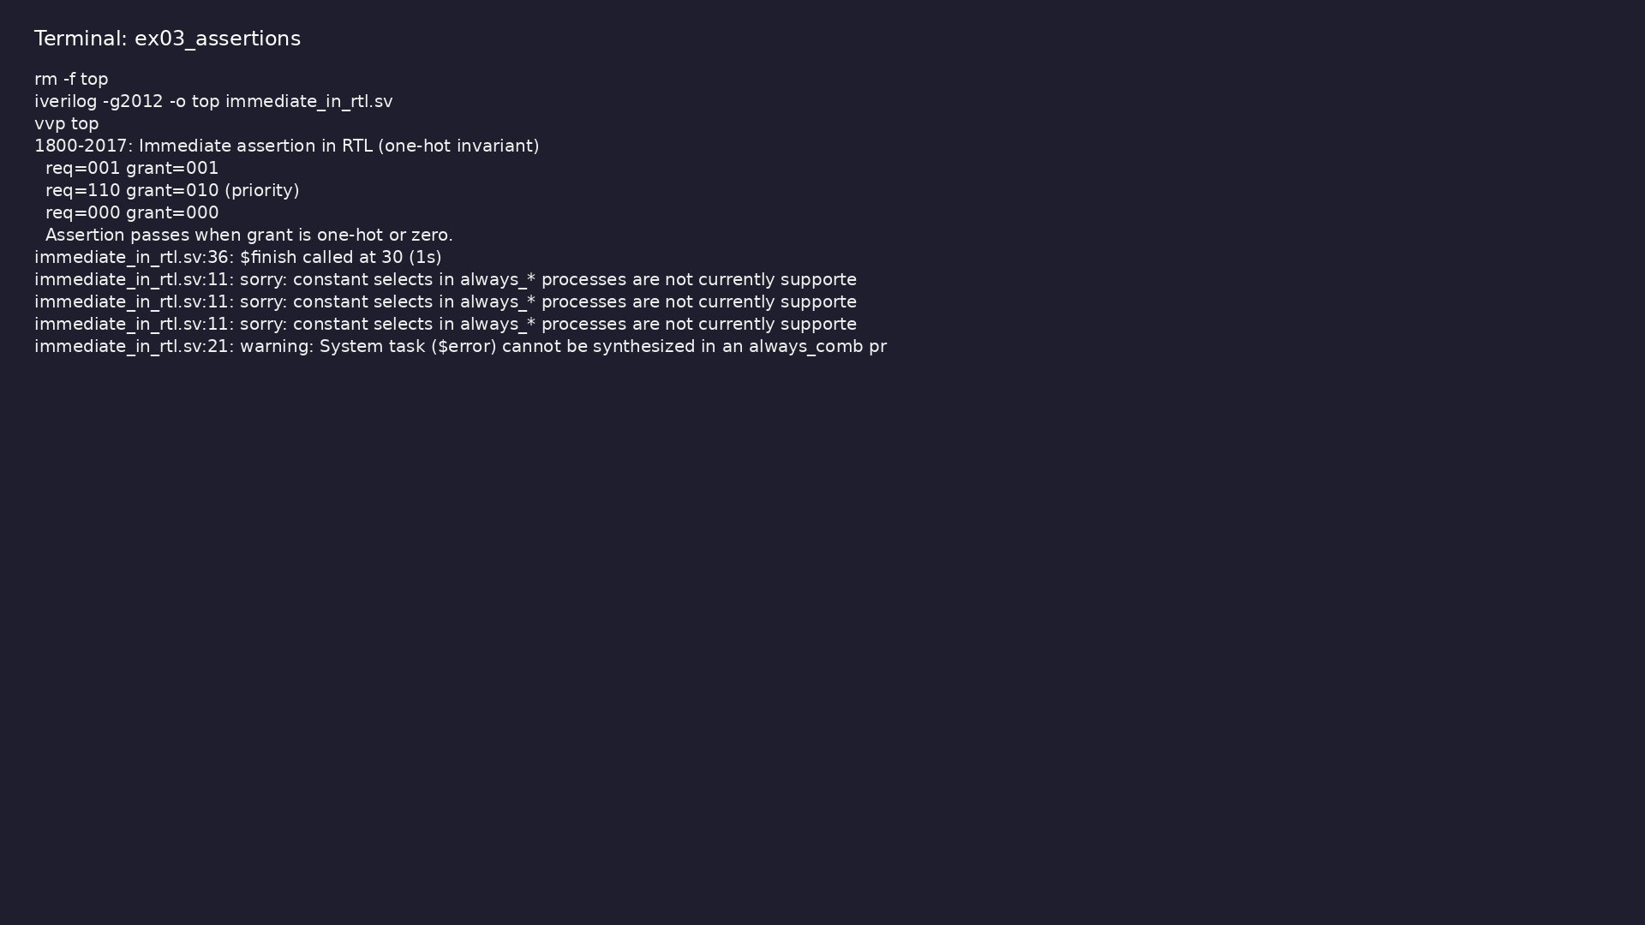
Demo: Simple invariant (e.g. one-hot state) with assert in design
$ cd module6/examples/assertions && make clean && make run
learn_verilog_systemverilog / Module 6
Notes:
Hands-on: module6/examples/assertions/

Slide 74
Example 4: Table or script that lists which construct belongs to whic…
• Full version timeline; choosing a standard
learn_verilog_systemverilog / Module 6
Notes:
module6/examples/version_summary/README.md

Slide 75
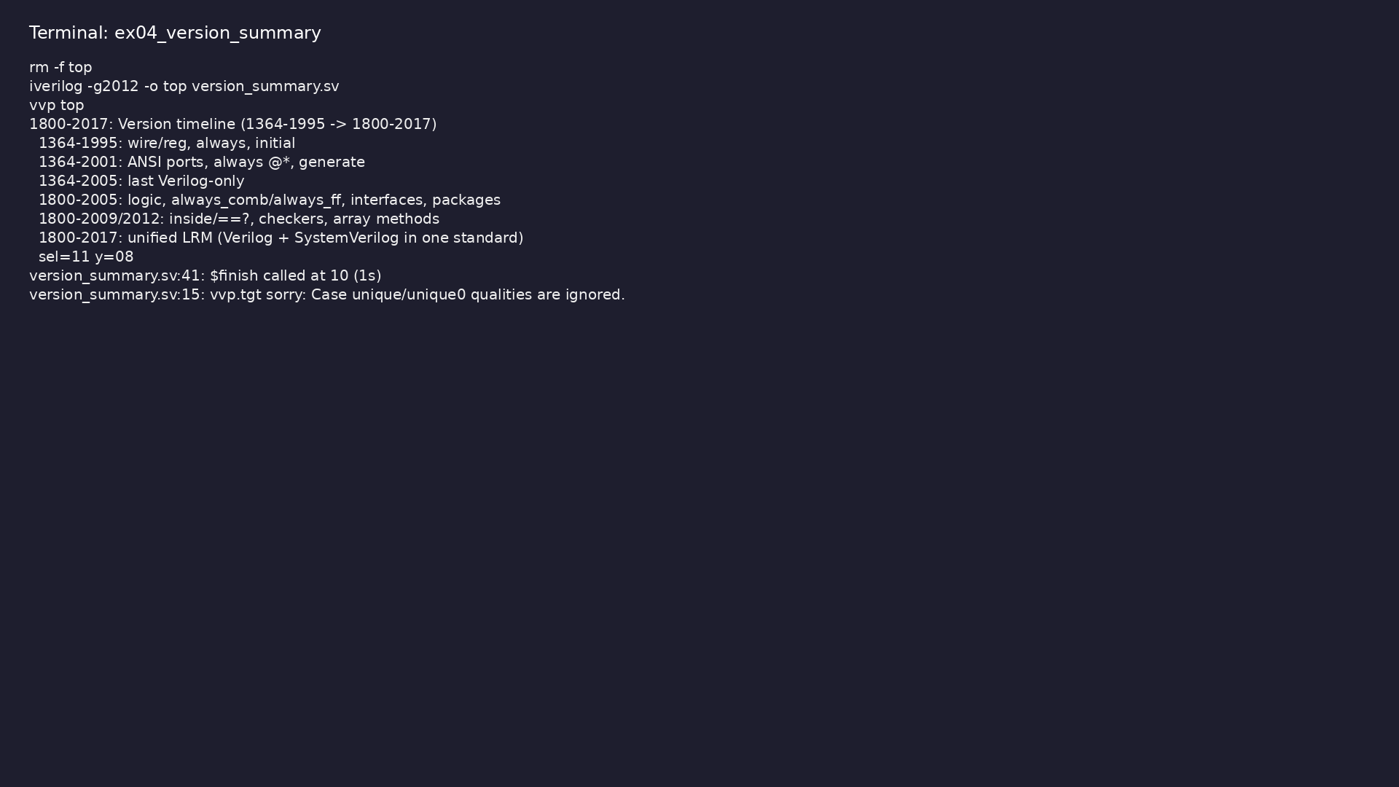
Demo: Table or script that lists which construct belongs to which sta…
$ cd module6/examples/version_summary && make clean && make run
learn_verilog_systemverilog / Module 6
Notes:
Hands-on: module6/examples/version_summary/

Slide 76
Example 5: Same 4:1 mux in 1364-2005 style vs 1800-2017 style (wire/r…
• Step-by-step migration from 1364 to 1800 design
subset
learn_verilog_systemverilog / Module 6
Notes:
module6/examples/migration/README.md

Slide 77
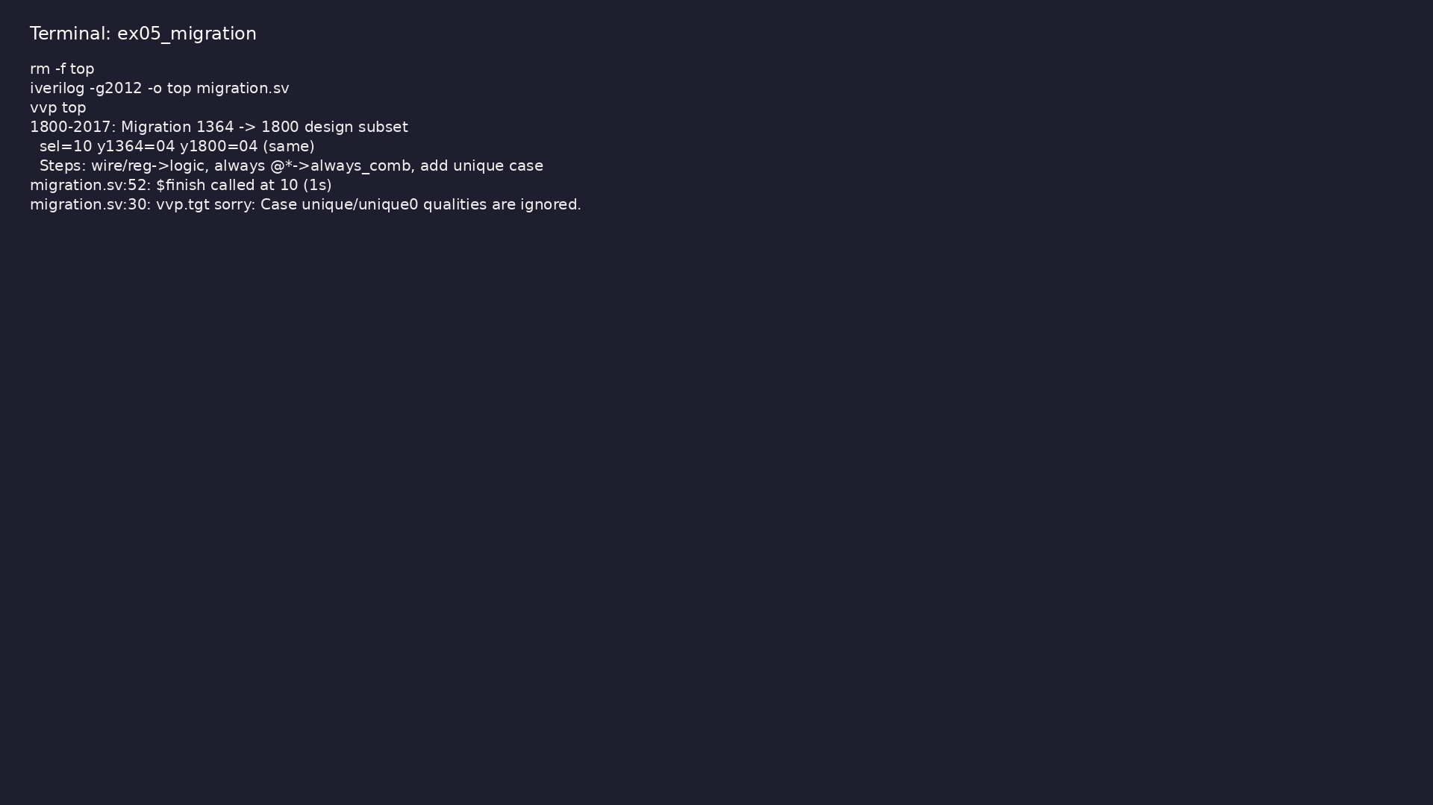
Demo: Same 4:1 mux in 1364-2005 style vs 1800-2017 style (wire/reg→lo…
$ cd module6/examples/migration && make clean && make run
learn_verilog_systemverilog / Module 6
Notes:
Hands-on: module6/examples/migration/

Slide 78
Example 6: Comb and seq blocks; each logic has exactly one driver (20…
• Single driver for logic; assign, always_comb,
always_ff
learn_verilog_systemverilog / Module 6
Notes:
module6/examples/logic_single_driver/README.md

Slide 79
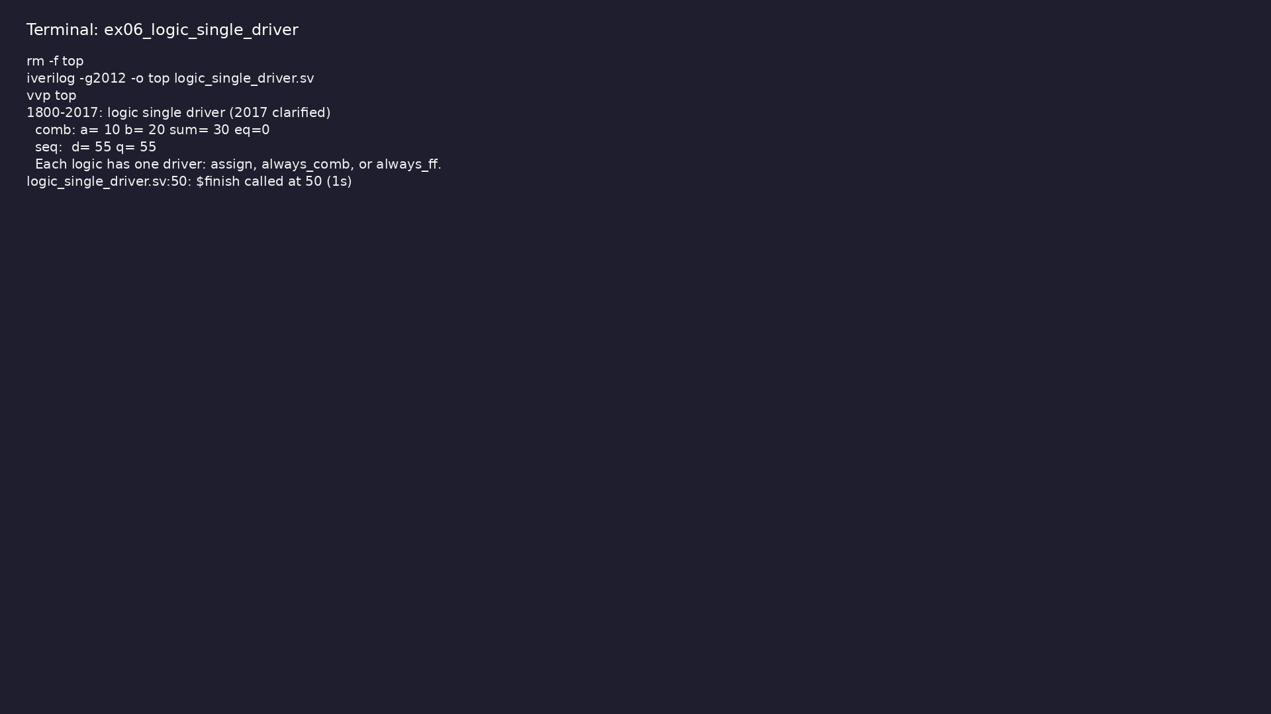
Demo: Comb and seq blocks; each logic has exactly one driver (2017 cl…
$ cd module6/examples/logic_single_driver && make clean && make run
learn_verilog_systemverilog / Module 6
Notes:
Hands-on: module6/examples/logic_single_driver/

Slide 80
Example 7: Priority encoder using priority case (first match wins)
• priority case; 2017 semantics for encoders/arbiters
learn_verilog_systemverilog / Module 6
Notes:
module6/examples/priority_case/README.md

Slide 81
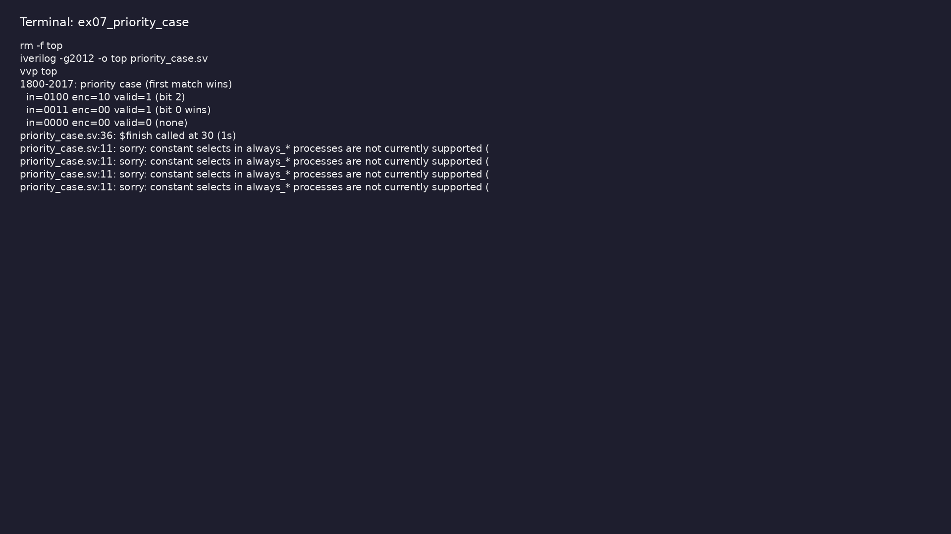
Demo: Priority encoder using priority case (first match wins)
$ cd module6/examples/priority_case && make clean && make run
learn_verilog_systemverilog / Module 6
Notes:
Hands-on: module6/examples/priority_case/

Slide 82
Example 8: Shared types and parameters in package; import in module a…
• Package and import; 2017 scope and search order
clarifications
learn_verilog_systemverilog / Module 6
Notes:
module6/examples/package_import/README.md

Slide 83
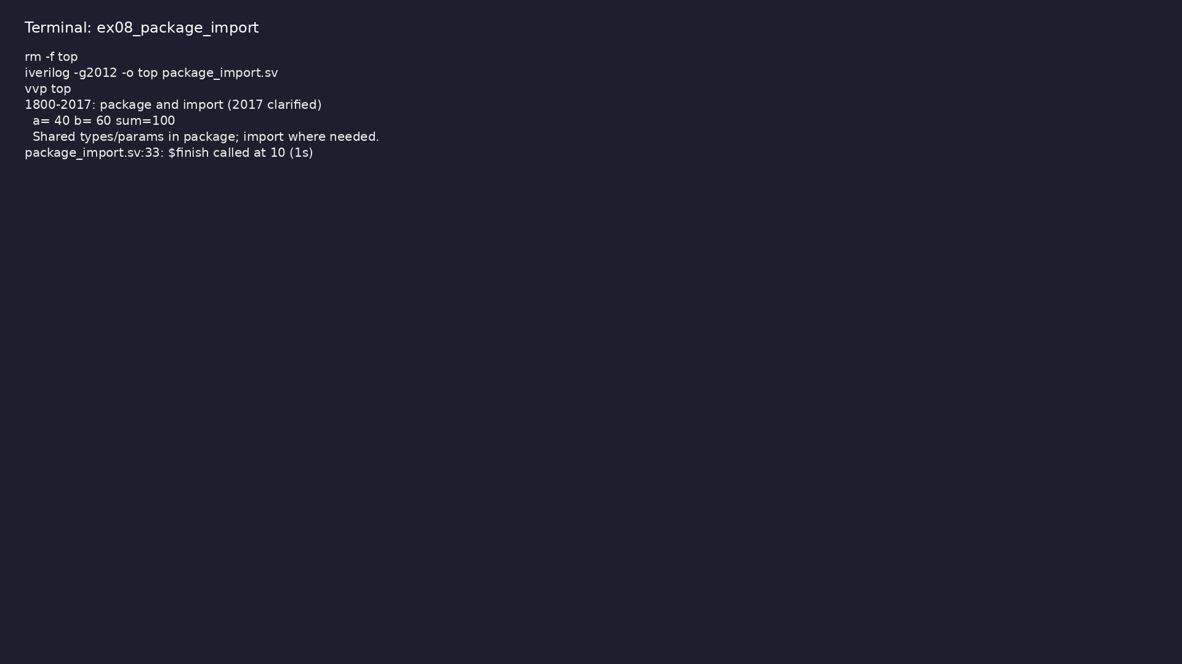
Demo: Shared types and parameters in package; import in module and top
$ cd module6/examples/package_import && make clean && make run
learn_verilog_systemverilog / Module 6
Notes:
Hands-on: module6/examples/package_import/

Slide 84
Example 9: Decoder with unique case and default (no latch)
• unique case; at most one match; 2017 clarified
learn_verilog_systemverilog / Module 6
Notes:
module6/examples/unique_case/README.md

Slide 85
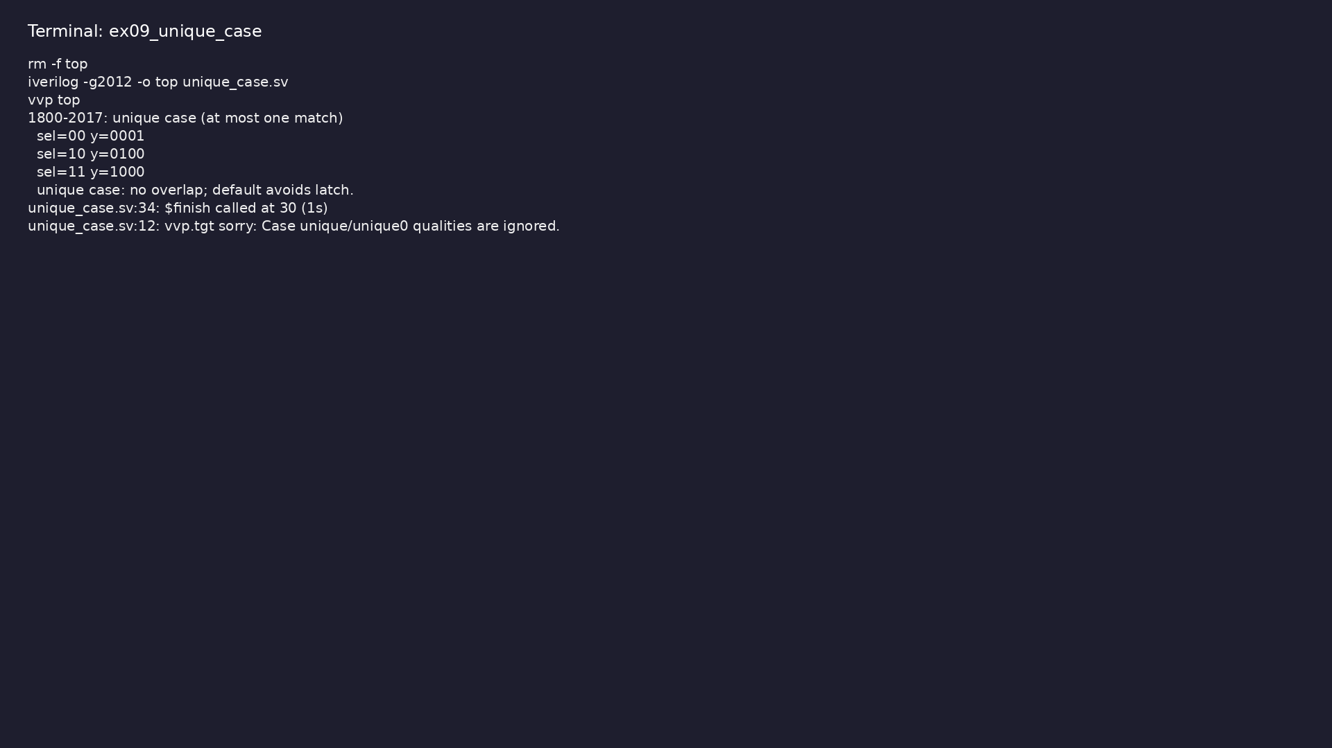
Demo: Decoder with unique case and default (no latch)
$ cd module6/examples/unique_case && make clean && make run
learn_verilog_systemverilog / Module 6
Notes:
Hands-on: module6/examples/unique_case/

Slide 86
Common pitfalls
learn_verilog_systemverilog / Module 6

Slide 87
Assuming 1364 Is Still a Separate Standard
• Mistake: Citing "IEEE 1364-2005" as the current
Verilog standard for new designs.
• Reality: 1364 is merged into 1800-2017; new work
should reference 1800-2017 (and use a subset if Ve…
• Correct: Use "1800-2017" as the reference; say
"Verilog subset of 1800-2017" when restricting to
no…
• Why: Avoids confusion and ensures one LRM for all
language questions.
learn_verilog_systemverilog / Module 6
Notes:
From MODULE6 Common Pitfalls.

Slide 88
Mixing Revisions in One Project
• Mistake: Using 1800-2017 in one file and
1800-2005-only in another without a clear subset
rule.
• Reality: Can lead to tool-dependent behavior or
subtle bugs.
• Correct: Define one project standard (e.g.
1800-2017) and a subset (e.g. design only, no SVA in
RTL…
• Why: Predictable tool behavior and easier
maintenance.
learn_verilog_systemverilog / Module 6
Notes:
From MODULE6 Common Pitfalls.

Slide 89
Ignoring Tool Support
• Mistake: Writing 1800-2017 syntax that the synthesis
or simulation tool does not support.
• Reality: Compile or elaboration errors; or tool-
specific interpretation.
• Correct: Check tool documentation for supported LRM
revision and synthesizable subset; restrict cod…
• Why: Ensures portability and correct results.
learn_verilog_systemverilog / Module 6
Notes:
From MODULE6 Common Pitfalls.

Slide 90
Assertions in Synthesis
• Mistake: Expecting concurrent assertions or complex
checkers to be synthesized.
• Reality: Most assertion/checker logic is for
simulation and formal; not for netlist.
• Correct: Use immediate assertions for simple
invariants if the tool supports them in RTL; keep
heav…
• Why: Synthesis tools typically ignore or strip
assertions; RTL should remain synthesizable.
learn_verilog_systemverilog / Module 6
Notes:
From MODULE6 Common Pitfalls.

Slide 91
Over-Migrating Legacy Code
• Mistake: Converting all legacy 1364 RTL to 1800
(logic, interfaces, etc.) without need.
• Reality: Risk of introducing bugs; effort may not
pay off if the block is stable and Verilog-only i…
• Correct: Migrate when adding features, fixing bugs,
or when the project standard moves to 1800; oth…
• Why: Balance benefit (readability, tool checking)
with risk and effort.
learn_verilog_systemverilog / Module 6
Notes:
From MODULE6 Common Pitfalls.

Slide 92
Practice & assessment
learn_verilog_systemverilog / Module 6

Slide 93
What you should know
• ✓ Describe IEEE 1800-2017 as the unified LRM
(Verilog + SystemVerilog in one standard)
• ✓ Explain "Verilog" as a subset of 1800-2017 and
when to use Verilog-only vs SystemVerilog design
• ✓ Recap design constructs (logic,
always_comb/always_ff, interfaces, packages,
unique/priority case…
• ✓ Use immediate assertions in RTL appropriately;
understand SVA/checker context
• ✓ Summarize the version timeline (1364-1995 through
1800-2017) and choose a standard for a project
• ✓ Plan simple migration from older Verilog or
SystemVerilog to 1800-2017
learn_verilog_systemverilog / Module 6
Notes:
From MODULE6 Learning Outcomes.

Slide 94
Exercises
• Subset Comparison
• 1800-2017 Design Checklist
• Immediate Assertion
• Version Table
• Migration Plan
learn_verilog_systemverilog / Module 6

Slide 95
Exercises
• Assuming 1364 Is Still a Separate Standard
• Mixing Revisions in One Project
• Ignoring Tool Support
• Assertions in Synthesis
• Over-Migrating Legacy Code
learn_verilog_systemverilog / Module 6

Slide 96
Summary & next steps
• Master the current SystemVerilog standard (IEEE
1800-2017): unified LRM, merged Verilog and SystemV…
• Complete module6/CHECKLIST.md
• Review module6/EXAMPLES.md and run each lab
• Next: Next module in course
learn_verilog_systemverilog / Module 6

