Slide 1
Module 7
Version Comparison and Migration
learn_verilog_systemverilog / Module 7

Slide 2
Learning objectives
• Compare Verilog and SystemVerilog across IEEE
versions side-by-side, plan migration between
standar…
learn_verilog_systemverilog / Module 7

Slide 3
Prerequisites
• See module README
learn_verilog_systemverilog / Module 7

Slide 4
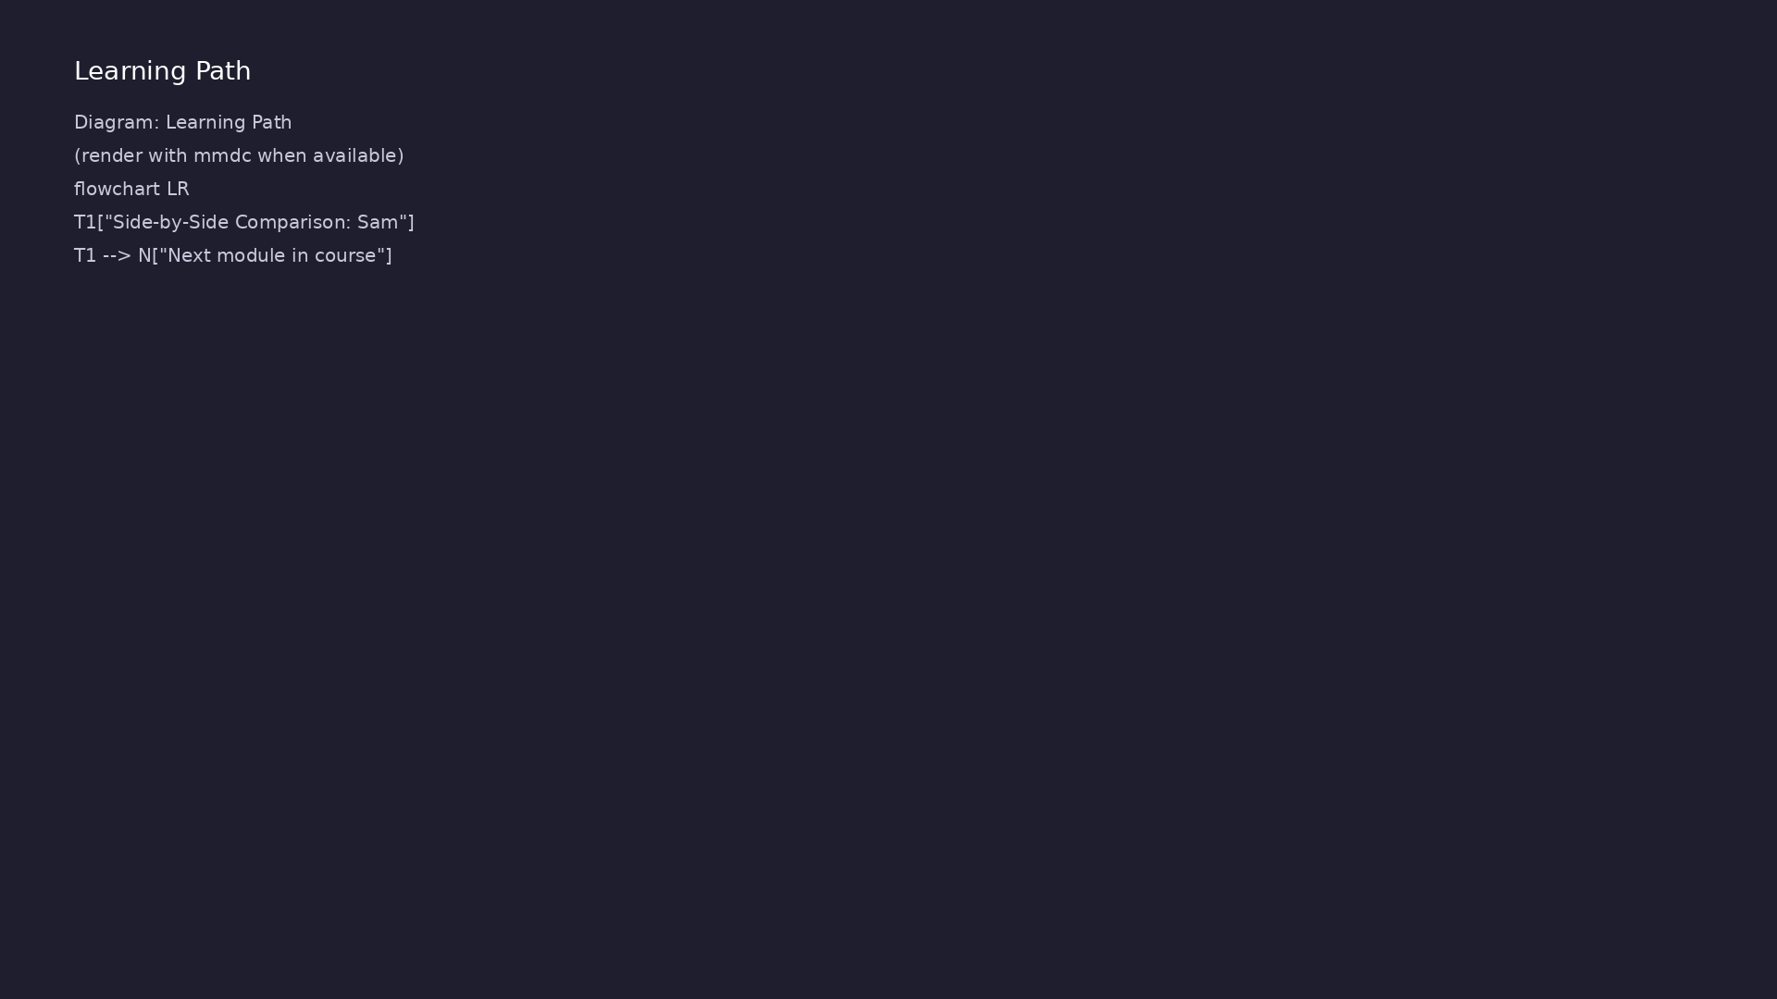
Learning path
Compare Verilog and SystemVerilog across IEEE versions side-by-side, plan migration between standards, and choose the right version for...
learn_verilog_systemverilog / Module 7

Slide 5
Overview
• This module ties together Modules 1–6 by comparing
the same design across standards (1364-1995 thro…
learn_verilog_systemverilog / Module 7

Slide 6
How to learn this module
learn_verilog_systemverilog / Module 7

Slide 7
Suggested learning path (1/2)
• Skim this document — Goal, Overview, and Topics
Covered set the IEEE scope for Module 7.
• Study design architecture — See how DUTs, examples,
and testbenches fit together under `module7/`.
• Work through labs in order — Open
`module7/EXAMPLES.md` and run each `make clean &&
make run` from…
• Run the full module script — `./scripts/module7.sh`
from the repo root to simulate all examples and…
• Complete the exercises — Try each exercise in this
document before reading solutions or peeking at…
learn_verilog_systemverilog / Module 7
Notes:
From docs/MODULE7.md — read guides before running demos.

Slide 8
Suggested learning path (2/2)
• Compare side-by-side — Open 1364 and 1800 versions
of the same design and note port style, types, a…
• Review Common Pitfalls — Can you explain each
mistake and the fix?
• Self-check — Use `module7/CHECKLIST.md` before
starting the next module.
learn_verilog_systemverilog / Module 7
Notes:
From docs/MODULE7.md — read guides before running demos.

Slide 9
Design architecture
learn_verilog_systemverilog / Module 7

Slide 10
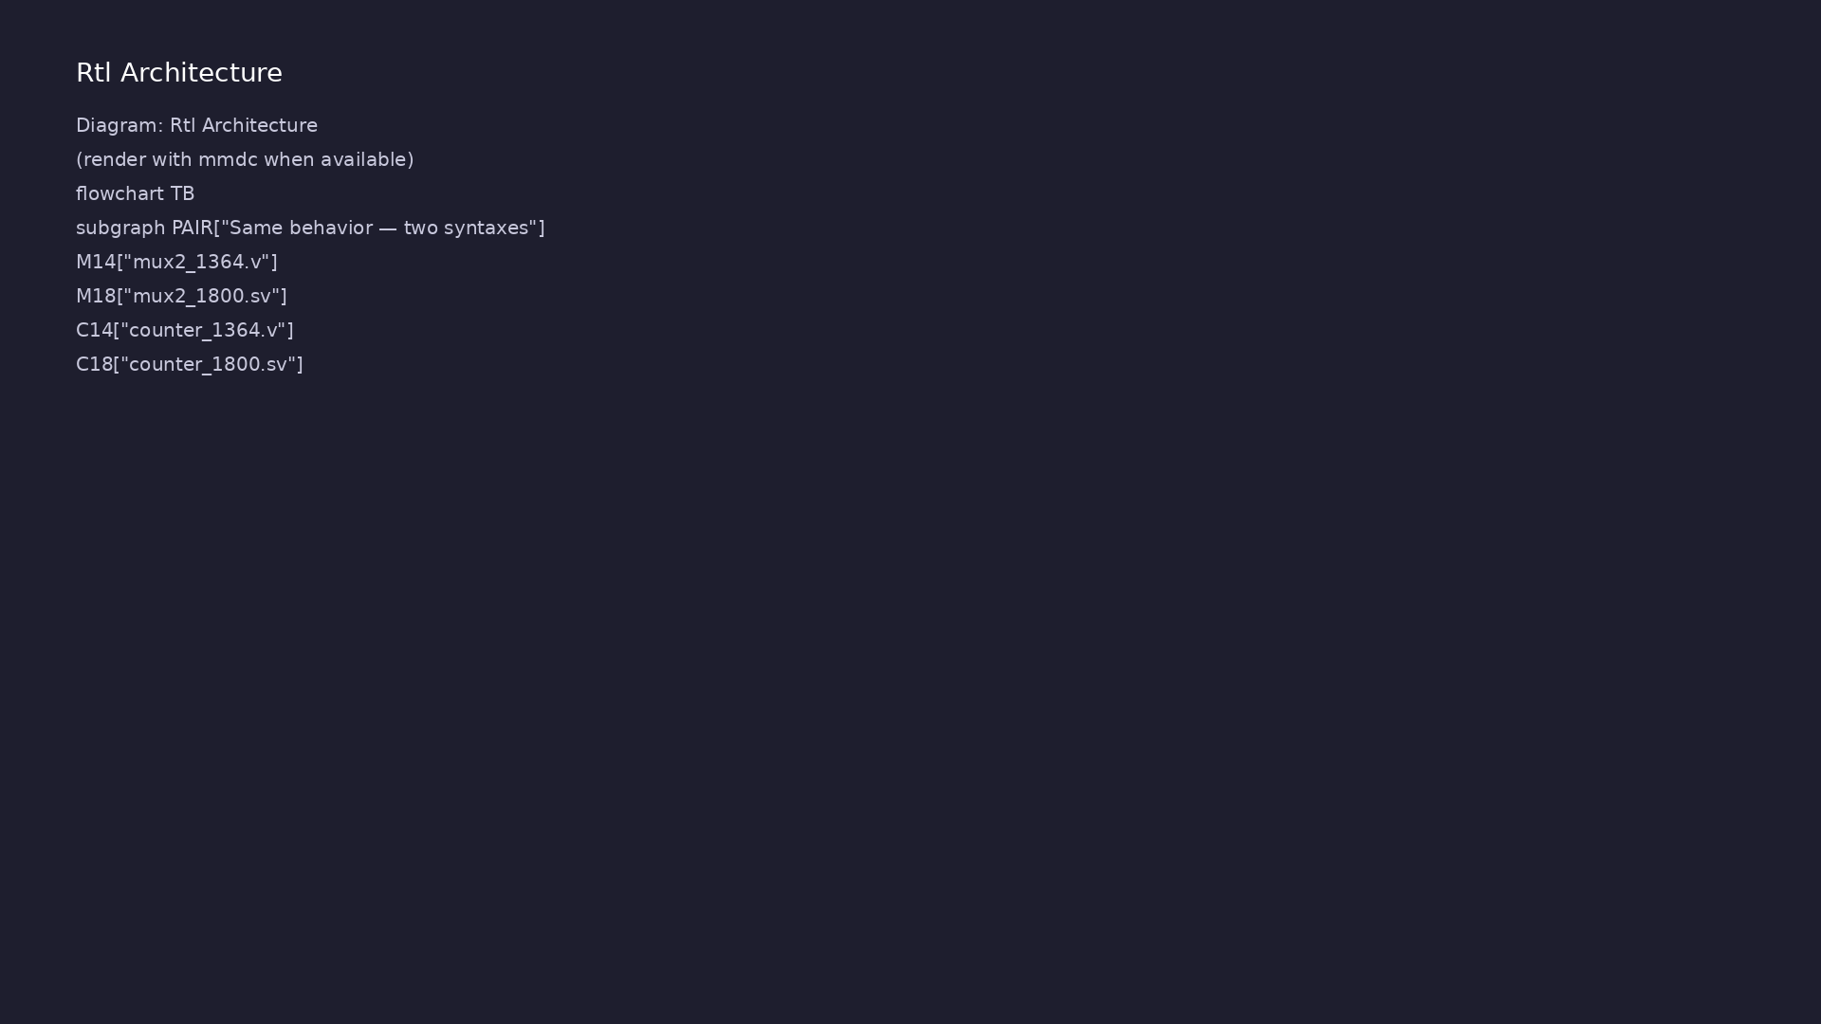
1. Repository layout (module7/) (1/2)
• Side-by-side 1364 vs 1800
versions of the same designs
• module7/dut/ — mux2_1364.v and
mux2_1800.sv for direct
comparison
• examples/side_by_side/ —
decoder, counter, FSM migration
pairs
• examples/migration/ — step-by-
step 1995 → 2017 patterns
learn_verilog_systemverilog / Module 7
Notes:
From MODULE7 Design Architecture.

Slide 11
1. Repository layout (module7/) (2/2)
• scripts/module7.sh — runs comparison and migration
labs
learn_verilog_systemverilog / Module 7
Notes:
From MODULE7 Design Architecture.

Slide 12
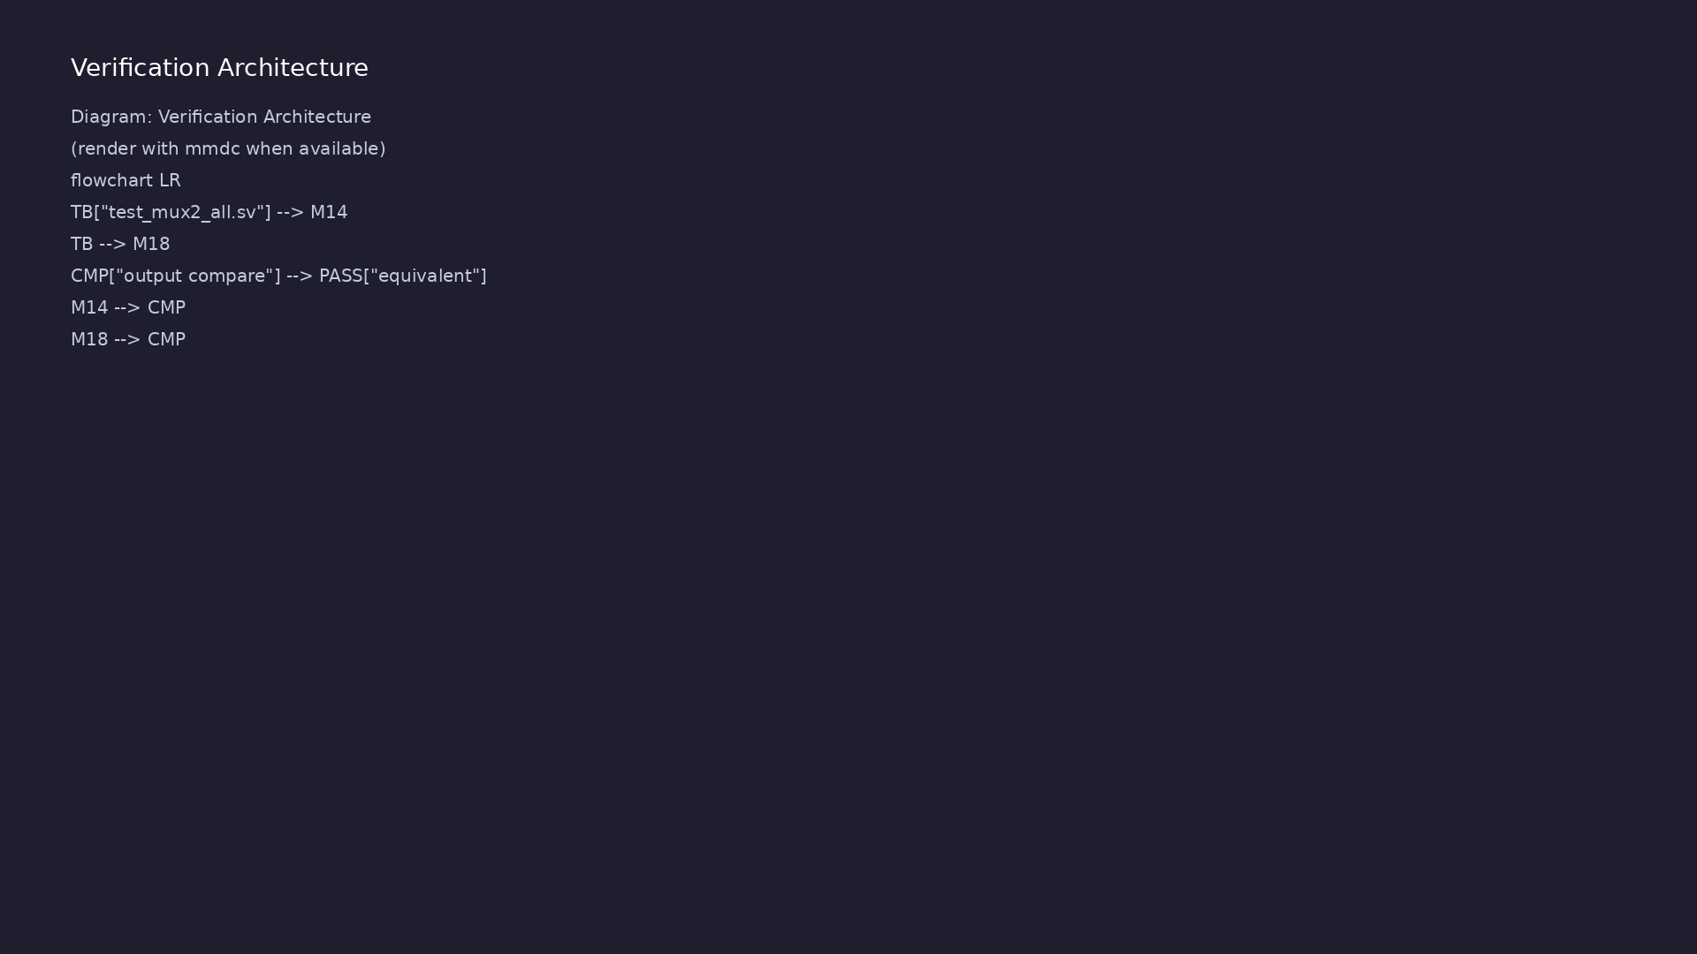
2. Side-by-side comparison architecture
• Same behavior, different syntax
— ports, types, procedural
blocks
• 1364: wire/reg, always @(a or
b), many scalar ports
• 1800: logic, always_comb/ff,
optional interface for bus
bundles
• Testbench can instantiate both
versions and compare outputs
learn_verilog_systemverilog / Module 7
Notes:
From MODULE7 Design Architecture.

Slide 13
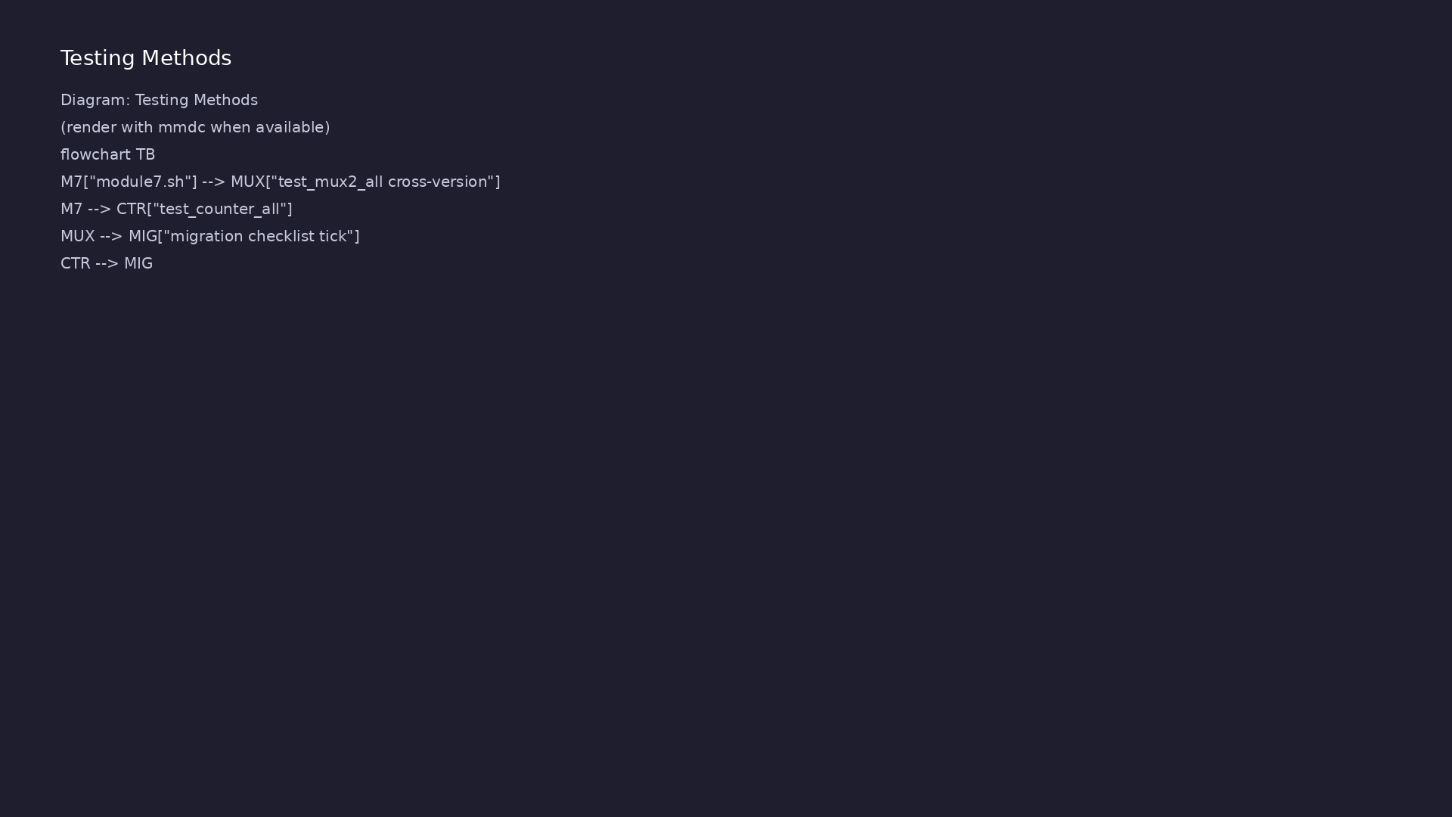
3. Migration workflow
• Inventory features used — match
to target standard checklist
• Migrate ports first (ANSI,
logic), then procedural blocks,
then connectivity
• Simulate after each step — do
not big-bang rewrite
• Document project standard and
tool support decision
learn_verilog_systemverilog / Module 7
Notes:
From MODULE7 Design Architecture.

Slide 14
RTL block diagram (reference)
Module 7: DUT hierarchy and signal flow.
learn_verilog_systemverilog / Module 7

Slide 15
Verification / testbench diagram (reference)
Module 7: stimulus, observation, and checking.
learn_verilog_systemverilog / Module 7

Slide 16
1364 mux — wire/reg and explicit sensitivity
module mux2_1995(a, b, sel, y);
input a, b, sel;
output y;
wire a, b, sel;
reg y;
always @(a or b or sel)
y = sel ? b : a;
endmodule
learn_verilog_systemverilog / Module 7

Slide 17
1800 mux — logic and always_comb
module mux2_1800 (
input logic a, b, sel,
output logic y
);
always_comb y = sel ? b : a;
endmodule
learn_verilog_systemverilog / Module 7

Slide 18
Execution & simulation flow
learn_verilog_systemverilog / Module 7

Slide 19
How the example runs (toolchain)
• Makefile: Verilator compiles RTL + SystemVerilog
testbench into a C++ model
• sim_main.cpp: generates clk/rst_n, calls eval()
until $finish
• Directed test (initial block or C++): drive
stimulus, wait for DUT flags
• Self-check: compare outputs; print PASS/FAIL (see
terminal demo slide)
• Repo path: module7/examples/<example>/ — run make
run from that directory
learn_verilog_systemverilog / Module 7
Notes:
From MODULE7 — execution and artifact layout.

Slide 20
Key files to study
learn_verilog_systemverilog / Module 7

Slide 21
Open these in the repo
• module7/dut/mux2_1364.v and mux2_1800.sv
• module7/examples/side_by_side/mux2_versions/
• module7/examples/migration_checklist/
• module7/examples/incremental_migration/
• scripts/module7.sh
learn_verilog_systemverilog / Module 7
Notes:
Trace while running module7/EXAMPLES.md labs.

Slide 22
Verification & testing methods
learn_verilog_systemverilog / Module 7

Slide 23
1. Comparison test execution
• test_mux2_all.sv — same stimulus
on 1364 and 1800 mux; compare y
• test_counter_all.sv —
reset/enable/wrap behavior must
match
• ./scripts/module7.sh runs all
migration and comparison
examples
learn_verilog_systemverilog / Module 7
Notes:
From MODULE7 Verification & Testing Methods.

Slide 24
2. Migration validation
• After each migration step: make
run must pass with identical
outputs
• Use migration_checklist example
as a template for real projects
learn_verilog_systemverilog / Module 7
Notes:
From MODULE7 Verification & Testing Methods.

Slide 25
Migration checklist pattern
/*
* Module 7: Migration checklist reminder (1364 -> 1800 design subset)
* Prints steps; full checklist in MODULE7.md.
*/
module top;
initial begin
$display("Module 7: Migration checklist (1364 -> 1800 design
subset)");
$display(" Pre: target standard, baseline sim/synth, list
files/hierarchy");
$display(" Per-module: ports wire/reg->logic, @*->always_comb,
posedge clk->always_ff");
$display(" Per-module: case->unique/priority case, optional
interface/package, no defparam");
$display(" Post: full regression, update style guide, document
1364-only blocks");
$display(" See MODULE7.md for full migration checklist.");
learn_verilog_systemverilog / Module 7

Slide 26
Syllabus topics
learn_verilog_systemverilog / Module 7

Slide 27
Protocol & design details
learn_verilog_systemverilog / Module 7

Slide 28
1. Side-by-Side Comparison: Same Design Across Versions
• Example: 2:1 Multiplexer
• What Changes Across Versions
learn_verilog_systemverilog / Module 7
Notes:
From MODULE7 Topics Covered.

Slide 29
Hands-on examples
learn_verilog_systemverilog / Module 7

Slide 30
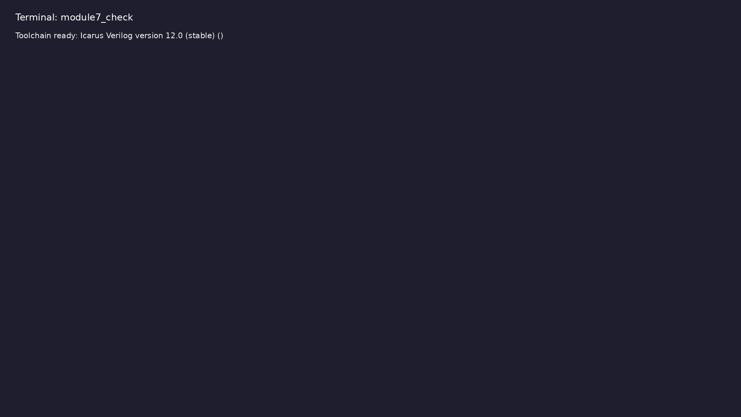
Module 7 toolchain check
$ command -v iverilog >/dev/null && echo "Toolchain ready: $(iverilog
-V 2>&1 | head -1)"
learn_verilog_systemverilog / Module 7
Notes:
Requires iverilog on PATH (apt install iverilog).

Slide 31
Example 1: Same 2:1 mux in 1364-1995, 1364-2001, 1364-2005, 1800-2005…
• Port style, type, procedural block, one driver
learn_verilog_systemverilog / Module 7
Notes:
module7/examples/side_by_side/README.md

Slide 32
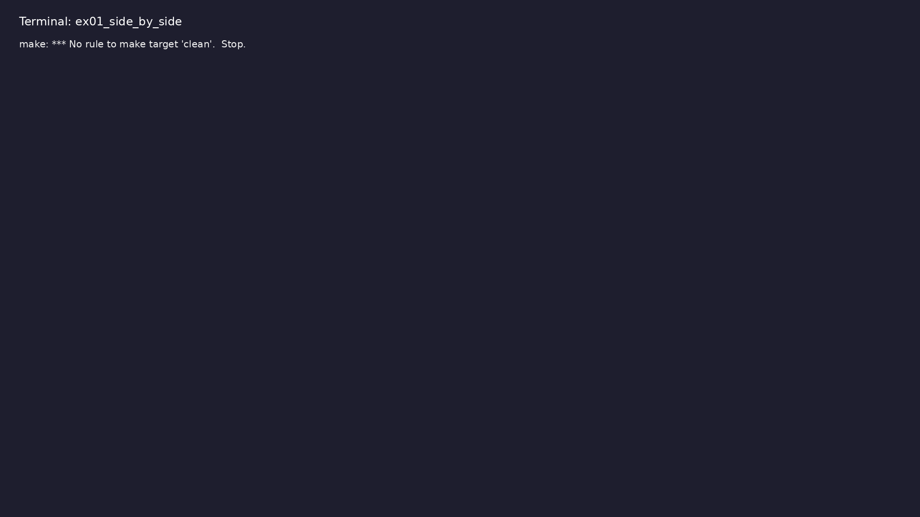
Demo: Same 2:1 mux in 1364-1995, 1364-2001, 1364-2005, 1800-2005 (and…
$ cd module7/examples/side_by_side && make clean && make run
learn_verilog_systemverilog / Module 7
Notes:
Hands-on: module7/examples/side_by_side/

Slide 33
Example 2: Same counter in 1995, 2001, 2005, 1800-2005
• Sequential block, reset, parameter/localparam
learn_verilog_systemverilog / Module 7
Notes:
module7/examples/side_by_side/README.md

Slide 34

Demo: Same counter in 1995, 2001, 2005, 1800-2005
$ cd module7/examples/side_by_side && make clean && make run
learn_verilog_systemverilog / Module 7
Notes:
Hands-on: module7/examples/side_by_side/

Slide 35
Example 3: Same 2:4 decoder in 1995, 2001, 2005, 1800; case vs unique…
• Port style, always @(sel) vs @* vs always_comb,
unique case
learn_verilog_systemverilog / Module 7
Notes:
module7/examples/side_by_side/README.md

Slide 36

Demo: Same 2:4 decoder in 1995, 2001, 2005, 1800; case vs unique case
$ cd module7/examples/side_by_side && make clean && make run
learn_verilog_systemverilog / Module 7
Notes:
Hands-on: module7/examples/side_by_side/

Slide 37
Example 4: Same 8-bit adder in 1995, 2001, 2005, 1800 (continuous ass…
• wire vs logic; assign unchanged across versions
learn_verilog_systemverilog / Module 7
Notes:
module7/examples/side_by_side/README.md

Slide 38

Demo: Same 8-bit adder in 1995, 2001, 2005, 1800 (continuous assign)
$ cd module7/examples/side_by_side && make clean && make run
learn_verilog_systemverilog / Module 7
Notes:
Hands-on: module7/examples/side_by_side/

Slide 39
Example 5: Same parameterized shift in 1364 (parameter/localparam) vs…
• parameter int, localparam int; same behavior
learn_verilog_systemverilog / Module 7
Notes:
module7/examples/side_by_side/README.md

Slide 40

Demo: Same parameterized shift in 1364 (parameter/localparam) vs 1800…
$ cd module7/examples/side_by_side && make clean && make run
learn_verilog_systemverilog / Module 7
Notes:
Hands-on: module7/examples/side_by_side/

Slide 41
Example 6: Same master/slave connection: many ports (1364)
• Port list size, direction, reuse; interface (1800)
optional per tool
learn_verilog_systemverilog / Module 7
Notes:
module7/examples/side_by_side/README.md

Slide 42

Demo: Same master/slave connection: many ports (1364)
$ cd module7/examples/side_by_side && make clean && make run
learn_verilog_systemverilog / Module 7
Notes:
Hands-on: module7/examples/side_by_side/

Slide 43
Example 7: Before/after: wire/reg, always @* vs logic, always_comb, u…
• Order of steps, testing, regression
learn_verilog_systemverilog / Module 7
Notes:
module7/examples/migration/README.md

Slide 44
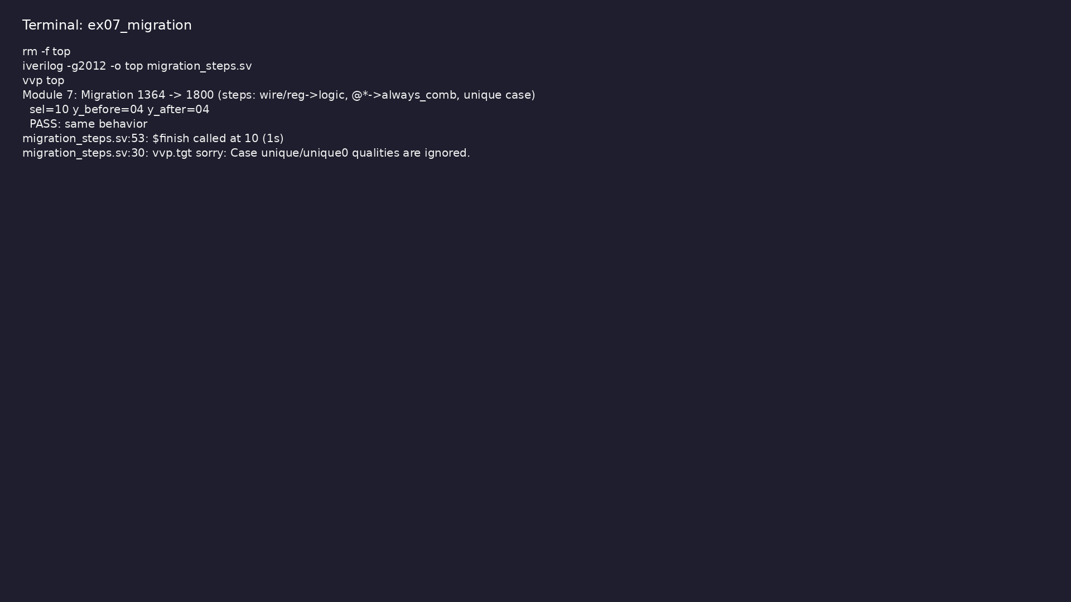
Demo: Before/after: wire/reg, always @* vs logic, always_comb, unique…
$ cd module7/examples/migration && make clean && make run
learn_verilog_systemverilog / Module 7
Notes:
Hands-on: module7/examples/migration/

Slide 45
Example 8: Before: non-ANSI, @(a or b or sel). After: ANSI, always @*
• ANSI ports, implicit sensitivity
learn_verilog_systemverilog / Module 7
Notes:
module7/examples/migration_1995_to_2001/README.md

Slide 46
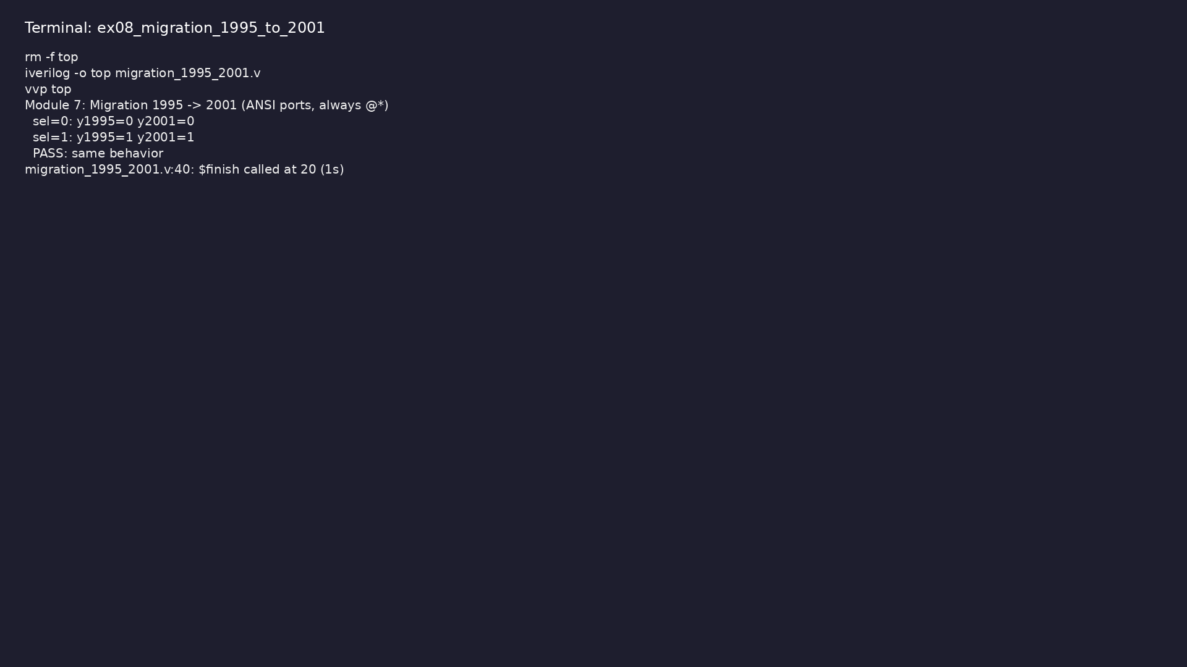
Demo: Before: non-ANSI, @(a or b or sel). After: ANSI, always @*
$ cd module7/examples/migration_1995_to_2001 && make clean && make run
learn_verilog_systemverilog / Module 7
Notes:
Hands-on: module7/examples/migration_1995_to_2001/

Slide 47
Example 9: Same 4:1 mux: 1364 case+default vs 1800 unique case
• case semantics; unique case for tool checking
learn_verilog_systemverilog / Module 7
Notes:
module7/examples/case_versions/README.md

Slide 48
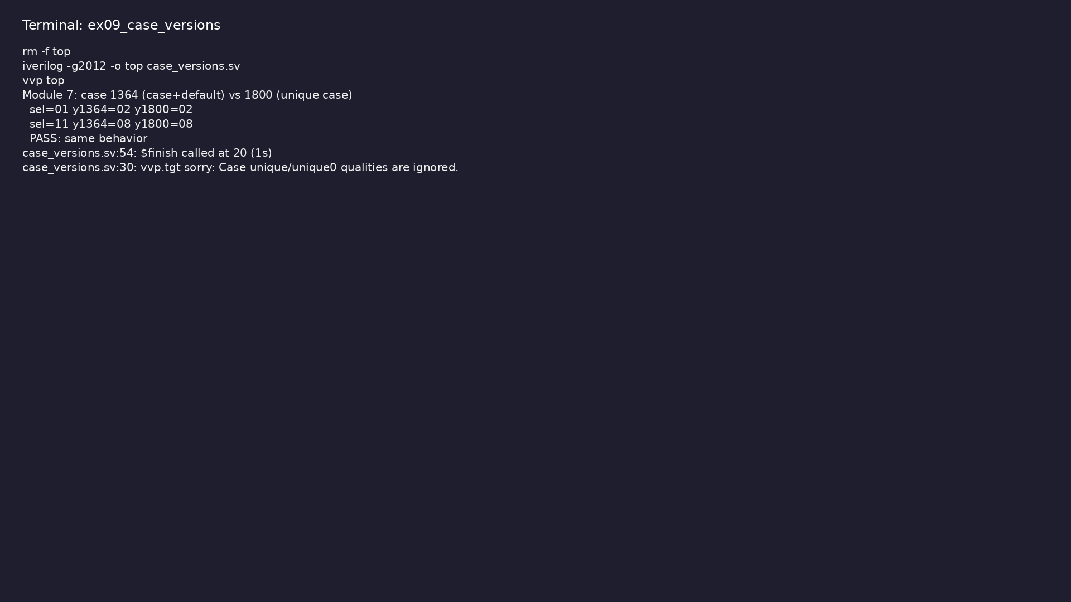
Demo: Same 4:1 mux: 1364 case+default vs 1800 unique case
$ cd module7/examples/case_versions && make clean && make run
learn_verilog_systemverilog / Module 7
Notes:
Hands-on: module7/examples/case_versions/

Slide 49
Example 10: Single reference: construct vs standard (1995–2017)
• When each feature was introduced; minimum revision
learn_verilog_systemverilog / Module 7
Notes:
module7/examples/version_table/README.md

Slide 50
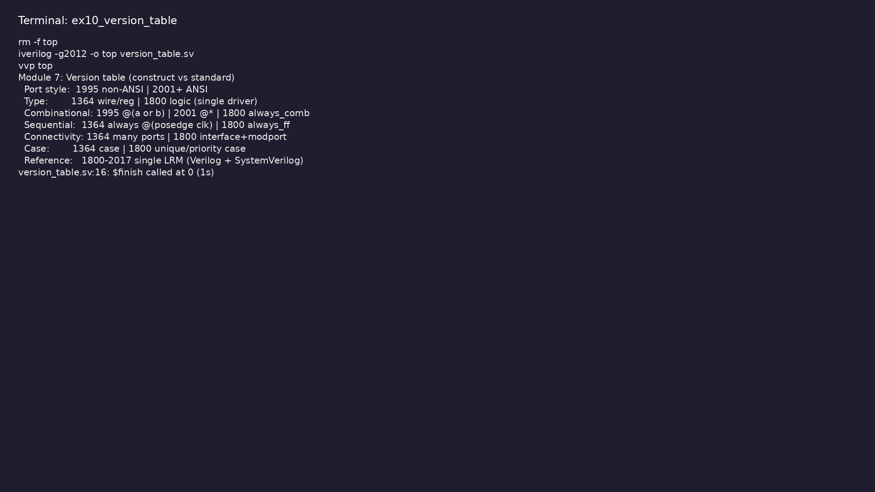
Demo: Single reference: construct vs standard (1995–2017)
$ cd module7/examples/version_table && make clean && make run
learn_verilog_systemverilog / Module 7
Notes:
Hands-on: module7/examples/version_table/

Slide 51
Example 11: Runnable reminder of version-selection checklist (constra…
• See MODULE7.md for full checklist
learn_verilog_systemverilog / Module 7
Notes:
module7/examples/version_selection/README.md

Slide 52
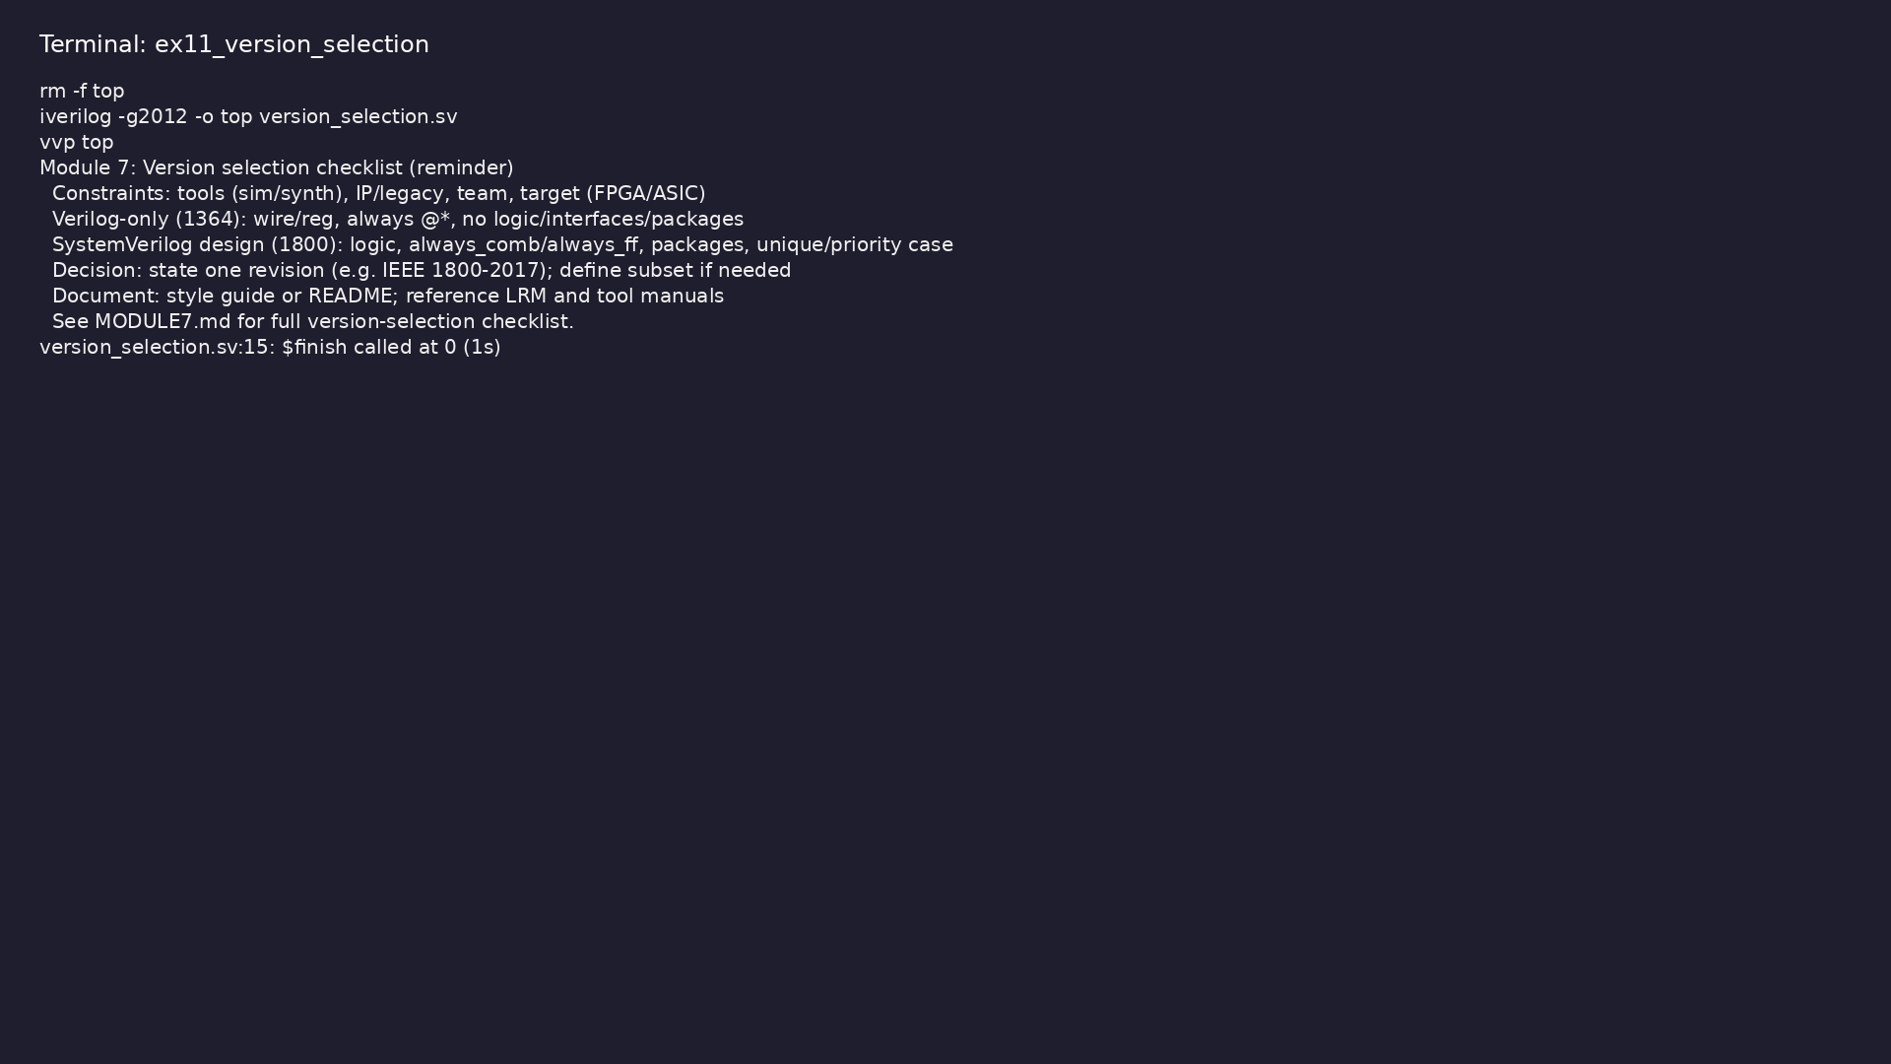
Demo: Runnable reminder of version-selection checklist (constraints,…
$ cd module7/examples/version_selection && make clean && make run
learn_verilog_systemverilog / Module 7
Notes:
Hands-on: module7/examples/version_selection/

Slide 53
Example 12: Same D flip-flop in 1995, 2001, 2005, 1800 (sequential bl…
• always @(posedge clk) vs always_ff; wire/reg vs
logic
learn_verilog_systemverilog / Module 7
Notes:
module7/examples/side_by_side/README.md

Slide 54

Demo: Same D flip-flop in 1995, 2001, 2005, 1800 (sequential block st…
$ cd module7/examples/side_by_side && make clean && make run
learn_verilog_systemverilog / Module 7
Notes:
Hands-on: module7/examples/side_by_side/

Slide 55
Example 13: Same tiny FSM in 1364 vs 1800 (case vs unique case, alway…
• Sequential FSM; 1800 always_ff and unique case
learn_verilog_systemverilog / Module 7
Notes:
module7/examples/side_by_side/README.md

Slide 56

Demo: Same tiny FSM in 1364 vs 1800 (case vs unique case, always_ff)
$ cd module7/examples/side_by_side && make clean && make run
learn_verilog_systemverilog / Module 7
Notes:
Hands-on: module7/examples/side_by_side/

Slide 57
Example 14: Runnable reminder of 1364→1800 migration steps (pre, per-…
• See MODULE7.md for full migration checklist
learn_verilog_systemverilog / Module 7
Notes:
module7/examples/migration_checklist/README.md

Slide 58
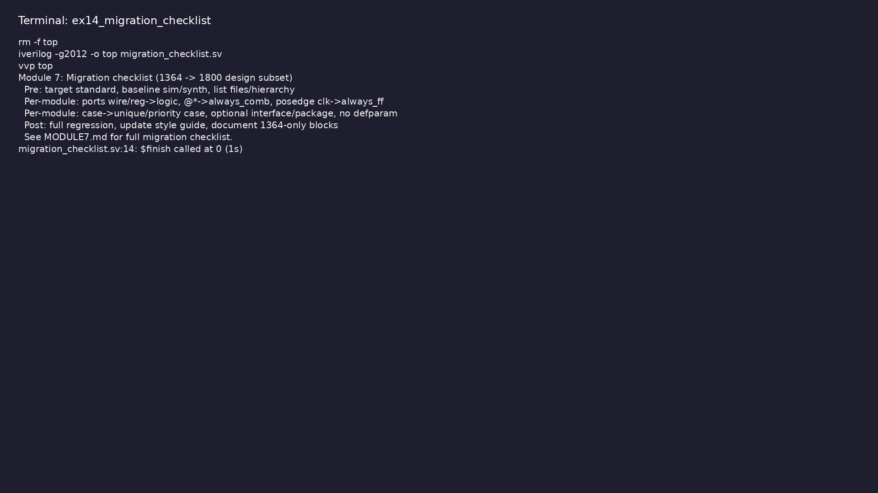
Demo: Runnable reminder of 1364→1800 migration steps (pre, per-module…
$ cd module7/examples/migration_checklist && make clean && make run
learn_verilog_systemverilog / Module 7
Notes:
Hands-on: module7/examples/migration_checklist/

Slide 59
Example 15: Two steps: step1 1364 style, step2 1800 style; same mux,…
• Migrate one construct at a time; test after each
step
learn_verilog_systemverilog / Module 7
Notes:
module7/examples/incremental_migration/README.md

Slide 60
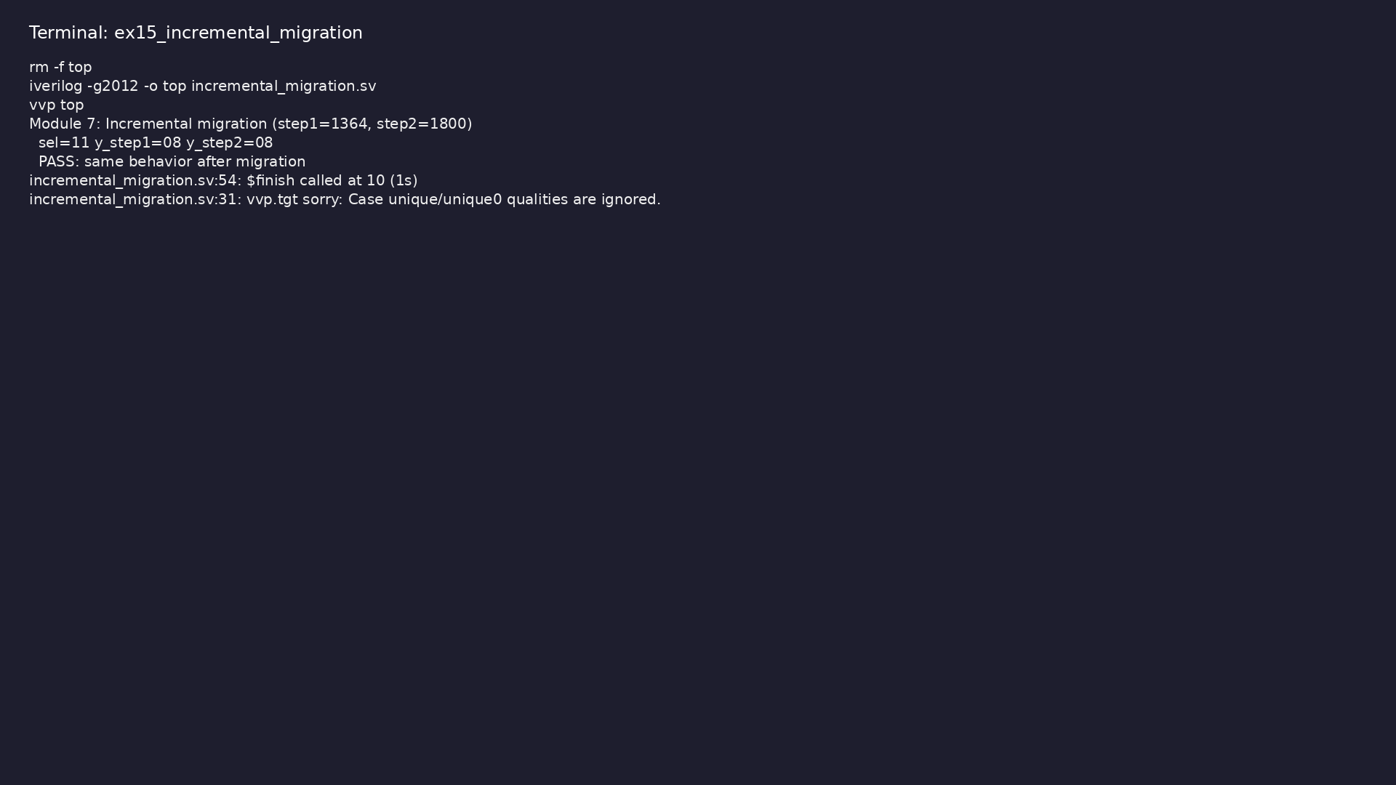
Demo: Two steps: step1 1364 style, step2 1800 style; same mux, compar…
$ cd module7/examples/incremental_migration && make clean && make run
learn_verilog_systemverilog / Module 7
Notes:
Hands-on: module7/examples/incremental_migration/

Slide 61
Example 16: Same 2:1 mux: non-ANSI (1995) vs ANSI (2001) ports only
• Port declaration style; no other change
learn_verilog_systemverilog / Module 7
Notes:
module7/examples/port_style_compare/README.md

Slide 62
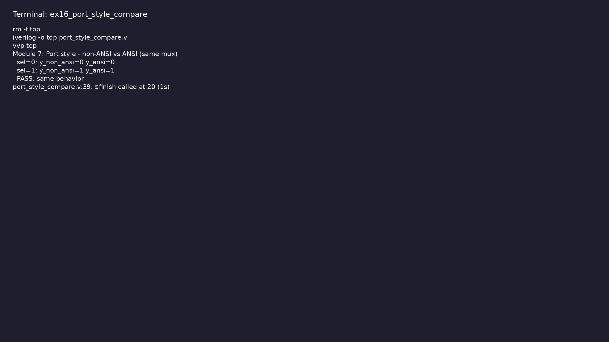
Demo: Same 2:1 mux: non-ANSI (1995) vs ANSI (2001) ports only
$ cd module7/examples/port_style_compare && make clean && make run
learn_verilog_systemverilog / Module 7
Notes:
Hands-on: module7/examples/port_style_compare/

Slide 63
Example 17: 1364-2005: parameter override at instantiation #(.WIDTH(n…
• defparam deprecated; use instantiation override
learn_verilog_systemverilog / Module 7
Notes:
module7/examples/no_defparam/README.md

Slide 64
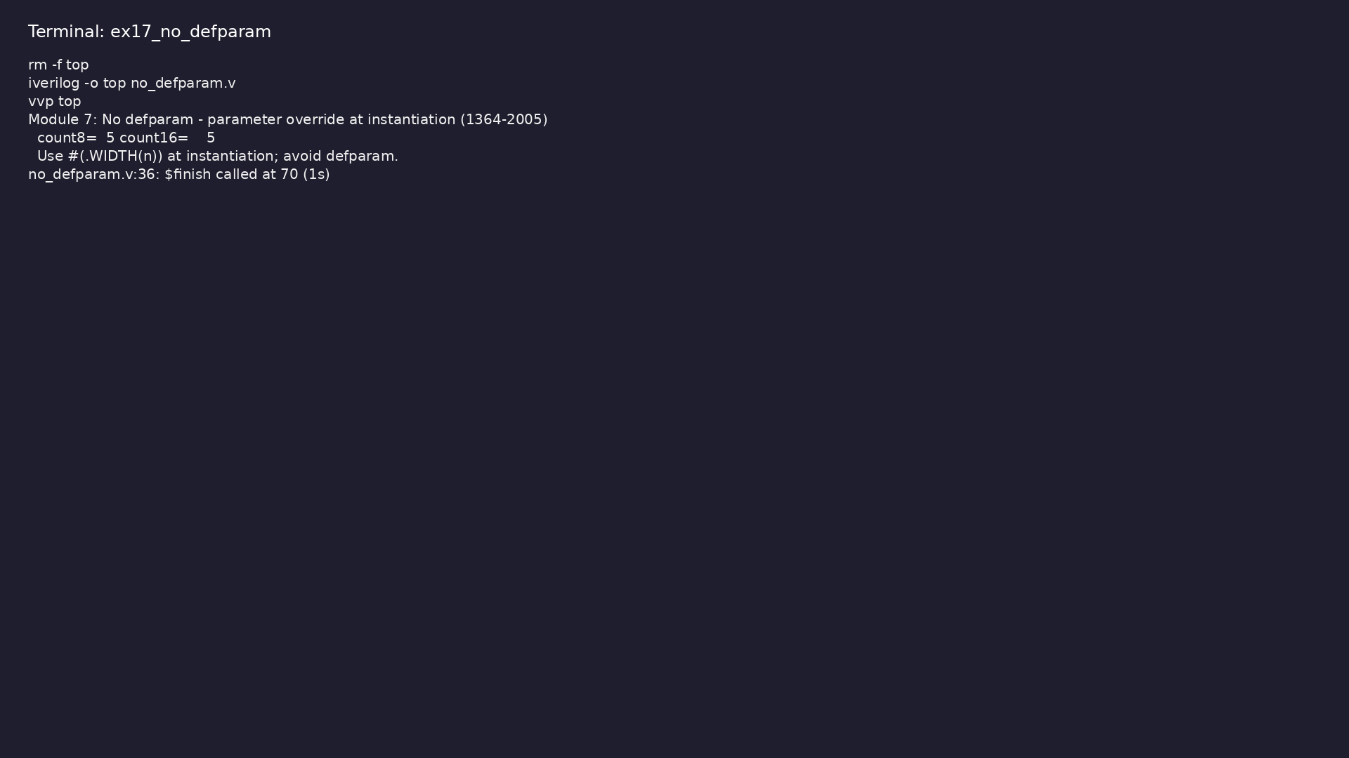
Demo: 1364-2005: parameter override at instantiation #(.WIDTH(n)); av…
$ cd module7/examples/no_defparam && make clean && make run
learn_verilog_systemverilog / Module 7
Notes:
Hands-on: module7/examples/no_defparam/

Slide 65
Common pitfalls
learn_verilog_systemverilog / Module 7

Slide 66
Migrating Everything at Once
• Mistake: Converting a large codebase from 1364 to
1800 in one big change.
• Reality: Hard to debug; regressions are difficult to
isolate.
• Correct: Migrate incrementally (one module or one
feature at a time); run regression after each ste…
• Why: Reduces risk and keeps a clear baseline.
learn_verilog_systemverilog / Module 7
Notes:
From MODULE7 Common Pitfalls.

Slide 67
Ignoring Tool Support
• Mistake: Choosing 1800-2017 and using constructs the
synthesis or simulator does not support.
• Reality: Compile or elaboration errors; or tool-
specific behavior.
• Correct: Check tool manuals for supported revision
and synthesizable subset; align RTL with that.
• Why: Ensures the project builds and matches tool
expectations.
learn_verilog_systemverilog / Module 7
Notes:
From MODULE7 Common Pitfalls.

Slide 68
Breaking Interfaces During Migration
• Mistake: Changing port list or interface of a block
while migrating its internals, so that other mo…
• Reality: Large ripple of changes; integration
failures.
• Correct: Keep external interface (ports or interface
modport) unchanged during internal migration;…
• Why: Limits scope of change and preserves
compatibility with rest of design.
learn_verilog_systemverilog / Module 7
Notes:
From MODULE7 Common Pitfalls.

Slide 69
Mixing Revisions in One File
• Mistake: Using 1995 ports in one module and 1800
logic in another in the same file without a clear…
• Reality: Confusing for readers and tools; possible
tool-dependent behavior.
• Correct: Use one project standard per file (or per
project); document the standard in the style gui…
• Why: Consistency and predictable tool behavior.
learn_verilog_systemverilog / Module 7
Notes:
From MODULE7 Common Pitfalls.

Slide 70
Forgetting to Test After Migration
• Mistake: Changing syntax (e.g. wire→logic, always
@*→always_comb) and not re-running simulation or…
• Reality: Subtle bugs (e.g. latch, wrong sensitivity)
can appear.
• Correct: Run full regression (simulation and
synthesis) after every migration step; compare with
ba…
• Why: Catches functional or synthesis differences
early.
learn_verilog_systemverilog / Module 7
Notes:
From MODULE7 Common Pitfalls.

Slide 71
Practice & assessment
learn_verilog_systemverilog / Module 7

Slide 72
What you should know
• ✓ Compare the same design across 1364-1995,
1364-2001, 1364-2005, and 1800 (design subset) and
list…
• ✓ Compare connectivity style: many ports (1364) vs
interface (1800)
• ✓ Plan and execute migration from 1364 to 1800
design subset (or between 1364 revisions) using the…
• ✓ Choose a project standard (revision and subset)
based on tool support and constraints
• ✓ Use the version-selection checklist for new or
existing projects
• ✓ Describe how to extend the course when a new IEEE
1800 revision is released
learn_verilog_systemverilog / Module 7
Notes:
From MODULE7 Learning Outcomes.

Slide 73
Exercises
• Side-by-Side Mux
• Side-by-Side Connectivity
• Migration One Block
• Version Selection
• Version Table
learn_verilog_systemverilog / Module 7

Slide 74
Exercises
• Migrating Everything at Once
• Ignoring Tool Support
• Breaking Interfaces During Migration
• Mixing Revisions in One File
• Forgetting to Test After Migration
learn_verilog_systemverilog / Module 7

Slide 75
Summary & next steps
• Compare Verilog and SystemVerilog across IEEE
versions side-by-side, plan migration between
standar…
• Complete module7/CHECKLIST.md
• Review module7/EXAMPLES.md and run each lab
• Next: Next module in course
learn_verilog_systemverilog / Module 7

