Slide 1
Module 8
Quick Reference and Course Summary
learn_verilog_systemverilog / Module 8

Slide 2
Learning objectives
• Provide a single quick reference and course summary
for Verilog and SystemVerilog across IEEE versi…
learn_verilog_systemverilog / Module 8

Slide 3
Prerequisites
• See module README
learn_verilog_systemverilog / Module 8

Slide 4
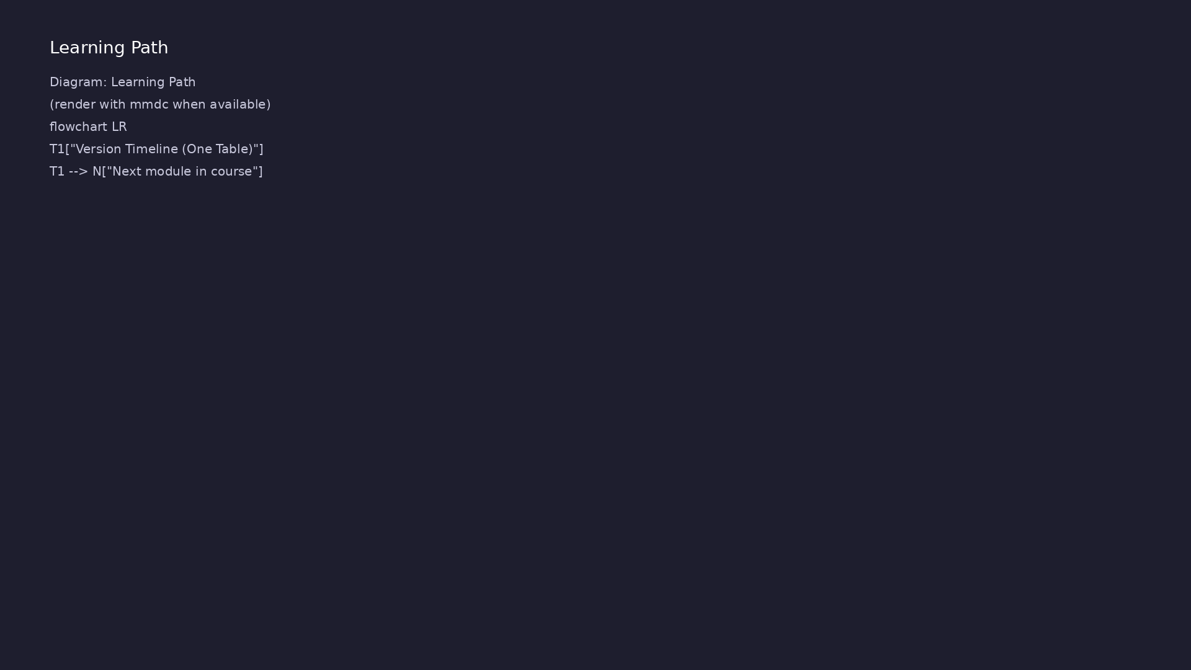
Learning path
Provide a single quick reference and course summary for Verilog and SystemVerilog across IEEE versions (1364-1995 through 1800-2017).
learn_verilog_systemverilog / Module 8

Slide 5
Overview
• This module is a **reference and summary** for the
version-centric Verilog/SystemVerilog course (Mo…
learn_verilog_systemverilog / Module 8

Slide 6
How to learn this module
learn_verilog_systemverilog / Module 8

Slide 7
Suggested learning path (1/2)
• Skim this document — Goal, Overview, and Topics
Covered set the IEEE scope for Module 8.
• Study design architecture — See how DUTs, examples,
and testbenches fit together under `module8/`.
• Work through labs in order — Open
`module8/EXAMPLES.md` and run each `make clean &&
make run` from…
• Run the full module script — `./scripts/module8.sh`
from the repo root to simulate all examples and…
• Complete the exercises — Try each exercise in this
document before reading solutions or peeking at…
learn_verilog_systemverilog / Module 8
Notes:
From docs/MODULE8.md — read guides before running demos.

Slide 8
Suggested learning path (2/2)
• Use as reference — Module 8 summarizes the full
course; run examples to print quick-reference slice…
• Review Common Pitfalls — Can you explain each
mistake and the fix?
• Self-check — Use `module8/CHECKLIST.md` before
starting the next module.
learn_verilog_systemverilog / Module 8
Notes:
From docs/MODULE8.md — read guides before running demos.

Slide 9
Design architecture
learn_verilog_systemverilog / Module 8

Slide 10
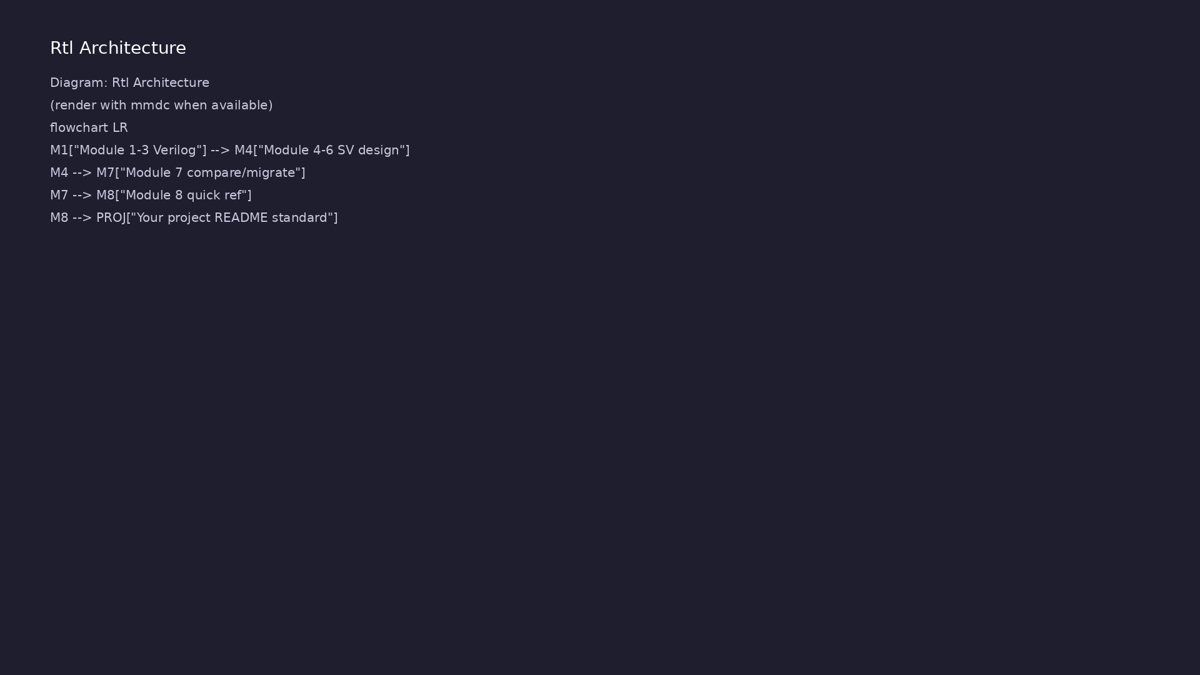
1. Reference module layout (module8/)
• No new language — consolidates
Modules 1–7 into quick-reference
tables
• examples/ print version
timelines, migration reminders,
tool notes
• Use after completing the course
or as a lookup during real
projects
• scripts/module8.sh — runs
reference printouts, not new RTL
lessons
learn_verilog_systemverilog / Module 8
Notes:
From MODULE8 Design Architecture.

Slide 11
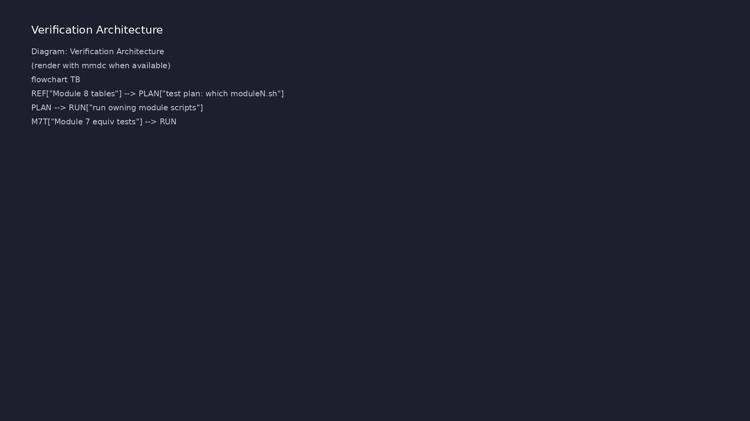
2. Course map architecture
• Module 1–3 — Verilog-only path
(1995, 2001, 2005)
• Module 4–6 — SystemVerilog
design path (2005, 2009/12,
2017)
• Module 7 — comparison and
migration between standards
• Module 8 — this reference layer
on top of the version stack
learn_verilog_systemverilog / Module 8
Notes:
From MODULE8 Design Architecture.

Slide 12
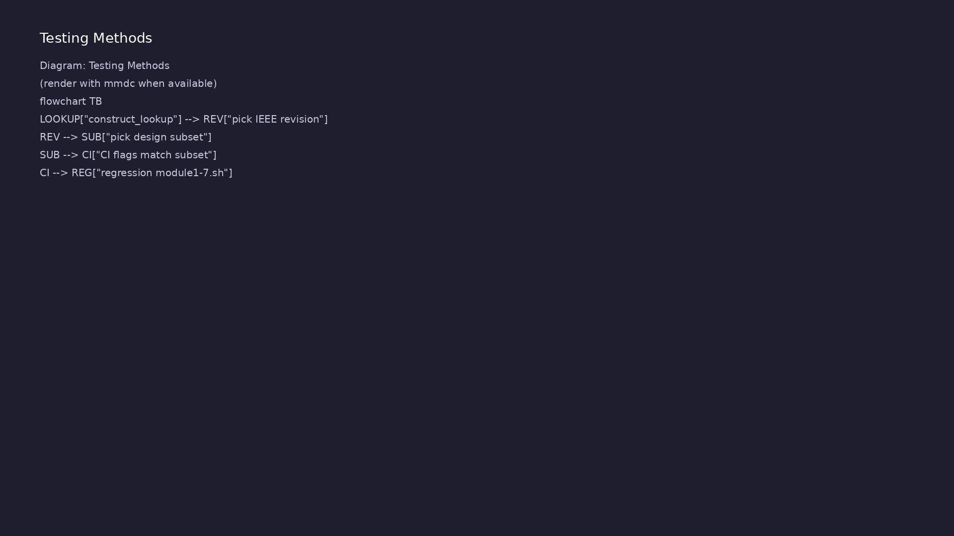
3. How reference examples execute
• Most labs $display tables or
cheat-sheet rows to stdout
• No new DUT hierarchy — output is
documentation you can grep
• Pair with docs/MODULE8.md for
full tables
learn_verilog_systemverilog / Module 8
Notes:
From MODULE8 Design Architecture.

Slide 13
One-page course map
/*
* Module 8: Course map - module number, title, content summary
* Reference only; see module8/docs/course_map.md for links.
*/
module top;
initial begin
$display("=== Module 8: Course map (Modules 1-8) ===");
$display(" 1 | IEEE 1364-1995 | Verilog-95: wire/reg,
assign, always/initial, explicit sensitivity");
$display(" 2 | IEEE 1364-2001 | ANSI ports, always @*,
generate, signed, arrays, localparam");
$display(" 3 | IEEE 1364-2005 | Clarifications,
synthesizable subset, defparam deprecated");
$display(" 4 | IEEE 1800-2005 | logic,
always_comb/always_ff, interfaces, packages, unique/priority case");
$display(" 5 | IEEE 1800-2009/12 | Interface refinements,
checkers, array/string methods, assertions");
learn_verilog_systemverilog / Module 8

Slide 14
Installation & execution
learn_verilog_systemverilog / Module 8

Slide 15
How to run this module
• From repo root: ./scripts/module8.sh --check —
validate environment
• ./scripts/module8.sh --demo — print demo commands to
run locally
• ./scripts/module8.sh --scaffold — create
~/unix_practice/ exercise files
• Open module8/EXAMPLES.md — run each numbered lab in
your terminal
• Track progress with module8/CHECKLIST.md before
moving on
learn_verilog_systemverilog / Module 8
Notes:
From MODULE8 — execution and artifact layout.

Slide 16
Key files to study
learn_verilog_systemverilog / Module 8

Slide 17
Open these in the repo
• docs/MODULE8.md — master reference tables
• module8/examples/version_timeline/
• module8/examples/migration_steps/
• module8/examples/course_map/
• scripts/module8.sh
learn_verilog_systemverilog / Module 8
Notes:
Trace while running module8/EXAMPLES.md labs.

Slide 18
Verification & testing methods
learn_verilog_systemverilog / Module 8

Slide 19
1. Using Module 8 as closure
• Run ./scripts/module8.sh once to
print all reference slices
• Cross-check “which standard has
X?” against printed tables
• Bookmark slides.pdf and
MODULE8.md for day-to-day lookup
learn_verilog_systemverilog / Module 8
Notes:
From MODULE8 Verification & Testing Methods.

Slide 20
2. When to re-run labs
• Re-run a specific Module 1–7
example when you need hands-on
refresh
• Module 8 examples confirm you
know where to find detail, not
replace it
learn_verilog_systemverilog / Module 8
Notes:
From MODULE8 Verification & Testing Methods.

Slide 21
Version timeline printer
/*
* Module 8: Version timeline - prints standard, year, role, module
* Reference only; see docs/MODULE8.md and module8/docs/
*/
module top;
initial begin
$display("=== Module 8: Version timeline ===");
$display(" 1364-1995 | 1995 | First Verilog; base language
| Module 1");
$display(" 1364-2001 | 2001 | ANSI, @*, generate, signed
| Module 2");
$display(" 1364-2005 | 2005 | Last Verilog-only; defparam
deprecated | Module 3");
$display(" 1800-2005 | 2005 | First SystemVerilog; logic,
always_comb/ff | Module 4");
$display(" 1800-2009 | 2009 | Interface refinements;
clarifications | Module 5");
learn_verilog_systemverilog / Module 8

Slide 22
Syllabus topics
learn_verilog_systemverilog / Module 8

Slide 23
1. Version Timeline (One Table)
• See docs/MODULE8.md
learn_verilog_systemverilog / Module 8
Notes:
From MODULE8 Topics Covered.

Slide 24
Hands-on examples
learn_verilog_systemverilog / Module 8

Slide 25
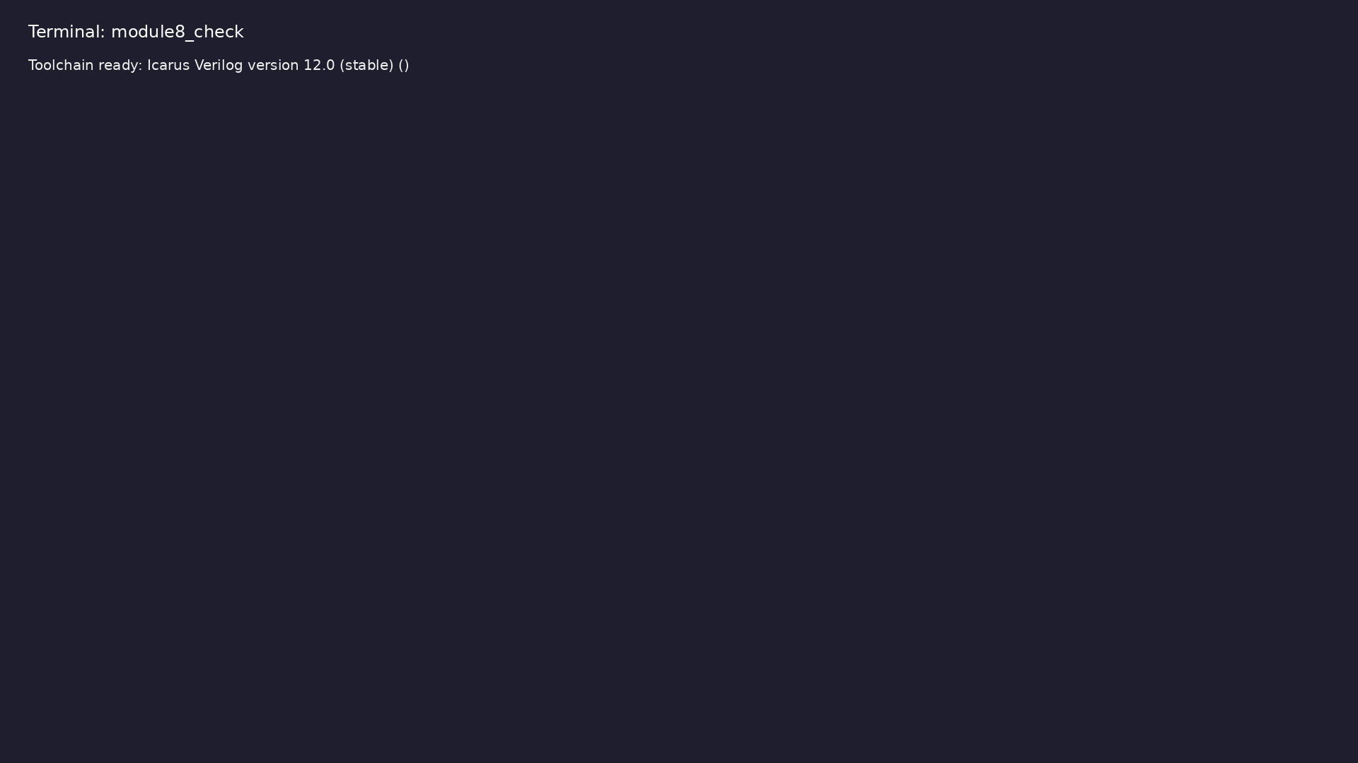
Module 8 toolchain check
$ command -v iverilog >/dev/null && echo "Toolchain ready: $(iverilog
-V 2>&1 | head -1)"
learn_verilog_systemverilog / Module 8
Notes:
Requires iverilog on PATH (apt install iverilog).

Slide 26
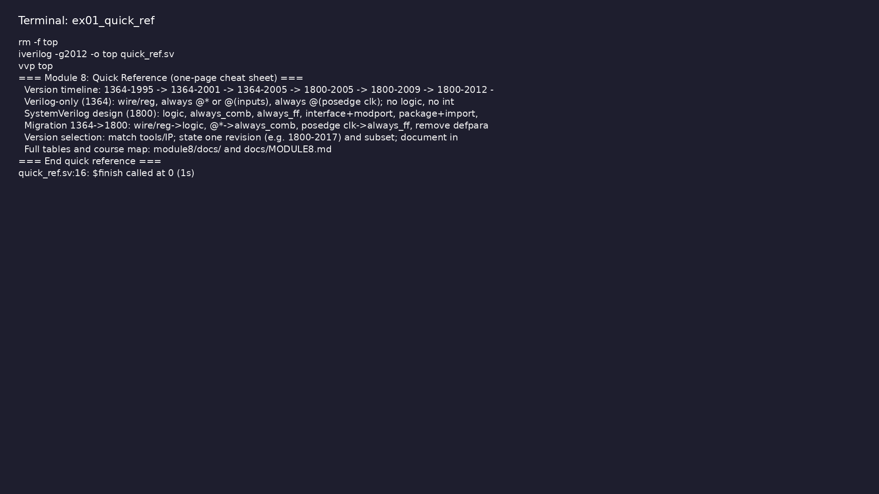
Demo: One-page cheat sheet (version timeline, subsets, migration, ver…
$ cd module8/examples && make clean && make run
learn_verilog_systemverilog / Module 8
Notes:
Hands-on: module8/examples/quick_ref/

Slide 27
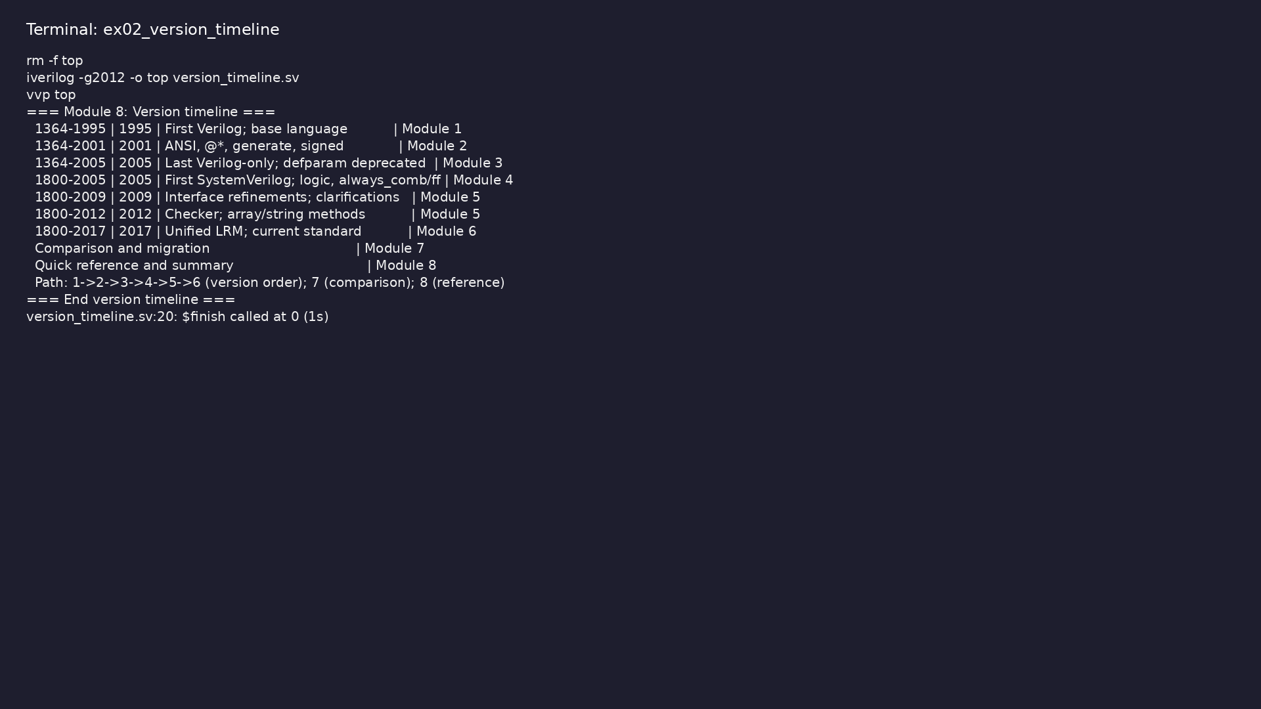
Demo: Version timeline (standard, year, role, module)
$ cd module8/examples/version_timeline && make clean && make run
learn_verilog_systemverilog / Module 8
Notes:
Hands-on: module8/examples/version_timeline/

Slide 28
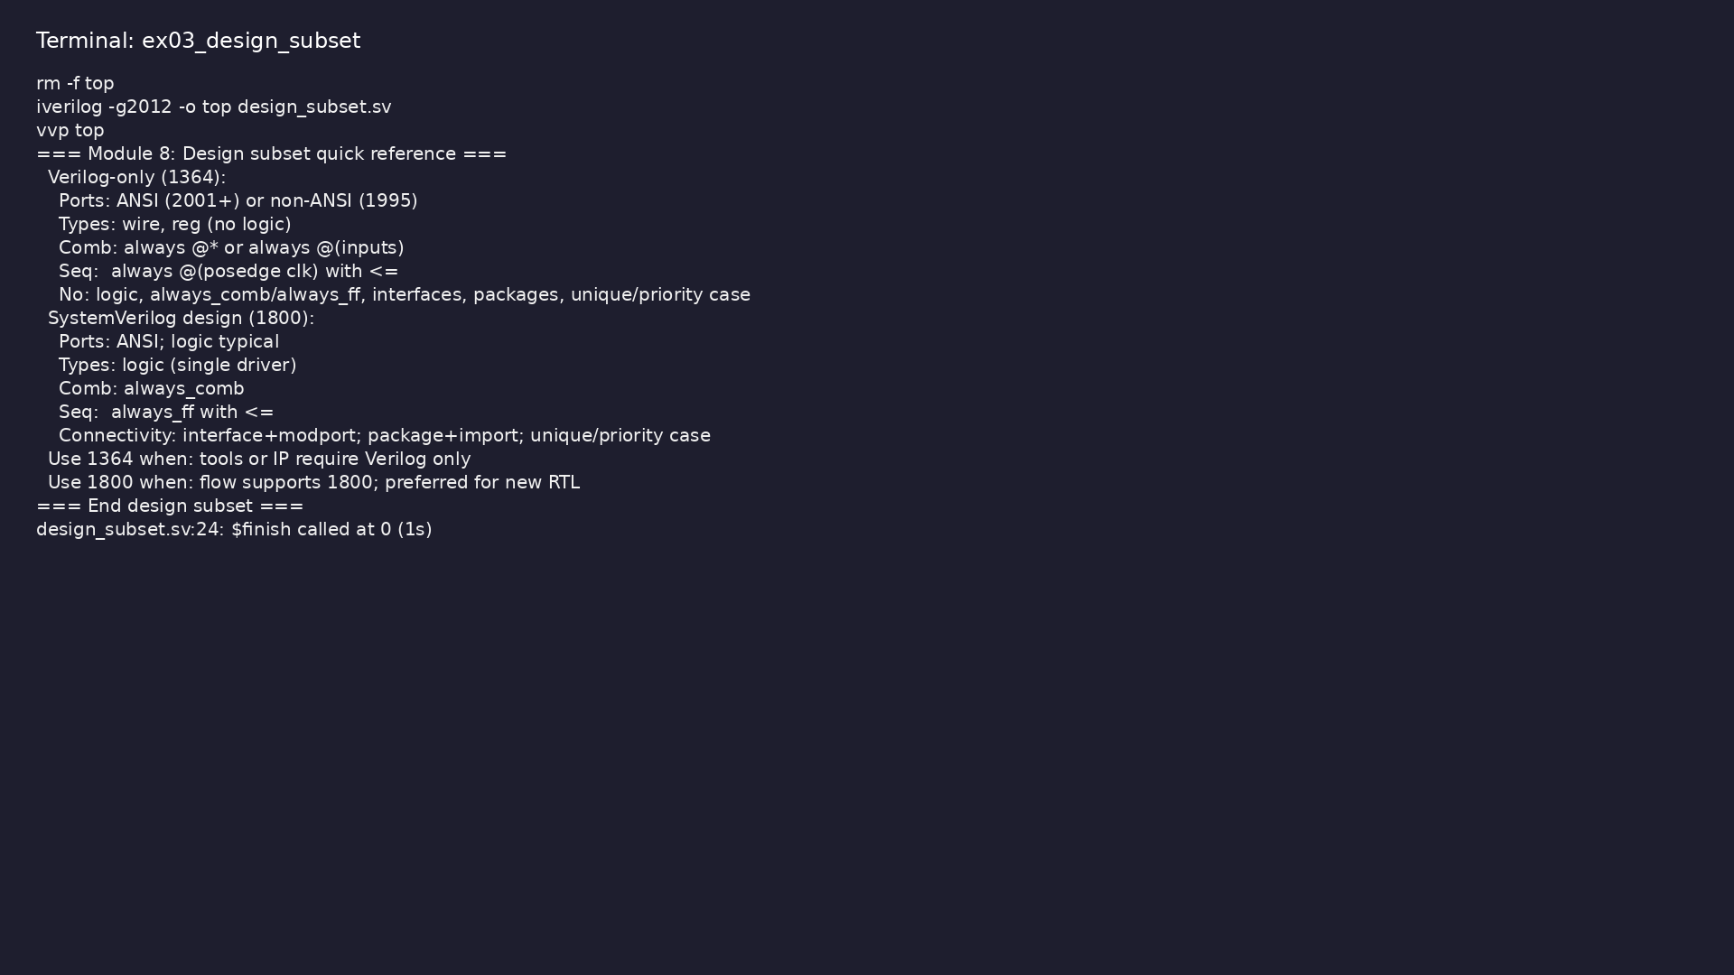
Demo: Verilog-only vs SystemVerilog design subset (ports, types, comb…
$ cd module8/examples/design_subset && make clean && make run
learn_verilog_systemverilog / Module 8
Notes:
Hands-on: module8/examples/design_subset/

Slide 29
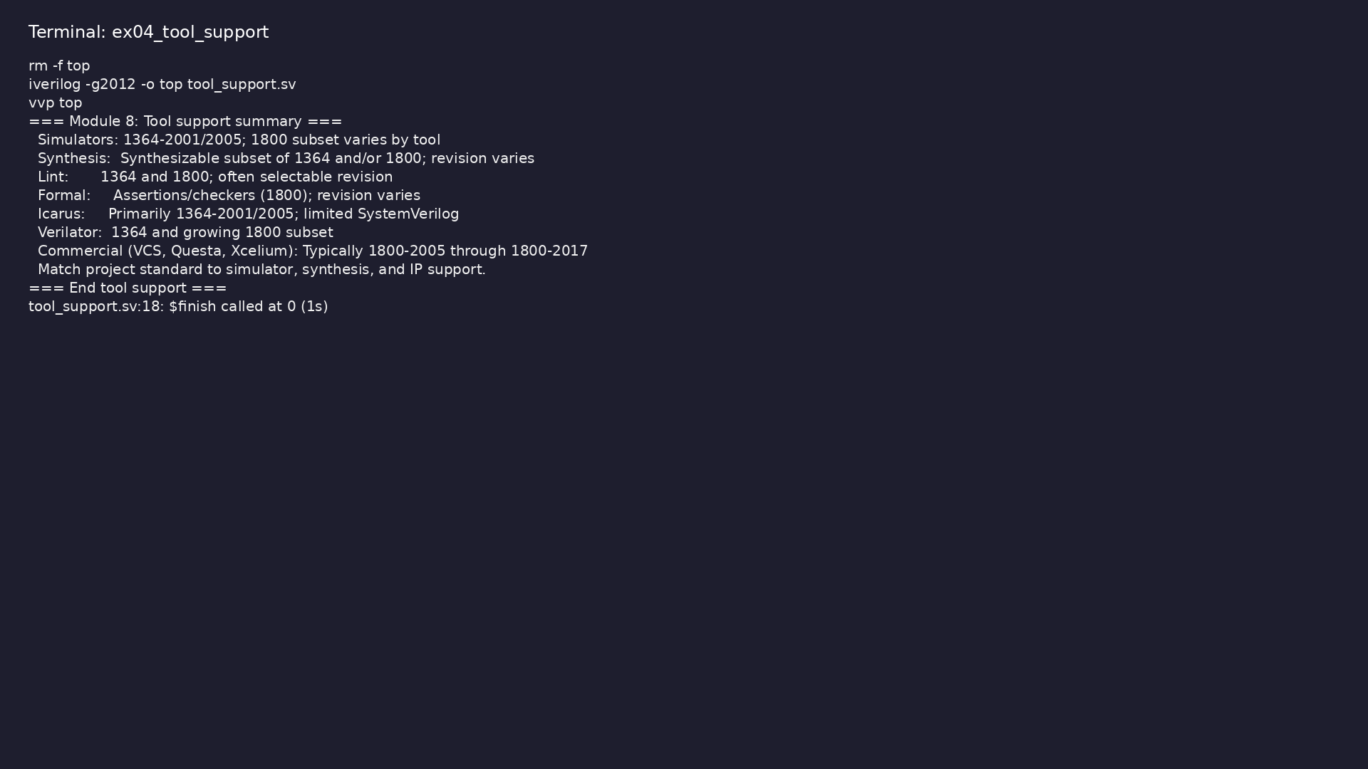
Demo: Tool support summary (simulators, synthesis, lint, formal; Icar…
$ cd module8/examples/tool_support && make clean && make run
learn_verilog_systemverilog / Module 8
Notes:
Hands-on: module8/examples/tool_support/

Slide 30
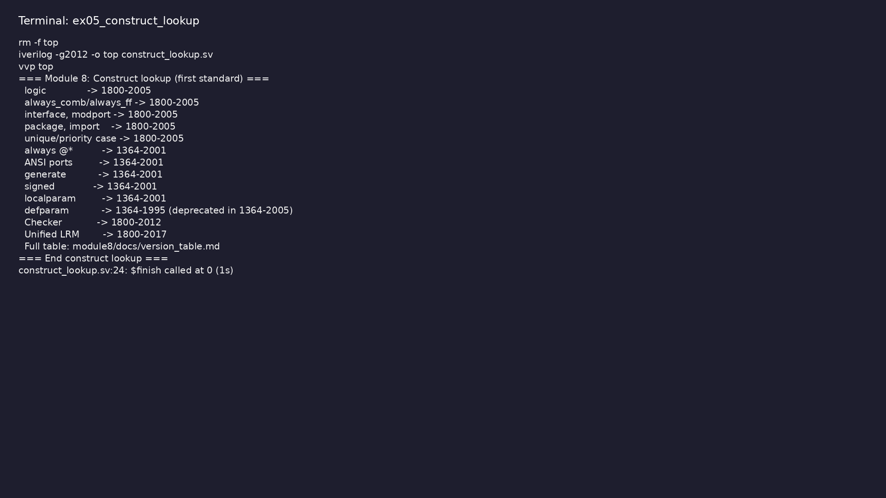
Demo: "Which standard has X?" for key constructs (logic, always_comb,…
$ cd module8/examples/construct_lookup && make clean && make run
learn_verilog_systemverilog / Module 8
Notes:
Hands-on: module8/examples/construct_lookup/

Slide 31
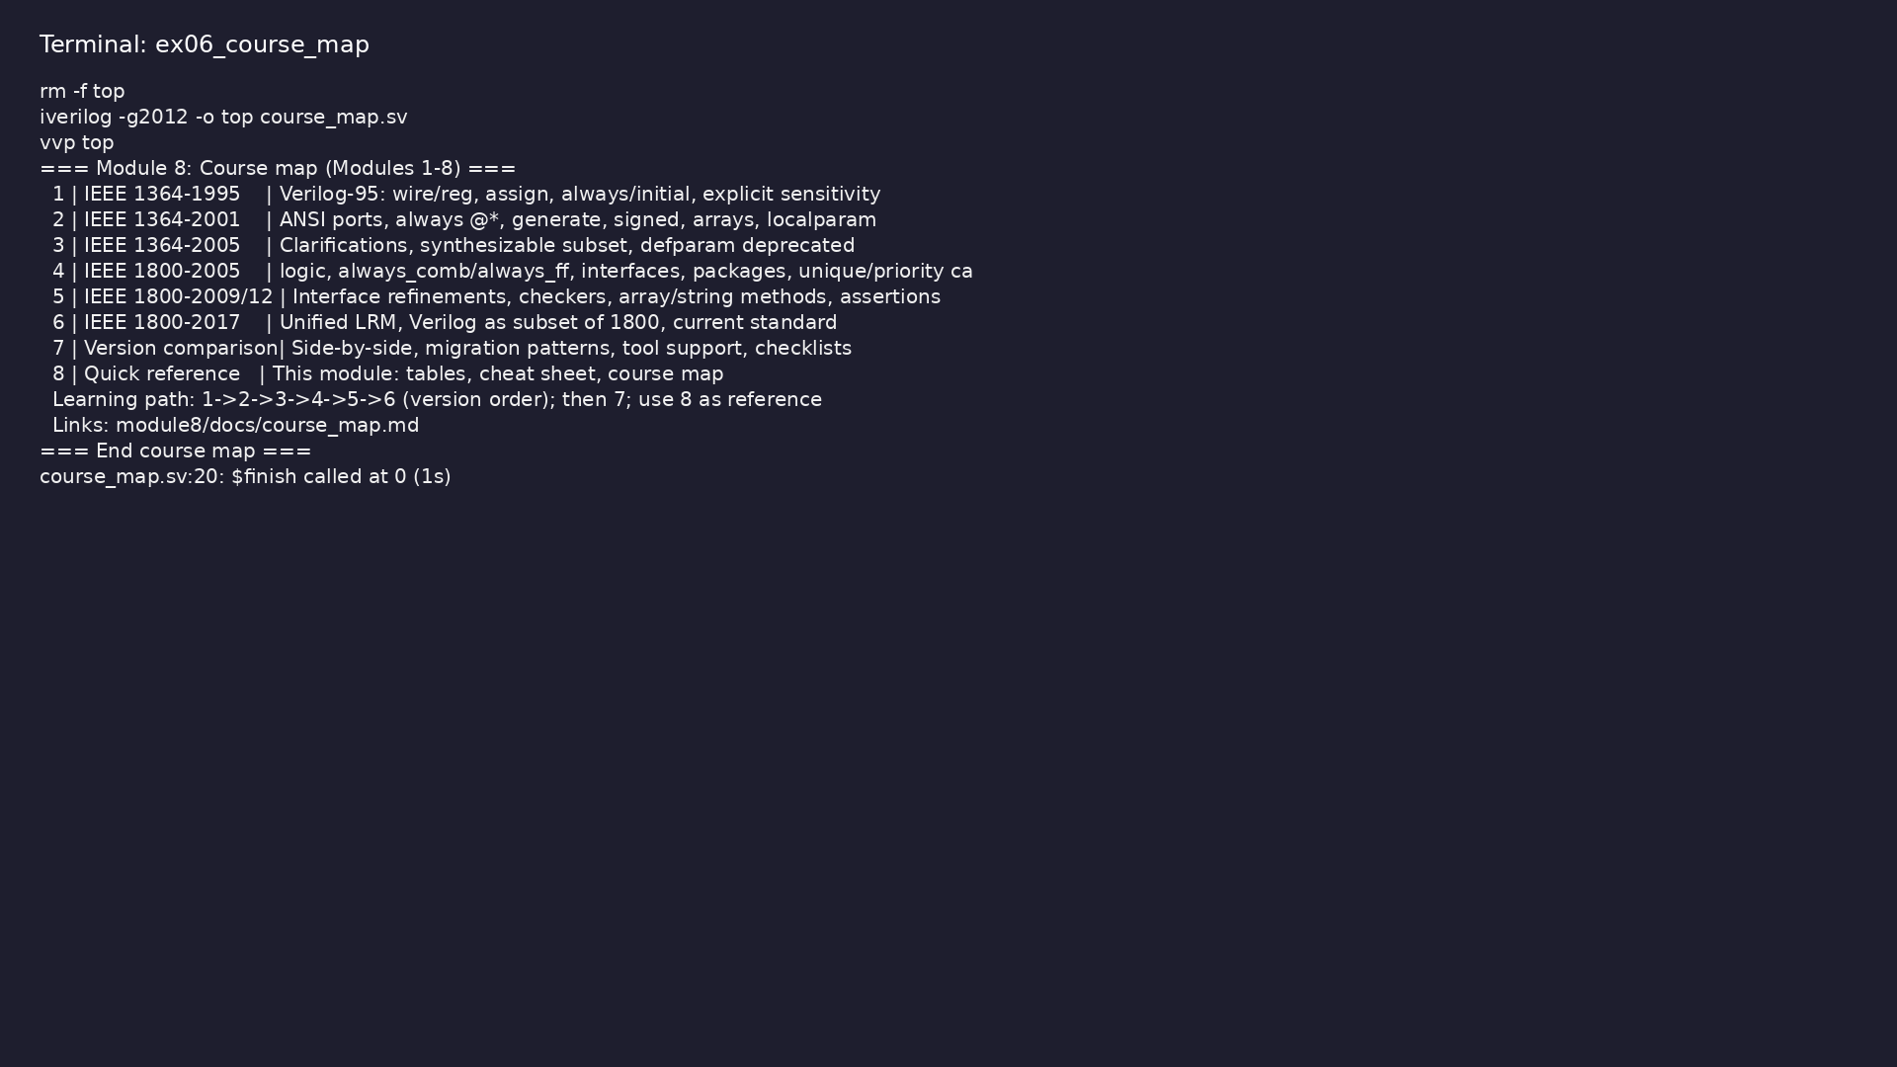
Demo: Course map (Modules 1–8 with title and content summary)
$ cd module8/examples/course_map && make clean && make run
learn_verilog_systemverilog / Module 8
Notes:
Hands-on: module8/examples/course_map/

Slide 32
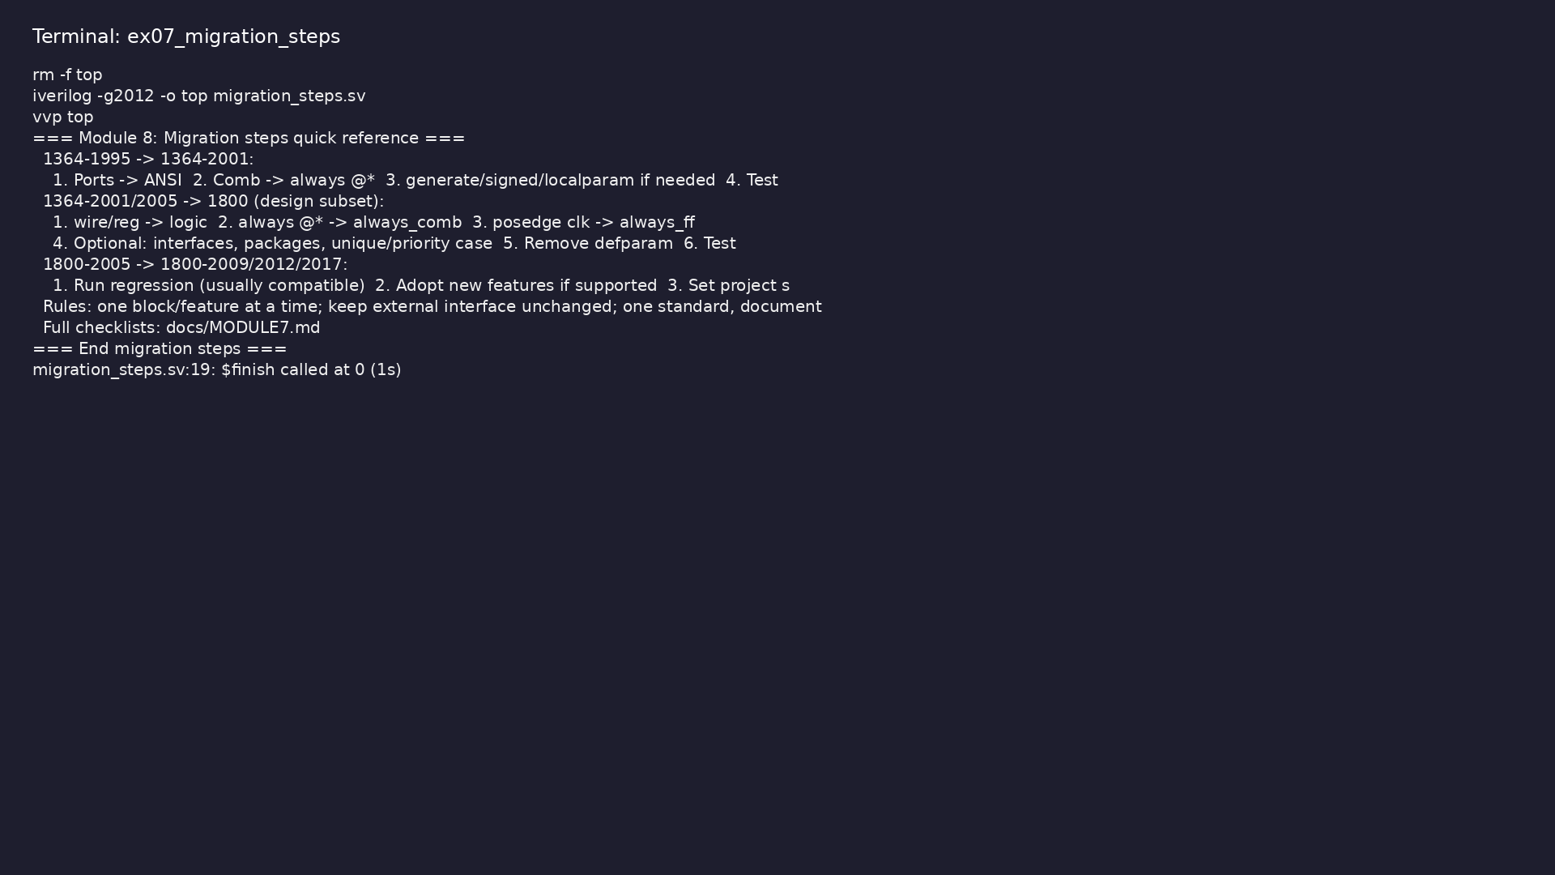
Demo: Migration steps (1995→2001, 1364→1800, 1800→1800) and rules of…
$ cd module8/examples/migration_steps && make clean && make run
learn_verilog_systemverilog / Module 8
Notes:
Hands-on: module8/examples/migration_steps/

Slide 33
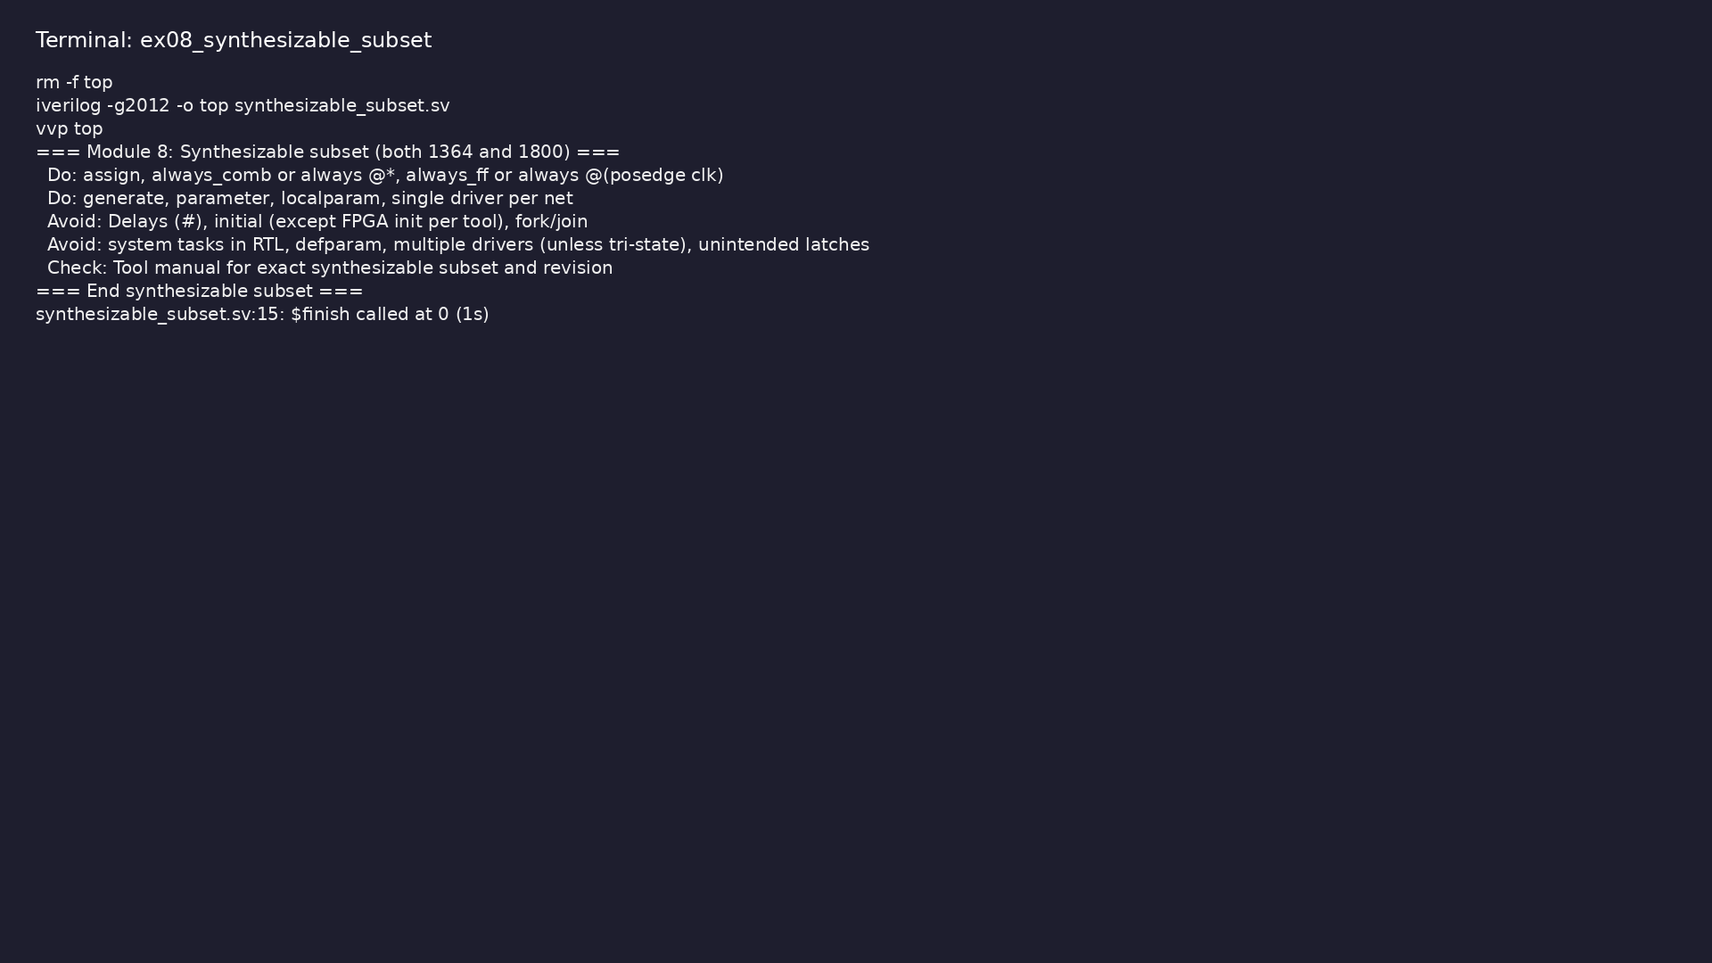
Demo: Synthesizable do/avoid (assign, always_comb/@*, single driver;…
$ cd module8/examples/synthesizable_subset && make clean && make run
learn_verilog_systemverilog / Module 8
Notes:
Hands-on: module8/examples/synthesizable_subset/

Slide 34
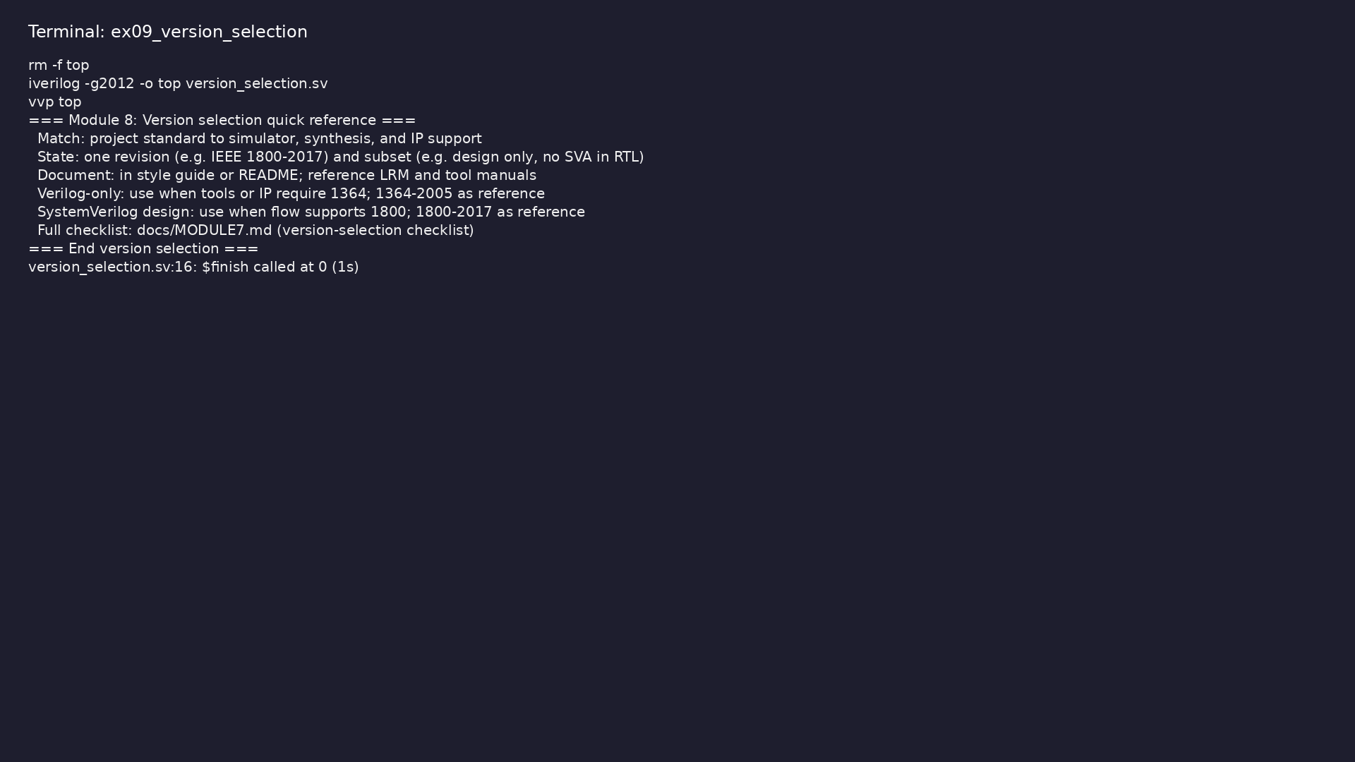
Demo: Version selection (match tools/IP, state one revision and subse…
$ cd module8/examples/version_selection && make clean && make run
learn_verilog_systemverilog / Module 8
Notes:
Hands-on: module8/examples/version_selection/

Slide 35
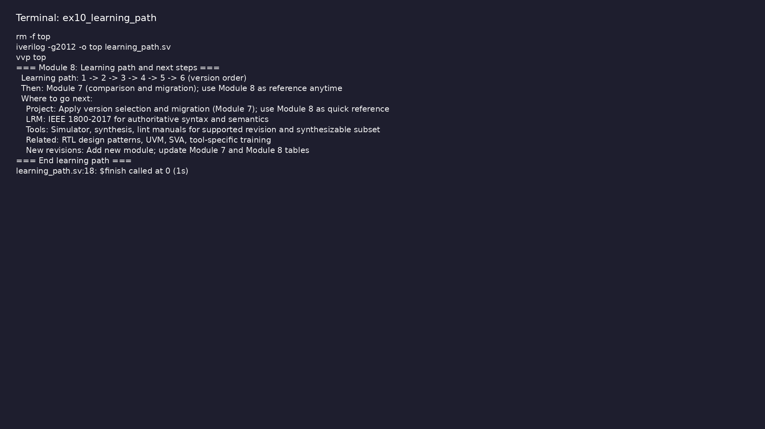
Demo: Learning path (1→…→6, then 7; use 8 as reference) and where to…
$ cd module8/examples/learning_path && make clean && make run
learn_verilog_systemverilog / Module 8
Notes:
Hands-on: module8/examples/learning_path/

Slide 36
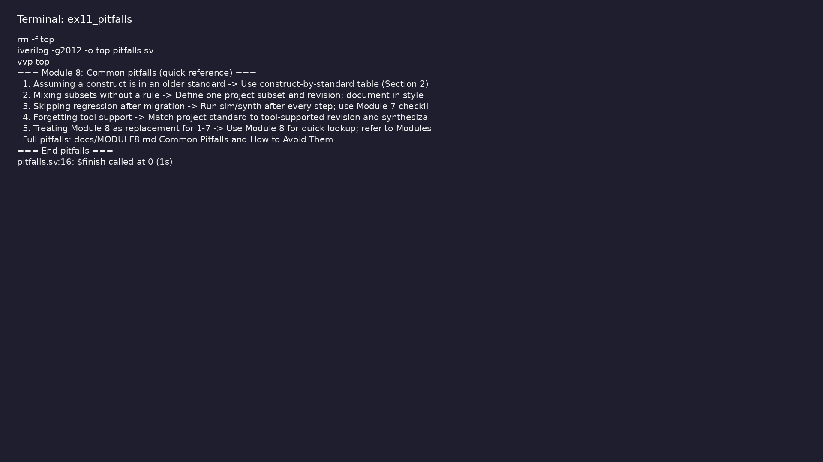
Demo: Common pitfalls quick reference (construct table, subset rule,…
$ cd module8/examples/pitfalls && make clean && make run
learn_verilog_systemverilog / Module 8
Notes:
Hands-on: module8/examples/pitfalls/

Slide 37
Practice & assessment
learn_verilog_systemverilog / Module 8

Slide 38
What you should know
• ✓ Use the version timeline and construct-by-standard
table to look up “which standard has X?”
• ✓ Use the design-subset quick reference to choose
Verilog-only vs SystemVerilog design
• ✓ Use the migration quick reference and Module 7
checklists for migration and version selection
• ✓ Use the course map to find which module covers a
given standard or topic
• ✓ Use this module as a single reference after
completing the course
learn_verilog_systemverilog / Module 8
Notes:
From MODULE8 Learning Outcomes.

Slide 39
Exercises
• Lookup
• Subset
• Migration
• Course map
• Cheat sheet
learn_verilog_systemverilog / Module 8

Slide 40
Exercises
• Assuming a construct is in an older standard
• Mixing subsets without a rule
• Skipping regression after migration
• Forgetting tool support
• Treating this module as a replacement for Modules
1–7
learn_verilog_systemverilog / Module 8

Slide 41
Summary & next steps
• Provide a single quick reference and course summary
for Verilog and SystemVerilog across IEEE versi…
• Complete module8/CHECKLIST.md
• Review module8/EXAMPLES.md and run each lab
• Next: Next module in course
learn_verilog_systemverilog / Module 8

