Slide 1
Module / port diagram
Every RTL block starts with a boundary you can draw on paper
learn_verilog — module diagram
Notes:
Every RTL block starts with a boundary you can draw on paper: a module name, ports going in and out, and sometimes child instances inside. This module is that picture made explicit—how Verilog declares a module, what each port direction means, and how a parent connects to a child. We will use the browser lab for the diagram, then write the same shape in a real dot-v file.

Slide 2
Modules, ports, and instances
A module is a named design unit
Ports are the named wires on its edge, input, output, or inout
Inside the module you describe behavior with assigns or always blocks
Named connects like dot-a open-paren a close-paren tie a formal port to an actual wire
Hierarchy is simply the tree of parents and instances you get when one module contains
learn_verilog — module diagram
Notes:
A module is a named design unit. Ports are the named wires on its edge—input, output, or inout—and they are how the parent talks to the child. Inside the module you describe behavior with assigns or always blocks; outside, you instantiate the module with a cell name and port connections. Named connects like dot-a open-paren a close-paren tie a formal port to an actual wire without guessing order. Hierarchy is simply the tree of parents and instances you get when one module contains another.

Slide 3
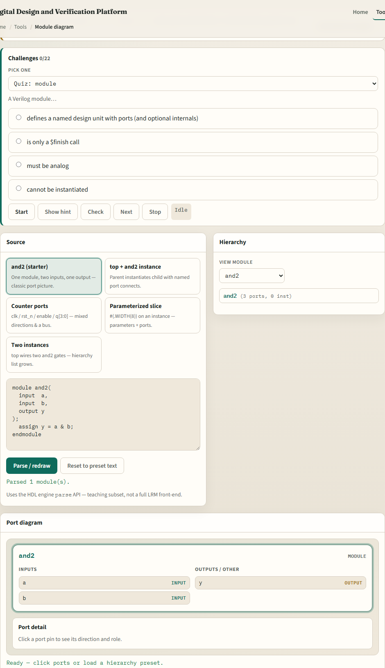
Browser lab
Module diagram lab starter
learn_verilog — module diagram
Notes:
In the browser lab track, open the module and port diagram lab from the tools page. You will see three regions: the challenge card and preset picker at the top, the Verilog source editor on one side, and the port diagram on the other. Load the and-two starter so you see two inputs and one output on a small gate. Try a hierarchy preset next—watch how an instance appears when top instantiates and-two. Work a few challenges, then use Check when the diagram matches what the prompt asks. The lab guides the details; you do not need a full UI tour here.

Slide 4
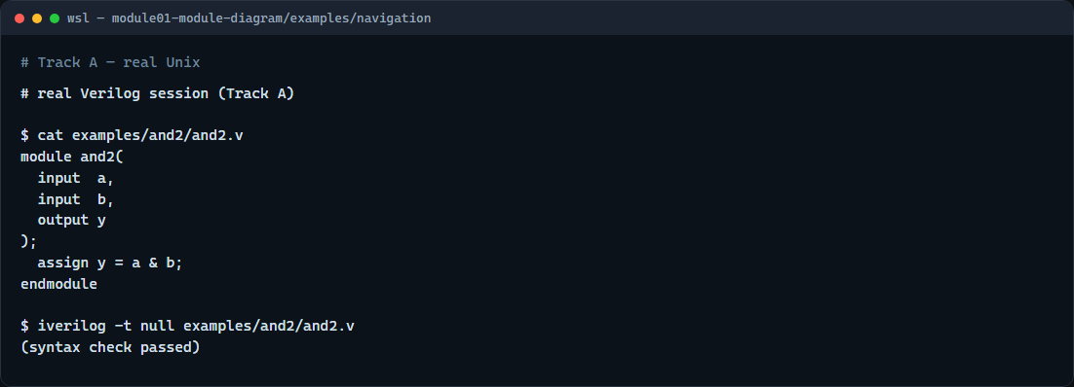
Real Verilog practice
Real Verilog — and2 module shell
learn_verilog — module diagram
Notes:
In the real Verilog track, open this module’s examples folder and look at the tiny and-two sketch. Read the module header: two inputs, one output, then a single assign that ANDs them. If Icarus is on your path, run a syntax-only compile to confirm the file parses; if not, keeping a clean module shell in your editor is still valid practice. That header-and-assign pattern is the template you will reuse all course long.
```verilog
// and2.v — minimal module: ports on the boundary, logic inside
module and2(
input a,
input b,
output y
);
assign y = a & b;
endmodule
// iverilog -t null and2.v — syntax check only (no simulation run)
```

Slide 5
Pitfalls to watch
Do not swap input and output directions, a port driven inside must be an output
Do not assume positional port order when named connects are clearer
And remember
learn_verilog — module diagram
Notes:
Do not swap input and output directions—a port driven inside must be an output. Do not assume positional port order when named connects are clearer; the lab’s hierarchy challenges exist partly to train named association. And remember: a pretty diagram does not replace synthesizable logic—the browser lab teaches the boundary picture; you still owe real RTL in your editor.

Slide 6
Your turn
Complete the checklist for at least one track, preferably both
In the browser, load the starter and finish a few challenges
On real Verilog, write or edit a minimal module shell for this idea
When you are ready
learn_verilog — module diagram
Notes:
Complete the checklist for at least one track—preferably both. In the browser, load the starter and finish a few challenges. On real Verilog, write or edit a minimal module shell for this idea. When you are ready, take the short quiz, then continue to Verilog literals in the next module.

