Slide 1
Latch risk
Combinational logic should depend only on current inputs, not on what the output was last cycle
learn_verilog — latch risk
Notes:
Combinational logic should depend only on current inputs—not on what the output was last cycle. When an always block at-star leaves a variable unassigned on some input combination, synthesis may infer a latch to hold the previous value. This module is that failure mode: incomplete if branches, partial case statements, and how assign differs from procedural combo style.

Slide 2
Complete versus incomplete paths
A continuous assign is purely combinational, there is no path where Y fails to update
In always at-star
If you write only if open-paren S close-paren Y equals D1 with no else
A full if-else or a case with all labels covered, or a default, gives every path a value
At-star fixes sensitivity; it does not fix missing branches
learn_verilog — latch risk
Notes:
A continuous assign is purely combinational—there is no path where Y fails to update. In always at-star, every input combination must drive every output you intend to be combinational. If you write only if open-paren S close-paren Y equals D1 with no else, then when S is zero Y is not assigned and tools infer storage. A full if-else or a case with all labels covered—or a default—gives every path a value. At-star fixes sensitivity; it does not fix missing branches.

Slide 3
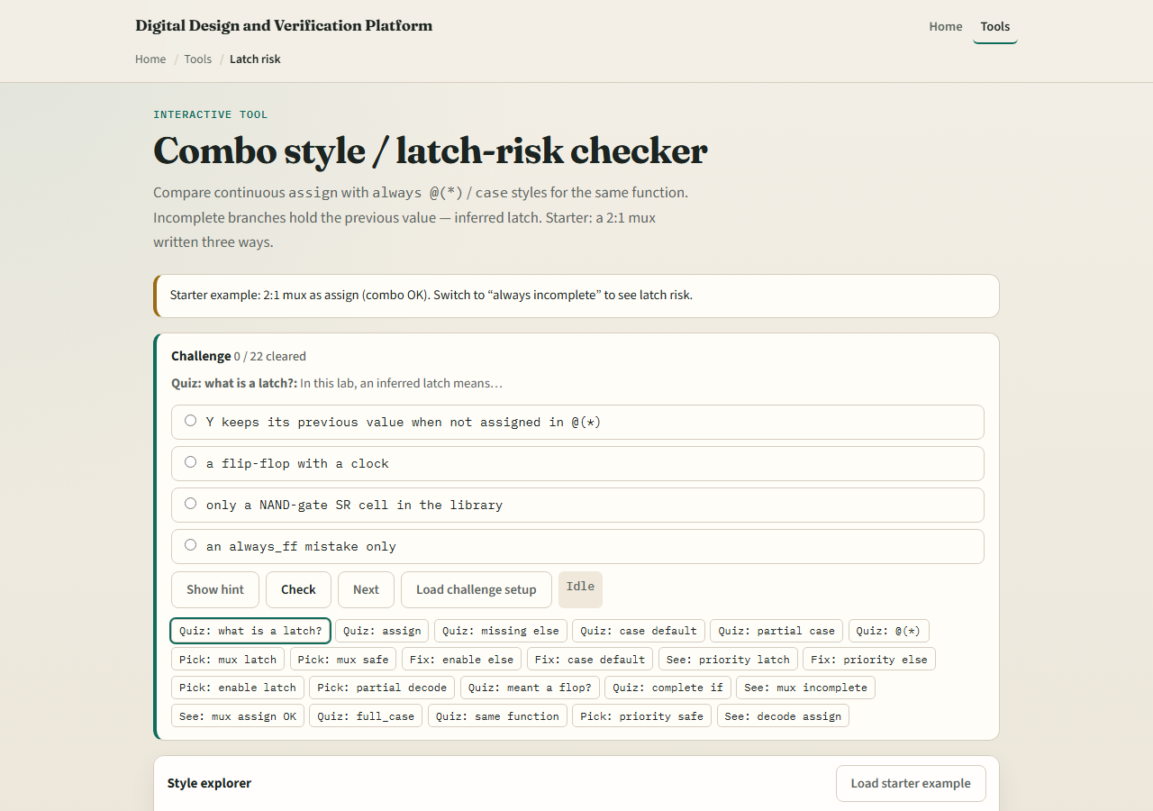
Browser lab
Latch risk lab starter
learn_verilog — latch risk
Notes:
In the browser lab track, open the latch-risk checker from the tools page. You will see challenges at the top, a function picker for the two-to-one mux, style tabs comparing assign versus always forms, and a latch verdict with sample code. Load the starter example and flip between assign, complete always, and incomplete always. Toggle the else checkbox on the priority-if scenario and watch the verdict change. Work a few challenges, then use Check when you picked the risky style.

Slide 4
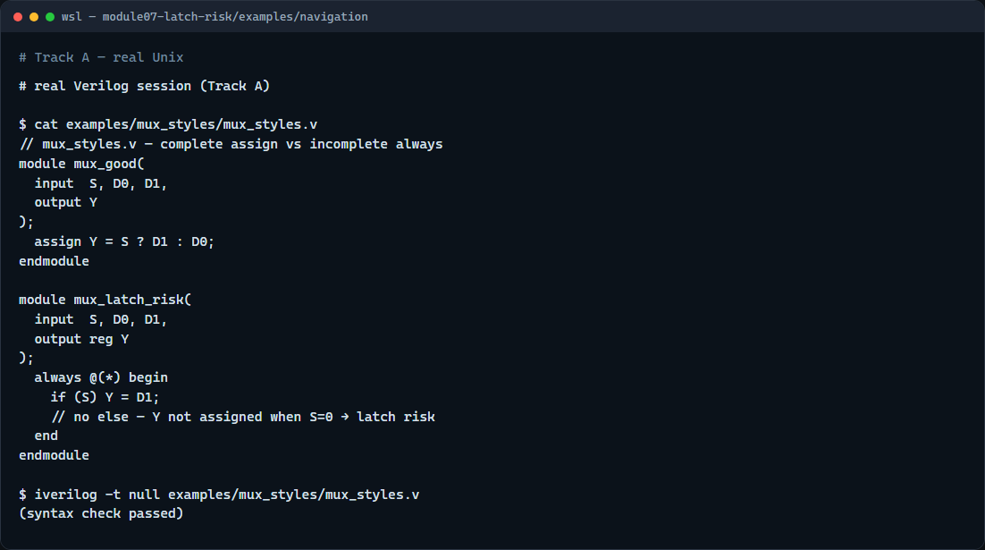
Real Verilog practice
Real Verilog — mux with and without latch risk
learn_verilog — latch risk
Notes:
In the real Verilog track, open this module’s examples folder and compare two mux sketches. One uses continuous assign—latch-free by construction. The other uses always at-star with only the true branch of if—classic latch bait. If Icarus is available, run a syntax-only compile; both parse, but only the first is safe combinational style for synthesis. Your linter and synthesis reports are where latch inference shows up in real projects.
```verilog
// mux_styles.v — complete assign vs incomplete always
module mux_good(
input S, D0, D1,
output Y
);
assign Y = S ? D1 : D0;
endmodule
module mux_latch_risk(
input S, D0, D1,
output reg Y
);
always @(*) begin
if (S) Y = D1;
// no else — Y not assigned when S=0 → latch risk
end
endmodule
// iverilog -t null mux_styles.v — syntax check only
```

Slide 5
Pitfalls to watch
Do not assume at-star means latch-free, it only builds the sensitivity list
In coursework you usually do not
Partial case without default is the same class of bug for wider selects
Prefer assign or always_comb with every path assigning outputs when you mean pure
learn_verilog — latch risk
Notes:
Do not assume at-star means latch-free—it only builds the sensitivity list. Do not write enable-looking if open-paren EN close-paren without else unless you deliberately want a latch—and in coursework you usually do not. Partial case without default is the same class of bug for wider selects. Prefer assign or always_comb with every path assigning outputs when you mean pure combinational logic.

Slide 6
Your turn
Complete the checklist for at least one track, preferably both
In the browser, load the starter and identify which mux style infers a latch
On real Verilog, write or fix an always block so every branch assigns the output
When you are ready
learn_verilog — latch risk
Notes:
Complete the checklist for at least one track—preferably both. In the browser, load the starter and identify which mux style infers a latch. On real Verilog, write or fix an always block so every branch assigns the output. When you are ready, take the short quiz, then continue to blocking versus non-blocking in the next module.

