Slide 1
Named vs positional
When you instantiate a module, you must connect its ports to nets in your design
learn_verilog — named vs positional
Notes:
When you instantiate a module, you must connect its ports to nets in your design. Positional connection lists signals in the same order as the module’s port list—first port to first argument, and so on. Named connection uses dot-port-name open-paren net close-paren for each port, so order does not matter. This module is that choice: why positional miswires can compile silently, and why named ports are the safer default for real RTL.

Slide 2
Order matters for positional
A D flip-flop might declare ports clk, d, q in that order
Positional dff u open-paren clk, din, qout close-paren wires them correctly
Swap the last two arguments to clk
Named dot-d open-paren din close-paren dot-q open-paren qout close-paren makes the intent
For a two-input AND gate, swapping a and b is harmless
learn_verilog — named vs positional
Notes:
A D flip-flop might declare ports clk, d, q in that order. Positional dff u open-paren clk, din, qout close-paren wires them correctly. Swap the last two arguments to clk, qout, din and the file still parses—but d and q are crossed. Named dot-d open-paren din close-paren dot-q open-paren qout close-paren makes the intent obvious and survives port reordering in the child module. For a two-input AND gate, swapping a and b is harmless; for control and data ports, it is not.

Slide 3
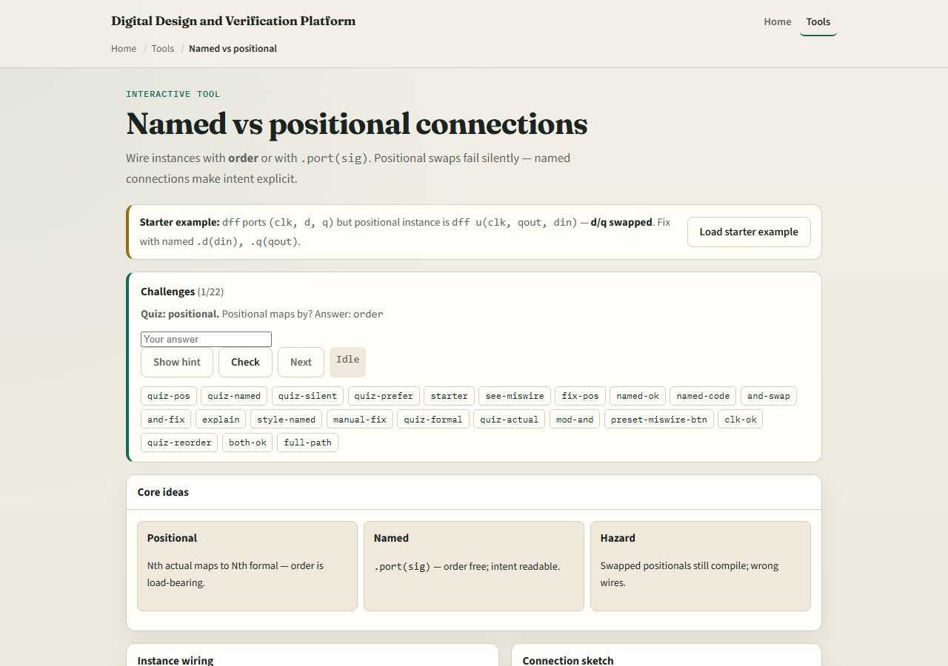
Browser lab
Named vs positional lab starter
learn_verilog — named vs positional
Notes:
In the browser lab track, open the named-versus-positional lab from the tools page. You will see a module picker, a style toggle between positional and named, net selectors for each port, and a binding verdict that flags mismatches. The starter loads a D flip-flop with a positional d-and-q swap. Try the fix buttons or switch to named connections, then work the challenges—including an AND gate swap that compiles but changes nothing useful.

Slide 4
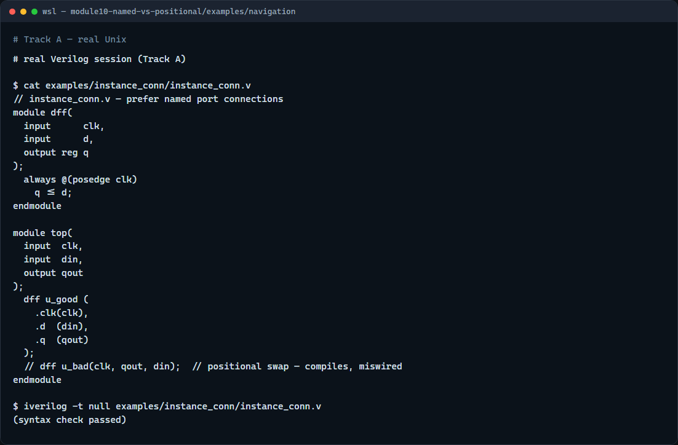
Real Verilog practice
Real Verilog — named instance connections
learn_verilog — named vs positional
Notes:
In the real Verilog track, open this module’s examples folder. You will see a small D flip-flop module and a top-level that instantiates it with named ports—dot-clk, dot-d, dot-q—so each connection is explicit. A commented positional miswire shows how easy it is to swap data and output without a syntax error. If Icarus is available, run a syntax-only compile on the named version.
```verilog
// instance_conn.v — prefer named port connections
module dff(
input clk,
input d,
output reg q
);
always @(posedge clk)
q <= d;
endmodule
module top(
input clk,
input din,
output qout
);
dff u_good (
.clk(clk),
.d (din),
.q (qout)
);
// dff u_bad(clk, qout, din); // positional swap — compiles, miswired
endmodule
// iverilog -t null instance_conn.v — syntax check only
```

Slide 5
Pitfalls to watch
Do not assume positional order matches how you drew the schematic
Do not mix named and positional on the same instance unless your style guide allows it
Do not rely on the compiler to catch swapped functional ports
For generated or macro cells with dozens of ports
learn_verilog — named vs positional
Notes:
Do not assume positional order matches how you drew the schematic—check the child module’s port list. Do not mix named and positional on the same instance unless your style guide allows it; prefer all-named. Do not rely on the compiler to catch swapped functional ports—binding errors are often silent until simulation or silicon. For generated or macro cells with dozens of ports, named connections are not optional—they are how you stay sane.

Slide 6
Your turn
Complete the checklist for at least one track, preferably both
In the browser
On real Verilog, rewrite one instance using named ports
When you are ready, take the short quiz, then continue to localparam in the next module
learn_verilog — named vs positional
Notes:
Complete the checklist for at least one track—preferably both. In the browser, fix the starter D flip-flop miswire and explain why the broken version still compiled. On real Verilog, rewrite one instance using named ports. When you are ready, take the short quiz, then continue to localparam in the next module.

