Slide 1
Generate and replication
Verilog gives you two related ideas that sound like loops but run at elaboration, not on every clock edge
learn_verilog — sv generate
Notes:
Verilog gives you two related ideas that sound like loops but run at elaboration, not on every clock edge. Replication brace-N-brace-expression copies an expression N times inside a concatenation—brace-four-brace one-prime-b-one becomes four copies of one. Generate blocks use parameters and genvar to build structure: a for loop that instantiates one cell per index, or an if that keeps exactly one branch. This module is that toolbox—when to replicate bits versus when to replicate hierarchy.

Slide 2
Elaboration, not runtime
Replication is expression math: brace-N-brace expr widens a bus by repeating expr
Bit cell open-bracket i close-bracket dot u, and so on
Generate if tests a parameter or localparam at elaboration and discards the other branch
That is different from a for loop inside always at-star, which runs during simulation
Generate conditions must be constants known before simulation starts
learn_verilog — sv generate
Notes:
Replication is expression math: brace-N-brace expr widens a bus by repeating expr. Generate for uses a genvar index from zero to N minus one and elaborates one instance per pass—bit cell open-bracket i close-bracket dot u, and so on. Generate if tests a parameter or localparam at elaboration and discards the other branch entirely. That is different from a for loop inside always at-star, which runs during simulation. Generate conditions must be constants known before simulation starts—not ordinary signals that change every cycle.

Slide 3
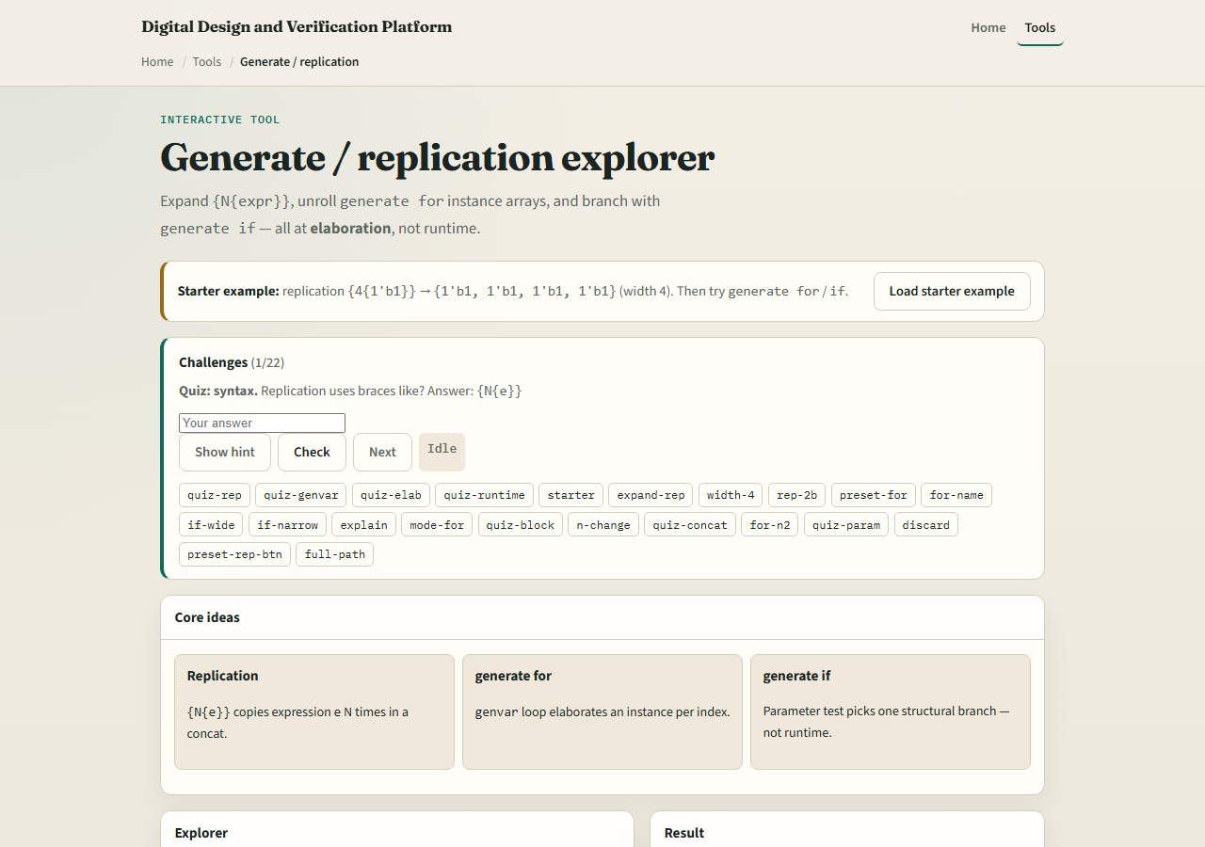
Browser lab
Generate replication lab starter
learn_verilog — sv generate
Notes:
In the browser lab track, open the generate-replication explorer from the tools page. Pick a mode—replication, generate for, or generate if—and set N or WIDTH. Load the starter with brace-four-brace one-prime-b-one, hit Expand, and read the bit width. Switch to generate for and see instance names unroll. Try generate if with WIDTH eight versus two and watch which branch elaborates. Work the challenges, then use Check.

Slide 4
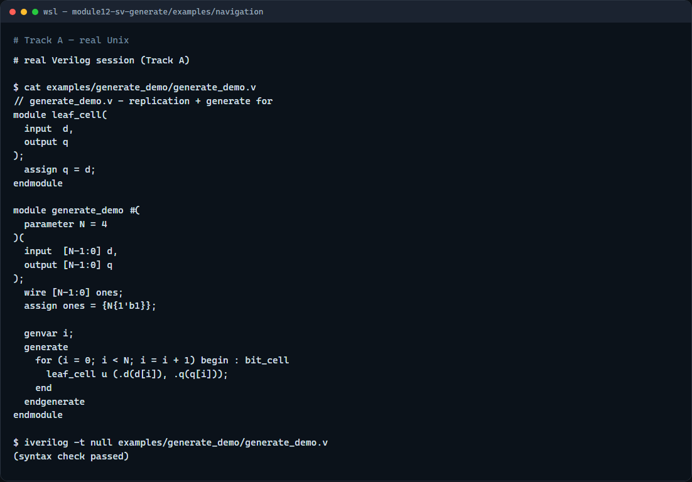
Real Verilog practice
Real Verilog - replication and generate for
learn_verilog — sv generate
Notes:
In the real Verilog track, open this module’s examples folder. The sketch assigns a bus of all ones with replication, then uses generate for with a genvar to instantiate one cell per bit. If Icarus is available, run a syntax-only compile—the lesson is elaboration-time structure, not a full testbench run.
```verilog
// generate_demo.v - replication + generate for
module leaf_cell(
input d,
output q
);
assign q = d;
endmodule
module generate_demo #(
parameter N = 4
)(
input [N-1:0] d,
output [N-1:0] q
);
wire [N-1:0] ones;
assign ones = {N{1'b1}};
genvar i;
generate
for (i = 0; i < N; i = i + 1) begin : bit_cell
leaf_cell u (.d(d[i]), .q(q[i]));
end
endgenerate
endmodule
// iverilog -t null generate_demo.v - syntax check only
```

Slide 5
Pitfalls to watch
Do not confuse replication brace-N-brace with generate for, they solve different problems
Do not put a runtime signal in a generate if condition, use parameters or localparams
Do not expect generate for to behave like a procedural for loop inside always
Do name generate blocks when you need hierarchical paths like bit_cell open-bracket i
learn_verilog — sv generate
Notes:
Do not confuse replication brace-N-brace with generate for—they solve different problems. Do not put a runtime signal in a generate if condition—use parameters or localparams. Do not expect generate for to behave like a procedural for loop inside always. Do name generate blocks when you need hierarchical paths like bit_cell open-bracket i close-bracket dot u in waveforms and lint reports.

Slide 6
Your turn
Complete the checklist for at least one track, preferably both
In the browser, expand brace-four-brace one-prime-b-one and state the resulting bit width
On real Verilog, write a generate for that instantiates N copies of a leaf cell
When you are ready
learn_verilog — sv generate
Notes:
Complete the checklist for at least one track—preferably both. In the browser, expand brace-four-brace one-prime-b-one and state the resulting bit width. On real Verilog, write a generate for that instantiates N copies of a leaf cell. When you are ready, take the short quiz, then continue to one-driver nets in the next module.

