Slide 1
Synthesizability lint
Not every Verilog fragment that simulates cleanly will synthesize to real gates
learn_verilog — synth lint
Notes:
Not every Verilog fragment that simulates cleanly will synthesize to real gates. Synthesizability lint is a static check that flags constructs a synthesis tool cannot map to hardware: delays, initial blocks, system tasks, latch-risk incomplete branches, blocking assignment inside flip-flops, and non-blocking assignment in combinational logic. This module teaches you to read those warnings before they become late surprises in your flow.

Slide 2
What the linter catches
The teaching rule pack covers the most common classroom mistakes
Hash-delay on assigns or gates is simulation timing, not hardware
Initial blocks and dollar-display tasks belong in testbenches, not RTL modules
An always-at-star if without else can infer a latch
Inside an always-ff clocked block, use non-blocking assignment for register outputs
Inside always-comb, use blocking assignment instead
learn_verilog — synth lint
Notes:
The teaching rule pack covers the most common classroom mistakes. Hash-delay on assigns or gates is simulation timing, not hardware. Initial blocks and dollar-display tasks belong in testbenches, not RTL modules. An always-at-star if without else can infer a latch. Inside an always-ff clocked block, use non-blocking assignment for register outputs. Inside always-comb, use blocking assignment instead. Timed always loops with hash-five are clock generators for simulation only. Clean RTL like a simple assign of Y equals A and B passes with zero findings.

Slide 3
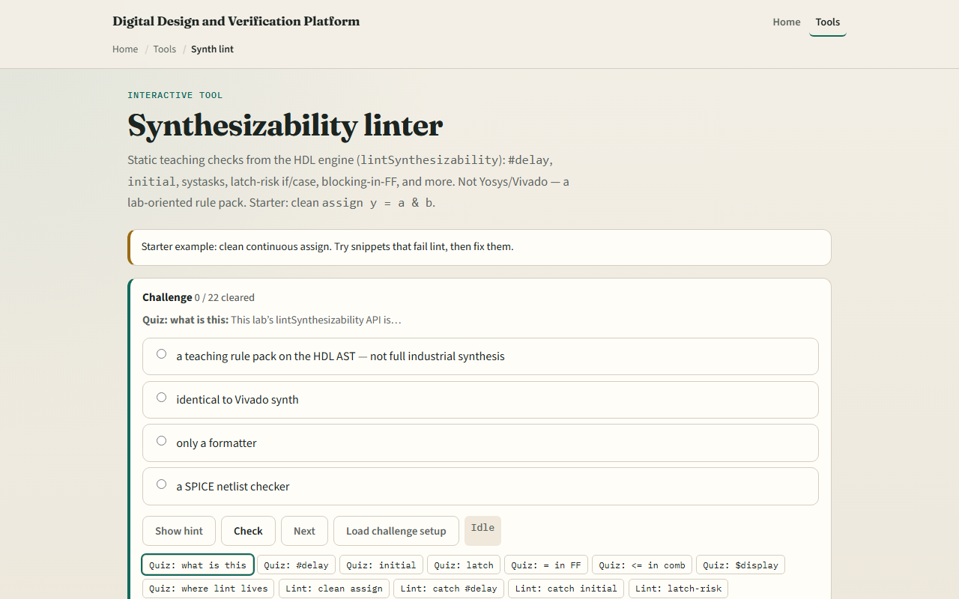
Browser lab
Synth lint lab starter
learn_verilog — synth lint
Notes:
In the browser lab track, open the synthesizability linter from the tools page. The starter loads a clean two-input AND with assign — lint reports ok with no findings. Use the snippet buttons to load bad examples: assign with hash-delay, initial blocks, incomplete if for latch risk, blocking equals in a flip-flop, and non-blocking in combinational logic. Hit Lint after each snippet and read the rule name and severity. Work the challenges until you can predict which rule fires, then use Check.

Slide 4
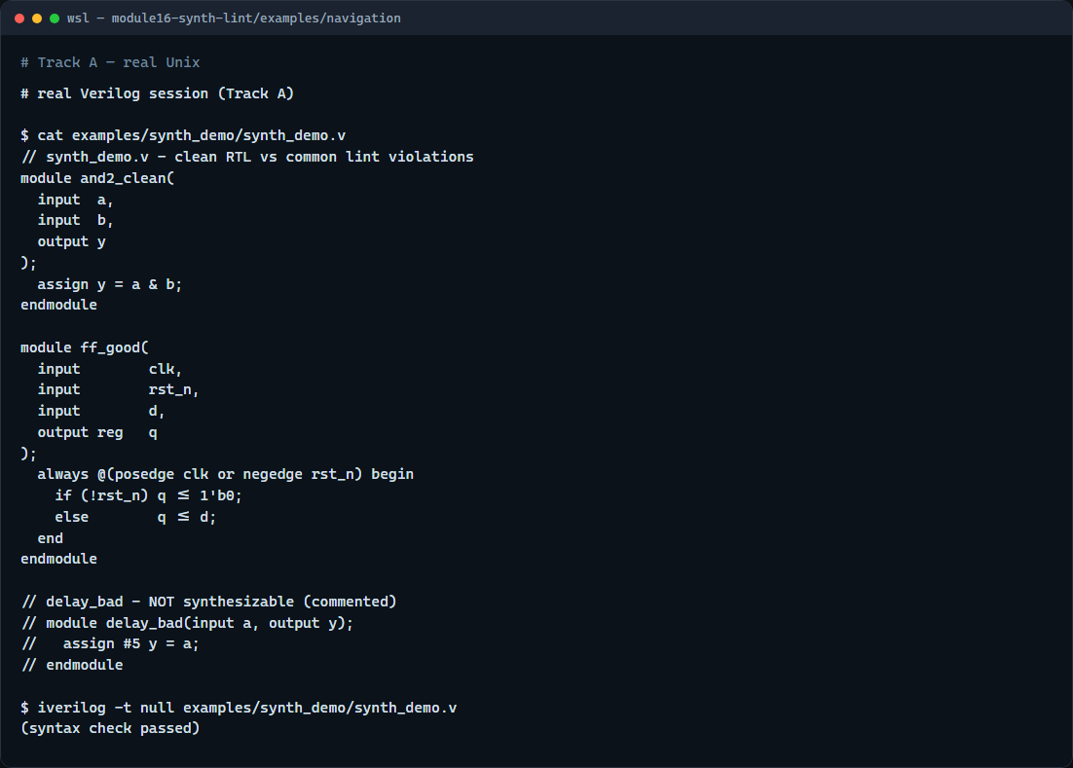
Real Verilog practice
Real Verilog - clean vs lint violations
learn_verilog — synth lint
Notes:
In the real Verilog track, open this module's examples folder. One sketch is a clean AND gate that passes synthesizability lint. The second is a proper flip-flop using always-ff with non-blocking assignment and async reset. A commented delay example shows what not to ship — it parses in simulation but would fail lint. If Icarus is available, run a syntax-only compile on the clean modules.
```verilog
// synth_demo.v - clean RTL vs common lint violations
module and2_clean(
input a,
input b,
output y
);
assign y = a & b;
endmodule
module ff_good(
input clk,
input rst_n,
input d,
output reg q
);
always @(posedge clk or negedge rst_n) begin
if (!rst_n) q <= 1'b0;
else q <= d;
end
endmodule
// delay_bad - NOT synthesizable (commented)
// module delay_bad(input a, output y);
// assign #5 y = a;
// endmodule
// iverilog -t null synth_demo.v - syntax check only
```

Slide 5
Pitfalls to watch
Do not treat a green simulation as proof of synthesizability
Do not copy testbench patterns like dollar-display into RTL modules
Do not mix blocking and non-blocking styles inside the same clocked always block
Do not assume this teaching linter replaces industrial tools like Yosys or Vivado
Run lint early and fix findings before you commit
learn_verilog — synth lint
Notes:
Do not treat a green simulation as proof of synthesizability — delays and initial blocks simulate fine but do not map to gates. Do not copy testbench patterns like dollar-display into RTL modules. Do not mix blocking and non-blocking styles inside the same clocked always block. Do not assume this teaching linter replaces industrial tools like Yosys or Vivado — it teaches the rule categories, not every vendor quirk. Run lint early and fix findings before you commit.

Slide 6
Your turn
Complete the checklist for at least one track, ideally both
In the browser lab, load the latch snippet and name the rule that fires
Any delays, initial blocks, or incomplete branches?
When you finish, take the short quiz, then continue to HDL style in the next module
learn_verilog — synth lint
Notes:
Complete the checklist for at least one track, ideally both. In the browser lab, load the latch snippet and name the rule that fires. In real Verilog, take a sketch from an earlier module and run it through the linter mentally: any delays, initial blocks, or incomplete branches? When you finish, take the short quiz, then continue to HDL style in the next module.

