Slide 1
Verilog path complete
You have walked the Verilog RTL path, from modules and ports, through wire versus reg, sensitivity lists, latch risk
learn_verilog — wrap
Notes:
You have walked the Verilog RTL path—from modules and ports, through wire versus reg, sensitivity lists, latch risk, and blocking versus non-blocking assignment, to parameters, generate, one-driver rules, counters, shift registers, synthesizability lint, HDL style, and the bridge into finite-state machines and datapaths. This short wrap names what you can do now and points you to the next courses on the ladder.

Slide 2
What you can do now
You can sketch modules, ports, and literals in IEEE 1364 style
You can choose wire or reg appropriately and avoid latch risk and sensitivity bugs
You can parameterize widths, generate instances, and keep one driver per net
You can write small sequential blocks with non-blocking updates for counters and shift
You can run style and synthesizability checks before you push RTL
That is the coding literacy every later SystemVerilog and simulation course expects
learn_verilog — wrap
Notes:
You can sketch modules, ports, and literals in IEEE 1364 style. You can choose wire or reg appropriately and avoid latch risk and sensitivity bugs. You can parameterize widths, generate instances, and keep one driver per net. You can write small sequential blocks with non-blocking updates for counters and shift registers. You can run style and synthesizability checks before you push RTL. That is the coding literacy every later SystemVerilog and simulation course expects.

Slide 3
Close the track gaps
Lint, so ports and always blocks feel like work you will keep
One-driver nets
Either track works for self-study; both together stick best before you move on
learn_verilog — wrap
Notes:
If you mainly used browser labs, write one small dot-v sketch for the modules that matter most—latch risk, blocking versus non-blocking, counters, and lint—so ports and always blocks feel like work you will keep. If you mainly used real Verilog, skim any skipped browser labs for the interactive challenges on operators, sensitivity, and one-driver nets. Either track works for self-study; both together stick best before you move on.

Slide 4
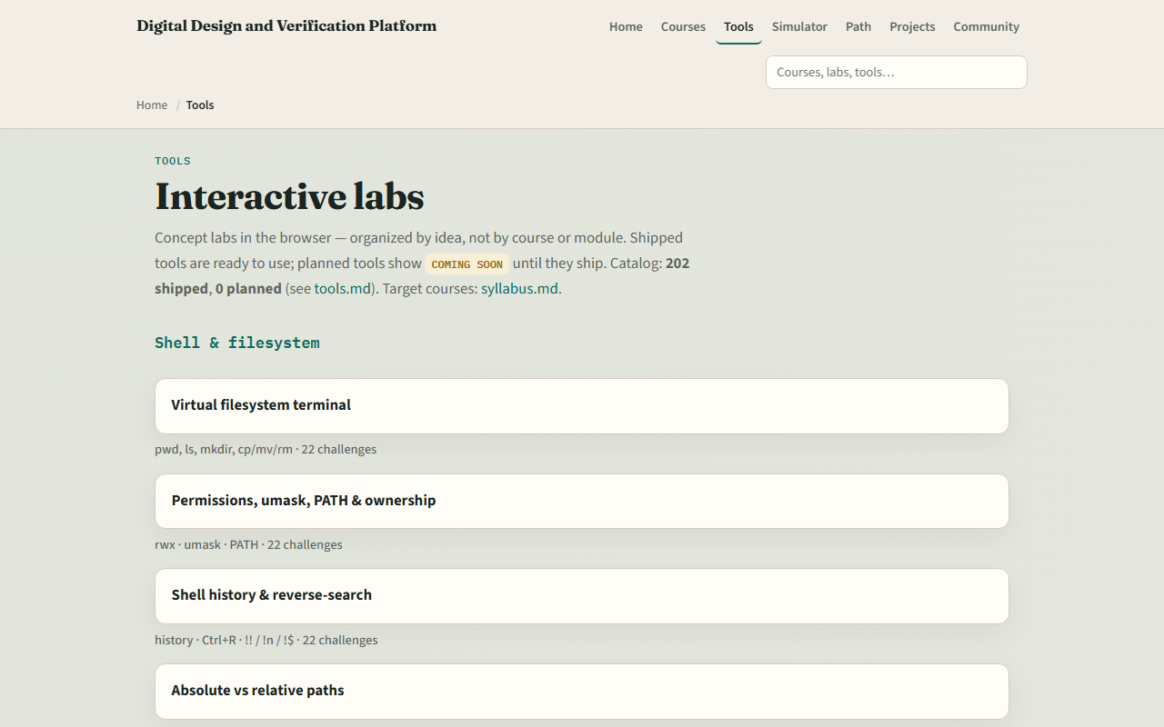
The tools you practiced
Here is the tools index again, the same shelf of concept labs you opened along the way
You do not need to re-clear every challenge
Use it as a map
learn_verilog — wrap
Notes:
Here is the tools index again—the same shelf of concept labs you opened along the way. You do not need to re-clear every challenge. Use it as a map: if a skill still feels shaky, jump back to that lab, then return here when you are ready for SystemVerilog design constructs or a dedicated simulator course.

Slide 5
Next
Complete the quiz for this part
Continue to learn SystemVerilog for design constructs beyond plain Verilog
learn_verilog — wrap
Notes:
Continue to learn SystemVerilog for design constructs beyond plain Verilog. Or pick a simulator path: learn Icarus, learn Verilator, or learn HDL simulator for running and debugging RTL in a flow that feels like real project work. Unix and Git fluency from earlier courses still help for Make, scripts, and version control. When your wrap checklist feels honest, open the next course that matches your path on the syllabus ladder.

Slide 6
Your turn
Review the wrap checklist in the module README
Confirm you can explain wire versus reg and blocking versus non-blocking without guessing
When you are ready
learn_verilog — wrap
Notes:
Review the wrap checklist in the module README. Confirm you can explain wire versus reg and blocking versus non-blocking without guessing, and that you know where style and synth lint live in the tools index. When you are ready, take the short quiz, then open learn SystemVerilog or a simulator course as your next step.

