Slide 1
Module 1
Verification Planning & Management Foundations (SV/UVM)
verification_planning_management / Module 1

Slide 2
Learning objectives
• Learn how to turn a DUT specification into a
concrete verification plan, with clear strategy,
cover…
verification_planning_management / Module 1

Slide 3
Prerequisites
• See module README
verification_planning_management / Module 1

Slide 4

Learning path
Learn how to turn a DUT specification into a concrete verification plan, with clear strategy, coverage intent, and regression approach, usi…
verification_planning_management / Module 1

Slide 5
Overview
• This module establishes the foundation for
**verification planning and management**. Instead of
sta…
verification_planning_management / Module 1

Slide 6
How to learn this module
verification_planning_management / Module 1

Slide 7
Suggested learning path (1/2)
• Read this module doc and `module1/README.md` for
objectives and workspace layout.
• Scaffold planning files if needed:
`./scripts/module1.sh --scaffold`
• Edit `module1/VERIFICATION_PLAN.md` and
`module1/REQUIREMENTS_MATRIX.md` from templates.
• Inspect shared DUT RTL at
`common_dut/rtl/stream_fifo.sv` and the TB skeleton
under `common_dut/tb/…
• Validate planning artifacts: `./scripts/module1.sh
--check`
verification_planning_management / Module 1
Notes:
From docs/MODULE1.md — read guides before running demos.

Slide 8
Suggested learning path (2/2)
• Complete `module1/CHECKLIST.md` before starting
Module 2.
verification_planning_management / Module 1
Notes:
From docs/MODULE1.md — read guides before running demos.

Slide 9
Design architecture
verification_planning_management / Module 1

Slide 10

1. Stream FIFO DUT (shared course RTL)
• Course DUT:
`common_dut/rtl/stream_fifo.sv`
— parameterizable `DEPTH` and
`DATA_WIDTH`.
• Source interface: `s_valid`,
`s_ready`, `s_data` (push when
both valid and ready).
• Sink interface: `m_valid`,
`m_ready`, `m_data` (pop on
handshake).
• Internal storage: circular
buffer (`mem`, `wr_ptr`,
`rd_ptr`, `count`).
• Status outputs: `level`, sticky
`overflow` / `underflow` on
illegal handshakes.
verification_planning_management / Module 1
Notes:
From MODULE1 Design Architecture.

Slide 11

2. Planning-level verification view (Module 1)
• No full UVM implementation
required yet — document intended
env boundaries in
`VERIFICATION_PLAN.md…
• `REQUIREMENTS_MATRIX.md` traces
features → future tests and
coverage bins.
• `common_dut/tb/` holds skeleton
stubs so architecture decisions
are concrete, not abstract.
verification_planning_management / Module 1
Notes:
From MODULE1 Design Architecture.

Slide 12
3. Repository layout and planning workflow
• Inputs: DUT spec, course README, Module 1 templates
and optional solutions.
• Workspace: edit `module1/*.md` planning documents
directly in the repository.
• Shared RTL/TB: `common_dut/` holds the physical DUT
and skeleton env reused in later modules.
• Validation loop: edit plan → run
`./scripts/module1.sh --check` → fix TODOs →
checklist sign-off.
• Outputs: verification scope, strategy, test
catalogue intents, and coverage sketch for Module 2.
verification_planning_management / Module 1
Notes:
From MODULE1 Design Architecture.

Slide 13
DUT — stream_fifo ports
module stream_fifo #(
parameter int DATA_WIDTH = 8,
parameter int DEPTH = 16
) (
input logic clk,
input logic rst_n,
// Source (input) interface
input logic s_valid,
input logic [DATA_WIDTH-1:0] s_data,
output logic s_ready,
// Sink (output) interface
output logic m_valid,
output logic [DATA_WIDTH-1:0] m_data,
input logic m_ready,
# ...
verification_planning_management / Module 1

Slide 14
UVM env skeleton
class stream_fifo_env_skeleton extends uvm_env;
stream_fifo_agent_skeleton src_agent;
stream_fifo_agent_skeleton snk_agent;
`uvm_component_utils(stream_fifo_env_skeleton)
function new(string name = "stream_fifo_env_skeleton", uvm_component
parent = null);
super.new(name, parent);
endfunction
function void build_phase(uvm_phase phase);
super.build_phase(phase);
src_agent = stream_fifo_agent_skeleton::type_id::create("src_agent",
this);
snk_agent = stream_fifo_agent_skeleton::type_id::create("snk_agent",
this);
verification_planning_management / Module 1

Slide 15
Key files to study
verification_planning_management / Module 1

Slide 16
Open these in the repo (1/2)
• `module1/VERIFICATION_PLAN.md` — verification
strategy, scope, and test intents
• `module1/REQUIREMENTS_MATRIX.md` — requirements-to-
test traceability
• `module1/templates/` — empty templates for a fresh
start
• `module1/.solutions/` — reference solutions
(optional comparison)
• `common_dut/rtl/stream_fifo.sv` — shared course DUT
(stream FIFO)
• `common_dut/tb/stream_fifo_env_skeleton.sv` — UVM
env stub hierarchy
verification_planning_management / Module 1
Notes:
Trace while running module1/EXAMPLES.md labs.

Slide 17
Open these in the repo (2/2)
• `scripts/module1.sh` — validation and scaffold
orchestrator
verification_planning_management / Module 1
Notes:
Trace while running module1/EXAMPLES.md labs.

Slide 18
Verification & testing methods
verification_planning_management / Module 1

Slide 19

1. Planning-first methodology
• Start from spec → scope →
strategy before writing large
amounts of testbench code.
• Use risk-based prioritization to
decide what to verify first in
later modules.
• Separate verification objectives
(quality/risk) from
implementation details.
verification_planning_management / Module 1
Notes:
From MODULE1 Verification & Testing Methods.

Slide 20
2. Test intent and validation (Module 1)
• Capture test intents (names, goals, tiers) in the
verification plan — not full UVM tests yet.
• Directed vs constrained-random choices are
documented with rationale for the FIFO DUT.
• Self-check: `./scripts/module1.sh --check` validates
planning artifacts; simulation is optional.
verification_planning_management / Module 1
Notes:
From MODULE1 Verification & Testing Methods.

Slide 21
3. Early closure thinking
• Sketch functional coverage intent and regression
tiers (sanity / nightly / full) for later modules.
• Define sign-off preview criteria (coverage goals,
bug bars) in the plan from day one.
verification_planning_management / Module 1
Notes:
From MODULE1 Verification & Testing Methods.

Slide 22
Module 1 — validation commands
EXAMPLES:
# Full summary (plan, matrix, checklist)
$0
# Focus only on plan status
$0 --plan-status
# Focus only on traceability matrix
$0 --matrix-status
EOF
}
verification_planning_management / Module 1

Slide 23
Syllabus topics
verification_planning_management / Module 1

Slide 24
1. Verification Mindset and Goals (1/2)
• Design vs Verification
• What verification is responsible for (and what it is
not).
• “Bug-finding” vs “quality and risk management”.
• Verification Objectives
• Proving conformance to spec (as far as practical).
• Managing risk: focusing on high-impact features and
scenarios.
verification_planning_management / Module 1
Notes:
From MODULE1 Topics Covered.

Slide 25
1. Verification Mindset and Goals (2/2)
• Balancing schedule, quality, and resources.
• UVM/SV Context
• Why constrained-random and coverage-driven
verification (CDV) matter.
• Where SV/UVM and Verilog DUTs fit in the overall
flow.
verification_planning_management / Module 1
Notes:
From MODULE1 Topics Covered.

Slide 26
2. From Specification to Verification Scope (1/2)
• Requirements Intake
• Extracting verifiable requirements from a
product/design spec.
• Identifying interfaces, modes, configurations, and
corner cases.
• Capturing assumptions and dependencies (e.g.,
upstream/downstream blocks, firmware behavior).
• In-Scope vs Out-of-Scope
• Deciding what this verification effort will and will
not cover.
verification_planning_management / Module 1
Notes:
From MODULE1 Topics Covered.

Slide 27
2. From Specification to Verification Scope (2/2)
• Handling legacy behavior, debug features, and low-
priority modes.
• Risk-Based Prioritization
• High-risk vs low-risk features.
• Safety/criticality, complexity, novelty, and usage
frequency.
verification_planning_management / Module 1
Notes:
From MODULE1 Topics Covered.

Slide 28
3. Verification Strategy (SV/UVM Focus) (1/2)
• Strategy Dimensions
• Directed vs constrained-random vs scenario-based
testing.
• Use of reference models, assertions, and protocol
checkers.
• Layered testbench and reuse (block/IP → subsystem →
SoC).
• UVM Testbench Architecture Concepts
• How your env/agent/sequence/scoreboard choices
influence planning.
verification_planning_management / Module 1
Notes:
From MODULE1 Topics Covered.

Slide 29
3. Verification Strategy (SV/UVM Focus) (2/2)
• Mapping features and scenarios to sequences and
configuration knobs.
• Choosing Strategies for the DUT
• For a FIFO: corner-case heavy, error injection,
stress tests.
• For a bus/reg block: protocol correctness, access
patterns, error responses.
• For a UART: timing, framing/parity errors, flow
control.
verification_planning_management / Module 1
Notes:
From MODULE1 Topics Covered.

Slide 30
3. Verification flow
Stimulus, observation, and check strategy for this module.
verification_planning_management / Module 1

Slide 31
4. Test Planning and Test Catalogue Basics (1/2)
• Test Intent vs Test Implementation
• Writing test descriptions at the intent level (what
to prove).
• Mapping intents to one or more concrete UVM
tests/sequences.
• Test Types and Tiers
• Smoke/sanity vs feature tests vs stress/error-
injection.
• Nightly vs weekly regressions (preview; detailed in
later modules).
verification_planning_management / Module 1
Notes:
From MODULE1 Topics Covered.

Slide 32
4. Test Planning and Test Catalogue Basics (2/2)
• Early Test Catalogue
• Building a first-pass list of 10–20 key
tests/intents from the spec.
• Tagging each with requirements, priority, and
expected coverage impact.
verification_planning_management / Module 1
Notes:
From MODULE1 Topics Covered.

Slide 33
5. Coverage Planning Primer (1/2)
• Why Coverage is Central to Planning
• Functional vs code coverage and their roles.
• “Coverage as a question”: what do you need to know
to sleep at night?
• Sketching Coverage Models
• Listing features, modes, and scenarios that deserve
covergroups.
• Identifying important crosses (e.g., mode × error
type, address ranges × operations).
verification_planning_management / Module 1
Notes:
From MODULE1 Topics Covered.

Slide 34
5. Coverage Planning Primer (2/2)
• Defining Initial Coverage Goals
• Setting measurable but realistic targets.
• Separating “must cover” from “nice to have”.
verification_planning_management / Module 1
Notes:
From MODULE1 Topics Covered.

Slide 35
6. Intro to Regression and Sign-off Thinking
• Regression at a High Level
• Why we need repeatable, automated regressions.
• Basic tiers (sanity / nightly / full).
• Sign-off Preview
• Types of sign-off criteria: coverage, bug bars,
waivers, stability.
• Why it’s important to think about exit criteria from
Day 1.
verification_planning_management / Module 1
Notes:
From MODULE1 Topics Covered.

Slide 36
Command reference highlights
verification_planning_management / Module 1

Slide 37
Scaffold planning workspace
• ./scripts/module1.sh --scaffold
verification_planning_management / Module 1
Notes:
Full detail in docs/MODULE1.md command reference.

Slide 38
Validate Module 1 artifacts
• ./scripts/module1.sh --check
verification_planning_management / Module 1
Notes:
Full detail in docs/MODULE1.md command reference.

Slide 39
Inspect templates and shared DUT
• head -30 module1/templates/VERIFICATION_PLAN.md
verification_planning_management / Module 1
Notes:
Full detail in docs/MODULE1.md command reference.

Slide 40
Hands-on examples
verification_planning_management / Module 1

Slide 41
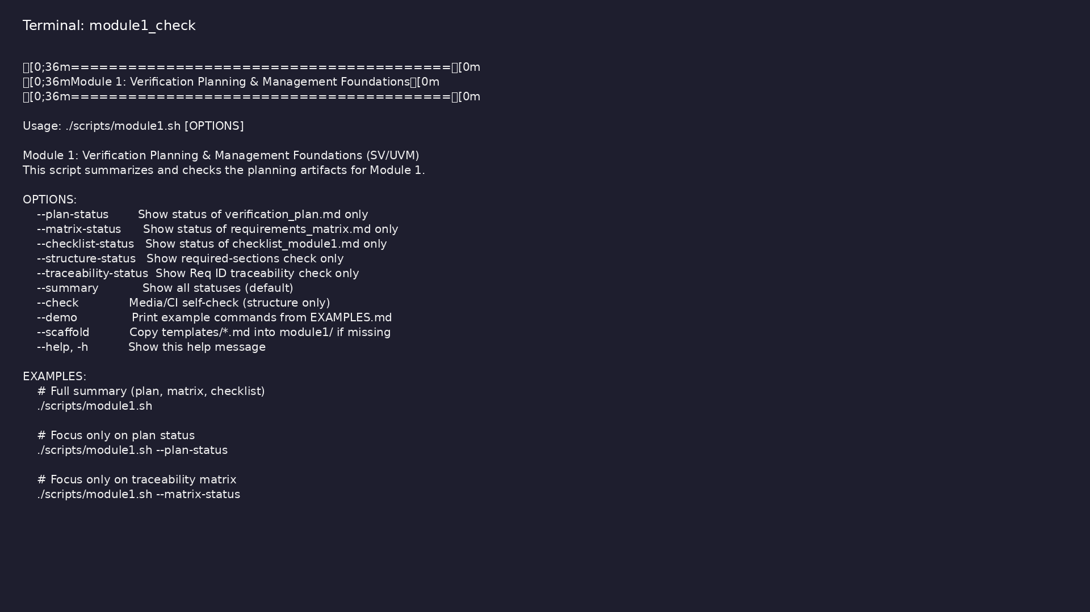
Module 1 self-check
$ ./scripts/module1.sh --help
verification_planning_management / Module 1
Notes:
Run from course repository root.

Slide 42
Exercise scaffold
./scripts/module1.sh --scaffold
verification_planning_management / Module 1

Slide 43
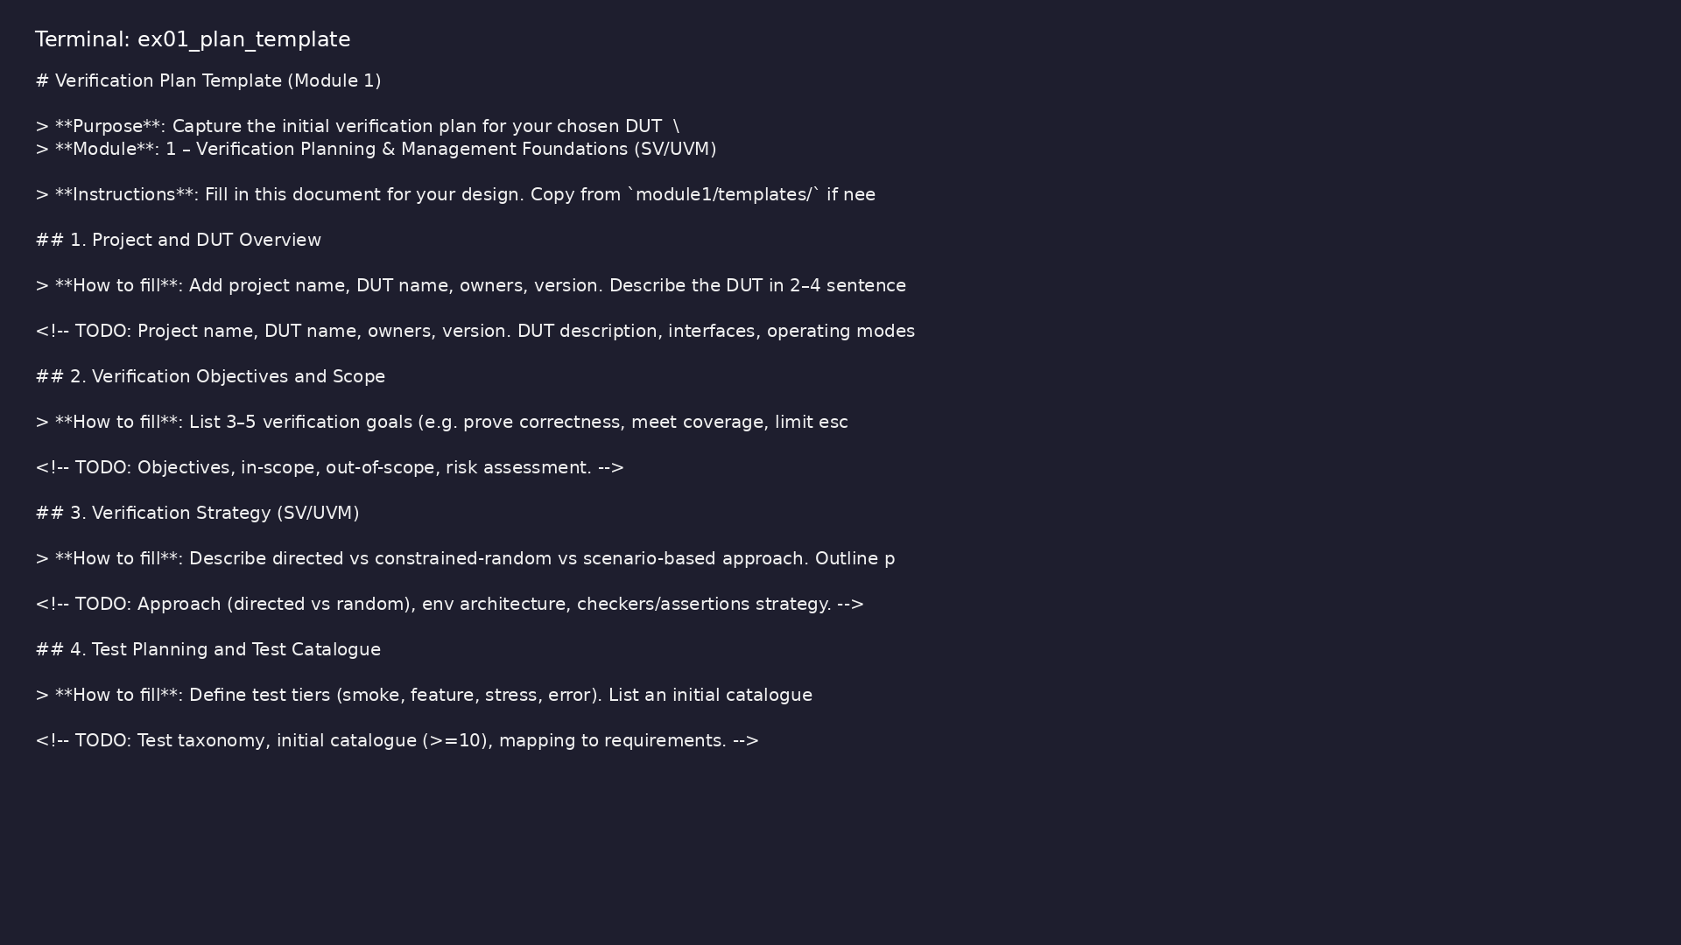
Demo: Verification plan template
$ head -30 module1/templates/VERIFICATION_PLAN.md
verification_planning_management / Module 1
Notes:
Hands-on: module1/examples/plan_template/

Slide 44
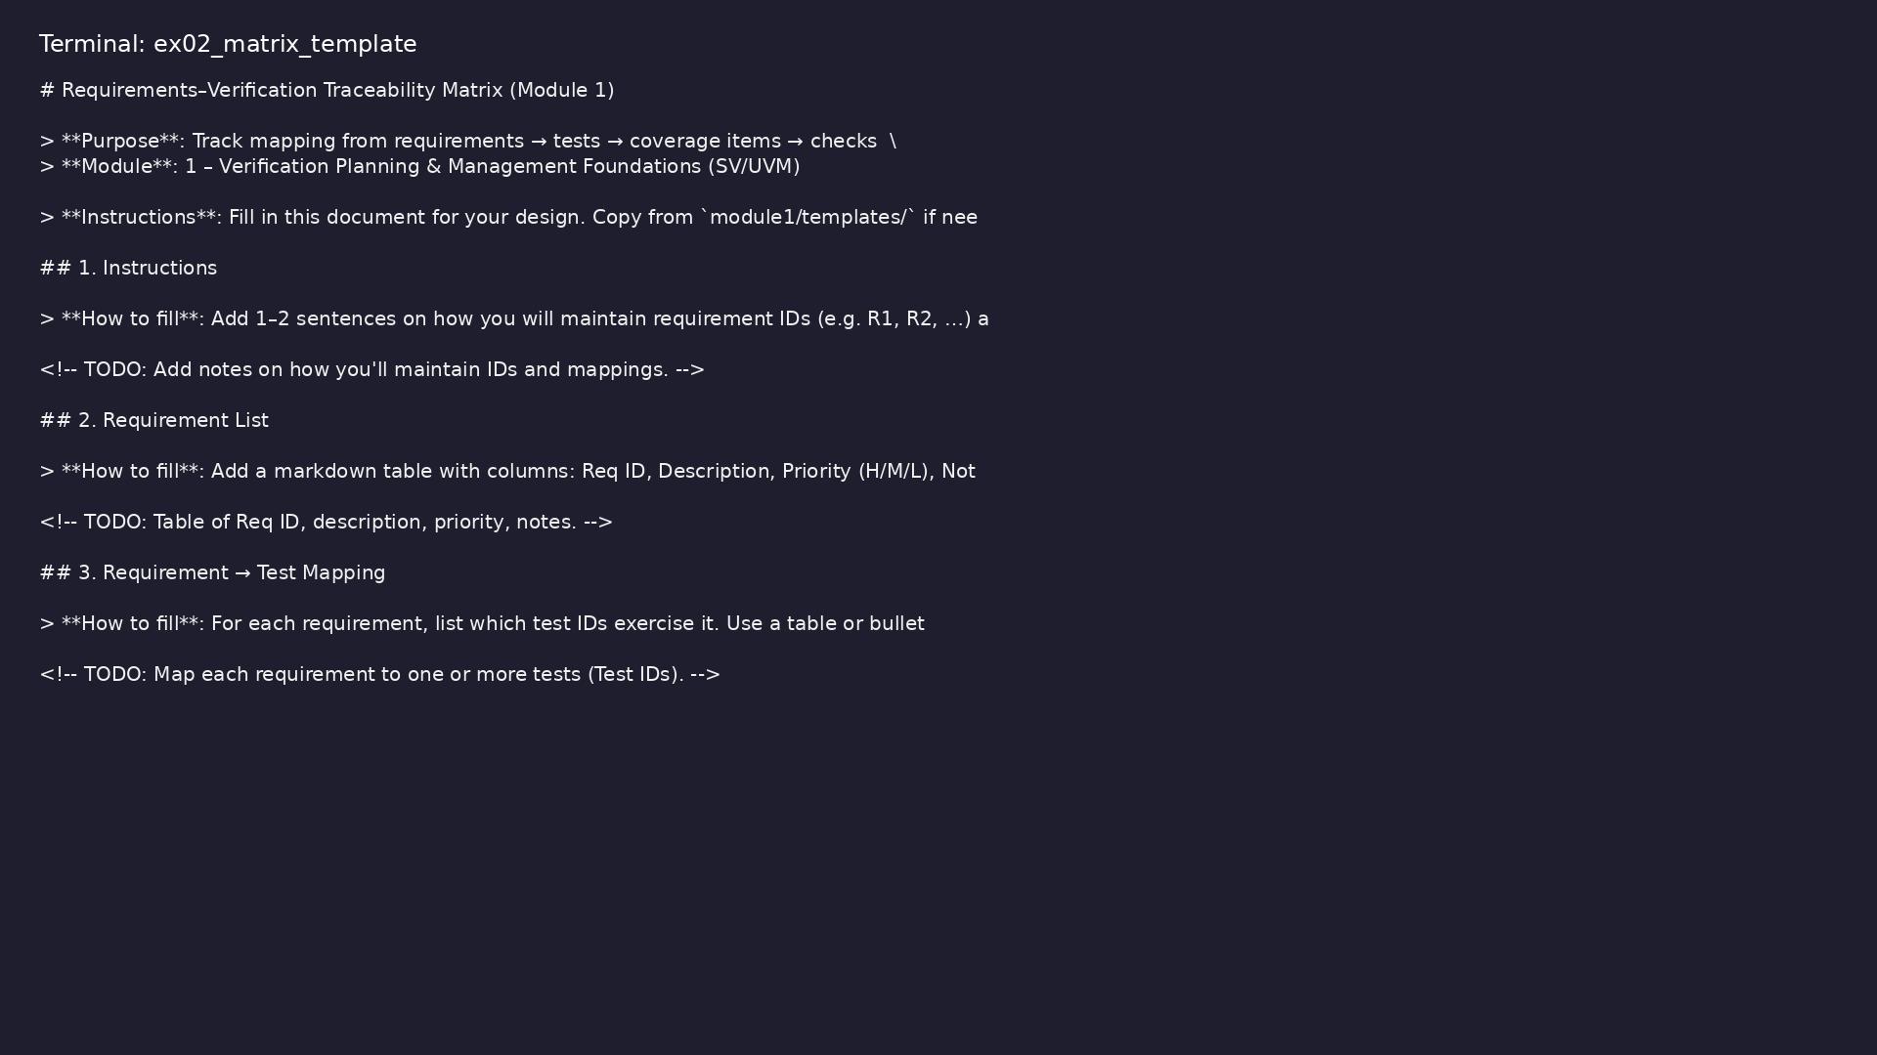
Demo: Requirements matrix template
$ head -25 module1/templates/REQUIREMENTS_MATRIX.md
verification_planning_management / Module 1
Notes:
Hands-on: module1/examples/matrix_template/

Slide 45

Demo: Reference solution
$ head -20 module1/.solutions/VERIFICATION_PLAN.md
verification_planning_management / Module 1
Notes:
Hands-on: module1/examples/solutions/

Slide 46
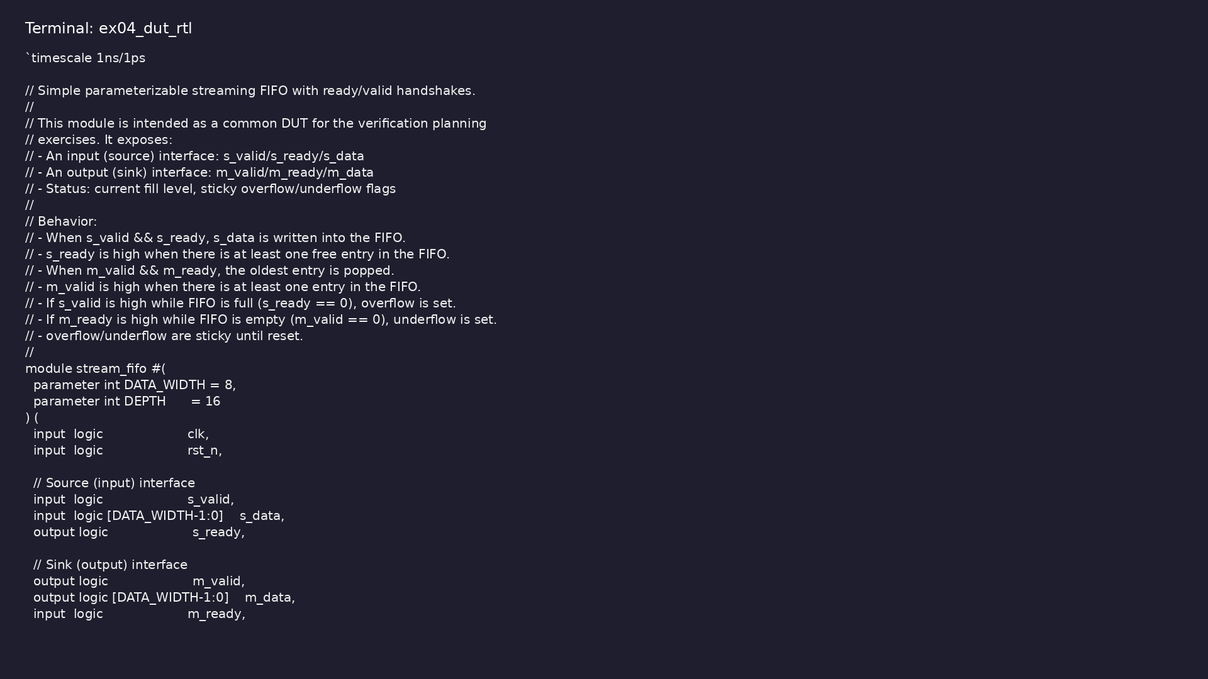
Demo: Shared DUT RTL
$ head -35 common_dut/rtl/stream_fifo.sv
verification_planning_management / Module 1
Notes:
Hands-on: module1/examples/dut_rtl/

Slide 47

Demo: Module validation
$ ./scripts/module1.sh --check
verification_planning_management / Module 1
Notes:
Hands-on: module1/examples/validate/

Slide 48
Practice & assessment
verification_planning_management / Module 1

Slide 49
What you should know (1/6)
• Explain the role of verification and its
relationship to design.
• Turn a DUT specification into a verification scope
with clear assumptions and boundaries.
• Draft a verification strategy for a simple Verilog
DUT and SV/UVM environment.
• Create an initial test catalogue (test intents)
linked to requirements.
• Sketch a coverage plan (what to measure and rough
coverage goals).
• Describe a basic regression concept and outline
high-level sign-off ideas.
verification_planning_management / Module 1
Notes:
From MODULE1 Learning Outcomes.

Slide 50
What you should know (2/6)
• Given a short DUT spec (e.g., FIFO or UART), list:
• Functional requirements (what the DUT must do).
• Non-functional/quality requirements (throughput,
latency constraints, etc.).
• Assumptions and environment constraints.
• Classify each requirement as must-have, nice-to-
have, or future.
• Mark items explicitly as in-scope or out-of-scope
for this project.
verification_planning_management / Module 1
Notes:
From MODULE1 Learning Outcomes.

Slide 51
What you should know (3/6)
• Choose your DUT (FIFO / UART / AXI-lite block / your
own).
• In `module1/VERIFICATION_PLAN.md`, add sections for:
• Objectives and success criteria.
• High-level SV/UVM environment concept (env, agents,
scoreboard, reference model).
• Use of directed, random, and scenario-based tests.
• Planned use of assertions and protocol checkers.
verification_planning_management / Module 1
Notes:
From MODULE1 Learning Outcomes.

Slide 52
What you should know (4/6)
• Keep the strategy to 1–2 pages maximum.
• Create a table with columns:
• Test ID
• Test name
• Intent / description
• Related requirement IDs
verification_planning_management / Module 1
Notes:
From MODULE1 Learning Outcomes.

Slide 53
What you should know (5/6)
• Priority (H/M/L)
• Type (smoke/feature/stress/error)
• Populate at least 10 test intents for your DUT.
• From your requirement list and test catalogue,
identify:
• Signals/fields that deserve coverpoints (e.g.,
addresses, opcodes, status flags, error types).
• Crosses that matter (e.g., mode × error_type,
burst_length × address_range).
verification_planning_management / Module 1
Notes:
From MODULE1 Learning Outcomes.

Slide 54
What you should know (6/6)
• Write a brief description (no code required yet) of:
• Where each covergroup would live in the UVM
testbench (monitor, scoreboard, etc.).
• What hitting those bins would tell you about
verification completeness.
verification_planning_management / Module 1
Notes:
From MODULE1 Learning Outcomes.

Slide 55
Exercises
• Scope and Risk Matrix
• Assumption Log
• UVM Architecture Sketch
verification_planning_management / Module 1

Slide 56
Assessment checklist
• Can explain verification’s role and goals in the
SV/UVM context.
• Has produced a written verification scope (in-scope,
out-of-scope, assumptions).
• Has a concise verification strategy document for the
chosen DUT.
• Has an initial test catalogue with traceability to
requirements.
• Has a high-level coverage plan (what to cover and
why).
• Can articulate a basic regression and sign-off
concept, even if details come later.
verification_planning_management / Module 1

Slide 57
Summary & next steps
• Learn how to turn a DUT specification into a
concrete verification plan, with clear strategy,
cover…
• Complete module1/CHECKLIST.md
• Review module1/EXAMPLES.md and run each lab
• Next: Test Planning & Strategy in Depth
verification_planning_management / Module 1

