Slide 1
Module 2
Test Planning & Strategy in Depth (SV/UVM)
verification_planning_management / Module 2

Slide 2
Learning objectives
• Turn your initial verification plan into a detailed,
reviewable **test strategy**, with a structure…
verification_planning_management / Module 2

Slide 3
Prerequisites
• See module README
verification_planning_management / Module 2

Slide 4

Learning path
Turn your initial verification plan into a detailed, reviewable **test strategy**, with a structured test catalogue, negative/stress planni…
verification_planning_management / Module 2

Slide 5
Overview
• Module 1 gave you a high-level verification plan,
scope, and early test catalogue. In this module,…
verification_planning_management / Module 2

Slide 6
How to learn this module
verification_planning_management / Module 2

Slide 7
Suggested learning path (1/2)
• Re-read `module1/VERIFICATION_PLAN.md` and
`module1/REQUIREMENTS_MATRIX.md`.
• Scaffold Module 2 workspace if needed:
`./scripts/module2.sh --scaffold`
• Fill `module2/TEST_PLAN.md`, `REGRESSION_PLAN.md`,
and optionally refine `COVERAGE_PLAN.md`.
• Map each test intent to a future UVM test name,
sequence, and regression tier.
• Validate completeness: `./scripts/module2.sh
--check`
verification_planning_management / Module 2
Notes:
From docs/MODULE2.md — read guides before running demos.

Slide 8
Suggested learning path (2/2)
• Complete `module2/CHECKLIST.md` before Module 3.
verification_planning_management / Module 2
Notes:
From docs/MODULE2.md — read guides before running demos.

Slide 9
Design architecture
verification_planning_management / Module 2

Slide 10

1. UVM environment skeleton
• `common_dut/tb/stream_fifo_env_s
keleton.sv` — env + agent stubs
(source/sink agents).
• Hierarchy: `uvm_test` →
`stream_fifo_env` → agents →
(future) driver, sequencer,
monitor.
• Interfaces tie to DUT ports via
virtual interfaces or pin-level
connections in the top
testbench.
verification_planning_management / Module 2
Notes:
From MODULE2 Design Architecture.

Slide 11

2. Test-plan ↔ TB mapping
• `TEST_PLAN.md` catalogue entries
map to UVM tests, sequences, and
config knobs.
• `REGRESSION_PLAN.md` defines
tiers that will eventually
select subsets of tests.
• Naming conventions (`SMK_`,
`FTR_`, `ERR_`) link
documentation to future
`uvm_test` names.
verification_planning_management / Module 2
Notes:
From MODULE2 Design Architecture.

Slide 12
3. Test execution mapping (planning level)
• Each catalogue row specifies: UVM test class, base
sequence, plusargs/seeds, and regression tier.
• Smoke tests map to short directed sequences; stress
tests map to long-run or backpressure scenarios.
• Error-injection tests document illegal handshake or
overflow/underflow stimulus intent.
• `./scripts/module2.sh --check` confirms test plan
sections and TB skeleton references exist.
verification_planning_management / Module 2
Notes:
From MODULE2 Design Architecture.

Slide 13
Handshake logic (push/pop)
assign s_ready = (count < DEPTH);
assign m_valid = (count != 0);
assign level = count;
// Determine when to push/pop
always_comb begin
push = s_valid && s_ready;
pop = m_valid && m_ready;
end
verification_planning_management / Module 2

Slide 14
Agent stub — build_phase
class stream_fifo_agent_skeleton extends uvm_agent;
`uvm_component_utils(stream_fifo_agent_skeleton)
function new(string name = "stream_fifo_agent_skeleton", uvm_component
parent = null);
super.new(name, parent);
endfunction
function void build_phase(uvm_phase phase);
super.build_phase(phase);
// Stub: add driver, sequencer, monitor in later modules
endfunction
function void connect_phase(uvm_phase phase);
super.connect_phase(phase);
// Stub: connect driver to sequencer, etc.
# ...
verification_planning_management / Module 2

Slide 15
Key files to study
verification_planning_management / Module 2

Slide 16
Open these in the repo
• `module2/TEST_PLAN.md` — detailed test catalogue and
taxonomy
• `module2/REGRESSION_PLAN.md` — tier definitions and
pass/fail policy
• `module2/COVERAGE_PLAN.md` — coverage intent linked
to tests
• `common_dut/tb/stream_fifo_env_skeleton.sv` — env
hierarchy your tests will target
• `common_dut/rtl/stream_fifo.sv` — handshake and
status behavior to test
• `scripts/module2.sh` — structure and completeness
checks
verification_planning_management / Module 2
Notes:
Trace while running module2/EXAMPLES.md labs.

Slide 17
Verification & testing methods
verification_planning_management / Module 2

Slide 18

1. Test taxonomy
• Smoke/sanity — fast checks after
every change; feature — per-
requirement depth.
• Stress / long-run — backlog
pressure, sustained traffic;
error injection — overflow,
underflow, ill…
• Each type documents expected
runtime class and whether seeds
are fixed or varied.
verification_planning_management / Module 2
Notes:
From MODULE2 Verification & Testing Methods.

Slide 19
2. Regression tiering (planning level)
• Assign every catalogue test to sanity, core, stress,
or full tiers.
• Document pass/fail policy preview and which negative
tests are safe for frequent runs.
• `./scripts/module2.sh --check` verifies plan
completeness and TB skeleton presence.
verification_planning_management / Module 2
Notes:
From MODULE2 Verification & Testing Methods.

Slide 20
3. Reproducibility
• Plan seed strategy, constraint overrides, and
plusargs per test for debuggable random runs.
verification_planning_management / Module 2
Notes:
From MODULE2 Verification & Testing Methods.

Slide 21
Module 2 — scaffold and check
#!/usr/bin/env bash
# Module 2: Test Planning & Strategy Orchestrator
# This script summarizes and checks the planning artifacts for Module 2.
# Usage: ./scripts/module2.sh [OPTIONS]
set -euo pipefail
# Colors for output
RED='\033[0;31m'
GREEN='\033[0;32m'
YELLOW='\033[1;33m'
verification_planning_management / Module 2

Slide 22
Syllabus topics
verification_planning_management / Module 2

Slide 23
1. Test Taxonomy and Structure (1/2)
• Test Types
• Smoke/sanity vs feature vs stress vs error-injection
vs performance (if applicable).
• Directed vs constrained-random vs scenario-based
tests.
• Tiers and Frequency
• Per-commit / pre-push tests.
• Nightly regression suites.
verification_planning_management / Module 2
Notes:
From MODULE2 Topics Covered.

Slide 24
1. Test Taxonomy and Structure (2/2)
• Weekly full or long-running suites.
• Mapping to UVM
• How test types relate to UVM tests and sequences.
• Using configuration objects / plusargs / factory
overrides to specialize tests.
verification_planning_management / Module 2
Notes:
From MODULE2 Topics Covered.

Slide 25
2. Test Catalogue Refinement (1/2)
• From List to Catalogue
• Expanding the initial 10–20 test intents into a more
complete catalogue.
• Grouping tests by feature, interface, or requirement
group.
• Naming and Metadata
• Test ID conventions (e.g., `SMK_`, `FTR_`, `STR_`,
`ERR_` prefixes).
• Metadata: owner, runtime class (short/medium/long),
deterministic vs random, seed handling.
verification_planning_management / Module 2
Notes:
From MODULE2 Topics Covered.

Slide 26
2. Test Catalogue Refinement (2/2)
• Redundancy and Value
• Identifying overlapping tests and merging where
reasonable.
• Distinguishing “coverage-driving” tests vs
“regression guardrail” tests.
verification_planning_management / Module 2
Notes:
From MODULE2 Topics Covered.

Slide 27
3. Negative, Stress, and Corner-Case Planning (1/2)
• Negative Testing
• Illegal sequences, protocol violations, out-of-range
values.
• Malformed packets/transactions, timing violations
(where meaningful).
• Stress and Long-Run Scenarios
• High-load / long-duration tests.
• Pseudo-random traffic, back-to-back operations,
resource exhaustion.
verification_planning_management / Module 2
Notes:
From MODULE2 Topics Covered.

Slide 28
3. Negative, Stress, and Corner-Case Planning (2/2)
• Corner Cases
• Boundary values, wrap-around conditions, reset-in-
the-middle, mode transitions.
• Instrumentation Needs
• What additional checks, monitors, or assertions are
needed to support these tests.
verification_planning_management / Module 2
Notes:
From MODULE2 Topics Covered.

Slide 29
4. Seeds, Constraints, and Reproducibility (1/2)
• Seed Strategy
• When to fix seeds vs vary them.
• How to record seeds for debugging and
reproducibility.
• Constraints and Randomization Control
• High-level constraints in sequences vs constraint
overrides per test.
• Guarding against “over-constrained” tests that hide
bugs.
verification_planning_management / Module 2
Notes:
From MODULE2 Topics Covered.

Slide 30
4. Seeds, Constraints, and Reproducibility (2/2)
• Test Parameters and Configurations
• Using UVM configuration database, plusargs, or
config files.
• Planning for parametrization (e.g., data width,
depth, mode).
verification_planning_management / Module 2
Notes:
From MODULE2 Topics Covered.

Slide 31
5. Regression Tiering and Policies (Planning Level) (1/2)
• Regression Tiers
• Tier definitions (e.g., `sanity`, `core_feature`,
`stress`, `full`).
• Target runtimes and approximate test counts for each
tier.
• Test Assignment
• Mapping each test in the catalogue to one or more
tiers.
• Deciding which negative/stress tests are safe for
frequent runs.
verification_planning_management / Module 2
Notes:
From MODULE2 Topics Covered.

Slide 32
5. Regression Tiering and Policies (Planning Level) (2/2)
• Pass/Fail Policies (Preview)
• What counts as a pass, fail, flake.
• Basic quarantine strategy for flaky tests (details
in later modules).
verification_planning_management / Module 2
Notes:
From MODULE2 Topics Covered.

Slide 33
6. Coordination with Coverage and Requirements
• Closing Loops with Requirements
• Ensuring each high-priority requirement has enough
tests (not just one).
• Verifying that tests exercise planned coverage
points.
• Coverage-Driven Test Gaps
• Identifying missing tests from coverage perspective
(e.g., unhit bins).
• Planning targeted tests to close meaningful coverage
holes.
verification_planning_management / Module 2
Notes:
From MODULE2 Topics Covered.

Slide 34
Command reference highlights
verification_planning_management / Module 2

Slide 35
Scaffold and validate Module 2
• ./scripts/module2.sh --scaffold
verification_planning_management / Module 2
Notes:
Full detail in docs/MODULE2.md command reference.

Slide 36
Review test and regression templates
• head -40 module2/templates/TEST_PLAN.md
verification_planning_management / Module 2
Notes:
Full detail in docs/MODULE2.md command reference.

Slide 37
Hands-on examples
verification_planning_management / Module 2

Slide 38
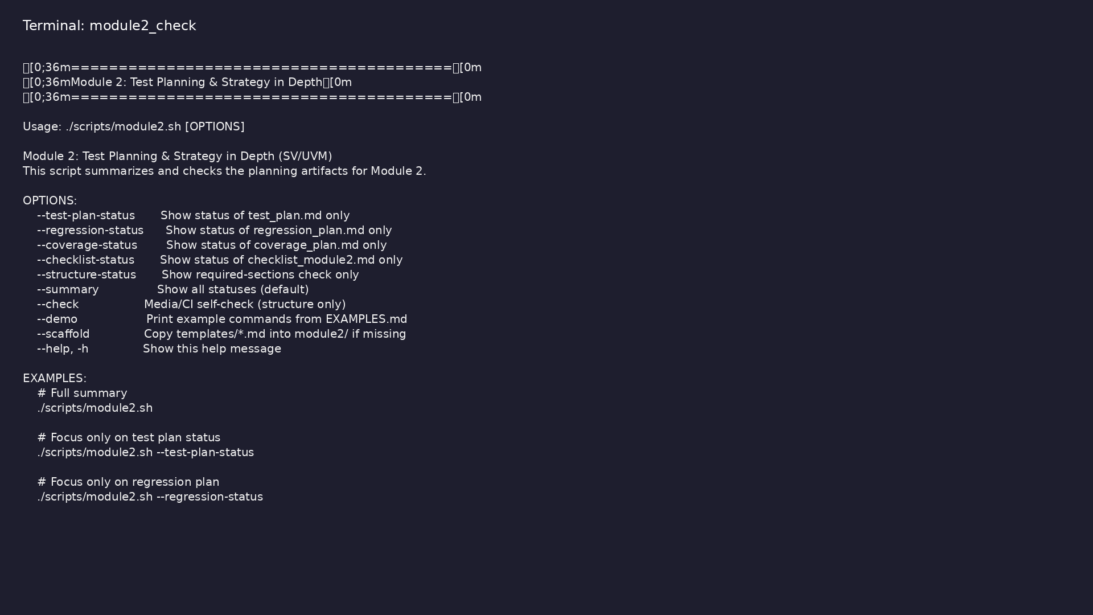
Module 2 self-check
$ ./scripts/module2.sh --help
verification_planning_management / Module 2
Notes:
Run from course repository root.

Slide 39
Exercise scaffold
./scripts/module2.sh --scaffold
verification_planning_management / Module 2

Slide 40
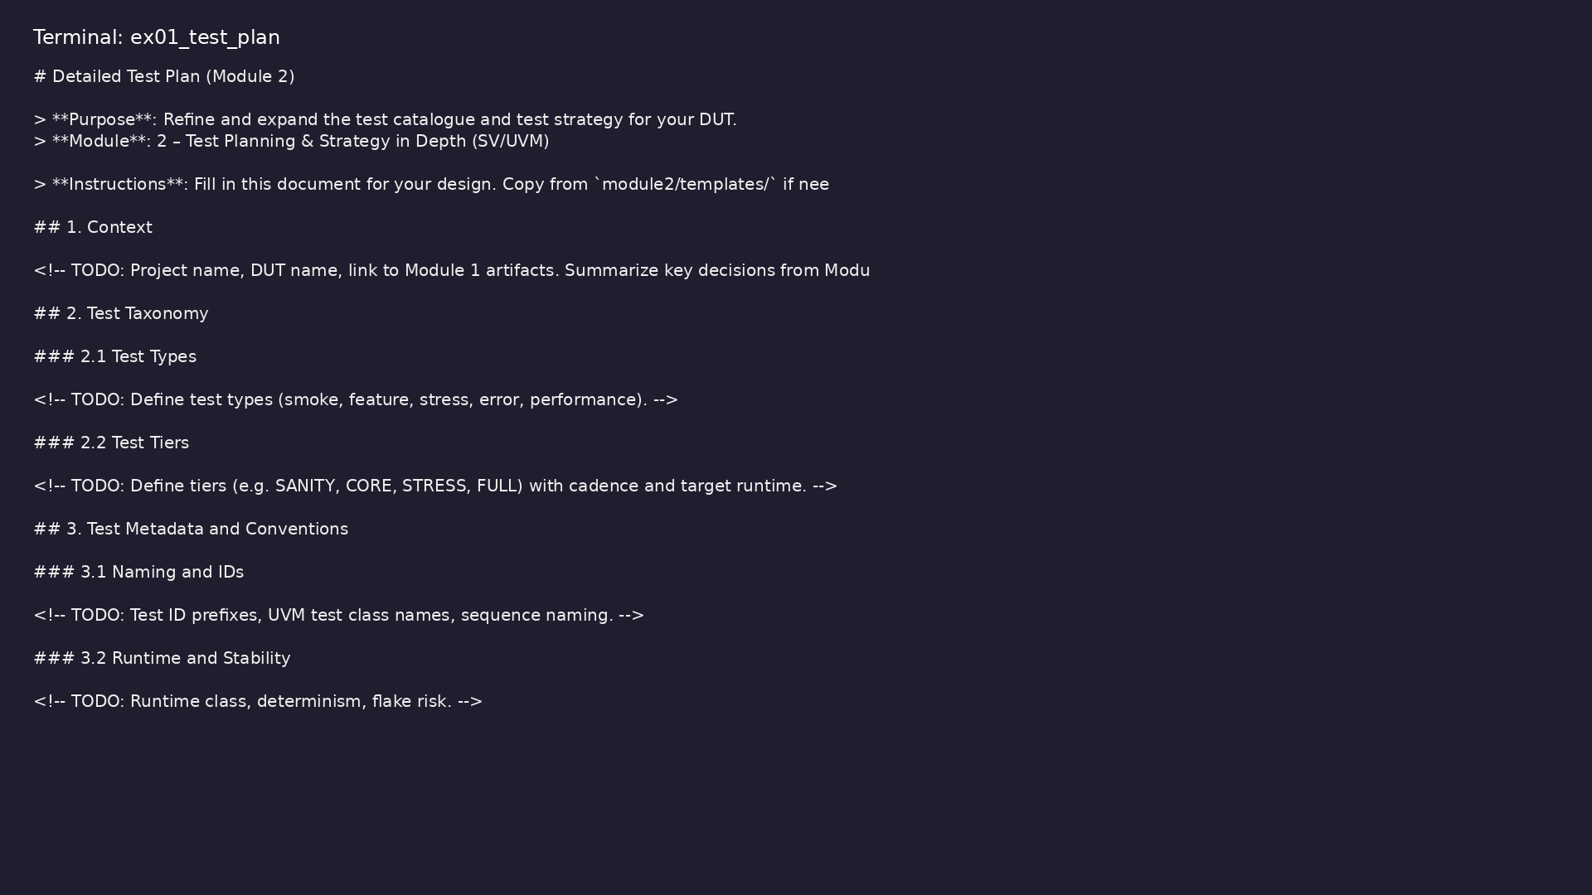
Demo: Test plan template
$ head -30 module2/templates/TEST_PLAN.md
verification_planning_management / Module 2
Notes:
Hands-on: module2/examples/test_plan/

Slide 41
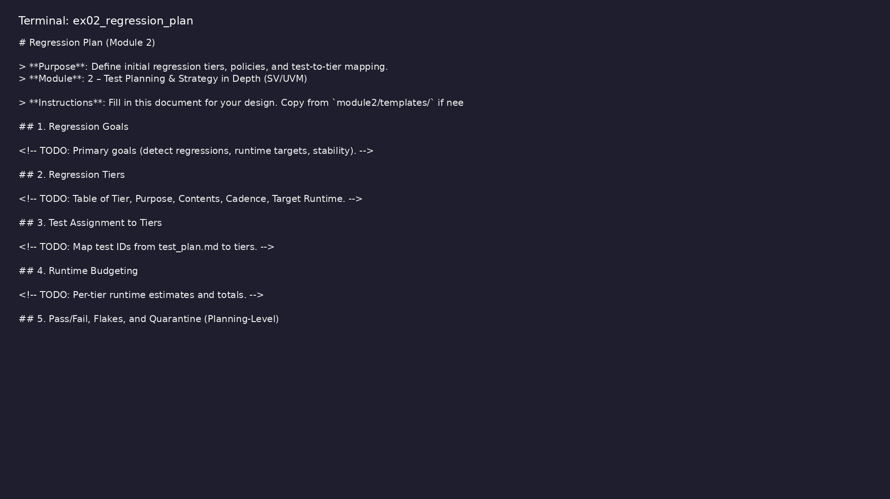
Demo: Regression plan template
$ head -25 module2/templates/REGRESSION_PLAN.md
verification_planning_management / Module 2
Notes:
Hands-on: module2/examples/regression_plan/

Slide 42
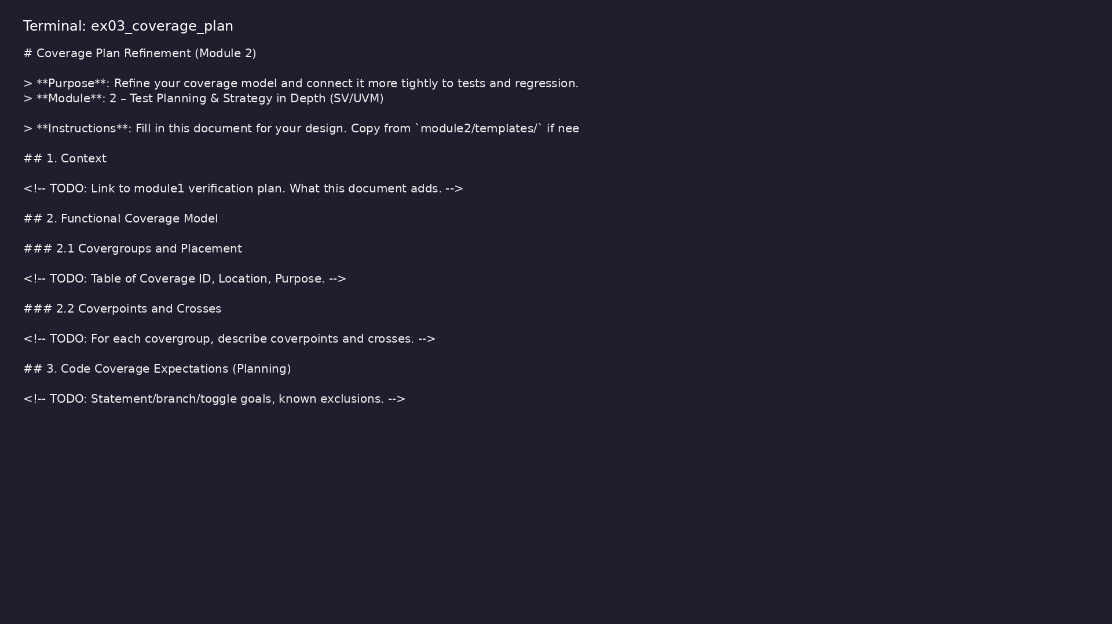
Demo: Coverage plan template
$ head -25 module2/templates/COVERAGE_PLAN.md
verification_planning_management / Module 2
Notes:
Hands-on: module2/examples/coverage_plan/

Slide 43
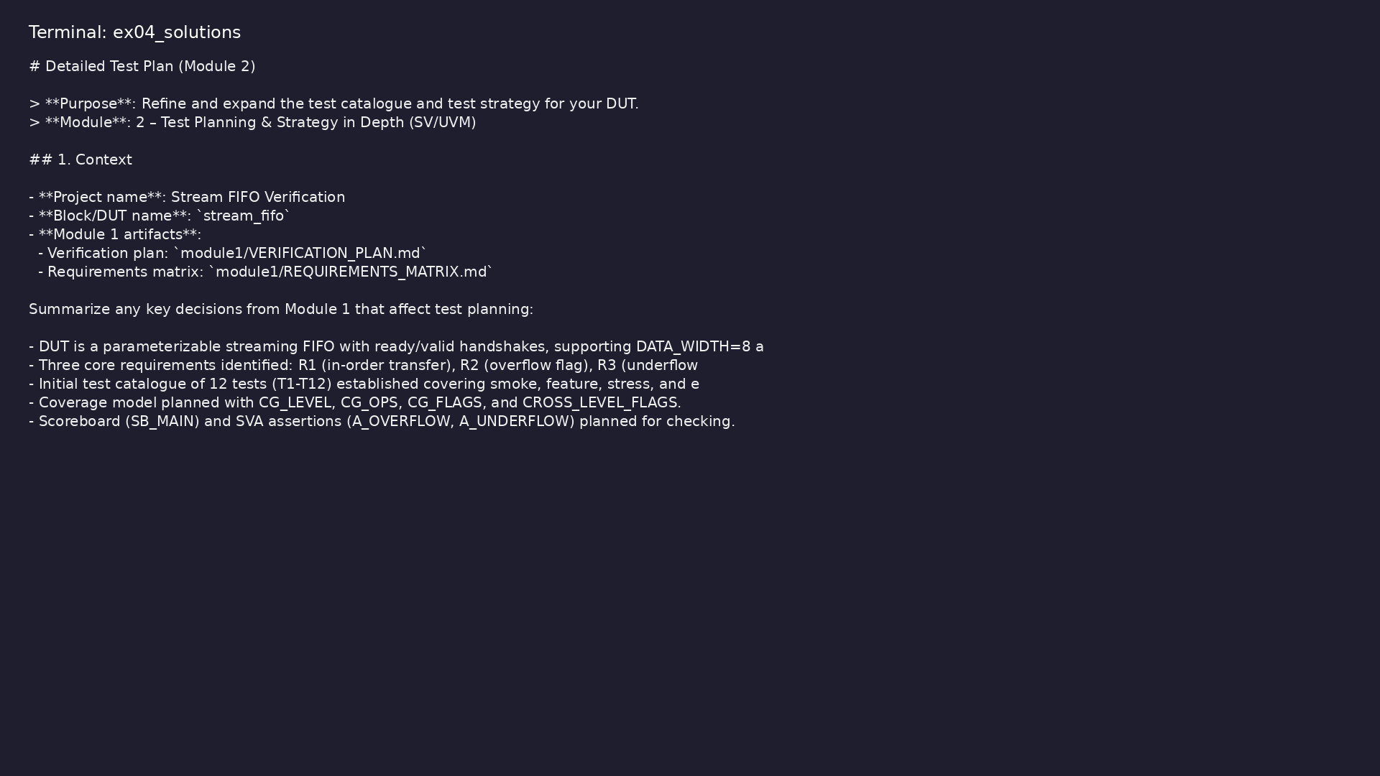
Demo: Reference test plan
$ head -20 module2/.solutions/TEST_PLAN.md
verification_planning_management / Module 2
Notes:
Hands-on: module2/examples/solutions/

Slide 44

Demo: Module validation
$ ./scripts/module2.sh --check
verification_planning_management / Module 2
Notes:
Hands-on: module2/examples/validate/

Slide 45
Practice & assessment
verification_planning_management / Module 2

Slide 46
What you should know (1/6)
• Design a structured test taxonomy tailored to your
DUT and UVM environment.
• Maintain a rich test catalogue with clear metadata
and priorities.
• Plan explicit negative, stress, and corner-case
tests.
• Define initial regression tiers and assign tests to
them.
• Explain how your test plan supports requirements
coverage and coverage closure.
• In `module2/TEST_PLAN.md`, define:
verification_planning_management / Module 2
Notes:
From MODULE2 Learning Outcomes.

Slide 47
What you should know (2/6)
• Test types with definitions and examples.
• Tiers (sanity, core, stress, full) with expected
runtime budgets.
• For at least 10 existing tests from Module 1,
assign:
• Type, tier, and expected runtime.
• Grow your catalogue to 25–40 tests (intents),
focusing on:
• Feature coverage.
verification_planning_management / Module 2
Notes:
From MODULE2 Learning Outcomes.

Slide 48
What you should know (3/6)
• Interface/protocol scenarios.
• Mode and configuration combinations.
• Identify at least 3 redundant or low-value tests
and:
• Merge or remove them, documenting the decision.
• Add at least:
• 3 negative tests (illegal, malformed, or out-of-
range behavior).
verification_planning_management / Module 2
Notes:
From MODULE2 Learning Outcomes.

Slide 49
What you should know (4/6)
• 3 stress or long-run tests.
• For each, define:
• Preconditions and exact stimuli.
• Expected behavior (including assertions/flags).
• Special logging or debug support needed.
• Decide:
verification_planning_management / Module 2
Notes:
From MODULE2 Learning Outcomes.

Slide 50
What you should know (5/6)
• Which tests will run with fixed vs varying seeds.
• How seeds will be passed (e.g., plusargs, config).
• Document this in `module2/TEST_PLAN.md` and update
`module1/REQUIREMENTS_MATRIX.md` if needed.
• In `module2/REGRESSION_PLAN.md`, define:
• Tier names, cadence (per-commit, nightly, weekly),
and runtime targets.
• Inclusion criteria for tests in each tier.
verification_planning_management / Module 2
Notes:
From MODULE2 Learning Outcomes.

Slide 51
What you should know (6/6)
• For each test in your catalogue, add a column
indicating:
• Primary tier(s) it belongs to.
verification_planning_management / Module 2
Notes:
From MODULE2 Learning Outcomes.

Slide 52
Exercises
• Runtime Budgeting
• Flake-Resistance Design
• Traceability Check
verification_planning_management / Module 2

Slide 53
Assessment checklist
• Has a written test taxonomy and tier definition.
• Test catalogue expanded and de-duplicated with clear
metadata.
• Negative, stress, and corner-case tests are
explicitly planned.
• Seed and randomness policy is documented.
• A draft regression plan exists with test-to-tier
mapping.
• Requirements and coverage implications are reflected
in the updated plan/matrix.
verification_planning_management / Module 2

Slide 54
Summary & next steps
• Turn your initial verification plan into a detailed,
reviewable **test strategy**, with a structure…
• Complete module2/CHECKLIST.md
• Review module2/EXAMPLES.md and run each lab
• Next: Coverage Planning & Analysis in Practice
verification_planning_management / Module 2

