Slide 1
Module 3
Coverage Planning & Analysis in Practice (SV/UVM)
verification_planning_management / Module 3

Slide 2
Learning objectives
• Design and implement a practical **coverage model**
(functional + code), connect it to your UVM env…
verification_planning_management / Module 3

Slide 3
Prerequisites
• See module README
verification_planning_management / Module 3

Slide 4

Learning path
Design and implement a practical **coverage model** (functional + code), connect it to your UVM environment and test plan, and perform firs…
verification_planning_management / Module 3

Slide 5
Overview
• Modules 1–2 focused on **what to test** and **how to
structure tests and regressions**. Module 3 tu…
verification_planning_management / Module 3

Slide 6
How to learn this module
verification_planning_management / Module 3

Slide 7
Suggested learning path (1/2)
• Re-open `module2/TEST_PLAN.md` and
`module2/COVERAGE_PLAN.md`.
• Scaffold Module 3 workspace: `./scripts/module3.sh
--scaffold`
• Design covergroups in `module3/COVERAGE_DESIGN.md`
and plan runs in `COVERAGE_RUN.md`.
• Implement or review
`common_dut/tb/stream_fifo_coverage.sv` covergroup
definitions.
• Run a small CORE-tier regression and capture
coverage (document in `COVERAGE_RUN.md`).
verification_planning_management / Module 3
Notes:
From docs/MODULE3.md — read guides before running demos.

Slide 8
Suggested learning path (2/2)
• Validate: `./scripts/module3.sh --check`
verification_planning_management / Module 3
Notes:
From docs/MODULE3.md — read guides before running demos.

Slide 9
Design architecture
verification_planning_management / Module 3

Slide 10

1. Coverage in the UVM environment
• Functional coverage lives in `co
mmon_dut/tb/stream_fifo_coverage
.sv` (covergroups, crosses).
• Monitors/agents sample
transactions that feed
coverpoints (fill level,
handshake patterns, errors).
• `COVERAGE_DESIGN.md` is the
authoritative map from
requirements → coverpoints →
tests.
verification_planning_management / Module 3
Notes:
From MODULE3 Design Architecture.

Slide 11

2. Code coverage integration
• Simulator line/branch/FSM
coverage configured in your run
scripts (documented in
`COVERAGE_RUN.md`).
• Separate functional vs code
coverage roles: intent vs
implementation exercised.
verification_planning_management / Module 3
Notes:
From MODULE3 Design Architecture.

Slide 12
3. Coverage run and merge pipeline
• Run: select CORE-tier tests → enable functional +
code coverage in simulator → save per-test databa…
• Merge: combine run databases into a session or
regression snapshot for analysis.
• Analyze: compare merged coverage against goals in
`COVERAGE_PLAN.md`; record gaps in `COVERAGE_RUN.…
• Close: add targeted tests or refine coverpoints; re-
run until must-cover bins are hit.
verification_planning_management / Module 3
Notes:
From MODULE3 Design Architecture.

Slide 13
Coverage model — covergroups
covergroup cg_ops;
option.per_instance = 1;
cp_op_type: coverpoint op_type {
bins idle = { 0 };
bins push_only = { 1 };
bins pop_only = { 2 };
bins push_and_pop = { 3 };
}
endgroup
// -------------------------------------------------------------------
------
// CG_LEVEL: Occupancy levels (empty / low / mid / high / full)
// -------------------------------------------------------------------
------
covergroup cg_level;
option.per_instance = 1;
cp_level: coverpoint level {
verification_planning_management / Module 3

Slide 14
Key files to study
verification_planning_management / Module 3

Slide 15
Open these in the repo
• `module3/COVERAGE_DESIGN.md` — coverpoints, crosses,
and requirement mapping
• `module3/COVERAGE_RUN.md` — run logs, merge steps,
and gap analysis notes
• `common_dut/tb/stream_fifo_coverage.sv` — functional
coverage implementation
• `module2/COVERAGE_PLAN.md` — coverage goals and tier
linkage
• `scripts/module3.sh` — coverage design and TB
presence checks
verification_planning_management / Module 3
Notes:
Trace while running module3/EXAMPLES.md labs.

Slide 16
Verification & testing methods
verification_planning_management / Module 3

Slide 17

1. Coverage-driven verification (CDV)
• Run a CORE-tier regression
subset, merge coverage, and
compare against goals in
`COVERAGE_PLAN.md`.
• Use gap analysis to add targeted
tests or relax/remove low-value
bins — not blind random runs.
verification_planning_management / Module 3
Notes:
From MODULE3 Verification & Testing Methods.

Slide 18
2. Closure loop
• Requirements → tests → coverpoints → measured bins →
updated plan/tests.
• `./scripts/module3.sh --check` expects covergroup
references and coverage design docs.
verification_planning_management / Module 3
Notes:
From MODULE3 Verification & Testing Methods.

Slide 19
3. Reporting discipline
• Log each run in `COVERAGE_RUN.md` with tool, seed,
tier, and top uncovered items.
verification_planning_management / Module 3
Notes:
From MODULE3 Verification & Testing Methods.

Slide 20
sample() integration point
function new(int depth_param = 16);
depth = depth_param;
cg_ops = new();
cg_level = new();
cg_flags = new();
endfunction
// Call from monitor on posedge clk after driving level, op_type,
overflow, underflow
function void sample();
cg_ops.sample();
cg_level.sample();
cg_flags.sample();
endfunction
verification_planning_management / Module 3

Slide 21
Module 3 — coverage checks
#!/usr/bin/env bash
# Module 3: Coverage Planning & Analysis Orchestrator
# This script summarizes and checks the coverage artifacts for Module 3.
# Usage: ./scripts/module3.sh [OPTIONS]
set -euo pipefail
# Colors for output
RED='\033[0;31m'
GREEN='\033[0;32m'
YELLOW='\033[1;33m'
verification_planning_management / Module 3

Slide 22
Syllabus topics
verification_planning_management / Module 3

Slide 23
1. From Coverage Plan to Concrete Model
• Refinement of Coverage Goals
• Translating high-level goals into specific
covergroups and bins.
• Deciding which metrics are *must-hit* vs *nice-to-
have*.
• Coverage Model Structure
• Organizing covergroups by feature, interface, or
component.
• Choosing the right placement (agent monitor,
scoreboard, reference model, etc.).
verification_planning_management / Module 3
Notes:
From MODULE3 Topics Covered.

Slide 24
2. Functional Coverage Implementation (SV/UVM) (1/2)
• Covergroup Basics
• `covergroup` declaration, sampling events (`@`), and
options.
• Coverpoints: bins, ranges, wildcards, ignore/illegal
bins.
• Cross coverage: when and how to cross (and when not
to).
• Sampling Strategy
• Sampling on transactions vs clocks vs protocol
events.
verification_planning_management / Module 3
Notes:
From MODULE3 Topics Covered.

Slide 25
2. Functional Coverage Implementation (SV/UVM) (2/2)
• Avoiding oversampling/undersampling.
• Integration with UVM Components
• Embedding covergroups in monitors/scoreboards.
• Using analysis ports/exports for coverage sampling.
verification_planning_management / Module 3
Notes:
From MODULE3 Topics Covered.

Slide 26
3. Code Coverage Setup and Interpretation (1/2)
• Enabling Code Coverage
• Turning on statement/branch/toggle coverage in your
simulator.
• Handling compile-time options and run-time switches.
• Interpreting Results
• Reading coverage reports and understanding common
metrics.
• Distinguishing real gaps from unreachable or out-of-
scope code.
verification_planning_management / Module 3
Notes:
From MODULE3 Topics Covered.

Slide 27
3. Code Coverage Setup and Interpretation (2/2)
• Managing Exclusions
• Identifying truly unreachable code.
• Documenting exclusions and waivers with rationale.
verification_planning_management / Module 3
Notes:
From MODULE3 Topics Covered.

Slide 28
4. Running Coverage-Enabled Regressions (1/2)
• Pilot Regressions
• Start with a modest CORE-tier run (not full
regression).
• Ensure coverage data collection is working end-to-
end.
• Merging Coverage
• Combining coverage from multiple tests/regressions.
• Understanding how your tool merges coverage across
runs and seeds.
verification_planning_management / Module 3
Notes:
From MODULE3 Topics Covered.

Slide 29
4. Running Coverage-Enabled Regressions (2/2)
• Automating Coverage Collection
• Hooks in your regression/CI scripts to generate
coverage databases/reports.
verification_planning_management / Module 3
Notes:
From MODULE3 Topics Covered.

Slide 30
5. Coverage Analysis and Gap Closure (1/3)
• Gap Identification
• Finding unhit or low-hit coverpoints and crosses.
• Detecting missing or ineffective coverage (bins that
never can be hit).
• Root-Cause Analysis
• Is the gap due to:
• Missing or mis-specified tests?
verification_planning_management / Module 3
Notes:
From MODULE3 Topics Covered.

Slide 31
5. Coverage Analysis and Gap Closure (2/3)
• Overly tight constraints?
• Incomplete coverage model?
• Truly unreachable or out-of-scope functionality?
• Closure Actions
• Adding or modifying tests (directed or constrained-
random).
• Adjusting constraints or sequences.
verification_planning_management / Module 3
Notes:
From MODULE3 Topics Covered.

Slide 32
5. Coverage Analysis and Gap Closure (3/3)
• Refining or pruning coverage points.
• Documenting waivers where appropriate.
verification_planning_management / Module 3
Notes:
From MODULE3 Topics Covered.

Slide 33
6. Connecting Coverage to Requirements and Sign-off (1/2)
• Traceability
• Ensuring high-priority requirements are covered by
both tests and coverage.
• Updating `REQUIREMENTS_MATRIX.md` with coverage IDs
and status.
• Interpreting Coverage for Sign-off
• Understanding when “100% coverage” is meaningful
(and when it isn’t).
• Combining coverage with bug metrics and expert
judgment.
verification_planning_management / Module 3
Notes:
From MODULE3 Topics Covered.

Slide 34
6. Connecting Coverage to Requirements and Sign-off (2/2)
• Preparing for Later Modules
• How coverage insights will influence later
regression and sign-off modules.
verification_planning_management / Module 3
Notes:
From MODULE3 Topics Covered.

Slide 35
Command reference highlights
verification_planning_management / Module 3

Slide 36
Scaffold and validate Module 3
• ./scripts/module3.sh --scaffold
verification_planning_management / Module 3
Notes:
Full detail in docs/MODULE3.md command reference.

Slide 37
Inspect coverage model in TB
• head -60 common_dut/tb/stream_fifo_coverage.sv
verification_planning_management / Module 3
Notes:
Full detail in docs/MODULE3.md command reference.

Slide 38
Hands-on examples
verification_planning_management / Module 3

Slide 39

Module 3 self-check
$ ./scripts/module3.sh --help
verification_planning_management / Module 3
Notes:
Run from course repository root.

Slide 40
Exercise scaffold
./scripts/module3.sh --scaffold
verification_planning_management / Module 3

Slide 41
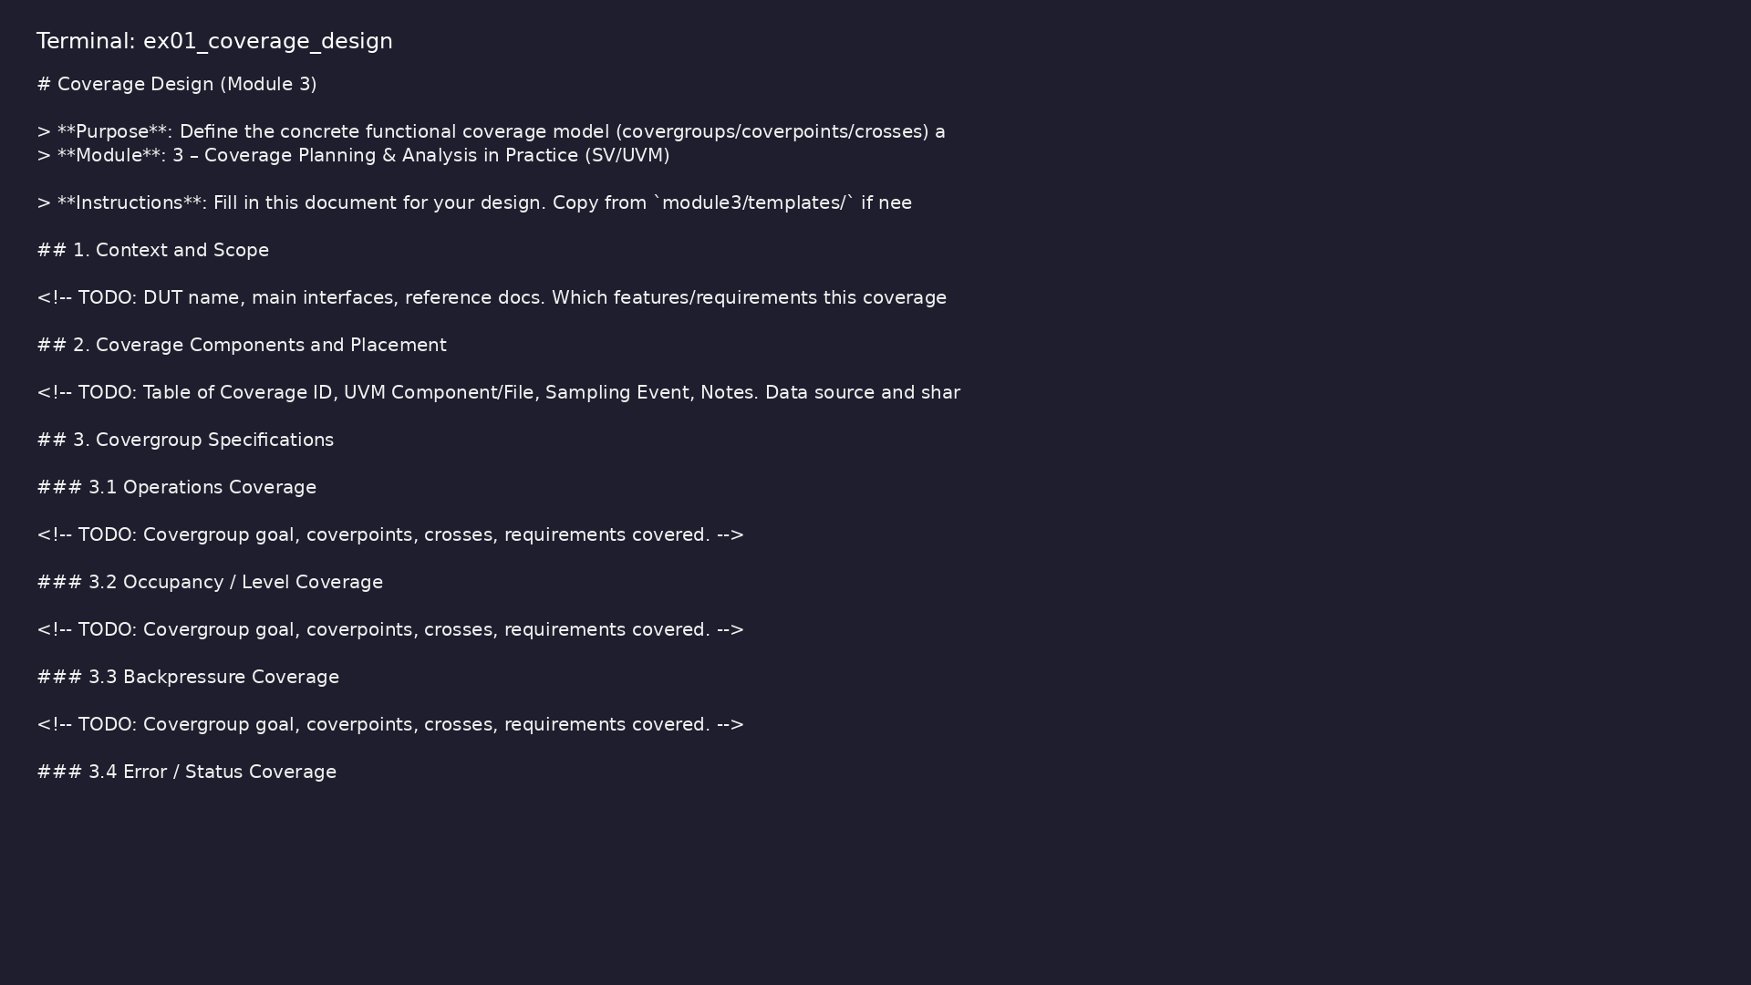
Demo: Coverage design template
$ head -30 module3/templates/COVERAGE_DESIGN.md
verification_planning_management / Module 3
Notes:
Hands-on: module3/examples/coverage_design/

Slide 42
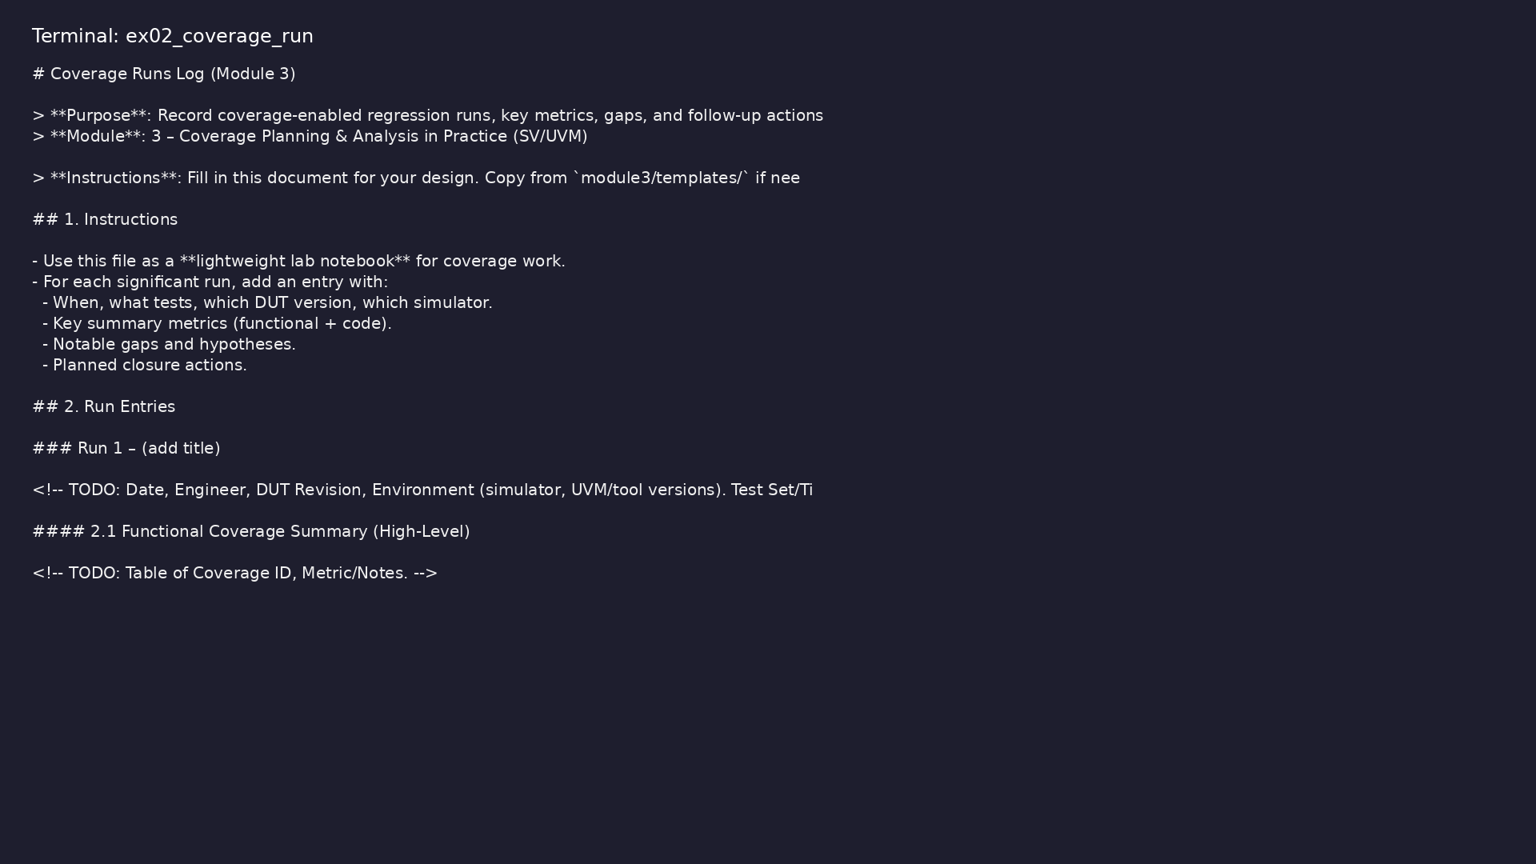
Demo: Coverage run log template
$ head -25 module3/templates/COVERAGE_RUN.md
verification_planning_management / Module 3
Notes:
Hands-on: module3/examples/coverage_run/

Slide 43

Demo: TB coverage skeleton
$ head -40 common_dut/tb/stream_fifo_coverage.sv
verification_planning_management / Module 3
Notes:
Hands-on: module3/examples/tb_coverage/

Slide 44
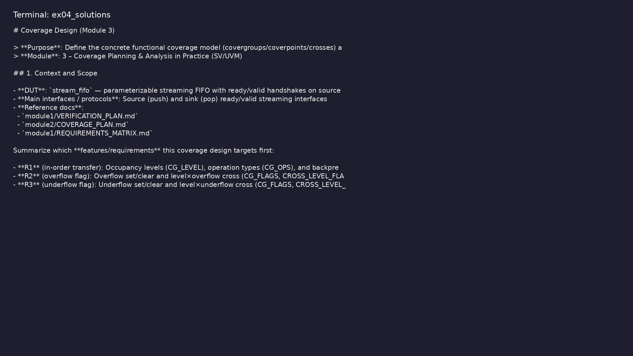
Demo: Reference coverage design
$ head -20 module3/.solutions/COVERAGE_DESIGN.md
verification_planning_management / Module 3
Notes:
Hands-on: module3/examples/solutions/

Slide 45

Demo: Module validation
$ ./scripts/module3.sh --check
verification_planning_management / Module 3
Notes:
Hands-on: module3/examples/validate/

Slide 46
Practice & assessment
verification_planning_management / Module 3

Slide 47
What you should know (1/5)
• Design and implement a concrete functional coverage
model for your DUT.
• Enable and collect code coverage from your
simulator.
• Run coverage-enabled regressions and interpret
coverage reports.
• Perform a structured coverage gap analysis and plan
closure actions.
• Tie coverage results back to requirements and sign-
off criteria.
• Choose 2–4 key features or interfaces.
verification_planning_management / Module 3
Notes:
From MODULE3 Learning Outcomes.

Slide 48
What you should know (2/5)
• For each, implement:
• At least one covergroup with meaningful coverpoints.
• At least one useful cross (if warranted).
• Integrate sampling into your UVM monitor/scoreboard.
• Verify that bins are being hit in basic tests (e.g.,
SANITY/CORE tests).
• Enable statement/branch coverage in your simulator
build/run scripts.
verification_planning_management / Module 3
Notes:
From MODULE3 Learning Outcomes.

Slide 49
What you should know (3/5)
• Run a small set of tests (e.g., SANITY or a subset
of CORE).
• Generate and inspect the coverage report.
• Identify:
• Any obvious coverage gaps in well-understood code.
• Any code that appears to be unreachable or out-of-
scope.
• In `module3/COVERAGE_RUN.md`, record at least one
coverage run:
verification_planning_management / Module 3
Notes:
From MODULE3 Learning Outcomes.

Slide 50
What you should know (4/5)
• Date, DUT version, test set/tier, seed policy,
simulator version.
• Key coverage metrics (summary) and major
observations.
• List at least 5 concrete coverage gaps and your
initial hypotheses.
• For at least 3 significant gaps:
• Decide whether to: add tests, tune constraints,
refine coverage, or waive.
• Document the chosen action and expected impact.
verification_planning_management / Module 3
Notes:
From MODULE3 Learning Outcomes.

Slide 51
What you should know (5/5)
• Update:
• `module2/TEST_PLAN.md` (new/updated tests).
• `module2/COVERAGE_PLAN.md` /
`module3/COVERAGE_DESIGN.md`.
• `module1/REQUIREMENTS_MATRIX.md` (coverage mappings,
waivers).
verification_planning_management / Module 3
Notes:
From MODULE3 Learning Outcomes.

Slide 52
Exercises
• Over-Coverage vs Under-Coverage
• Coverage vs Bug History (if available)
• Tooling Experiment
verification_planning_management / Module 3

Slide 53
Assessment checklist
• Functional coverage model implemented for key
features/interfaces.
• Code coverage successfully enabled and reports
generated.
• At least one coverage run documented in
`COVERAGE_RUN.md`.
• Coverage gaps identified and categorized
(test/constraint/model/waiver).
• Closure actions planned and reflected in
test/coverage/requirements docs.
verification_planning_management / Module 3

Slide 54
Summary & next steps
• Design and implement a practical **coverage model**
(functional + code), connect it to your UVM env…
• Complete module3/CHECKLIST.md
• Review module3/EXAMPLES.md and run each lab
• Next: UVM Environment and Checker Maturity
verification_planning_management / Module 3

