Slide 1
Module 4
UVM Environment & Checker Maturity (SV/UVM)
verification_planning_management / Module 4

Slide 2
Learning objectives
• Design and mature your **UVM environment** (env,
agents, drivers, monitors, sequencers) and **check…
verification_planning_management / Module 4

Slide 3
Prerequisites
• See module README
verification_planning_management / Module 4

Slide 4

Learning path
Design and mature your **UVM environment** (env, agents, drivers, monitors, sequencers) and **checking strategy** (scoreboards, reference m…
verification_planning_management / Module 4

Slide 5
Overview
• Modules 1–3 focused on planning (scope, tests,
regressions) and measurement (coverage). In Module
4…
verification_planning_management / Module 4

Slide 6
How to learn this module
verification_planning_management / Module 4

Slide 7
Suggested learning path (1/2)
• Re-read `module2/TEST_PLAN.md` and
`module3/COVERAGE_DESIGN.md`.
• Scaffold Module 4 workspace: `./scripts/module4.sh
--scaffold`
• Complete `module4/ENV_DESIGN.md` (agents,
transactions, connectivity).
• Complete `module4/CHECKER_PLAN.md` (scoreboard,
reference model, SVA split).
• Implement or refine UVM components in `module4/tb/`
and `common_dut/tb/`.
verification_planning_management / Module 4
Notes:
From docs/MODULE4.md — read guides before running demos.

Slide 8
Suggested learning path (2/2)
• Validate: `./scripts/module4.sh --check`
verification_planning_management / Module 4
Notes:
From docs/MODULE4.md — read guides before running demos.

Slide 9
Design architecture
verification_planning_management / Module 4

Slide 10
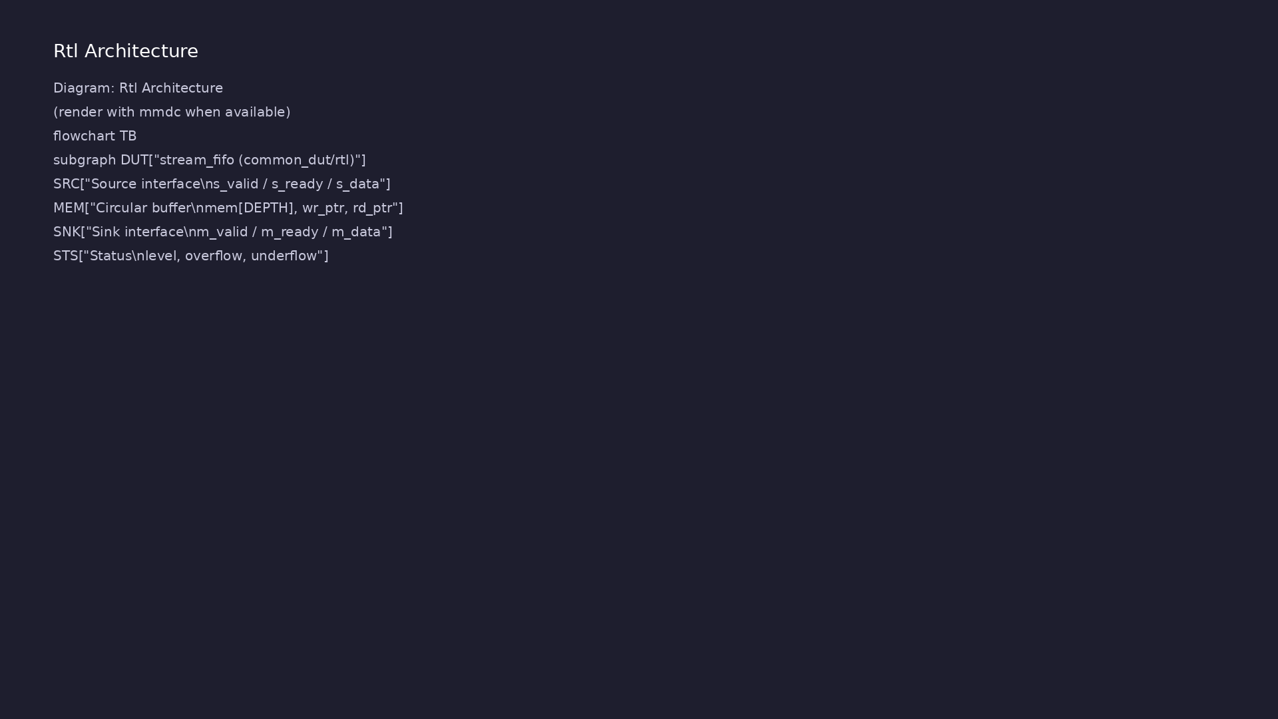
1. Mature UVM environment (stream_fifo)
• Env (`stream_fifo_env`):
connects source/sink agents,
scoreboard, coverage
subscribers.
• Agents: driver + sequencer +
monitor per interface; active vs
passive roles documented in
`ENV_DESI…
• Transactions: item fields mirror
DUT handshake semantics (data,
valid/ready timing).
• Reference implementation sketch:
`module4/tb/tb_stream_fifo_uvm.s
v` and `stream_pkg.sv` patterns.
verification_planning_management / Module 4
Notes:
From MODULE4 Design Architecture.

Slide 11
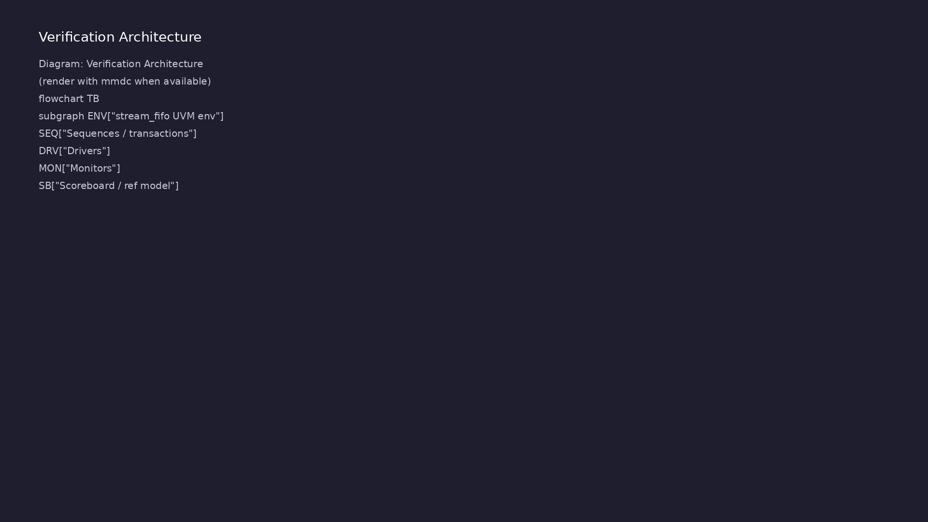
2. Checking architecture
• Scoreboard / reference model —
golden data path and ordering
checks (`CHECKER_PLAN.md`).
• SVA — protocol and functional
assertions on interfaces and
internal flags.
• Clear split: what is checked in
SVA vs scoreboard vs test self-
check.
verification_planning_management / Module 4
Notes:
From MODULE4 Design Architecture.

Slide 12
3. UVM phase execution flow
• build_phase: create env, agents, scoreboard,
coverage subscribers via factory.
• connect_phase: connect monitor analysis ports to
scoreboard and coverage; tie virtual interfaces.
• run_phase: raise objection, start sequences on
sequencers, wait for drain, drop objection.
• report_phase: summarize errors, assertion failures,
and coverage sampling status.
• Top module `module4/tb/tb_stream_fifo_uvm.sv`
instantiates DUT and calls `run_test()`.
verification_planning_management / Module 4
Notes:
From MODULE4 Design Architecture.

Slide 13
DUT instantiation in UVM top
// DUT instance
stream_fifo #(
.DATA_WIDTH (DATA_WIDTH),
.DEPTH (DEPTH)
) dut (
.clk (clk),
.rst_n (rst_n),
// source side
.s_valid (s_if.valid),
.s_data (s_if.data),
.s_ready (s_if.ready),
// sink side
.m_valid (m_if.valid),
.m_data (m_if.data),
.m_ready (m_if.ready),
// status
# ...
verification_planning_management / Module 4

Slide 14
stream_env — build & connect
class stream_env extends uvm_env;
`uvm_component_utils(stream_env)
stream_driver drv;
stream_monitor mon;
stream_scoreboard sb;
function new(string name, uvm_component parent);
super.new(name, parent);
endfunction
function void build_phase(uvm_phase phase);
super.build_phase(phase);
drv = stream_driver ::type_id::create("drv", this);
mon = stream_monitor ::type_id::create("mon", this);
# ...
verification_planning_management / Module 4

Slide 15
Scoreboard write() hook
class stream_scoreboard extends uvm_component;
`uvm_component_utils(stream_scoreboard)
uvm_analysis_imp #(stream_item, stream_scoreboard) imp_in;
int unsigned num_seen;
function new(string name, uvm_component parent);
super.new(name, parent);
imp_in = new("imp_in", this);
num_seen = 0;
endfunction
// Called for each transaction seen by the monitor
function void write(stream_item t);
# ...
verification_planning_management / Module 4

Slide 16
Key files to study
verification_planning_management / Module 4

Slide 17
Open these in the repo
• `module4/ENV_DESIGN.md` — env, agent, driver,
monitor, sequencer design
• `module4/CHECKER_PLAN.md` — scoreboard, reference
model, and assertion strategy
• `module4/tb/stream_pkg.sv` — reference UVM package
(env, agents, scoreboard)
• `module4/tb/tb_stream_fifo_uvm.sv` — top-level UVM
testbench and DUT hookup
• `common_dut/rtl/stream_fifo.sv` — DUT under
verification
• `scripts/module4.sh` — env/checker doc and TB file
checks
verification_planning_management / Module 4
Notes:
Trace while running module4/EXAMPLES.md labs.

Slide 18
Verification & testing methods
verification_planning_management / Module 4

Slide 19
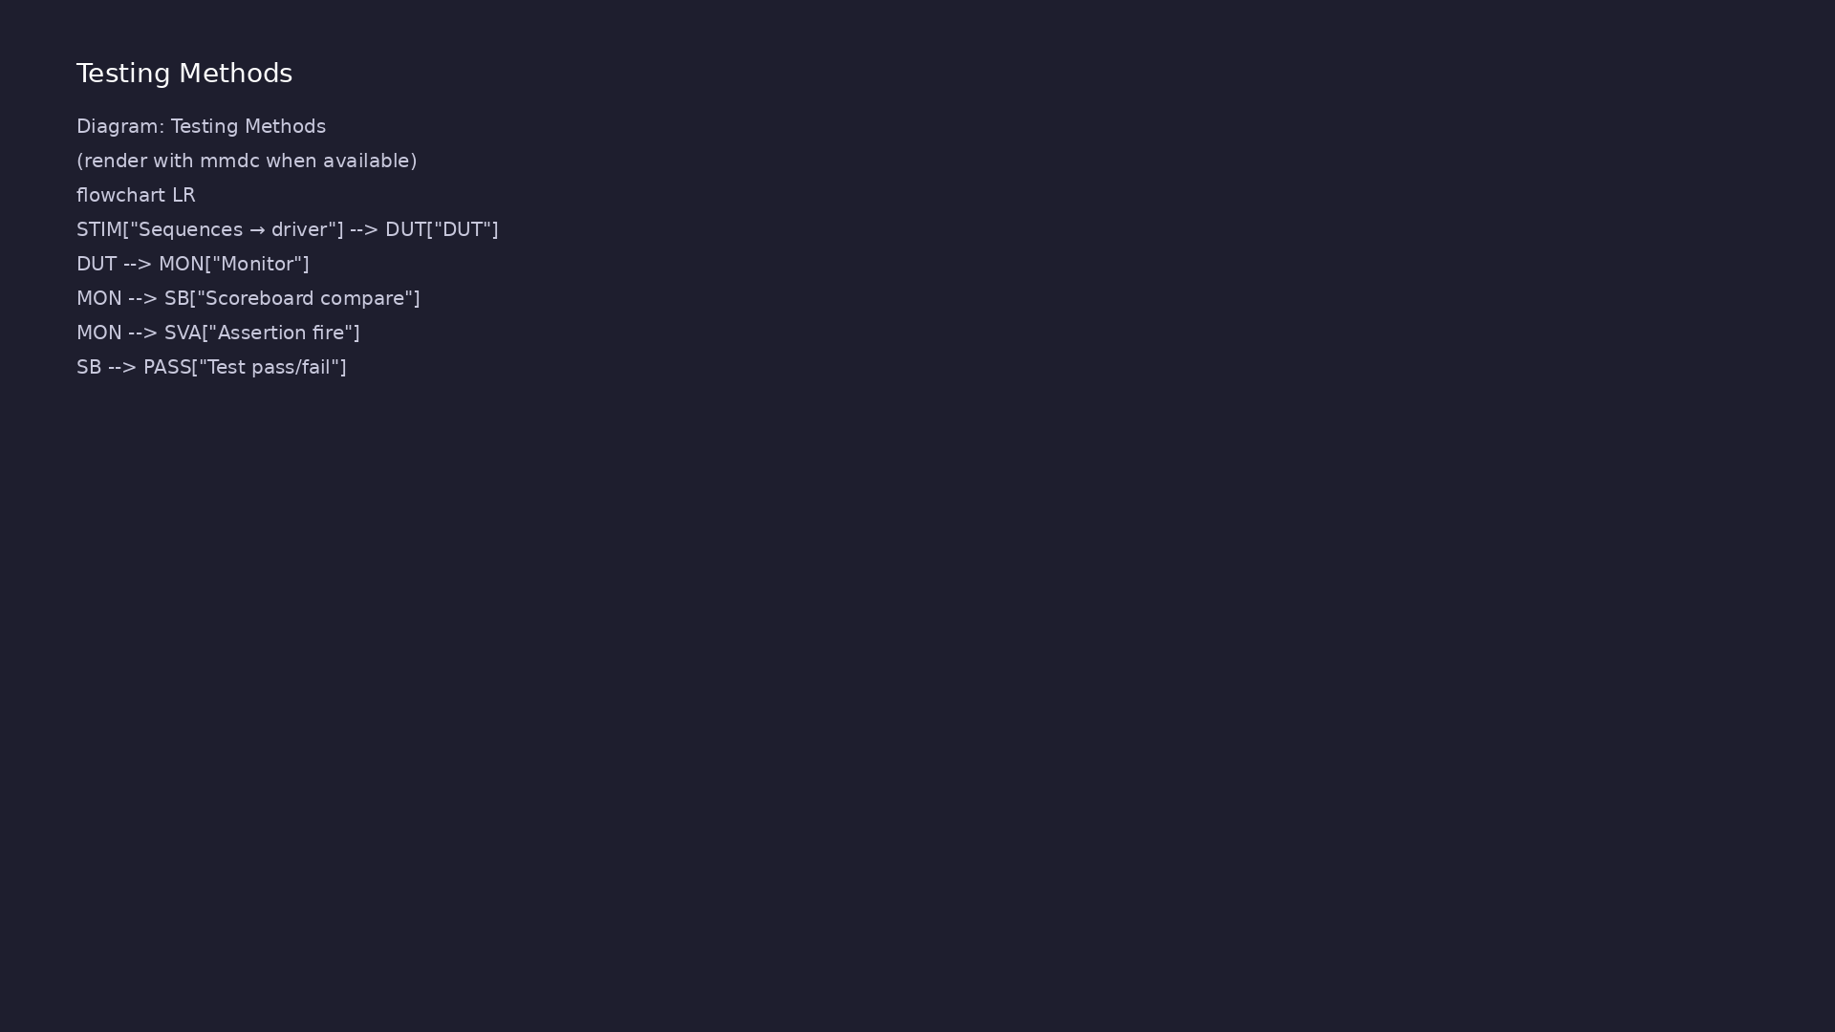
1. Stimulus and checking flow
• Sequences → driver → DUT →
monitor → scoreboard compare and
assertion sampling.
• Reset, backpressure, and error-
injection scenarios exercised
per `TEST_PLAN.md`.
verification_planning_management / Module 4
Notes:
From MODULE4 Verification & Testing Methods.

Slide 20
2. Assertion-based verification (ABV)
• Place assertions close to interfaces; use
`assert`/`assume` policy consistent with your
simulator f…
• Document waiver and severity policy for known benign
cases.
verification_planning_management / Module 4
Notes:
From MODULE4 Verification & Testing Methods.

Slide 21
3. Environment review
• Peer/self review of `ENV_DESIGN.md` and
`CHECKER_PLAN.md` before expanding regression scope.
• `./scripts/module4.sh --check` validates design docs
and TB file presence.
verification_planning_management / Module 4
Notes:
From MODULE4 Verification & Testing Methods.

Slide 22
stream_test — run_phase
class stream_test extends uvm_test;
`uvm_component_utils(stream_test)
stream_env env;
function new(string name, uvm_component parent);
super.new(name, parent);
endfunction
function void build_phase(uvm_phase phase);
super.build_phase(phase);
env = stream_env::type_id::create("env", this);
endfunction
task run_phase(uvm_phase phase);
# ...
verification_planning_management / Module 4

Slide 23
Syllabus topics
verification_planning_management / Module 4

Slide 24
1. Environment and Agent Architecture
• Environment and agent architecture (env vs agents vs
tests).
• Layered testbench structure and reuse across tiers
and DUT variants.
verification_planning_management / Module 4
Notes:
From MODULE4 Topics Covered.

Slide 25
2. Transactions and Sequences
• Transaction and sequence design aligned with your
test plan.
• Mapping test intents to UVM sequences and
configuration.
verification_planning_management / Module 4
Notes:
From MODULE4 Topics Covered.

Slide 26
3. Drivers and Monitors
• Driver and monitor behavior, including resets,
backpressure, and error handling.
verification_planning_management / Module 4
Notes:
From MODULE4 Topics Covered.

Slide 27
4. Scoreboards and Reference Models
• Scoreboard and reference model design.
verification_planning_management / Module 4
Notes:
From MODULE4 Topics Covered.

Slide 28
5. Assertions and Checking Strategy
• Assertion strategy: what to check with SVA vs
scoreboards vs tests.
verification_planning_management / Module 4
Notes:
From MODULE4 Topics Covered.

Slide 29
Command reference highlights
verification_planning_management / Module 4

Slide 30
Scaffold and validate Module 4
• ./scripts/module4.sh --scaffold
verification_planning_management / Module 4
Notes:
Full detail in docs/MODULE4.md command reference.

Slide 31
Inspect UVM env and scoreboard
• head -80 module4/tb/stream_pkg.sv
verification_planning_management / Module 4
Notes:
Full detail in docs/MODULE4.md command reference.

Slide 32
Hands-on examples
verification_planning_management / Module 4

Slide 33
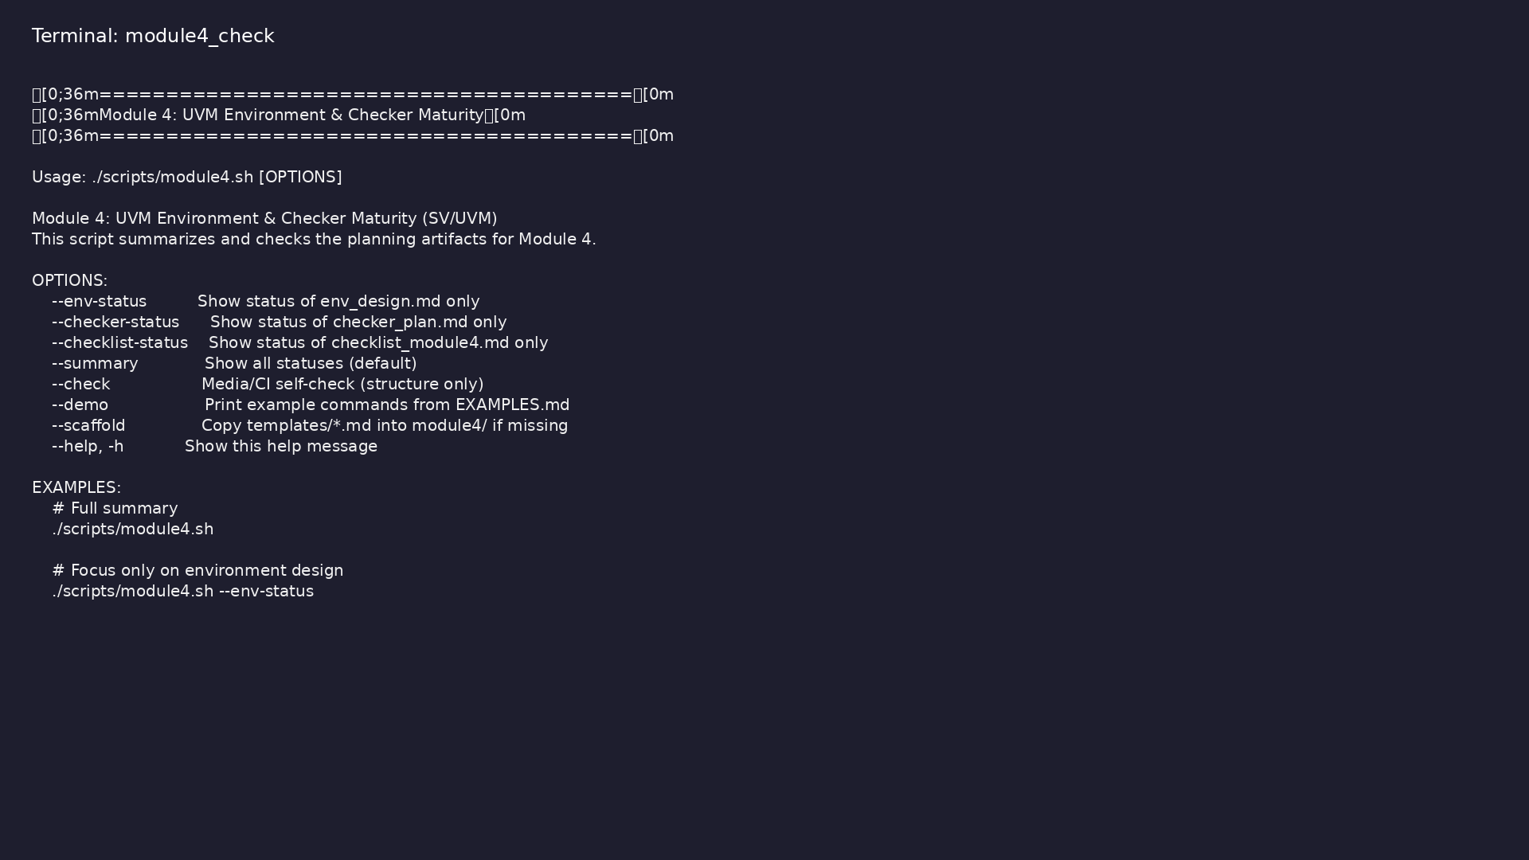
Module 4 self-check
$ ./scripts/module4.sh --help
verification_planning_management / Module 4
Notes:
Run from course repository root.

Slide 34
Exercise scaffold
./scripts/module4.sh --scaffold
verification_planning_management / Module 4

Slide 35
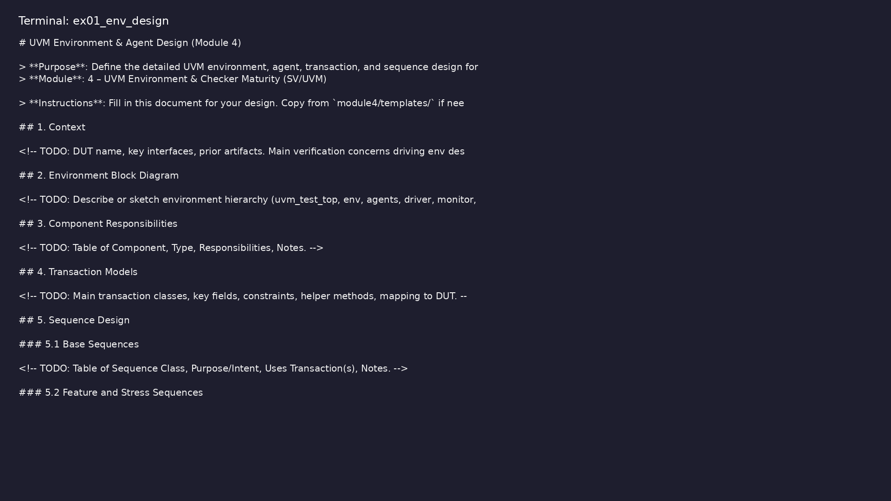
Demo: Environment design template
$ head -30 module4/templates/ENV_DESIGN.md
verification_planning_management / Module 4
Notes:
Hands-on: module4/examples/env_design/

Slide 36
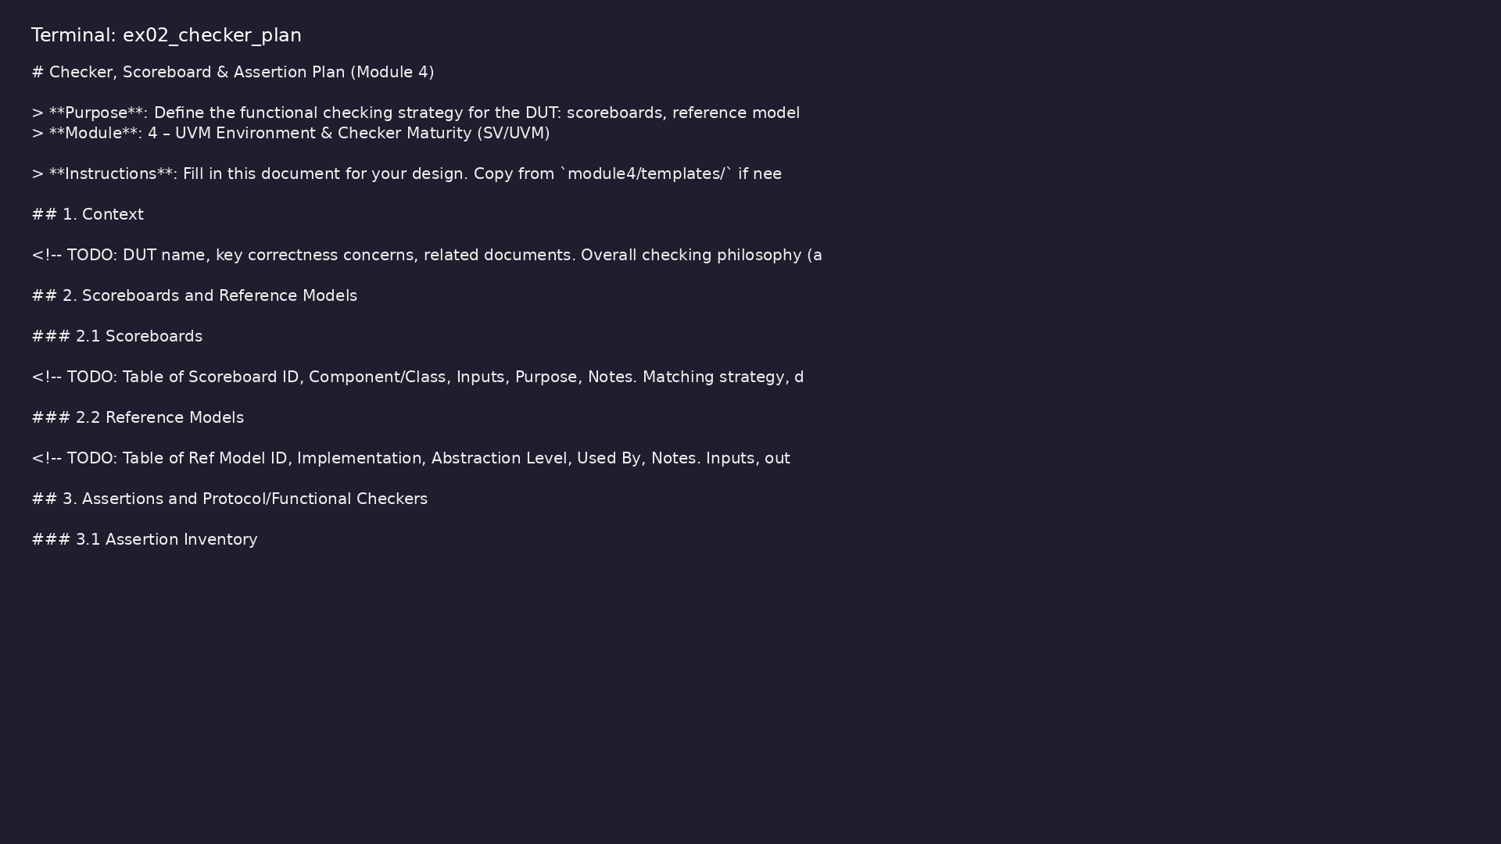
Demo: Checker plan template
$ head -25 module4/templates/CHECKER_PLAN.md
verification_planning_management / Module 4
Notes:
Hands-on: module4/examples/checker_plan/

Slide 37
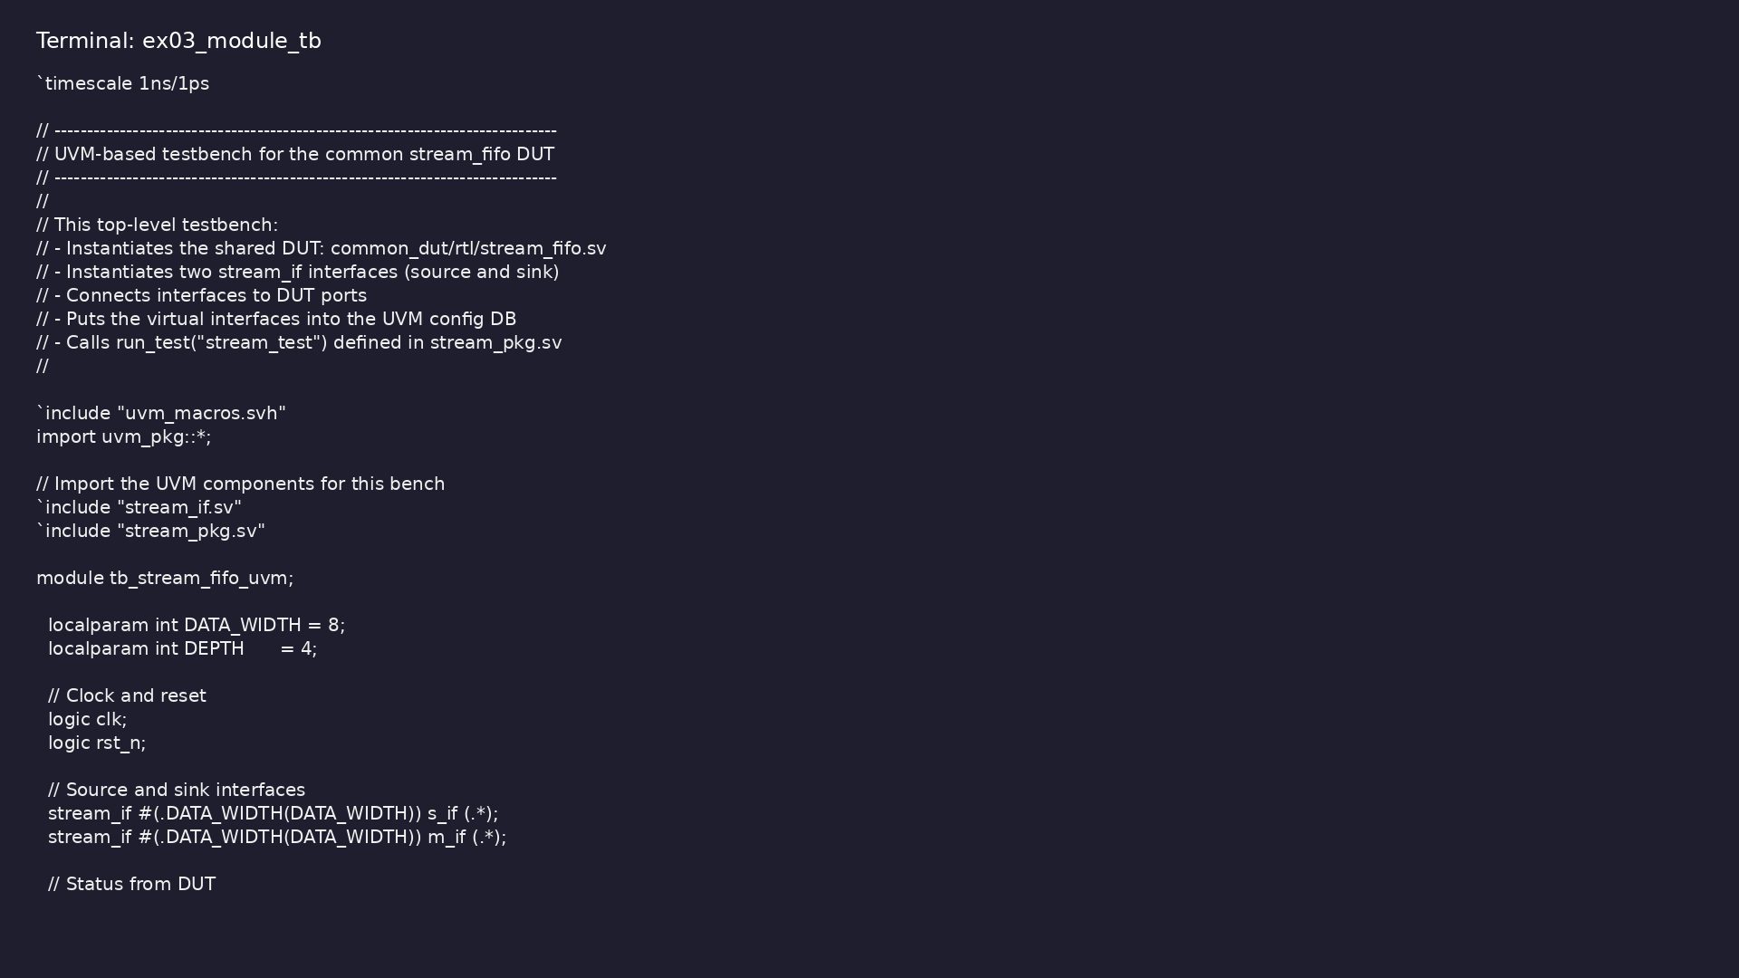
Demo: Module-local UVM TB
$ head -35 module4/tb/tb_stream_fifo_uvm.sv
verification_planning_management / Module 4
Notes:
Hands-on: module4/examples/module_tb/

Slide 38
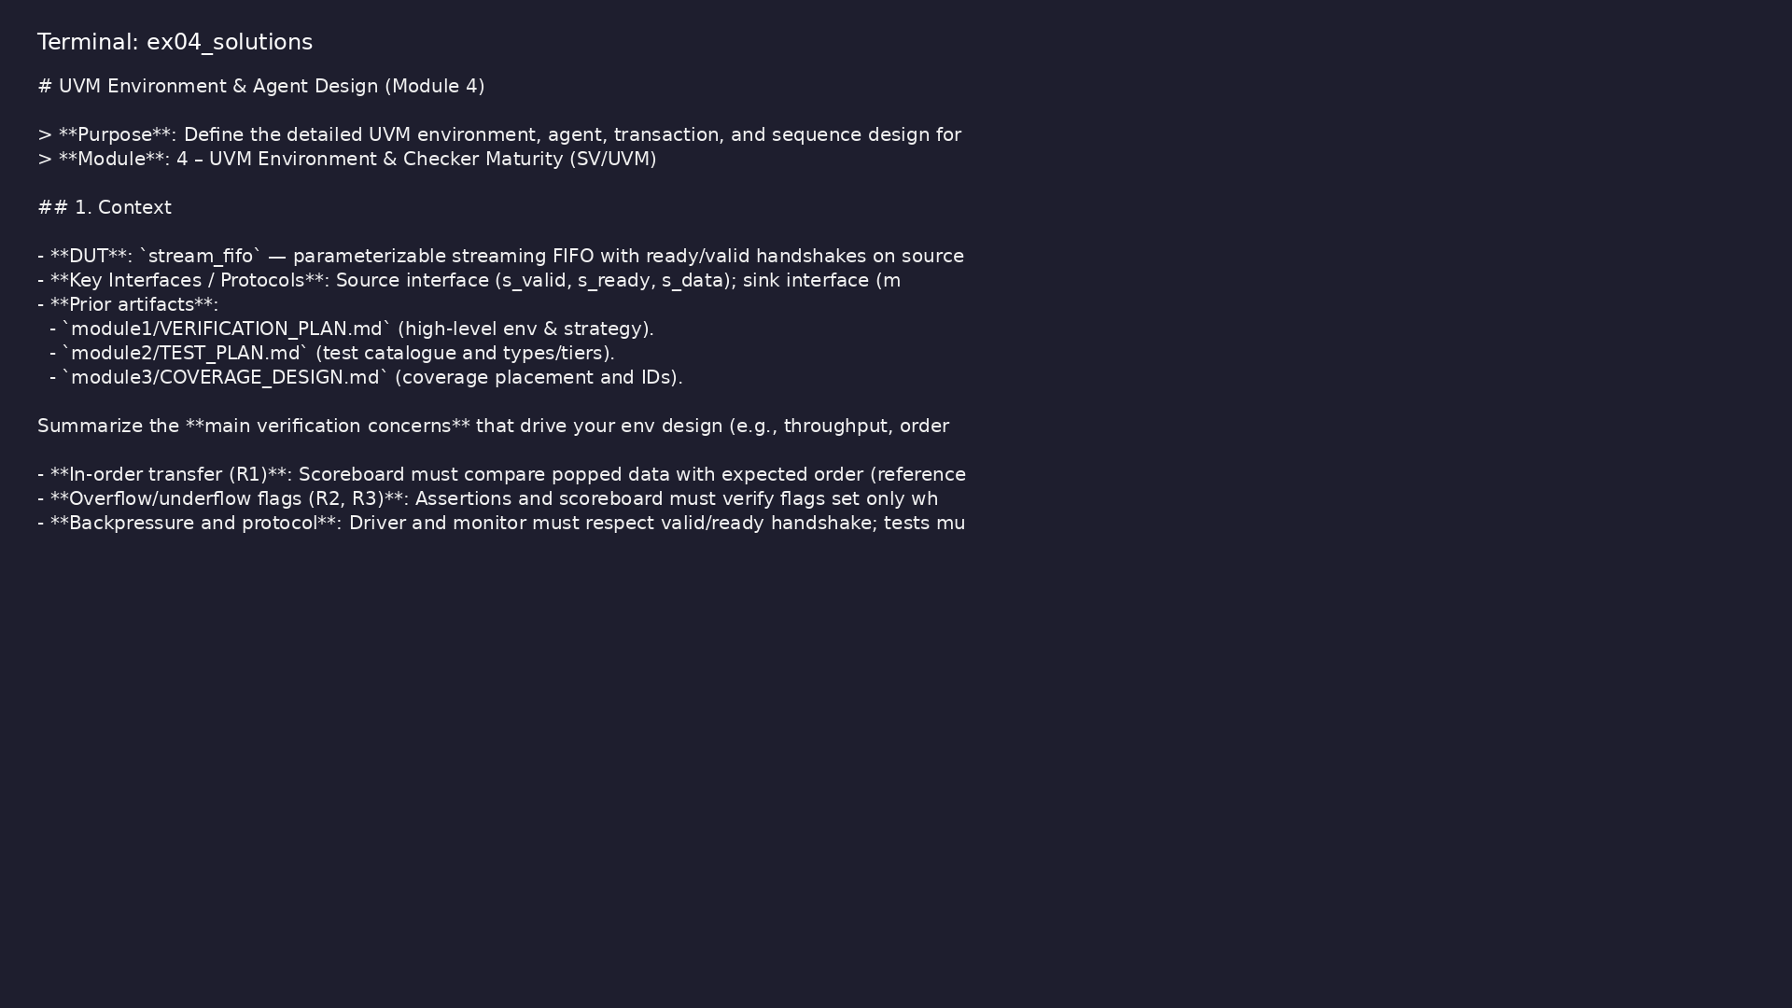
Demo: Reference env design
$ head -20 module4/.solutions/ENV_DESIGN.md
verification_planning_management / Module 4
Notes:
Hands-on: module4/examples/solutions/

Slide 39
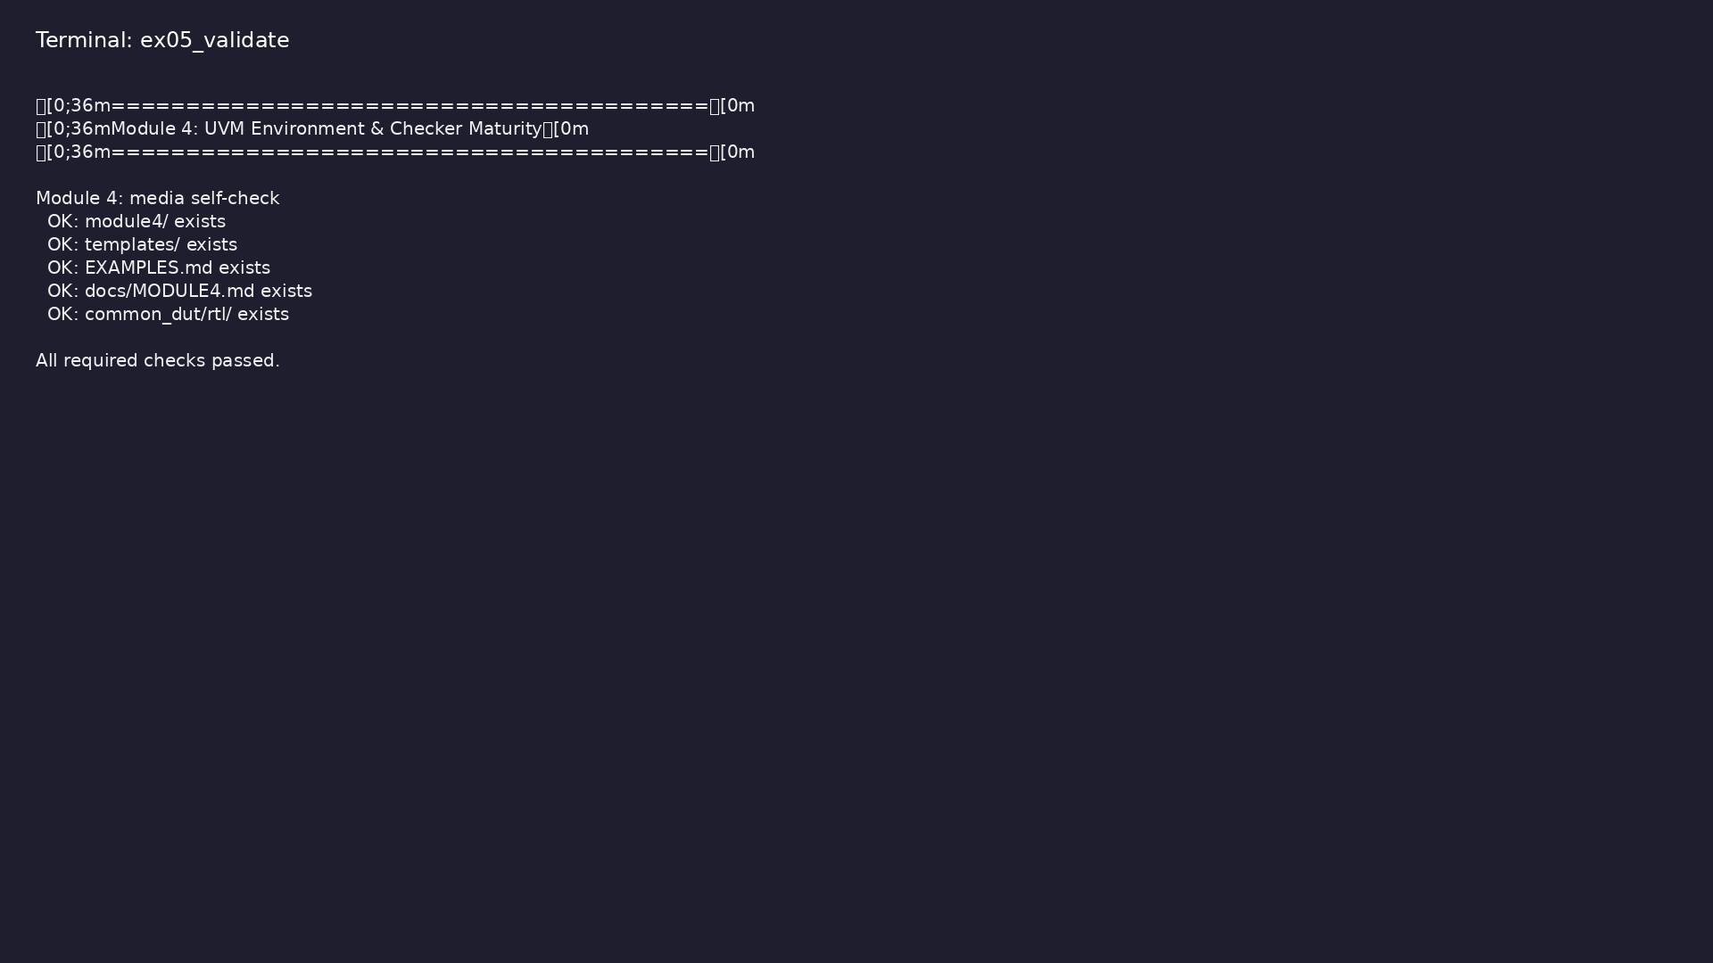
Demo: Module validation
$ ./scripts/module4.sh --check
verification_planning_management / Module 4
Notes:
Hands-on: module4/examples/validate/

Slide 40
Practice & assessment
verification_planning_management / Module 4

Slide 41
What you should know (1/2)
• Describe and justify your UVM environment and agent
architecture.
• Implement and maintain drivers, monitors,
sequencers, and transactions that match your DUT and
test…
• Implement or integrate scoreboards and reference
models for robust checking.
• Design and place protocol and functional assertions
that support your verification goals.
• Configure your environment for different modes and
regression tiers.
• UVM env/agent architecture documented in
`module4/ENV_DESIGN.md`.
verification_planning_management / Module 4
Notes:
From MODULE4 Learning Outcomes.

Slide 42
What you should know (2/2)
• Transaction and sequence designs documented and
aligned with `module2/TEST_PLAN.md`.
• Scoreboards and reference models specified in
`module4/CHECKER_PLAN.md`.
• Key protocol/functional assertions listed and
placed.
• At least one env/checker review (self or peer)
completed; action items captured.
verification_planning_management / Module 4
Notes:
From MODULE4 Learning Outcomes.

Slide 43
Assessment checklist
• UVM env/agent architecture documented in
`module4/ENV_DESIGN.md`.
• Transaction and sequence designs documented and
aligned with `module2/TEST_PLAN.md`.
• Scoreboards and reference models specified in
`module4/CHECKER_PLAN.md`.
• Key protocol/functional assertions listed and
placed.
• At least one env/checker review (self or peer)
completed; action items captured.
verification_planning_management / Module 4

Slide 44
Summary & next steps
• Design and mature your **UVM environment** (env,
agents, drivers, monitors, sequencers) and **check…
• Complete module4/CHECKLIST.md
• Review module4/EXAMPLES.md and run each lab
• Next: Next module in course
verification_planning_management / Module 4

