Slide 1
Module 5
Regression Management & Advanced UVM Orchestration (SV/UVM)
verification_planning_management / Module 5

Slide 2
Learning objectives
• Turn your test, coverage, and environment designs
into a **robust regression system** that scales:…
verification_planning_management / Module 5

Slide 3
Prerequisites
• See module README
verification_planning_management / Module 5

Slide 4

Learning path
Turn your test, coverage, and environment designs into a **robust regression system** that scales: advanced sequence orchestration (includi…
verification_planning_management / Module 5

Slide 5
Overview
• Modules 1–4 established **what to test**, **how to
measure**, and **how to build a solid UVM enviro…
verification_planning_management / Module 5

Slide 6
How to learn this module
verification_planning_management / Module 5

Slide 7
Suggested learning path (1/2)
• Re-read `module2/REGRESSION_PLAN.md` and
`module4/ENV_DESIGN.md`.
• Scaffold Module 5 workspace: `./scripts/module5.sh
--scaffold`
• Document regression ops in
`module5/REGRESSION_OPS.md` and advanced UVM in
`ADVANCED_UVM_PLAN.md`.
• Plan flake handling in `DEBUG_FLAKE_PLAN.md`.
• Implement virtual sequences, callbacks, or config
patterns in `common_dut/tb/`.
verification_planning_management / Module 5
Notes:
From docs/MODULE5.md — read guides before running demos.

Slide 8
Suggested learning path (2/2)
• Validate: `./scripts/module5.sh --check`
verification_planning_management / Module 5
Notes:
From docs/MODULE5.md — read guides before running demos.

Slide 9
Design architecture
verification_planning_management / Module 5

Slide 10

1. Regression system architecture
• Local quick loops, CI gated
merges, optional farm for long
suites (`REGRESSION_OPS.md`).
• Regression launcher selects tier
→ test list → seeds → coverage
merge → report artifacts.
verification_planning_management / Module 5
Notes:
From MODULE5 Design Architecture.

Slide 11

2. Advanced UVM orchestration
• Virtual sequences coordinate
multiple agents (e.g.,
concurrent source/sink traffic).
• Callbacks and config DB patterns
for mode switches without
rewriting tests.
• Documented in
`ADVANCED_UVM_PLAN.md`;
implemented under
`common_dut/tb/`.
verification_planning_management / Module 5
Notes:
From MODULE5 Design Architecture.

Slide 12
3. Regression launch and triage pipeline
• Launch: tier script selects test list, seeds,
plusargs, and parallelism level.
• Execute: each test produces log, optional waveform,
and coverage database.
• Collect: merge coverage, aggregate pass/fail, and
flag timeouts or assertion failures.
• Triage: reproduce with saved seed; use
`DEBUG_FLAKE_PLAN.md` for intermittent failures.
• Report: publish tier summary for sign-off review and
nightly dashboard consumption.
verification_planning_management / Module 5
Notes:
From MODULE5 Design Architecture.

Slide 13
Monitor — analysis port
class stream_monitor extends uvm_component;
`uvm_component_utils(stream_monitor)
virtual stream_if.slave vif;
uvm_analysis_port #(stream_item) ap;
function new(string name, uvm_component parent);
super.new(name, parent);
ap = new("ap", this);
endfunction
task run_phase(uvm_phase phase);
stream_item tr;
if (vif == null) begin
# ...
verification_planning_management / Module 5

Slide 14
stream_test — run_phase
class stream_test extends uvm_test;
`uvm_component_utils(stream_test)
stream_env env;
function new(string name, uvm_component parent);
super.new(name, parent);
endfunction
function void build_phase(uvm_phase phase);
super.build_phase(phase);
env = stream_env::type_id::create("env", this);
endfunction
task run_phase(uvm_phase phase);
# ...
verification_planning_management / Module 5

Slide 15
Key files to study
verification_planning_management / Module 5

Slide 16
Open these in the repo
• `module5/REGRESSION_OPS.md` — tiers, launchers,
CI/farm integration
• `module5/ADVANCED_UVM_PLAN.md` — virtual sequences,
callbacks, config DB usage
• `module5/DEBUG_FLAKE_PLAN.md` — flake detection,
quarantine, debug workflow
• `module4/tb/stream_pkg.sv` — monitor, test, and
sequence patterns to extend
• `scripts/module5.sh` — regression and advanced-UVM
doc checks
verification_planning_management / Module 5
Notes:
Trace while running module5/EXAMPLES.md labs.

Slide 17
Verification & testing methods
verification_planning_management / Module 5

Slide 18
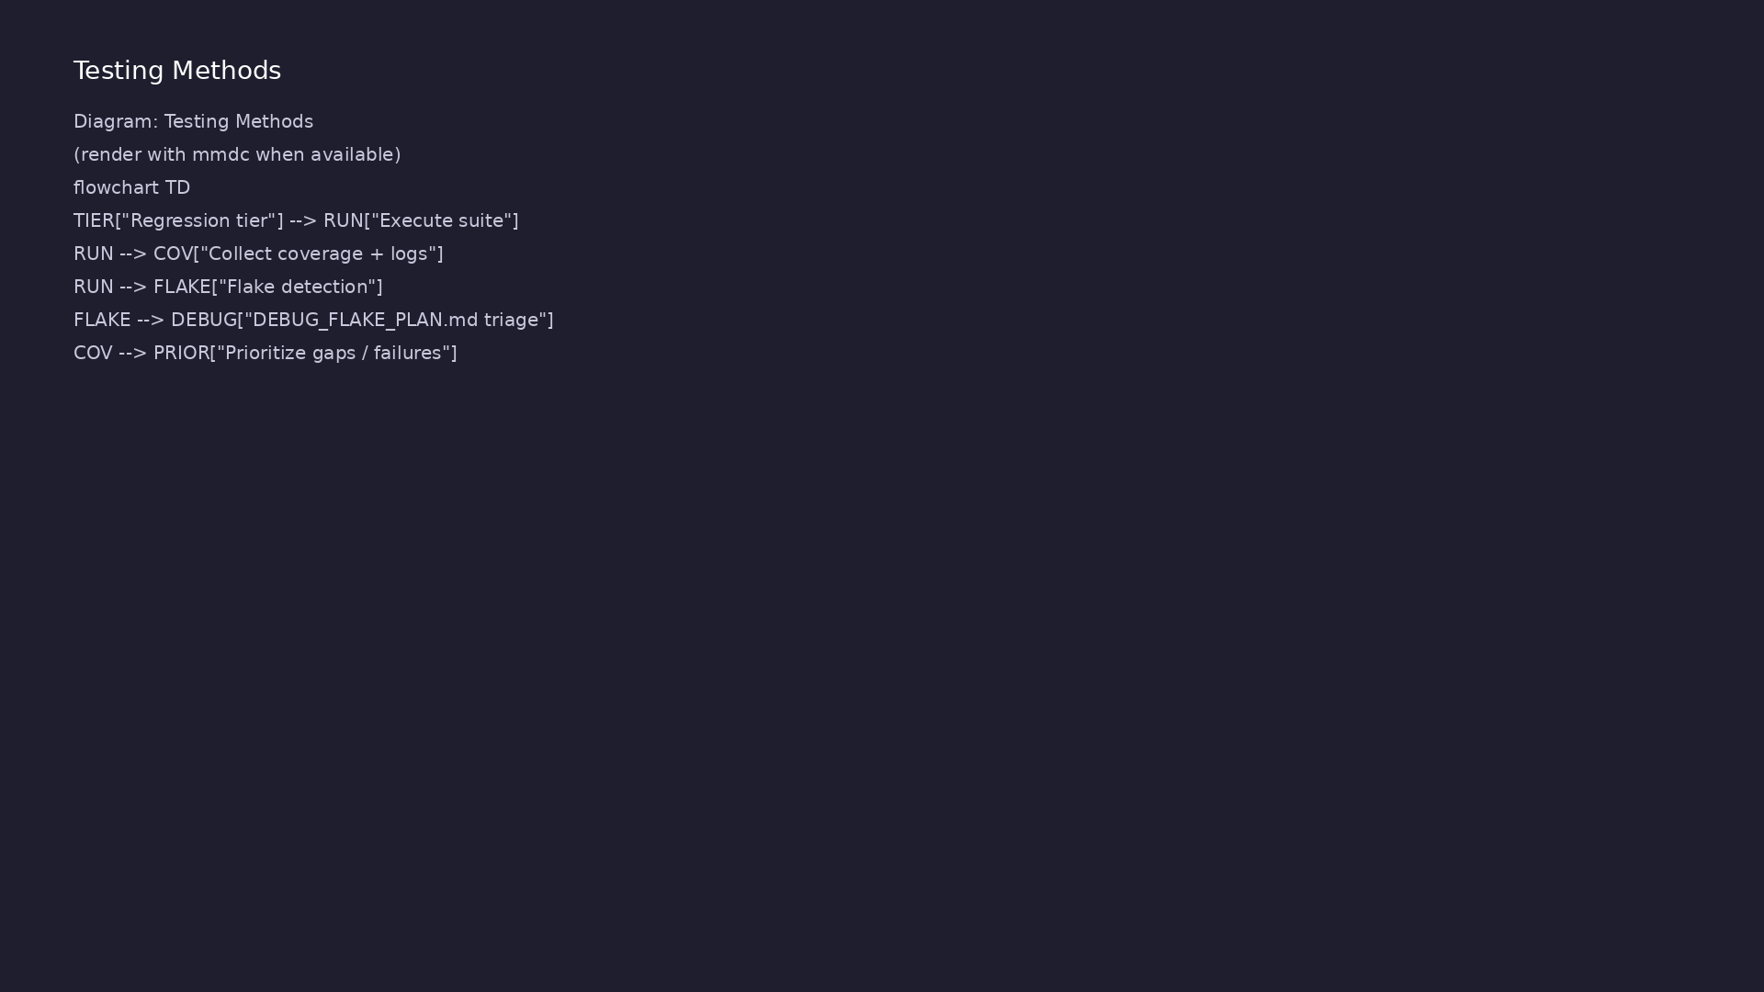
1. Operational regression testing
• Every tier has target runtime,
pass criteria, and artifact
retention (logs, waves, coverage
DB).
• Failures triaged with
reproducible seeds and minimized
waveforms.
verification_planning_management / Module 5
Notes:
From MODULE5 Verification & Testing Methods.

Slide 19
2. Flake and performance management
• `DEBUG_FLAKE_PLAN.md` — detect flaky tests,
quarantine policy, timeout budgets.
• Performance tuning: parallel jobs, test ordering,
and dropping redundant long tests.
verification_planning_management / Module 5
Notes:
From MODULE5 Verification & Testing Methods.

Slide 20
3. Data-driven refinement
• Use regression + coverage history to prioritize new
tests and retire low-value ones.
• `./scripts/module5.sh --check` validates ops and
advanced-UVM planning docs.
verification_planning_management / Module 5
Notes:
From MODULE5 Verification & Testing Methods.

Slide 21
Module 5 — regression validation
#!/usr/bin/env bash
# Module 5: Regression & Advanced UVM Orchestrator
# This script summarizes and checks the artifacts for Module 5.
# Usage: ./scripts/module5.sh [OPTIONS]
set -euo pipefail
# Colors for output
RED='\033[0;31m'
GREEN='\033[0;32m'
YELLOW='\033[1;33m'
verification_planning_management / Module 5

Slide 22
Syllabus topics
verification_planning_management / Module 5

Slide 23
1. Concrete Regression Flows (1/2)
• Local vs CI vs Farm
• Developer “inner loop” (fast, focused subsets).
• CI per-commit/per-PR runs (sanity + selected CORE
tests).
• Nightly/weekly farm runs (CORE/STRESS/FULL tiers).
• Command-Line Interfaces
• Standardizing make/pytest/regression wrapper
interfaces.
verification_planning_management / Module 5
Notes:
From MODULE5 Topics Covered.

Slide 24
1. Concrete Regression Flows (2/2)
• Passing seeds, tiers, and configuration via
plusargs/env/CLI options.
• Job Definitions
• Defining named regression jobs (e.g., `sanity`,
`core_nightly`, `stress_weekly`).
• Mapping jobs to tiers, test lists, and resource
limits.
verification_planning_management / Module 5
Notes:
From MODULE5 Topics Covered.

Slide 25
2. Advanced UVM Orchestration (Virtual Sequences & Multi-Agent) (1/2)
• Virtual Sequencers & Virtual Sequences
• Coordinating multiple agents (e.g., data + control +
sideband).
• Layered sequences that correspond to system-level
scenarios.
• Mapping to Test Plan
• Mapping high-level test intents to virtual
sequences.
• Using virtual sequences to implement complex
scenarios (reset-in-flight, multi-channel flows).
verification_planning_management / Module 5
Notes:
From MODULE5 Topics Covered.

Slide 26
2. Advanced UVM Orchestration (Virtual Sequences & Multi-Agent) (2/2)
• Configuration & Callbacks
• Using complex configuration objects to parameterize
regressions.
• Using callbacks to inject debug behavior or
temporary instrumentation.
verification_planning_management / Module 5
Notes:
From MODULE5 Topics Covered.

Slide 27
3. Flake Management and Stability (1/2)
• Flaky Test Identification
• Signals of flakiness (non-deterministic failures,
timeouts).
• Logging and metadata needed to diagnose flakiness
(test ID, seed, environment).
• Policies
• Criteria for marking a test as flaky.
• Temporary quarantine vs immediate fix.
verification_planning_management / Module 5
Notes:
From MODULE5 Topics Covered.

Slide 28
3. Flake Management and Stability (2/2)
• Automatic rerun strategies (e.g., N-of-M reruns to
confirm flakiness).
• Designing Flake-Resistant Tests
• Avoiding hidden dependencies on timing or
environment.
• Ensuring proper resets and deterministic seeding.
verification_planning_management / Module 5
Notes:
From MODULE5 Topics Covered.

Slide 29
4. Debug & Observability Strategy (1/2)
• Logging
• Standardized log formats (prefixes, IDs, levels).
• Per-test log collection and retention policies.
• Waveforms and Traces
• When to dump waves (always for failures, selectively
for passes).
• How to configure trace windows (e.g., last N
microseconds before failure).
verification_planning_management / Module 5
Notes:
From MODULE5 Topics Covered.

Slide 30
4. Debug & Observability Strategy (2/2)
• Failure Triage Workflow
• Quick checks (assertion vs scoreboard vs timeout).
• Reproduction steps (same test, same seed, smaller
subset).
verification_planning_management / Module 5
Notes:
From MODULE5 Topics Covered.

Slide 31
5. Performance and Scalability (1/2)
• Bottleneck Identification
• Longest-running tests and why.
• Hot spots in sequences, drivers, or reference
models.
• Optimization Strategies
• Reducing redundant work (e.g., fewer warm-up cycles,
targeted stress).
• Using configuration to scale test depth per tier.
verification_planning_management / Module 5
Notes:
From MODULE5 Topics Covered.

Slide 32
5. Performance and Scalability (2/2)
• Regression Capacity Planning
• Estimating how many tests can run per hour/day.
• Planning parallelism and job sharding.
verification_planning_management / Module 5
Notes:
From MODULE5 Topics Covered.

Slide 33
6. Coverage-Driven Regression Refinement
• Using Coverage to Shape Regressions
• Prioritizing tests that contribute most to coverage
gaps.
• Designing “closure suites” for specific coverage
areas.
• Bug-Driven Refinement
• Using bug history to prioritize tests and sequences.
• Ensuring that fixed bugs get regression tests and
coverage.
verification_planning_management / Module 5
Notes:
From MODULE5 Topics Covered.

Slide 34
Command reference highlights
verification_planning_management / Module 5

Slide 35
Scaffold and validate Module 5
• ./scripts/module5.sh --scaffold
verification_planning_management / Module 5
Notes:
Full detail in docs/MODULE5.md command reference.

Slide 36
Inspect test run_phase and monitor hooks
• grep -n "class stream_test" module4/tb/stream_pkg.sv
verification_planning_management / Module 5
Notes:
Full detail in docs/MODULE5.md command reference.

Slide 37
Hands-on examples
verification_planning_management / Module 5

Slide 38
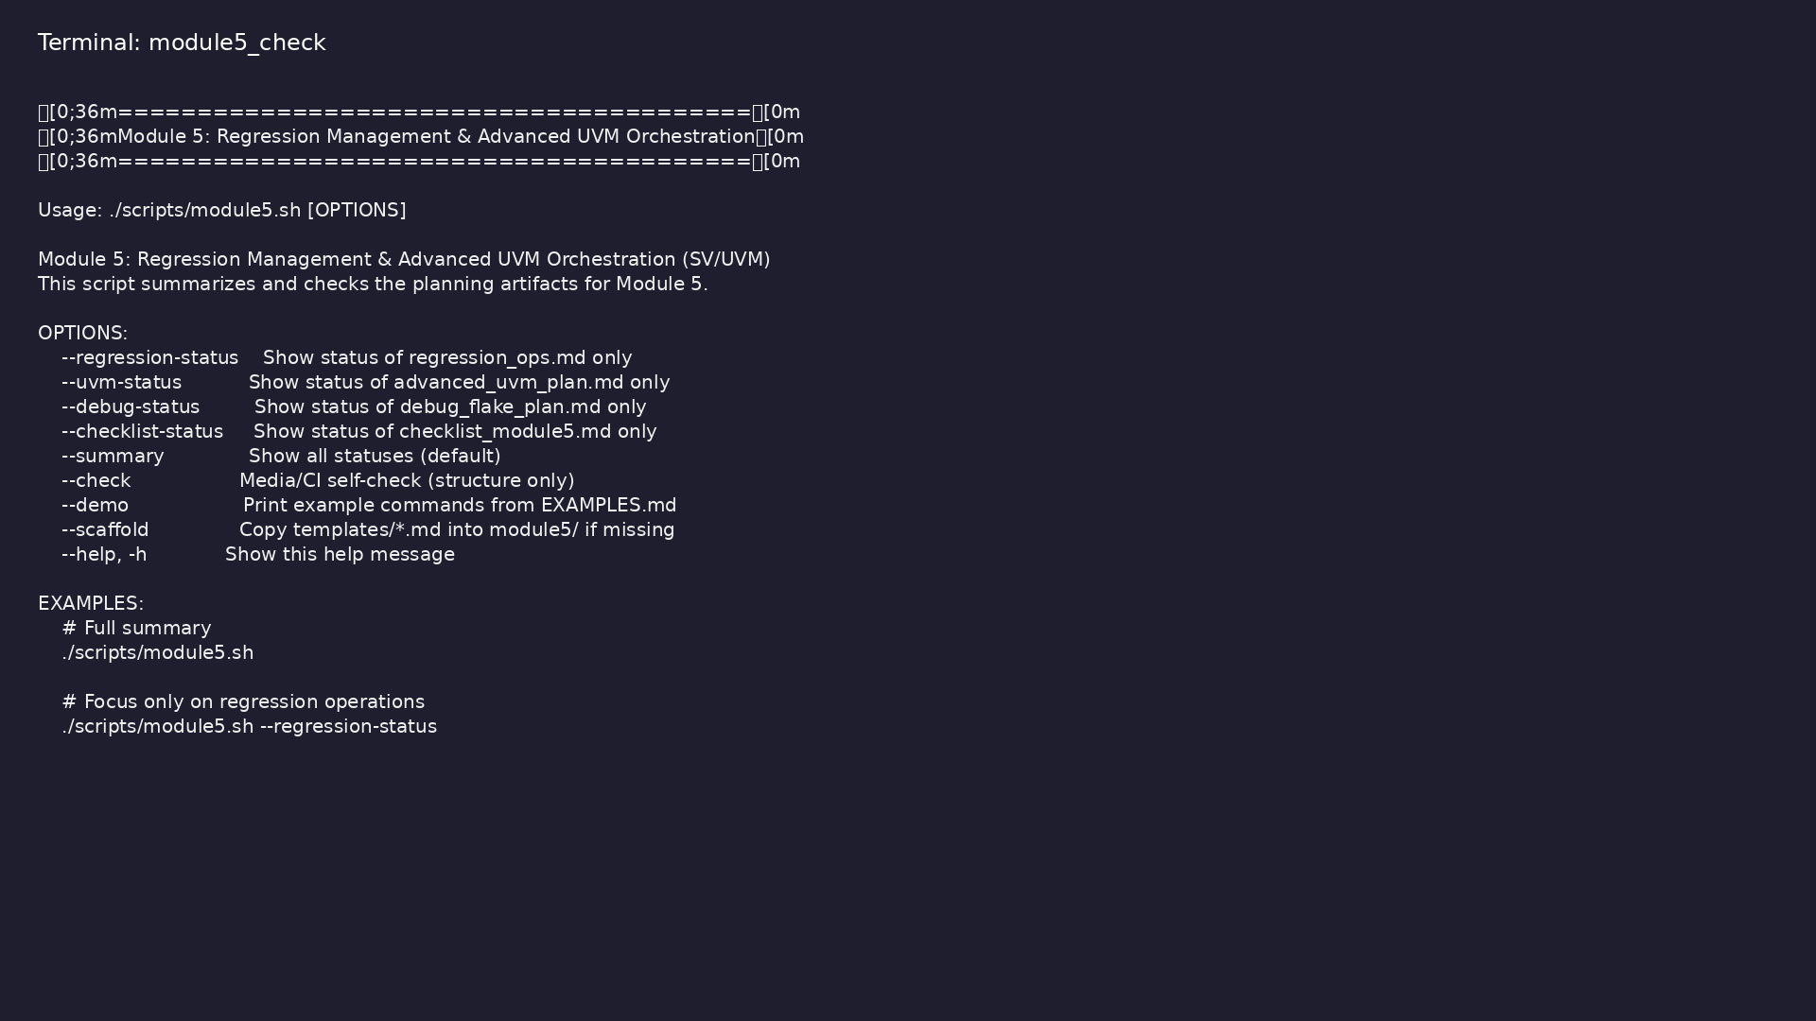
Module 5 self-check
$ ./scripts/module5.sh --help
verification_planning_management / Module 5
Notes:
Run from course repository root.

Slide 39
Exercise scaffold
./scripts/module5.sh --scaffold
verification_planning_management / Module 5

Slide 40
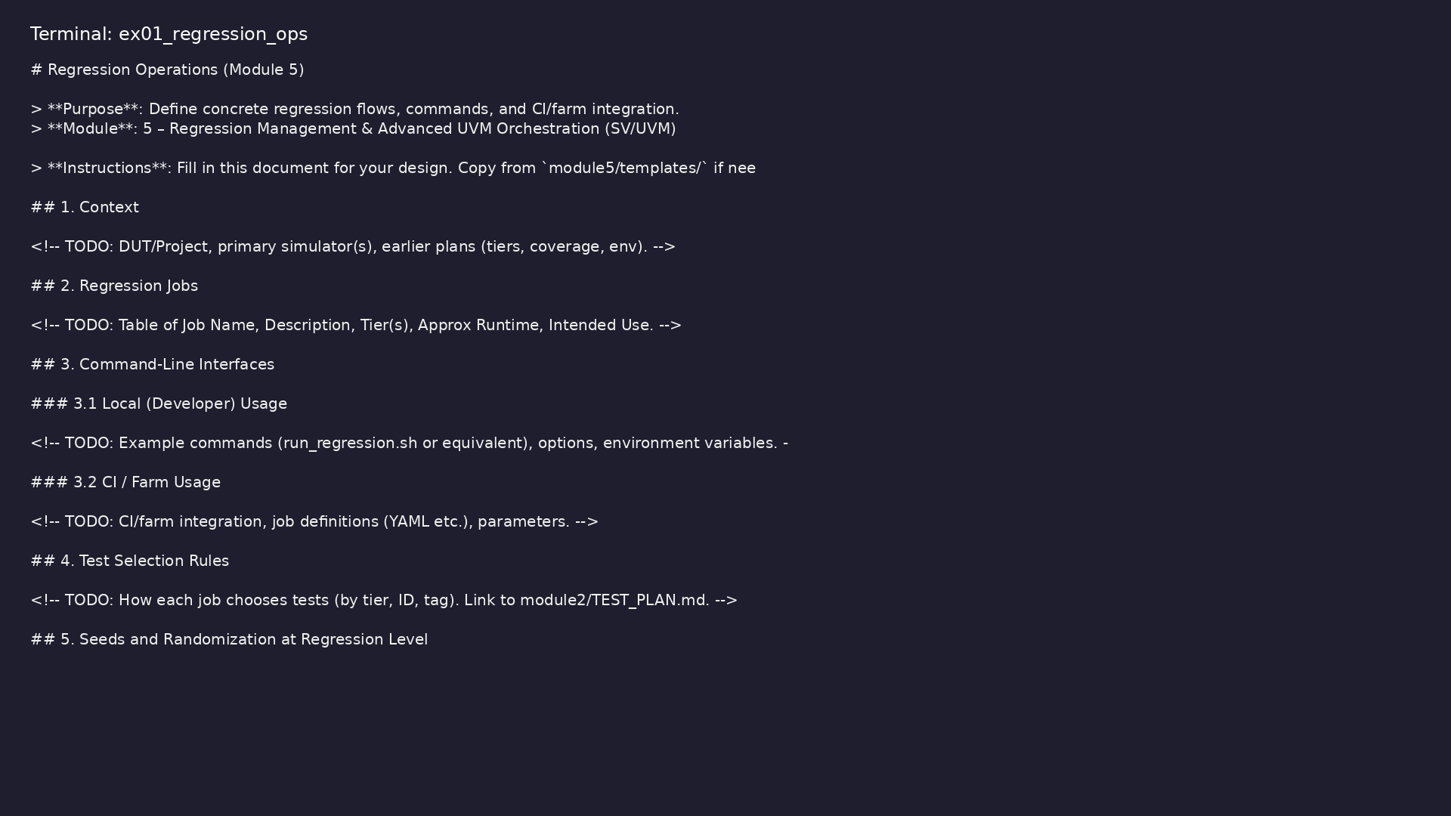
Demo: Regression operations template
$ head -30 module5/templates/REGRESSION_OPS.md
verification_planning_management / Module 5
Notes:
Hands-on: module5/examples/regression_ops/

Slide 41
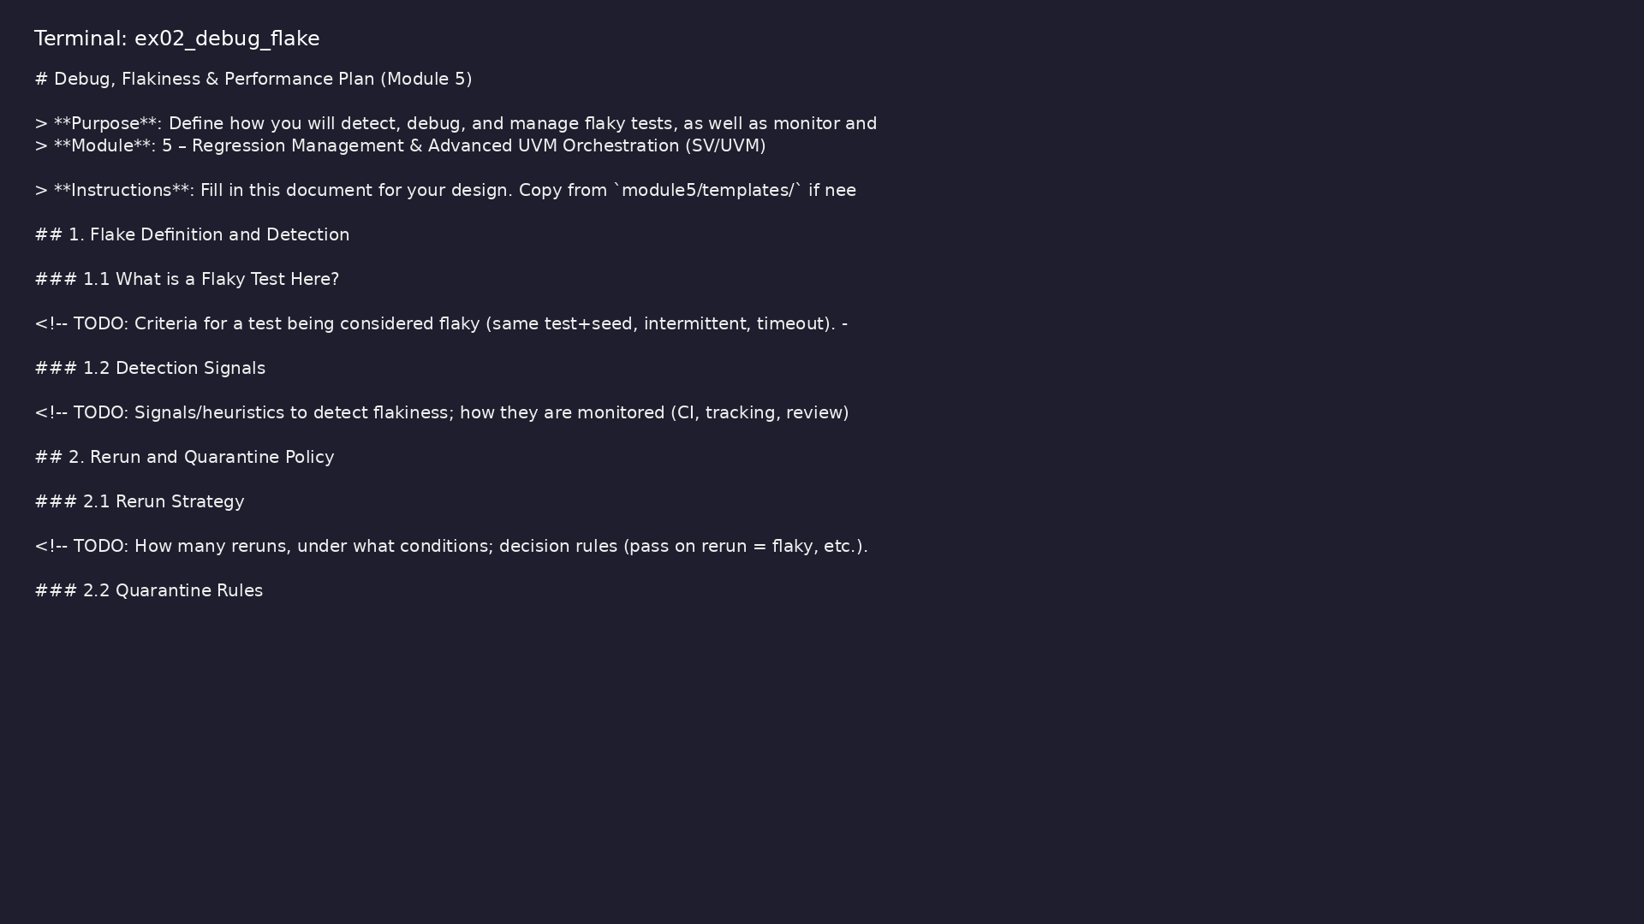
Demo: Debug and flake plan
$ head -25 module5/templates/DEBUG_FLAKE_PLAN.md
verification_planning_management / Module 5
Notes:
Hands-on: module5/examples/debug_flake/

Slide 42
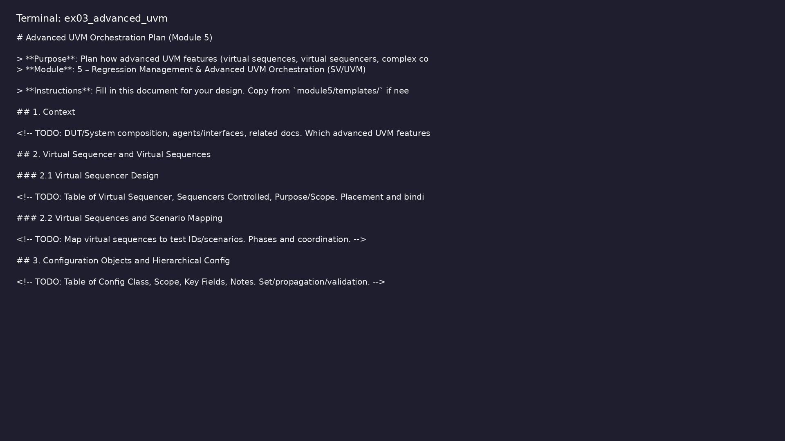
Demo: Advanced UVM plan
$ head -25 module5/templates/ADVANCED_UVM_PLAN.md
verification_planning_management / Module 5
Notes:
Hands-on: module5/examples/advanced_uvm/

Slide 43
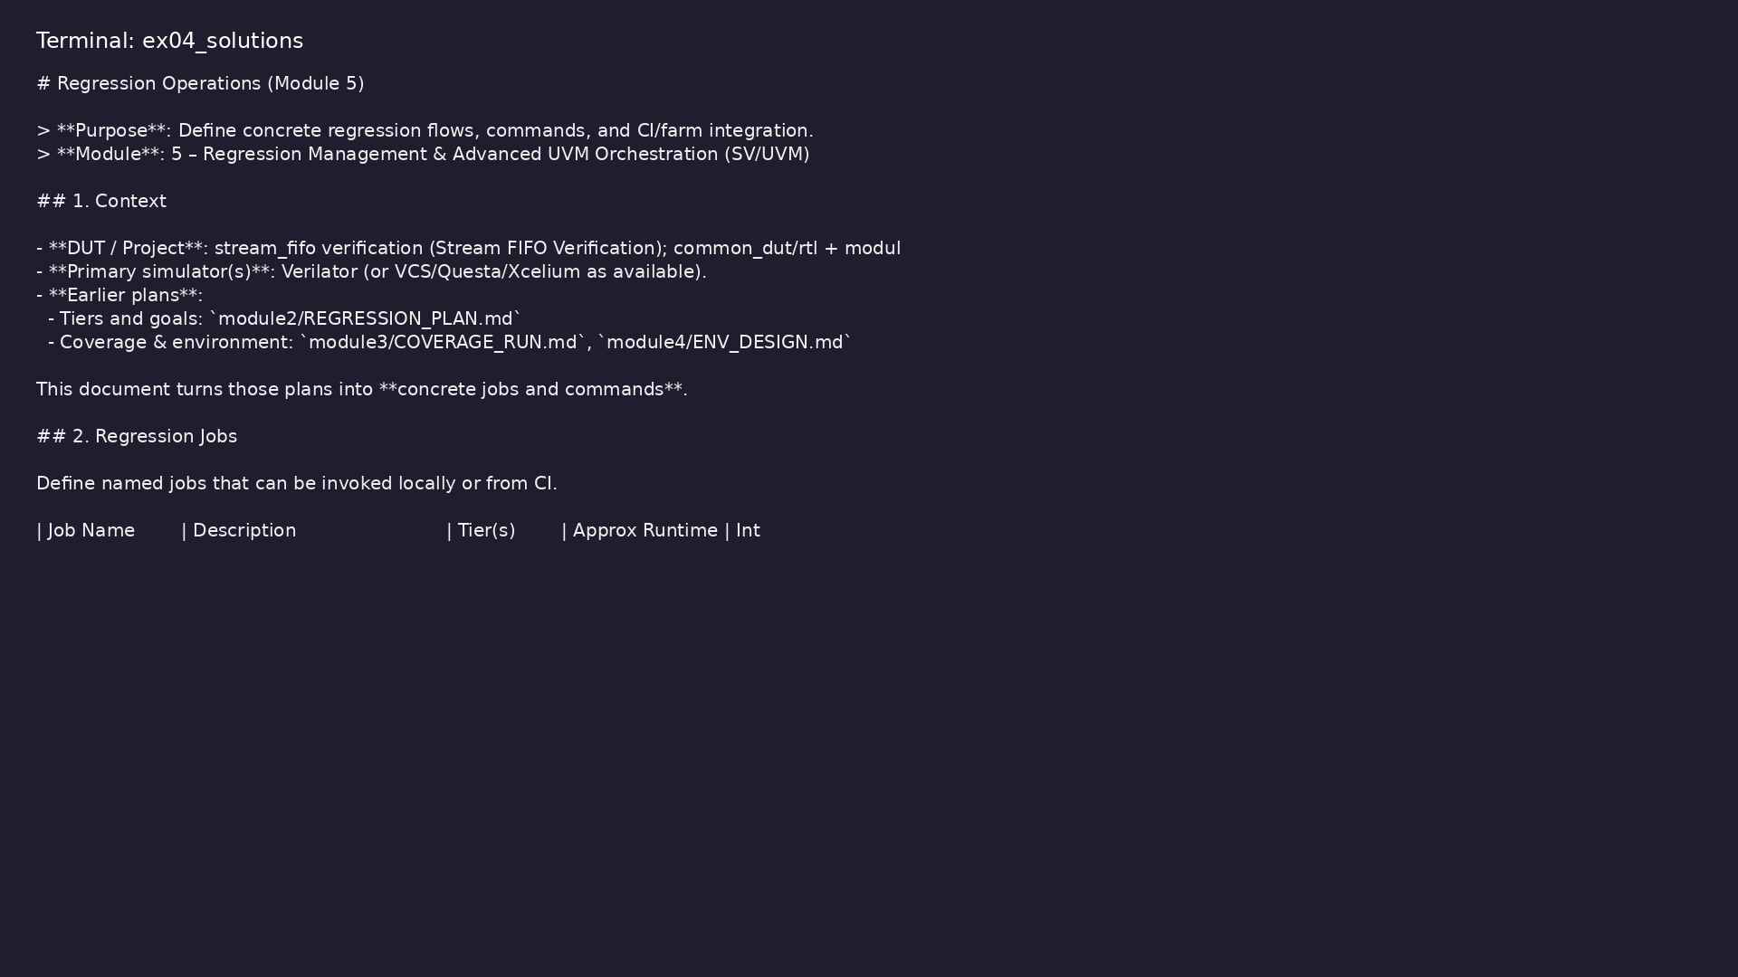
Demo: Reference regression ops
$ head -20 module5/.solutions/REGRESSION_OPS.md
verification_planning_management / Module 5
Notes:
Hands-on: module5/examples/solutions/

Slide 44

Demo: Module validation
$ ./scripts/module5.sh --check
verification_planning_management / Module 5
Notes:
Hands-on: module5/examples/validate/

Slide 45
Practice & assessment
verification_planning_management / Module 5

Slide 46
What you should know (1/5)
• Define and run repeatable regression flows across
local and CI/farm environments.
• Use virtual sequences and advanced UVM patterns to
orchestrate complex scenarios.
• Detect, triage, and manage flaky tests and
instability in regressions.
• Implement a practical debug and observability
strategy (logs, waves, metadata).
• Use coverage and bug data to prioritize and refine
regression content.
• In `module5/REGRESSION_OPS.md`, define at least:
verification_planning_management / Module 5
Notes:
From MODULE5 Learning Outcomes.

Slide 47
What you should know (2/5)
• A `sanity` job (fast, per-commit).
• A `core_nightly` job.
• A `stress_weekly` or `full_release` job.
• For each job, specify:
• Tier(s), test selection rules, expected runtime, and
invocation commands.
• In `module5/ADVANCED_UVM_PLAN.md`, map several high-
level tests to:
verification_planning_management / Module 5
Notes:
From MODULE5 Learning Outcomes.

Slide 48
What you should know (3/5)
• Specific virtual sequences and their participating
agents/sequencers.
• Key configuration parameters (modes, seeds, error-
injection toggles).
• Identify at least 3 scenarios that require multi-
agent coordination.
• In `module5/DEBUG_FLAKE_PLAN.md`, define:
• What constitutes a flake in your context.
• How many reruns you perform to confirm flakiness.
verification_planning_management / Module 5
Notes:
From MODULE5 Learning Outcomes.

Slide 49
What you should know (4/5)
• How you quarantine and track flaky tests.
• How/when they must be fixed before sign-off.
• Define:
• Standard log naming and locations.
• When and how to generate waveforms.
• Minimum metadata required in failure reports (test
ID, seed, tier, DUT hash).
verification_planning_management / Module 5
Notes:
From MODULE5 Learning Outcomes.

Slide 50
What you should know (5/5)
• Verify on at least one failing test that you can
reproduce and debug using these artifacts.
verification_planning_management / Module 5
Notes:
From MODULE5 Learning Outcomes.

Slide 51
Exercises
• Runtime Tuning
• Coverage-Driven Job
• Resilience Drill
verification_planning_management / Module 5

Slide 52
Assessment checklist
• Concrete regression jobs and commands captured in
`module5/REGRESSION_OPS.md`.
• Virtual sequence and advanced UVM usage planned in
`module5/ADVANCED_UVM_PLAN.md`.
• Flake and debug strategy documented in
`module5/DEBUG_FLAKE_PLAN.md`.
• Regression flows demonstrably support coverage and
sign-off goals.
verification_planning_management / Module 5

Slide 53
Summary & next steps
• Turn your test, coverage, and environment designs
into a **robust regression system** that scales:…
• Complete module5/CHECKLIST.md
• Review module5/EXAMPLES.md and run each lab
• Next: Next module in course
verification_planning_management / Module 5

