Slide 1
Module 6
Complex Multi-Agent & Protocol Testbenches (SV/UVM)
verification_planning_management / Module 6

Slide 2
Learning objectives
• Apply your planning, environment, and regression
skills to **complex multi-agent, protocol-heavy te…
verification_planning_management / Module 6

Slide 3
Prerequisites
• See module README
verification_planning_management / Module 6

Slide 4
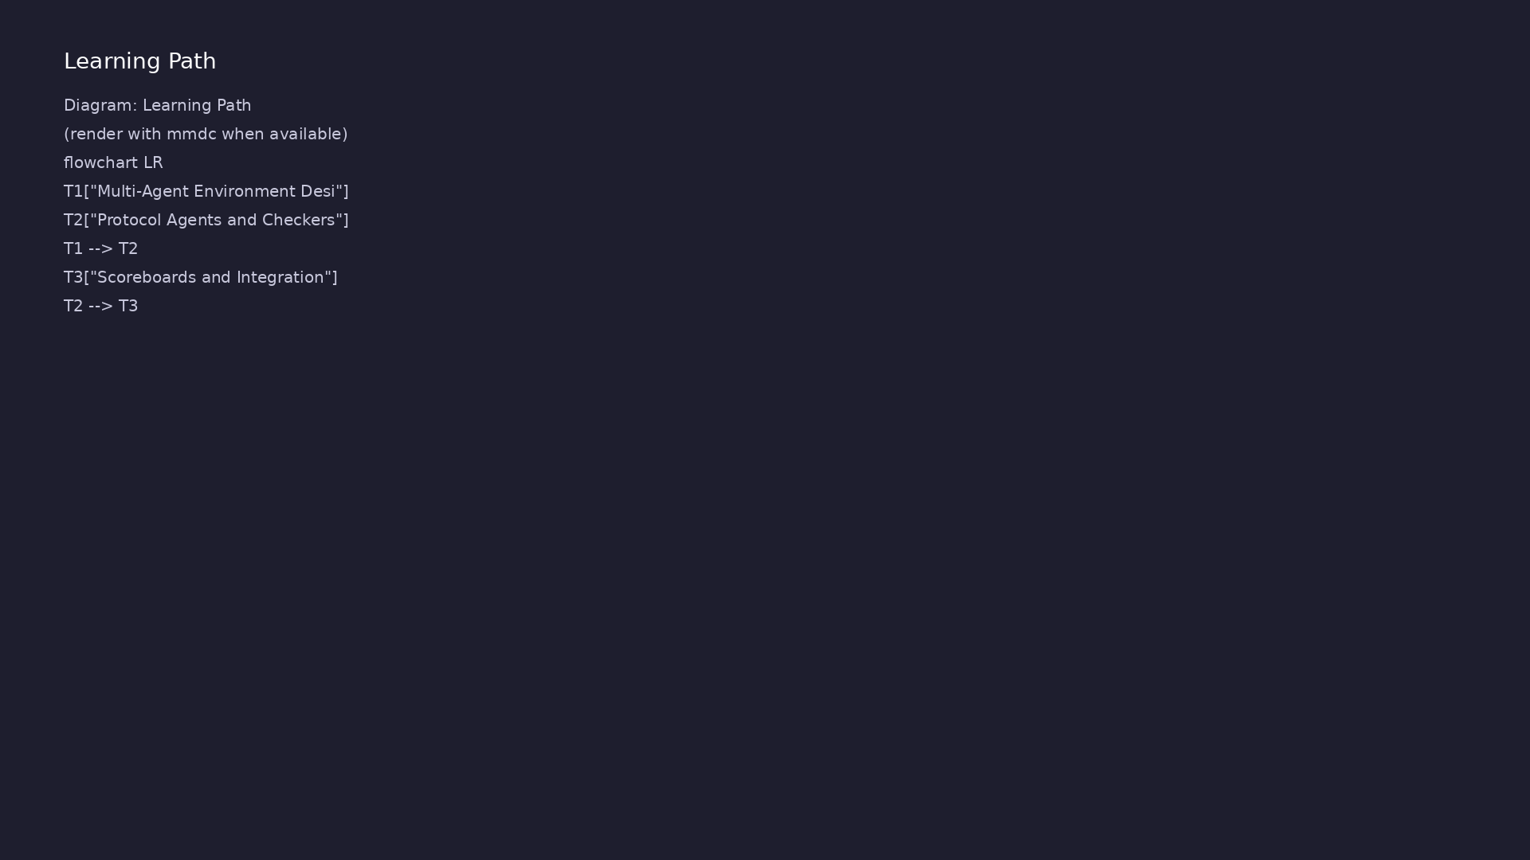
Learning path
Apply your planning, environment, and regression skills to **complex multi-agent, protocol-heavy testbenches** (e.g., AXI-like, multi-chann…
verification_planning_management / Module 6

Slide 5
Overview
• By Module 6, you have:
verification_planning_management / Module 6

Slide 6
How to learn this module
verification_planning_management / Module 6

Slide 7
Suggested learning path
• Re-read `module4/ENV_DESIGN.md` and
`module5/REGRESSION_OPS.md`.
• Scaffold Module 6 workspace: `./scripts/module6.sh
--scaffold`
• Complete `MULTI_AGENT_ARCHITECTURE.md`,
`PROTOCOL_VERIFICATION_PLAN.md`, and
`INTEGRATION_PLAN.md`.
• Add or refine multi-agent and protocol checker
components in `common_dut/tb/`.
• Validate: `./scripts/module6.sh --check`
verification_planning_management / Module 6
Notes:
From docs/MODULE6.md — read guides before running demos.

Slide 8
Design architecture
verification_planning_management / Module 6

Slide 9
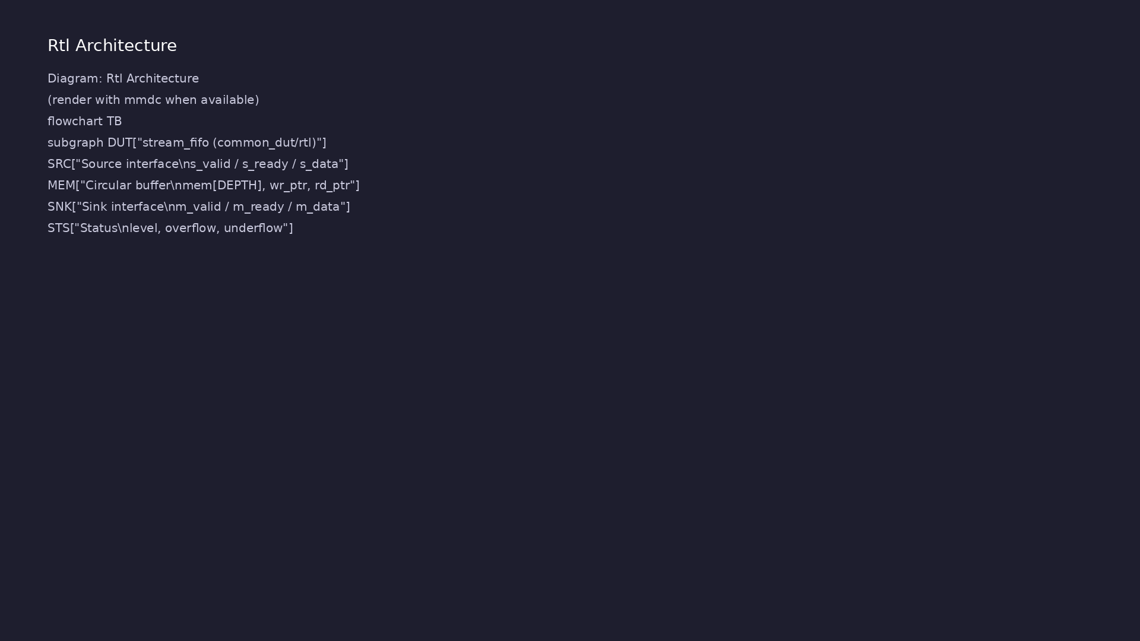
1. Multi-agent / multi-channel TB
• Multiple agents (per interface
or channel) coordinated by env
and virtual sequences.
• Layered architecture: block
agents → fabric/scoreboard →
subsystem scenarios
(`MULTI_AGENT_ARCHITEC…
verification_planning_management / Module 6
Notes:
From MODULE6 Design Architecture.

Slide 10
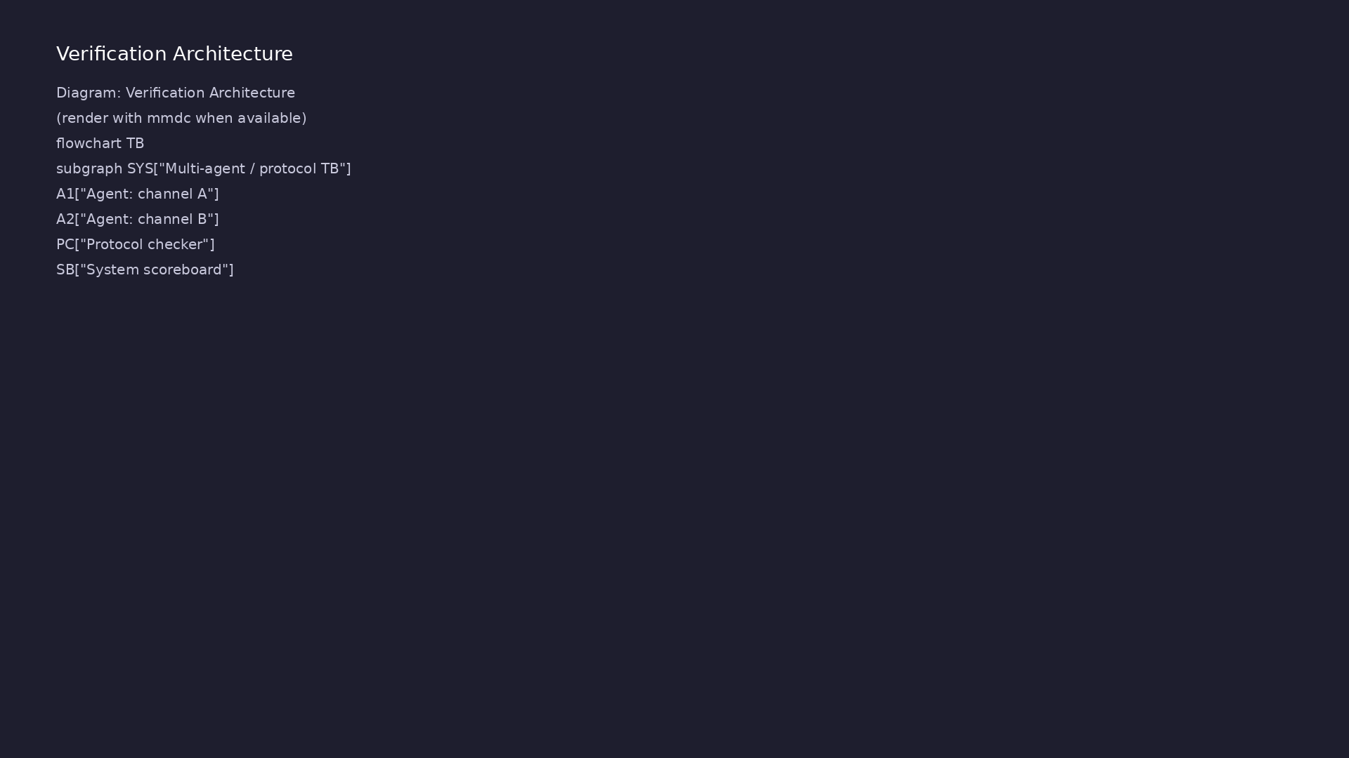
2. Protocol verification layer
• Dedicated protocol checker (SVA
or monitor-based) separate from
scoreboard data checks.
• `PROTOCOL_VERIFICATION_PLAN.md`
lists rules, coverage, and
integration with agents.
verification_planning_management / Module 6
Notes:
From MODULE6 Design Architecture.

Slide 11
3. System integration view
• `INTEGRATION_PLAN.md` describes how block-level env
connects to subsystem tests.
• Reuse agents/VIP across DUT variants via
configuration and factory overrides.
verification_planning_management / Module 6
Notes:
From MODULE6 Design Architecture.

Slide 12
Monitor observes transactions
class stream_monitor extends uvm_component;
`uvm_component_utils(stream_monitor)
virtual stream_if.slave vif;
uvm_analysis_port #(stream_item) ap;
function new(string name, uvm_component parent);
super.new(name, parent);
ap = new("ap", this);
endfunction
task run_phase(uvm_phase phase);
stream_item tr;
if (vif == null) begin
# ...
verification_planning_management / Module 6

Slide 13
Multi-agent architecture template
# Multi-Agent & Multi-Channel Architecture (Module 6)
> **Purpose**: Describe the architecture and coordination of multi-
agent, multi-channel UVM environments for your DUT.
> **Module**: 6 – Complex Multi-Agent & Protocol Testbenches (SV/UVM)
> **Instructions**: Fill in this document for your design. Copy from
`module6/templates/` if needed, or edit the file in `module6/` directly.
Reference: `module6/.solutions/`.
## 1. Context
<!-- TODO: DUT/System, interfaces/channels, existing env. Why a multi-
agent design is required. -->
## 2. High-Level Environment Diagram
<!-- TODO: Describe multi-agent env hierarchy (uvm_test_top, env,
verification_planning_management / Module 6

Slide 14
Key files to study
verification_planning_management / Module 6

Slide 15
Open these in the repo
• `module6/MULTI_AGENT_ARCHITECTURE.md` — multi-
channel env and virtual sequence coordination
• `module6/PROTOCOL_VERIFICATION_PLAN.md` — protocol
rules, checkers, and coverage
• `module6/INTEGRATION_PLAN.md` — block-to-subsystem
integration strategy
• `module4/tb/stream_pkg.sv` — monitor and agent
patterns to extend
• `scripts/module6.sh` — multi-agent and protocol doc
checks
verification_planning_management / Module 6
Notes:
Trace while running module6/EXAMPLES.md labs.

Slide 16
Verification & testing methods
verification_planning_management / Module 6

Slide 17
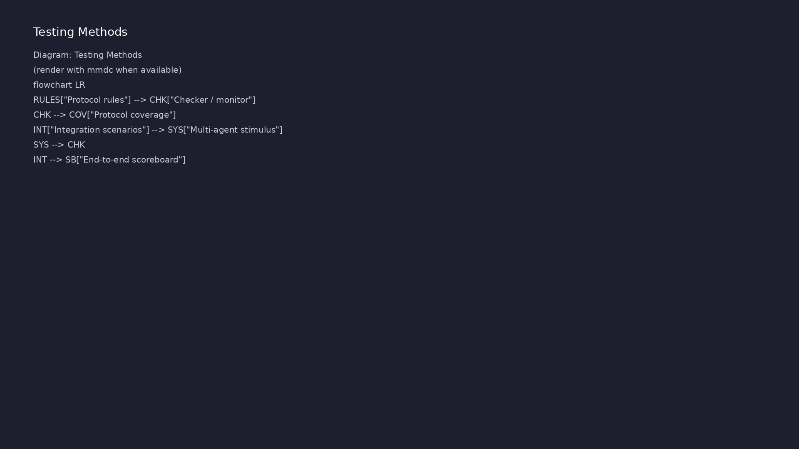
1. Protocol rule testing
• Each protocol rule maps to
checker fires, coverpoints, and
at least one directed or random
test.
• Illegal sequences and corner
timing documented with expected
checker behavior.
verification_planning_management / Module 6
Notes:
From MODULE6 Verification & Testing Methods.

Slide 18
2. Multi-agent scenario testing
• Virtual sequences stress cross-agent ordering,
arbitration, and backpressure.
• System scoreboard validates end-to-end data and
sideband signals.
verification_planning_management / Module 6
Notes:
From MODULE6 Verification & Testing Methods.

Slide 19
3. Maintainability reviews
• Architecture review before adding agents — avoid
duplicate monitors and conflicting checkers.
• `./scripts/module6.sh --check` validates multi-agent
and protocol planning artifacts.
verification_planning_management / Module 6
Notes:
From MODULE6 Verification & Testing Methods.

Slide 20
Protocol verification plan excerpt
# Protocol Verification Plan (Module 6)
> **Purpose**: Define how you will verify protocol correctness (e.g.,
AXI-like, custom bus) using agents, checkers, coverage, and tests.
> **Module**: 6 – Complex Multi-Agent & Protocol Testbenches (SV/UVM)
> **Instructions**: Fill in this document for your design. Copy from
`module6/templates/` if needed, or edit the file in `module6/` directly.
Reference: `module6/.solutions/`.
## 1. Protocol Overview
<!-- TODO: Protocol name, key characteristics (channels, handshakes,
ordering, error/response semantics). How the protocol is used by the DUT
(roles, traffic patterns). -->
## 2. Protocol Agent Strategy
verification_planning_management / Module 6

Slide 21
Syllabus topics
verification_planning_management / Module 6

Slide 22
1. Multi-Agent Environment Design
• Multi-agent and multi-channel environment design.
• Layered and reusable testbench architecture
patterns.
verification_planning_management / Module 6
Notes:
From MODULE6 Topics Covered.

Slide 23
2. Protocol Agents and Checkers
• Protocol agent and protocol checker design.
verification_planning_management / Module 6
Notes:
From MODULE6 Topics Covered.

Slide 24
3. Scoreboards and Integration
• Integration of complex scoreboards and time-based
matching.
verification_planning_management / Module 6
Notes:
From MODULE6 Topics Covered.

Slide 25
4. Debug and Analysis
• Debugging and analyzing complex, protocol-heavy
simulations.
verification_planning_management / Module 6
Notes:
From MODULE6 Topics Covered.

Slide 26
Command reference highlights
verification_planning_management / Module 6

Slide 27
Scaffold and validate Module 6
• ./scripts/module6.sh --scaffold
verification_planning_management / Module 6
Notes:
Full detail in docs/MODULE6.md command reference.

Slide 28
Review multi-agent architecture template
• head -40
module6/templates/MULTI_AGENT_ARCHITECTURE.md
verification_planning_management / Module 6
Notes:
Full detail in docs/MODULE6.md command reference.

Slide 29
Hands-on examples
verification_planning_management / Module 6

Slide 30
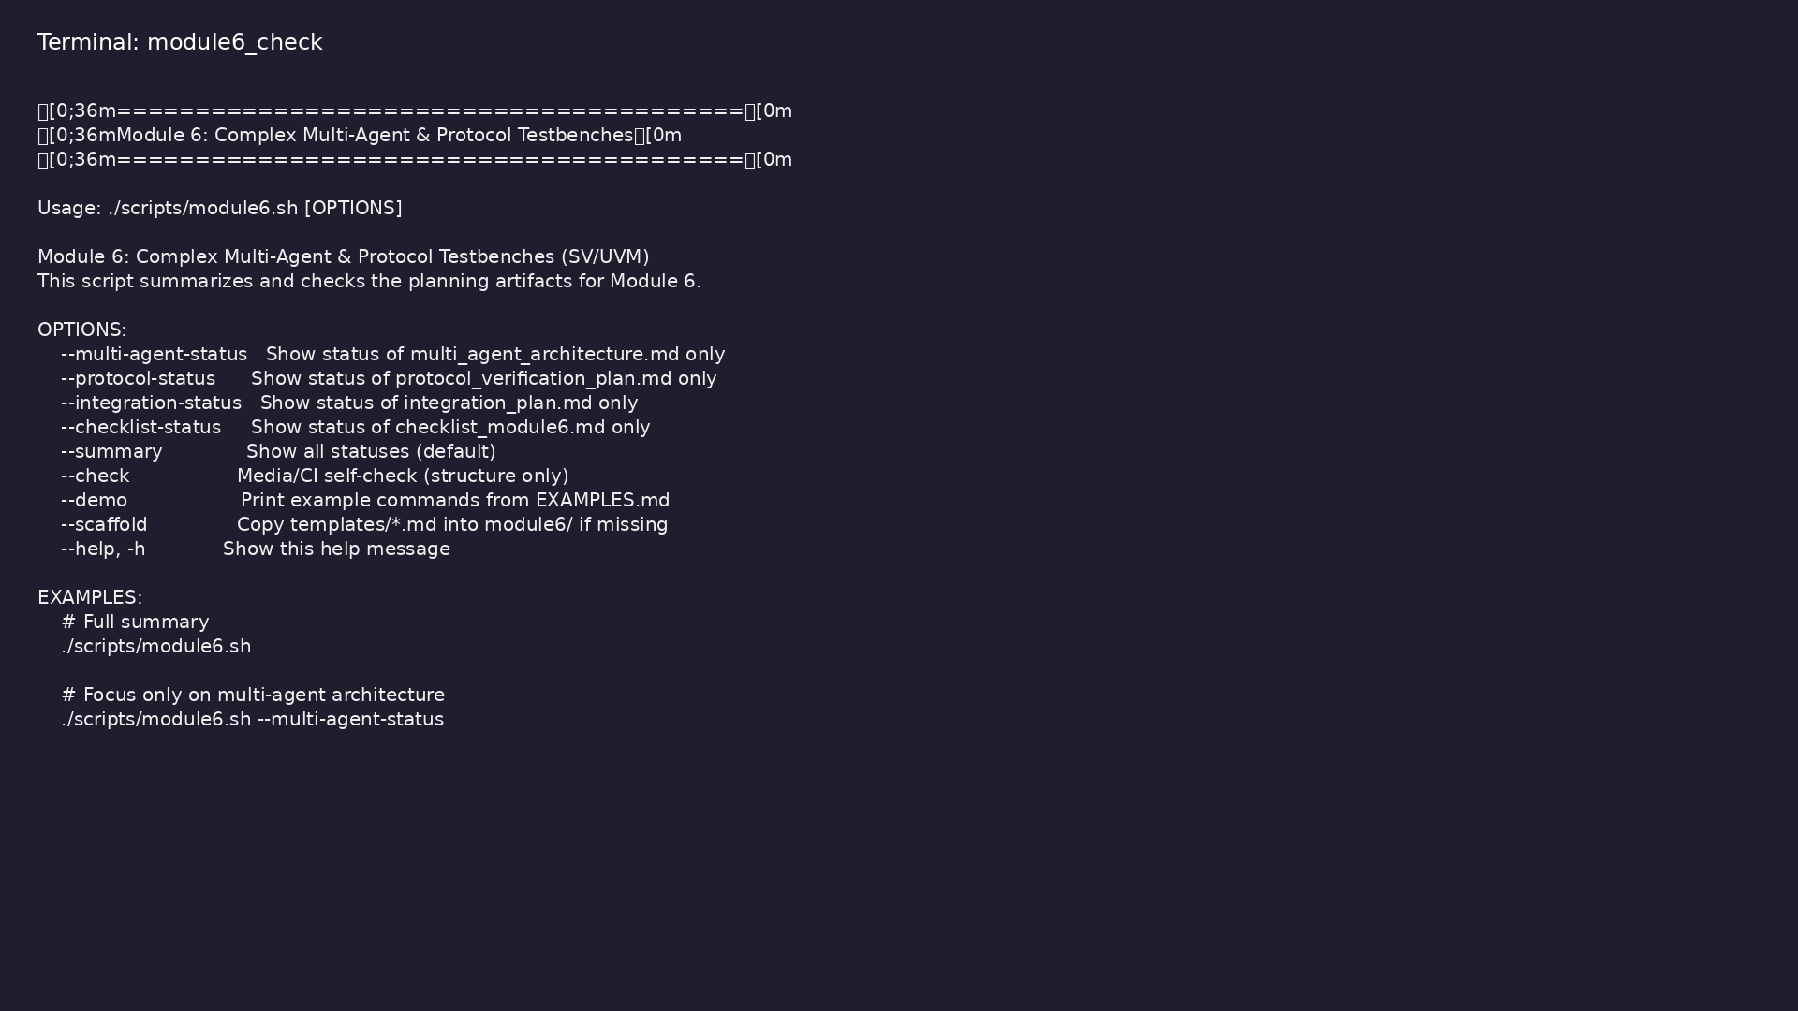
Module 6 self-check
$ ./scripts/module6.sh --help
verification_planning_management / Module 6
Notes:
Run from course repository root.

Slide 31
Exercise scaffold
./scripts/module6.sh --scaffold
verification_planning_management / Module 6

Slide 32
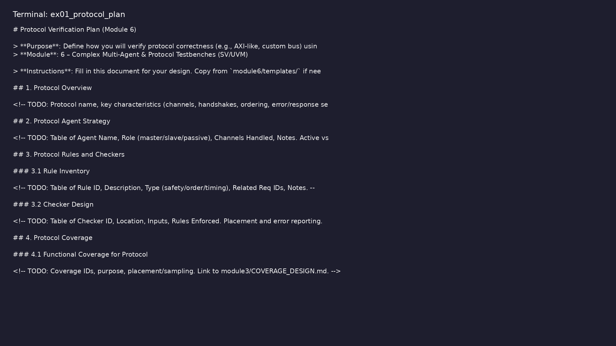
Demo: Protocol verification plan
$ head -30 module6/templates/PROTOCOL_VERIFICATION_PLAN.md
verification_planning_management / Module 6
Notes:
Hands-on: module6/examples/protocol_plan/

Slide 33
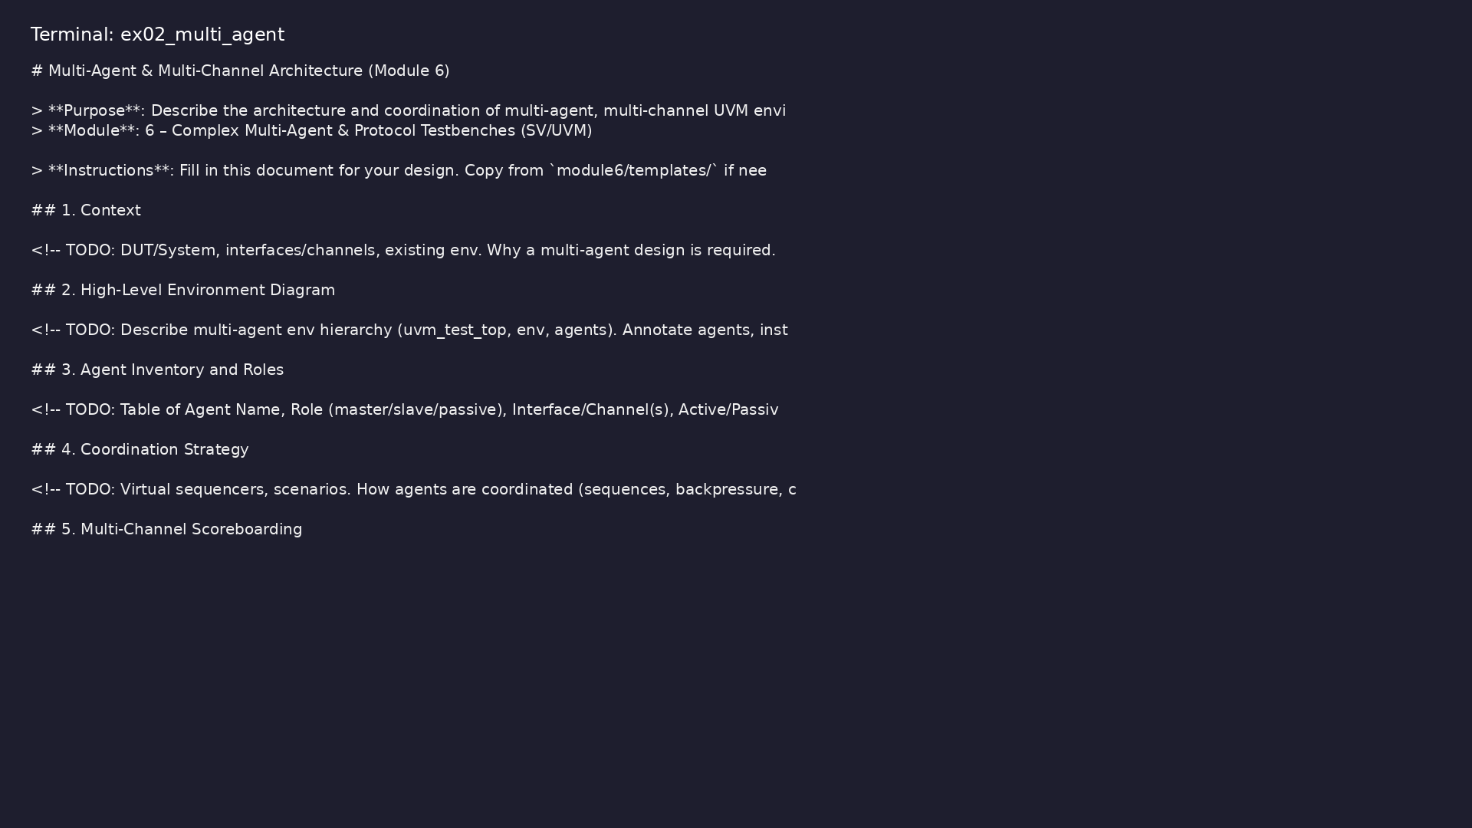
Demo: Multi-agent architecture
$ head -25 module6/templates/MULTI_AGENT_ARCHITECTURE.md
verification_planning_management / Module 6
Notes:
Hands-on: module6/examples/multi_agent/

Slide 34
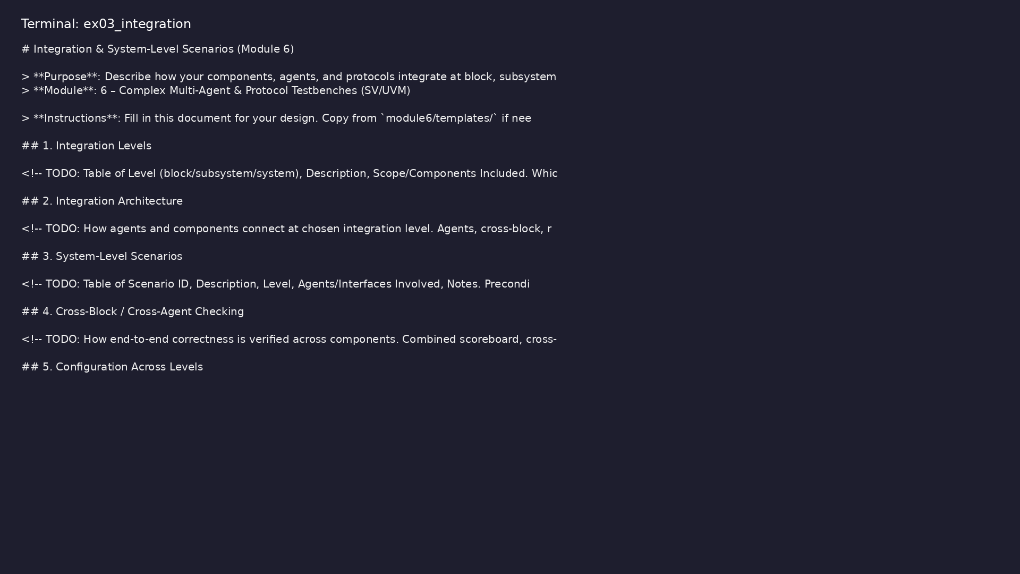
Demo: Integration plan
$ head -25 module6/templates/INTEGRATION_PLAN.md
verification_planning_management / Module 6
Notes:
Hands-on: module6/examples/integration/

Slide 35
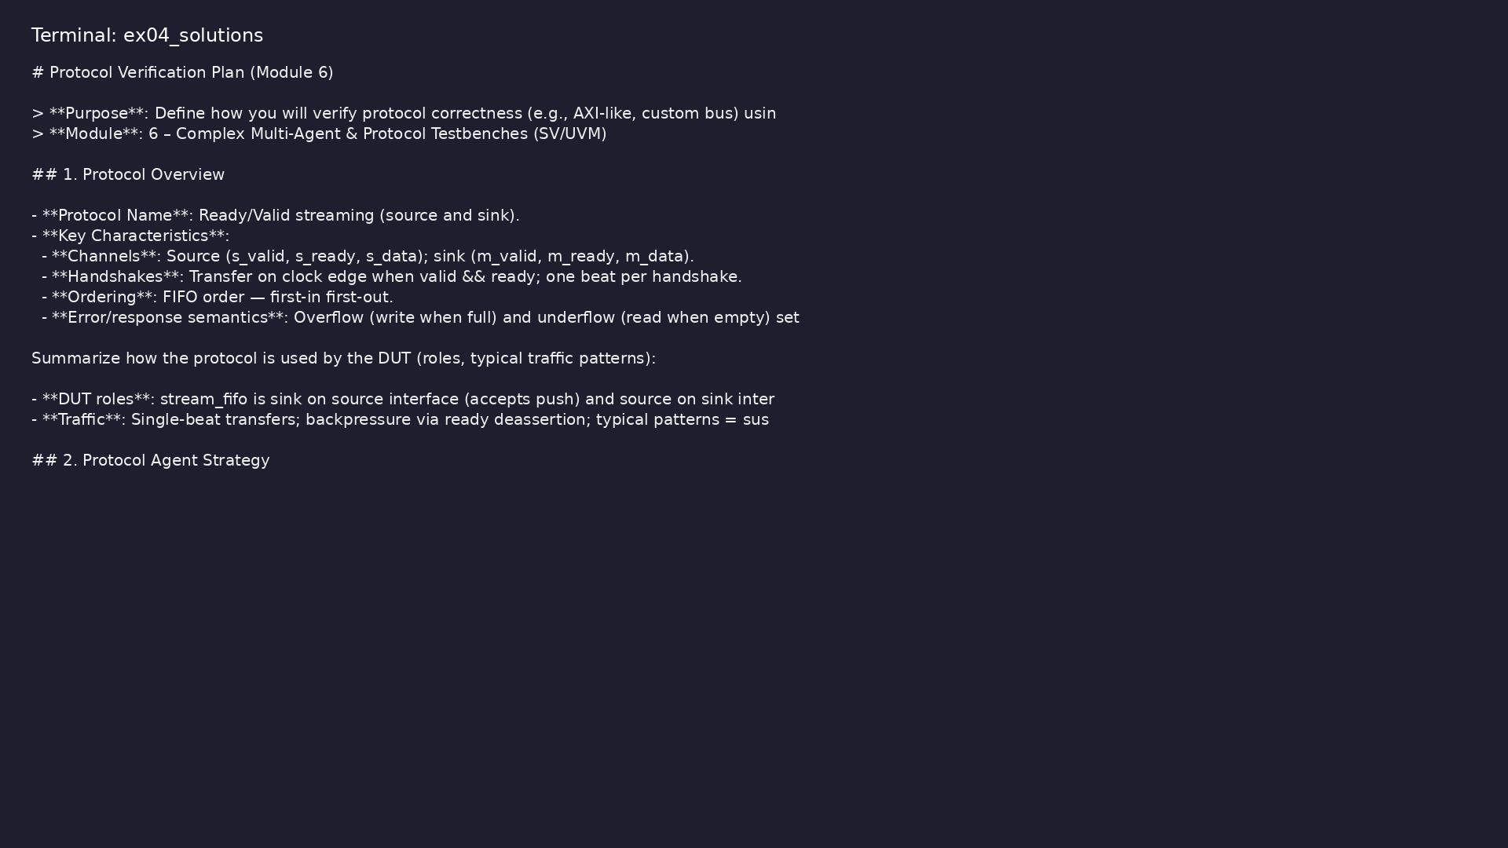
Demo: Reference protocol plan
$ head -20 module6/.solutions/PROTOCOL_VERIFICATION_PLAN.md
verification_planning_management / Module 6
Notes:
Hands-on: module6/examples/solutions/

Slide 36
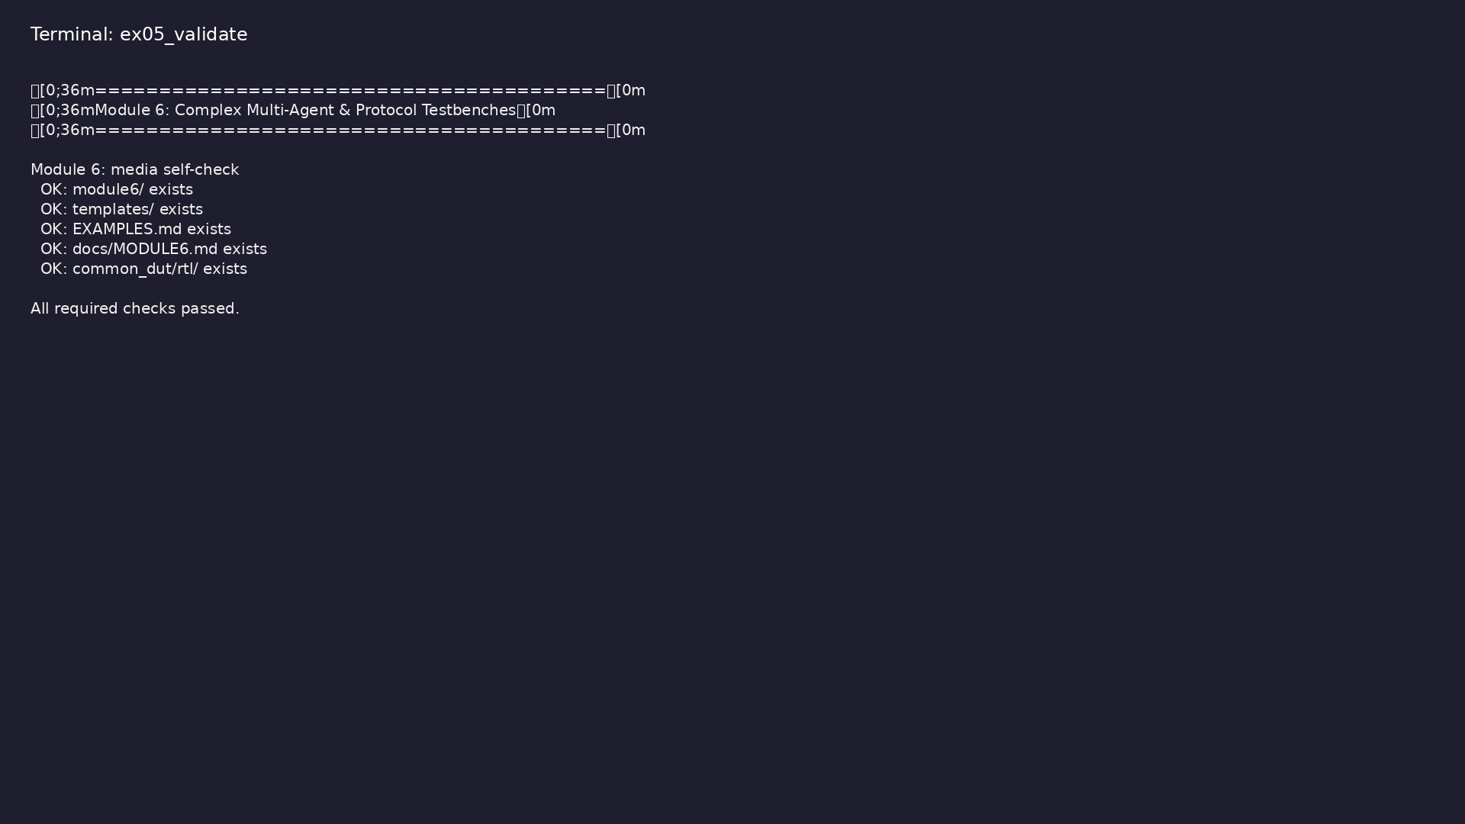
Demo: Module validation
$ ./scripts/module6.sh --check
verification_planning_management / Module 6
Notes:
Hands-on: module6/examples/validate/

Slide 37
Practice & assessment
verification_planning_management / Module 6

Slide 38
What you should know (1/2)
• Design and document multi-agent UVM environments for
protocol-based DUTs.
• Implement and integrate protocol agents and protocol
checkers.
• Apply layered architecture patterns to keep complex
benches maintainable.
• Analyze and debug multi-channel, protocol-level
behavior in simulations.
• Multi-agent/multi-channel environment design
documented in `module6/MULTI_AGENT_ARCHITECTURE.md`.
• Protocol verification strategy documented in
`module6/PROTOCOL_VERIFICATION_PLAN.md`.
verification_planning_management / Module 6
Notes:
From MODULE6 Learning Outcomes.

Slide 39
What you should know (2/2)
• Integration patterns and system-level scenarios
documented in `module6/INTEGRATION_PLAN.md`.
• Complex bench design reviewed; action items captured
in the docs.
verification_planning_management / Module 6
Notes:
From MODULE6 Learning Outcomes.

Slide 40
Assessment checklist
• Multi-agent/multi-channel environment design
documented in `module6/MULTI_AGENT_ARCHITECTURE.md`.
• Protocol verification strategy documented in
`module6/PROTOCOL_VERIFICATION_PLAN.md`.
• Integration patterns and system-level scenarios
documented in `module6/INTEGRATION_PLAN.md`.
• Complex bench design reviewed; action items captured
in the docs.
verification_planning_management / Module 6

Slide 41
Summary & next steps
• Apply your planning, environment, and regression
skills to **complex multi-agent, protocol-heavy te…
• Complete module6/CHECKLIST.md
• Review module6/EXAMPLES.md and run each lab
• Next: Next module in course
verification_planning_management / Module 6

