Slide 1
Module 7
Real-World Verification Applications & VIP (SV/UVM)
verification_planning_management / Module 7

Slide 2
Learning objectives
• Apply the full methodology (planning, UVM env,
coverage, regressions) to **real-world style blocks…
verification_planning_management / Module 7

Slide 3
Prerequisites
• See module README
verification_planning_management / Module 7

Slide 4

Learning path
Apply the full methodology (planning, UVM env, coverage, regressions) to **real-world style blocks and protocols** (e.g., DMA, UART/SPI/I2C…
verification_planning_management / Module 7

Slide 5
Overview
• Modules 1–6 built up your **skills and
infrastructure**. Module 7 is about **applying**
them to rea…
verification_planning_management / Module 7

Slide 6
How to learn this module
verification_planning_management / Module 7

Slide 7
Suggested learning path
• Choose a real-world DUT or subsystem scope in
`module7/PROJECTS.md`.
• Scaffold Module 7 workspace: `./scripts/module7.sh
--scaffold`
• Design reusable VIP structure in
`module7/VIP_DESIGN.md`.
• Apply best practices from
`module7/BEST_PRACTICES.md` to naming, docs, and API
boundaries.
• Validate: `./scripts/module7.sh --check`
verification_planning_management / Module 7
Notes:
From docs/MODULE7.md — read guides before running demos.

Slide 8
Design architecture
verification_planning_management / Module 7

Slide 9

1. Real-world DUT / subsystem
• Choose DMA-style block,
bus/register IP, or protocol DUT
(UART/SPI/I2C/AXI-lite style).
• Document block diagram,
clocks/resets, and interface
contracts in `PROJECTS.md`.
verification_planning_management / Module 7
Notes:
From MODULE7 Design Architecture.

Slide 10
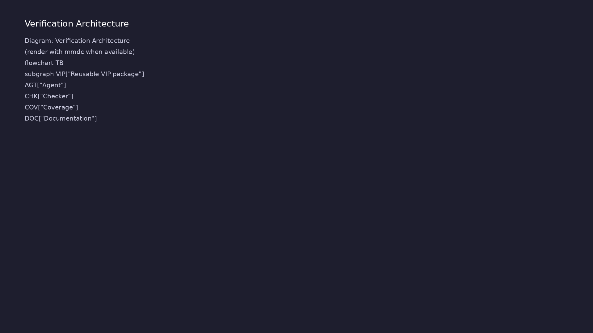
2. VIP package architecture
• Reusable VIP: agent, sequencer,
driver, monitor, checker,
coverage, config objects.
• `VIP_DESIGN.md` defines public
API, sequences, and integration
guide for adopters.
• Package boundaries: what
integrators configure vs what
VIP owns internally.
verification_planning_management / Module 7
Notes:
From MODULE7 Design Architecture.

Slide 11
3. Production layout
• Separate `rtl/`, `tb/`, `tests/`, `docs/` with
consistent naming for handoff to another team.
verification_planning_management / Module 7
Notes:
From MODULE7 Design Architecture.

Slide 12
VIP design template
# Verification IP (VIP) Design Plan (Module 7)
> **Purpose**: Design and document a reusable Verification IP (VIP) for
a chosen protocol or IP block.
> **Module**: 7 – Real-World Verification Applications & VIP (SV/UVM)
> **Instructions**: Fill in this document for your design. Copy from
`module7/templates/` if needed, or edit the file in `module7/` directly.
Reference: `module7/.solutions/`.
## 1. VIP Overview
<!-- TODO: Protocol/IP name, intended use. What this VIP should enable
users to do (drive, observe, check, measure, configure). -->
## 2. VIP Components
<!-- TODO: Table of Component ID, Type, Purpose. Location in codebase.
verification_planning_management / Module 7

Slide 13
Key files to study
verification_planning_management / Module 7

Slide 14
Open these in the repo
• `module7/PROJECTS.md` — DUT scope, interfaces, and
verification goals
• `module7/VIP_DESIGN.md` — VIP package architecture
and public API
• `module7/BEST_PRACTICES.md` — production-quality
verification and delivery standards
• `module6/MULTI_AGENT_ARCHITECTURE.md` — prior multi-
agent patterns to reuse
• `scripts/module7.sh` — project and VIP design doc
checks
verification_planning_management / Module 7
Notes:
Trace while running module7/EXAMPLES.md labs.

Slide 15
Verification & testing methods
verification_planning_management / Module 7

Slide 16
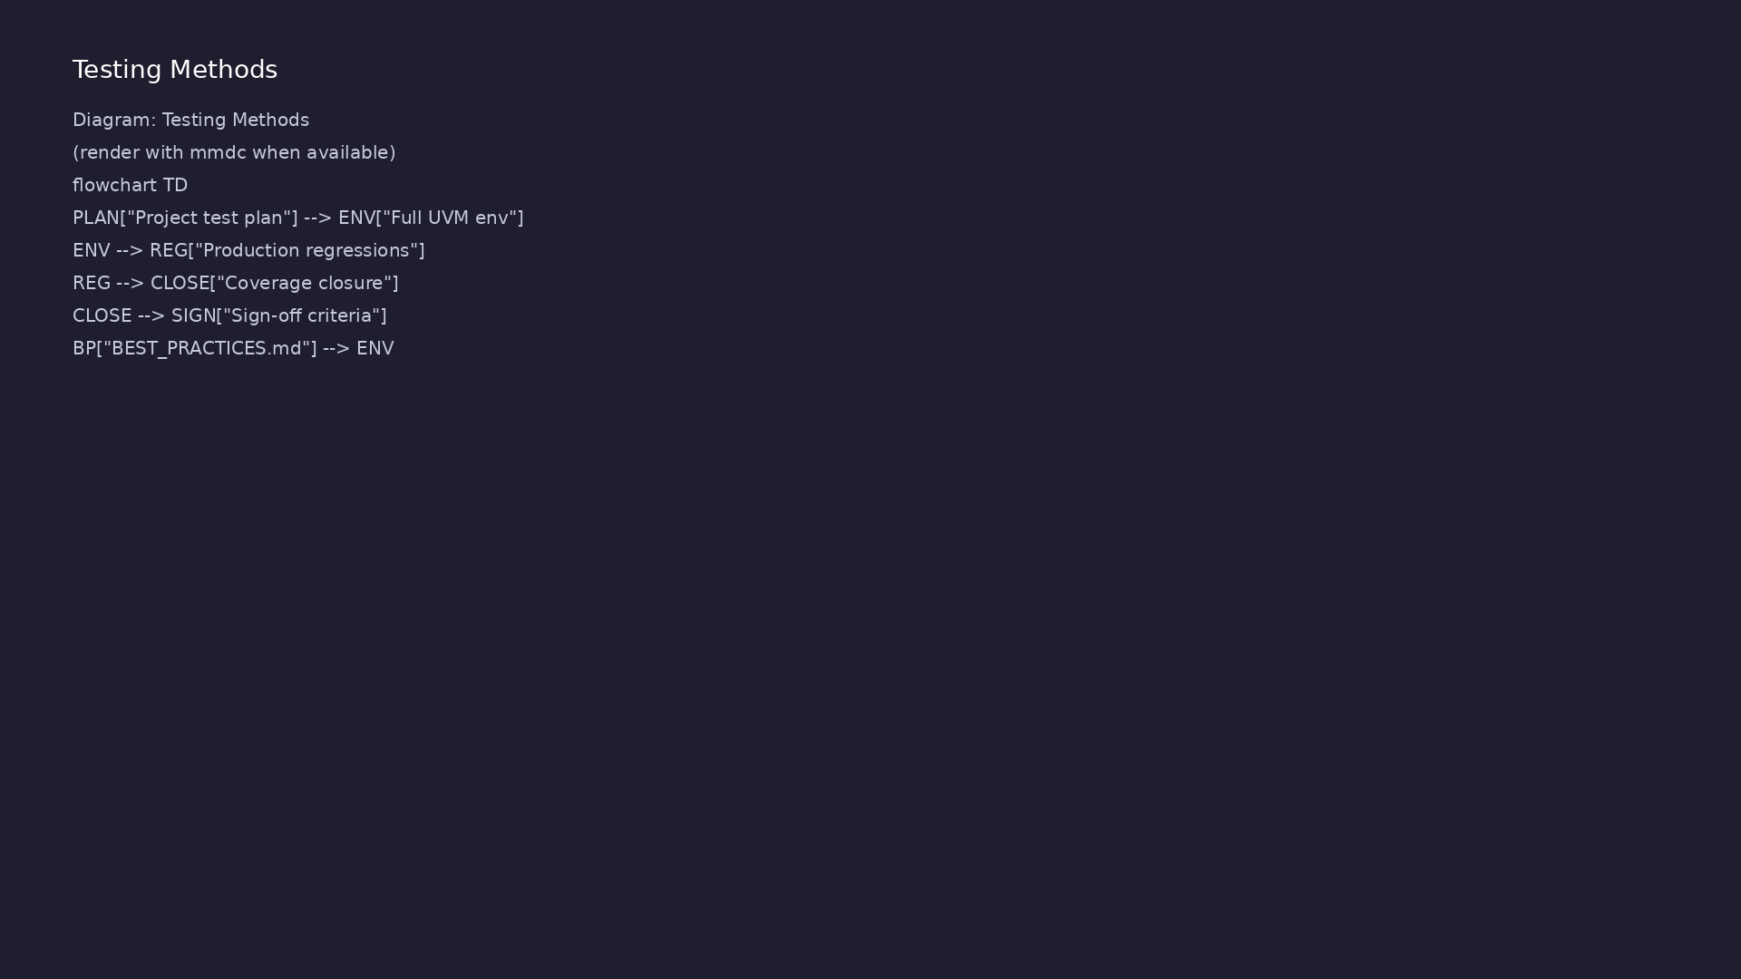
1. End-to-end IP verification
• Full lifecycle: requirements →
env → tests → coverage →
regressions → sign-off preview.
• Regression tiers and coverage
goals match production
expectations.
verification_planning_management / Module 7
Notes:
From MODULE7 Verification & Testing Methods.

Slide 17
2. VIP validation
• Self-test environment for the VIP plus integrator
tests on a reference DUT.
• Documentation-driven review: another engineer can
adopt VIP from docs alone.
verification_planning_management / Module 7
Notes:
From MODULE7 Verification & Testing Methods.

Slide 18
3. Quality bar
• `BEST_PRACTICES.md` — coding standards, review
checklist, maintenance and versioning.
• `./scripts/module7.sh --check` validates project and
VIP design documentation.
verification_planning_management / Module 7
Notes:
From MODULE7 Verification & Testing Methods.

Slide 19
Project scope template
# Real-World Verification Projects (Module 7)
> **Purpose**: Describe one or more real-world style verification
projects you will implement (DMA, protocols, custom IP, etc.).
> **Module**: 7 – Real-World Verification Applications & VIP (SV/UVM)
> **Instructions**: Fill in this document for your design. Copy from
`module7/templates/` if needed, or edit the file in `module7/` directly.
Reference: `module7/.solutions/`.
## 1. Project Overview
<!-- TODO: For each project: DUT/IP, scope (level, features), goals,
status. Add more projects as needed. -->
## 2. Requirements and Use Cases
<!-- TODO: For each project, list key requirements and use cases. Link
verification_planning_management / Module 7

Slide 20
VIP best practices excerpt
# Best Practices & Quality Checklist (Module 7)
> **Purpose**: Capture and enforce best practices for code, structure,
and maintenance in your real-world verification/VIP projects.
> **Module**: 7 – Real-World Verification Applications & VIP (SV/UVM)
> **Instructions**: Fill in this document for your design. Copy from
`module7/templates/` if needed, or edit the file in `module7/` directly.
Reference: `module7/.solutions/`.
## 1. Project Structure
<!-- TODO: Guidelines: separation (DUT, UVM/VIP, tests/scripts, docs).
Project-specific layout and naming. -->
## 2. Code Quality and Naming
<!-- TODO: Checklist: clear names, no magic numbers, consistent
verification_planning_management / Module 7

Slide 21
Syllabus topics
verification_planning_management / Module 7

Slide 22
1. End-to-End IP Verification
• Applying planning + UVM + coverage + regression to
realistic IP.
• Realistic test planning, coverage closure, and
regression operation.
verification_planning_management / Module 7
Notes:
From MODULE7 Topics Covered.

Slide 23
2. VIP Design and Reuse
• Designing and documenting verification IP (VIP) for
protocols or blocks.
verification_planning_management / Module 7
Notes:
From MODULE7 Topics Covered.

Slide 24
3. Production Quality and Maintenance
• Best practices for project structure, code quality,
docs, and maintenance.
verification_planning_management / Module 7
Notes:
From MODULE7 Topics Covered.

Slide 25
Command reference highlights
verification_planning_management / Module 7

Slide 26
Scaffold and validate Module 7
• ./scripts/module7.sh --scaffold
verification_planning_management / Module 7
Notes:
Full detail in docs/MODULE7.md command reference.

Slide 27
Review VIP and project templates
• head -40 module7/templates/VIP_DESIGN.md
verification_planning_management / Module 7
Notes:
Full detail in docs/MODULE7.md command reference.

Slide 28
Hands-on examples
verification_planning_management / Module 7

Slide 29
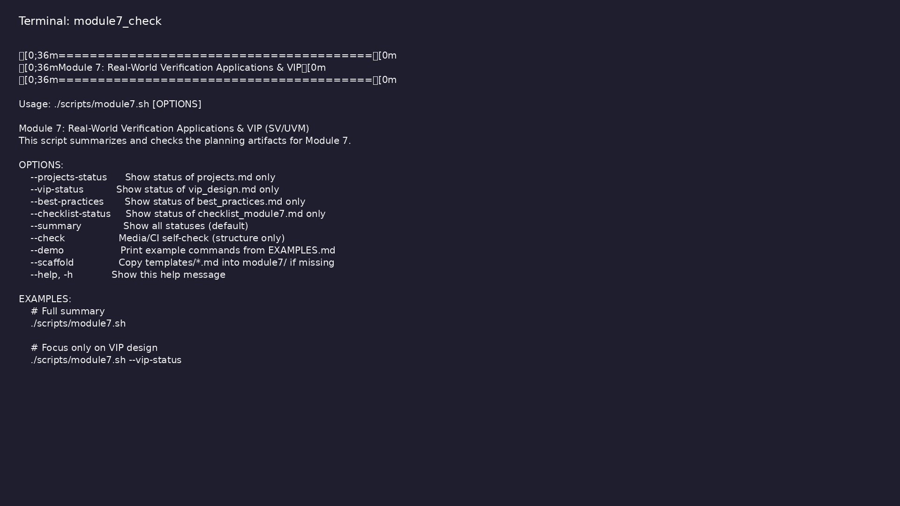
Module 7 self-check
$ ./scripts/module7.sh --help
verification_planning_management / Module 7
Notes:
Run from course repository root.

Slide 30
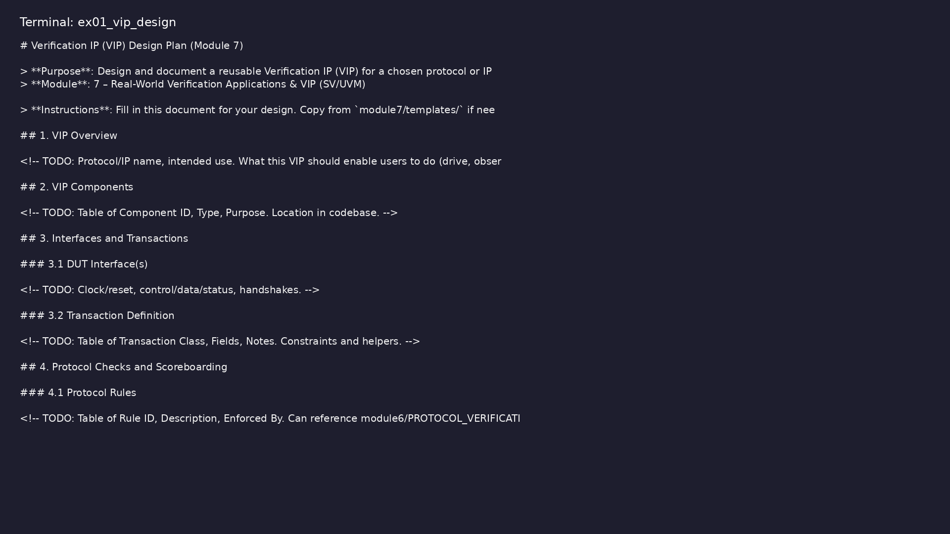
Demo: VIP design template
$ head -30 module7/templates/VIP_DESIGN.md
verification_planning_management / Module 7
Notes:
Hands-on: module7/examples/vip_design/

Slide 31
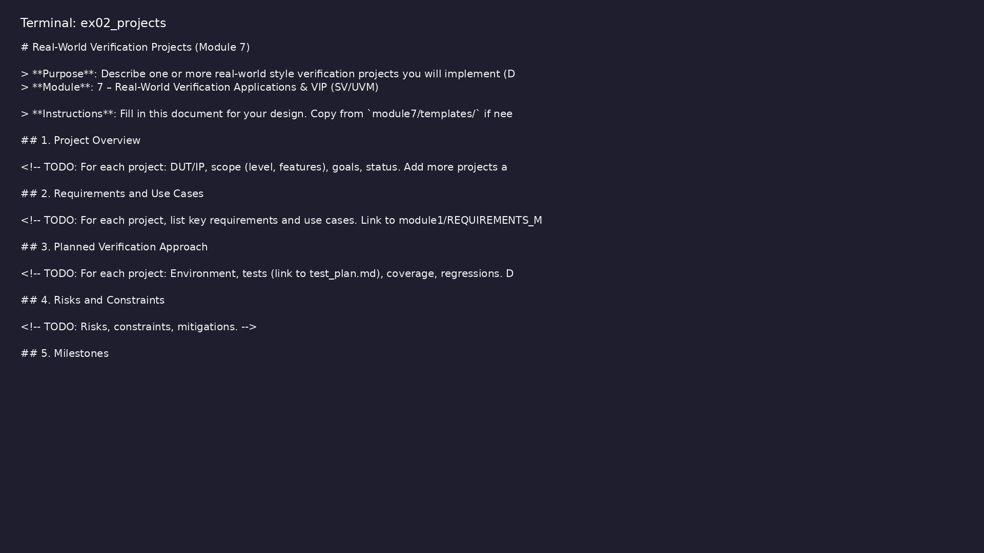
Demo: Projects overview
$ head -25 module7/templates/PROJECTS.md
verification_planning_management / Module 7
Notes:
Hands-on: module7/examples/projects/

Slide 32
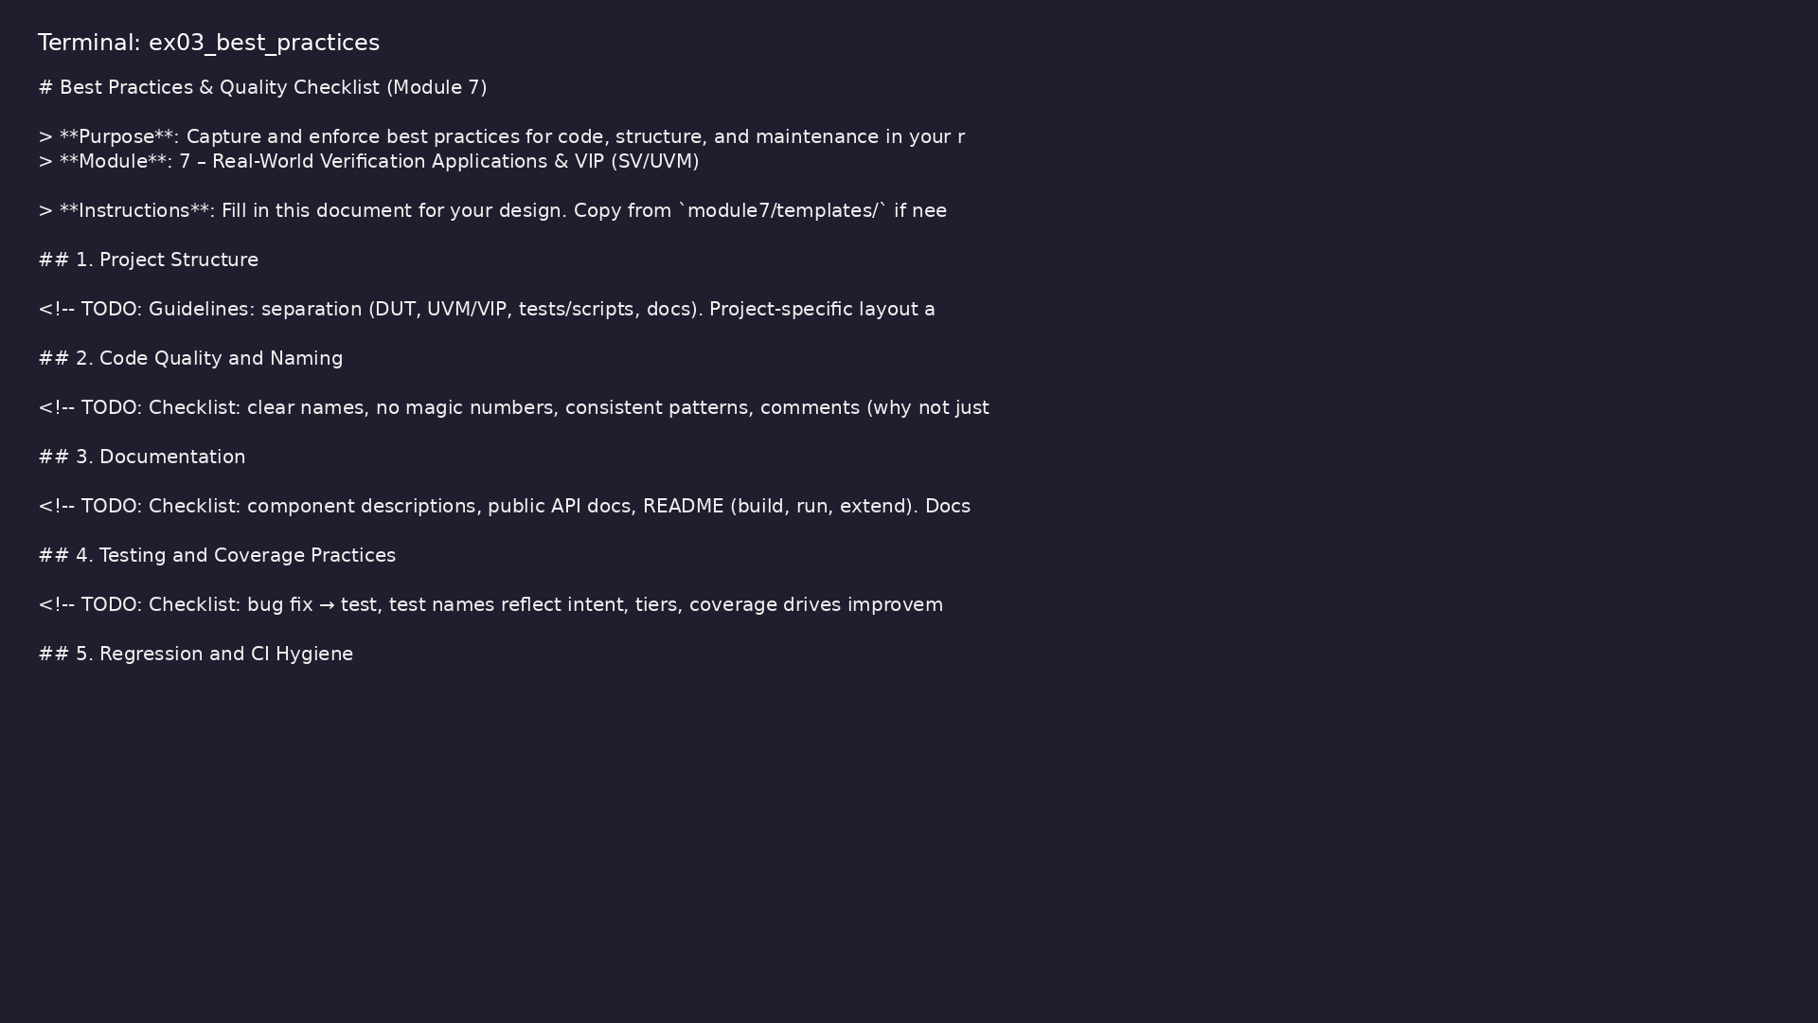
Demo: Best practices
$ head -25 module7/templates/BEST_PRACTICES.md
verification_planning_management / Module 7
Notes:
Hands-on: module7/examples/best_practices/

Slide 33
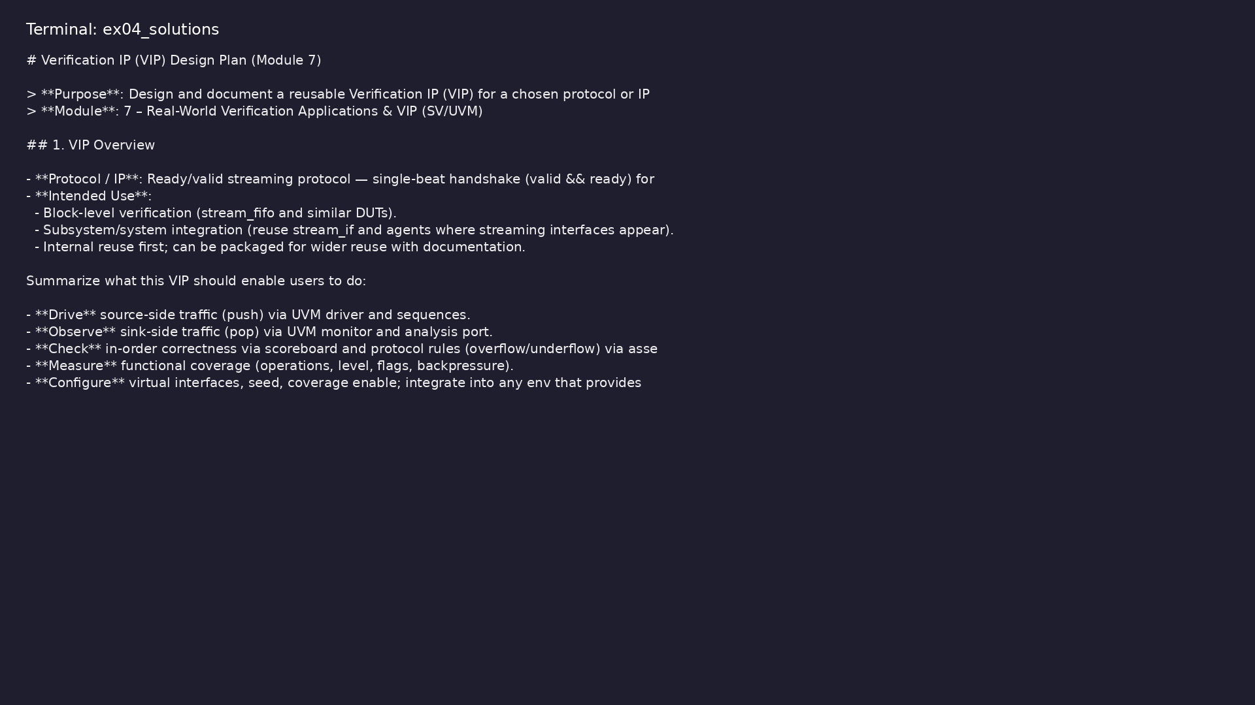
Demo: Reference VIP design
$ head -20 module7/.solutions/VIP_DESIGN.md
verification_planning_management / Module 7
Notes:
Hands-on: module7/examples/solutions/

Slide 34

Demo: Module validation
$ ./scripts/module7.sh --check
verification_planning_management / Module 7
Notes:
Hands-on: module7/examples/validate/

Slide 35
Practice & assessment
verification_planning_management / Module 7

Slide 36
What you should know (1/2)
• Design and implement a complete verification
environment for a realistic DUT.
• Create and document reusable VIP that others could
adopt.
• Operate regressions and coverage closure as you
would in a real team.
• Maintain production-quality code, docs, and tests
over the lifetime of a project.
• At least one substantial real-world style project is
described and partially/fully implemented.
• VIP or environment design is documented in
`module7/VIP_DESIGN.md` and `module7/PROJECTS.md`.
verification_planning_management / Module 7
Notes:
From MODULE7 Learning Outcomes.

Slide 37
What you should know (2/2)
• Best-practices checklist largely satisfied
(`module7/BEST_PRACTICES.md` /
`module7/CHECKLIST.md`).
• You can explain your project and design decisions as
if presenting to a review board.
verification_planning_management / Module 7
Notes:
From MODULE7 Learning Outcomes.

Slide 38
Assessment checklist
• At least one substantial real-world style project is
described and partially/fully implemented.
• VIP or environment design is documented in
`module7/VIP_DESIGN.md` and `module7/PROJECTS.md`.
• Best-practices checklist largely satisfied
(`module7/BEST_PRACTICES.md` /
`module7/CHECKLIST.md`).
• You can explain your project and design decisions as
if presenting to a review board.
verification_planning_management / Module 7

Slide 39
Summary & next steps
• Apply the full methodology (planning, UVM env,
coverage, regressions) to **real-world style blocks…
• Complete module7/CHECKLIST.md
• Review module7/EXAMPLES.md and run each lab
• Next: Next module in course
verification_planning_management / Module 7

