Slide 1
Module 8
Capstone – End‑to‑End Verification & VIP Delivery (SV/UVM)
verification_planning_management / Module 8

Slide 2
Learning objectives
• Plan and execute a **single, substantial capstone
project** that exercises the full verification li…
verification_planning_management / Module 8

Slide 3
Prerequisites
• See module README
verification_planning_management / Module 8

Slide 4

Learning path
Plan and execute a **single, substantial capstone project** that exercises the full verification lifecycle (Modules 1–7), from requirements…
verification_planning_management / Module 8

Slide 5
Overview
• Module 8 is not another theory module; it is a
**major project** that ties everything together:
verification_planning_management / Module 8

Slide 6
How to learn this module
verification_planning_management / Module 8

Slide 7
Suggested learning path
• Select capstone DUT and scope in
`module8/CAPSTONE_PROJECT.md`.
• Scaffold Module 8 workspace: `./scripts/module8.sh
--scaffold`
• Assemble artifacts from Modules 1–7: plans, env,
coverage, regression ops, VIP (if applicable).
• Run full regression tiers and document sign-off
status in the capstone checklist.
• Validate deliverable completeness:
`./scripts/module8.sh --check`
verification_planning_management / Module 8
Notes:
From docs/MODULE8.md — read guides before running demos.

Slide 8
Design architecture
verification_planning_management / Module 8

Slide 9

1. Capstone system architecture
• `CAPSTONE_PROJECT.md` defines
DUT hierarchy, interfaces,
clocks, and verification scope.
• Apply Modules 1–7 artifacts:
plans, env, VIP (if applicable),
coverage, regression ops.
• Deliverable layout: RTL, UVM
env, tests, scripts, and user-
facing documentation.
verification_planning_management / Module 8
Notes:
From MODULE8 Design Architecture.

Slide 10

2. End-to-end verification package
• Single coherent verification
solution or VIP another team can
integrate.
• Traceability matrix from
requirements through tests,
coverage, and sign-off criteria.
verification_planning_management / Module 8
Notes:
From MODULE8 Design Architecture.

Slide 11
3. Capstone delivery and handoff workflow
• Plan: consolidate Modules 1–2 plans into capstone
scope and test/regression strategy.
• Build: mature env, checkers, coverage, and VIP
(Module 4–7 artifacts) under `rtl/` and `tb/`.
• Execute: run sanity → core → stress tiers; merge
coverage; triage failures with saved seeds.
• Sign off: meet exit criteria in
`CAPSTONE_PROJECT.md`; complete `CHECKLIST.md`.
• Deliver: package RTL, UVM env, tests, scripts, and
user docs for another team to integrate.
verification_planning_management / Module 8
Notes:
From MODULE8 Design Architecture.

Slide 12
Capstone project plan template
# Capstone Project Plan (Module 8)
> **Purpose**: Define and track your major end‑to‑end verification or
VIP project.
> **Module**: 8 – Capstone: End‑to‑End Verification & VIP Delivery
(SV/UVM)
> **Instructions**: Fill in this document for your design. Copy from
`module8/templates/` if needed, or edit the file in `module8/` directly.
Reference: `module8/.solutions/`.
## 1. Capstone Choice
<!-- TODO: Project ID/Name, brief description, type
(block/subsystem/VIP). -->
## 2. Requirements and Goals
verification_planning_management / Module 8

Slide 13
Key files to study
verification_planning_management / Module 8

Slide 14
Open these in the repo
• `module8/CAPSTONE_PROJECT.md` — end-to-end project
definition and deliverables
• `module8/CHECKLIST.md` — capstone sign-off and
delivery checklist
• `docs/FILL_GUIDES.md` — guidance for completing
planning artifacts
• Prior module workspaces (`module1/` … `module7/`) —
reusable verification assets
• `scripts/module8.sh` — capstone documentation and
checklist validation
verification_planning_management / Module 8
Notes:
Trace while running module8/EXAMPLES.md labs.

Slide 15
Verification & testing methods
verification_planning_management / Module 8

Slide 16

1. Full-lifecycle testing
• Execute planned regression tiers
with coverage merge and
documented closure status.
• Include negative, stress, and
protocol/rule tests appropriate
to your capstone DUT.
verification_planning_management / Module 8
Notes:
From MODULE8 Verification & Testing Methods.

Slide 17
2. Sign-off and delivery testing
• Define explicit exit criteria (coverage %, bug bar,
stability window).
• Retrospective: what worked, gaps, and improvements
for a real project review.
verification_planning_management / Module 8
Notes:
From MODULE8 Verification & Testing Methods.

Slide 18
3. Validation
• `./scripts/module8.sh --check` validates capstone
documentation and checklist completion.
• Optional demo or walkthrough recorded as part of the
deliverable.
verification_planning_management / Module 8
Notes:
From MODULE8 Verification & Testing Methods.

Slide 19
Capstone checklist excerpt
# Module 8 Checklist – Capstone: End‑to‑End Verification & VIP Delivery
> **Purpose**: Track completion of your major capstone project.
> **Instructions**: Check off items as you complete them. Copy from
`module8/templates/` if needed, or edit the file in `module8/` directly.
Reference: `module8/.solutions/`.
## 1. Capstone Definition
- [ ] Capstone project chosen and described in `CAPSTONE_PROJECT.md`.
- [ ] Key requirements and success criteria documented.
- [ ] Scope (block/subsystem/VIP) clearly defined and realistic for the
time frame.
## 2. Re‑use of Earlier Modules
- [ ] Existing plans (verification, test, coverage, regression)
verification_planning_management / Module 8

Slide 20
Capstone validation script
#!/usr/bin/env bash
# Module 8: Capstone Orchestrator
# This script summarizes and checks the artifacts for the Module 8
capstone.
# Usage: ./scripts/module8.sh [OPTIONS]
set -euo pipefail
# Colors for output
RED='\033[0;31m'
GREEN='\033[0;32m'
YELLOW='\033[1;33m'
verification_planning_management / Module 8

Slide 21
Command reference highlights
verification_planning_management / Module 8

Slide 22
Scaffold and validate capstone
• ./scripts/module8.sh --scaffold
verification_planning_management / Module 8
Notes:
Full detail in docs/MODULE8.md command reference.

Slide 23
Review capstone templates
• head -45 module8/templates/CAPSTONE_PROJECT.md
verification_planning_management / Module 8
Notes:
Full detail in docs/MODULE8.md command reference.

Slide 24
Hands-on examples
verification_planning_management / Module 8

Slide 25
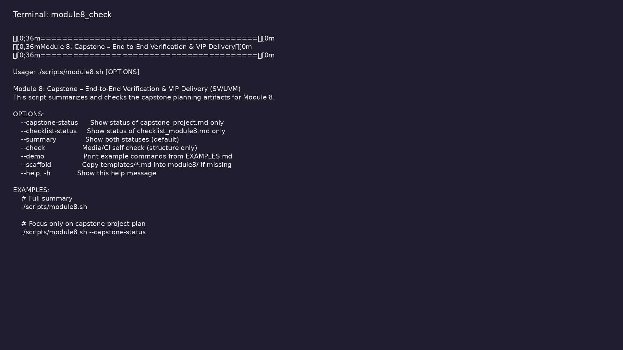
Module 8 self-check
$ ./scripts/module8.sh --help
verification_planning_management / Module 8
Notes:
Run from course repository root.

Slide 26
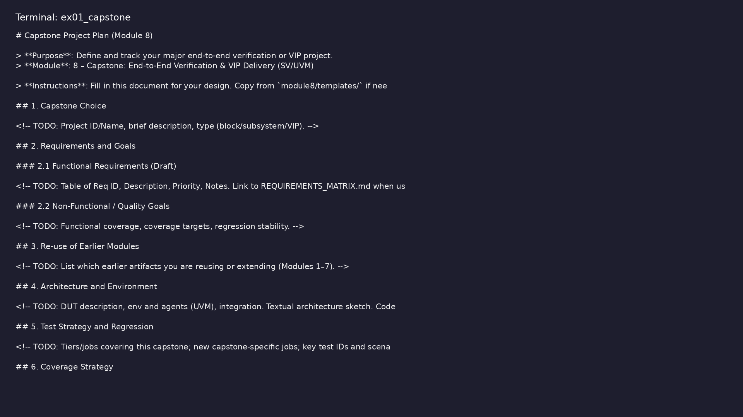
Demo: Capstone project template
$ head -35 module8/templates/CAPSTONE_PROJECT.md
verification_planning_management / Module 8
Notes:
Hands-on: module8/examples/capstone/

Slide 27
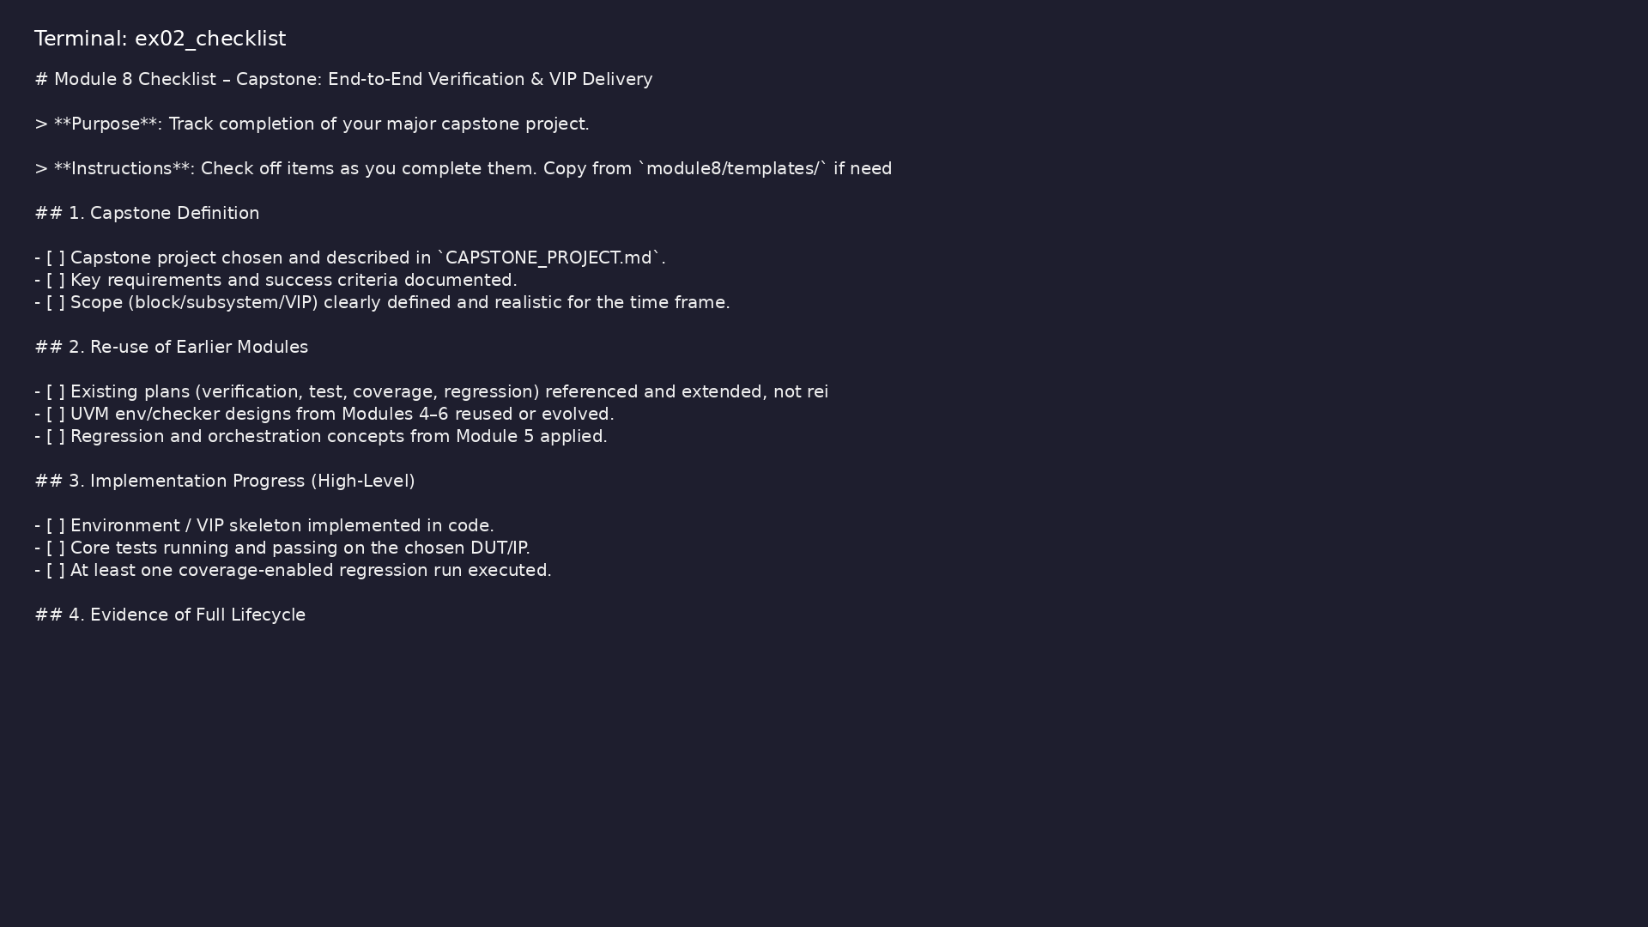
Demo: Capstone checklist
$ head -25 module8/templates/CHECKLIST.md
verification_planning_management / Module 8
Notes:
Hands-on: module8/examples/checklist/

Slide 28
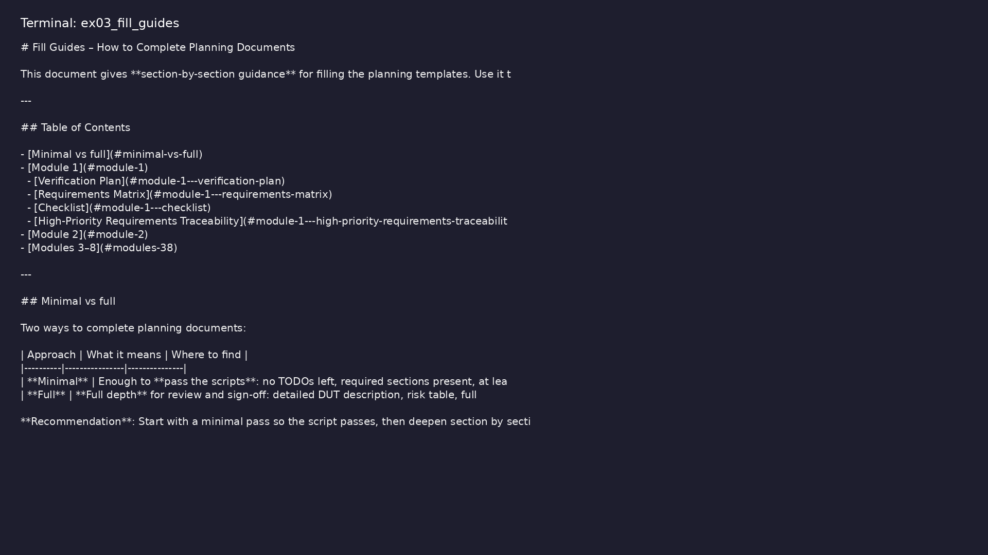
Demo: Fill guides
$ head -30 docs/FILL_GUIDES.md
verification_planning_management / Module 8
Notes:
Hands-on: module8/examples/fill_guides/

Slide 29
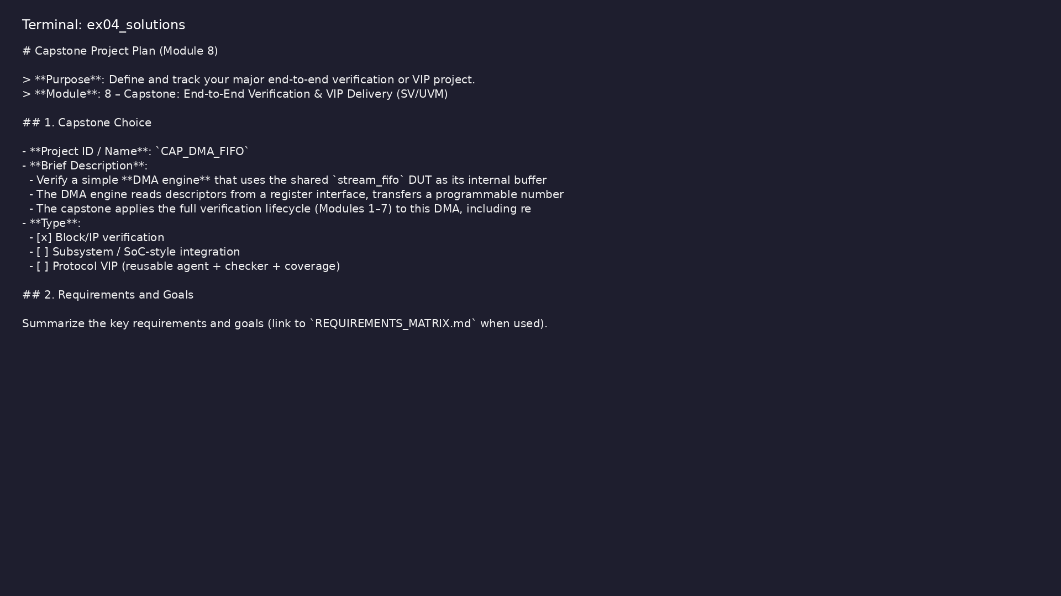
Demo: Reference capstone
$ head -20 module8/.solutions/CAPSTONE_PROJECT.md
verification_planning_management / Module 8
Notes:
Hands-on: module8/examples/solutions/

Slide 30

Demo: Module validation
$ ./scripts/module8.sh --check
verification_planning_management / Module 8
Notes:
Hands-on: module8/examples/validate/

Slide 31
Practice & assessment
verification_planning_management / Module 8

Slide 32
What you should know (1/2)
• Drive an end‑to‑end verification effort from
requirements → plan → env → tests → coverage →
regress…
• Deliver a coherent, documented verification package
or VIP that others can understand and use.
• Reflect on trade‑offs and improvements as if you
were preparing for a real project review.
• A clearly defined capstone project documented in
`capstone_project.md`.
• Evidence that Modules 1–7 have been applied (plans,
env, tests, coverage, regressions).
• A “deliverable” verification solution or VIP (code +
docs) that could be handed to another team.
verification_planning_management / Module 8
Notes:
From MODULE8 Learning Outcomes.

Slide 33
What you should know (2/2)
• A short written or presented retrospective on what
worked, what didn’t, and what you’d improve next.
verification_planning_management / Module 8
Notes:
From MODULE8 Learning Outcomes.

Slide 34
Assessment checklist
• A clearly defined capstone project documented in
`capstone_project.md`.
• Evidence that Modules 1–7 have been applied (plans,
env, tests, coverage, regressions).
• A “deliverable” verification solution or VIP (code +
docs) that could be handed to another team.
• A short written or presented retrospective on what
worked, what didn’t, and what you’d improve next.
verification_planning_management / Module 8

Slide 35
Summary & next steps
• Plan and execute a **single, substantial capstone
project** that exercises the full verification li…
• Complete module8/CHECKLIST.md
• Review module8/EXAMPLES.md and run each lab
• Next: Next module in course
verification_planning_management / Module 8

