Slide 1
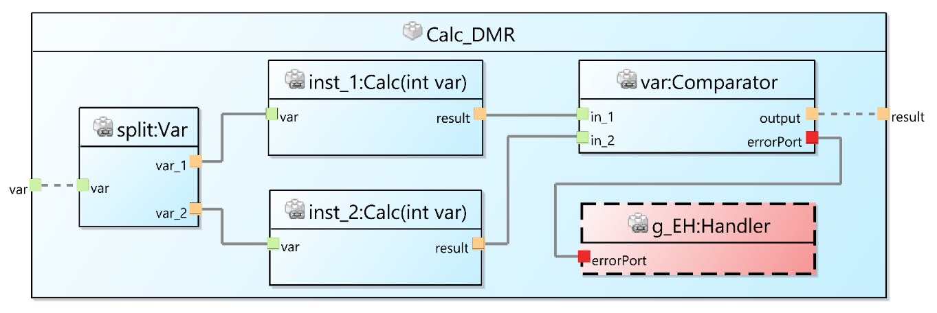
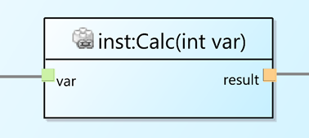
DMR
USF
Transformation
USF Library

Slide 2
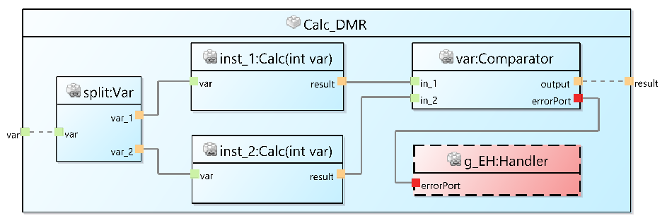
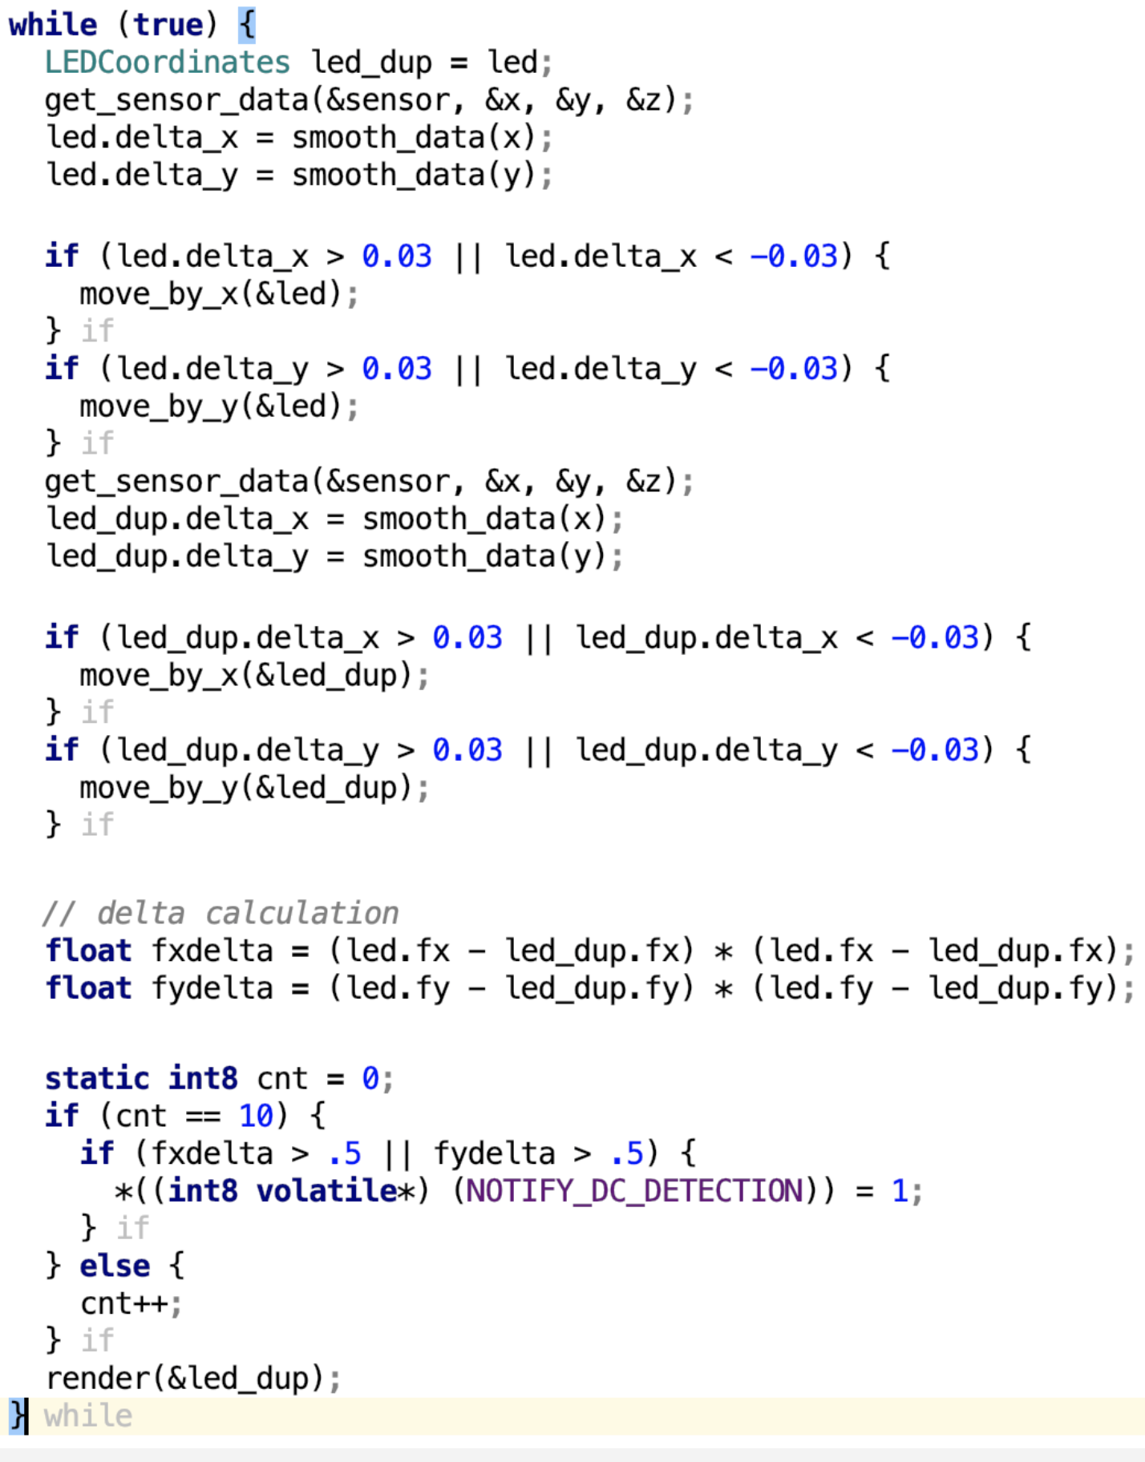
Analogue USF Model
USF
Transformation
DMR
USF Library
split
orig
C-Domain
Transformation
dupl
{
get_sensor_data(&sensor, &x, &y, &z);
led.delta_x = smooth_data(x);
led.delta_y = smooth_data(y);
if (led.delta_x > 0.03 || led.delta_x < -0.03) {
move_by_x(&led);
}
if (led.delta_y > 0.03 || led.delta_y < -0.03) {
move_by_y(&led);
}
render(&led);
}
C-Domain
DMR
comp
handler

