Slide 1
Cherry Philip v4 Build Instructions
By thegreatgunbantoad

Slide 2
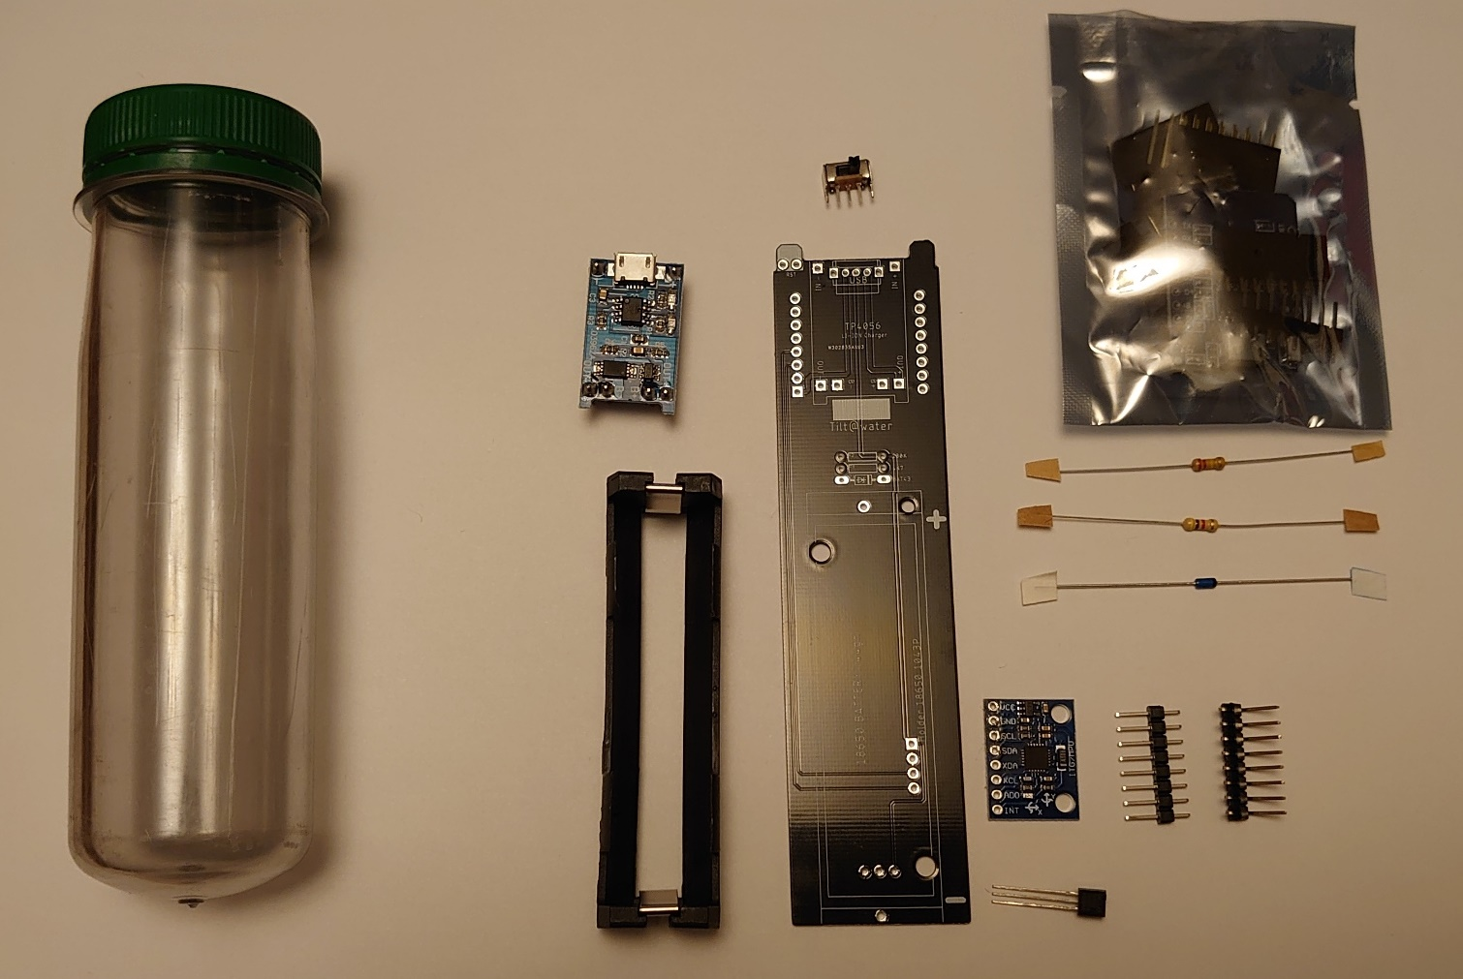
Kit contents
PET Tube
Wemos
D1 Mini
Switch
TP4056
LiPo Charger
Cherry Philip v4 PCB
Keystone
1043
Battery
Holder
220k Resistor
4k7 Resistor
BAT43 Diode
GY521 Accelerometer
DS18B20
Temp. Sensor

Slide 3
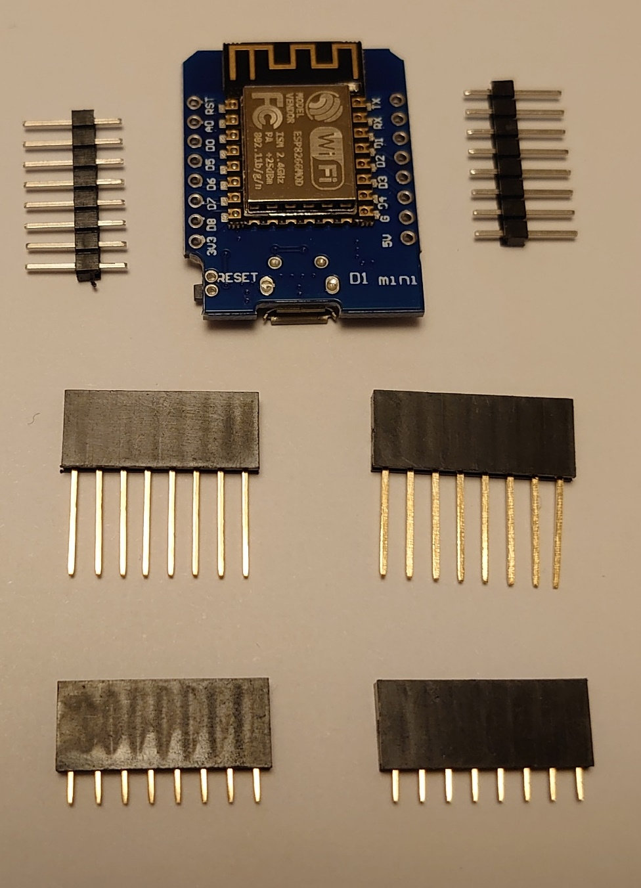
Wemos D1 Mini
Keep the main board
Keep 2x 8 way board headers
Throw away the bottom 4 board sockets

Slide 4
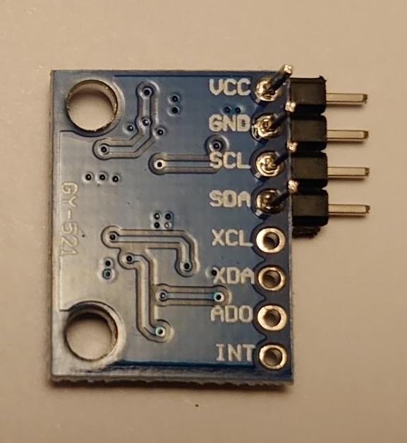
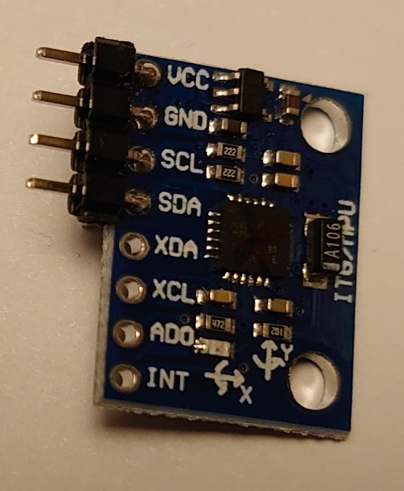
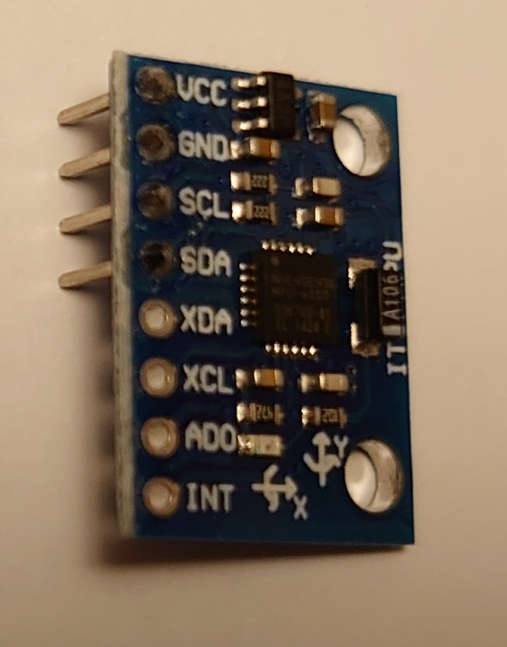
Prep: Accelerometer
The accelerometer comes with:
GY521 Board
8 way straight header
8 way 90 degree angled header
Cut the 8 way angles header down to 4 way and solder as shown
Snip off the excess header section as shown
Keep the straight 8 way for the LiPo Charger

Slide 5
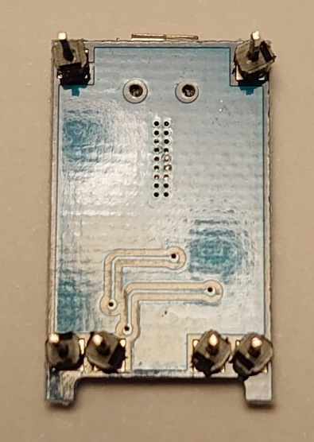
Prep: LiPo Charger
Cut the 8 way header from the accelerometer into 6 off 1 way and 1 off 2 way, set the 2 way aside for later
Solder the 6 off 1 ways as shown

Slide 6
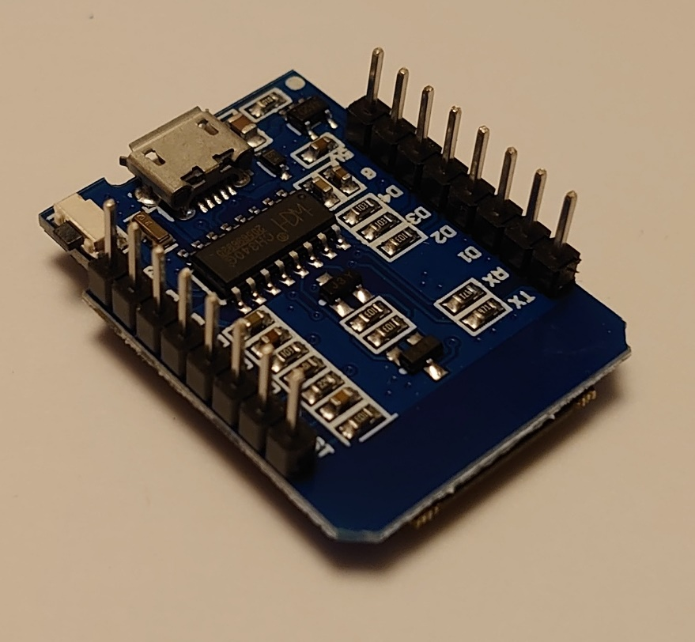
Prep: Wemos D1 Mini
Solder the 2x 8 way board headers as shown
Program the board now, before it is soldered

Slide 7
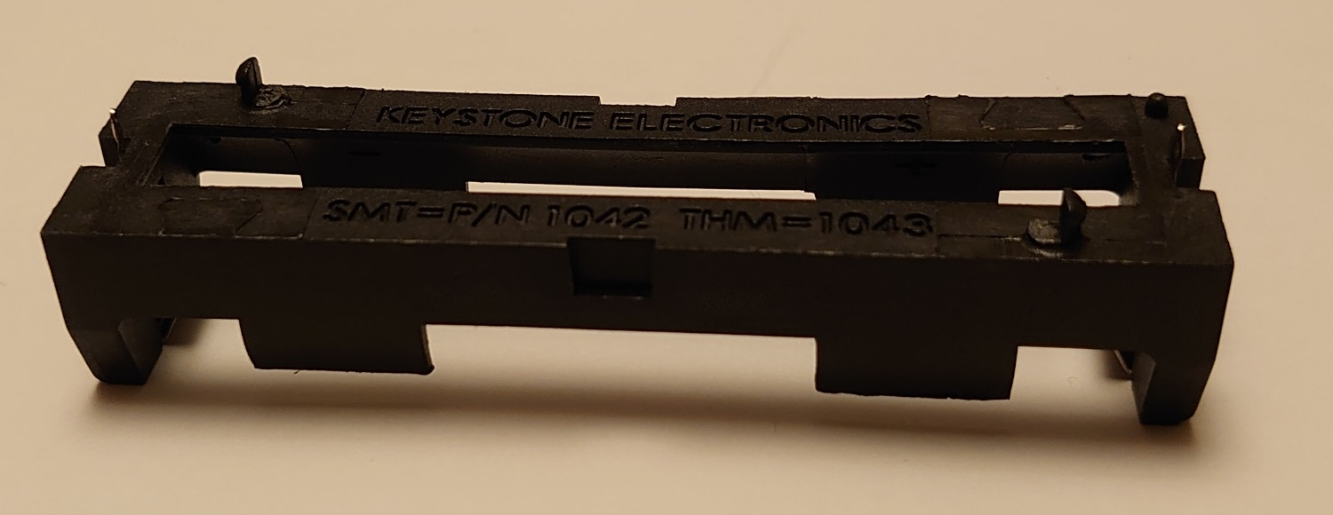
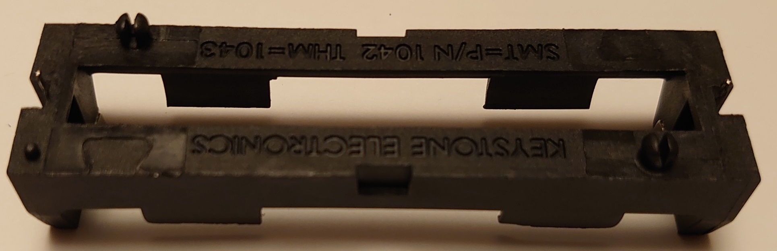
Prep: Battery holder
Snip the inside halves of the battery clips

Slide 8
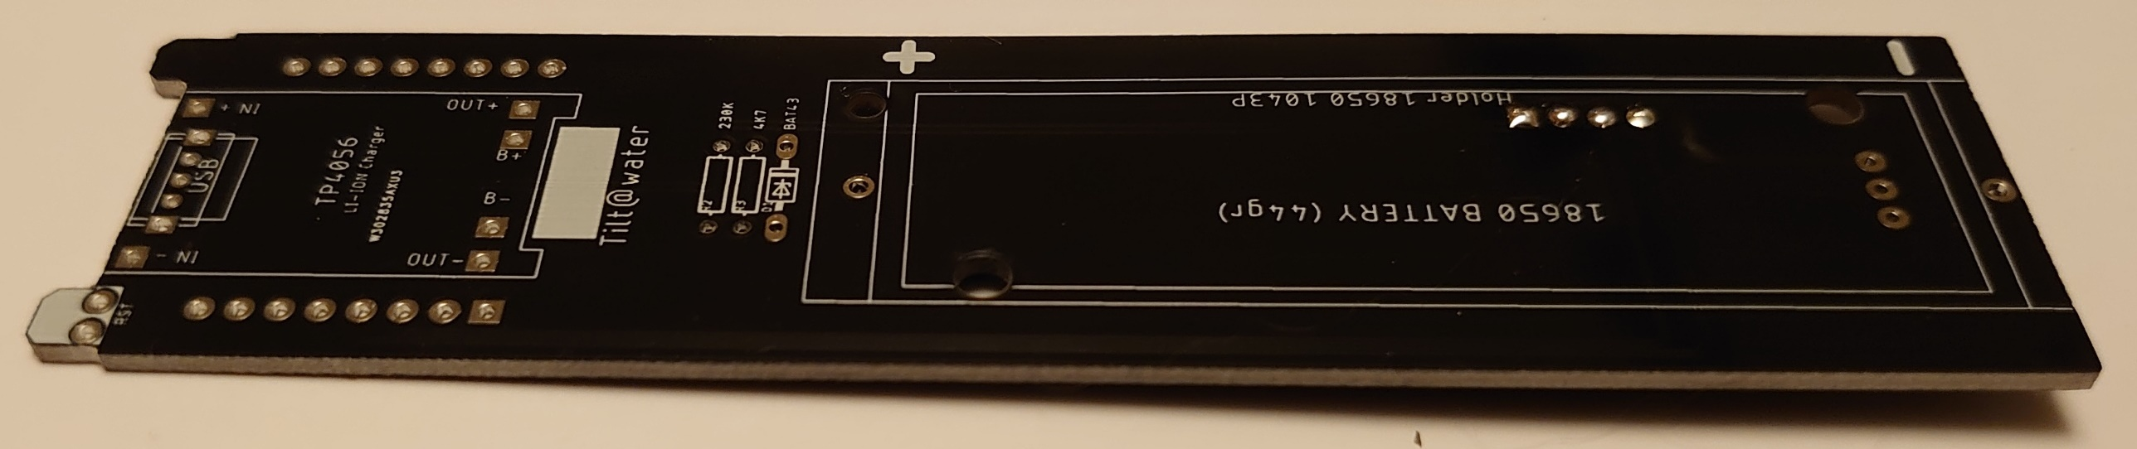
The Build: Quick Warning
Care must be taken during the build so as not to foul the battery when fitted in the holder, if the leads pierce the battery you risk a lithium fire
Ensure all joints are as flush as possible in the RED area, cut all legs flush to the board before soldering.

Slide 9
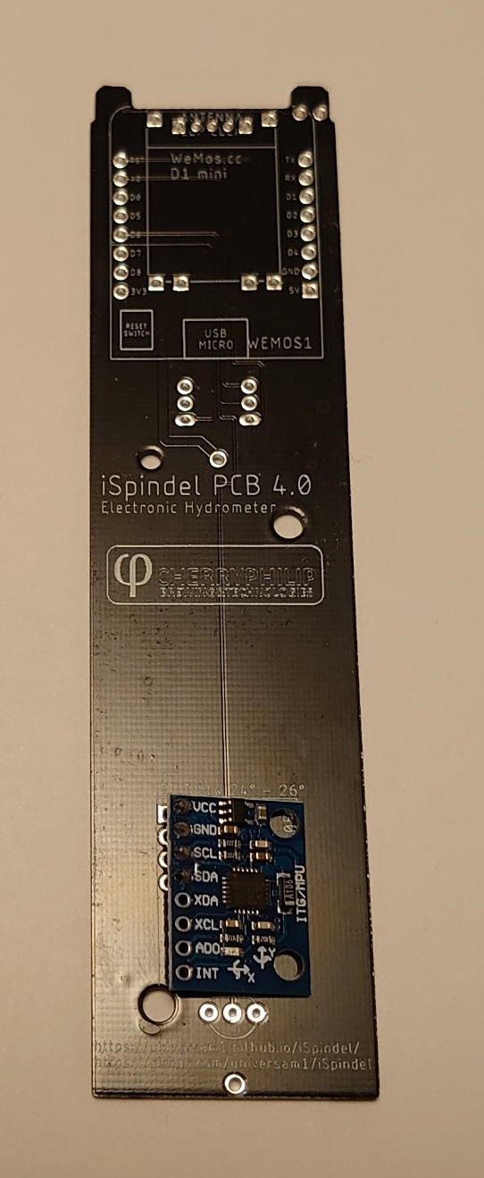
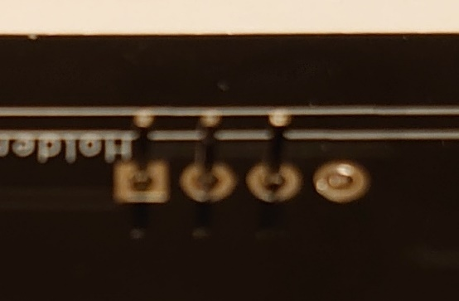
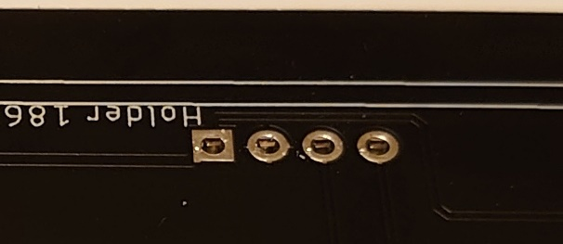
The Build: 1: Accelerometer
Fit the prepped accelerometer as shown
Before soldering cut all legs flush to the PCB

Slide 10
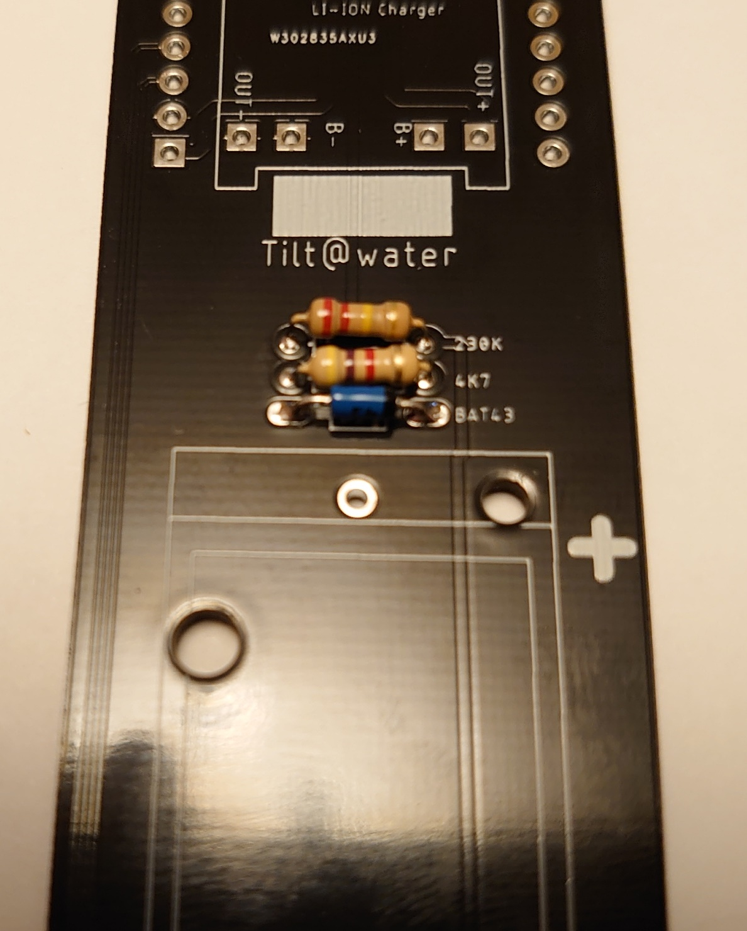
The Build: 2: Passives
Fit the 220k resistor
Fit the 4k7 resistor
Fit the BAS43 diode (take care that it is the correct way around)

Slide 11
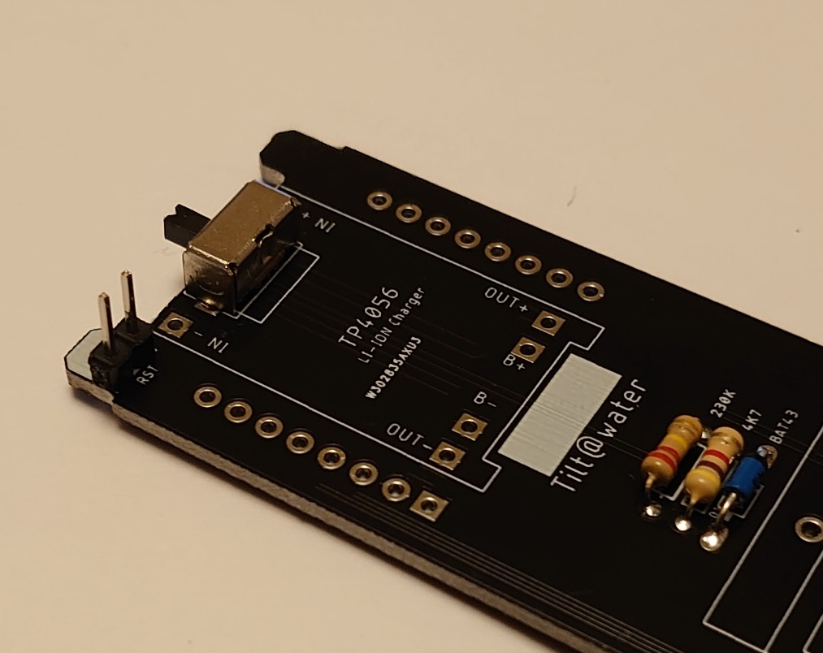
The Build: 3: Switch and Reset Header
Fit the Switch
Fit the 2 way header left over from the accelerometer

Slide 12
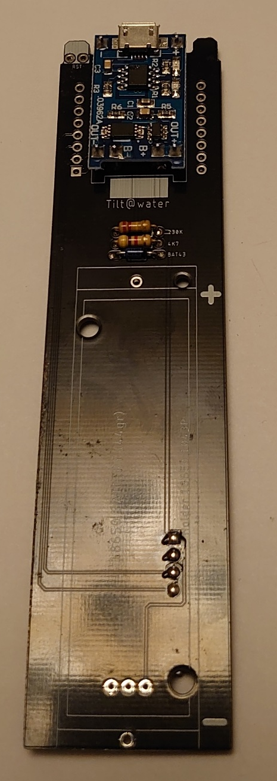
The Build: 4: LiPo Charger
Fit prepped LiPo charger
Once fitted trim the pins down to prevent the shorting to the Wemos D1 Mini

Slide 13
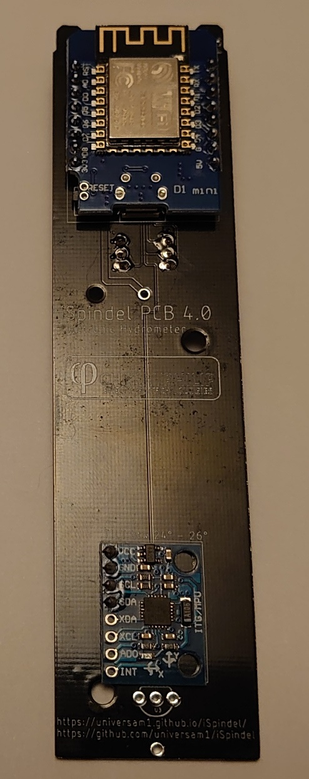
The Build: 5: Wemos D1 Mini
Fit the prepped and programmed Wemos D1 Mini
Don’t skip the programming before soldering it down, it USB connector gets difficult to get to

Slide 14
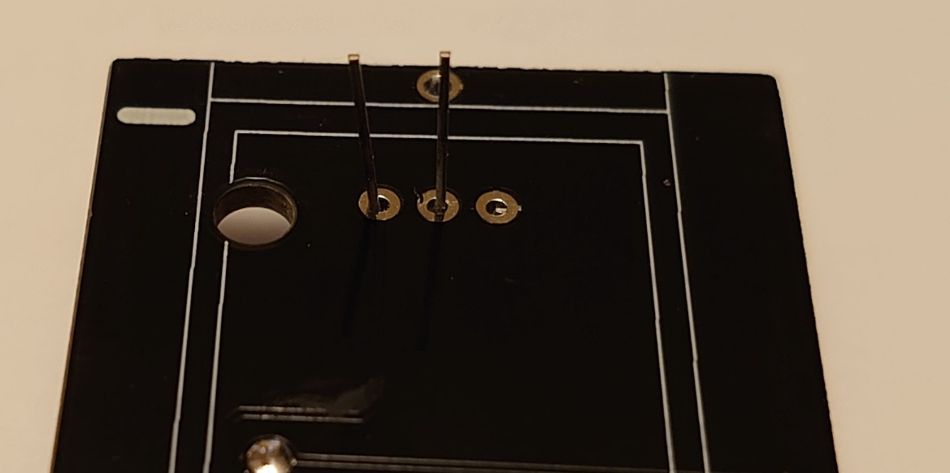
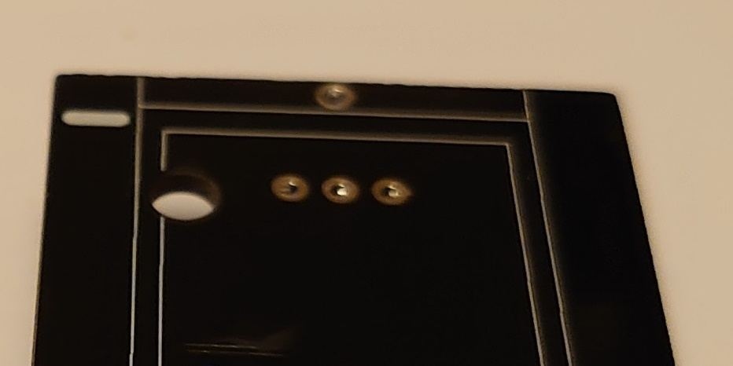
The Build: 5: Temperature Sensor
Fit the DS18B20 temp. sensor
Before soldering cut all legs flush to the PCB

Slide 15
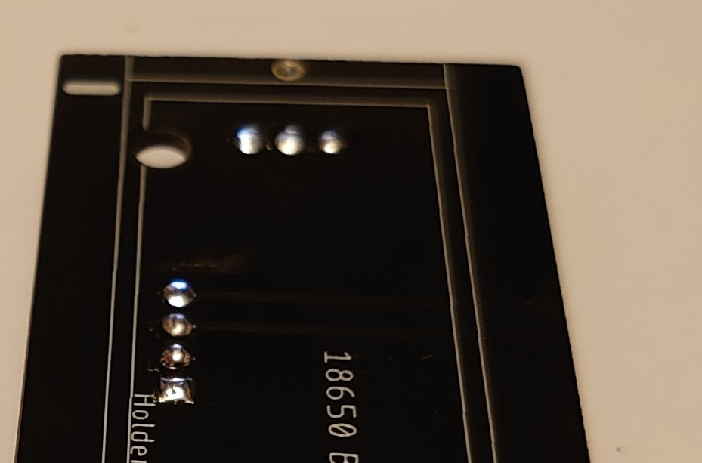
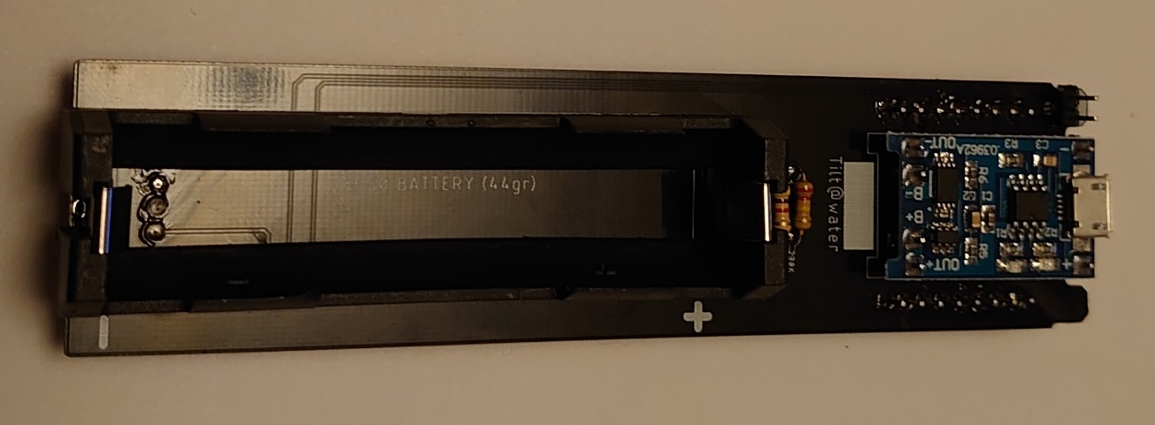
The Build: 6: Battery Holder
Ensure all the solder joints on the board under the battery holder are as flush as they can be
Fit the prepped battery holder

Slide 16
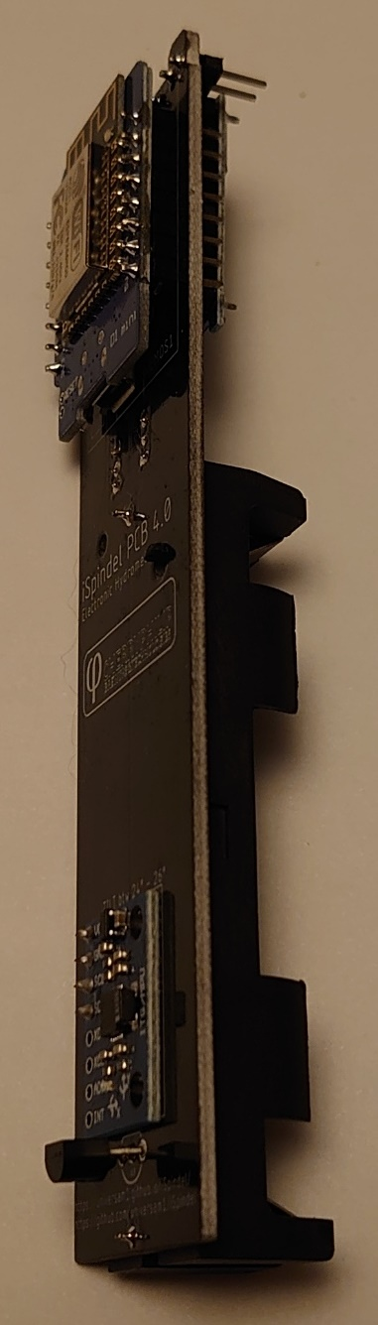
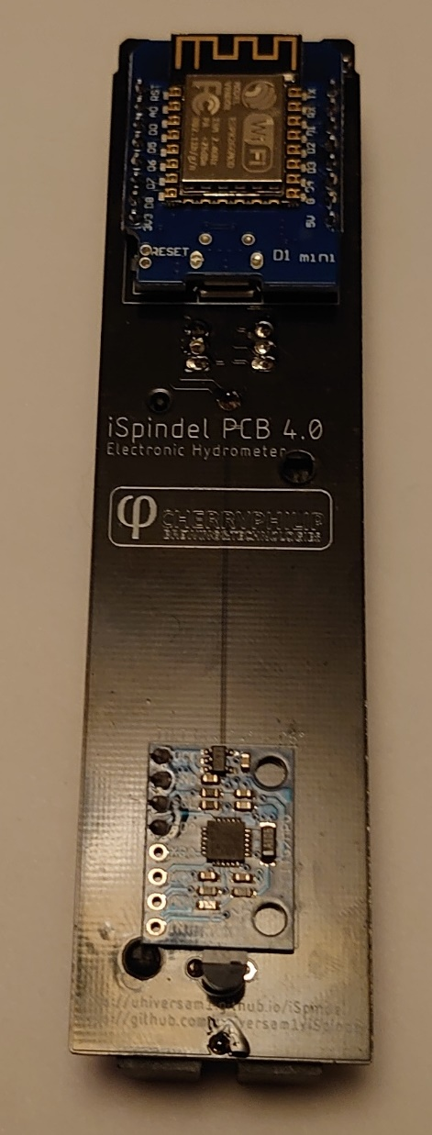
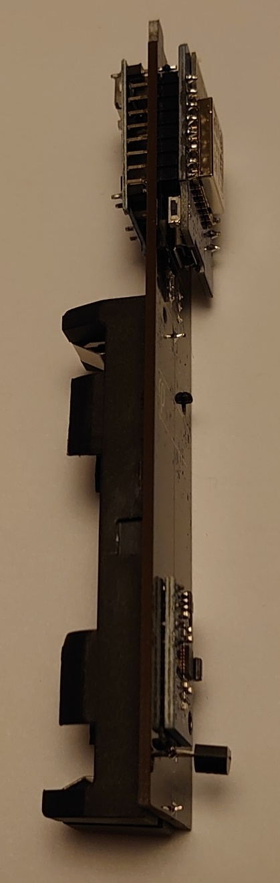
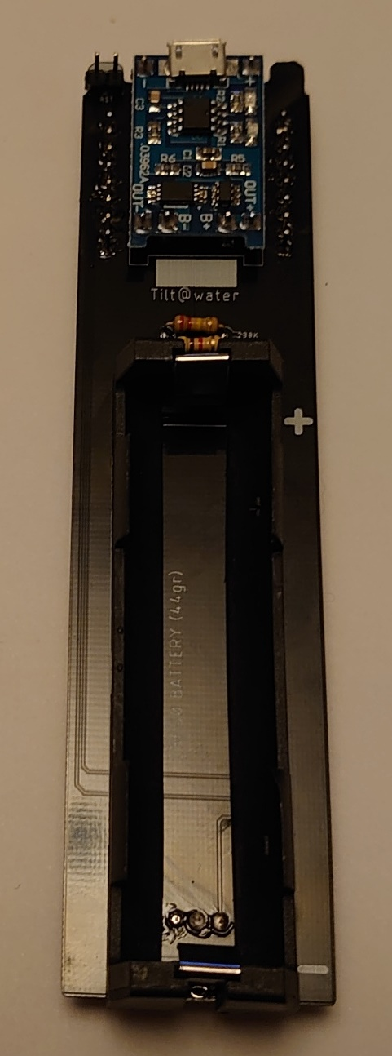
The Build: Complete

