Slide 1
Java-inspect
2021302111484 吴昊骏
https://github.com/universetraveller/java-inspect

Slide 2
选题动机

Slide 3
Programming - Debugging
程序运行时发生了什么
程序的bug出现在什么地方
程序执行有何不合理之处
程序哪部分效率低
重复的人工debugging
不断手动尝试的断点调试
debugger重复的step in/step out
难以注意到的细节之处

Slide 4
Automatic Debugging

Slide 5
Automatic Debugging
自动记录程序执行时的行为
可以控制的自动事件处理
变量级别的程序分析

Slide 6
Automatic Debugging
Java-inspect 软件功能
· 自动记录debugger的事件，可以形成格式化的程序行为报告
· 变量级别的程序监测
· 可编程，可扩展的程序接口和事件处理模型
· 编写为Maven插件
Method Invocation
Field/Variable Accessment
Field/Variable Changing
Line Accessment
Exception Handling
etc.

Slide 7
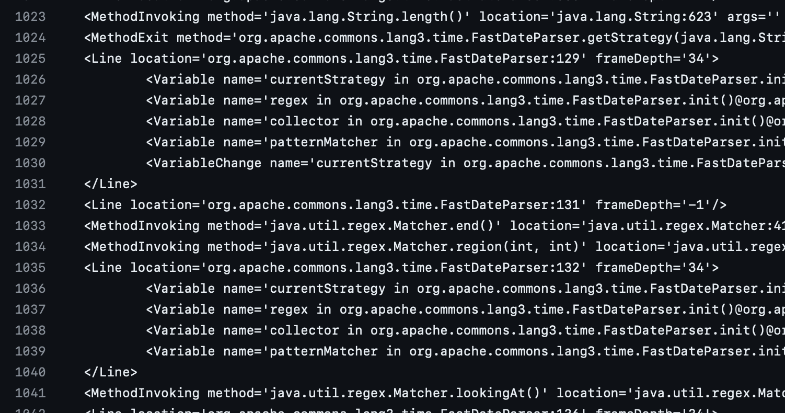
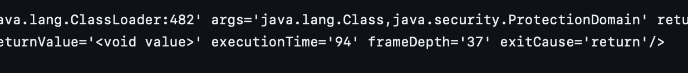
运用方向
· 程序性能分析和Automatic Debugging
从InspectionReport中看到程序各部分的性能表现，找到优化的突破口
看到程序不合理之处，如变量值与预期不符，没有按预期调用函数
更好地理解程序的行为，如观察程序中各函数的调用
自动监控程序中某事件的发生，并进行处理和记录
作为debugger框架结合算法构造新的debugger程序
便捷地从编程层面监控程序的运行而不用修改程序
· 软件的可视化执行
某需监控的变量的变化历史
程序的执行过程可视化
InspectionReport示例

Slide 8
Downstream Task Example
For demonstrating the potential of java-inspect
variable level Spectrum Based Fault Localization

Slide 9
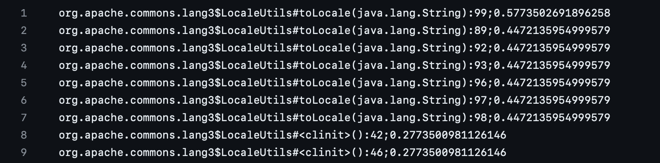
Current state-of-the-art line level SBFL technique
e.g. Gzoltar
https://github.com/GZoltar/gzoltar
Generates report on line level with a score
Developers only know which line is suspicious

Slide 10
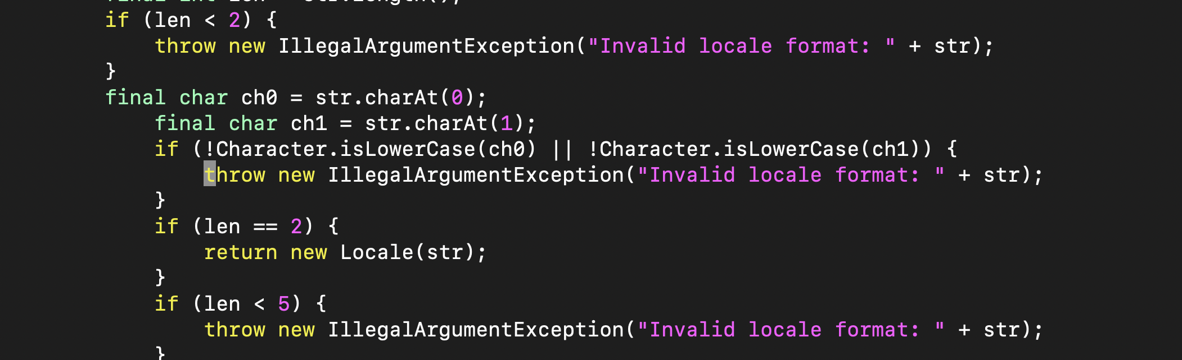
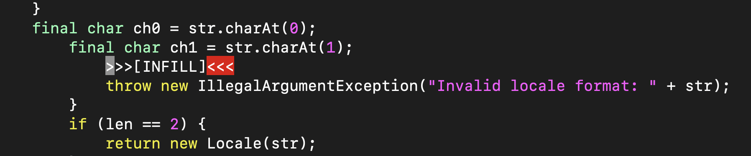
Cloze-style Patching with LLM
Buggy hunk
Prompt to request LLM

Slide 11
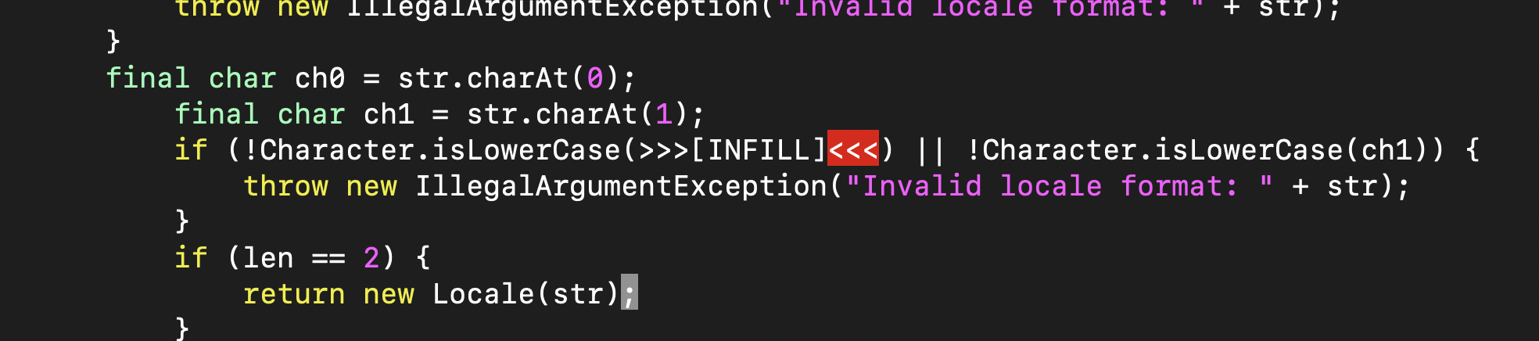
Variable-level prompt
More accurate
More efficient

Slide 12

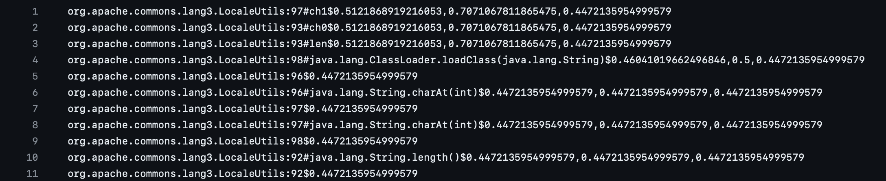
Ochiai metric
Ochiai score =
ef and ep are the numbers of failing and passing tests executing the program entity e, while nf and np are the numbers of failing and passing tests that do not execute e.
Suspicious score = line_score * 0.75 + variable_score * 0.25
For instance, the variable level result of the previous bug is:

Slide 13
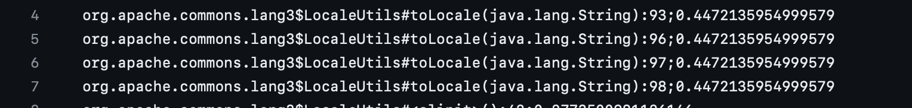
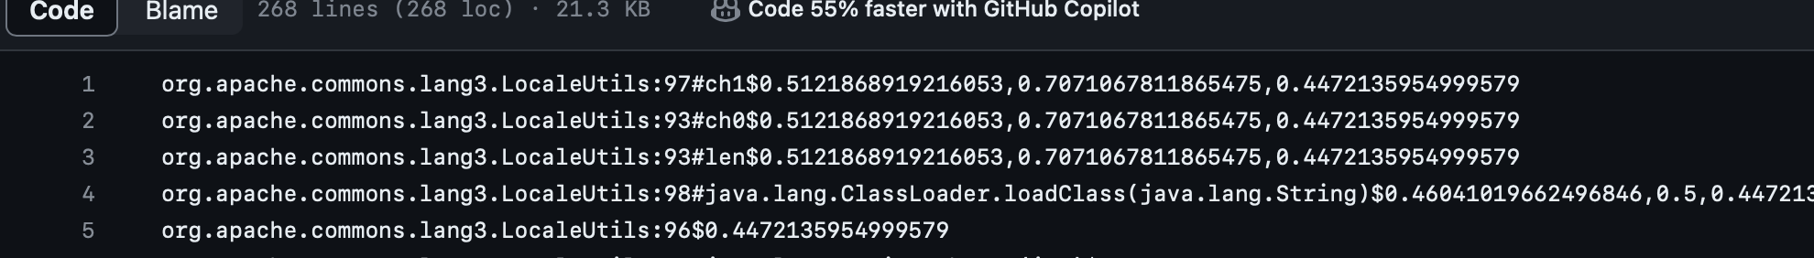
Comparison to the baseline
More Efficient:
GroundTruth lineno: 97
Result of Gzoltar (Ochiai):
Result of variable-level Ochiai SBFL:
Higher rank with more accurate position

Slide 14
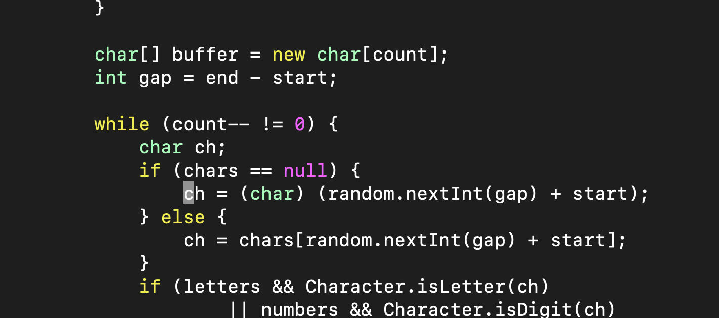
More Accurate:
GroundTruth root cause:
Incorrect exception message from line 253 that variable ‘gap’ is negative
Results from Gzoltar:
Results from Variable level SBFL:

Slide 15
技术路线

Slide 16
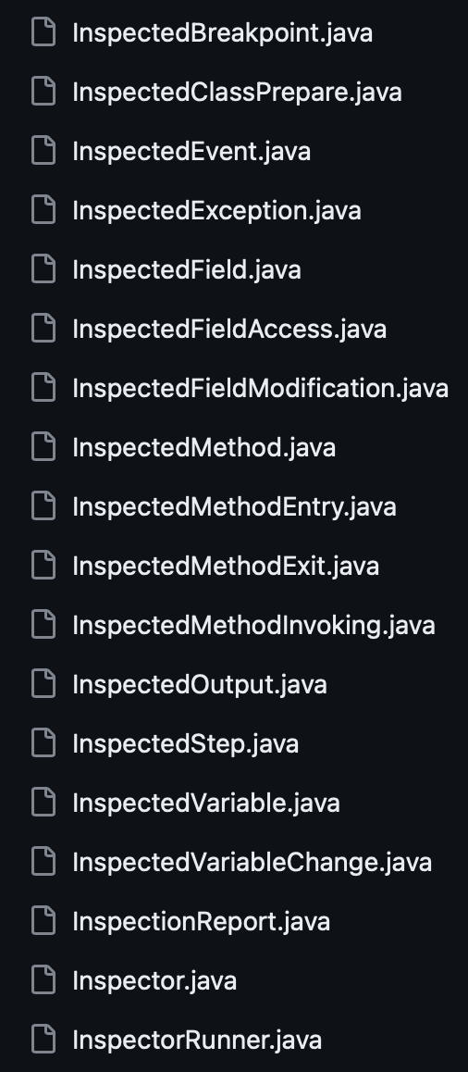
This demo project implements a basic inspector using Java Debug Interface (JDI) which is the top level interface of Java Platform Debugger Architecture (JPDA).
See also: VSCode java-debug plugin
https://github.com/microsoft/java-debug/tree/main
Overview
Run on
Passing Events
Snapshot
- Generate snapshots for events and stack frames
- Apply events filter
- Manage event handlers
Runner
Inspector
Handle events and process programming level inspection
JDI Interface
Make requests
JVM
Snapshot instances

Slide 17
创新点及特色
· 首先实现的可扩展的Inspector框架及其基本实现
· Maven plugin形式的可用工具
· 监控-报告的debugging方式
· 应用实例：Variable-level SBFL

Slide 18
功能实际展示

