Slide 1
The Amazing Self-Rescue
With Tim Wright

Slide 2
Tim Wright demonstrates how to reenter a sea kayak, a useful skill even if you are just paddling on the lake and find yourself out of your boat. Be sure to read the captions for explanation! And the be sure to practice yourself, for example with instruction at a lake session!

Slide 3
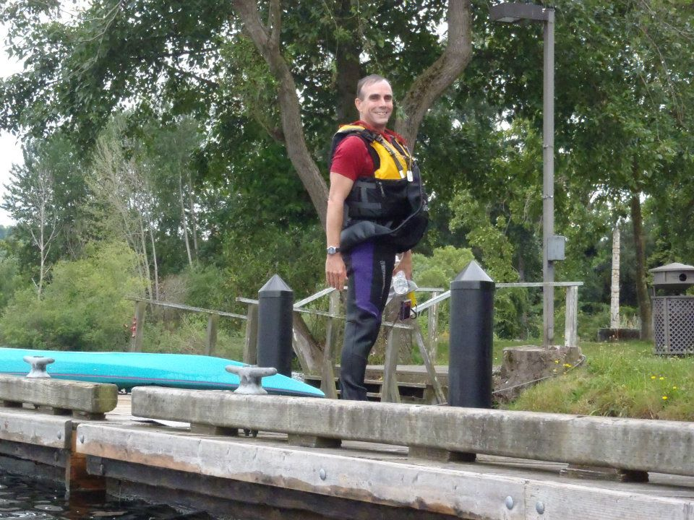
Tim Wright is ready to paddle on the lake in his wetsuit and PFD.

Slide 4
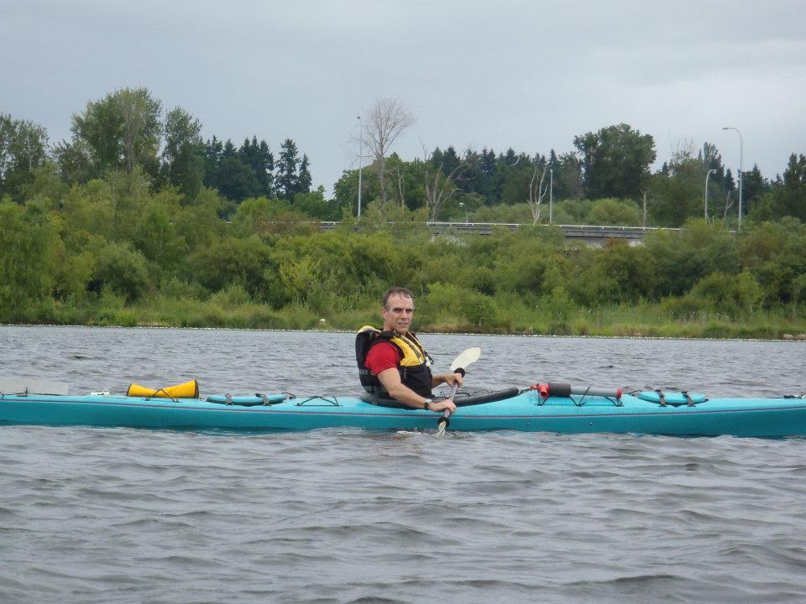
He is always ready. He has checked that his grab loop is outside of his spray skirt, and he always brings a paddle float and pump.

Slide 5
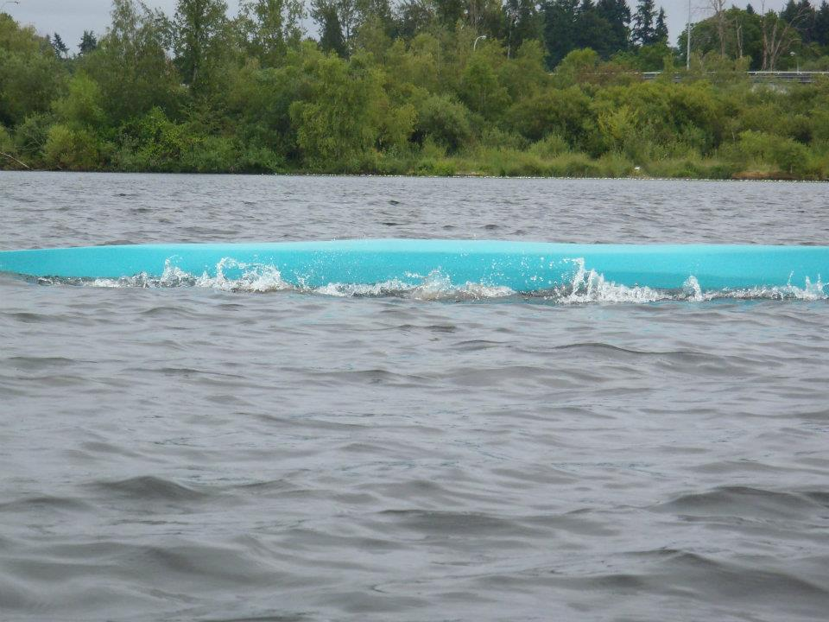
Oh no! He capsized!

Slide 6
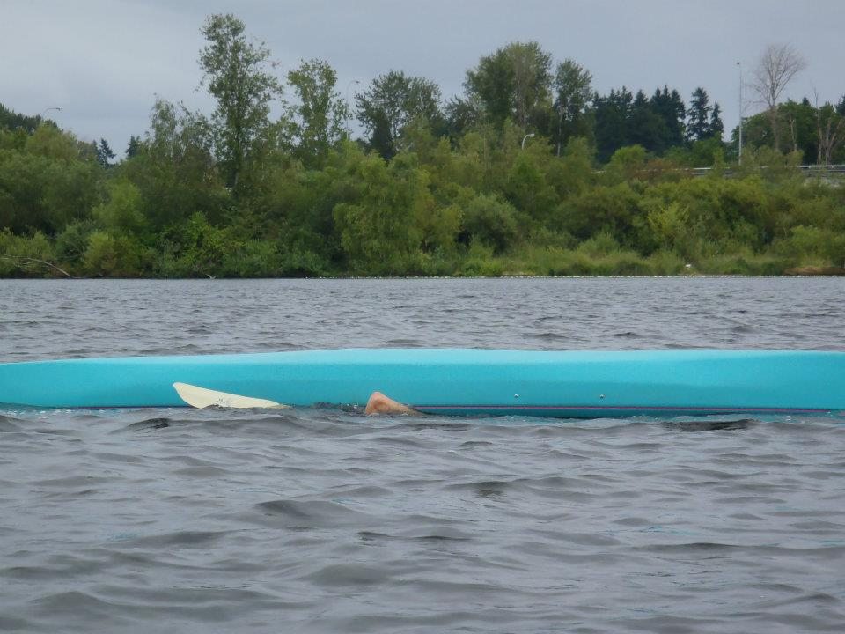
Once underwater, he pounds 3 times on the bottom of his boat to try and get a buddy rescue.

Slide 7
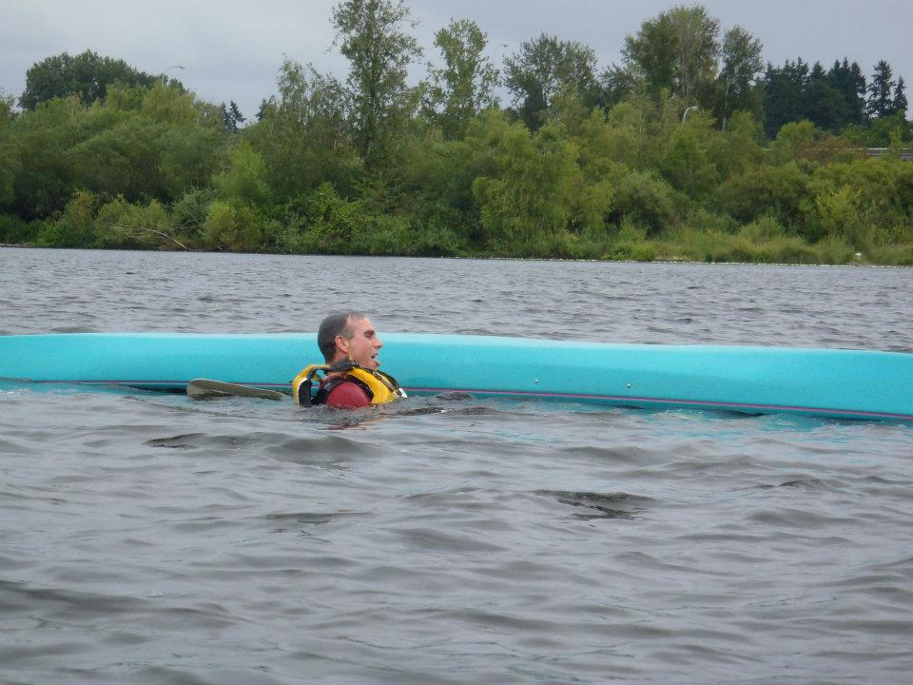
When no one comes, he pulls his grab loop and pushes himself out of his cockpit and surfaces. Without losing his paddle.

Slide 8
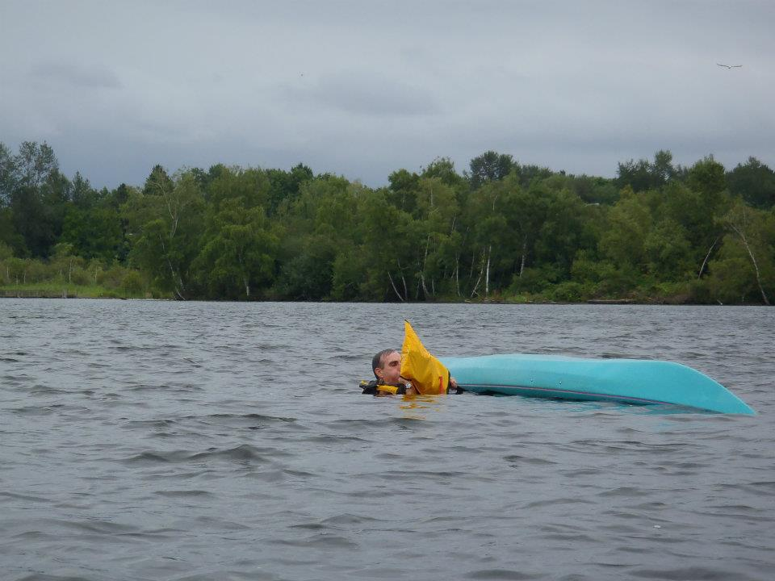
He gets his paddle float, puts it on the end of his paddle, and blows it up (you can skip blowing it up if you have a foam float).

Slide 9
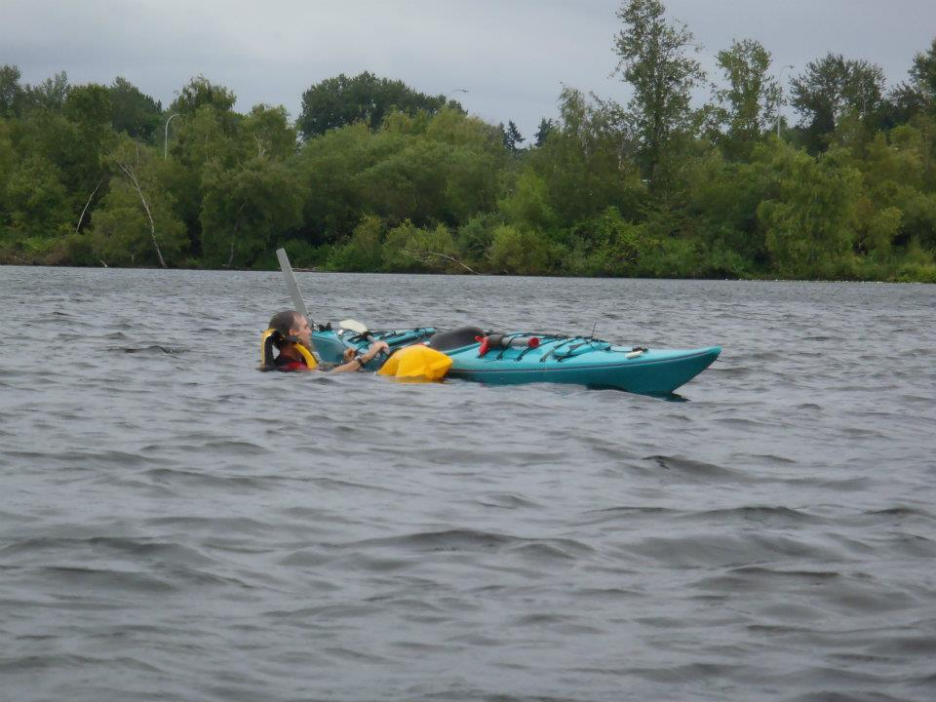
Now he rights the boat.

Slide 10
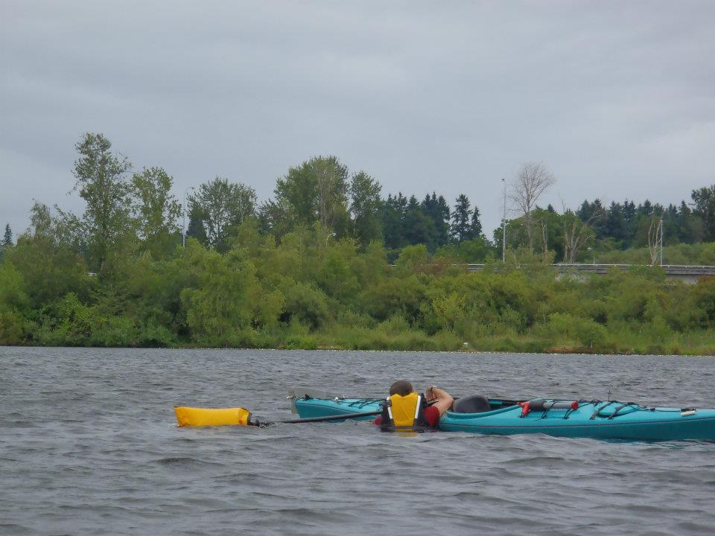
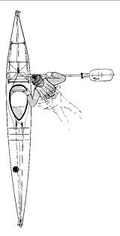
Now he attaches the paddle to the boat, floating end out, by putting it under the deck webbing. Keep reading for a better view of this. The paddle should be flat against the deck.

Slide 11
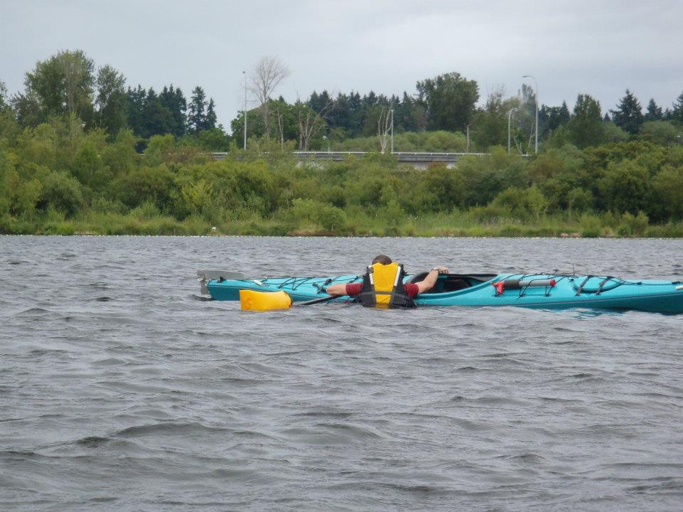
Now he gets ready to climb into the boat. He puts his weight partially on the boat and partially on the paddle.

Slide 12
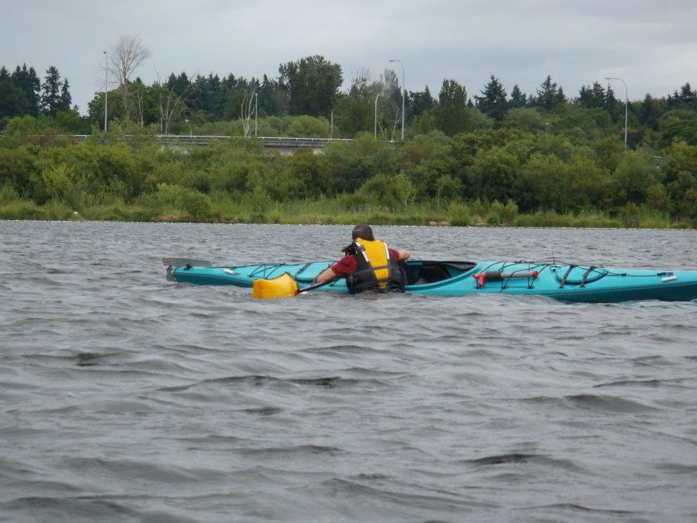
He keeps some weight on the paddle as he climbs up because there is nothing to keep the boat from rolling over the other direction if he puts too much weight on it.

Slide 13
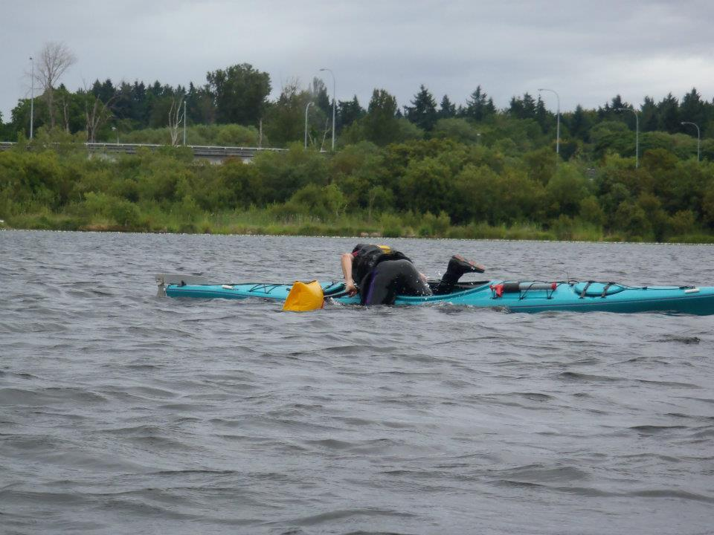
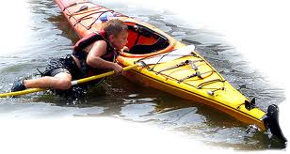
He puts one leg in the boat at a time. Although it didn't matter because the water was so calm, I actually miffed this move: I should have had the ankle of my left leg hooked on the paddle shaft to give me some extra leverage to heft myself in. Also, I'm too far forward: My chest should be planted, right about the front edge of the rear hatch. That way I don't have to stick my butt up in the air to slide in—and you always want to stay as low as you can as you re-enter—it make you and the boat more stable. Stable is good.

Slide 14
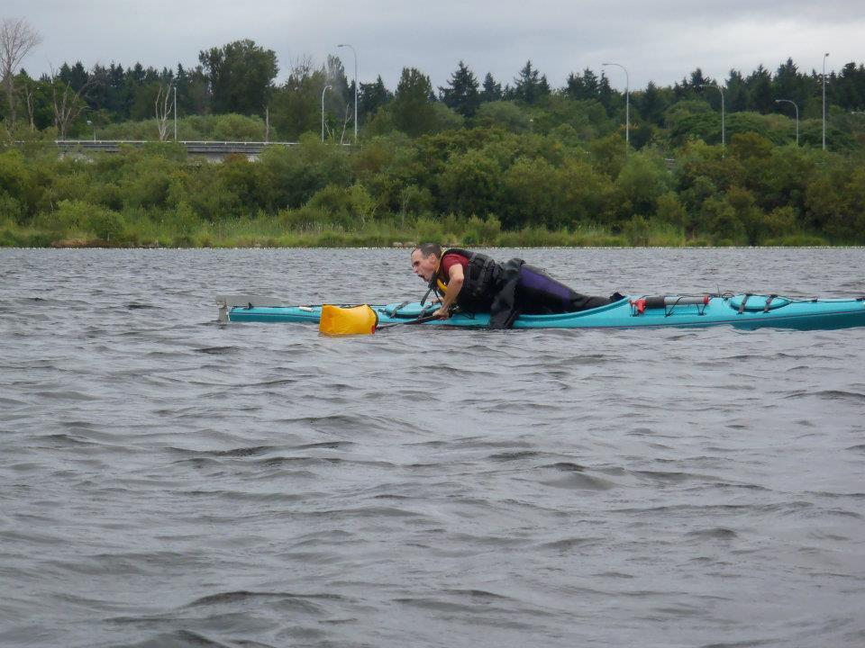
Now he's all the way in the boat, but facing backwards.

Slide 15
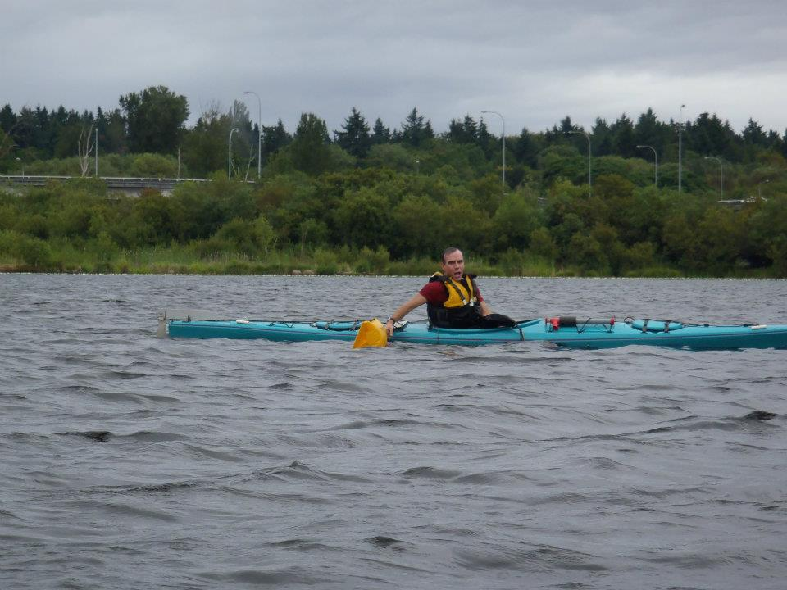
He'll gracefully turns around to be seated forward in the cockpit.

Slide 16
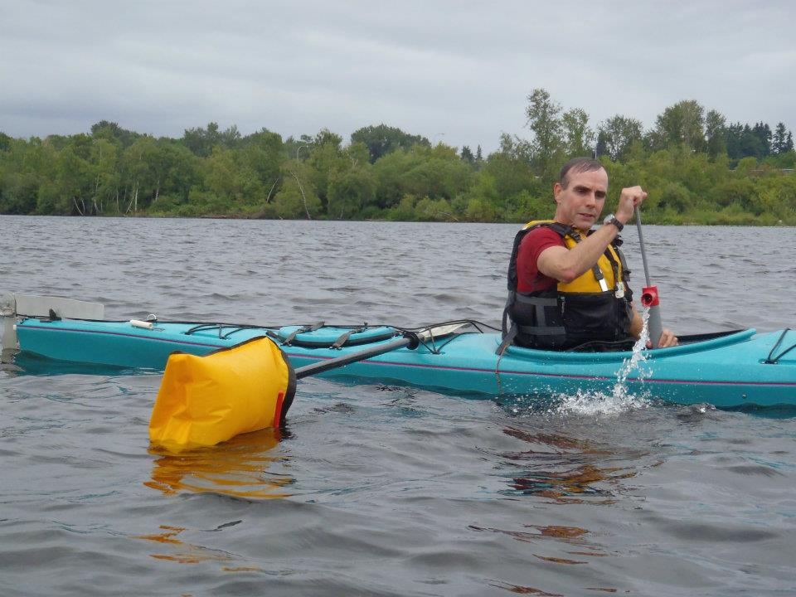
Bailing water out of a boat is slow process—it's much better to know how to do a two-person rescue. In that, your paddling friend lifts your capsized boat across her deck, scoots it up to empty most of the water out of the cockpit, flips it over and slides it back in the water—ready for you to get into a nice, almost dry boat.

Slide 17
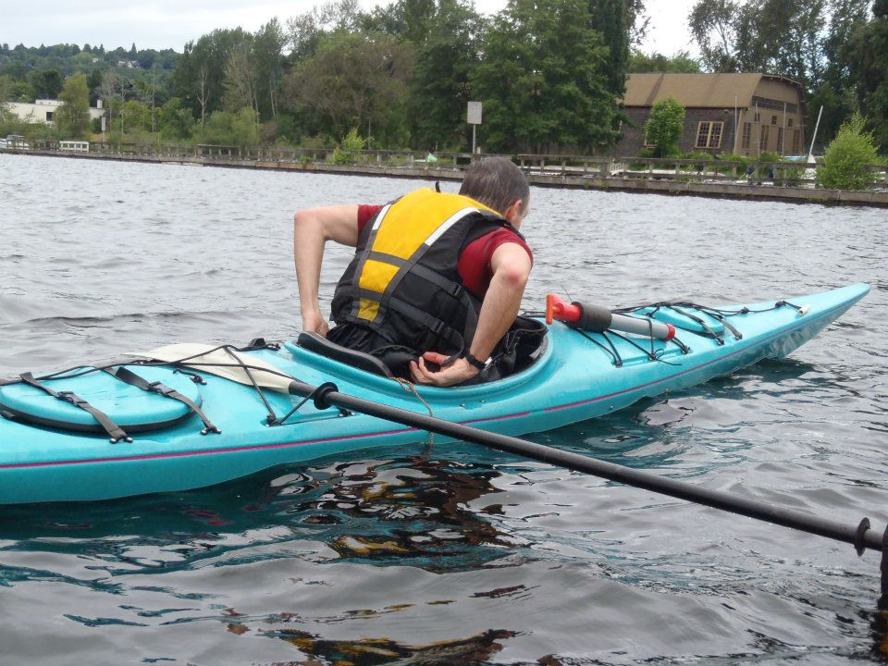
Once the water is out of his boat he can reattached his spray skirt. Note how the paddle is attached to the deck webbing.

Slide 18
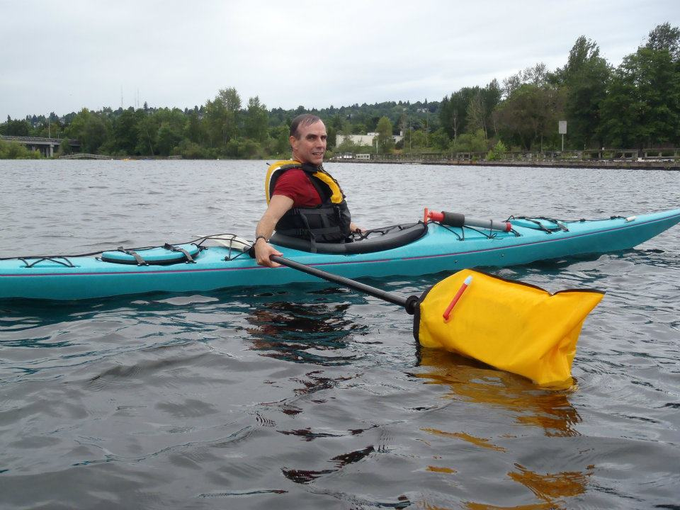
Now the time has come to detach the paddle from the boat.

Slide 19
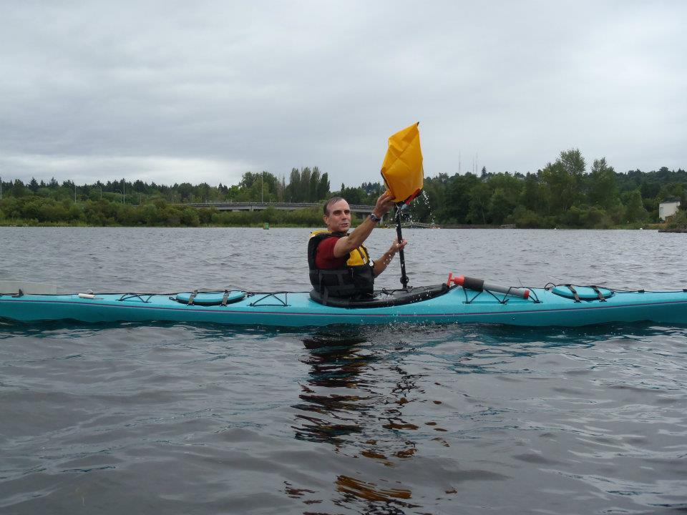
He takes the float off the paddle, deflates it, and puts it away.

Slide 20
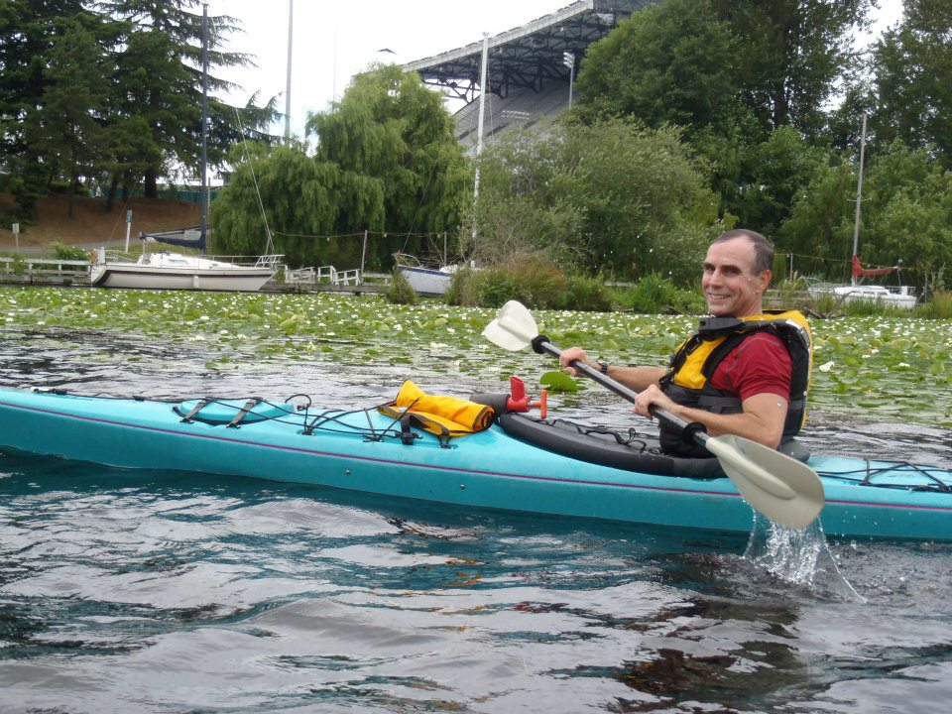
And off he goes! Ready to paddle away!

