Slide 1
Propaganda, PSYOP and Public Diplomacy
Lecture 5
War in the Gulf, 1991: the first information war?
Prof. Phil Taylor, ICS, University of Leeds

Slide 2
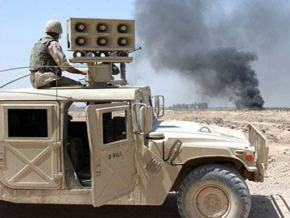
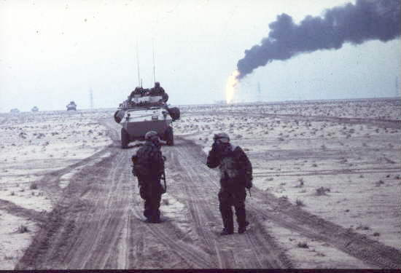

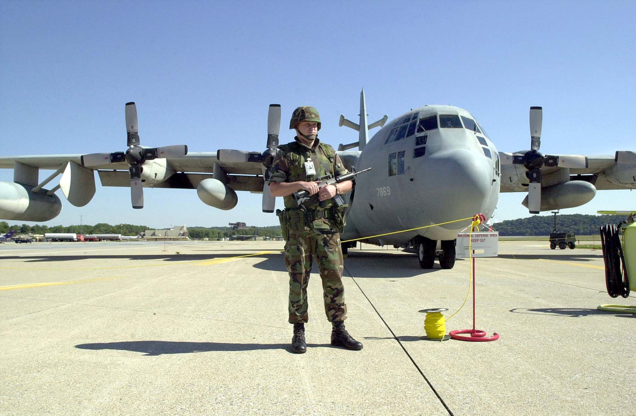
4 POG badge

Slide 3
Main elements – is war the failure of PD?
‘The Gulf War did not happen’!
The Video-Game War
Real War and Media War
Military management of the media
The Baghdad Loophole
The Ground War
PSYOPS and the boost to IW/IO thinking

Slide 4
‘The Gulf War did not happen’!
It did, but just how much of it did we see?
How did this happen given the presence of so many journalists?
Pools, press conferences and scudfests
Censorship – role has been exaggerated
This is not to suggest that the media were not part of the propaganda war

Slide 5
‘The Video Game War
‘The luckiest man in Iraq’
Illusion (?) of accuracy and high-tech warfare
War as spectacle
War as a mediated event
Television as a microscope of events, not context

Slide 6
Real War and Media War
‘The image-reality gap’
What can the media show?
How can they get access (OWs and OPWs)?
How can they get their material out of theatre?
How can they check material?

Slide 7
‘
Military Management of the Media
‘The Vietnam Syndrome’
Air war and the nature of media coverage
Live press conferences and ‘star’ military performers
Ask a stupid question……
The unilaterals
The deception campaign

Slide 8
The Baghdad Loophole
CNN and ‘Baghdad Broadcasting Corporation’ (i.e. The BBC)
Cruise missiles and ‘collateral damage’
The ‘Baby Milk Plant’ bombing
Parading the captured pilots
Amiriya, 13 February 1991

Slide 9
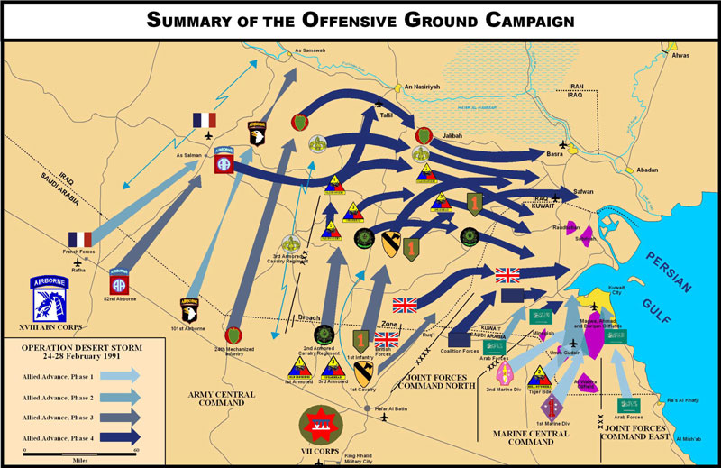
The Hail Mary Play

Slide 10
The Ground War and the Highway of Death
Apocalypse where?
The firing of the Kuwaiti oil wells
The Iraqi flight from Kuwait and the ‘turkey shoot’
Where were all the bodies?
What impact did these images have on the ending of the military operation?

Slide 11
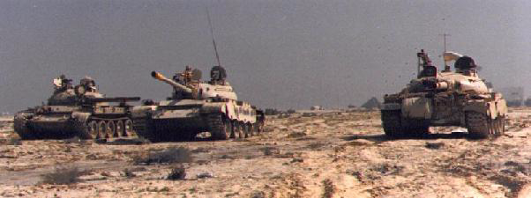
The Gulf War of 1991 as catalyst
US-led ‘Burning Hawk’
29 million leaflets for Iraqis in KTO
4 POG and 193rd PNG deployment of leaflets, radio, loudspeakers and Commando Solo
44% of Iraqi army deserted (60-80,000)

Slide 12
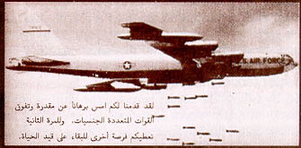
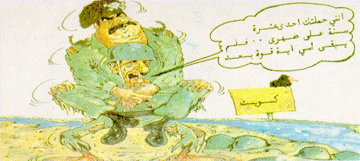
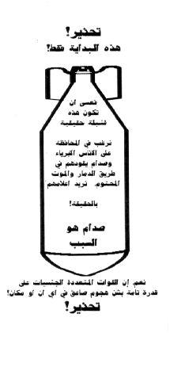
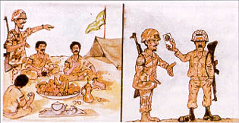
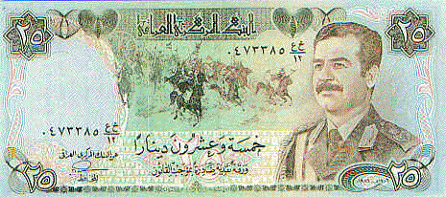
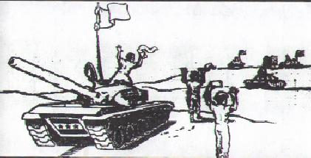


Slide 13
The Propaganda War
Largely through the media: whose performance in question?
PSYOPS as the ‘combat force multiplier’
‘Information warfare’ and deception
Saddam’s ‘winning by losing’
The legacy of 1991 on 2003

